Slide 1
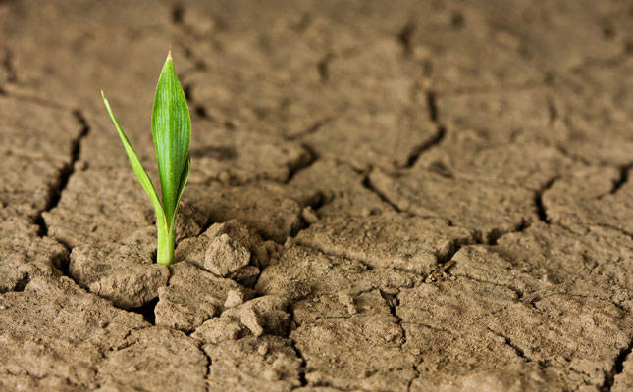
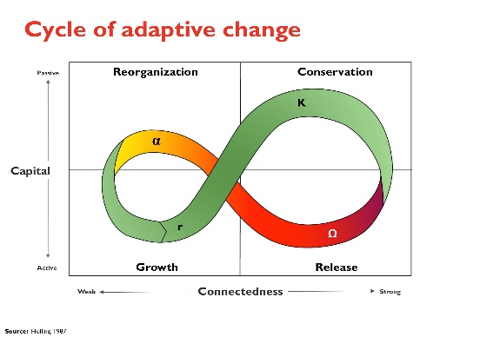
NEW COURSE: Community Resilience (IPM 516/URBDP 598B, 3 credits)
Our world is becoming increasingly dynamic with larger and more frequent disasters (episodic extreme and chronic events). Preparing for these expected changes is vital to building safe livable communities. Resilience has emerged as a goal enabling organizations to recover from and adapt to change.
This course will introduce you to a systems theory approach to resilience thinking and provide opportunities to apply resilience concepts to real world problems. ­­
YOU WILL:
Apply resilience concepts to real world communities and infrastructures threated by real events.
Gain practice in supporting policies, programs and projects that enhance overall resilience. The course employs a case study approach to bridge the theoretical concepts and practical applications.
Develop a toolkit of approaches and strategies designed to enhance community resilience
You can attend this course in-person or on-line at a remote location. The course will be offered Mondays and Wednesday, from 4p – 5:20p.
Email kfishler@uw.edu for add code.
Instructors: Bob Freitag CFM, Graduate Faculty and Director of Institute for Hazards Mitigation Planning and Research, bfreitag@uw.edu and Himanshu Grover (Phd., AICP) Assistant Professor and Co-Director, Institute for Hazard Mitigation and Planning, groverh@uw.edu

