Slide 1
Overview of Health and the Built Environment
Andrew L. Dannenberg, MD, MPH
National Center for Environmental Health
Centers for Disease Control and Prevention
acd7@cdc.gov
Healthy Community Design Class
University of Washington, January 6, 2011

Slide 2
Factors that Affect Health
Education
Long-lasting Protective Interventions
Socio-Economic Factors
Clinical Interventions
Changing the Context to make individuals’ default decisions healthy:
BUILT ENVIRONMENT
Smallest Impact
Largest
Impact
Frieden, AJPH, 100:590, 2010

Slide 3
Community Design and Health
Related to land use
Related to automobile dependency
Related to social processes
Obesity, physical activity, CVD
Water quantity and quality
Air pollution and asthma
Climate change contribution
Car crashes
Pedestrian injuries
Mental health impact
Social capital
Environmental justice
Notes:
To summarize, we can identify at least nine ways in which sprawl might affect health.

Slide 4
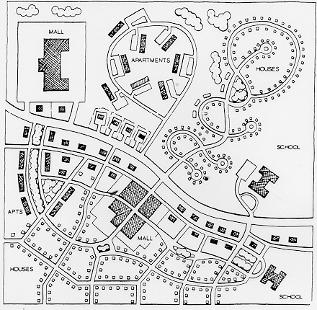
Walkable Community Designs: Connectivity and Physical Activity
Suburban Development
Traditional Neighborhood
Drawing by Duany Plater Zyberk,
in ITE Journal 1989;59:17-18
Notes:
Features to demonstrate:
Segregation of uses
Low connectivity
Large distances

Slide 5
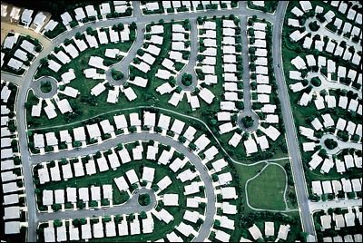

Slide 6
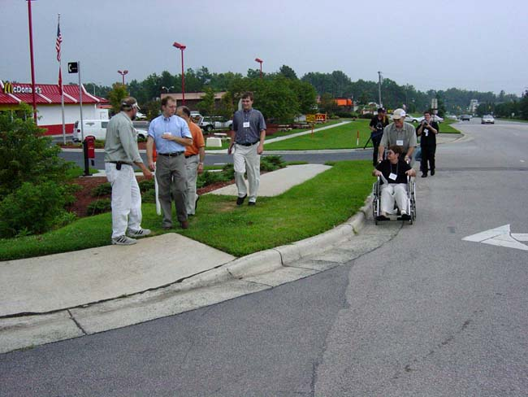
Durham, NC

Slide 7
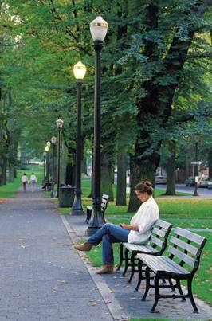
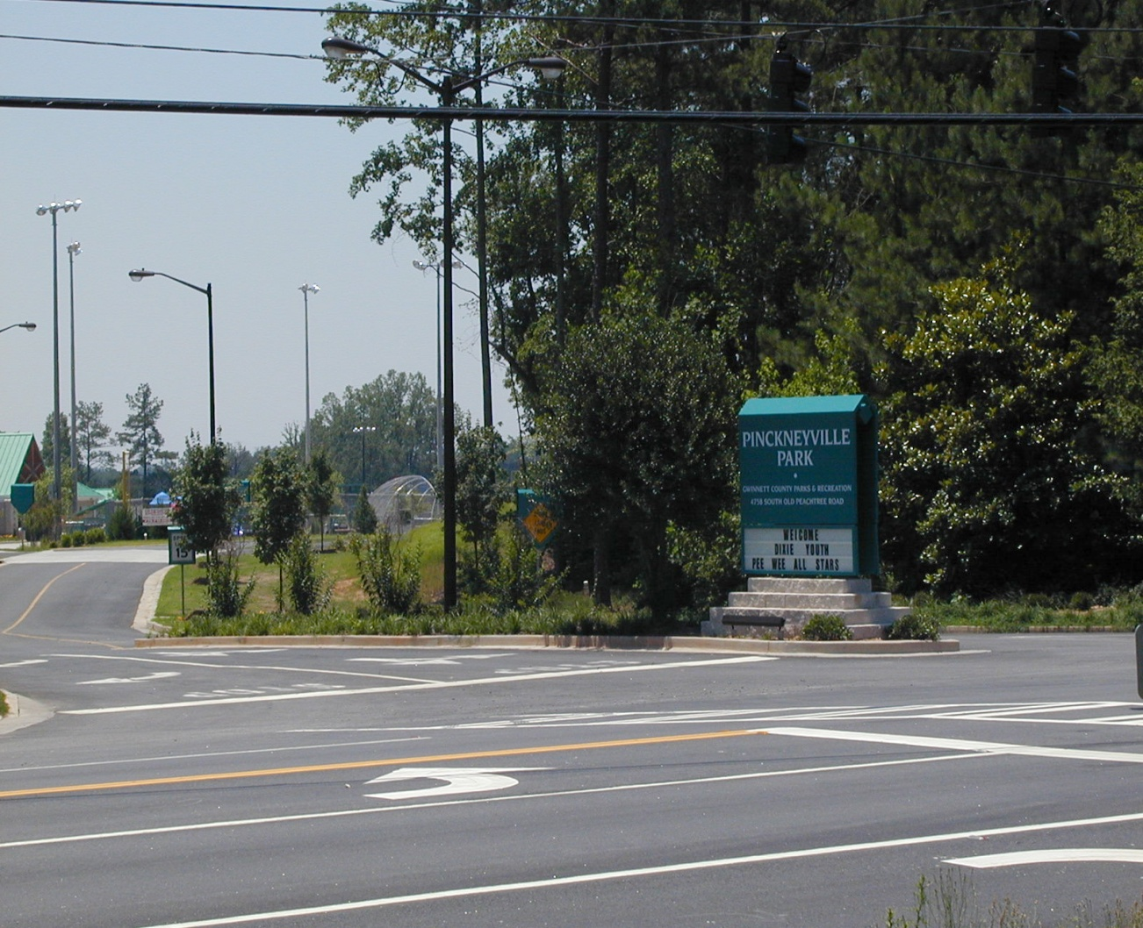
Access to Parks

Slide 8

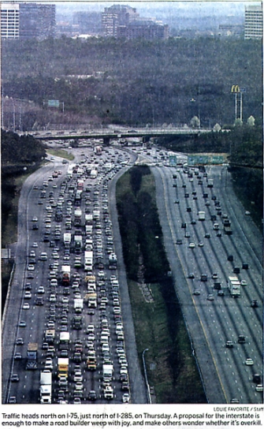
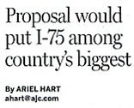
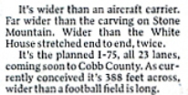
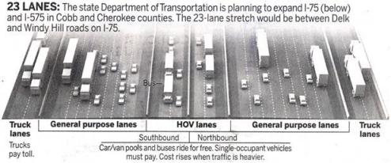
Transportation Planning and Land Use Choices
Source: Atlanta Journal-Constitution, March 10, 2006

Slide 9
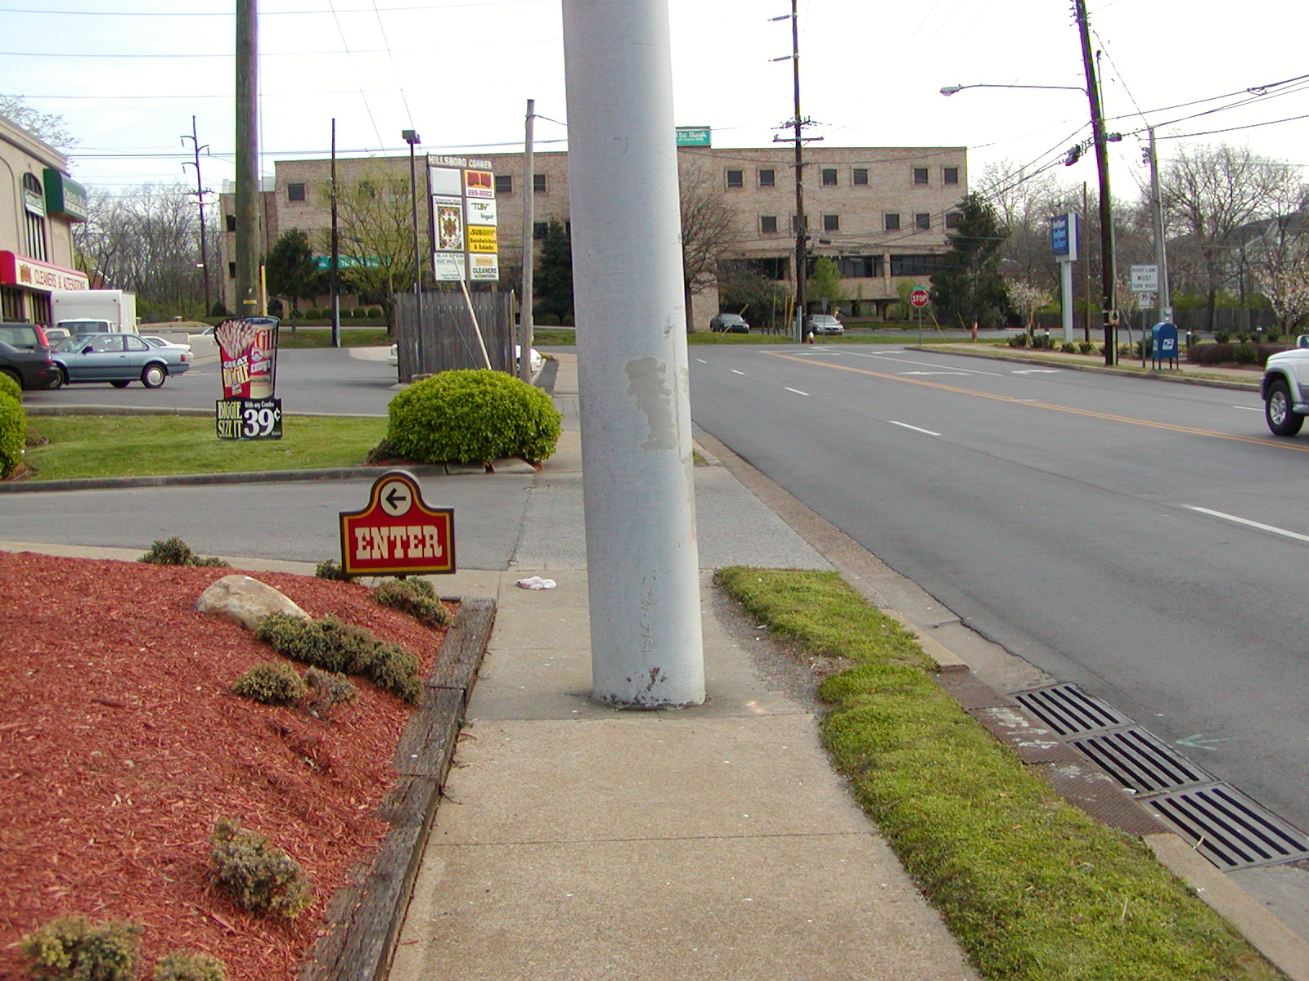
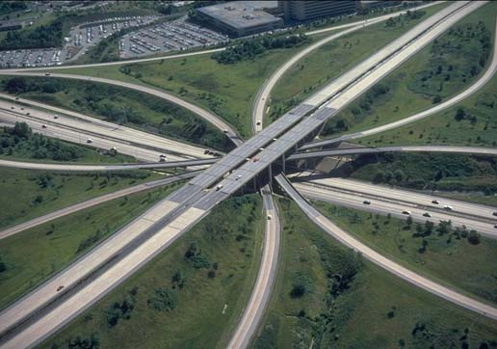
Transportation Design
to Discourage Physical Activity

Slide 10
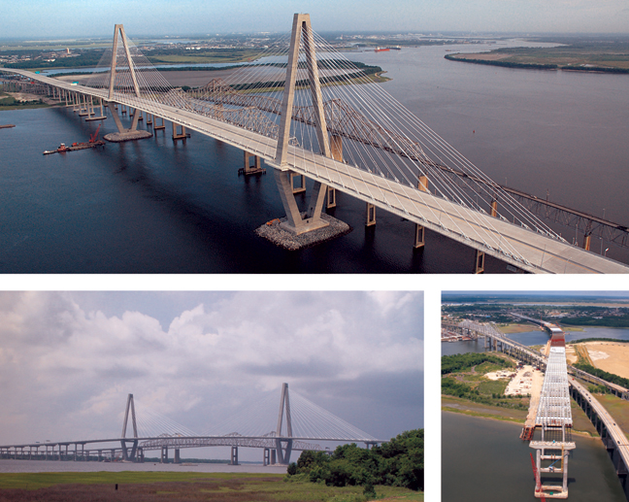
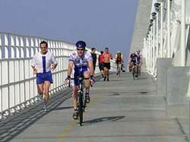
Cooper River Bridge, Charleston, SC
Transportation Design
to Encourage Physical Activity

Slide 11
Increasing Bicycle Use, Portland, OR
Cyclists Per Day
Bikeway Miles
12,500
350
Bridge Bicycle Traffic
300
10,000
Bikeway Miles
250
7,500
1991:
78 miles of bikeways
2,850 daily trips
200
5,000
150
2006:
263 miles of bikeways
11,956 daily trips
100
2,500
50
0
0
Year:
1991
1992
1993
1994
1995
1996
1997
1998
1999
2000
2001
2002
2003
2004
2005
2006
Bridge Bicycle Traffic
2,850
3,555
3,885
3,830
3,207
4,520
5,225
5,690
5,910
6,015
7,686
8,250
8,562
8,875
10,192
11,956
Bikeway Miles
78
83
86
103
113
144
166
183
213
222
235
252
254
260
262
263

Slide 12
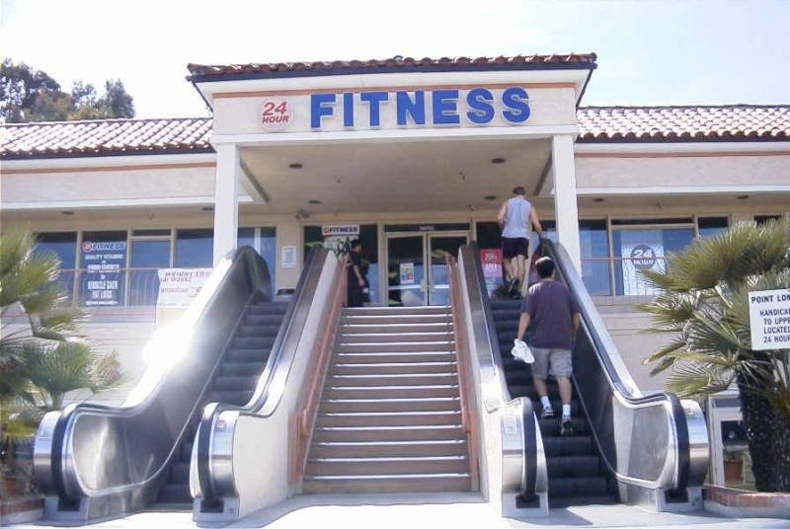

Slide 13
Obesity Trends* Among U.S. Adults
BRFSS, 1990, 1998, 2007
(*BMI ≥30, or about 30 lbs. overweight for 5’4” person)
1990
1998
2007
No Data <10% 10%–14% 15%–19% 20%–24% 25%–29% ≥30%

Slide 14
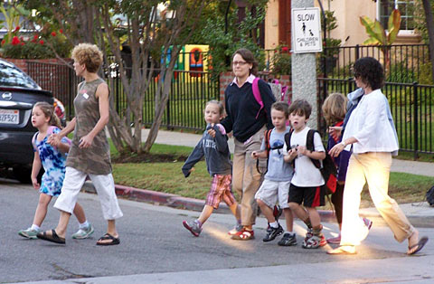
Children Walking to School
Parental reported barriers to walking/biking to school: 55% distance, 40% traffic danger
Source: MMWR 2002;51(32):701-704

Slide 15

Asthma and Air Pollution
Natural experiment during 1996 Summer Olympic games in Atlanta
Peak morning traffic decreased 23% and peak ozone levels decreased 28%
Asthma-related emergency room visits by children decreased 42%
Children’s emergency visits for non-asthma causes did not change during same period
Friedman et al. JAMA 2001;285:897

Slide 16
Water Quality
Water run-off from roads and parking lots can pollute water supplies with possible impact on human health
Increased erosion and
stream siltation causes
environmental damage
and may affect water
treatment plants
Notes:
It also has several effects on water quality.

Slide 17
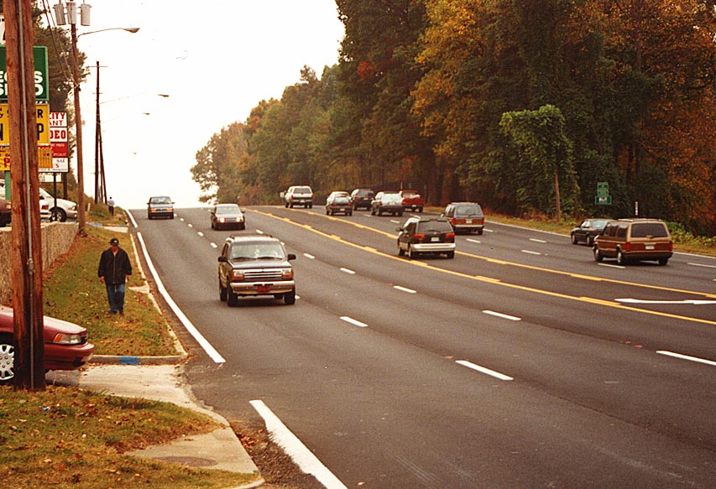
Deaths and Injuries to Motor Vehicle Occupants and Pedestrians
Leading cause of deaths among persons 1-34 years old
Annual toll from motor vehicle crashes in United States:
  34,000 deaths
  2.4 million nonfatal injuries
  $100 billion in costs
Sources: NHTSA 2010; USDOT 2008; Naumann 2010
Notes:
Sources:
NHTSA data for 2009: http://www-fars.nhtsa.dot.gov/People/PeopleAllVictims.aspx
U.S. Department of Transportation. National Highway Traffic Safety Administration, National Center for Statistics and Analysis. Traffic safety facts 2008: a compilation of motor vehicle crash data from the fatality analysis reporting System and the general estimates system. Washington, DC: NHTSA; 2008.
Naumann, Rebecca B., Dellinger, Ann M., Zaloshnja, Eduard, Lawrence, Bruce A. and Miller, Ted R.(2010) 'Incidence and Total Lifetime Costs of Motor Vehicle-Related Fatal and Nonfatal Injury by Road User Type, United States, 2005', Traffic Injury Prevention, 11: 4, 353 — 360.

Slide 18
Mental Health Issues that may Relate to Community Design
Depression
  Relieved by physical activity and social interaction
Stress
  Aggravated by long commutes
Attention Deficit-Hyperactivity Disorder
  Greenspace may improve function in ADHD
Violent Behavior – Impulse Control
  Example: road rage
Notes:
Chris – need references

Slide 19
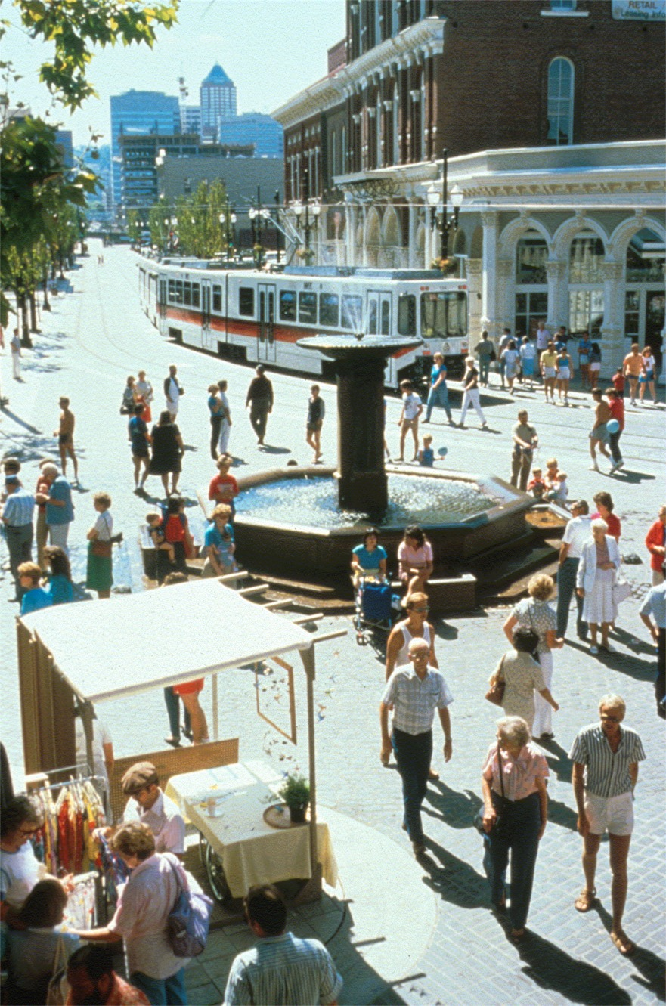
Social Capital
Defined as social networking, civic engagement, trust and reciprocity
Decreased by long commutes
Notes:
This leads to the final health outcome we will discuss, an outcome so broad that it stretches even the WHO definition of health. This is social capital, an accumulation of social networking, civic engagement, and shared trust and reciprocity.
Numerous writers have observed a loss of social capital in recent years(1, 2), and some authors have attributed this decline, in part, to suburbanization and sprawl.(3, 4)
1. Etzioni A. The Spirit of Community : The Reinvention of American Society. New York: Crown Publishers, 1993.
2. Putnam R. Bowling Alone: The Collapse and Revival of American Community. New York: Simon & Schuster, 2000.
3. Mo R and Wilkie C. Changing Places: Rebuilding Community in the Age of Sprawl. New York: Henry Holt and Co., 1997.
4. Calthorpe P. The Next American Metropolis: Ecology, Community, and the American Dream. Princeton: Princeton Architectural Press, 1993.

Slide 20

Design Principles to
Address Climate Change
Transportation alternatives
Density
Mixed land use
Parks and green spaces
Energy efficient buildings

Slide 21
Smart Growth is Likely to Feature:
Higher density, more contiguous development
Preserved green spaces
Mixed land uses with walkable neighborhoods
Limited road construction, balanced by transportation alternatives
Architectural heterogeneity
Economic and racial heterogeneity
Development and capital investment balanced between central city and periphery
Effective, coordinated regional planning
Notes:
Smart growth initiatives are well advanced in some areas. While they vary greatly, they often include the features shown here, features that are familiar to those who have visited certain European cities lately. From a health point of view, these are highly attractive features. They offer the potential of more walking, less driving, fewer car crashes and pedestrian fatalities, and more livable regions with enhanced social capital—all important health benefits.

Slide 22

What Smart Growth “Is” And “Is Not”
More transportation choices and less traffic
Not against cars and roads
Vibrant cities, suburbs, and towns
Not anti-suburban
Wider variety of housing choices
Not about telling people where or how to live
Well-planned growth that improves quality-of-life
Not against growth
Slide credit:
Notes:
It is important to point out what Smart Growth “IS” and what it “IS NOT.” Smart Growth IS about more transportation choices and less traffic. It’s NOT against cars and roads. Cars are our dominant mode of transportation, and will remain dominant. Smart Growth is about more choices in how we get around. Smart Growth is about a variety of vibrant communities for families to choose among. It’s not anti-suburban. It’s about a variety of housing choices. It’s not about telling people where or how to live. Smart Growth provides more than just one kind of home--it gives people more choices, not fewer. Smart Growth is well-planned growth. It’s NOT against growth.

Slide 23
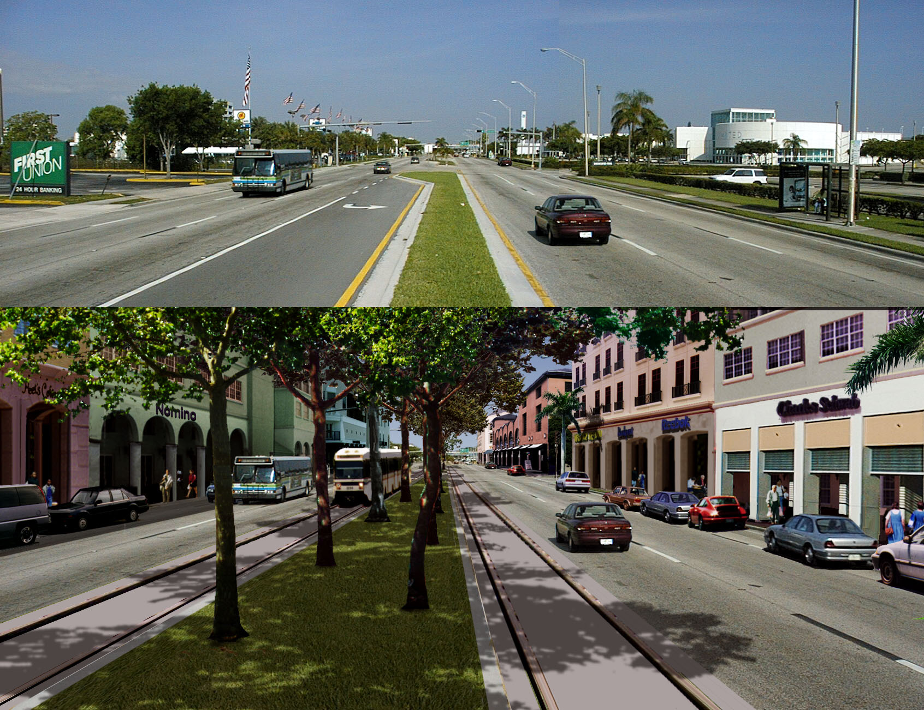
Development Patterns
http://www.smartgrowthamerica.org/smartgrowthintro.htm

Slide 24
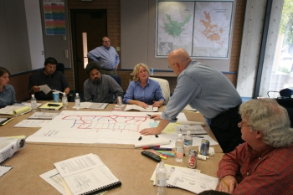
Health Impact Assessment
A tool to increase partnerships and communication between public health professionals and planners and other decision-makers

Slide 25
Health Impact Assessment
Definition
Collection of procedures and tools by which projects, policies, and programs can be evaluated based on their potential effects on the health of a population, and the distribution of those effects within the population
Gothenburg consensus statement, 1999

Slide 26
A Vision of
Health Impact Assessment
Planners and others will request information on potential health consequences of projects and policies as part of their decision-making process
Health officials will have a tool to facilitate their involvement in planning and land use decisions
HIAs will lead to a better informed decisions

Slide 27
Steps in Conducting an HIA
Screening
  Identify projects/policies for which HIA useful
Scoping
  Identify which health impacts to include
Risk assessment
  Identify how many and which people may be affected
  Assess how they may be affected
Recommendations
  Identify changes to promote health or mitigate harm
Reporting of results to decision-makers
Evaluation of impact of HIA on decision process

Slide 28
Completed HIAs in the United States
1999–2009 (N = 54)
WA 4
MT 1
MN 5
OR 2
MI 1
PA 1
MA 2
OH 1
NJ 1
CO 2
CA 25
MD 1
GA 4
FL 1
AK 3
Notes:
Although we know of 64 HIA-type projects, only 48 have been totally completed.
As for the others:
6 HIAs are in progress
4 are not actually HIAs (yet, but could eventually be so we are tracking them)
2 are HIA “checklists” and not HIA projects/programs/policies
2 HIAs were cancelled
2 HIAs have an unknown status- we have abstracts for the “Injury Liability Protection for Physical Activity” out of Los Angeles, but there have been no reports published. The status of the Tacoma/Pierce County South Hill Neighborhood Plan HIA is also unknown. The contact information we have for people associated with the project (Rick Porso and Beth Glynn) no longer work. Arthur or Andy, do you know anything about these two projects?
Also, Andy, I only have 3 HIAs in Minnesota and Alaska, but your map listed 4…

Slide 29
HIAs of Projects and Policies
  Housing redevelopment
  Highway corridor redevelopment
  Pedestrian/bicycle trail development
  Highway bridge replacement
  Transit line
  Community transportation plan
  Local area and comprehensive plans
  After-school programs
  Living wage ordinance
  Paid sick leave policy
  Coal-fired power plant
  Low income home energy subsidies
  Oil and gas leasing policies

Slide 30
HIA of Housing Redevelopment Projects
Rajiv Bhatia, San Francisco Health Department
Rapid assessment of health impacts in housing redevelopment projects
Qualitative review of Environmental Impact Report, community engagement, secondary data analysis
Findings: Effects on housing affordability, vehicle commutes, displacement of residents, segregation, and public infrastructure
HIA analyses led to improved project with replacement housing for low income residents

Slide 31
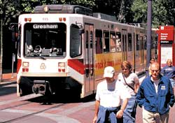
Minutes of Walking To and
From Public Transit Per Day
SCIENCE
Documenting Health and Transportation Links
Data from National Household Travel Survey, 2001, USDOT
N= 3312 transit users
Besser LM, Dannenberg AL
Amer J Prev Med 29:273, 2005

Slide 32
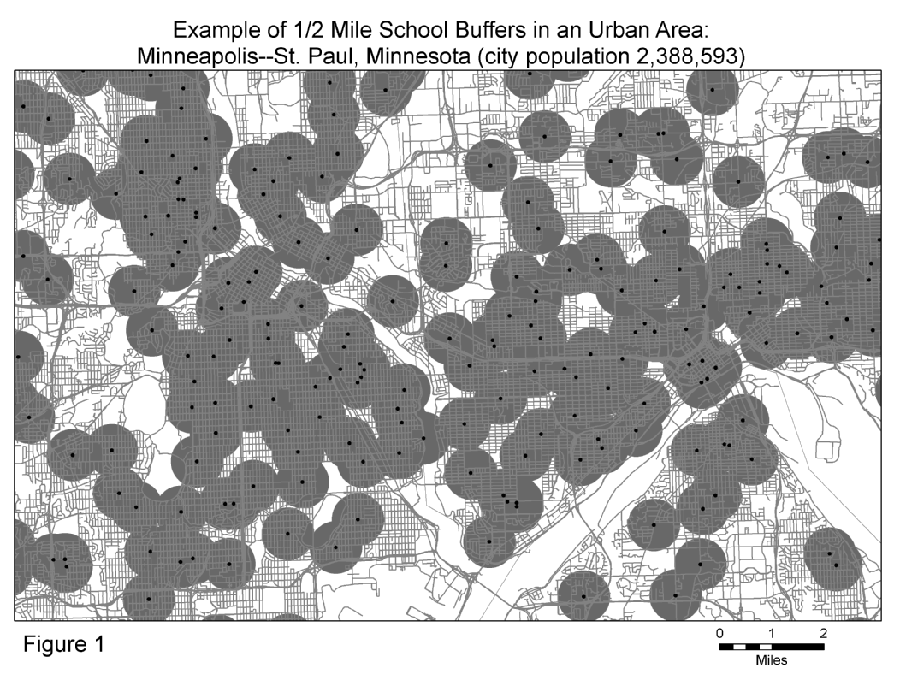
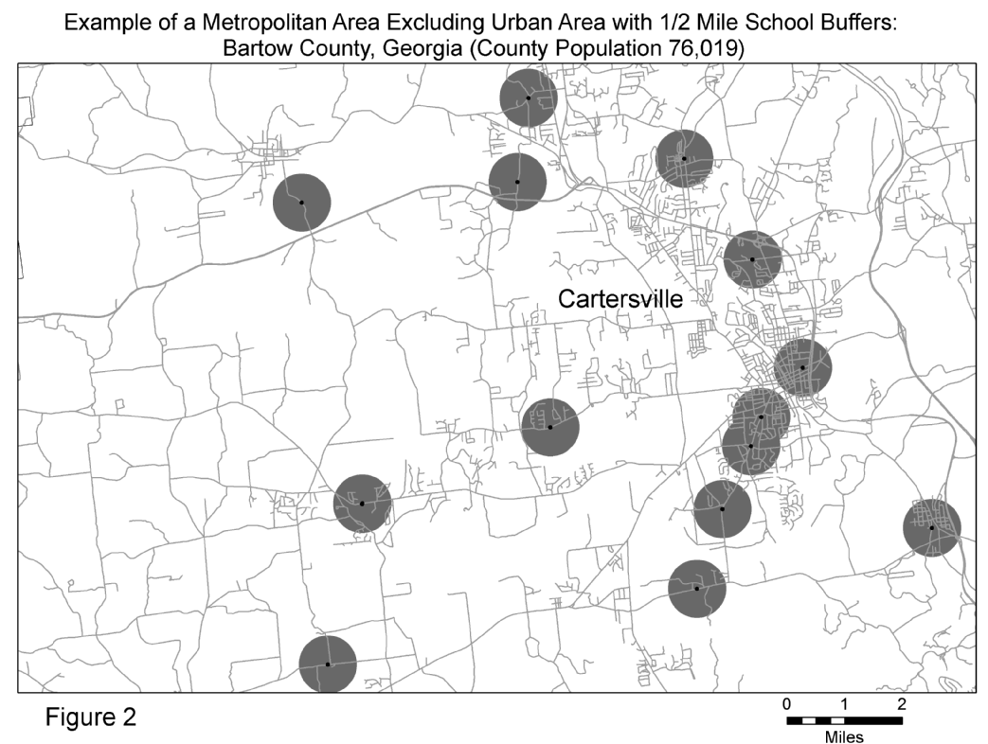
Safe Routes to School: Benefits for the Larger Community
SCIENCE
Using GIS to Examine Health Impacts
Watson M, Dannenberg AL. Preventing Chronic Disease. July 2008; 5(3):A90

Slide 33

SURVEILLANCE
Alliance for Biking and Walking Benchmarking project
Existing data from 50 states and 50 cities on walking and bicycling and their relation to obesity and other health outcomes
peoplepoweredmovement.org/pdf/benchmarking2007.pdf
Notes:
33
Surveillance is a vital component of public health and also for transportation planning. We have wonderful data for how many miles vehicles travel and where they travel, but the same sort of data is lacking for bicycling and pedestrians.
We contracted with Thunderhead alliance to conduct a benchmarking project to describe, using already available data sources, bicycling and walking in the US, and put it in context with health data, such as obesity rates.

Slide 34
PARTNERSHIPS
Working with Developers
LEED for Neighborhood Development Rating System integrates the principles of smart growth, urbanism, public health, and green building into the first national standard for neighborhood design
Supported in part by NCEH and EPA
http://www.usgbc.org/DisplayPage.aspx?CMSPageID=148

Slide 35
Green, Sustainable and Healthy Actions
Unplug unused electronics
Recycle newspapers
Install solar panels
Build and use walking and biking infrastructure
Use non-toxic cleaners
Take the stairs
Plant trees
Buy locally grown organic food
Get regular exercise
Get adequate sleep
Eat a low-salt diet
Healthy
Green and Sustainable

Slide 36
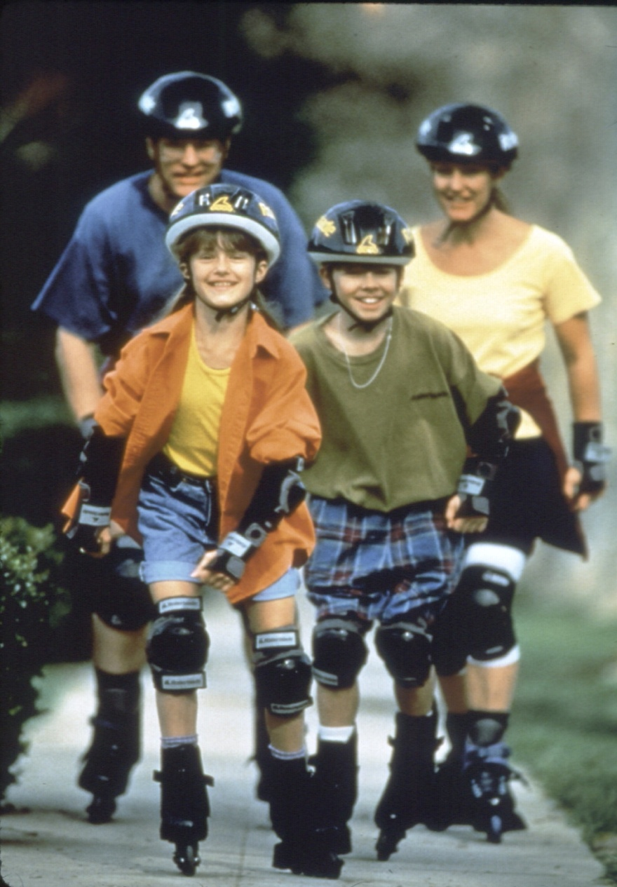
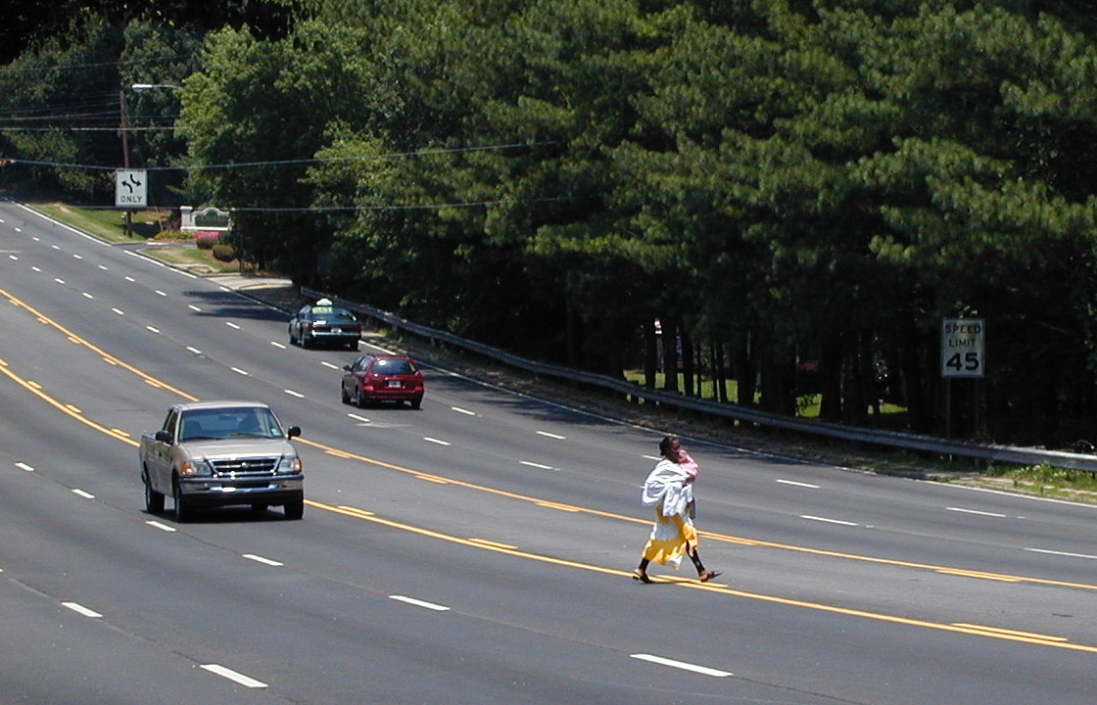
Community design choices can be used to promote human health
www.cdc.gov/healthyplaces www.epa.gov/smartgrowth

