Slide 1
Food access: concepts and frameworks
Presented by:
Bridget Igoe, University of Washington Graduate Student
WA-NOPREN Meeting
July 22, 2011

Slide 2
Presentation outline
Rural Food Access Work Group
  Report out from NOPREN Collaborator Meeting (Austin, TX Feb 2011)
  Measuring & modeling food access, literature
  Revisiting food system stakeholder interviews
  Conceptual model examples
Summarize supporting activities
Discuss 4 different conceptual models

Slide 3
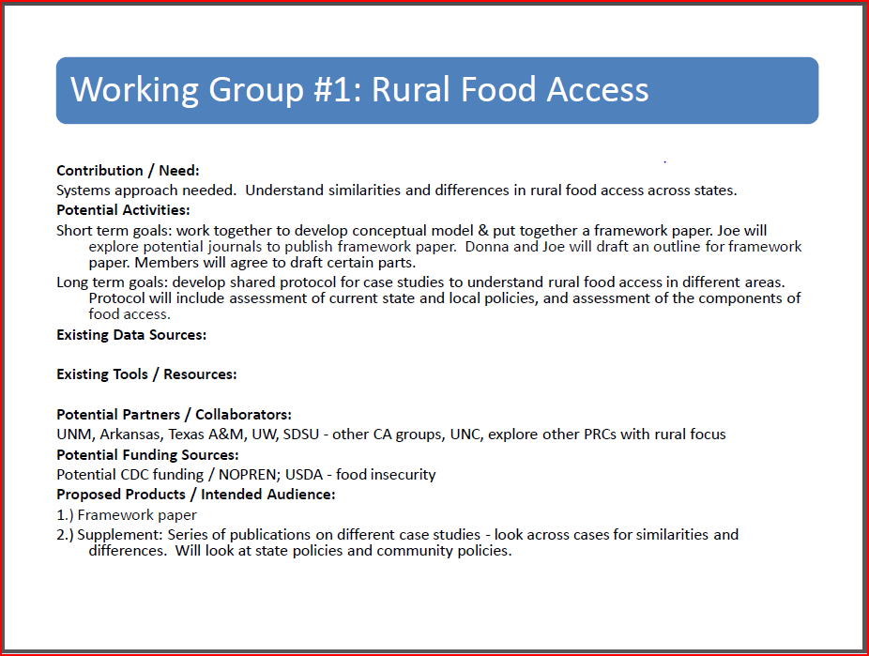
NOPREN Collaborator Meeting
(Austin, TX Feb 2011)
Rural Food Access Work Group
Summarize supporting activities
Discuss 4 different conceptual models

Slide 4
Perspectives and understandings of rural food access
Academic researchers
Food system stakeholders & advocates
Residents, households, consumers
Rural Food Access Work Group
Summarize supporting activities
Discuss 4 different conceptual models

Slide 5
Measures & Dimensions of
Accessibility
Academic researchers
Acceptable travel, reasonable distance
Accepts SNAP, WIC
Advertising, promotion
Being a single parent
Built environment (distance, safety, walkability)
Consumer knowledge, ability, resources
Convenience
Cultural, personal acceptability; familiarity
Demographics (e.g. race/ethnicity, income, age, gender)
Density (of food stores)
Disparities ( racial/ethnic and income)
Economic accessibility
Financial, economic
Food price/variety, availability
“Healthy” vs. “Unhealthy” food options– Zipf’s Principle
“Healthy”/nutrition accessibility
Linear shelf space
Neighborhood characteristics
Perception
Physical accessibility, financial resources
Potential access (availability) vs. Realized access (actual use)
Proximity (minimum distance), distance
Purchasing power
Quality characteristics ( of food, stores, retail environment)
Rural vs. Urban location
Season, climate
Social capital
Spatial access
Time (to shop, to prepare meals)
Traffic flow—Gravity model
Transportation, transport system, car ownership/access
Variety/diversity (of stores, food service places)
Rural Food Access Work Group
Summarize supporting activities
Discuss 4 different conceptual models
Notes:
This is a snapshot of measures and dimensions of food access based on a nonsystematic literature search focused on methods to measure food access. See reference section for literature that was consulted to create this free list of terms. *N.B.: Terms are in alphabetical order and do not reflection priority measures/dimensions nor all possible measures/dimensions. See slide 30 for references consulted for this slide.
These are imprecise terms, therefore the measurement decisions are significant, e.g.
-Proximity might be nearest location, a single location, multiple locations, from origins other than homes (trip chaining) (Sharkey 2009)
-Physical accessibility might be road network drive time, walking time (Muamba et al., 2010)
-Measures are often combined, e.g. Diversity refers to density and type of food store; Variety refers to availability of different types of food stores or restaurants as well as their price and quality (McKinnon et al., 2009)
Dimensions of accessibility is nuanced: e.g.
-Distance to the nearest store may not reflect the actual experience of people. Decisions on where to shop are influenced by opening hours, standard of service, family preferences, and established relationships (cited in Sharkey & Horel, 2008)
-Reasonable distance is not well established in rural food studies; acceptable travel expresses distance in time (Hubley 2010)
-There are feedback loops
Gravity model (used in transportation and urban planning research): predicts aggregate human behaviors related to spatial interaction, such as traffic flow and shopping activities (Glanz et al., 2005)
Zipf’s Principle of Least Effort suggests that relative proximity in space of healthy vs. unhealthy food products affects the odds of a healthy vs. unhealthy diet (Glanz et al., 2005)

Slide 6
What should I measure?
How should I measure it?
How should I analyze the data?
What can I credibly infer?
(Oakes et al., 2009)
Rural Food Access Work Group
Summarize supporting activities
Discuss 4 different conceptual models
Notes:
“Many questions naturally follow from any attempt to measure these environments…” (Oakes et al., 2009 p. S177)

Slide 7
Measurement challenges for rural food environments
Sharkey, J.R., Measuring Potential Access to Food Stores and Food-Service Places in Rural Areas in the U.S. American Journal of Preventive Medicine, 2009. 36(4): p. S151-S155.
Defining the rural food environment
Recognizing changing market factors (type of store, availability of food items)
Identifying all food stores and food-service places
Describing characteristics to differentiate similar types of food stores
Determining location coordinates (e.g. origin and destination)
Use of secondary data
Use of geographic boundaries, census block group
Rural Food Access Work Group
Summarize supporting activities
Discuss 4 different conceptual models
Notes:
Additionally, there are some important considerations for measuring rural food environments
Recognizing changing market factors: unless multiple measures of the food environment are made over time, many of the trends and changes to the food environment may go unobserved. Trends and changes include the consolidation of the retail food industry, loss of small town stores, increasing numbers of nontraditional stores (e.g. big box stores—even Home Depot– combine merchandise and full-line grocery; dollar store and drug stores)
Identifying all food stores and food-service places: there is a wider variety of food stores/food service places in rural areas than is reported by urban areas
Determining location coordinates: origin and destination points may produce dramatically different results and travel to a supermarket may not begin at the residence, neighborhood, or center of a census tract (relates to issue of how to account for trip-chaining)
Use of secondary data: may provide outdated food environment measures or overstate existing food stores. Sharkey recommends “ground-truthing” (in-person, neighborhood street canvas and enumeration of food stores) (see Sharkey & Horel, 2008)
Use of geographic boundaries may misrepresent access, e.g. residence may be located near the county edge and nearest food store may be in the adjacent county; census block group in rural areas are larger than in urban areas so the geographic center may not accurately represent the population center (see Sharkey & Horel, 2008)

Slide 8
Need for conceptual models & theories
Matthews, Vernez-Moudon, Daniel. Work Group II: Using Geographic Information Systems for Enhancing Research Relevant to Policy on Diet, Physical Activity, and Weight . Am J Prev Med 2009;36(4S).
Challenge #1: Theoretical and Conceptual Development in Framing Place Effects on Health
“…theoretical advances have seriously lagged behind these impressive developments in data, tools, and methods.” (p. S172)
Priority recommendation(s):
“…(1) foundational research on theoretical development and conceptual frameworks for the study of people, health behaviors, and place…” (p. S172)
Rural Food Access Work Group
Summarize supporting activities
Discuss 4 different conceptual models
Notes:
The 2007 Measures of the Food and Built Environments workshop, sponsored by the NIH and RWJF
Matthews et al discuss how GIS technologies are transforming research on social and built environments, however…
In Challenge #2 Matthews et al discuss “improving the understanding between place and the reciprocal dynamics between people and place”. Concept of place is a weak area in public health research and is based on tenuous assumptions. Static measures, e.g. administrative boundaries, ignore contextual influences that are significant to human behavior, such as personal characteristics, socio-cultural factors, commuting patterns, social networks, and preferences for use of facilities and resources (see p. S 172).

Slide 9
Need for conceptual models & theories
Oakes, Mâsse, Messer. Work Group III: Methodologic Issues in Research on the Food and Physical Activity Environments Addressing Data Complexity. Am J Prev Med 2009;36(4S):S177–S181.
Challenge #1: Conceptual Models and Theories
“The first barrier is surely the lack of precise conceptual models and elaborate theories of exactly which factors are presumed to affect which behaviors under which circumstances and by how much.” (p. S178)
Recommendation to address the “absence of clear, testable conceptual models” (p. S177)
“…improved conceptual models and more elaborate theories…” (p. S178)
Rural Food Access Work Group
Summarize supporting activities
Discuss 4 different conceptual models
Notes:
The 2007 Measures of the Food and Built Environments workshop, sponsored by the NIH and RWJF

Slide 10
Existing concepts and frameworks
For example:
  Community nutrition environments
  Food access model
  Food access theory (work in-progress)
  Food insecurity & determinants of access to food resources
  Food systems, food environments, social conditions as they contribute to diet and health disparities
  Rural food system
  Nutritional self-management model
  Food choice/purchasing
  Consumption of organic and local food
Rural Food Access Work Group
Summarize supporting activities
Discuss 4 different conceptual models
Notes:
I conducted a nonsystematic literature search with a focus on identifying existing conceptual models and frameworks in the published and gray literature. Searched PubMed, Google Scholar, and Google Image with terms: food access conceptual model, food access framework, rural food access conceptual model, rural food access framework.
I pulled 12 distinct example of models and frameworks (see addendum for complete list) to reflect the diversity of perspectives and paradigms that are used to conceptualize food access and other contextual factors related to food access. *N.B.: These models and frameworks do not reflect priority models nor all possibilities.
We will discuss 4 conceptual models later on.

Slide 11

Food System
Stakeholder Interviews
Perceptions of access to healthy foods
Dimensions of accessibility
Barriers, facilitators, mediators of access
Food system stakeholders & advocates
Academic researchers
Residents, households, consumers
Rural Food Access Work Group
Summarize supporting activities
Discuss 4 different conceptual models

Slide 12
[Pull quote slides]

Slide 13
“…multiple stakeholders with differing, conceivably conflicting perspectives…” (Lewis et al., 2007)
Public health
Nutrition policy advocates
Small producers
Large producers
Agriculture policy advocates
NGOs, private charities, CBOs
Food system stakeholders & advocates
Rural Food Access Work Group
Summarize supporting activities
Discuss 4 different conceptual models

Slide 14
Stakeholder Analysis
Lewis, Young, Mathiassen et al. Business process innovation based on stakeholder perceptions. Information Knowledge Systems Management 6 (2007) 7–27.
Valuable in complex organizational settings
Focus on contextual peculiarities, beliefs, and perceptions of involved stakeholders
Combine and integrate perspectives from multiple disciplines
May provide new ways to explain the relationship between an organization and its environment
Notes:
“The approach draws upon multiple stakeholders with differing and conceivably conflicting perceptions of current and future practices”
Models are analytic lenses and inherently exclude areas of potential interest
Lewis et al., 2007 Available online: http://www.business.unr.edu/faculty/kuechler/788/softsysBPinnovation.pdf

Slide 15
Stakeholder Analysis
Elias & Cavana. Stakeholder Analysis for Systems Thinking and Modelling [sic]. N.D. http://portals.wi.wur.nl/files/docs/ppme/BobCavana.pdf
“We would like to propose that a well structured stakeholder analysis along with the active interaction of stakeholders would enrich the different phases of the systems thinking and modeling process.” (p. 6)
Notes:
Systems thinking and modeling uses a systems approach, a set of conceptual and analytical methods. The development of a systems thinking and modeling intervention involves 5 phases: (1) problem structuring, (2) causal looping modeling, (3) dynamic modeling, (4) scenario planning and modeling, (5) implementational and organizational learning.
[See Elias & Cavana, N.D. http://portals.wi.wur.nl/files/docs/ppme/BobCavana.pdf]

Slide 16
Stakeholder Analysis Grid, e.g.:
Topic Stakeholder | Perceptions of access | Dimensions of accessibility | Barriers to food access | Enhancers, facilitators, mediators to food access
Public health
NGOs, private charities, CBOs
Nutrition policy advocates
Agricultural policy advocates
Small producers
Large producers

Slide 17
Group discussion
Conceptual models and frameworks
Rural Food Access Work Group
Summarize supporting activities
Discuss 4 different conceptual models

Slide 18
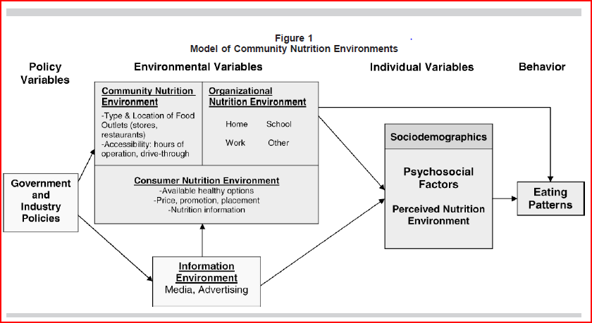
Model of Community Nutrition Environments
Glanz et al. Am J Health Promotion. 2005 May-Jun;19(5):330-3, ii.2005

Slide 19
Conceptual model of food access
Sharkey et al. International Journal of Health Geographics 2010, 9:26 2010

Slide 20
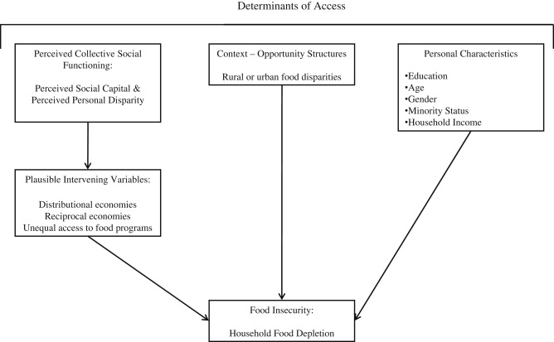
Conceptual Model of food insecurity and determinants of access to food resources
Dean & Sharkey. Soc Sci & Med. (2011) vol 72, issue 9, 1454-1462

Slide 21
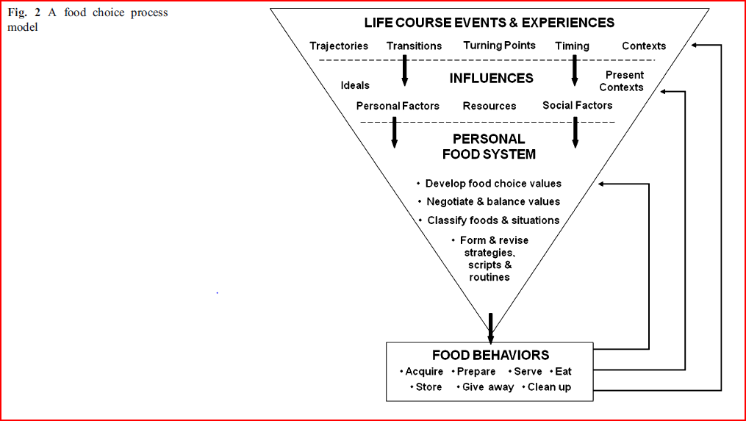
Food choice process model
Sobal & Bisogni. Ann. Behav. Med. (2009) 38 (Suppl 1):S37-S46

Slide 22
Six criteria to evaluate concept models
(Moody & Shanks, 1994)
Simplicity
Understandability
Flexibility
Completeness
Integration
Implementability
Wolff & Frank, N.D. A MULTI-PERSPECTIVE FRAMEWORK FOR EVALUATING CONCEPTUAL MODELS
IN ORGANISATIONAL CHANGE.
Available at: http://wit.tuwien.ac.at/research/tips/evaluating_conceptual_models.pdf

Slide 23
Questions
Does the model reflect “truth”?
  Are there domains that are missing?
  Are the facts described by the model correct?
Does the model capture the appropriate systemic relationships?
  What areas of interest/influence are excluded?
  Is the model language and infrastructure transferable?
Does the model inform future action and strategy?
Questions adapted from those in Wolff & Frank, N.D. Available at: http://wit.tuwien.ac.at/research/tips/evaluating_conceptual_models.pdf

Slide 24
Other References
Glanz K, Sallis J, Saelens BE, Frank LD. Health Nutrition Environments: Concepts and Measures. Am J Health Promotion. 2005;19(5):330-333.
Hubley TA. Assessing the Proximity of Healthy Food Options and Food Deserts in a Rural Area in Maine. Applied Geography. (2010).
McKinnon RA, Reedy J, Morrissett MA, Lytle LA, Yaroch AL. Measures of the Food Environment A Compilation of the Literature, 1990–2007. Am J Prev Med 2009;36(4S) [Review article]
Muamba F, Clark JK, Betz N. Food Access Gaps in Rural Ohio. Center for Farmland Policy Innovation. Department of Agricultural, Environmental and Development Economics. Research Brief #2010-5. May 24, 2010.
Sharkey JR, Horel S. Neighborhood Socioeconomic Deprivation and Minority Composition Are Associated with Better Potential Spatial Access to the Ground-Truthed Food Environment in a Large Rural Area. J. Nutr. March 1, 2008 vol. 138 no. 3 620-627.
Sharkey JR. Measuring potential access to food stores and food-service places in rural areas in the U.S. Am J Prev Med. 2009 Apr;36(4 Suppl):S151-5.
Walker RE, Keane CR, Burke JG. Disparities and access to healthy food in the United States: A review of food deserts literature. Health Place. 2010 Sep;16(5):876-84. Epub 2010 Apr 24.

Slide 25
ADDENDUM
Conceptual models and frameworks

Slide 26
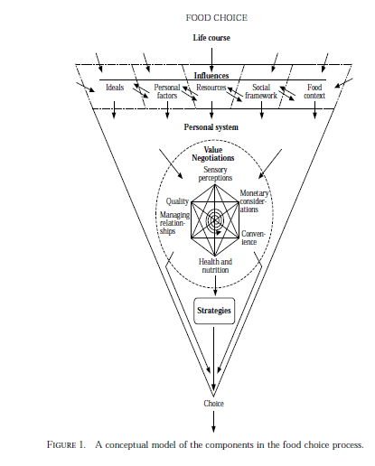
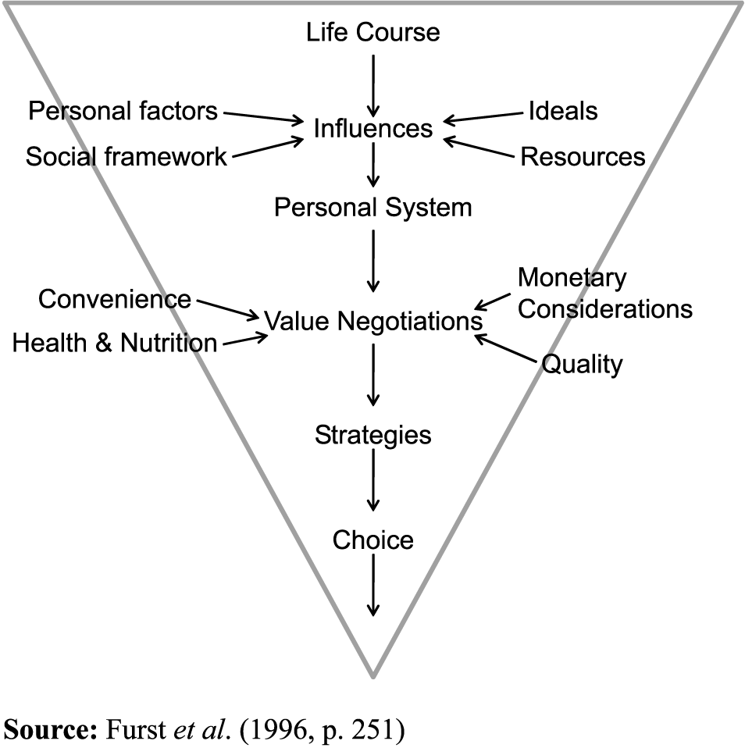
Conceptual model of food choice
Furst et al. Appetite, 26, 247-266, 1996
  Food choice/purchasing (1 of 3)

Slide 27
Food choice process model
Sobal & Bisogni. Ann. Behav. Med. (2009) 38 (Suppl 1):S37-S46
  Food choice/purchasing (1 of 3)

Slide 28
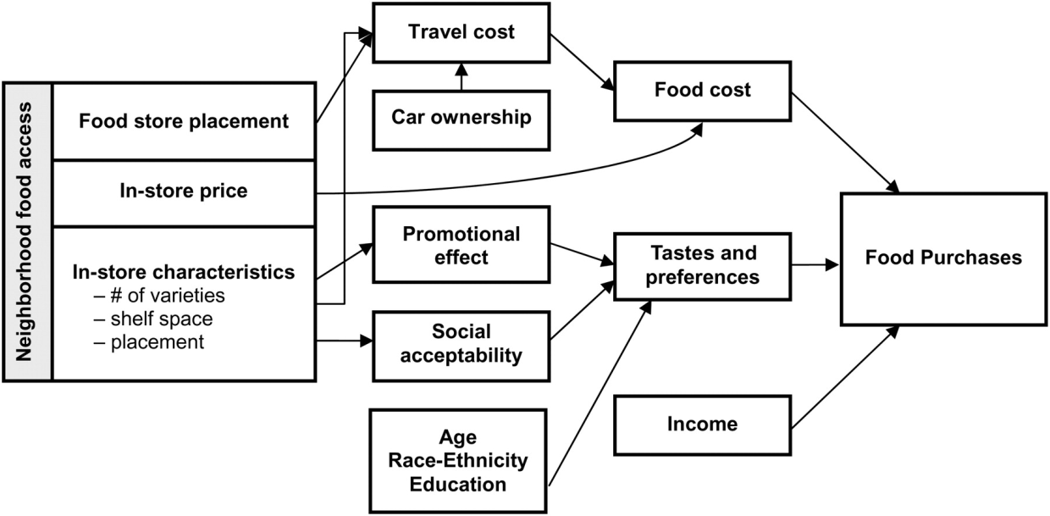
Economic model of food consumption adapted to include neighborhood effects
Rose et al. J of Nutr 2010
  Food choice/purchasing (2 of 3)

Slide 29
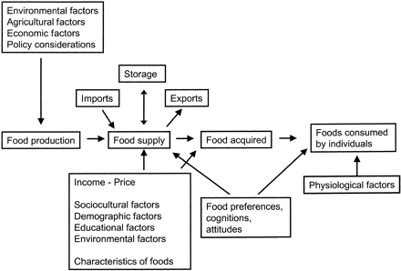
Conceptual model for understanding factors influencing food choice
Krebs-Smith & Kantor, J. Nutr. 2001 vol 131 no. 2 4875-5015
  Food choice/purchasing (3 of 3)

Slide 30
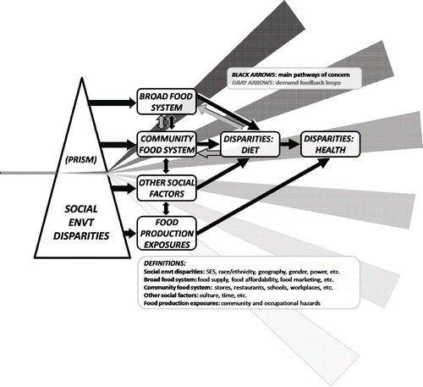
Conceptual Model: Food systems and health disparities
Neff et al. J of Hunger and Environmental Nutr (2009) 4:3-4, 282-314
  Food systems/conditions ↔ social conditions → health disparities (1 of 1)

Slide 31
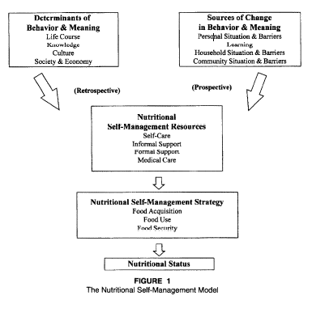
Nutritional Self-Management Model
Quandt, Arcury, & Bell. J of Aging Studies. 1998 vol 12 no. 4 351-368
  Nutritional self-management model
  (1 of 1)

Slide 32
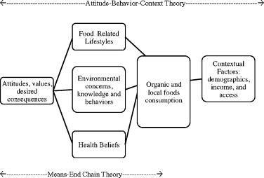
Attitude-Behavior-Context (ABC) theory as an overall framework, and containing Means-end chain (MEC) theory, Health Belief (HB), and Food-related lifestyle (FRL) models (Nie & Zepeda, 2011)
Nie & Zepeda. Appetite. 2011 vol 57, issue 1, 28-37
  Consumption of organic and local food (1 of 1)

Slide 33
Rural Food System Conceptual Framework
Stubblefield et al. California Center for Rural Policy. 2010 (?)
  Rural food system (1 of 1)

Slide 34
Conceptual model of food access
Sharkey et al. International Journal of Health Geographics 2010, 9:26 2010
  Food access, model and theory (1 of 2)

Slide 35
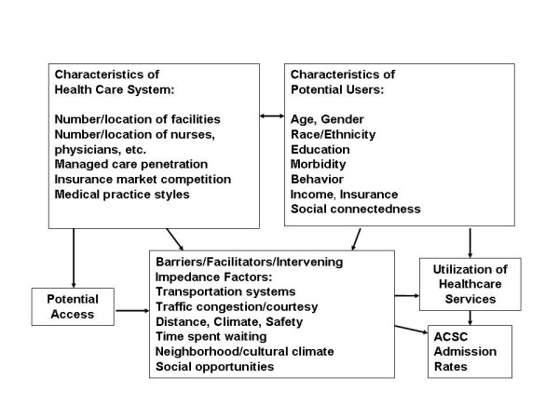
[Spatial model of the utilization of healthcare services]
Mobley et al. International Journal of Health Geographics 2006 5:19 doi:10.1186/1476-072X-5-19

Slide 36
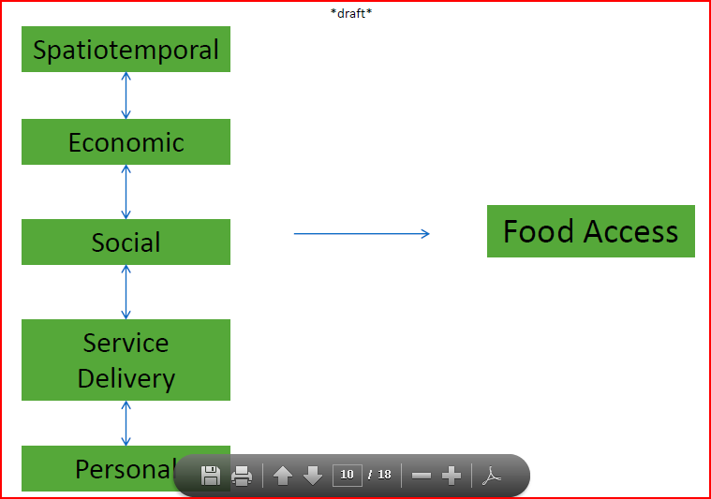
Developing a Theory of Food Access
Freedman et al. University of South Carolina, Center for Research in Nutrition and Health Disparities Healthy Eating in Context Symposium, March 18, 2011
  Food access, model and theory
  (2 of 2)

Slide 37
Conceptual Model of food insecurity and determinants of access to food resources
Dean & Sharkey. Soc Sci & Med. (2011) vol 72, issue 9, 1454-1462
  Food insecurity & determinants of access to food resources (1 of 2)

Slide 38
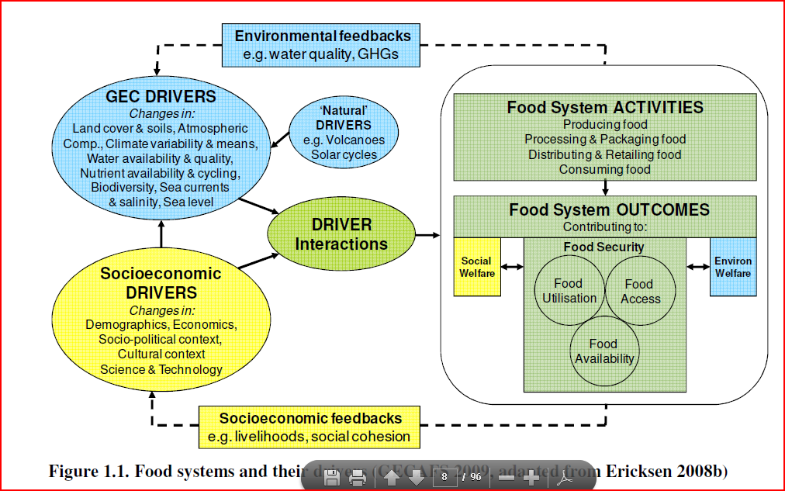
The Global Environmental Change and Food Security framework
White, Stewart, & O’Neill. Environmental Change Institute & Institute of Ageing at Oxford. N.D.
  Food insecurity & determinants of access to food resources (2 of 2)

Slide 39
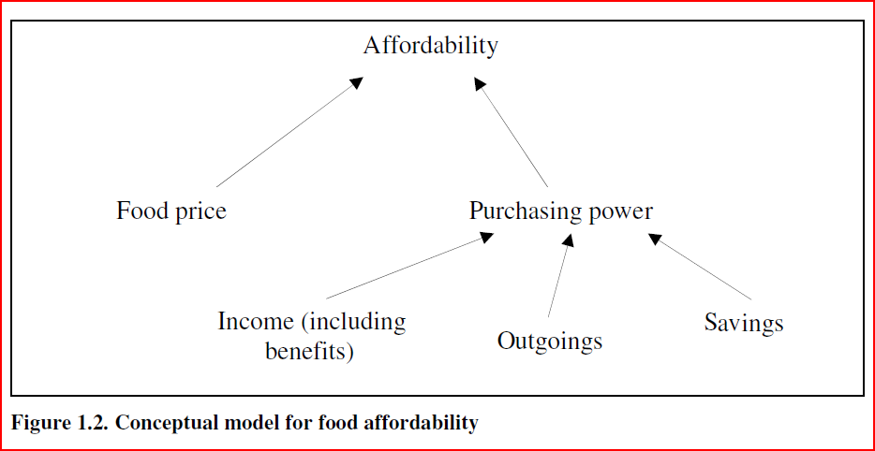
Conceptual model for food affordability
White, Stewart, & O’Neill. Environmental Change Institute & Institute of Ageing at Oxford. N.D.

Slide 40
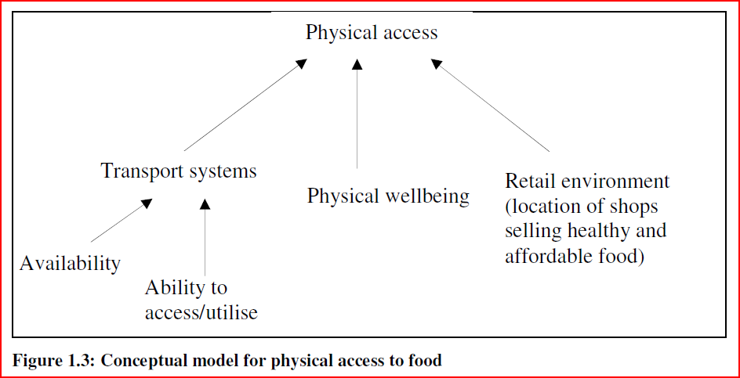
Conceptual model for physical access to food
White, Stewart, & O’Neill. Environmental Change Institute & Institute of Ageing at Oxford. N.D.

Slide 41
Model of Community Nutrition Environments
Glanz et al. Am J Health Promot. 2005 May-Jun;19(5):330-3, ii.2005
  Community nutrition environments (1 of 1)

