Slide 1
Heart Disease in the HIV⁺ Person
Ted Gibbons, MD January 15, 2015
Section Chief, Cardiology
Harborview Medical Center
University of Washington School of Medicine
efg@uw.edu

Slide 2
Outline
Coronary Artery Disease
Myocardial and Pericardial Disease
Pulmonary Hypertension
Atrial Fibrillation

Slide 3
The Spectrum of CAD in HIV⁺ Persons
Coronary Artery Disease
North America: 15% of deaths in HIV population due to CV dz
Severity spectrum: typically present with Acute Coronary Syndromes, but also subject to silent ischemia, stable angina and SCD
Typical patient:
Young man, mean age 48 years old
> 8 years of HIV disease
On ART (53-96% of reported series, 59% on PI)
Often a smoker (45%)
With Dyslipidemia (17-58%)
ACS Diagnosis:
STEMI 29-64% (an excess)
NSTEMI 20-48%
Unstable angina 18-46%
Male 81-97%
PCI, CABG efficacy is similar to non-HIV population
Mortality is similar for equivalent disease burden
ACS recurrence is substantially higher with HIV (HR 6.5): ~~Lipids/HIV
Boccara F et al. J Am Coll Cardiol 2013;61:511–23 (systematic review)
Collaborative analysis of 13 HIV cohort studies. Clin Infect Dis 2010;50:1387–96.
Notes:
Enhanced risk for PIs duration of treatment independent of lipid effects, less convincing for NNRTIs and NRTIs

Slide 4
MI Risk is Higher at Every Age of HIV⁺
Coronary Artery Disease
RR for CAD:
2.8--3.0 women
1.4—2.1 men
...but incomplete data on smoking
Triant VA JID 2012:205 (Suppl 3): S355-361
Triant VA et al. J Clin Endocrinol Metab 2007; 92: 2506–2512
AIDS 2010;24:1228 –30

Slide 5
Profile in HIV+ Persons: CAD Risk
Coronary Artery Disease
Risk for STEMI
>>
NSTEMI
⇑⇑
c/w general
population
Boccara F et al. J Am Coll Cardiol 2013;61:511–23
Notes:
Enhanced risk with Pis, unconvincing or inconsistent for NNRTIs and N

Slide 6
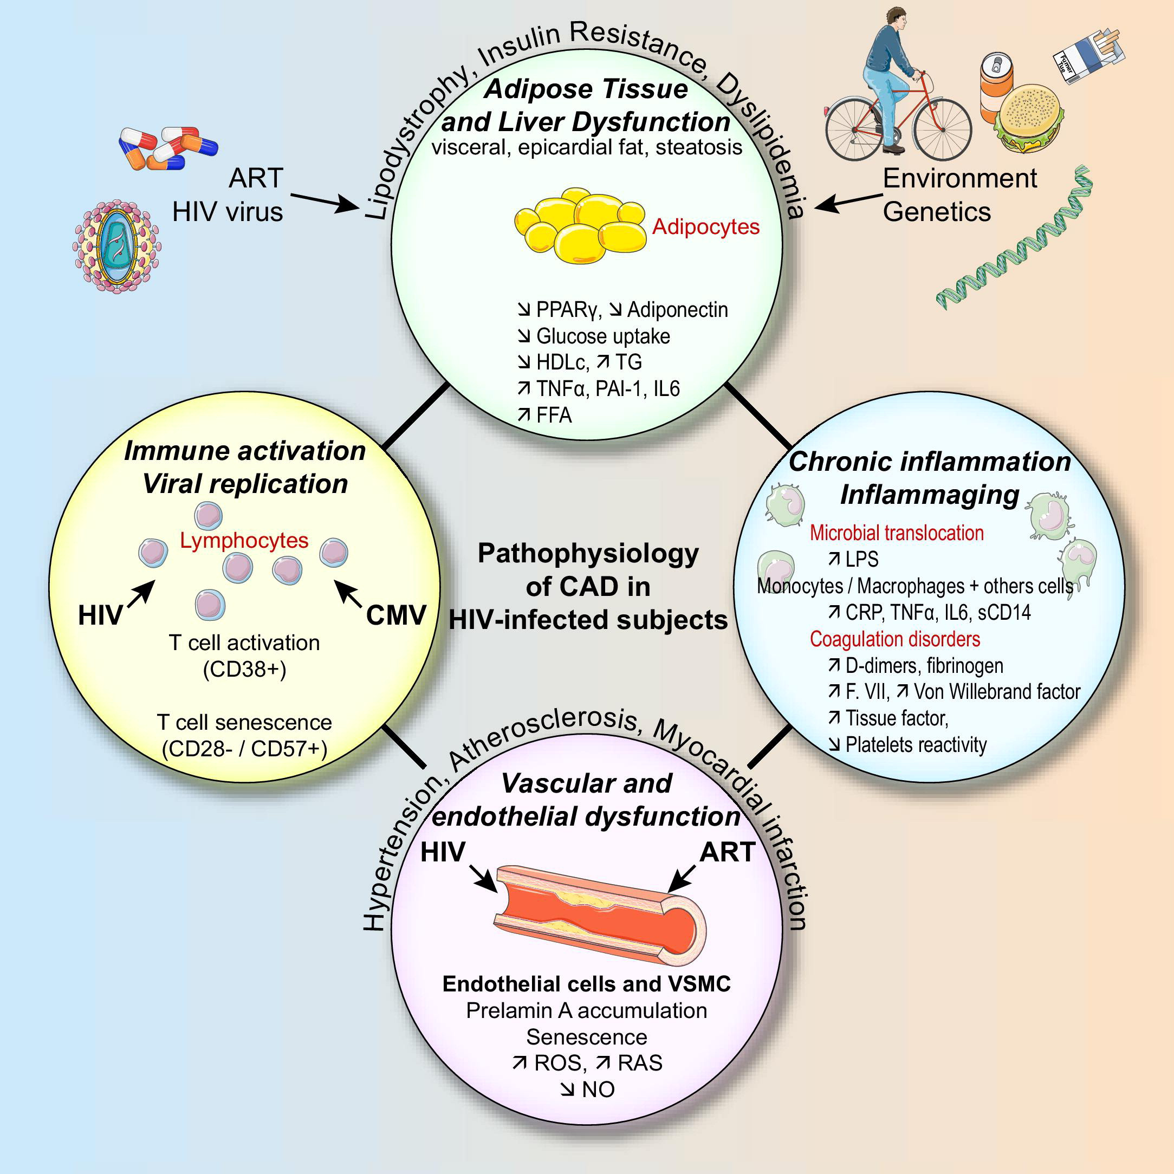
Pathophysiology of CAD in ART Era
Coronary Artery Disease
Traditional CAD Risk Factors
Age
Smoking (2.5 x risk of non-HIV+)
Hypertension ( ⇑ in ART)
Atherogenic Dyslipidemia ( ⇑ in some aRT)
Cf Dr Subramanian talk
Inflammatory state
Procoagulant state
Immune activation within atherosclerotic plaque
Vascular endothelial dysfunction
Enhanced CHD Risk with ART interruption
Boccara F et al. J Am Coll Cardiol 2013;61:511–23

Slide 7
“Cardiometabolic Risk”
Coronary Artery Disease
Brunzell JD et al. , Diabetes Care 31:811-822, 2008

Slide 8
Lipids: Age, Seroconversion and ART Therapy
Coronary Artery Disease
Adapted from data in Riddler SA et al. JAMA 2003; 299:2978-2982 (MACS data)

Slide 9
CAD Risk-Equivalent Conditions
Coronary Artery Disease
Coronary Artery Disease
Diabetes mellitus II
Abdominal Aortic Aneurysm
Symptomatic Carotid disease or > 50% CCA stenosis
Peripheral arterial disease
Framingham Score > 20% 10 yr risk
+CACS> 75th pctl
+Chronic Renal Disease, GFR < 59 ml/min/1.73M²
?+ HIV+
NCEP Guidelines Circulation 110:227, 2004

Slide 10
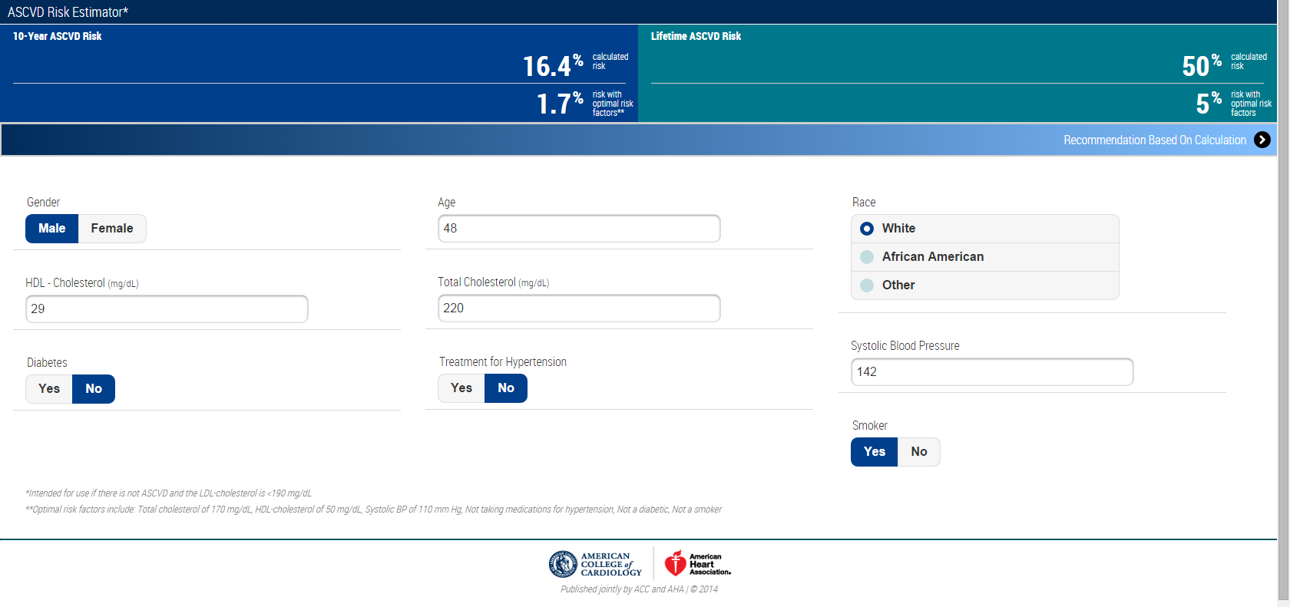
Is HIV⁺ Status a CAD Risk Equivalent?
Coronary Artery Disease
Average Baseline risk + HIV risk = 16.4% x (1.4-2.0) = 23-35%
Treatment recommended regardless of HIV status: highly dependent on age and other RF
http://tools.cardiosource.org/ASCVD-Risk-Estimator/

Slide 11
CHD Risk Workup in the HIV⁺ Person
Coronary Artery Disease
Smoking habits
Diet
Level of exercise activity
Family history of coronary artery or vascular disease,
hypertension, or diabetes mellitus
Baseline blood pressure
Waist circumference
Body mass index
Random lipid profile (fasting if TG > 200 mg/dL)
HbA1c, renal profile
Consider Stress Testing for symptoms or
markedly elevated risk*
Fihn SD et al. SIHD Guideline . J Am Coll Cardiol 2012;60:e44–164; 2014 Update*

Slide 12
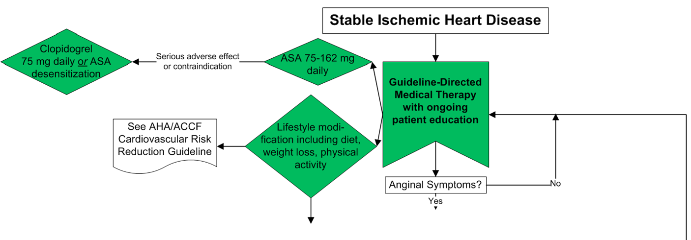
Initial Treatment of CAD-I
Coronary Artery Disease
Fihn SD et al. SIHD Guideline . J Am Coll Cardiol 2012;60:e44–164; 2014 Update

Slide 13
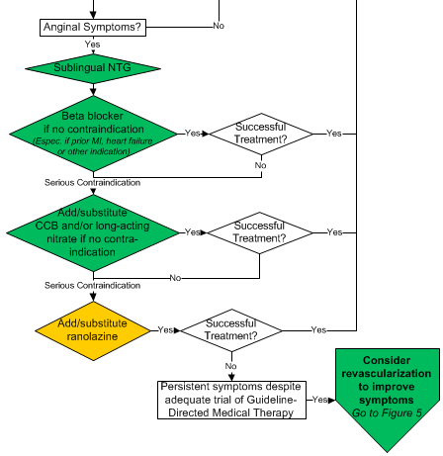
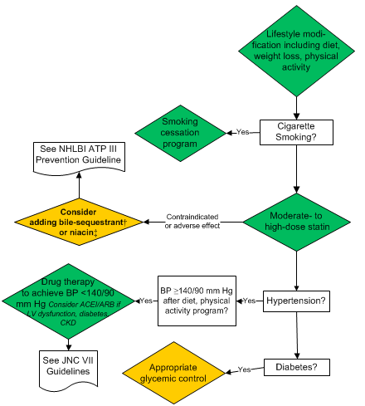
Initial Treatment of CAD-II
Coronary Artery Disease
Rx Symptoms
Rx Risk
Fihn SD et al. SIHD Guideline . J Am Coll Cardiol 2012;60:e44–164; 2014 Update

Slide 14
Guidelines 2013: 4 Statin Benefit Groups
Coronary Artery Disease
Clinical ASCVD*
LDL-C ≥190 mg/dL, Age ≥21 years
Primary prevention :
Diabetes: Age 40-75 years, LDL-C 70-189 mg/dL
Primary prevention:
No Diabetes†: ≥7.5%‡ 10-year ASCVD risk,
Age 40-75 years, LDL-C 70-189 mg/dL
http://circ.ahajournals.org/lookup/doi/10.1161/01.cir.0000437738.63853.7a

Slide 15
Individuals Not in a Statin Benefit Group
Coronary Artery Disease
In those for whom a risk decision is uncertain, these factors may inform clinical decision making:
Family history of premature ASCVD
Elevated lifetime risk of ASCVD
LDL-C ≥160 mg/dL
hs-CRP ≥2.0 mg/L
CAC score ≥300 Agatston units
ABI <0.9
This may sound familiar as “Enhanced Risk” from ATP III update
Statin use still requires discussion between clinician and patient
http://circ.ahajournals.org/lookup/doi/10.1161/01.cir.0000437738.63853.7a

Slide 16
Statin Treatment Goals
Coronary Artery Disease
High-intensity statin therapy is defined as a daily dose that lowers LDL-C by ≥50% and
Moderate-intensity by 30% to <50%.
All patients with ASCVD who are age ≤75 years, as well as patients >75 years, should receive high-intensity statin therapy
If not a candidate for high-intensity, should receive moderate-intensity statin therapy.
Follow-Up LDL/AST in 6-8 weeks
http://circ.ahajournals.org/lookup/doi/10.1161/01.cir.0000437738.63853.7a
Boccara F et al. J Am Coll Cardiol 2013;61:511–23
Notes:
Balance between CAD risk reduction and HIV containment can be a challenge

Slide 17
Systolic Dysfunction Pre-ART and On ART
Myocardial Disease
Focal myocarditis may be seen on bx or MRI regardless of ART
Cardiotropic viruses implicated
Symptomatic cardiomyopathy still only 1-3% in pre-ART era
In ART-limited areas (South Africa), up to 38% of new heart failure
has been attributed to HIV-associated cardiomyopathy
Etiologies proposed:
Inflammatory cytokines in HIV
Coxsackievirus, Cytomegalovirus, EpsteinBarr virus
Cryptococcus neoformans and toxoplasma (CD4= < 200 cells/mm³)
Illicit drugs: alcohol; cocaine and methamphetamine may be
synergistic with infectious agents
Pentamidine, zidovudine
Symptoms and treatment are similar to non-HIV associated
myocardial disease
Cardiac Tumors (Kaposi and non-Hodgkin lymphomas)
Autonomic Dysfunction (tachycardia, prolonged QTc)
Barbaro G et al. N Engl J Med. 1998;339(16):109
Ntsekhe M, Mayosi BM. Nat Clin Pract Cardiovasc Med 2009; 6:120.

Slide 18
Myocardial Disease: Systolic Dysfunction in ART Era
Myocardial Disease
Systematic review of 2,242 HIV⁺ minimally symptomatic
Median age 42 years, 8.1 years of HIV⁺ diagnosis
HAART in 98%
Median CD4+ 489 cells/mm³
No Heart Failure (NYHA 1)
8.3% had LVEF < 55%
Predictors of LVSD:
hcCRP > 5 mg/L
Active smoking
Hx of MI
Cerrato E et al. European Heart Journal (2013) 34, 1432–1436

Slide 19
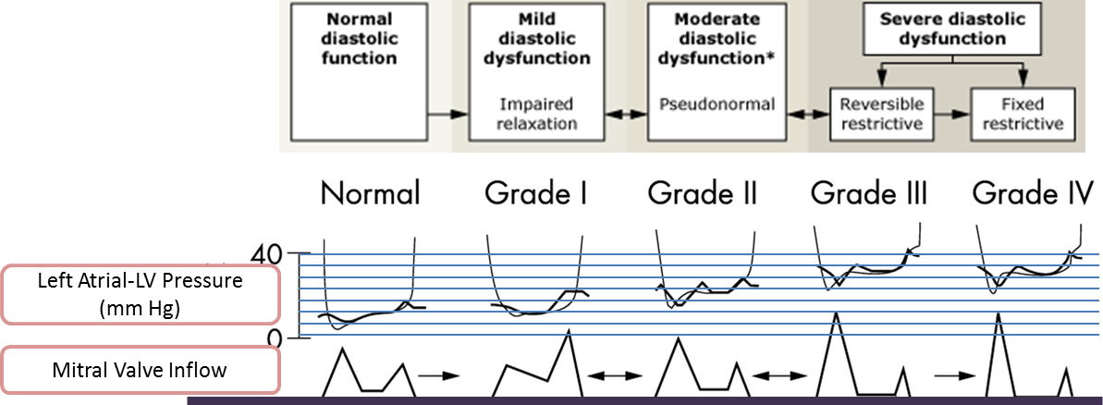
Myocardial Disease: Diastolic Dysfunction in ART Era
Myocardial Disease
43% had echo evidence of diastolic dysfunction:
32% grade I
8.5% grade II
3.0 % grade III
Predictors of diastolic dysfunction:
Age (OR 2.30)
Hypertension (OR 2.5 per decade rise)
Adapted from Ommen S R , Nishimura R A Heart 2003;89:iii18-iii23
Cerrato E et al. European Heart Journal (2013) 34, 1432–1436

Slide 20
Pericardial Disease in HIV
Pericardial Disease
Asymptomatic pericardial effusions 10-40% in AIDS pre-ART era
In symptomatic, myo-pericarditis commonly occurs (Africa), especially in TB
In symptomatic patients, 2/3 are caused by infection or neoplasm; up to 1/3
develop pericardial tamponade
Etiologies:
Mycobacteria: M. tuberculosis, M. aviumintracellulare, M. kansasii 42%,
90% of HIV pericardial effusion is M Tb in sub-Saharan Africa
Staphylococcus aureus (11%)
NH-Lymphoma and primary B-cell and Kaposi's sarcoma (15%)
No etiology (26%)
Rare fungals and others reported
Rx is based on agent and need for intervention with pericardial drainage
Prognosis related to agent and HIV state:
64% mortality at 6 months with AIDS vs 6% with no pericardial effusion
Chen Y et al. Am Heart J 1999; 137:516 Mayosi BM Circulation. 2005;112:3608-3616. Syed FF et al. Heart 2014; 100:135.

Slide 21
Pulmonary Hypertension in HIV Disease
Pulmonary Hypertension
Uncommon complication of HIV (~1/200)
Definition: Cath Mean PA pressure > 25 with PCW < 15 mm Hg
Evaluate for other causes of PH:
Hepatitis B and C
Methamphetamine use
L heart failure
Intrinsic pulmonary disease
Chronic thromboembolic disease (⇑ in HIV disease also)
Mixed etiologies (sarcoid/metabolic/heme/rheum)
Etiology uncertain: HIV proteins suggested/arteriopathy
Prognosis is poor with median survival 2-3 years
Therapy is for symptomatic relief, modest effect on survival:
Combination ART + PAH Therapy
PAH Therapy: epoprostenol or bosentan-like drugs
Ca++ channel blockers and sildenafil NOT recommended
Mehta NJ et al. Chest 2000; 118:1133 Zuber JP et al.. Clin Infect Dis 2004; 38:1178
Degano B et al. Eur Respir J. 2009;33:9 Simonneau G et al. J Am Coll Cardiol 2013; 62:S34

Slide 22
Atrial Fibrillation/Flutter and HIV Disease
Atrial Fibrillation
Unclear if CHADS2-Vasc is valid assessment of CVA Risk with HIV
Multivariate Predictors of AF:
Lower CD4+ count (< 200 cells/mm³
Higher viral load (100,000 copies/ml)
Older age
White Race
CAD
CHF
CKD, proteinuria
Hypothyroidism
Alcoholism
~50% higher than historical
age groups, more AA
Hsu JC et al. J Am Coll Cardiol 2013;61:2288–95 (VA cohort of 30, 543 HIV + Veterans)

Slide 23
Summary: Cardiac Disease with HIV
Wrap-Up
CAD risk is similar to that of family history of premature MI
Comorbidities enhance risk in many with HIV
Modifiable risk factors include smoking, dyslipidemia, obesity,
hypertension, illicit drug use, excess alcohol and
sedentary lifestyle
Standard EBM approaches to CAD risk reduction apply,
with important adjustments for ART drug interactions
Myocardial, pericardial disease and venous thromboembolism
have receded as important HIV-specific complications
in developed countries, but remain important complications
with CD4+ counts < 200 cells/μL
Atrial fibrillation is an emerging cardiovascular threat in the
aging and younger HIV population

Slide 24
Thank you

