Slide 1
Pre-exposure Prophylaxis for HIV Prevention
Efficacy and the importance of adherence
Joanne Stekler, MD MPH
August 20, 2015
Notes:
1

Slide 2
Key HIV PrEP Trials Using Oral Tenofovir (TDF) or Tenofovir-Emtricitabine (TDF-FTC)
Study | Study Population | Study Randomization | HIV Incidence Impact
IPrEx (Brazil, Ecuador, South Africa, Thailand, US) | 2499 MSM and transgender women | Daily oral TDF-FTC or placebo | TDF-FTC: 44% ⬇
Partners PrEP Study (Kenya, Uganda) | 4147 heterosexual HIV discordant couples | Daily oral TDF, TDF-FTC, or placebo | TDF: 67% ⬇ TDF-FTC: 75% ⬇
TDF2 Study (Botswana) | 1219 heterosexual men and women | Daily oral TDF-FTC or placebo | TDF-FTC: 63% ⬇
FEM-PrEP (Kenya, South Africa, Tanzania) | 2120 women | Daily oral TDF-FTC or placebo | TDF-FTC: no protection
VOICE (South Africa, Uganda, Zimbabwe) | 5029 women | Randomized to daily oral TDF, TDF-FTC, oral placebo, TDF vaginal gel, or gel placebo | TDF: no protection TDF-FTC: no protection TDF gel: no protection
Bangkok TDF Study (Thailand) | 2413 injection drug users | Randomized to daily oral TDF or placebo | TDF: 49% ⬇
IPERGAY (France, Quebec) | 400 MSM | Randomized to “on-demand” TDF-FTC or placebo | TDF-FTC: 86% ⬇
PROUD (United Kingdon) | 545 MSM and transgender women | Randomized to daily oral TDF-FTC immediately or delayed | Immediate TDF-FTC: 86% ⬇

Slide 3
Preexposure Prophylaxis (PrEP) for HIV Prevention in MSM iPrEx Trial: Methods
Study Design
- N = 2499 HIV-seronegative men (or transgender women)
- Sexual orientation: sex with men
- All received risk reduction counseling, condoms, & STI Rx
Regimens
- Tenofovir-Emtricitabine (Truvada): 1 pill PO daily
- Placebo: 1 pill PO daily
Baseline HIV Infection
- 10 subjects HIV-infected at time of enrollment
Source: Grant RM, et al. N Engl J Med. 2010;363:2587-99.

Slide 4
Preexposure Prophylaxis (PrEP) for HIV Prevention in MSM iPrEx Trial: Results
P = 0.005
⇓ 44%
Source: Grant RM, et al. N Engl J Med. 2010;363:2587-99.

Slide 5
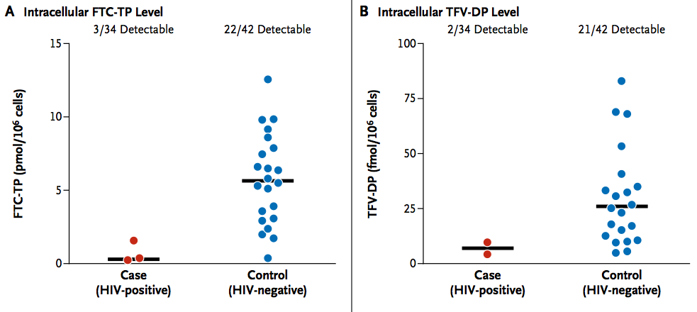
Preexposure Prophylaxis (PrEP) for HIV Prevention in MSM iPrEx Trial: Results
Detectable Drug Levels in Patients on Tenofovir-Emtricitabine
A. Intracellular Emtricitabine Levels
B. Intracellular Tenofovir-DF Levels
9%
52%
6%
50%
Adjusted RR reduction (any detectable level) = 95%
Source: Grant RM, et al. N Engl J Med. 2010;363:2587-99.

Slide 6
Vaginal and Oral Interventions to Control the Epidemic
The VOICE Trial: Background
VOICE Trial: Study Features
N = 5029 women Age 18-45 Setting: 14 sites in South Africa, Uganda, and Zimbabwe Eligibility: - Women who reported vaginal sex in previous 3 months - Not pregnant or breastfeeding - Willing to use effective contraception Regimens - Tenofovir 1% gel daily (TFV gel) - Tenofovir 300 mg po daily (TFV tablet) - Tenofovir 300 mg-emtricitabine 200 mg po daily (TDF-FTC tablet)
Source: Marrazzo JM, et al. N Engl J Med. 2015;372:509-18.

Slide 7
Vaginal and Oral Interventions to Control the Epidemic
VOICE Trial: Timeline
September 2009 to June 2011: accrual period
September 2011: oral TDF arm stopped
Independent DSMB review every 3-6 months
November 2011: vaginal TFV gel arm stopped
Deemed safe but not effective
August 2012: follow-up completed for oral TDF-FTC arm
Deemed safe but not effective
Deemed safe but not effective
Adherence shown to be low in all arms
Source: Marrazzo JM, et al. N Engl J Med. 2015;372:509-18.

Slide 8
Vaginal and Oral Interventions to Control the Epidemic
VOICE Trial: Results
P=0.37
P=0.81
P=0.07
*Data censored at time that oral TDF arm stopped
Source: Marrazzo JM, et al. N Engl J Med. 2015;372:509-18.

Slide 9
Vaginal and Oral Interventions to Control the Epidemic
VOICE Trial: Adherence
Mean Proportion of Quarterly Samples with Tenofovir Detected (%)
Source: Marrazzo JM, et al. N Engl J Med. 2015;372:509-18.

Slide 10
The relationship between adherence and efficacy
 | Efficacy in randomized comparison | % of blood samples with tenofovir detected
Partners PrEP | 75% | 81%
TDF2 | 62% | 79%
iPrEx | 44% | 51%
FEM-PrEP | 6% | 26%
VOICE | - | 29%
Baeten et al N Engl J Med 2012
Grant et al N Engl J Med 2010
Van Damme et al N Engl J Med 2012
Thigpen et al N Engl J Med 2012
Marrazzo et al CROI 2013 #26LB

Slide 11

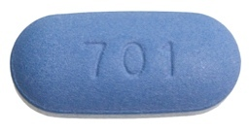
Intermittent or “On-Demand” Preexposure Prophylaxis
Event-Driven Strategy
HIV Exposure Event
Time
2 tabs 2-24 hours before sex (or 1 pill if most recent dose taken between 1-6 days prior)
1 tab 24 and 48
hours after the last pre-sex dose

Slide 12
Intermittent or “On-Demand” PrEP for High-Risk MSM
IPERGAY: Background
Study Features
N = 400 high-risk men-who-have-sex-with-men (MSM) Setting: France and Canada Condomless anal sex with ≥2 partners in prior 6 months eGFR >60 mL/min All received risk-reduction counseling, condoms, and HAV and HBV vaccines if needed, as well as information about PEP Randomized to one of two arms
Source: Molina JM, et al. CROI. 2015; Abstract 23LB.

Slide 13
Intermittent or “On-Demand” PrEP for High-Risk MSM
IPERGAY: Results
P = 0.002
⇓ 86%
Due to high effectiveness of PrEP, participants unrandomized and all offered PrEP
Source: Molina JM, et al. CROI. 2015; Abstract 23LB.
Notes:
Additional data that could be added:
Median follow-up was 8.8 months (IQR: 4.3 to 20.5).
The average number of sexual partners participants had had in the previous two months was eight. Seventy per cent had had condomless anal sex in the previous two months.
The two participants in the Truvada arm who acquired HIV did not become infected until late in the study – one 16 and one 21 months after entering the study. Principal investigator Jean-Michel Molina said that the two had pretty certainly stopped taking PrEP by that time – they had even been returning unused pill bottles to the clinic.
During the study, 35% of participants were diagnosed with a sexually transmitted infection including 20% with gonorrhoea and 10% with syphilis; Jean-Michel Molina reported two in a hundred participants acquired hepatitis C, equating to six infections.
Pts used a median of 14 pills/month (IQR: 8-20).
Reference:
Molina J-M et al. On Demand PrEP With Oral TDF-FTC in MSM: Results of the ANRS Ipergay Trial. 2015 Conference on Retroviruses and Opportunistic Infections (CROI), Seattle, USA, abstract 23LB, 2015.

Slide 14
HIV Prevention Efficacy
Source: Karim SS, Abdool QA Lancet. 2011;378:e23-5.
Notes:
1

Slide 15

Conclusion: “Highly active HIV prevention”
HIV Testing
&
Serosorting?
Needle
Exchange
Condoms
HIV and STI
Treatment
Vaccines
PEP & PrEP

