Slide 1
MAC Address Sensing for Multi-modal Data Collection
University of Washington STAR Lab
July 17th, 2015

Slide 2
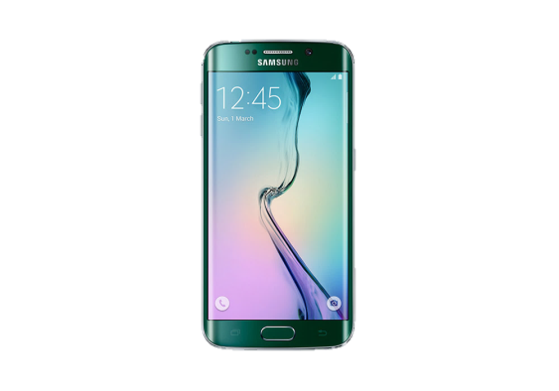
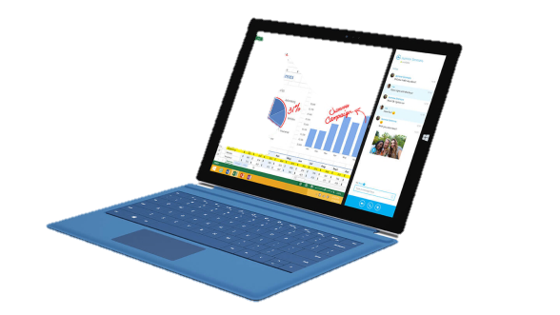
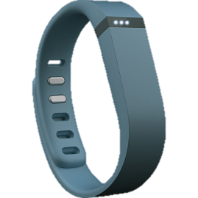
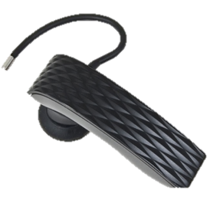
Mobile Device Detection
Devices that are equipped with Bluetooth or Wi-Fi have a unique MAC address
MAC address only broadcasted if device is “discoverable
Detectors scan all Bluetooth or Wi-Fi frequencies for devices
Portable, inexpensive

Slide 3
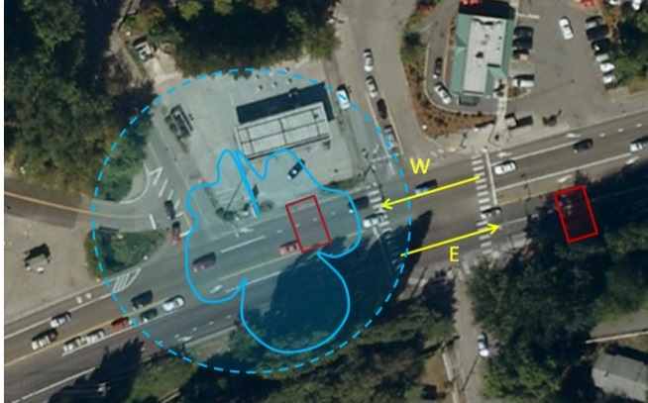
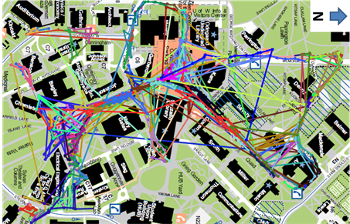
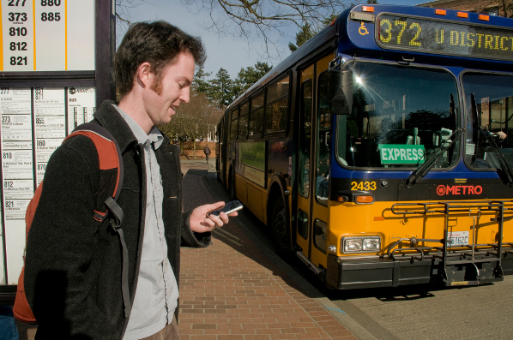
Previous Applications
Vehicle Travel Times
Pedestrian Travel Times and Routes
Wait Times at Bus Stops
Many Future Possibilities!

Slide 4
Current Application: Determining Bus Ridership and O-D Information

Slide 5
Project Description
What Did We Do?
Installed Bluetooth and Wi-Fi Sensors on 10 university transit vehicles
Installed static sensors at 4 stops
Bus Data collected from 4/27/2015 -> 6/08/2015
Multiple non-continuous days of static data

Slide 6
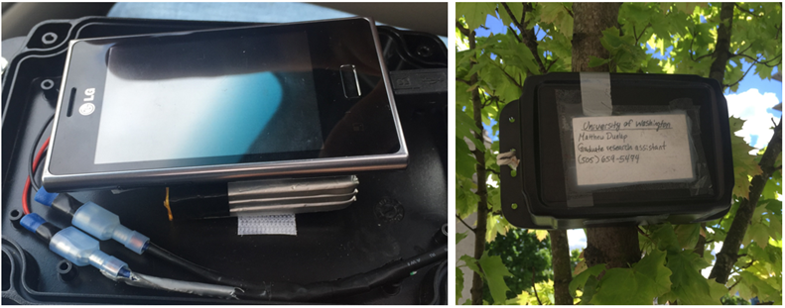
Project Description
Onboard Sensor
Static Sensor at Bus stop

Slide 7
Project Description
a) South Lake Union Shuttle
b) Health Science Express
eUWTS transit routes (UWTS, 2015)

Slide 8
Data
Raw Bluetooth detections onboard Bus #592

Slide 9
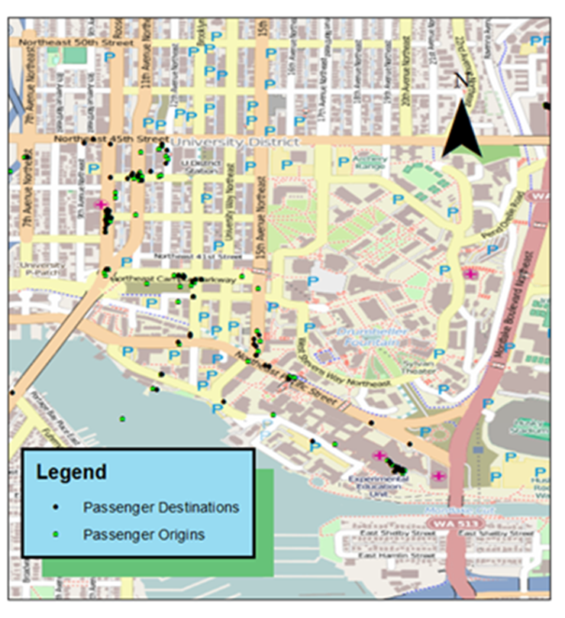
Data
Bluetooth data origins and destinations

Slide 10
Results: About 1 in 5 Detected
Actual vs. Detected Passengers

Slide 11
Estimated OD Matrices
Estimated OD matrix from Wi-Fi detections
Estimated OD matrix from Bluetooth detections
Is This the Actual O/D Matrix?

