Slide 1
Elicitation Methods: An incomplete list
Richard Wright
UW Phonetics Lab presentation
January 26, 2024

Slide 2
Choosing a method
The method should be chosen based on the goal of the research
Not for historical reasons
Not for convenience
Not for ignorance of the methods out there
Not all methods work in all settings
The method may be constrained by:
Culture
Technology
Population (ex literacy, number of living speakers, etc)
Time (either your own or your consultants)

Slide 3
Choosing a method
From Fulop & Wright 2020. See Dipaolo and Yaeger-Dror 2010; Labov 1984; Sands et al. 2011; Schilling 2013; Schilling-Estes 1998; Warner 2011; Warren and Hay 2011 for discussions

Slide 4
More is better, sometimes
When we describe a language, dialect, sociolect, we should strive to elicit more than one style of speech
This common practice in sociolinguistic research where there are typically wordlists, reading passages, interviews.
Sometimes not all of these work – find workarounds
Not enough time with participants
Non-literate populations
Populations that don’t have interview culture

Slide 5
Eliciting clear/hyperarticulated speech
Minimal pairs tasks
Can be automated
Easily understood task
Time efficient
Pretty hyperarticulated
However…
Minimal pair effect diminishes with repetition
More difficult for non-literate populations
Sometimes elicits sub-word hyperarticulation
Not all pairs are equally probable (frequency/familiarity)
Sometimes fails in the absence of a communicative load

Slide 6
Eliciting clear/hyperarticulated speech
Corrective hyperarticulation
Relatively intuitive
Can be automated (Harnsberger, Wright, Pisoni, 2008)
Elicits more hyperarticulation than minimal pairs
However
Harder to pull off
Takes longer
Researcher has to have a strong command of the language for it to work

Slide 7
Eliciting clear/hyperarticulated speech
Clear speech methods
Subjective tasks like “imagine that you are speaking to a person who is hard of hearing” or “imagine that you are speaking to someone who is not a native speaker” etc.
Easy to do, but what are you really getting?
Acted speech – some people are better acters than others
Speech in noise (Lombard response)
Specific type of clear speech
Only works reliably in collaborative tasks/informational tasks

Slide 8
Wordlists/Lexical elicitations
Great coverage
Great control over items and ordering
However:
Very specific style of speech
Not everyone reads as fluently as a typical college undergrad
Not all populations are literate in the language of interest
Lists have to be very carefully curated to avoid bias

Slide 9
Wordlists/Lexical elicitations
What to watch out for
Use real words unless you are trying to elicit hyperarticulated speech
Words on the list should be of equivalent usage probability
Low surprisal words are typically more reduced than high surprisal words
Open class words are typically less reduced than closed class words
Avoid archaisms, jargon, etc.
Repetitions effects – words typically become more reduced with repetition
Words on the list should be drawn from the same social register
Lists should be randomized to avoid word interactions
I typically use three randomizations (A, B, C) – different order for each consultant
Lists should be padded at the beginning and end to absorb list intonation

Slide 10
Wordlists/Lexical elicitations
What about Swadesh lists?
It depends on what you are trying to do
Lexicostatistics and glottochronology
Lists are likely to be missing sounds of interest
Lists don’t always live up putative culturally independent availability
Colors are often borrowed or missing
Not all concepts on the lists are typical words (ex: ice)
Frequency/probability effects

Slide 11
Wordlists/Lexical elicitations
Is a carrier phrase useful?
Not always
Doesn’t produce a “more natural” intonation
Doesn’t reduce list intonation
Can be harder in populations that aren’t used to reading aloud
Introduces sentence level effects that you may not want (like flapping)
“Please say _____ again” “Please say _______ to me”
Sometimes
Can help in finding the beginning of stop closures or the end of unreleased stops
Can shift creaky/breathy voicing away from the sound you’re measuring

Slide 12
Wordlists/Lexical elicitations
Picture naming
Can be a substitute for wordlists
Reduces orthographic bias somewhat
Useful in preliterate or illiterate populations
More intuitive/natural for some populations
Can be tricky
You don’t always get the word you want
People will sometime decide that what you want is a story
You need to plan ahead and have materials at hand

Slide 13
Wordlists/Lexical elicitations
Picture naming – what’s this?

Slide 14
Reading passage elicitations
Can be more “natural” than citation speech/wordlists
High level of control over lexical items
High level of control over position in utterance of lexical items
Prosody and intonation at the utterance level
Connected speech effects that may be of interest
Much harder task than wordlists
Not available to non-literate populations
Reading comfort effects more pronounced
Takes a long time to get everything in every prosodic environment
Potential word context effects that you may not be trying to elicit

Slide 15
Reading passage elicitations
Stories can be substituted in non-literate populations
But you won’t have control over structure of utterance
You may end up eliciting a very specific performance style
“Once upon a time, a very long time ago, there lived an itty-bitty dibbler …”

Slide 16
Interviews
Interviews elicit monologues
Connected speech and typically a natural style
More variation than reading tasks
Pretty good at eliciting specific lexical items/phrases
Interviewer can steer the topics and realign topics on the fly
However:
Specific speech style
Less control over prosodic and context effects
You don’t always get the word you want with enough power
More variation between participants
Interviewer effects
Microphone arrangements become important

Slide 17
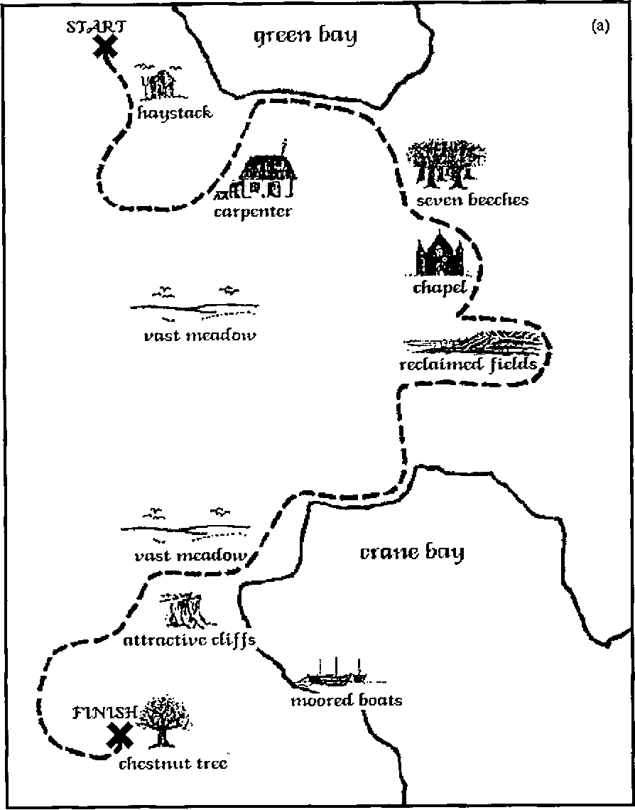
Map tasks
Devised to elicit natural and relatively spontaneous speech with control over lexical content (Anderson et al. 1991)
Pretty natural
Good control over lexical content
High density/power
However:
Less control over prosody
Not all cultures use maps
Limited content
Microphone placement important

Slide 18
Collaborative tasks
Variant on map tasks devised to keep the natural/spontaneous speech styles but increase the breadth of content and tasks (Warren and Hay 2011; Freeman et al. 2014 )
Spontaneous speech styles
High density/power
Prosody and intonation
Can be adapted to culturally appropriate settings
More intuitive than a map task
However:
Still limited in style compared to natural conversations
More self awareness/formality than conversations
Less control over content than map tasks or reading tasks
Microphone placement is really important

Slide 19
Summary
In acoustic studies it is important that the objects of comparison occur in equivalent discourse and prosodic environments, and that any set of speech sounds of interest occur in equivalent segmental environments with equivalent frequency.
You should choose the method that helps you answer your research question rather than having the method define what you can study.
If possible, employ several methods
Any recording is better than no recording

