Slide 1
Approaches to Ambient Noise Characterization at Tidal Energy Sites
Chris Bassett, Brian Polagye, Jim Thomson
Northwest National Marine Renewable Energy Center
University of Washington
141st Meeting of the American Fisheries Society
Seattle, WA
September 6, 2011

Slide 2
Need for Ambient Noise Characterization
Tidal energy projects will generate anthropogenic noise
Sound propagates over long distances in the marine environment
Potential to affect fish and marine mammal behavioral
Environmental impact depends on the context of other ambient noise
Post-installation characterization
Pre-installation baseline

Slide 3
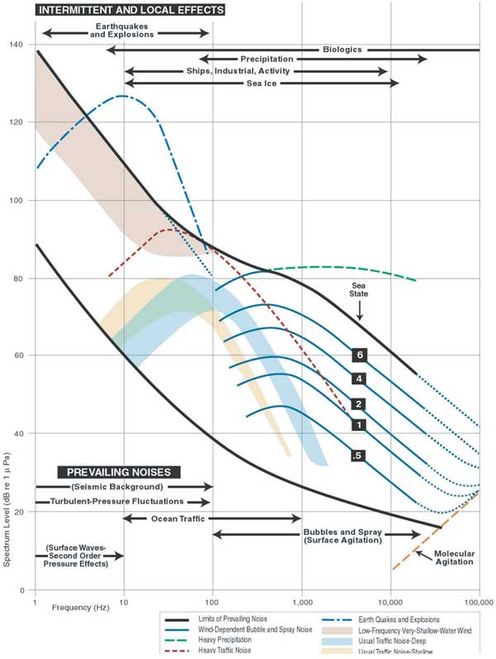
Sources of Noise
Natural
Rain
Surface waves and surf
Bedload transport
Biological
Anthropogenic
Maritime traffic
Active sonar
Construction
Aircraft
Seismic exploration
Contamination
Flow-noise
Self-noise
(NRC, 2003 as adapted from Wenz, 1962)

Slide 4
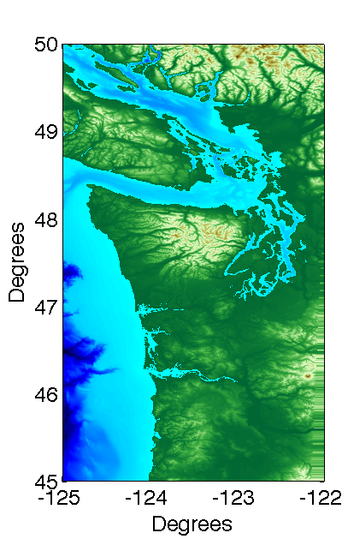
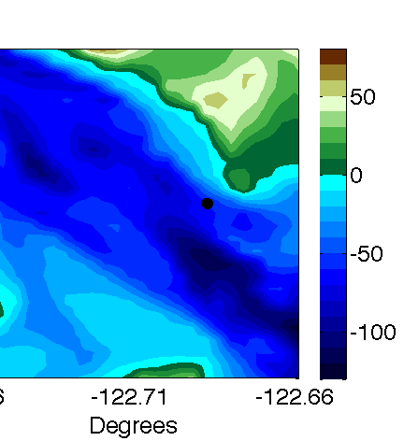
Characterization Methodologies
Study Area
Autonomous hydrophones on seabed (fixed)
Autonomous hydrophones on surface (drifting)
Cabled hydrophones at mid-water (drifting)

Slide 5
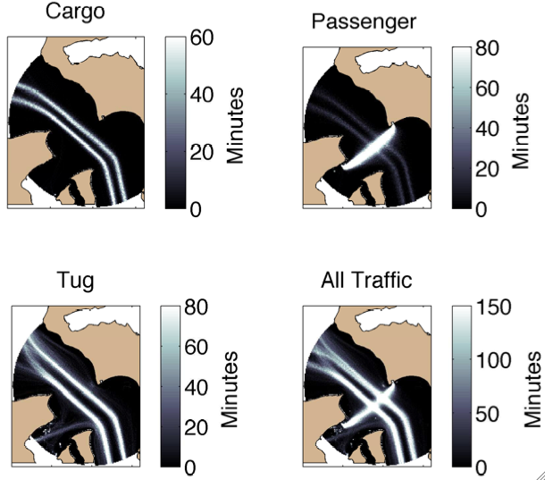
Anthropogenic (Vessel) Noise
Variable spatial and temporal patterns
Unique acoustic signatures
Different source levels
Primary contribution to ambient noise budget

Slide 6
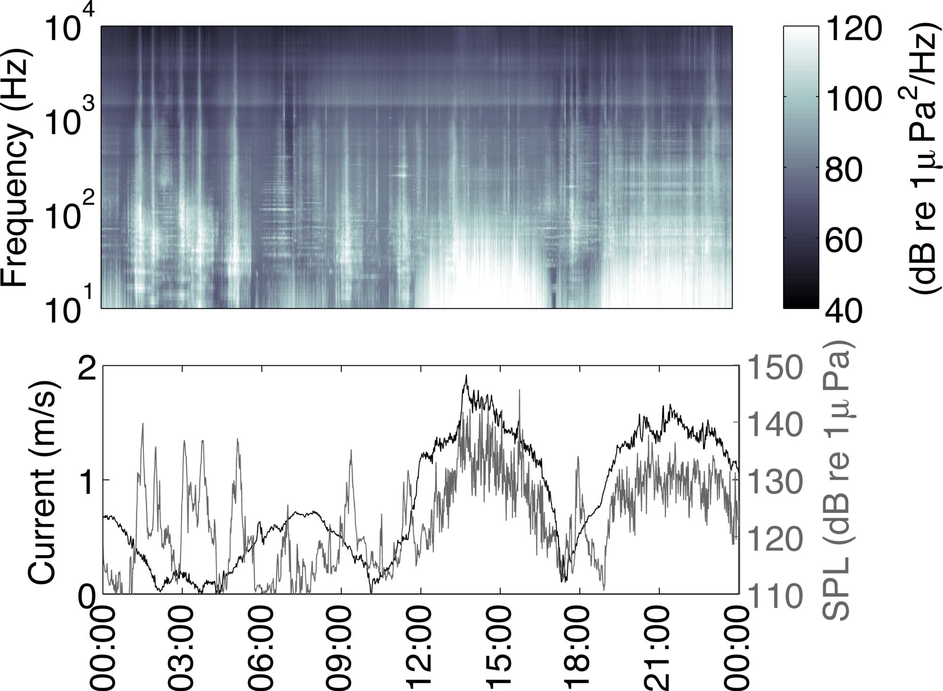
Flow Noise
Caused by turbulent pressure fluctuations across hydrophone
At 0.3 m/s, apparent at 20 Hz
Frequency and intensity increases with current speed
Masks ambient noise (up to 500 Hz)

Slide 7
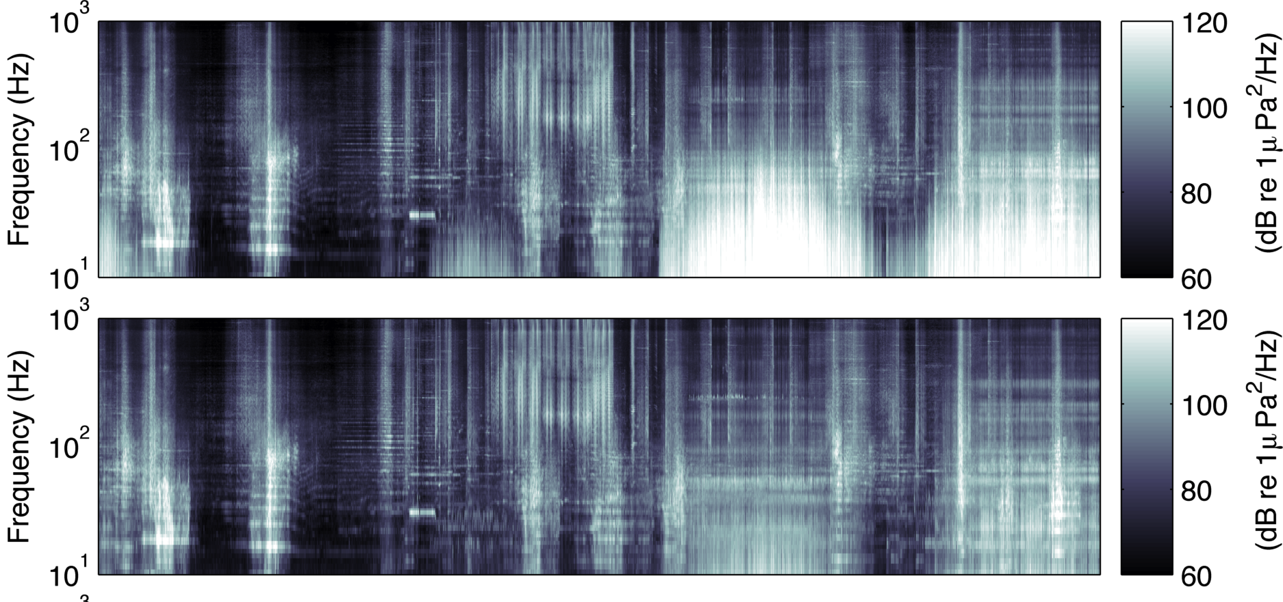
Flow Noise Suppression
Flow shields can mitigate flow noise during strong currents
Shield does not attenuate propagating noise up to (at least) 10 kHz
Unshielded
Shielded

Slide 8
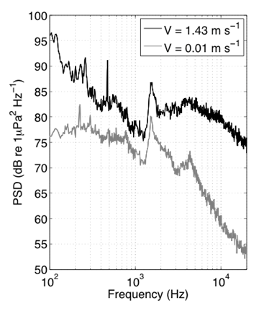
Bedload Transport
Noise source above 2 kHz during strong currents
General agreement with theory
(Hz)
(Thorne, 1986)
Notes:
Spectra implies mobilization of sediments/gravel/cobbles 8 cm and smaller

Slide 9
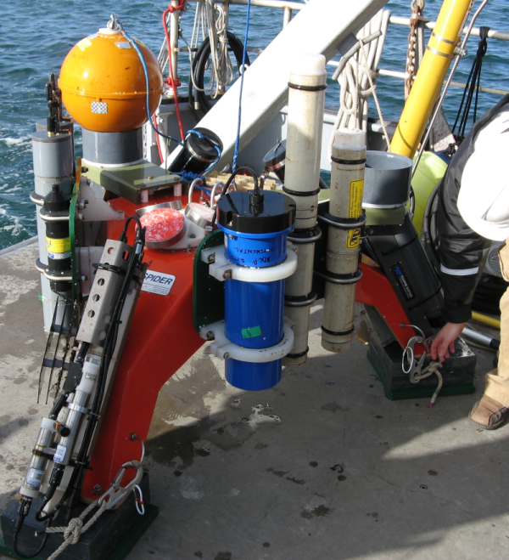
Seabed Hydrophones (Fixed)
Sea Spider Instrumentation Package
Autonomous hydrophone
Statistically well-resolved
2% duty cycle (over 3 months)
Susceptible to flow-noise
20 Hz – 30 kHz

Slide 10
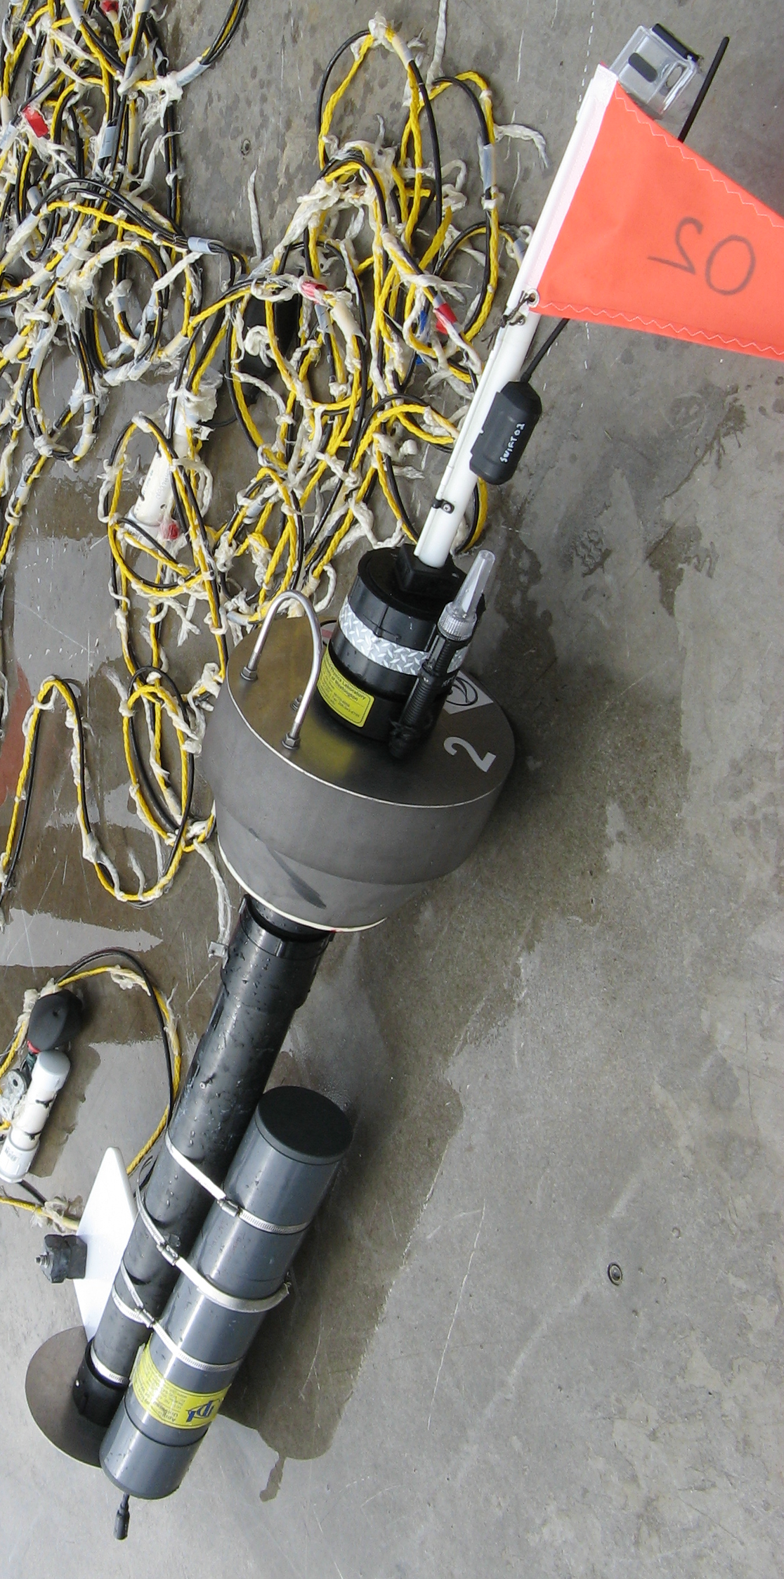
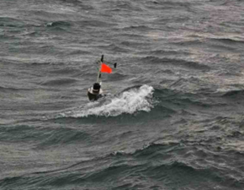
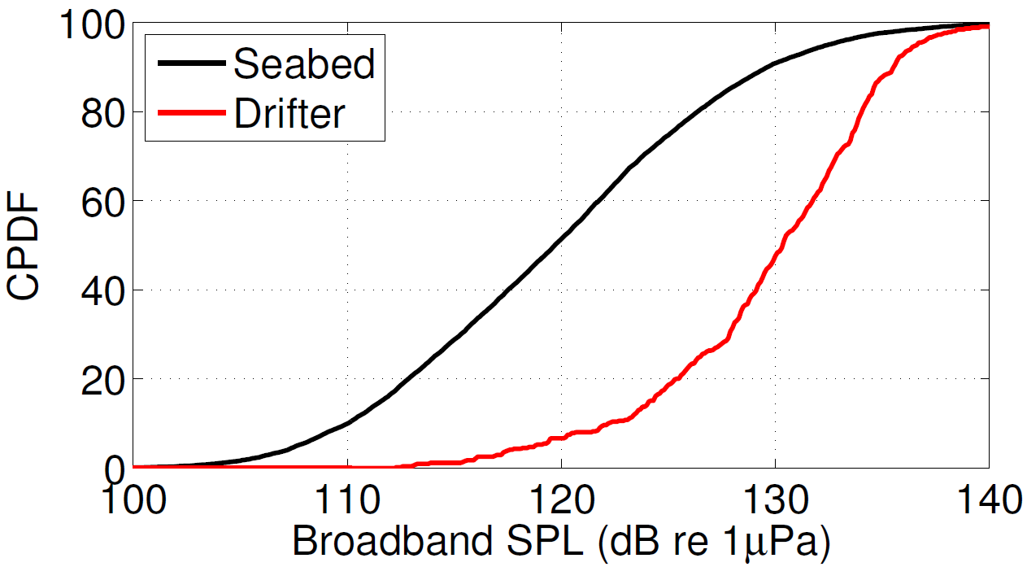
Surface Hydrophones (Drifting)
Continuous measurement
Unaffected by flow-noise
Convolution of temporal and spatial variability
Near-surface measurement

Slide 11
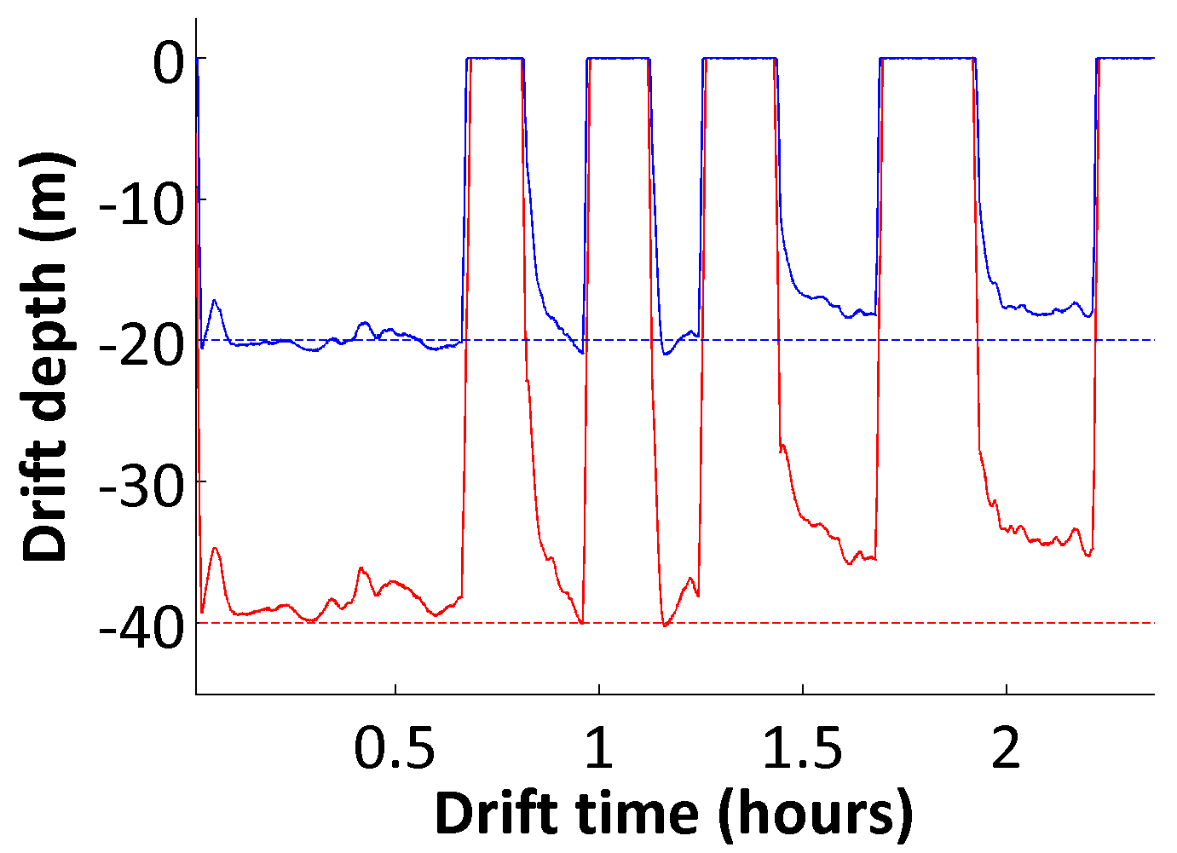
Cabled Hydrophones (Drifting)
Heave isolation
DAQ
Computer
Anti-strum faring
Hydrophone
Flow Shield
Pressure Logger
Continuous measurement at depth
Convolution of temporal and spatial variability
Difficult to maintain deployment depth
Potential for contamination by cable strum, self-noise, and flow noise

Slide 12
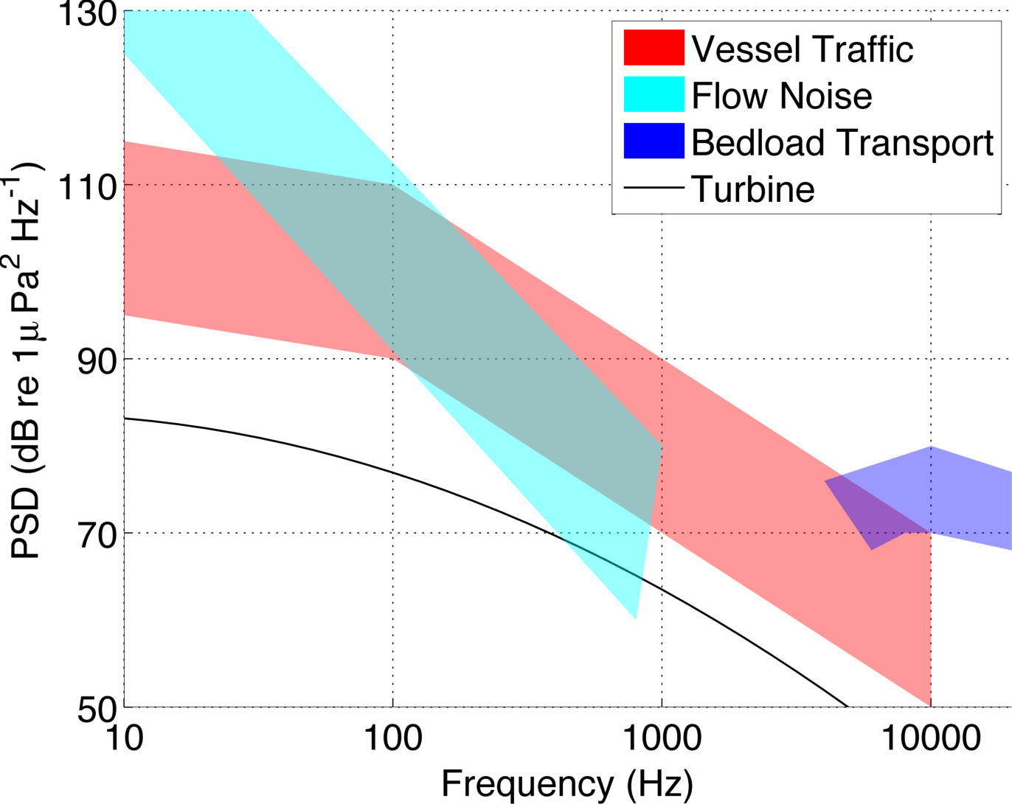
Context for Measuring Turbine Noise
Notes:
Receiver 1200 m from vessel or turbine

Slide 13
Conclusions
Baseline ambient noise assessments require “long-term” deployments
Difficult to capture temporal variability with drifting measurements
Differentiate between pseudo-sound (flow noise) propagating sound (bedload transport)
Drifting measurements best approach for “short-term” post-installation characterization
Anthropogenic sources are likely to drive the noise budget in populated coastal areas
Notes:
Tidal turbines will likely only be audible at small ranges that are dependent on site specific ambient noise conditions.
At sites with significant existing anthropogenic noise noise from turbines will often be masked even at close ranges (< 1 km)

Slide 14
Thank You
This material is based upon work supported by the Department of Energy, Snohomish County PUD, the National Science Foundation.
Field Engineers Joe Talbert and Alex DeKlerk
Captain Andy Reay-Ellers

