Slide 1
Developing Capabilities for Tidal Hydrokinetic Blade Strike Monitoring
Brian Polagye, Sharon Kramer, Sandra Parker-Stetter, and Jim Thomson
Northwest National Marine Renewable Energy Center
University of Washington
141st Meeting of the American Fisheries Society
Seattle, WA
September 6, 2011

Slide 2
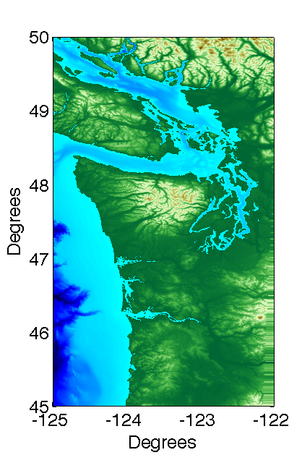
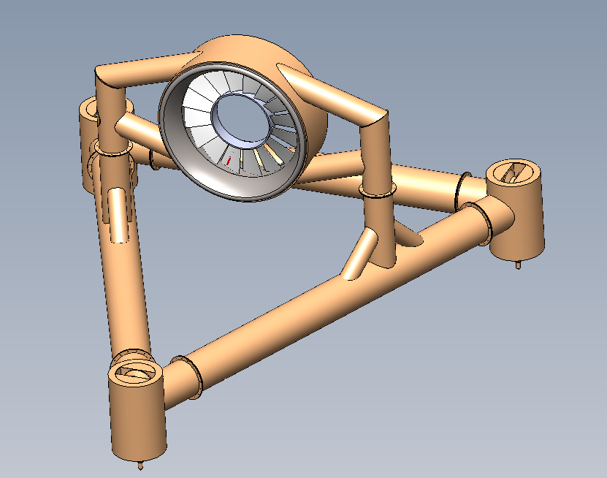
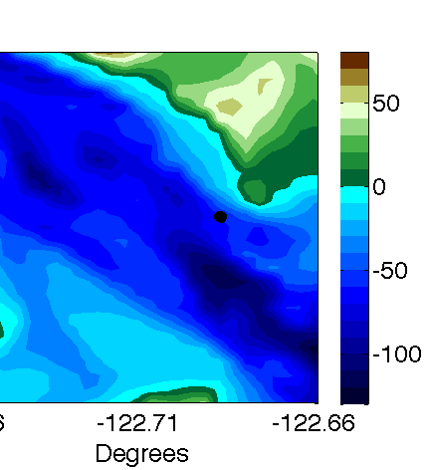
Tidal Energy Project Development
Snohomish PUD/OpenHydro
OpenHydro Turbines
Proposed Project
2 x 6 m turbines
250 kW peak power
60 m water depth
3.5 m/s peak currents
Cable to shore

Slide 3
Environmental Concerns
 | Device presence: Static effects | Device presence: Dynamic effects | Chemical effects | Acoustic effects | Electromagnetic effects | Energy removal | Cumulative effects
Physical environment: Near-field
Physical environment: Far-field
Habitat
Invertebrates
Fish: Migratory
Fish: Resident
Marine mammals
Seabirds
Ecosystem interactions
Pilot-Scale Effects
Polagye, B., B. Van Cleve, A. Copping, and K. Kirkendall (eds), (2011) Environmental effects of tidal energy development.

Slide 4
Dynamic Effects Monitoring
Objectives
Challenges
Quantify the risk of blade strike to marine life
Improve understanding of how marine life responds to device presence
Both of these should be at the lowest level of taxonomic classification possible
Laboratory and field studies to date suggest blade strike will be an infrequent occurrence
Monitoring should not alter behavior
Other projects have had limited success in improving our understanding of blade strike

Slide 5
Possible Monitoring Approaches
 | Underwater Imaging | Active Acoustics | Trawl Surveys | Fish Tags
Prior MHK Experience | OpenHydro (EMEC) | Verdant Power (East River) ORPC (Cobscook Bay) | None | OpenHydro (FORCE)
Blade Strike Detection
Taxonomic Classification
Functional Range
Behavioral Disturbance
Overall
Contrast?
Turbidity?
Illumination?

Slide 6
Underwater Imaging Considerations
Stereo imaging – absolute size, position, and speed
Similarities to trawl ground-truthing and benthic habitat surveys
High relative motion between camera and target
Taxonomic classification required
Several unique considerations for turbine monitoring
Positioning of lights and cameras relative to turbine
Long deployment time (biofouling, durability)
Recovery and redeployment instrumentation

Slide 7
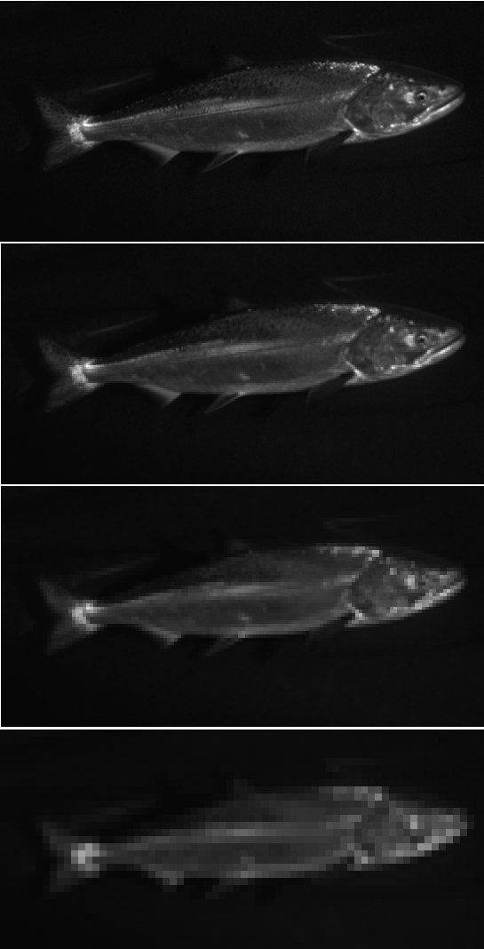
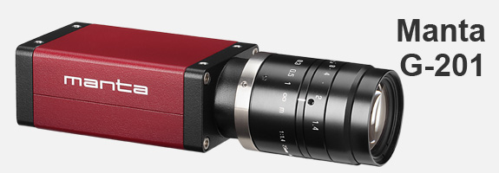
Camera and Optics Selection
500 pixels/target
Chinook salmon
2 Mpx machine vision cameras
ProSilica Manta G-201
10 Hz maximum frame rate
Resolution/bandwidth
45º FOV lens (in air)
Flat optical port (biofouling)
250 pixels/target
Chinook salmon?
125 pixels/target
Salmon
62 pixels/target
Fish?
Source: Kresimir Williams, NOAA Fisheries

Slide 8
Illumination Selection
Imaging fast moving targets
Short exposure time: 2-50 µs (Gallager, et al. 2004)
Large camera-light separation (Jaffe 1988)
Full-spectrum strobes (Excelitas MVS 5002)
Four strobes per stereo imaging system
Behavioral disturbance is problematic
Considered red, IR, and NIR lighting options
Initially, pre-set duty cycle with monitoring
As behavior/interactions are better understood, progress to event-based illumination

Slide 9
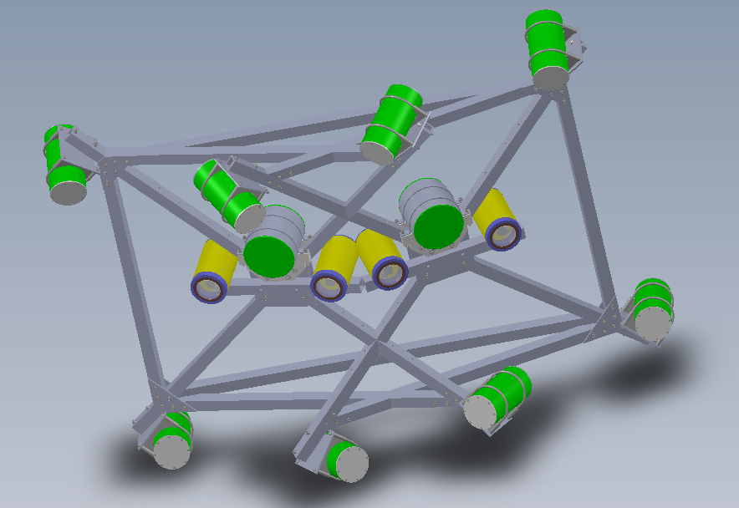
System Layout
Strobe housing
2 stereo camera systems
Strike detection
Taxonomic classification
1 m camera-light separation
Compact frame for maintenance
Main bottle
Power/Comms
Stereo cameras
Compact frame concept
Notes:
Spectra implies mobilization of sediments/gravel/cobbles 8 cm and smaller

Slide 10
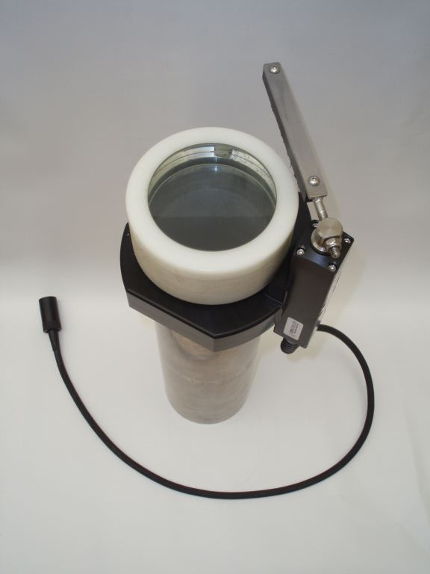
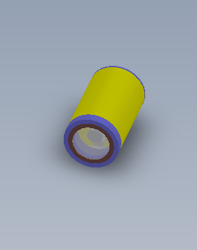
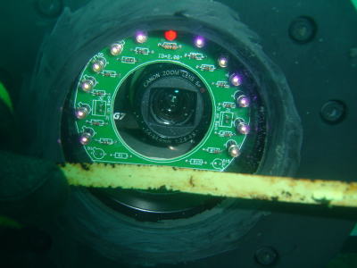
Biofouling Mitigation
Biofilms formation begins immediately after deployment
Mechanical Wiper
Copper Ring
Ultraviolet Lighting
(capability)

Slide 11
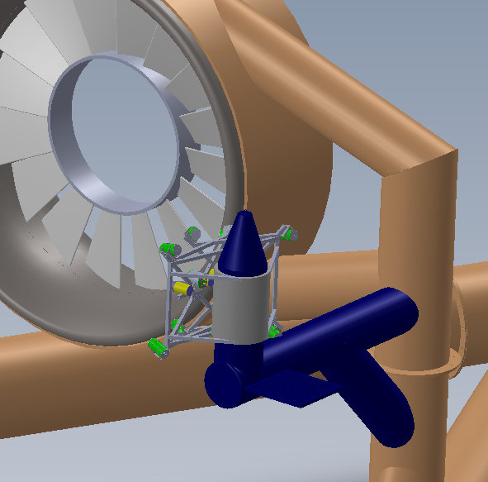
Recovery and Redeployment
Reasons for recovery:
Biofouling removal
Maintenance and repair
Additional instruments
Reorientation of cameras
Must be recovered independent of turbine
Must be reconnected to turbine power and data systems
Mounting & alignment infrastructure
Recovery frame
Compact frame concept

Slide 12
Monitoring System Integration
Stereo Imagers
CTDO
?
Junction Bottle
Power (400 V DC)
Fiber
Doppler profilers
Hydrophone Array
?
Main Power and Communications
To Shore
Turbine Monitoring

Slide 13
Discussion
How much emphasis should be placed on monitoring for blade strike?
Laboratory tests suggest low likelihood
How much species-to-species, site-to-site, and turbine-to-turbine variability is there?
Regulatory mandates are species-specific, but this limits the toolkit available to answer questions
Leverage environmental monitoring infrastructure whenever possible – camera can also monitor for fouling, damage, and vibration
Post-installation monitoring is essential, but technically challenging – need for prioritization

Slide 14
Questions?
This material is based upon work supported by the Department of Energy and Snohomish County PUD.

