Slide 1
Integrated Post-Installation Monitoring
Brian Polagye
Northwest National Marine Renewable Energy Center
University of Washington
bpolagye@uw.edu
Monitoring Technologies and Strategies for Marine and Hydrokinetic Devices Webinar
September 14, 2011

Slide 2
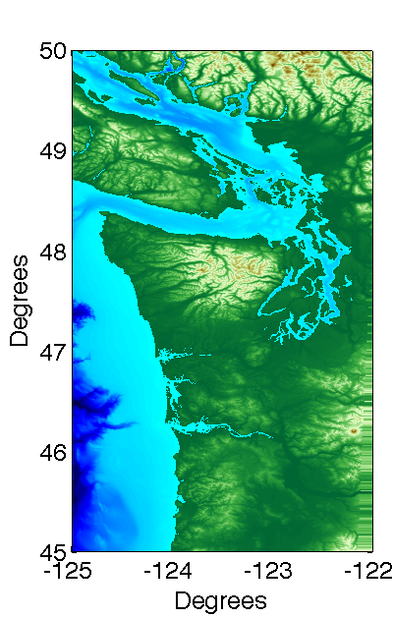
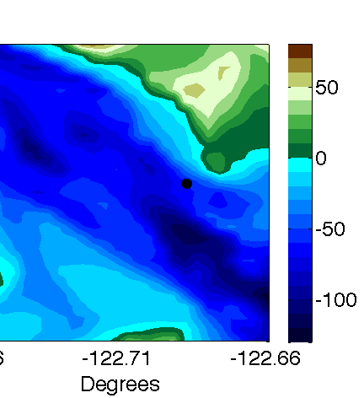
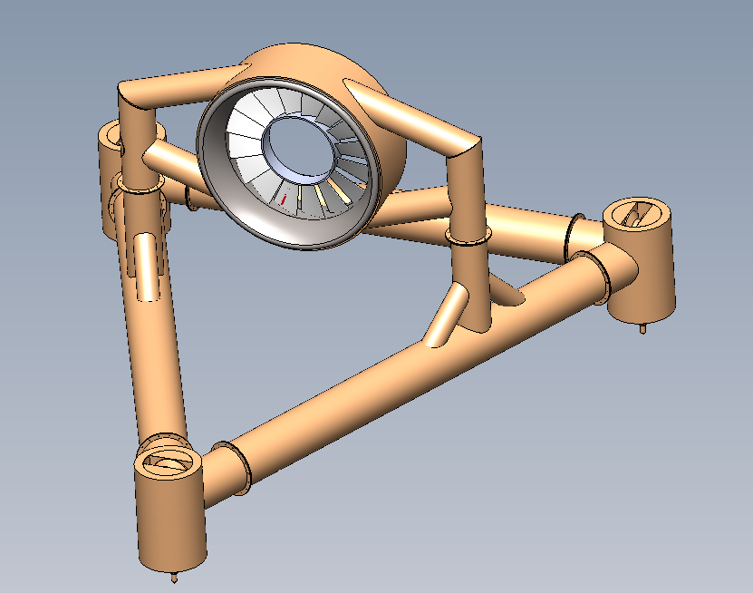
Tidal Energy Project Development
Snohomish PUD/OpenHydro
Proposed Turbines
OpenHydro Technology
60 m water depth
3.5 m/s peak currents
Low turbidity (< 1 NTU)
Cable to shore
2 x 6 m turbines
250 kW peak power
Gravity foundation
3-5 year deployment

Slide 3
Post-Installation Monitoring
At pilot-scale, provide information about high significance/high uncertainty interactions with devices
Key input to risk assessment frameworks
Monitoring should not change animal behavior nor affect device operation
Environmental monitoring should not dominate over other project costs
All projects are also demonstrating technical readiness and economic viability
Post-installation monitoring requires prioritization

Slide 4
Environmental Concerns
 | Device presence: Static effects | Device presence: Dynamic effects | Chemical effects | Acoustic effects | Electromagnetic effects | Energy removal | Cumulative effects
Physical environment: Near-field
Physical environment: Far-field
Habitat
Invertebrates
Fish: Migratory
Fish: Resident
Marine mammals
Seabirds
Ecosystem interactions
Proposed monitoring for Snohomish PUD/OpenHydro demonstration
Commercial-Scale Effects
Polagye, B., B. Van Cleve, A. Copping, and K. Kirkendall (eds), (2011) Environmental effects of tidal energy development.

Slide 5
Dynamic Effects Monitoring
Objectives
Challenges
Quantify the risk of blade strike to marine life
Improve understanding of how marine life responds to device presence
Both of these should be at the lowest level of taxonomic classification possible
Laboratory and field studies to date suggest blade strike will be an infrequent occurrence
Difficult and resource-intensive to monitor in the field

Slide 6
Monitoring Technology
 | Underwater Imaging | Active Acoustics | Trawl Surveys | Fish Tags
Prior MHK Experience | OpenHydro (EMEC) | Verdant Power (East River) ORPC (Cobscook Bay) | None | OpenHydro (FORCE) Hydro Green (Hastings)
Blade Strike Detection
Taxonomic Classification
Functional Range
Behavioral Disturbance
Overall
Contrast
Turbidity and Aeration
Tag Frequency
Illumination

Slide 7
Underwater Imaging Considerations
Stereo imaging – absolute size, position, and speed
Similarities to trawl ground-truthing and benthic habitat surveys
High relative motion between camera and target
Taxonomic classification required
Several unique considerations for turbine monitoring
Positioning of lights and cameras relative to turbine
Long deployment time (biofouling, durability)
Recovery and redeployment instrumentation

Slide 8
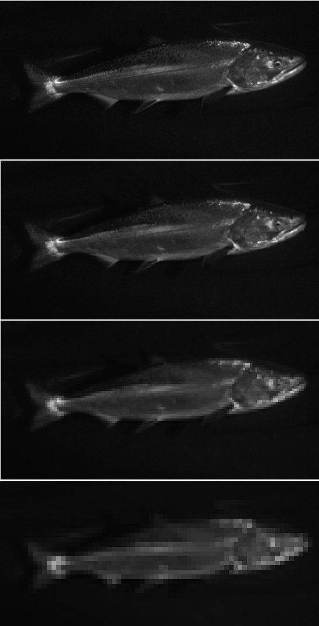
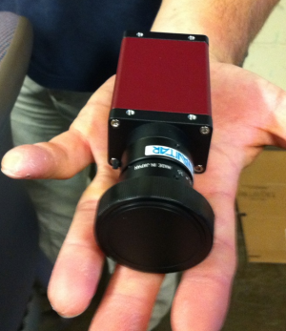
Camera and Optics Selection
500 pixels/target
Chinook salmon
2 Mpx machine vision cameras
10 Hz maximum frame rate
Resolution/bandwidth
45º FOV lens (in air)
Flat optical port (biofouling)
250 pixels/target
Chinook salmon?
125 pixels/target
Salmon
62 pixels/target
Fish?
Manta G-201 (to scale)
Source: Kresimir Williams, AK Fisheries Science Center

Slide 9
Illumination Selection
Imaging fast moving targets
Short exposure time: 2-50 µs (Gallager, et al. 2004)
Large camera-light separation (Jaffe 1988)
Full-spectrum strobes (Excelitas MVS 5002)
Four strobes per stereo imaging system
Behavioral disturbance is problematic
Considered red, IR, and NIR lighting options
Initially, pre-set duty cycle with disturbance analysis
As behavior/interactions are better understood, progress to event-based illumination

Slide 10
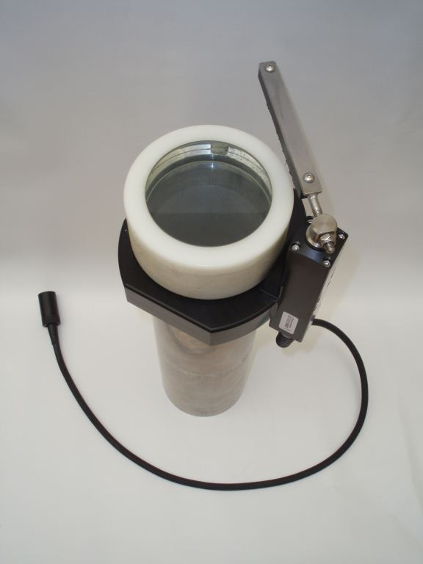
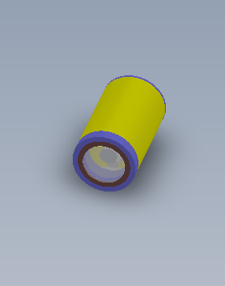
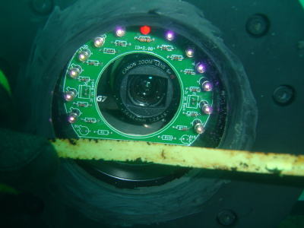
Biofouling Mitigation Strategies
Biofilm formation begins immediately after deployment
Mechanical Wiper
Copper Ring
Ultraviolet Lighting
Even with mitigation, performance will degrade with time

Slide 11
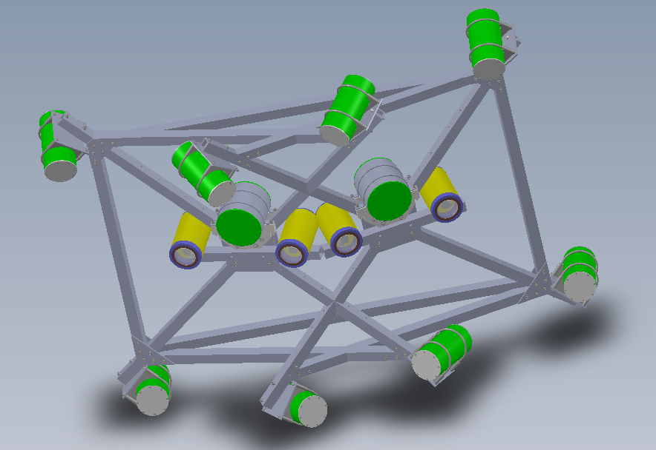
System Layout Concept
Strobe housing
2 stereo camera systems
Strike detection
Taxonomic classification
1 m camera-light separation
Compact frame for maintenance
Main bottle
Power/Comms
Stereo cameras
Compact frame concept

Slide 12
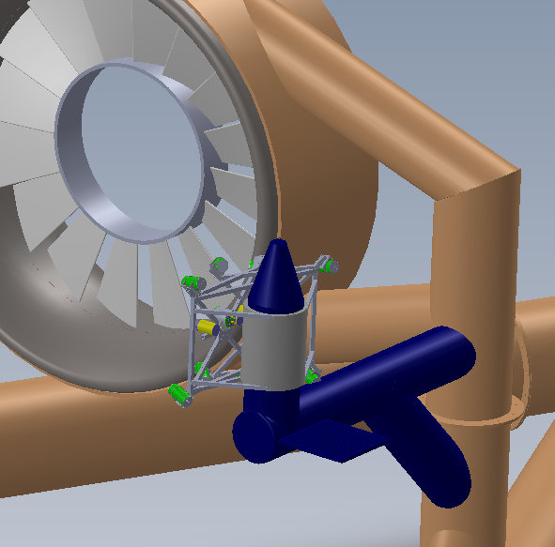
Recovery and Redeployment Concept
Reasons for recovery:
Biofouling removal
Maintenance and repair
Additional instruments
Reorientation of cameras
Must be recovered independent of turbine
Must be reconnected to turbine power and data systems
Mounting & alignment infrastructure
Recovery frame
Compact frame concept

Slide 13
Monitoring System Integration
Stereo Imagers
CTDO
Water quality
?
Marine life
Device condition
Junction Bottle
Power and fiber disconnect
Hydrophone Array
Doppler profilers
?
Marine mammals
Device noise
Wake
Inflow conditions
Main Power and Communications
To Shore
Turbine Monitoring

Slide 14
Discussion
How much emphasis should be placed on monitoring for blade strike?
Laboratory tests suggest low consequence
How much species-to-species, site-to-site, and turbine-to-turbine variability is there?
Regulatory mandates are species-specific, but this limits the tools available
Leverage environmental monitoring infrastructure whenever possible – camera can also monitor turbine health (biofouling, vibration)
Post-installation monitoring is essential, but technically challenging – prioritization required

Slide 15
Acknowledgments
This project leverages the expertise of many individuals:
University of Washington: Jim Thomson, Sandra Parker-Stetter, Joe Talbert, Alex de Klerk, Keith van Thiel, Tim McGinnis, Randy Sindelar, and Nick Stelzenmuller
H.T. Harvey & Associates: Sharon Kramer and David Zajanc
Sound & Sea Technology: Larry Armbruster
Sea Mammal Research Unit, Ltd: Dom Tollit, Jason Wood
Alaska Fisheries Science Center: Rick Towler and Kresimir Williams
This material is based upon work supported by the Department of Energy and Snohomish County PUD.

