Slide 1
Developing Monitoring Capabilities for Tidal Hydrokinetic Energy Installations
Brian Polagye
Northwest National Marine Renewable Energy Center
University of Washington
NSF Workshop: Research at the Interface of Marine/Hydrokinetic Energy and the Environment
October 6, 2011

Slide 2
Overview
Cabled monitoring: Dynamic effects
Discussion

Slide 3
Pilot-Scale Monitoring
Gather information about device performance
Gather information about environmental interactions with potentially high significance at commercial scale
Reduce uncertainty for risk assessment frameworks
Basis for modifications to device design
Address regulatory and stakeholder concerns
Environmental monitoring principles
Monitoring should not affect environmental receptors
Monitoring should not affect device performance
Costs must be in line with other aspects of projects

Slide 4
Pilot-Scale Monitoring Priorities
 | Device presence: Static effects | Device presence: Dynamic effects | Chemical effects | Acoustic effects | Electromagnetic effects | Energy removal | Cumulative effects
Physical environment: Near-field
Physical environment: Far-field
Habitat
Invertebrates
Fish: Migratory
Fish: Resident
Marine mammals
Seabirds
Ecosystem interactions
Need to understand stressor-receptor interactions first
Immeasurably small at pilot-scale
Small signal-to-noise ratio at pilot scale
Commercial-Scale Interactions
Polagye, B., B. Van Cleve, A. Copping, and K. Kirkendall (eds), (2011) Environmental effects of tidal energy development.

Slide 5
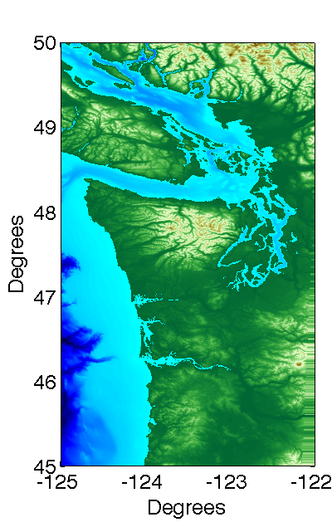
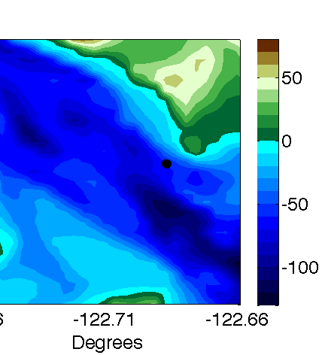
Site Overview
Northern Admiralty Inlet, Puget Sound
3.5 m/s peak currents
Well-mixed water column
Low turbidity (< 1 NTU)
Scoured seabed: cobbles over consolidated sediment
Several runs of migratory fish (anadromous, e.g. salmon)
Marine mammals (cetaceans, pinnipeds)
Proposed Turbines

Slide 6
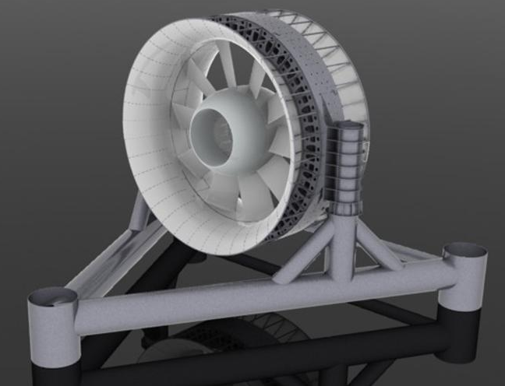
Project Overview
Site Developer: Snohomish PUD
Technology Provider: OpenHydro
OpenHydro Tidal Turbine
2 x 6 m turbines
250 kW peak power generation
Gravity foundation
55 m deployment depth
Cable to shore
3-5 year deployment, with maintenance every 1-2 years
Source: OpenHydro

Slide 7
Overview
Cabled monitoring: Dynamic effects
Discussion

Slide 8
Dynamic Effects Monitoring
Objectives
Challenges
Quantify the risk of blade strike to marine life
Improve understanding of how marine life responds to device presence
Both of these should be at the lowest level of taxonomic classification possible
Laboratory and field studies to date suggest blade strike will be an infrequent occurrence
Difficult and resource-intensive to monitor in the field

Slide 9
Monitoring Technology Options
 | Underwater Imaging | Active Acoustics | Trawl Surveys | Fish Tags
Prior MHK Experience | OpenHydro (EMEC) | Verdant Power (East River) ORPC (Cobscook Bay) | OpenHydro (Puget Sound) ORPC (Cobscook Bay) | OpenHydro (FORCE) Hydro Green (Hastings)
Blade Strike Detection
Taxonomic Classification
Functional Range
Behavioral Disturbance
Overall
Contrast
Turbidity and Aeration
Tag Frequency
Illumination

Slide 10
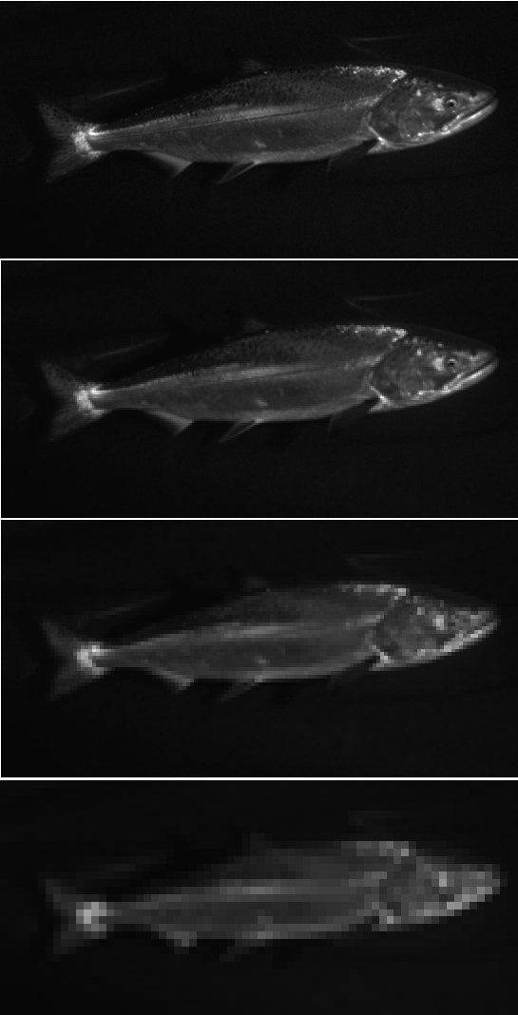
Stereo Imaging
Provides absolute size, position, and speed
MHK-specific issues
Long deployments (biofouling, corrosion)
Maintenance
Automated detection
Behavioral response to illumination is problematic
Strobes required to minimize image blur
Startle response or avoidance possible
500 pixels/target
Chinook salmon
250 pixels/target
Chinook salmon?
125 pixels/target
Salmon
62 pixels/target
Fish?
Source: Kresimir Williams, AK Fisheries Science Center

Slide 11
High Bandwidth Required
Gigabit Ethernet Capacity
5 Mpx Stereo
2 Mpx Stereo
Imaging Sonar
Hydrophone Array
Target Res (Juvenile salmon at 3 m)
150 pixels/target
100 pixels/target
Tetrahedral array sampling at 1 MHz

Slide 12
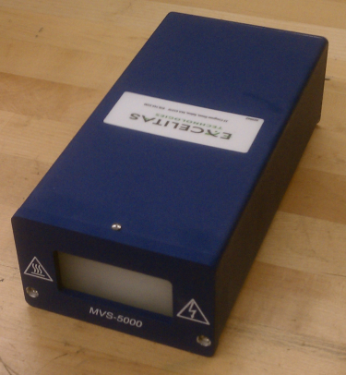
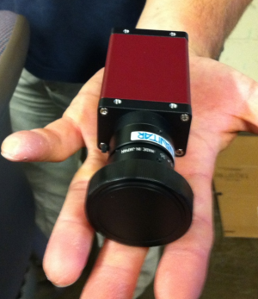
Component Selection
Camera
Strobe
Allied Vision Manta G201
Excelitas MVS 5002
Short exposure time: 2-50 µs (Gallager, et al. 2004)
Full-spectrum illumination
Investigating triggering approaches
2 Mpx resolution
45 degree FOV lens (in air)
Flat optical port

Slide 13
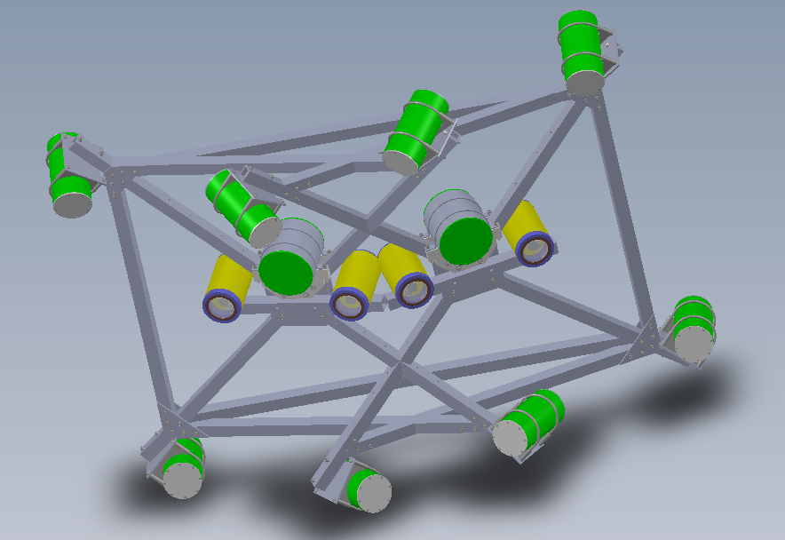
System Layout
Strobe housing
2 stereo camera systems
Rotor interaction
Taxonomic classification
1 m camera-light separation
Compact frame for maintenance
Main bottle
Power/Comms
Stereo cameras
Compact frame concept

Slide 14
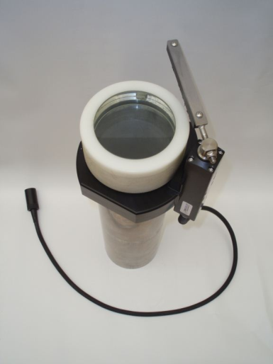
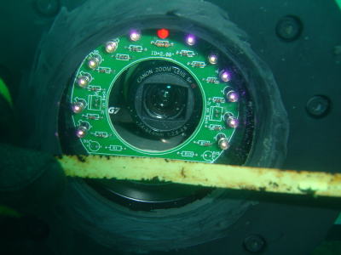
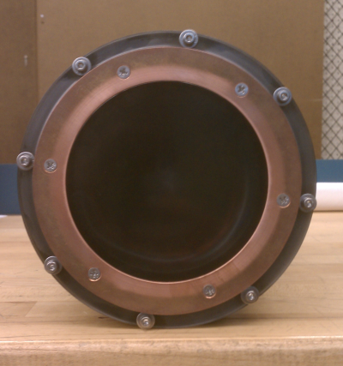
Biofouling Mitigation Strategies
Mechanical Wiper
Removal
Ultraviolet Light
Biocide
Copper Ring
Biocide
Transparent Coating
Reduced Adhesion
Even with mitigation, performance will degrade with time

Slide 15
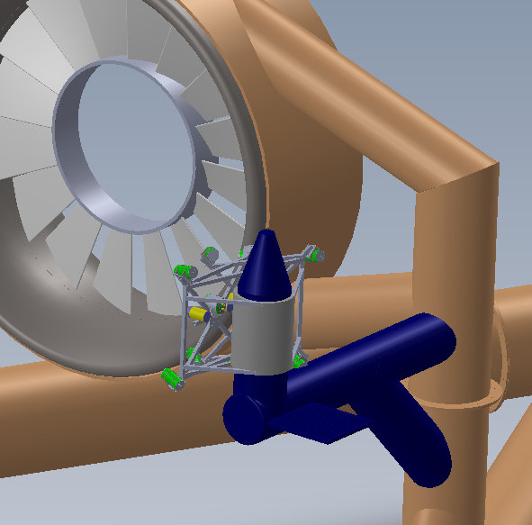
Recovery and Redeployment Concept
Mounting & alignment infrastructure
Reasons for recovery:
Biofouling removal
Maintenance and repair
Additional instruments
Reorientation of cameras
Must be recovered independent of turbine
Must be reconnected to turbine power and data systems
Recovery frame
Compact frame concept

Slide 16
Monitoring System Integration
Stereo Imagers
CTDO
Water quality
?
Marine life
Device condition
Junction Bottle
ROV-mate power and fiber
Hydrophone Array
Doppler profilers
?
Marine mammals
Device noise
Wake
Inflow conditions
Power and Comms Distribution
Export Cable
Generated power
Power for monitoring
> 4 fiber optic channels
Turbine Monitoring

Slide 17
Overview
Cabled monitoring: Dynamic effects
Discussion

Slide 18
Discussion Points
Study prioritization is necessary given finite resources
Appropriateness of studies may be site-specific
How much emphasis should be placed on monitoring for blade strike?
Regulatory mandates are species-specific, but this limits available monitoring tools
Post-installation monitoring is technically challenging
When possible, leverage dual-use infrastructure (e.g., cameras can also monitor turbine health)
How much flexibility/modularity is required?
What is the best way to assess potentially significant interactions that cannot be monitored at pilot scale?

Slide 19
Acknowledgments
This project leverages the expertise of many individuals:
University of Washington: Jim Thomson, Sandra Parker-Stetter, Joe Talbert, Alex de Klerk, Keith van Thiel, Tim McGinnis, Randy Sindelar, and Nick Stelzenmuller
H.T. Harvey & Associates: Sharon Kramer and David Zajanc
Sound & Sea Technology: Larry Armbruster
Sea Mammal Research Unit, Ltd: Dom Tollit, Jason Wood
Alaska Fisheries Science Center: Rick Towler and Kresimir Williams
This material is based upon work supported by the Department of Energy and Snohomish County PUD.

Slide 20
Overview
Cabled monitoring: Dynamic effects
Autonomous monitoring: Acoustic effects
Discussion

Slide 21
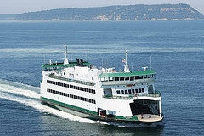
Effect of Turbine Noise on Marine Mammals
Harbor porpoises are known to avoid areas with high received levels of noise
Exposures exceeding 140 dB re 1 µ Pa result in sustained avoidance (Southall et al. 2007)
During operation, turbine noise will increase broadband received levels to more than 140 dB re 1 µPa
Therefore, harbor porpoises (currently abundant) will display sustained avoidance of tidal turbines?
Use passenger ferry as a pre-installation source of opportunity for proxy study
Broadband source level: 170±2 dB re 1 µPa at 1 m
Similar frequency content to turbine noise

Slide 22
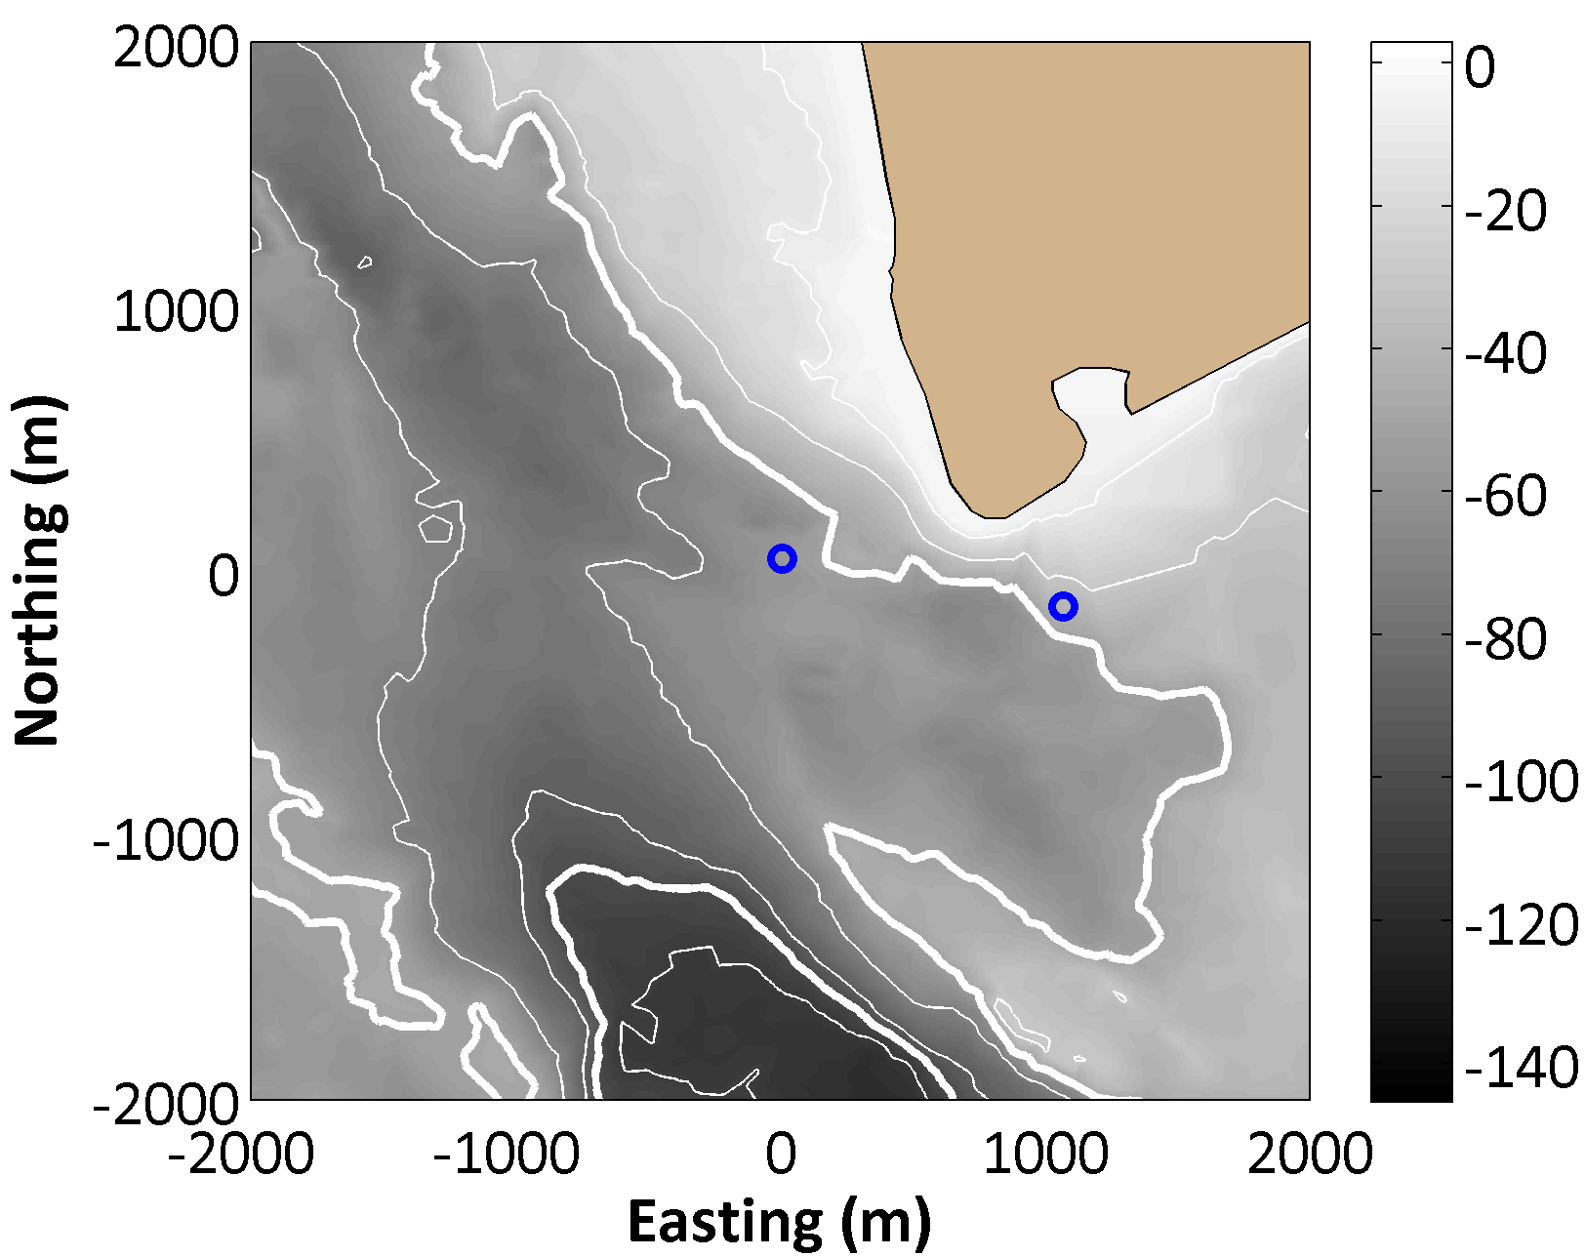
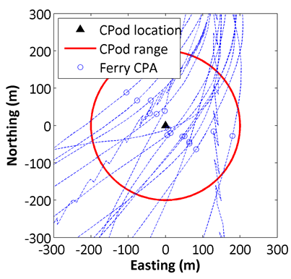
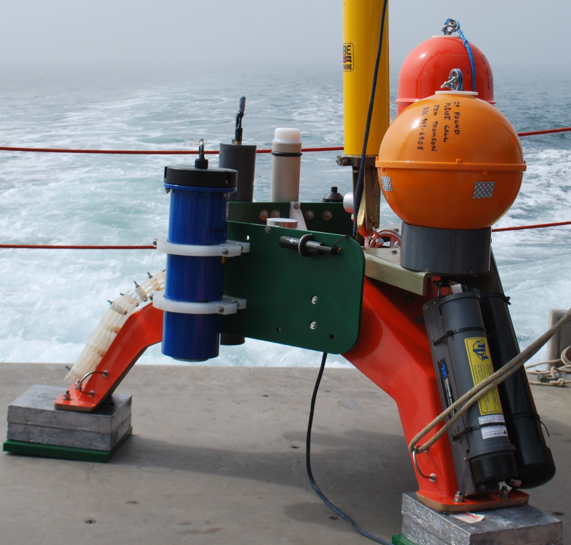
Proxy Study of Harbor Porpoise
Turbine Site
AIS
Study Site
Closest Points of Approach by Passenger Ferry

Slide 23
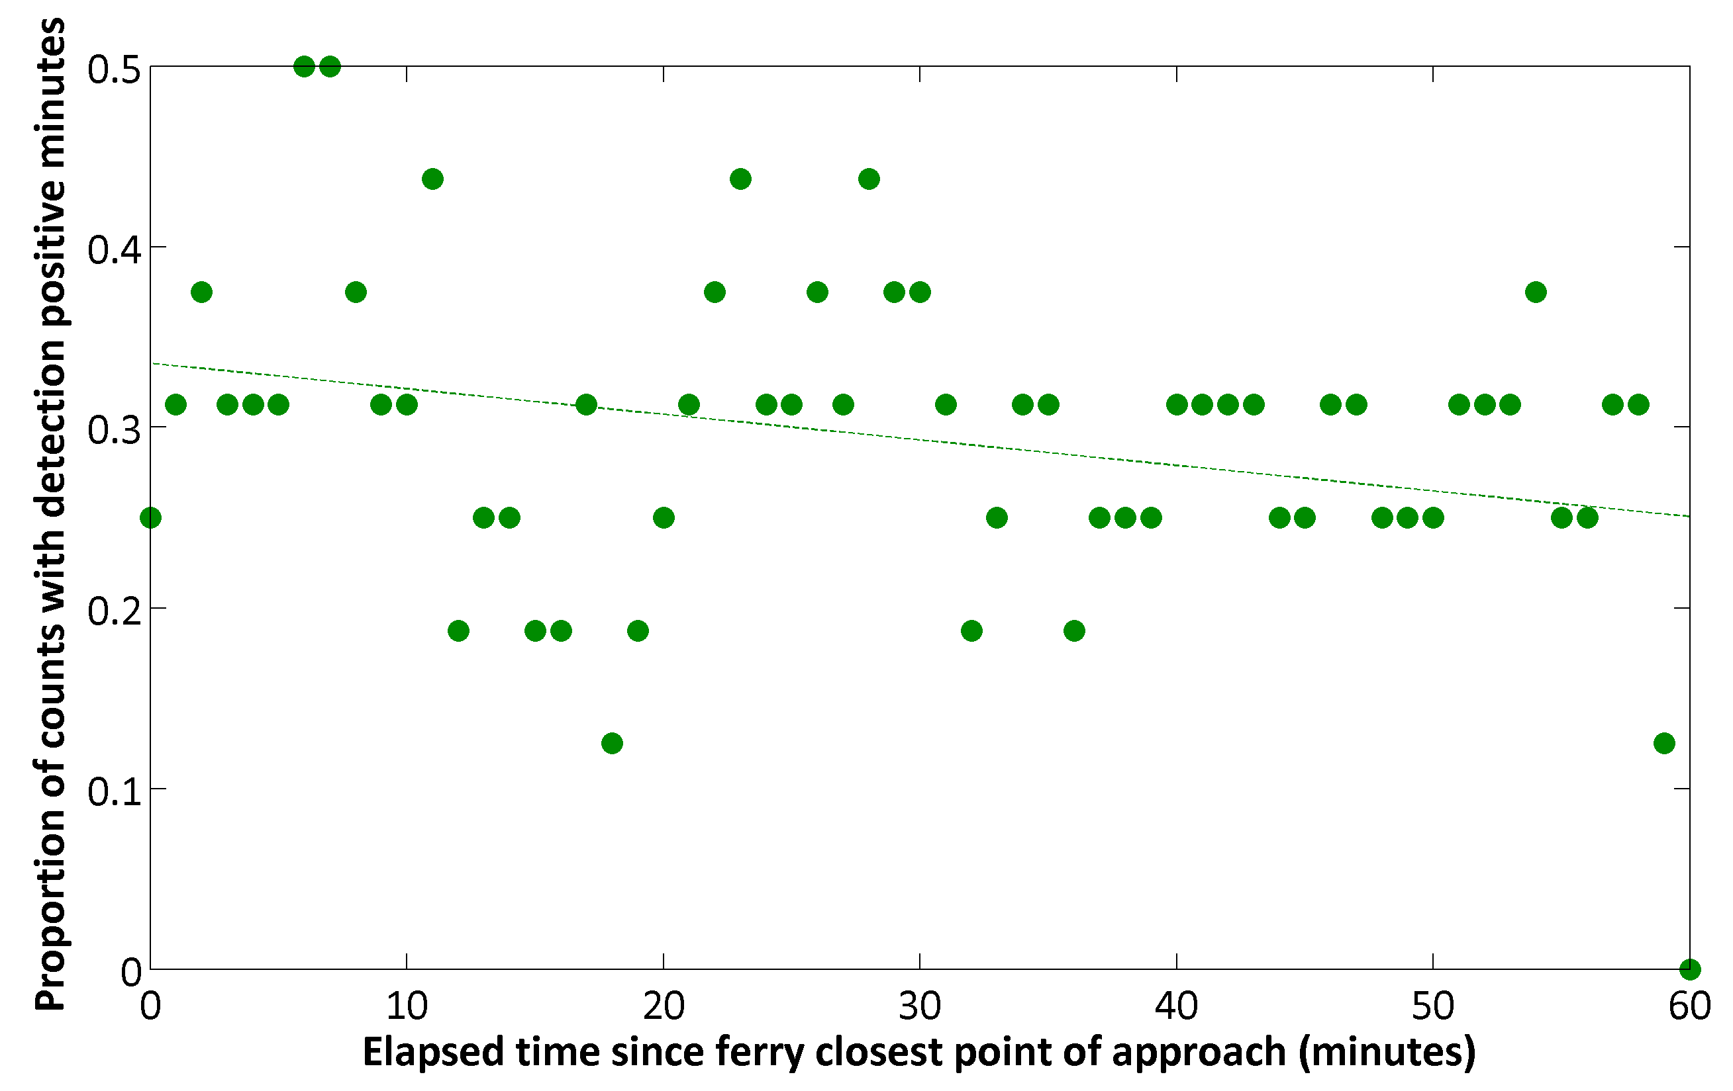
Response to Ferry – Presence/Absence
N = 16
R² = 0.1, F = 5.5, p = 0.02
No apparent avoidance to 140 dB (broadband) received levels
Indicator of noise habituation

