Slide 1
Marine and Hydrokinetic Energy R&D from a National Perspective
Brian Polagye
Northwest National Marine Renewable Energy Center
Department of Mechanical Engineering
University of Washington
FutureEnergy Conference
October 19, 2011

Slide 2
Marine and Hydrokinetic Energy Motivation
Interest in sustainable energy sources
  Renewable
  Compatible with the environment and society
  Enable diversification of supply
Desirable resource characteristics
  High power density
  More predictable than wind or solar
  Close proximity to loads and transmission

Slide 3
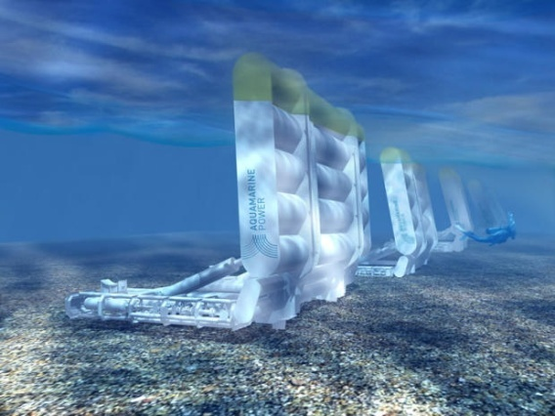
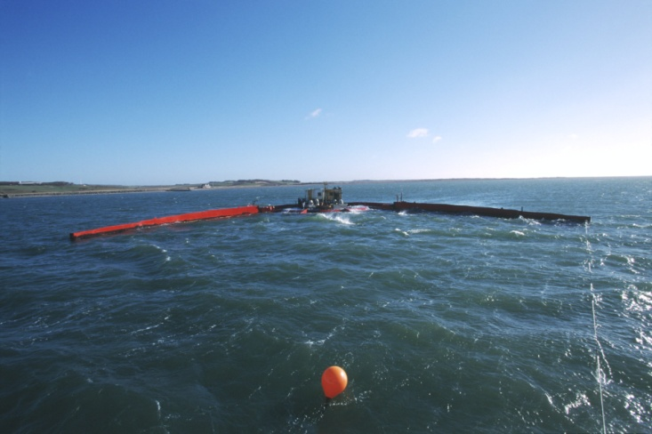
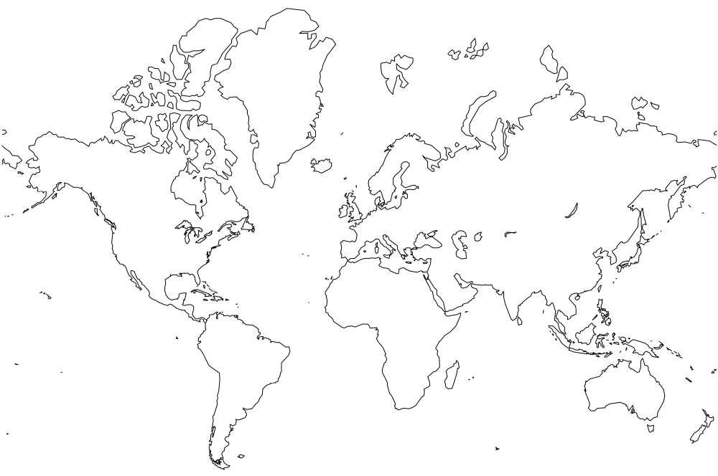
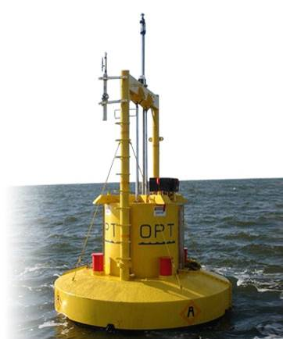
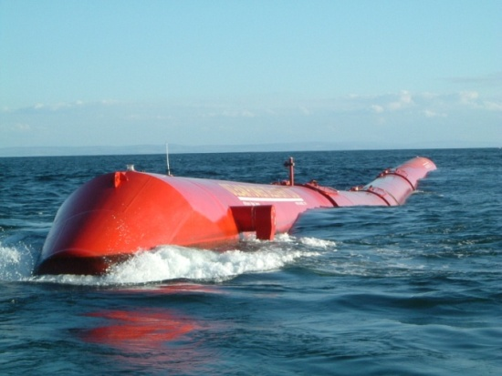
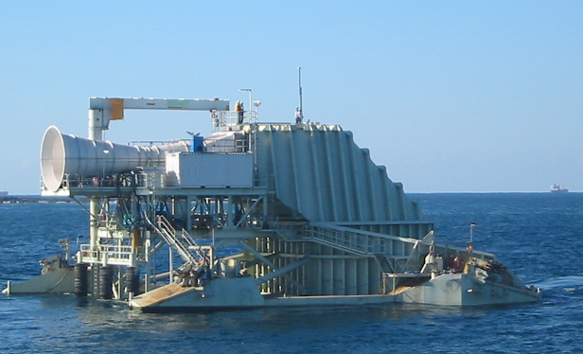
Wave Energy Development
EMEC
Pelamis
Aquamarine
WaveGen
Wave Dragon
CPT
Wavebob
OPT
Pelamis
OceanLinx
Finavera

Slide 4
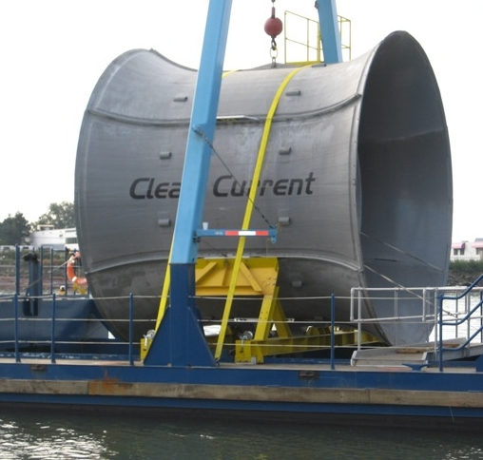
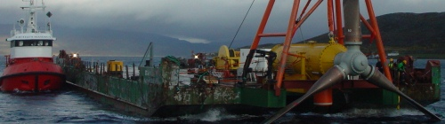
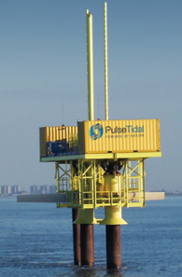
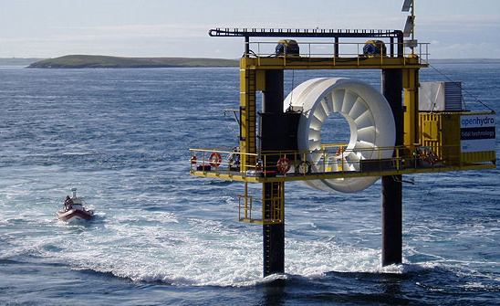
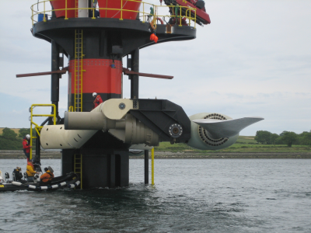
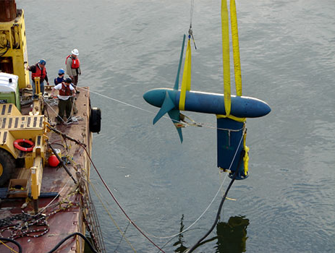
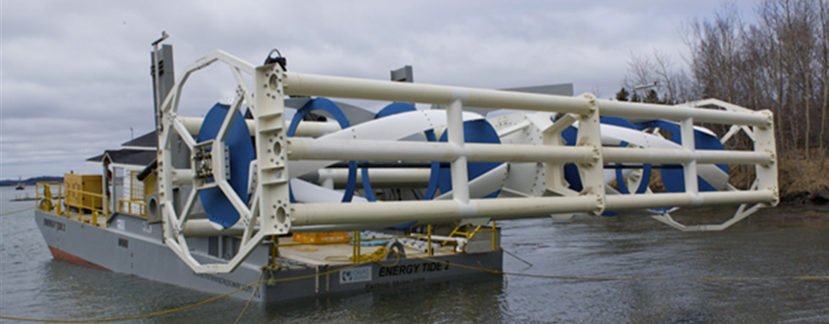
Tidal Energy Development
FORCE
OpenHydro
CleanCurrent
MCT
Atlantis
EMEC
OpenHydro
Atlantis
Tidal Generation Ltd.
Voith Hydro
CleanCurrent
Hammerfest Strøm
Pulse Tidal
Snohomish PUD/OpenHydro
Voith Hydro
MCT
ORPC
Verdant Power

Slide 5
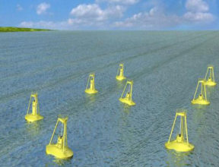
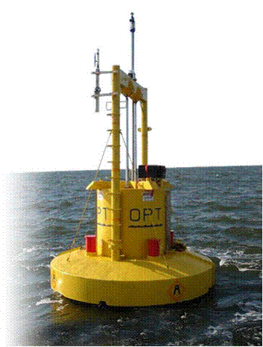
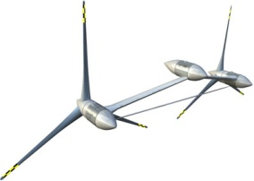
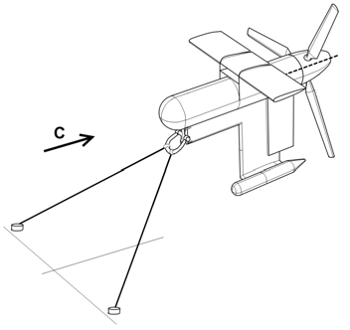
Technology Readiness Levels
DOE TRL 10:
Commercialization
Slide courtesy of US Department of Energy
Technology Readiness Levels:
A Disciplined Protocol for
Technology Development
DOE TRL 9:
Array Testing
DOE TRL 7/8:
Open Water System Testing,
Demonstration, and Operation
DOE TRL 5/6:
System Integration and
Laboratory Demonstration
DOE TRL 1-3
Discovery / Concept Definition / Early Stage Development,
Design and Engineering
DOE TRL 4:
Proof of Concept
FY 2010: DOE program committed up to $37 million over 4 years in order to accelerate the technological and commercial readiness of emerging marine and hydrokinetic (MHK) technologies. 27 projects were selected for funding, with individual awards ranging from $160,000 to up to $10 million.

Slide 6
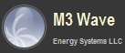
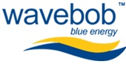




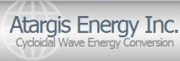






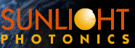







Department of Energy Sponsored Projects
 | TRL 1-4 | TRL 5-6 | TRL 7-8 | TRL 9
Wave Point Absorber Attenuator OWC Air Turbine
Current Ocean Tidal In-Stream Components
Power Transmission
Moorings / Anchorage
OTEC Cold Water Pipe Heat Exchanger
Resolute¹
Northwest Energy Innovations
Whitestone Power & Communications
Dehlsen
Dehlsen
Vortex Hydro Energy
Scientific Solutions
Slide courtesy of US Department of Energy

Slide 7
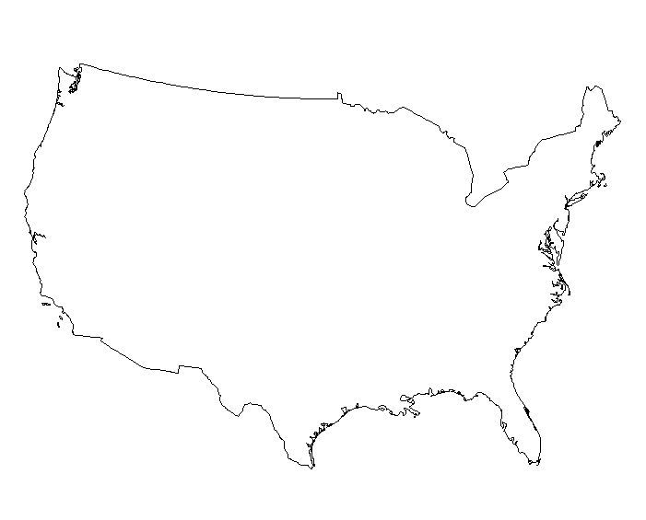










National Marine Renewable Energy Centers
Northwest National Marine Renewable Energy Center (NNMREC)
University of Washington (tidal)
Oregon State University (wave)
Southeast National Marine Renewable Energy Center (SNMREC)
Florida Atlantic University
Ocean Current, OTEC
Hawaii National Marine Renewable Energy Center (HINMREC)
University of Hawaii
Wave, OTEC

Slide 8
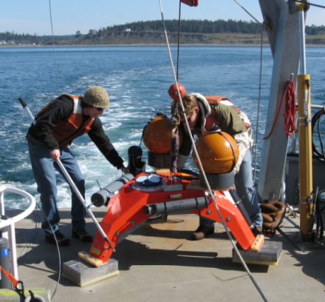
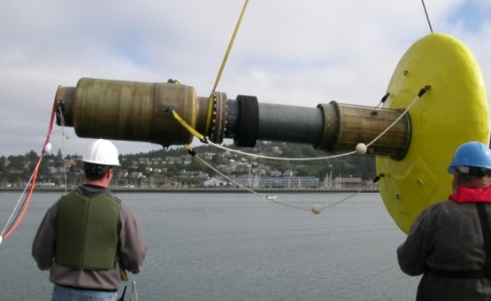
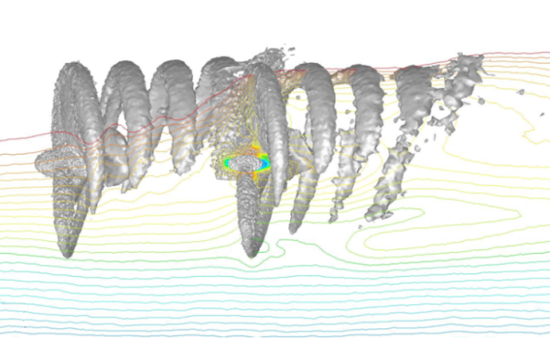
NNMREC Objectives
Develop a full range of capabilities to support wave and tidal energy development.
Center activities:
  Facilitate technology and commercialization
  Close key gaps in understanding
  Inform regulatory and policy decisions
  Educate the first generation of marine renewable energy engineers and scientists.

Slide 9







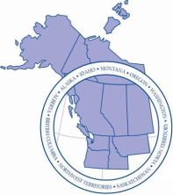

Research Areas
Environment
Acoustics
Dynamic Effects
Benthic Ecosystems
Sediment Transport
Technology
Testing and Demonstration
Site Characterization
Advanced Materials
Device and Array Modeling
Social
Fisheries/Crabbing
Outreach/Engagement
Existing Ocean Users
Local/State Economy

Slide 10
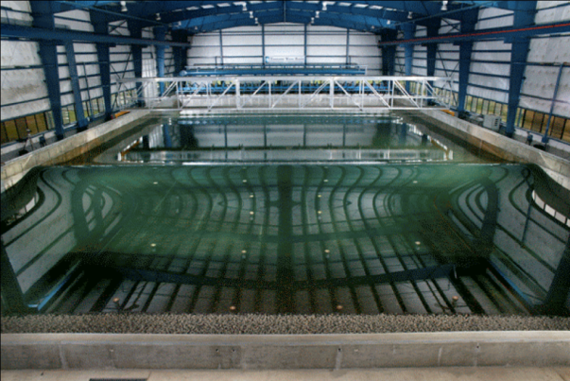
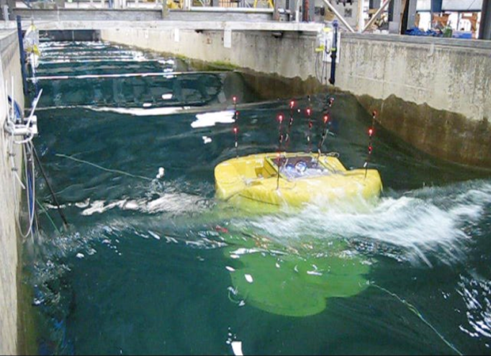
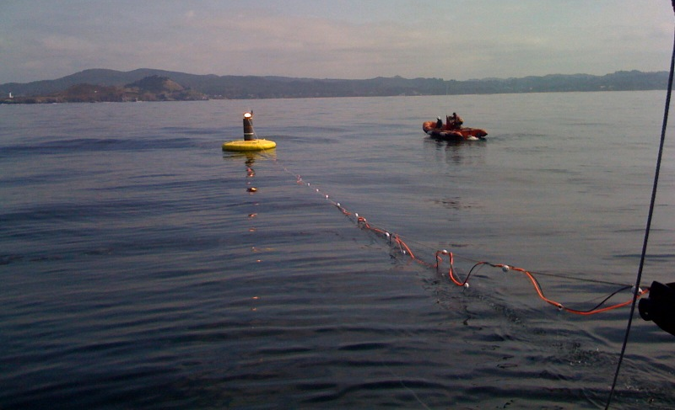
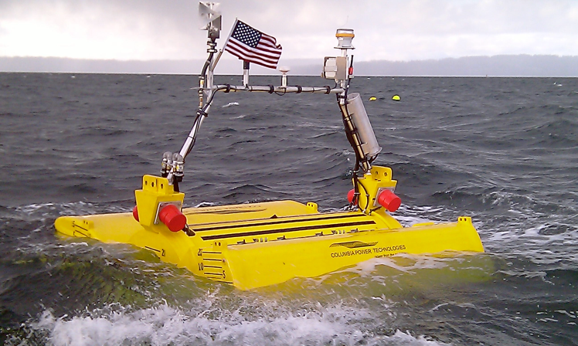
Test Facilities
TRL 4-5
    Tsunami Wave Basin 49 m x 26.5 m x 2.1 m
Columbia Power Technologies 1:15 scale
Long Wave Fume 104 m x 3.7 m x 4.6 m
TRL 7-9
    Newport, OR
TRL 5-6
    Puget Sound, WA
Columbia Power Technologies 1:7 scale
Open Ocean Buoy

Slide 11
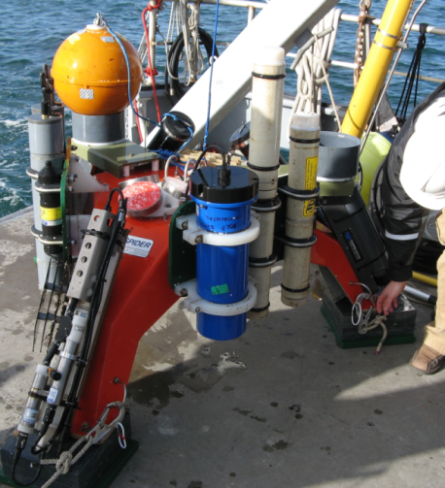
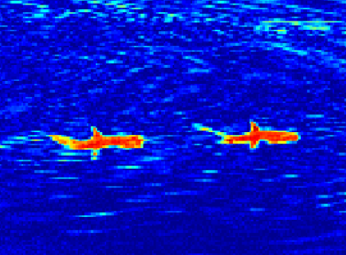
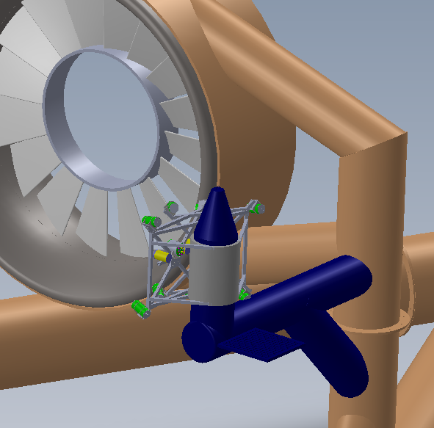
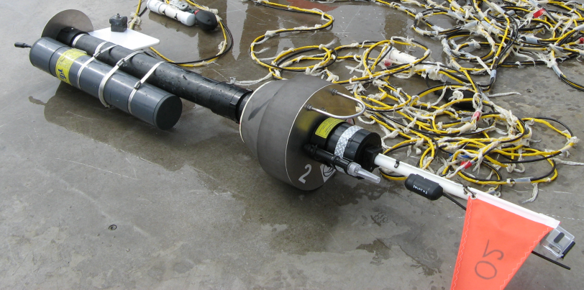
Monitoring Instrumentation
Infrared Detection of Marine Mammals
Sea Spider Instrumentation Package
Post-Installation Monitoring
Stereo Imaging System
SWIFT Buoy

Slide 12
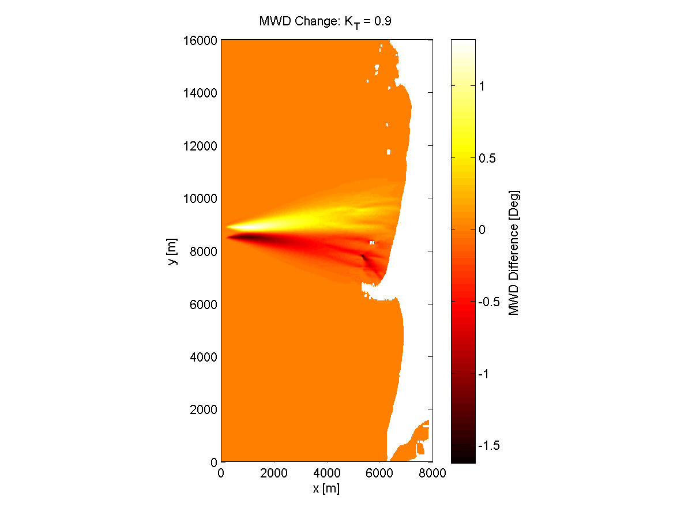
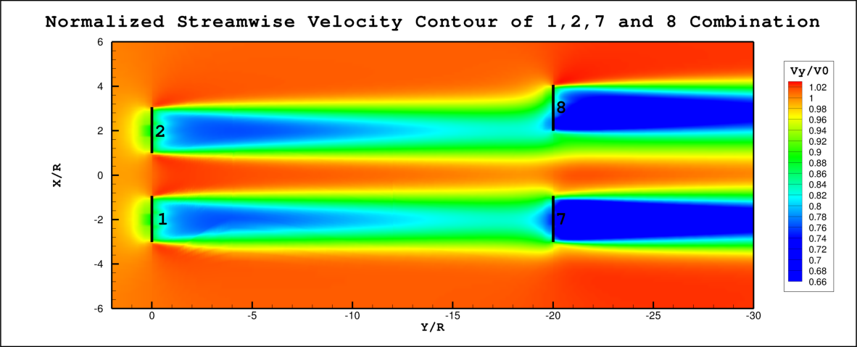
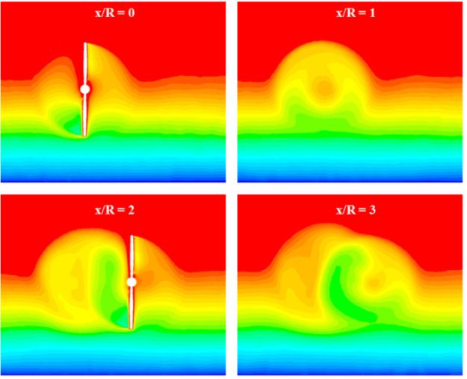
Numerical Modeling
Tidal Turbine Wakes
Numerical Modeling
Effect of Wave Array
Field and Laboratory Measurements
Tidal Turbine Performance

Slide 13

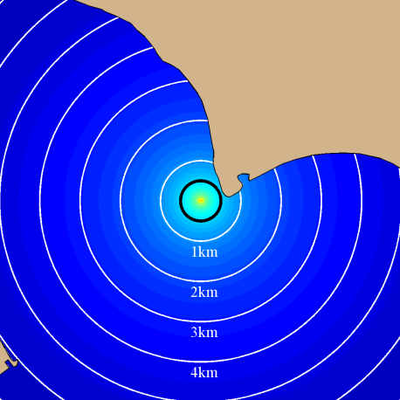

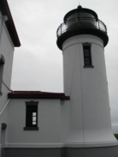
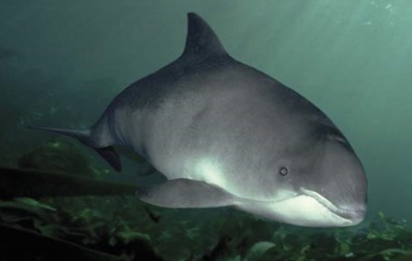
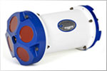
Closing Information Gaps
Recording Hydrophone
Estimated Stressor
CPOD
Potential for Behavioral Change
Automatic Identification System
Species Behavior
Doppler
Profiler
Study Plan Design
Data Collection
Data Synthesis and Analysis

Slide 14
What is the Future of Hydrokinetic Energy?
Pessimists
Optimists
Environmental and social costs outweigh the benefits of renewable power
Resource may not be able to satisfy all human needs
Oceans are already too crowded by existing uses
Important source of renewable power
Astounding progress in the past five years
UK roadmap calls for 2 GW of wave and tidal to come online by 2020
US roadmap calls for 20-30 GW of wave and tidal to come online by 2030

Slide 15

Thank You
For further information on wave energy contact:
  Belinda Batten, Director, Oregon State University
  http://nnmrec.oregonstate.edu
For further information on tidal energy contact:
  Phil Malte, co-Director, University of Washington
  http://depts.washington.edu/nnmrec
This material is based upon work supported by the Department of Energy.

