Slide 1
Hydrokinetic Energy
Research and Development
Brian Polagye
Northwest National Marine Renewable Energy Center
Department of Mechanical Engineering
University of Washington
Alaska Hydrokinetics Technical Conference
October 26, 2011

Slide 2
Marine and Hydrokinetic Energy Motivation
Interest in sustainable energy sources
  Renewable
  Compatible with the environment and society
  Enable diversification of supply
Desirable resource characteristics
  High power density
  More predictable than wind or solar
  Close proximity to loads and transmission

Slide 3
Industry Status
Challenges (and Opportunities)
Research and Development

Slide 4
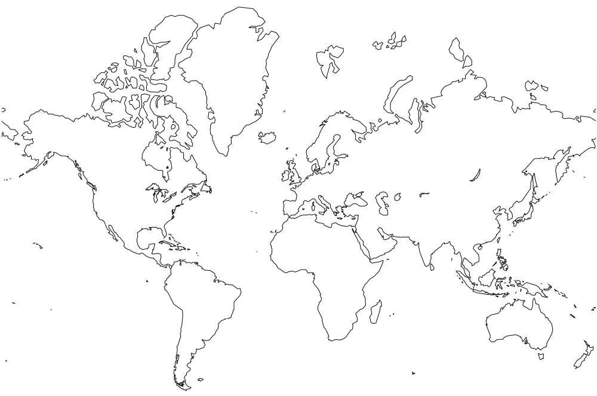
Wave Energy Development
EMEC
Pelamis
Aquamarine
WaveGen
Wave Dragon
CPT
Wavebob
OPT
Pelamis
OceanLinx
Finavera

Slide 5
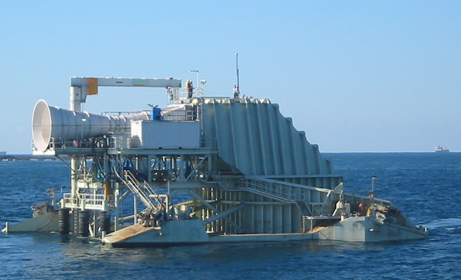
Wave Energy Development
EMEC
Pelamis
Aquamarine
WaveGen
Wave Dragon
CPT
Wavebob
OPT
Pelamis
Oscillating Water Column
OceanLinx
Finavera

Slide 6
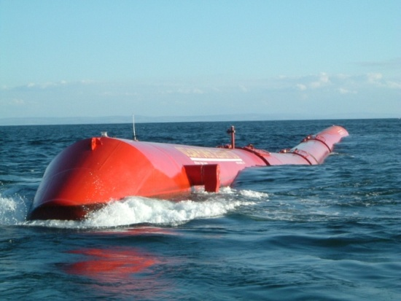
Wave Energy Development
EMEC
Pelamis
Aquamarine
WaveGen
Wave Dragon
CPT
Wavebob
OPT
Pelamis
Attenuator
OceanLinx
Finavera

Slide 7
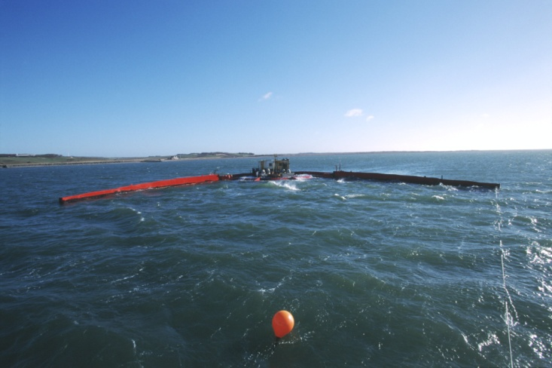
Wave Energy Development
Overtopping
EMEC
Pelamis
Aquamarine
WaveGen
Wave Dragon
CPT
Wavebob
OPT
Pelamis
OceanLinx
Finavera

Slide 8
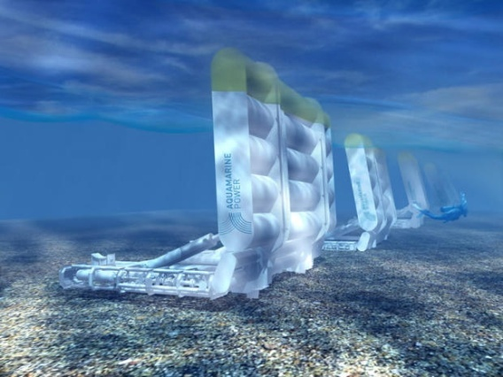
Wave Energy Development
Surge
EMEC
Pelamis
Aquamarine
WaveGen
Wave Dragon
CPT
Wavebob
OPT
Pelamis
OceanLinx
Finavera

Slide 9
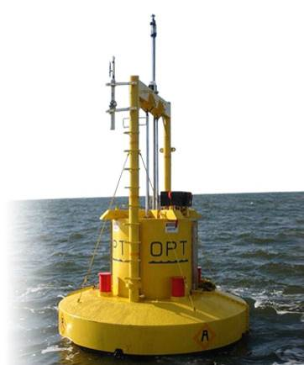
Wave Energy Development
EMEC
Pelamis
Aquamarine
WaveGen
Wave Dragon
CPT
Wavebob
OPT
Pelamis
OceanLinx
Finavera
Point Absorber

Slide 10
Tidal Energy Development
FORCE
OpenHydro
CleanCurrent
MCT
Atlantis
EMEC
OpenHydro
Atlantis
Tidal Generation Ltd.
Voith Hydro
ORPC
CleanCurrent
Hammerfest Strøm
Pulse Tidal
OpenHydro
Voith Hydro
MCT
ORPC
Verdant Power

Slide 11
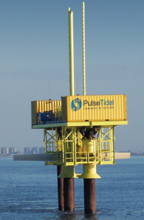
Tidal Energy Development
FORCE
OpenHydro
CleanCurrent
MCT
Atlantis
EMEC
OpenHydro
Atlantis
Tidal Generation Ltd.
Voith Hydro
ORPC
CleanCurrent
Hammerfest Strøm
Pulse Tidal
OpenHydro
Voith Hydro
MCT
ORPC
Verdant Power

Slide 12
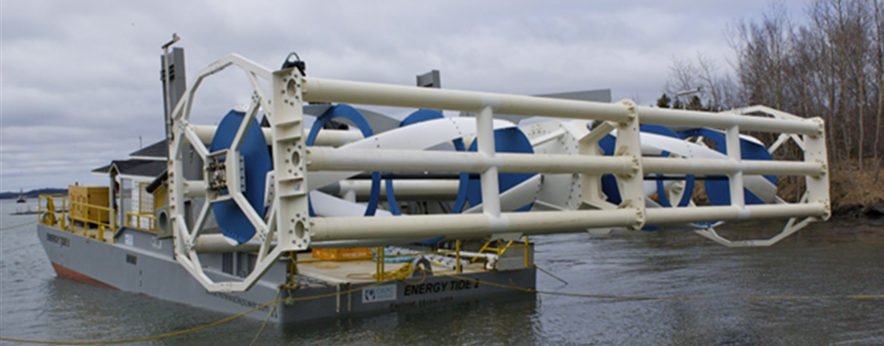
Tidal Energy Development
FORCE
OpenHydro
CleanCurrent
MCT
Atlantis
EMEC
OpenHydro
Atlantis
Tidal Generation Ltd.
Voith Hydro
ORPC
CleanCurrent
Hammerfest Strøm
Pulse Tidal
OpenHydro
Voith Hydro
MCT
ORPC
Verdant Power

Slide 13
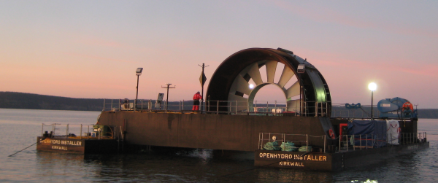
Tidal Energy Development
FORCE
OpenHydro
CleanCurrent
MCT
Atlantis
EMEC
OpenHydro
Atlantis
Tidal Generation Ltd.
Voith Hydro
ORPC
CleanCurrent
Hammerfest Strøm
Pulse Tidal
OpenHydro
Voith Hydro
MCT
ORPC
Verdant Power

Slide 14
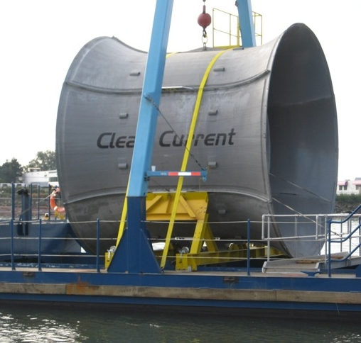
Tidal Energy Development
FORCE
OpenHydro
CleanCurrent
MCT
Atlantis
EMEC
OpenHydro
Atlantis
Tidal Generation Ltd.
Voith Hydro
ORPC
CleanCurrent
Hammerfest Strøm
Pulse Tidal
OpenHydro
Voith Hydro
MCT
ORPC
Verdant Power

Slide 15
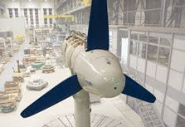
Tidal Energy Development
FORCE
OpenHydro
CleanCurrent
MCT
Atlantis
EMEC
OpenHydro
Atlantis
Tidal Generation Ltd.
Voith Hydro
ORPC
CleanCurrent
Hammerfest Strøm
Pulse Tidal
OpenHydro
Voith Hydro
MCT
ORPC
Verdant Power

Slide 16
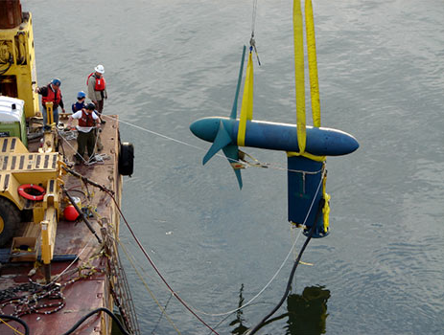
Tidal Energy Development
FORCE
OpenHydro
CleanCurrent
MCT
Atlantis
EMEC
OpenHydro
Atlantis
Tidal Generation Ltd.
Voith Hydro
ORPC
CleanCurrent
Hammerfest Strøm
Pulse Tidal
OpenHydro
Voith Hydro
MCT
ORPC
Verdant Power

Slide 17
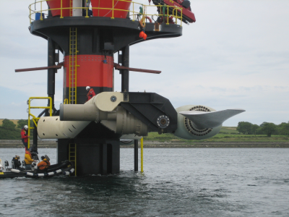
Tidal Energy Development
FORCE
OpenHydro
CleanCurrent
MCT
Atlantis
EMEC
OpenHydro
Atlantis
Tidal Generation Ltd.
Voith Hydro
ORPC
CleanCurrent
Hammerfest Strøm
Pulse Tidal
OpenHydro
Voith Hydro
MCT
ORPC
Verdant Power

Slide 18
Three Hydrokinetic Myths
Perception
Reality
Europeans have already solved all hydrokinetic challenges
Similar challenges exist worldwide – all projects at pilot scale
Developers are poised to install thousands of devices in the next 2-3 years
Economic viability must be proven before large-scale development can occur
Marine renewable energy is 30 years behind other renewables
MW-scale commercial prototypes are already in operation

Slide 19
Industry Status
Challenges (and Opportunities)
Research and Development

Slide 20
Elements of Sustainability
Technologically Feasible
Socially Acceptable
Economically Viable
Environmentally Compatible

Slide 21
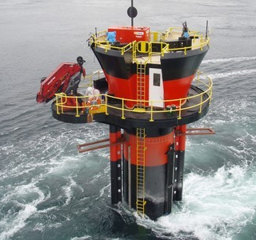
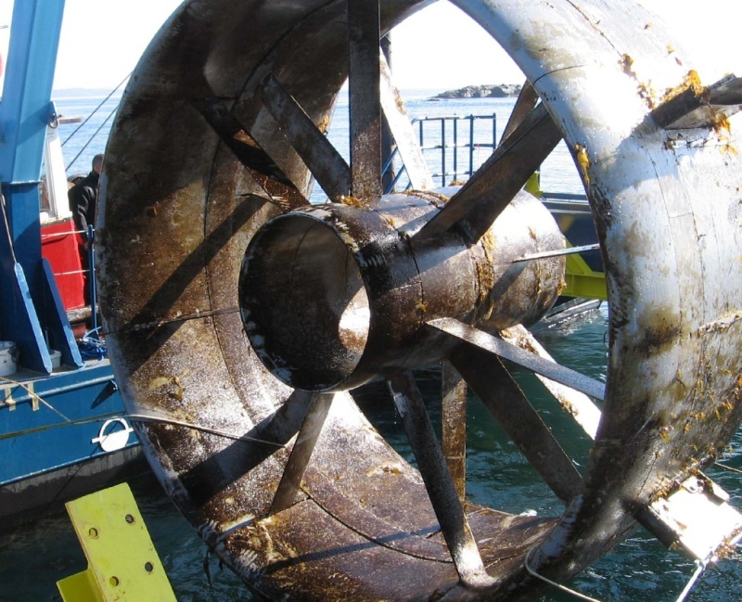
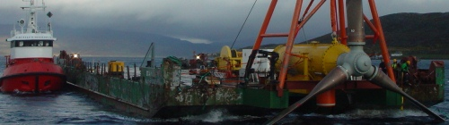
Technology Feasibility
Challenges
Opportunities
  Power generation, at low cost, in extreme environments
  Complicated by:
    Lack of standards
    Lack of test facilities
  Resource predictability and power density
  Leverage existing technology

Slide 22

Economic Viability
Challenges
Opportunities
  Energy, on the whole, is cheap
  Cost to deploy and operate marine renewables is currently higher than terrestrial alternatives
  Long and uncertain permitting requirements increase cost and financial risk
  Energy, locally, can be very expensive
  Potential to reinvigorate local manufacturing
  Distributed generation as an alternative to transmission upgrades

Slide 23
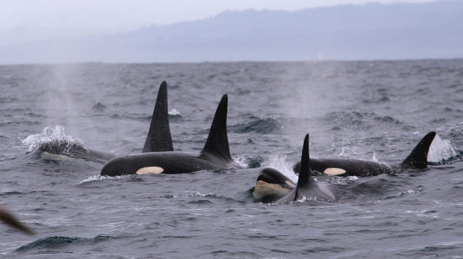
Environmental Compatibility
Challenges
Opportunities
  Regulatory “chicken and egg” problem
  Many possible stressor-receptor interactions
  Monitoring technologies are under-developed
  Overlap with basic research questions
  Sustainable energy sources
  Mitigate potential environmental impacts through device design
  Leverage projects as cabled observatories to better understand the oceans

Slide 24
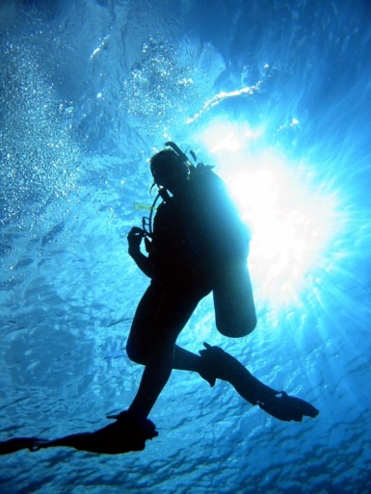
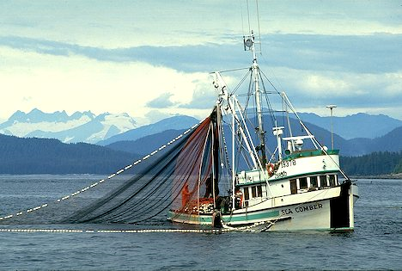
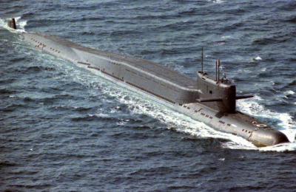
Social Acceptance
Challenges
Opportunities
  Existing users
  Uncertainty complicates marine spatial planning
  Displacing fossil fuels
  Low/no viewshed conflicts
  Enabling new uses

Slide 25
Industry Status
Challenges (and Opportunities)
Research and Development

Slide 26
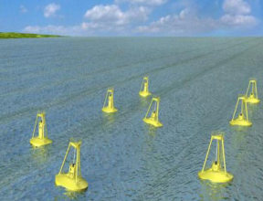
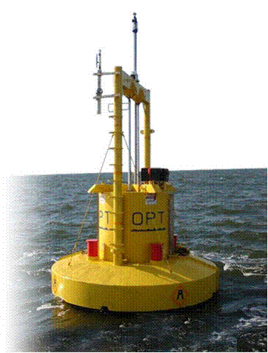
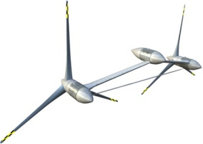
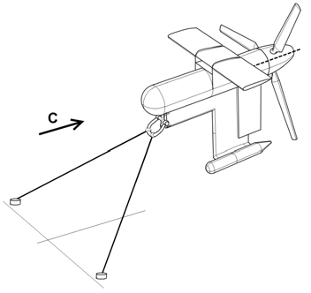
Technology Readiness Levels
DOE TRL 10:
Commercialization
Slide courtesy of US Department of Energy
Technology Readiness Levels:
A Disciplined Protocol for
Technology Development
DOE TRL 9:
Array Testing
DOE TRL 7/8:
Open Water System Testing,
Demonstration, and Operation
DOE TRL 5/6:
System Integration and
Laboratory Demonstration
DOE TRL 1-3
Discovery / Concept Definition / Early Stage Development,
Design and Engineering
DOE TRL 4:
Proof of Concept
FY 2010: DOE program committed up to $37 million over 4 years in order to accelerate the technological and commercial readiness of emerging marine and hydrokinetic (MHK) technologies. 27 projects were selected for funding, with individual awards ranging from $160,000 to up to $10 million.

Slide 27
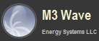
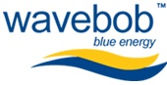




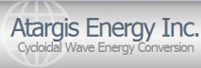






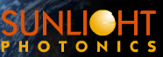







Department of Energy Sponsored Projects
 | TRL 1-4 | TRL 5-6 | TRL 7-8 | TRL 9
Wave Point Absorber Attenuator OWC Air Turbine
Current Ocean Tidal In-Stream Components
Power Transmission
Moorings / Anchorage
OTEC Cold Water Pipe Heat Exchanger
Resolute¹
Northwest Energy Innovations
Whitestone Power & Communications
Dehlsen
Dehlsen
Vortex Hydro Energy
Scientific Solutions
Slide courtesy of US Department of Energy

Slide 28
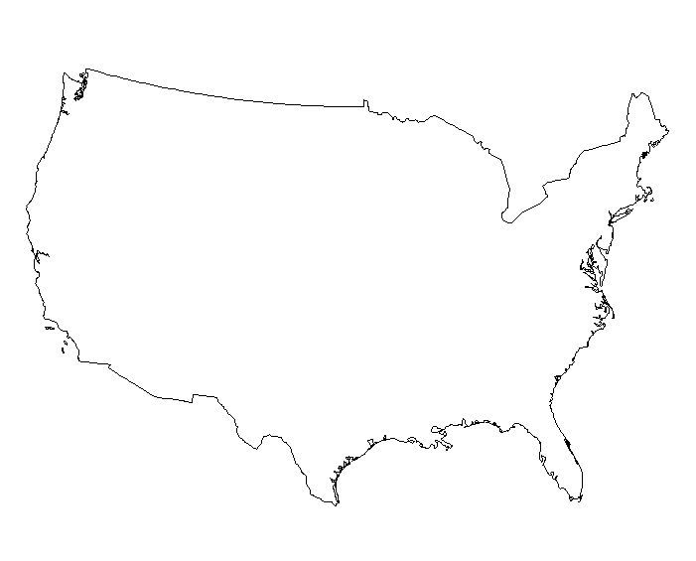










National Marine Renewable Energy Centers
Northwest National Marine Renewable Energy Center (NNMREC)
University of Washington (tidal)
Oregon State University (wave)
Southeast National Marine Renewable Energy Center (SNMREC)
Florida Atlantic University
Ocean Current, OTEC
Hawaii National Marine Renewable Energy Center (HINMREC)
University of Hawaii
Wave, OTEC

Slide 29
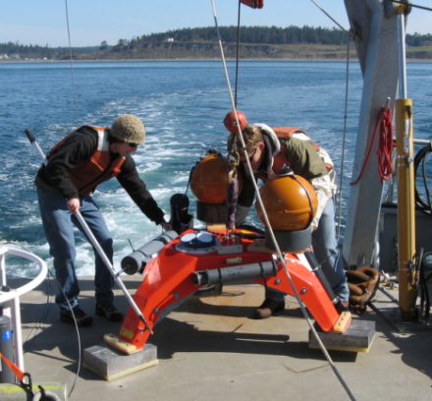
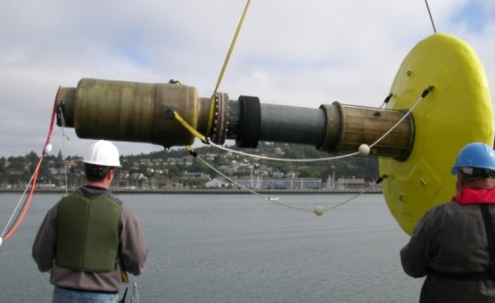
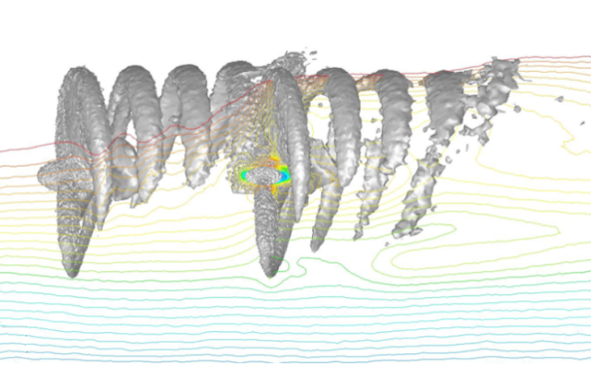
NNMREC Objectives
Develop a full range of capabilities to support wave and tidal energy development.
Center activities:
  Facilitate technology and commercialization
  Close key gaps in understanding
  Inform regulatory and policy decisions
  Educate the first generation of marine renewable energy engineers and scientists.

Slide 30







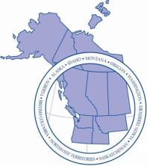

Research Areas
Environment
Acoustics
Dynamic Effects
Benthic Ecosystems
Sediment Transport
Technology
Testing and Demonstration
Site Characterization
Advanced Materials
Device and Array Modeling
Society
Fisheries/Crabbing
Outreach/Engagement
Existing Ocean Users
Local/State Economy

Slide 31
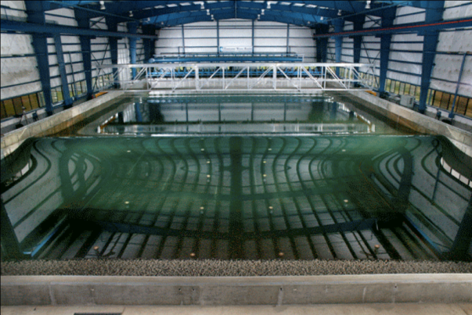
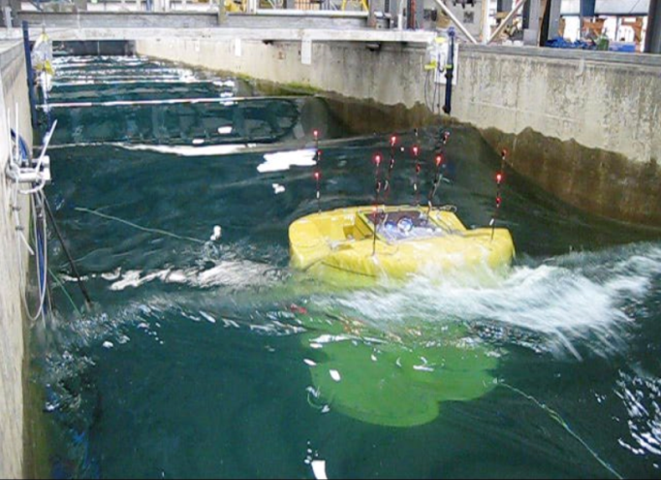
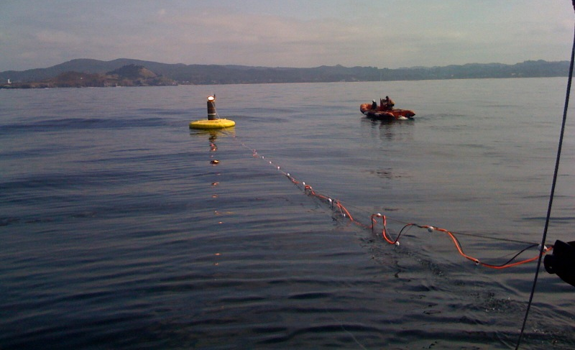
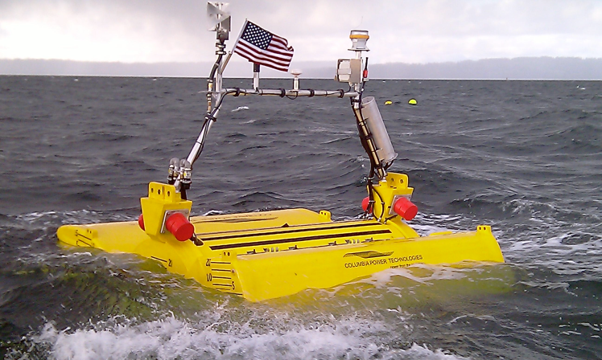
Test Facilities
TRL 4-5
    Tsunami Wave Basin 49 m x 26.5 m x 2.1 m
Columbia Power Technologies 1:15 scale
Long Wave Fume 104 m x 3.7 m x 4.6 m
TRL 7-9
    Newport, OR
TRL 5-6
    Puget Sound, WA
Columbia Power Technologies 1:7 scale
Open Ocean Buoy

Slide 32
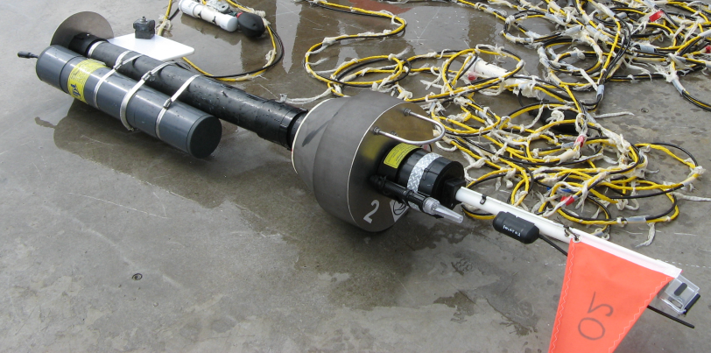
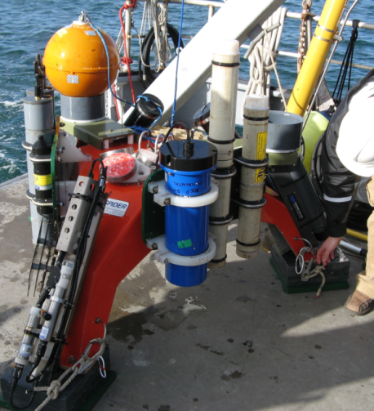
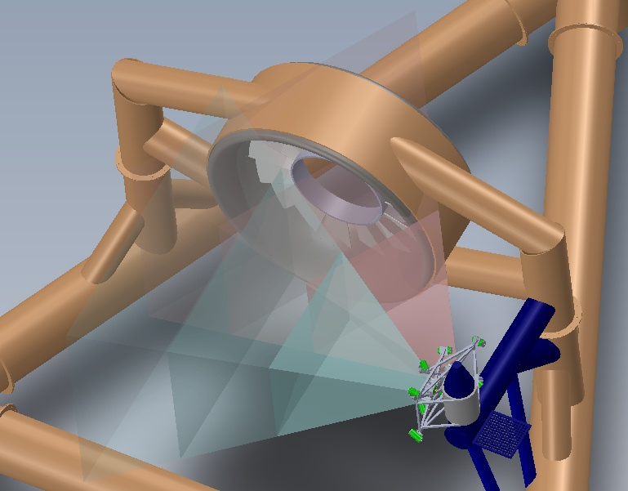
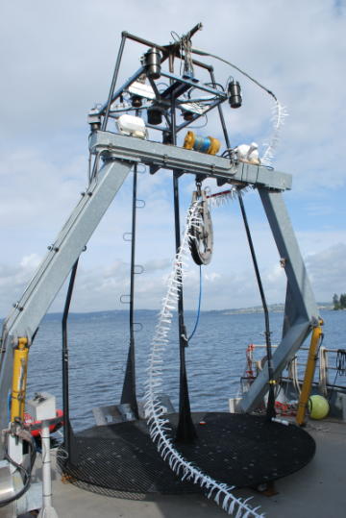
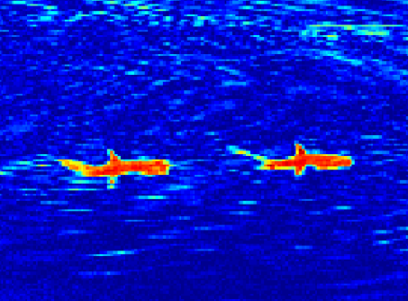
Monitoring Instrumentation
Sea Spider Instrumentation Package
SWIFT Buoy
Post-Installation Monitoring
Infrared Detection

Slide 33
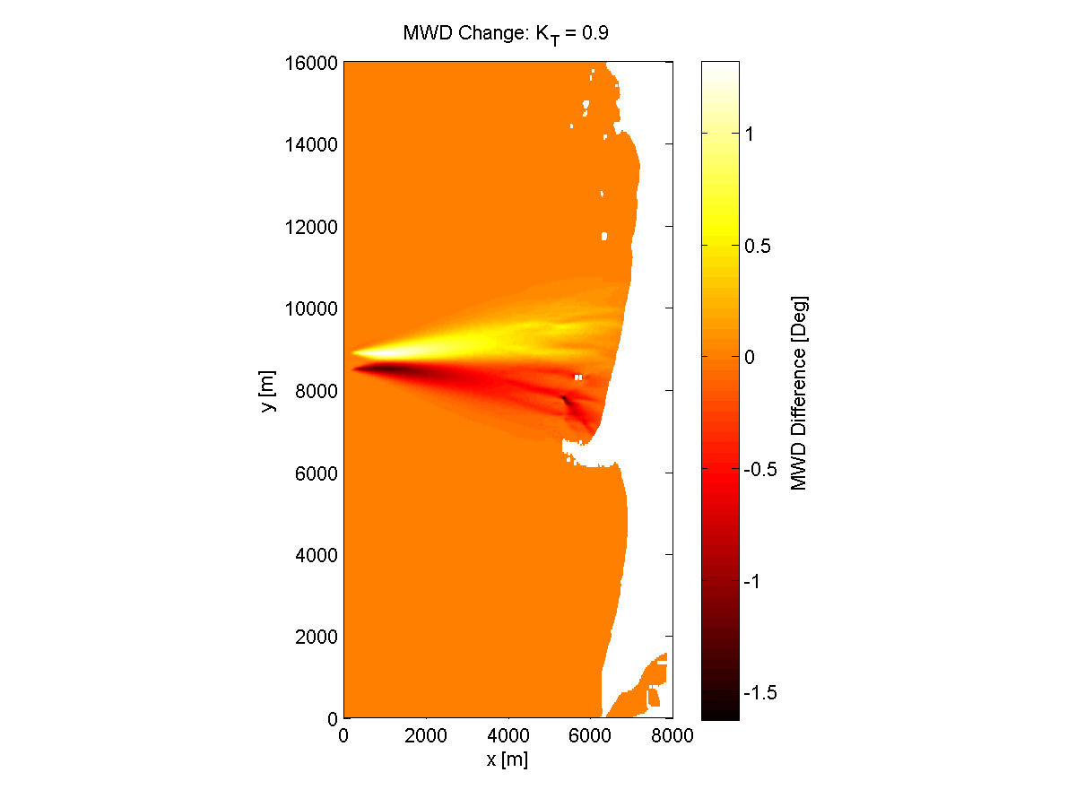
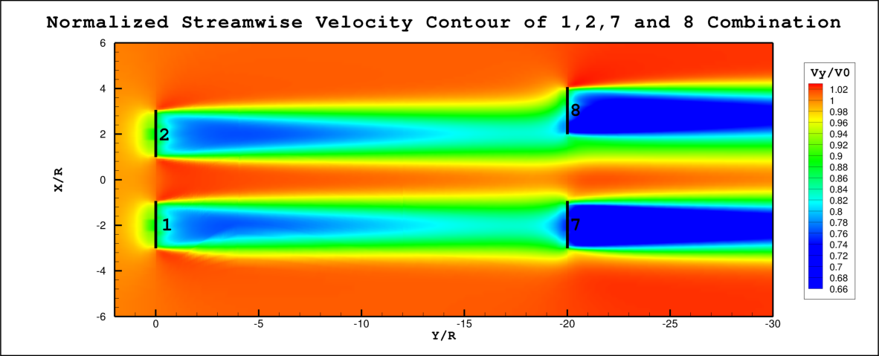
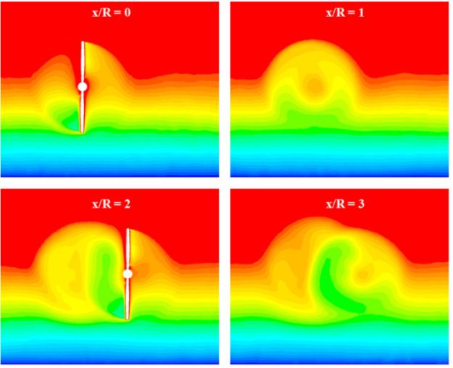
Numerical Modeling
Tidal Turbine Wakes
Numerical Modeling
Effect of Wave Array
Field and Laboratory Measurements
Tidal Turbine Performance

Slide 34
Pilot-Scale Monitoring Priorities
 | Device presence: Static effects | Device presence: Dynamic effects | Chemical effects | Acoustic effects | Electromagnetic effects | Energy removal | Cumulative effects
Physical environment: Near-field
Physical environment: Far-field
Habitat
Invertebrates
Fish: Migratory
Fish: Resident
Marine mammals
Seabirds
Ecosystem interactions
Need to understand stressor-receptor interactions first
Immeasurably small at pilot-scale
Small signal-to-noise ratio at pilot scale
Commercial-Scale Interactions
Polagye, B., B. Van Cleve, A. Copping, and K. Kirkendall (eds), (2011) Environmental effects of tidal energy development.

Slide 35

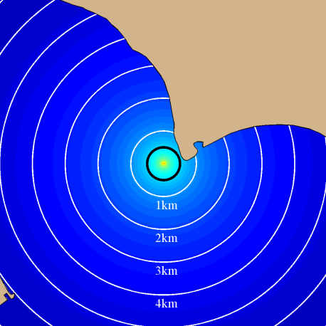

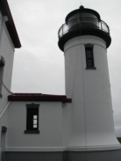
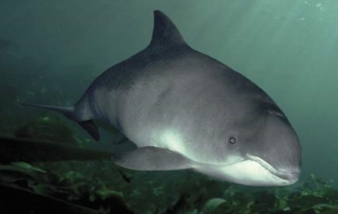
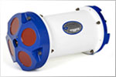
Closing Information Gaps
Recording Hydrophone
Estimated Stressor
CPOD
Potential for Behavioral Change
Automatic Identification System
Species Behavior
Doppler
Profiler
Study Plan Design
Data Collection
Data Synthesis and Analysis

Slide 36
What is the Future of Hydrokinetic Energy?
Pessimists
Optimists
Environmental and social costs outweigh the benefits of renewable power
Resource may not be able to satisfy all human needs
Oceans are already too crowded by existing users
Important source of renewable power
Rapid progress in the past five years
UK roadmap calls for 2 GW of wave and tidal to come online by 2020
US roadmap calls for 20-30 GW of wave and tidal to come online by 2030

Slide 37

Thank You
For further information on wave energy contact:
  Belinda Batten, Director, Oregon State University
  http://nnmrec.oregonstate.edu
For further information on tidal energy contact:
  Phil Malte, co-Director, University of Washington
  http://depts.washington.edu/nnmrec
This material is based upon work supported by the Department of Energy.

