Slide 1

Effects of localized energy extraction in an idealized, energetically complete numerical model of an ocean-estuary tidal system
Mitsuhiro Kawase and Marisa Gedney
Northwest National Marine Renewable Energy Center /
School of Oceanography
University of Washington
Seattle WA 98195 United States
MHK Instrumentation, Measurement & Computer Modeling Workshop, Broomfield CO, July 10 2012

Slide 2



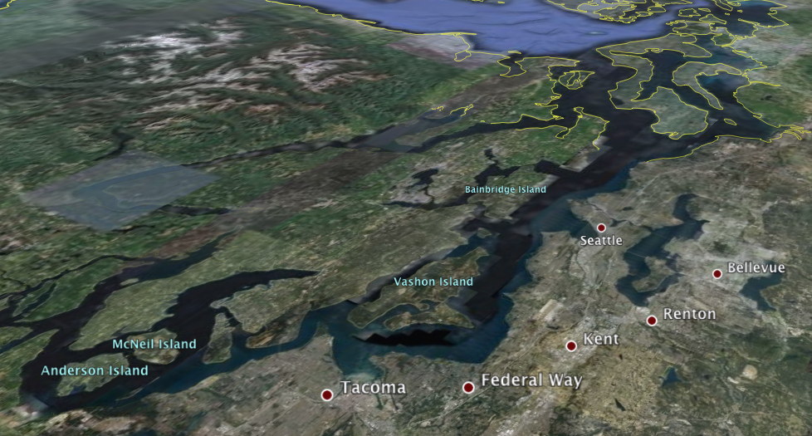
Environmental Effects of Tidal Energy Extraction
Near-field (Vicinity of the Device)
  Flow redirection
  Interaction with marine life
  Impact on bottom sediments and benthos
Far-field (Estuary-wide)
  Changes in the tidal range
  Changes in tidal currents

Slide 3
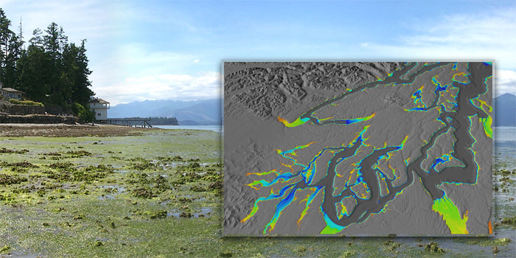


Far-field Effects of Tidal Power Extraction Devices
Reduction in tidal range can permanently expose/submerge tidal flats, altering nearshore habitats
www.prism.washington.edu
Reduction in kinetic energy of flow and mixing can slow down flushing of basins, affecting oxygen levels, water quality and pollutant dispersal
Hood Canal Salmon Enhancement Group

Slide 4
Effect of Energy Extraction on Tidal Range in Estuary
~1GW for Puget Sound (Polagye, pers.comm.)
Capacity build-up
As resistance increases in channel, energy starts to reflect back
~37% range reduction
Maximum Energy Extraction (physical limit)
Further increase in capacity results in energy reflection rather than extraction
Garrett and Cummins, 2005; Bryden and Couch, 2006; Sutherland et al., 2007; Blanchfield et al., 2008; Polagye et al., 2008, 2009; Draper et al., 2010; Polagye and Malte, 2011

Slide 5
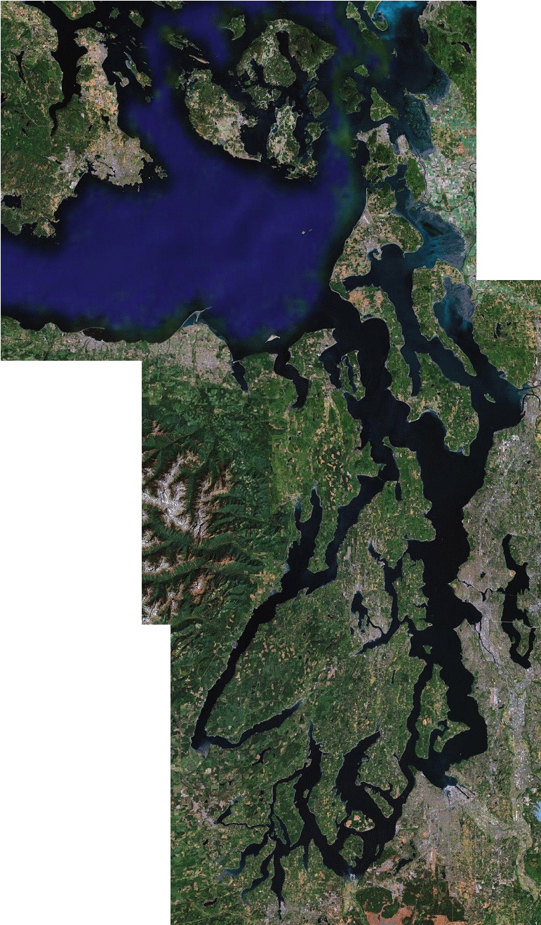

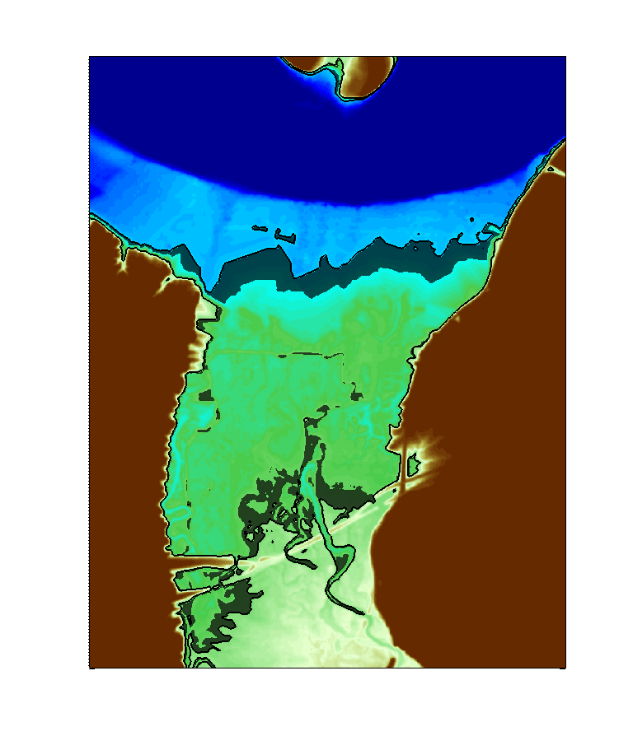
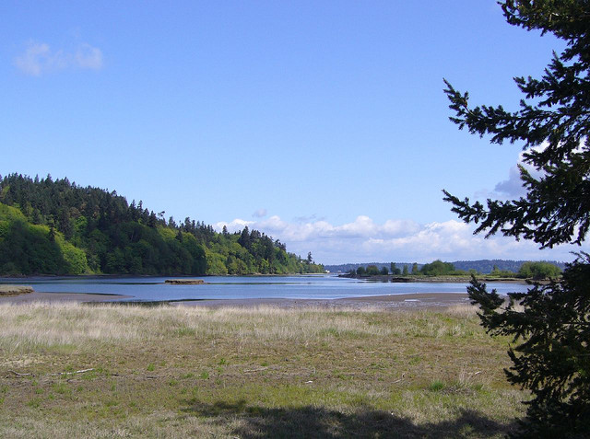

Impact of Tidal Range Reduction on Intertidal Zone
Hypothetical example: Nisqually National Wildlife Refuge, South Puget Sound, Washington
Data: Finlayson, 2005
37% reduction in tidal range would result in loss of 24% of the intertidal area.
Jim Culp
These form important habitats for protected and commercially important wildlife.
Andy Powell
US Fish and Wildlife Service

Slide 6
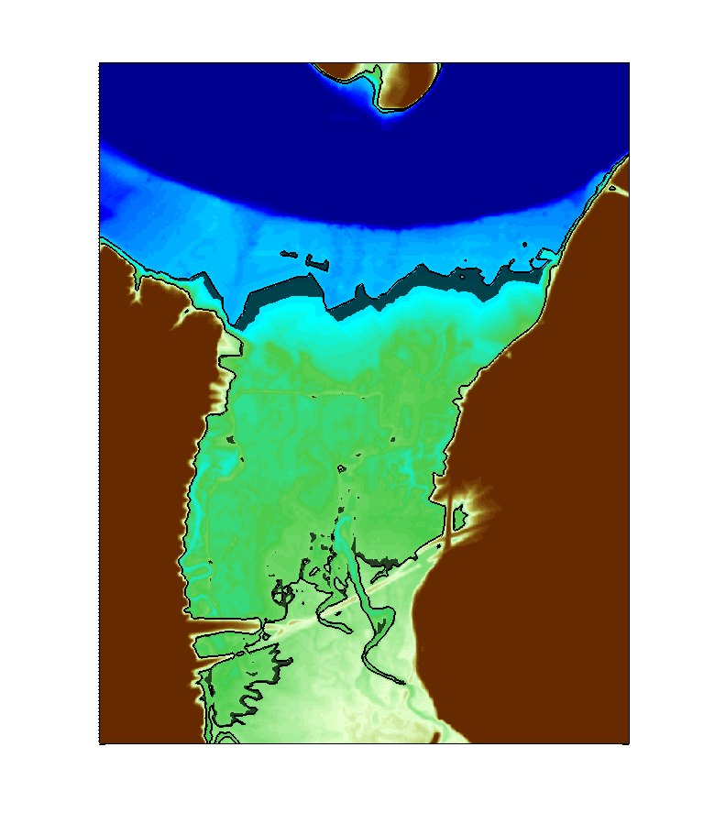
Impact of Tidal Range Reduction on Intertidal Zone
Suppose the mandate was to limit reduction in intertidal area to less than 10% reduction.
➔ Corresponds to 14% reduction in tidal range.
74% of maximum, or 735MW
14%

Slide 7
Environmental Limits on Extractable Tidal Energy
Physical vs. Practical Resource Limit
  Scaling relationships between energy extraction and various tidal parameters are needed in order to bound practically extractable resource size:
  Tidal range, tidal currents, tidally generated turbulence etc....
Numerical simulation can give us means of establishing these relationships for each tidal area
  Numerical hydrodynamic models of coastal and estuarine waters are implemented and run routinely.
  What are their capabilities and limitations for this kind of use?

Slide 8
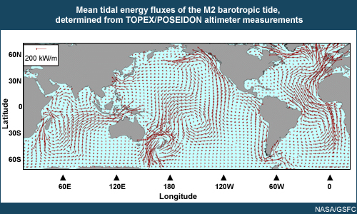
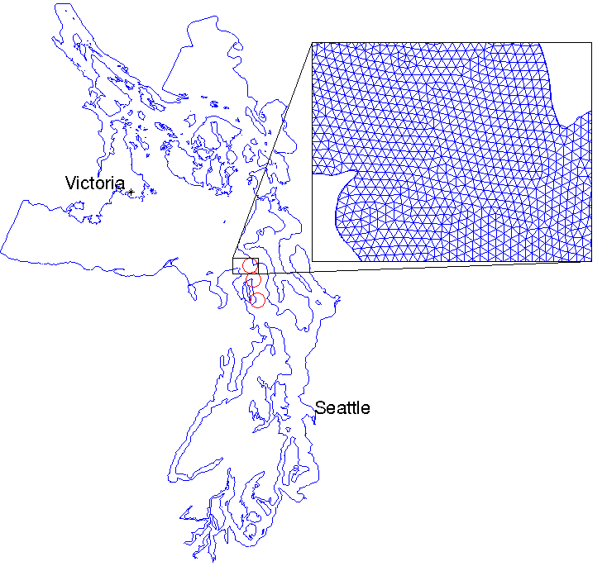
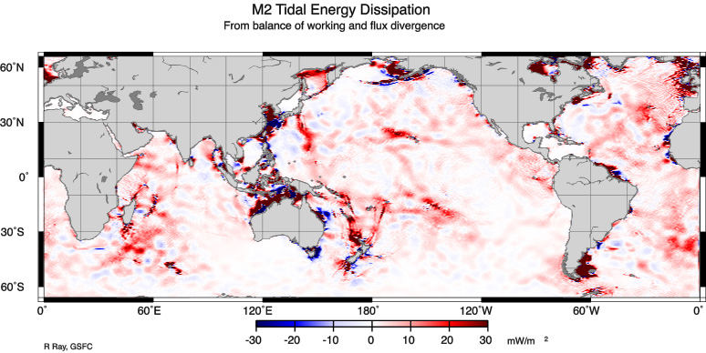
Energetics of Tides: Global vs. Regional
Tidal energy is globally harvested from gravity of sun and moon, and transported by wave process:
Regional hydrodynamic models receive tides from boundary conditions, and are often heavily “tuned” to reproduce tides as observed.
Kawase and Thyng, 2010
What are uncertainties associated with use in tidal energy applications?
R. Ray, GSFC

Slide 9
Munk and Wunsch (1998) Global Ocean Energy Schematic

Slide 10
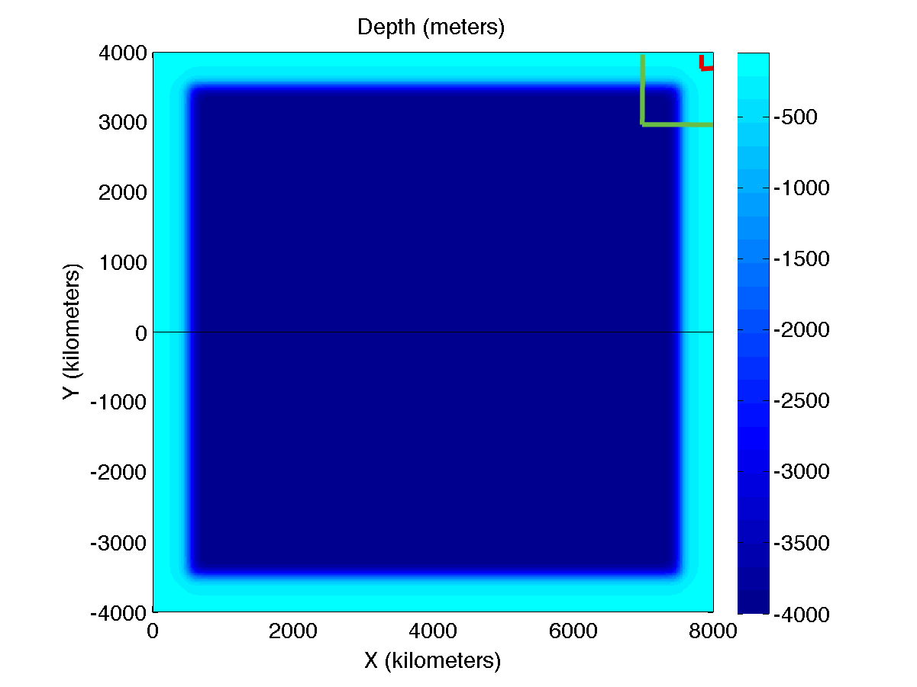
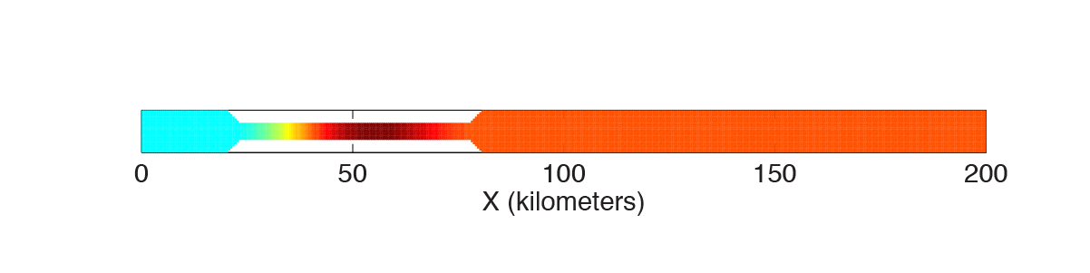
An idealized numerical model of an ocean-estuary tidal system
Goal: To understand consequences of regional representation on tidal dynamics
Ocean with 4000m-deep basin and 200m-deep, 500km-wide continental shelf
Tide is forced astronomically (lunar tide, 20° declination)
200km-long, 10km-wide silled “fjord” is appended at the northeastern corner.
  Tidal energy is extracted over the sill (locally enhanced quadratic drag).
The model also serves boundary conditions to three subdomain models:
  Regional model
  Coastal model
  Fjord-only model

Slide 11
Experimental Concept
Full Domain Model
Subdomain Models
Boundary condition
Energy Extraction Experiments
Energy Extraction Experiments
Intercomparison

Slide 12
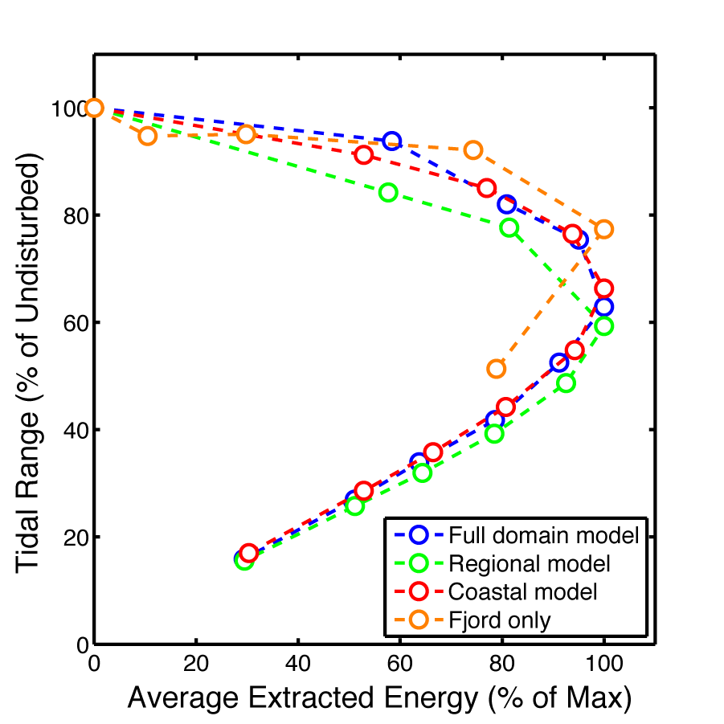
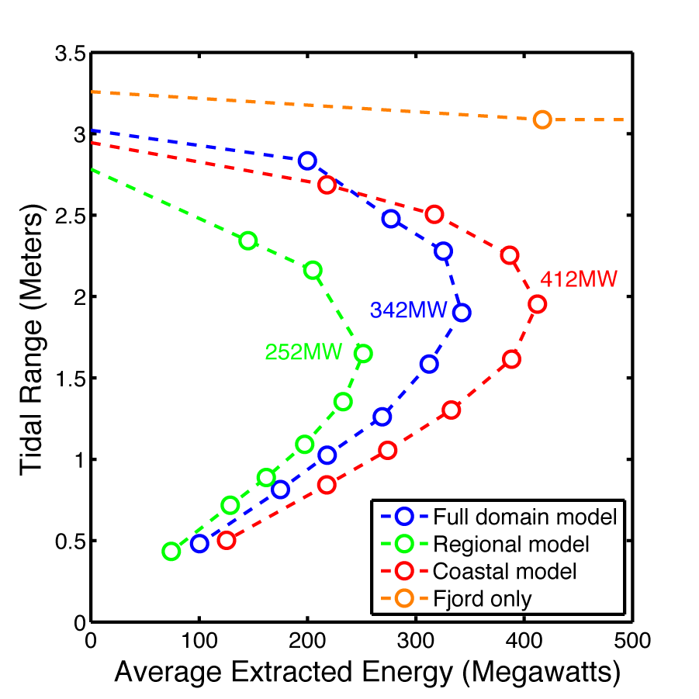
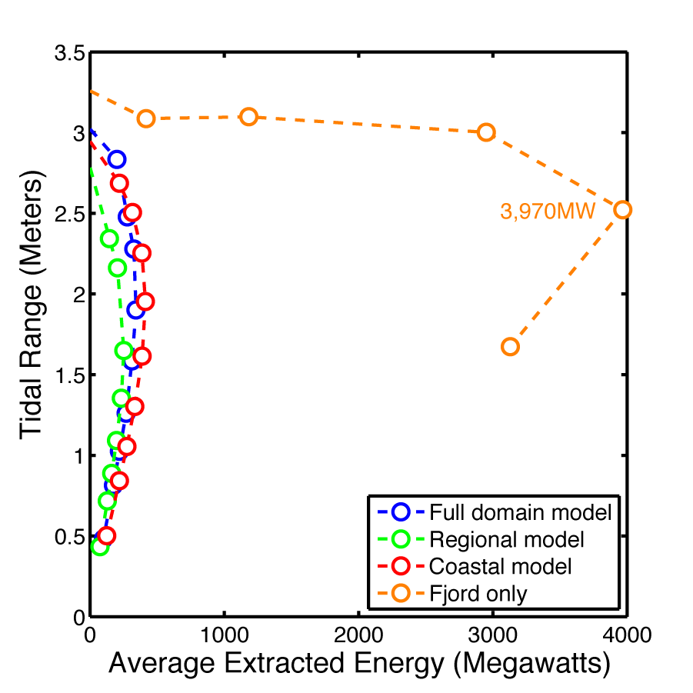
Energy Extraction and Tidal Range: Global and Subdomain Models
14% Range reduction ➔
  246MW (73%) Full domain model
  129MW (50%) Regional model
  298MW (72%) Coastal model

Slide 13
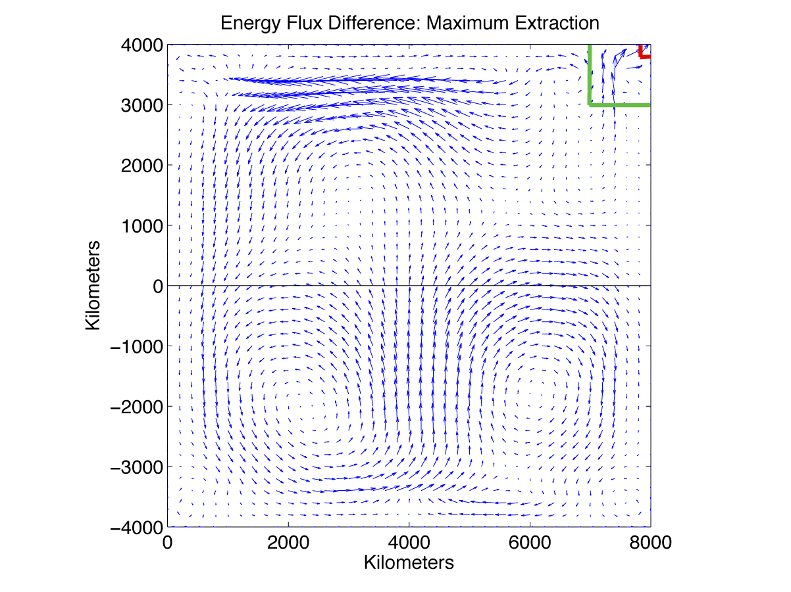
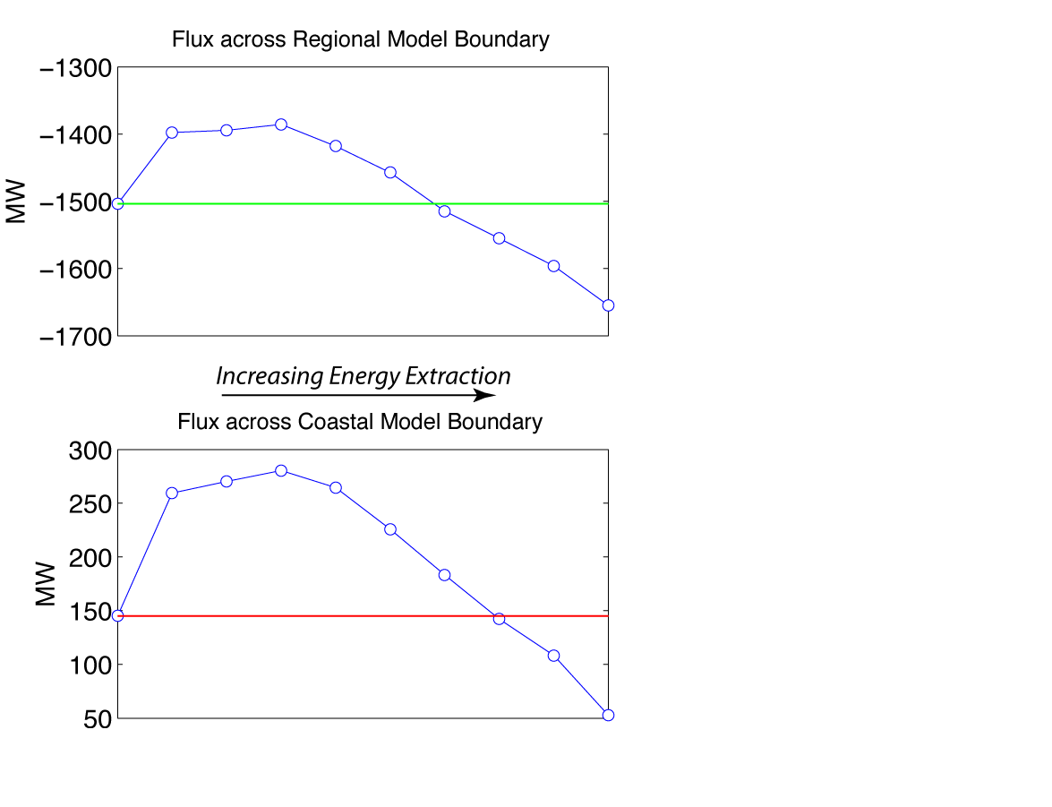
Effect of Localized Energy Extraction on Global Energy Flux
Extracting energy in the fjord has minuscule, but global, effect on the tidal energy flux. (Mathematically, the governing equation is elliptic)
Extraction changes energy flux across subdomain model boundaries in the full domain model;
Fixed (Dirichlet) boundary conition does not allow this in subdomain models.

Slide 14
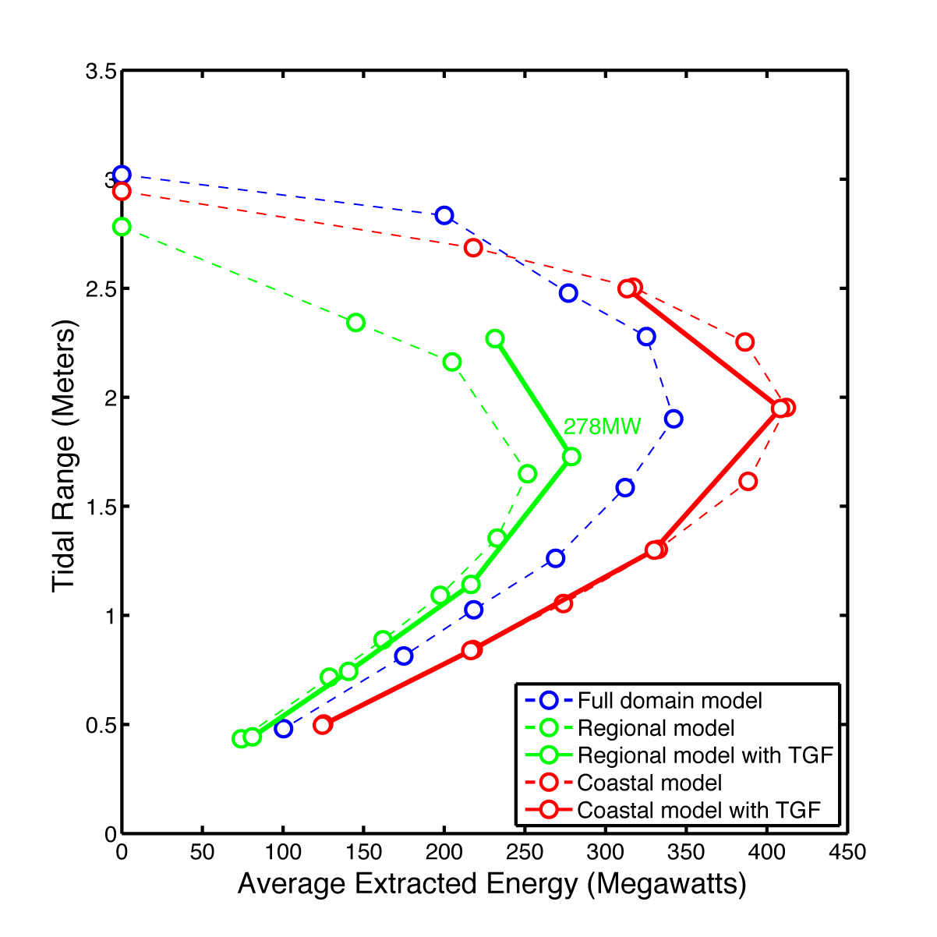
Effect of Local Tide-generating Force
Regional hydrodynamic models of tides do not routinely include local tide-generating force (TGF).
Doing so in our Regional model modestly improves energy extraction results.
Doing so in the Coastal model makes very small difference.

Slide 15
Summary of Work So Far:
Compared with a global tidal model, regional models of tidal energy extraction give a similar scaling relationship between energy extraction and tidal range reduction.
The quantitative maximum extraction limit is sensitive to the regional model configuration.
A regional model of a tidal embayment should include at least the continental shelf region adjacent to the bay.
A regional model should ideally include local tide generating force in addition to the tidal boundary condition.

Slide 16
Future Work
Normal vs. tidally resonant embayments (Bay of Fundy, etc.)
Alternative boundary conditions for subdomain models (Chapman-Flather)
  To be completed by / reported at AGU Fall 2012 Meeting MRE session
Estimate of the ocean impedance using the global model (Garrett and Greenberg, 1977)

Slide 17
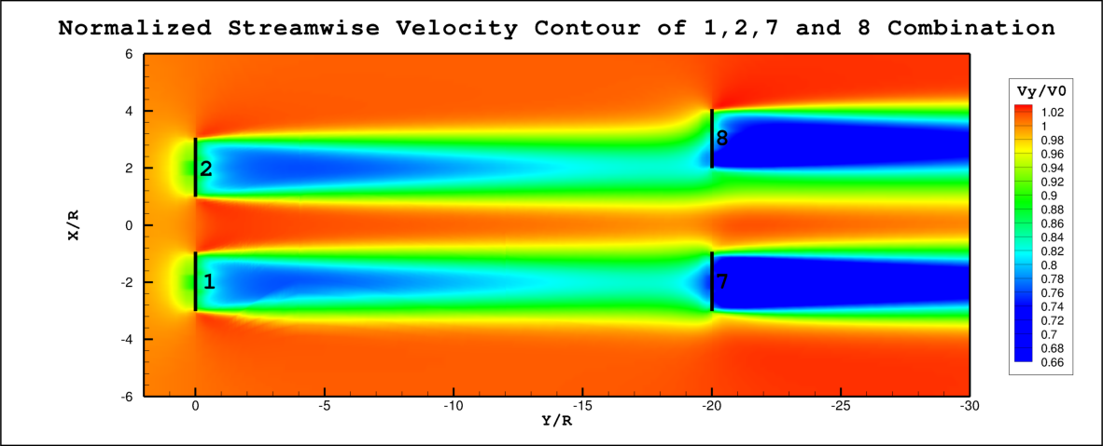
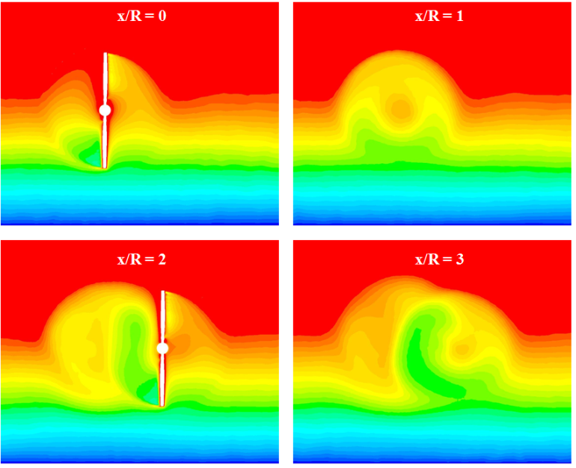
Optimal Spacing of Turbines
Alberto Aliseda and Teymour Javaherchi
Wake Evolution
Simulation output: velocity contours along an array
Cross-sectional Variation

Slide 18
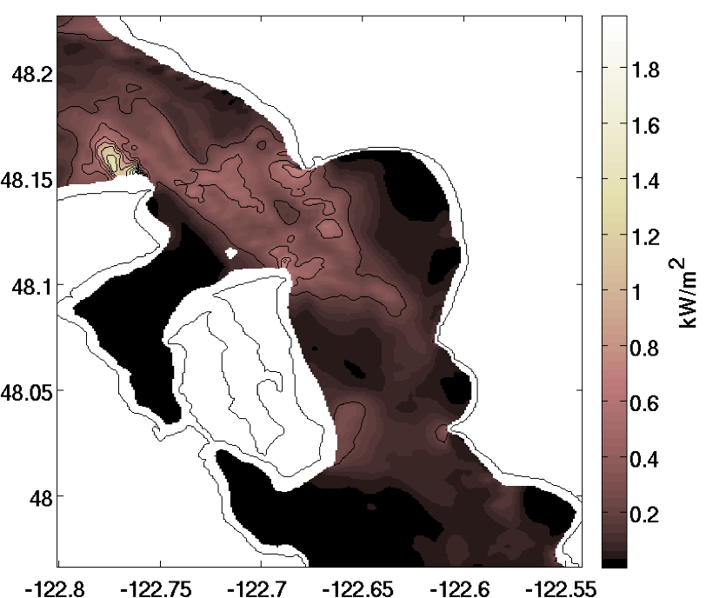
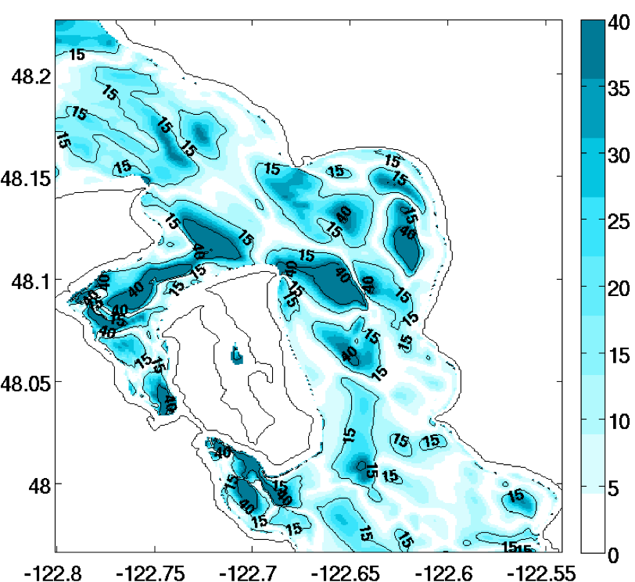
Regional Siting Models
Kristen Thyng and James Riley
The mean kinetic power density at 10 m hub height highlights areas with large resource potential.
The bidirectionality of the flow in degrees shows where the flow is best suited for fixed axis turbines (light) compared to OK for yaw turbines (darker)

Slide 19
Estuarine Circulation Modeling
Mitsuhiro Kawase and Kristina Huynh
Idealized, high-resolution model of an estuary-fjord-ocean system is used to study effect of turbine array placement over the fjord sill
Turbine array enhances turbulent mixing over the sill, leading to local enhancement of exchange circulation
Average Condition without Turbines
Changes due to Turbines

