Slide 1


Tidal Energy Extraction in an Idealized Ocean-Fjord Tidal Model with Astronomical Forcing
Mitsuhiro Kawase and Marisa Gedney
Northwest National Marine Renewable Energy Center /
School of Oceanography
University of Washington
Seattle WA 98195 United States
EWTEC 2013, Aalborg, Denmark, September 2012

Slide 2
Acknowledgment
Funding for this project was provided by
  U.S. Department of Energy Award Number DE-FG36-08GO18179
  Sandia National Laboratory

Slide 3
Contents
Introduction / Motivation
Model: Set-up, output and diagnosis
Energetics of tidal energy extraction
Subdomain model experiments
Summary / Take-home points

Slide 4
Tide is a Source of Energy for Oceanic and Coastal Processes:
Munk and Wunsch (1998) Global Ocean Energy Schematic
Divert to Tidal Energy Generation

Slide 5
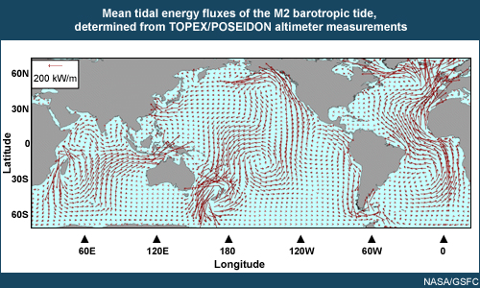
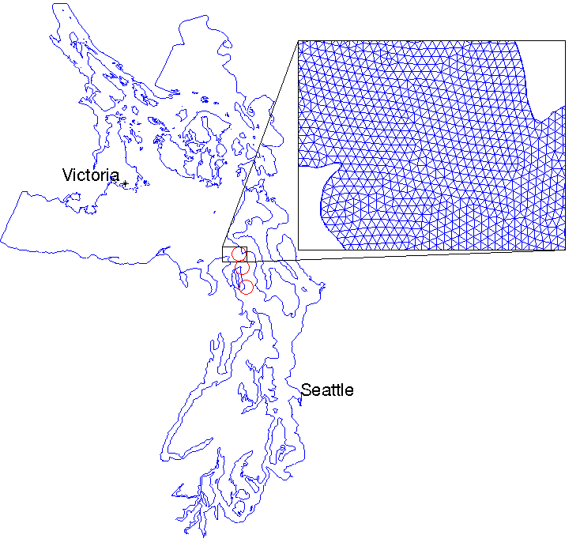
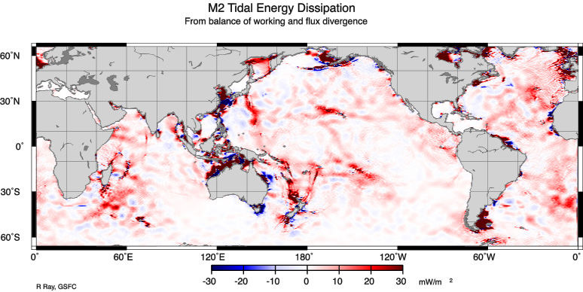
Tidal energy is globally harvested from gravity of sun and moon and transported by wave process:
Regional hydrodynamic models receive tides from boundary conditions, and are often heavily “tuned” to reproduce tides as observed.
Kawase and Thyng, 2010
R. Ray, GSFC

Slide 6
Questions Addressed by This Study
How does tidal energy extraction look like in the context of regional / global tidal energetics? What useful things might we learn from such a perspective?
What are significant limitations (if any) of studying tidal energy extraction with a regional model? What are the uncertainties in energy extraction estimates made using regional models?

Slide 7
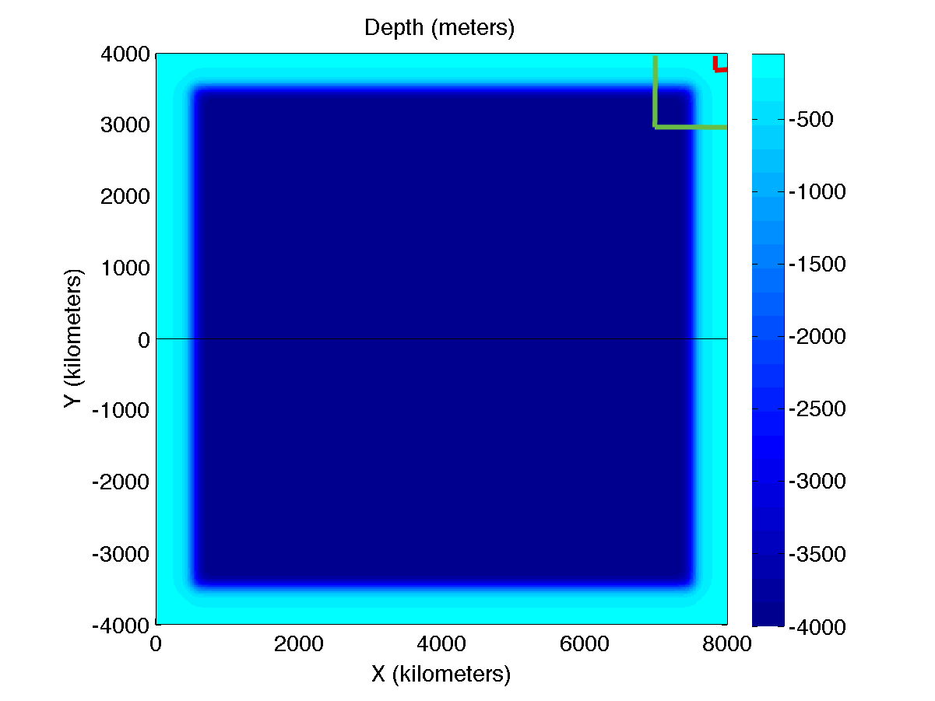
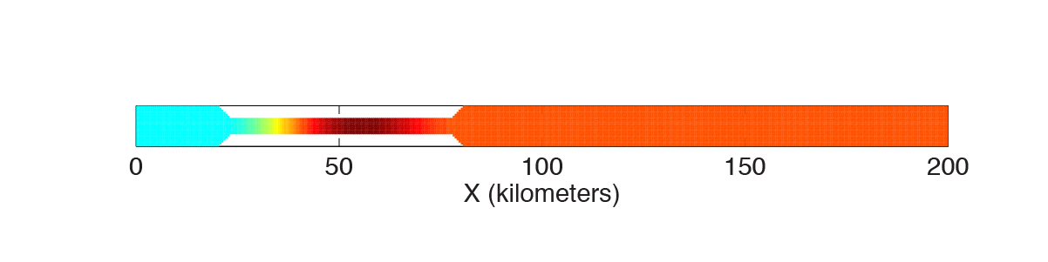
Approach: Construct an idealized numerical model of an ocean-estuary tidal system
Ocean with 4000m-deep basin and 200m-deep, 500km-wide continental shelf
Tide is forced astronomically by tide-generating force (TGF, lunar tide, 20° declination)
10km-wide silled “fjord” is appended at the northeastern corner.
  Normal case (200km long)
  Resonant case (400km long)
  Tidal energy is extracted over the sill (locally enhanced quadratic drag).
The model serves boundary conditions to subdomain models:
  Regional model
  Coastal model

Slide 8
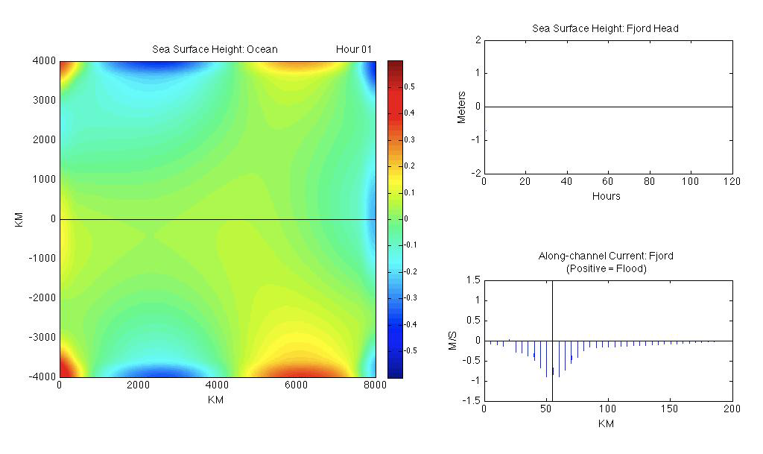
Model Tidal Response: Non-resonant Fjord

Slide 9
Energy Balance Equation
For any model subdomain,
Influx at the Boundary
Natural Dissipation
Energy Extraction
Gain from TGF
C_{N} = 0.003 C_{E} = Varied

Slide 10
Energy Balance Equation
For equilibrium, average over tidal period,
Influx at the Boundary
Natural Dissipation
Energy Extraction
Gain from TGF

Slide 11
Energy Extraction and Tidal Range Change
Energy Extraction
Tidal Range
MW
meters
Extraction Coeff. C_{E}
Extraction Coeff. C_{E}

Slide 12
Energy Extraction vs. Tidal Range
Tidal Range (meters)
Energy Extraction (MW)

Slide 13
Energetics of the Fjord: Non-resonant Case
Energy Flux
Change in Ocean Energy Flux
274MW
MW
163MW
Natural Dissipation
W/m²

Slide 14
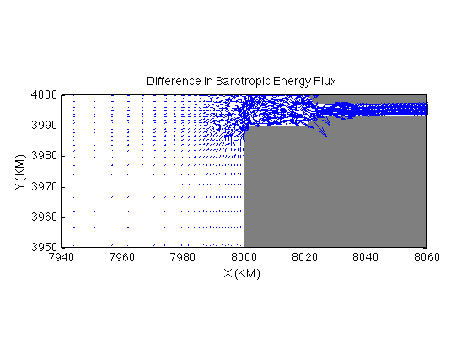
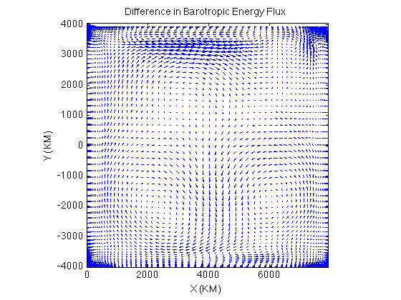
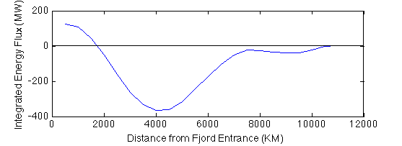
Mechanical Energy Flux Feeding Energy Extraction
r
There is no clearly defined outer boundary to the region from which the extracted energy is drawn – response to energy extraction is global.

Slide 15
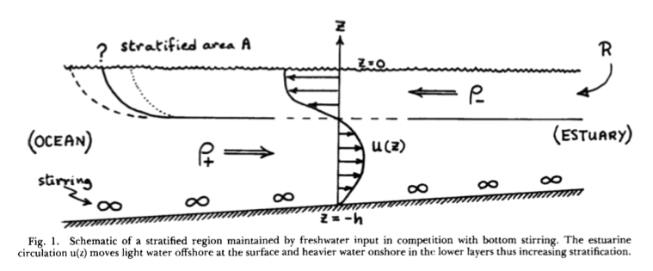
Why should we care about reduction in natural dissipation due to tidal energy development?
Simpson, et al. (1990)
Entrainment of dense water by tidal stirring
(Potential energy creation)
(Simpson and Bowers 1981)
Partially / Fully Mixed Estuaries
Always sufficient estuary length / kinetic energy available → exchange insensitive to reduction in u_{T}? (Stommel and Farmer 1953; MacCready and Geyer 2010)
However, other estuarine characteristics (e.g. salt intrusion length) might be strongly affected.
Fjords
Exchange always limited by the amount of entrainment that can occur within a basin of fixed size (Knudsen 1900; Proudman 1953) → exchange highly sensitive?

Slide 16
Energetics of the Fjord: Resonant Case
Energy Flux
Change in Ocean Energy Flux
1.57GW
MW
958MW
Natural Dissipation
W/m²

Slide 17
Subdomain Model Experiments

Slide 18
Subdomain Model Experiments
Full Domain Model
Subdomain Models
Boundary condition
Energy Extraction Experiments
Energy Extraction Experiments
Intercomparison

Slide 19
Energy Extraction vs. Tidal Range: Normalized

Slide 20
Energy Extraction vs. Tidal Range: Unscaled
298MW
657MW
182MW
247MW
562MW
679MW

Slide 21
Effect of Tide-Generating Force and Boundary Conditions on Maximum Extractable Energy
 | Full Domain (MW) | Regional Model (MW) |  |  |  | Coastal Model (MW)
 |  | Dirichlet | Dirichlet, TGF | CF | CF, TGF | Dirichlet | Dirichlet, TGF | CF | CF, TGF
Non-resonant | 247 | 182 (-26%) | 201 (-17%) | 145 (-43%) | 235 (-5%) | 298 (+21%) | 296 (+20%) | 246 (<+1%) | 244 (+1%)
Resonant | 657 | 562 (-14%) | 589 (-10%) | 538 (-18%) | 754 (+15%) | 679 (+3%) | 657 (0%) | 698 (+6%) | 689 (+5%)
CF = Chapman – Flather boundary condition

Slide 22
Summary
Energy is extracted from a tidal estuary in part at the expense of natural energy flux into estuarine processes
  Regional hydrodynamic models used for tidal energy applications should have its natural energetics validated
Limited-domain representation does not fundamentally change the physics of the energy extraction processes
  Introduces uncertainty of up to ~25% in the carrying capacity of the estuary
  With judicious choice of domain and boundary conditions, this could possibly be reduced down to ~10% (further research needed)

