Slide 1
Development of an Adaptable Monitoring Package for Marine Renewable Energy
James Joslin, Edward Celkis, Chris Roper, Andrew Stewart, Brian Polagye
Northwest National Marine Renewable Energy Center
University of Washington
MTS/IEEE Oceans 2013 Practice
September 18, 2013
Notes:
Thank you for intro!
Giving this talk next week at Oceans
Collaborative project with SeaEye and SeaView

Slide 2
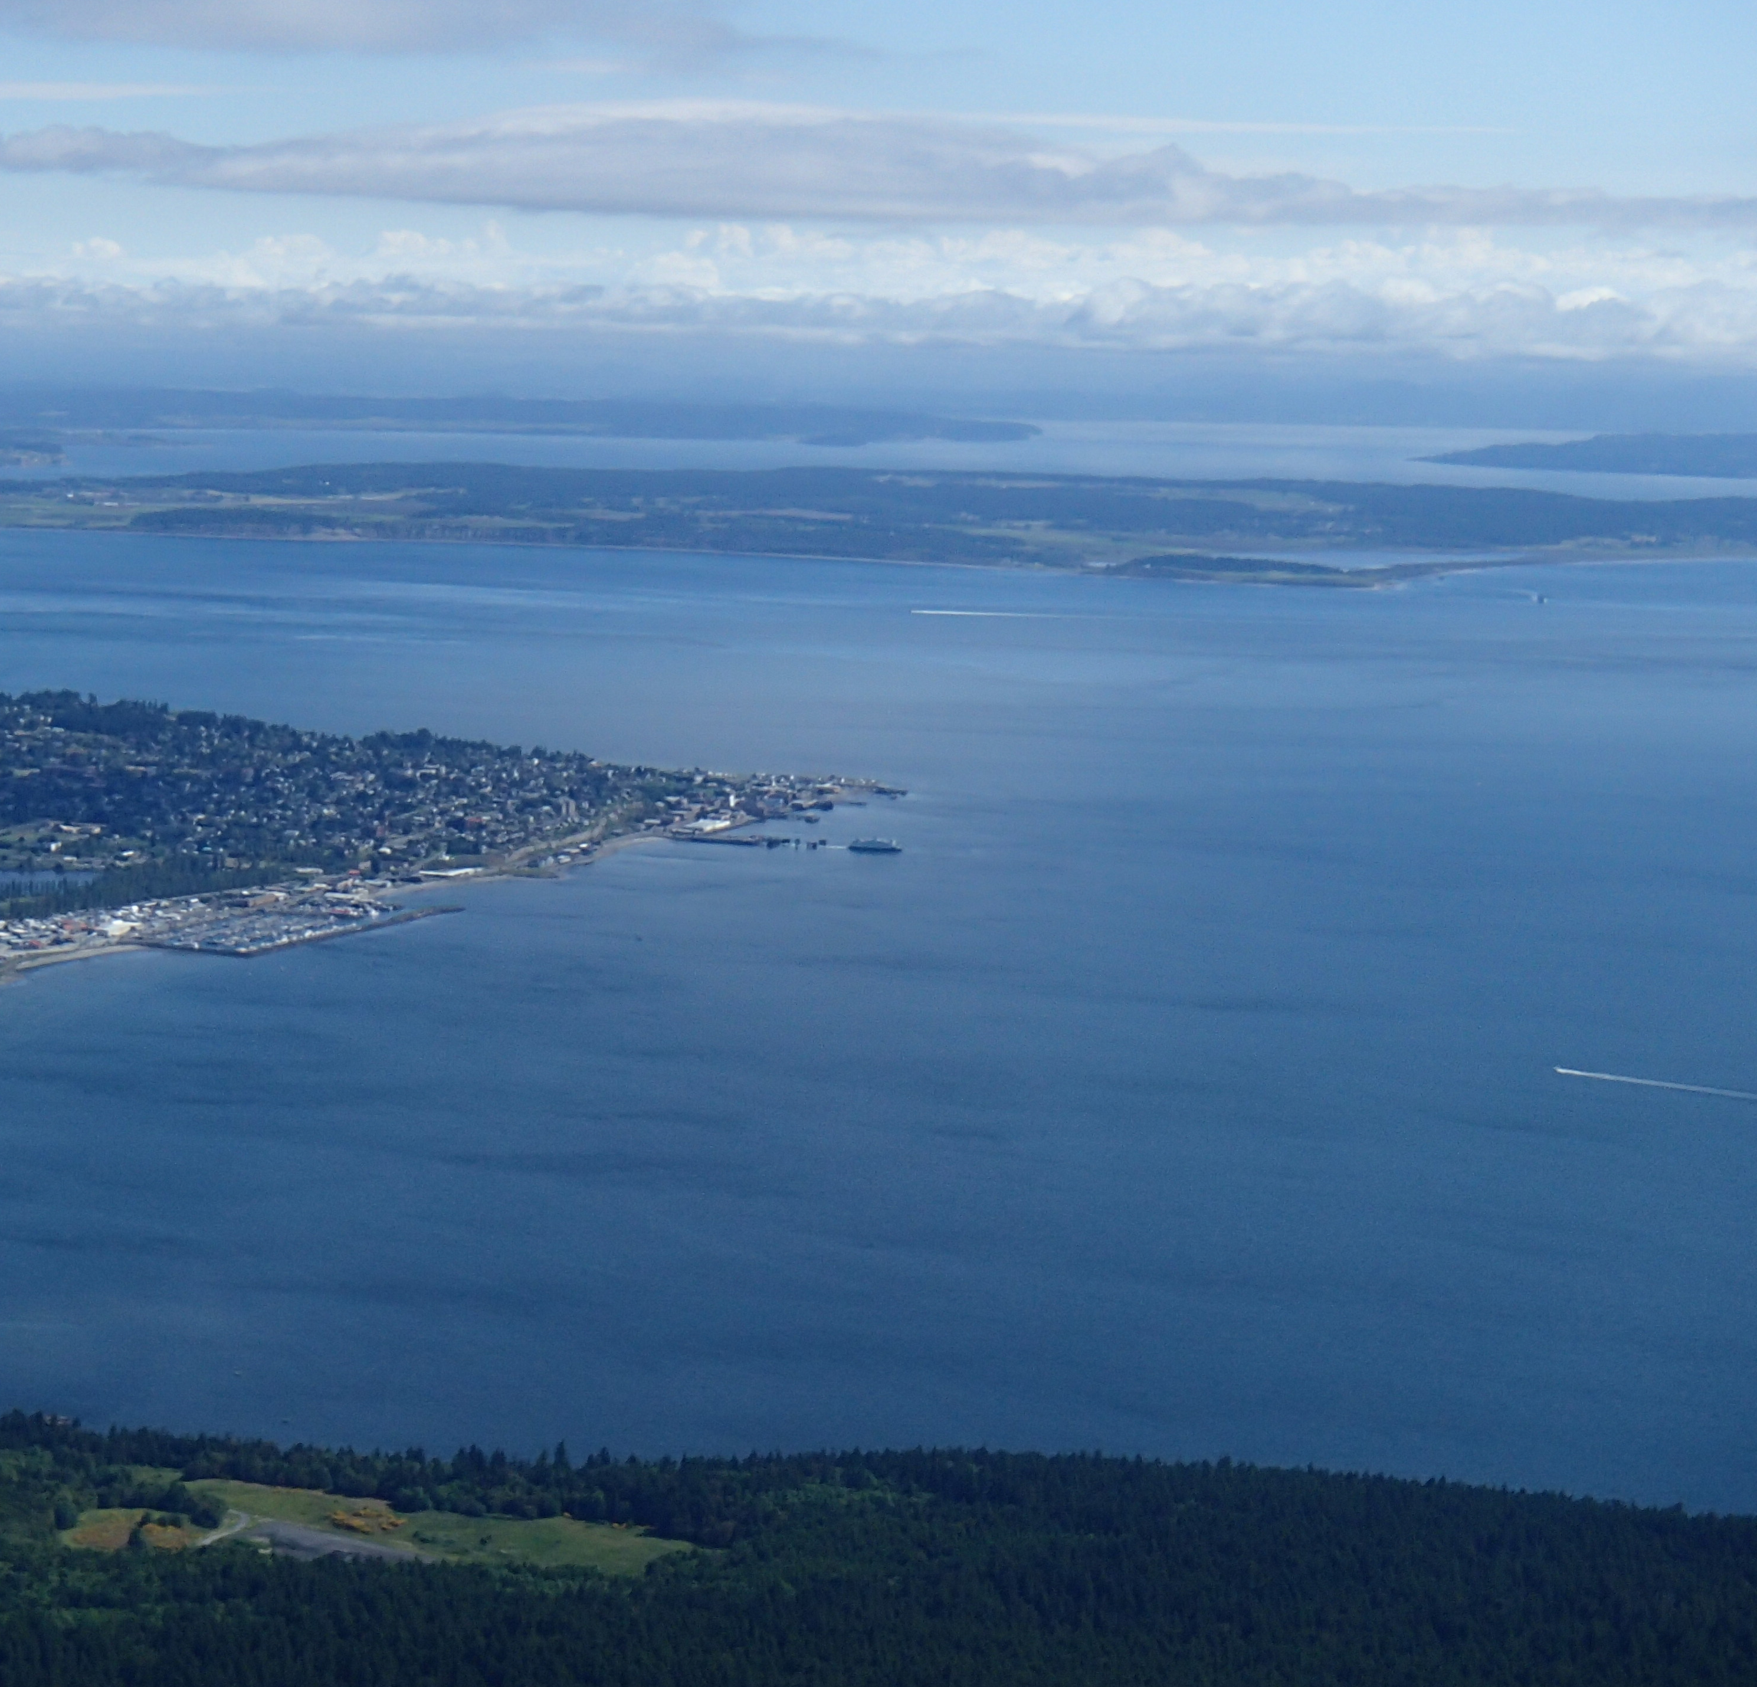
Presentation Overview
Project motivation and background
System description
Design analysis through CFD
Design optimizations
Next Steps and Summary
Admiralty Inlet, Puget Sound, WA

Slide 3
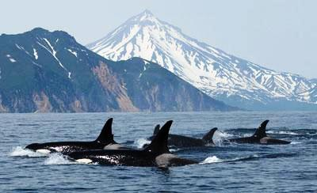
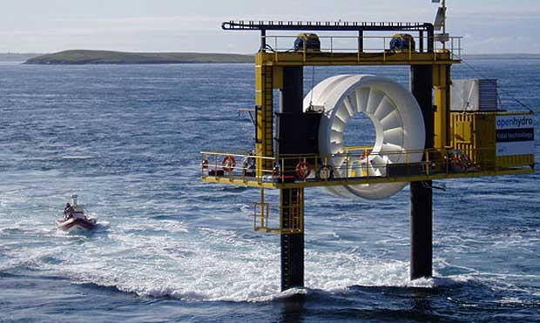
Project Motivation
Characterize the environment around marine energy converters through cabled monitoring
Monitor converter performance in real time
Notes:
First question people ask, sushi
Limited field studies, mostly laboratory, acoustic cameras

Slide 4
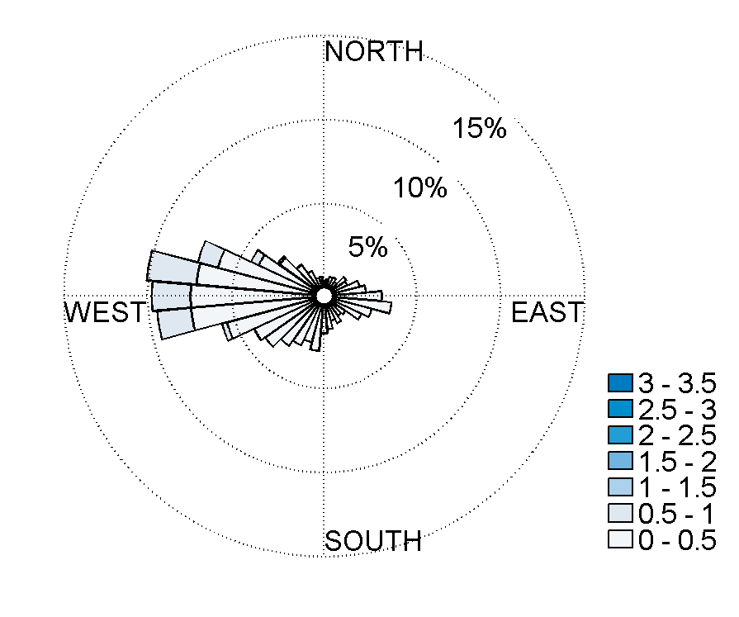
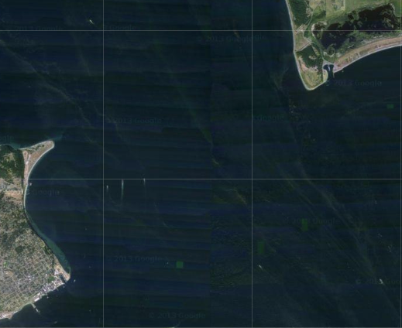
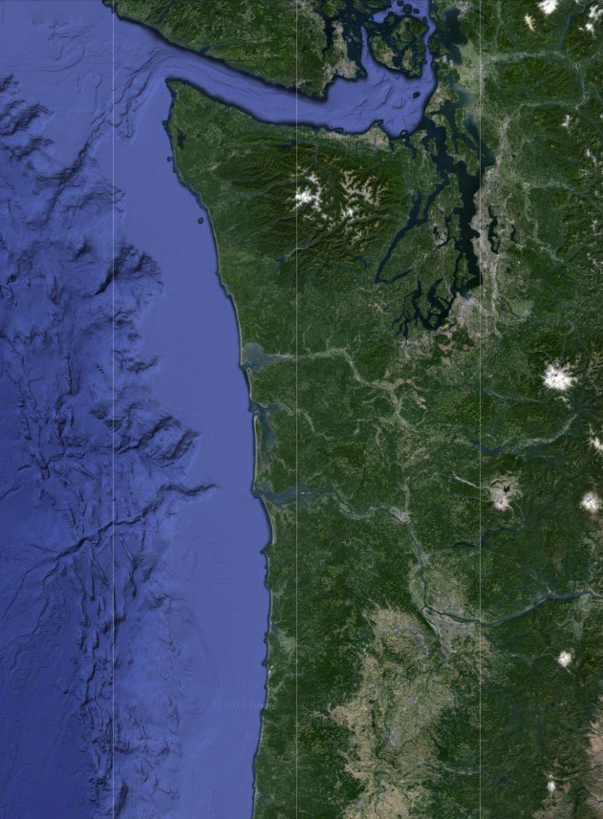
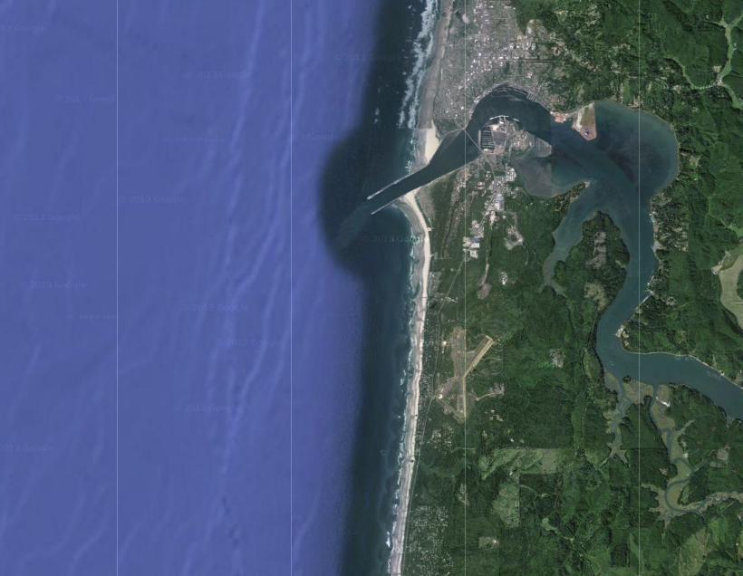
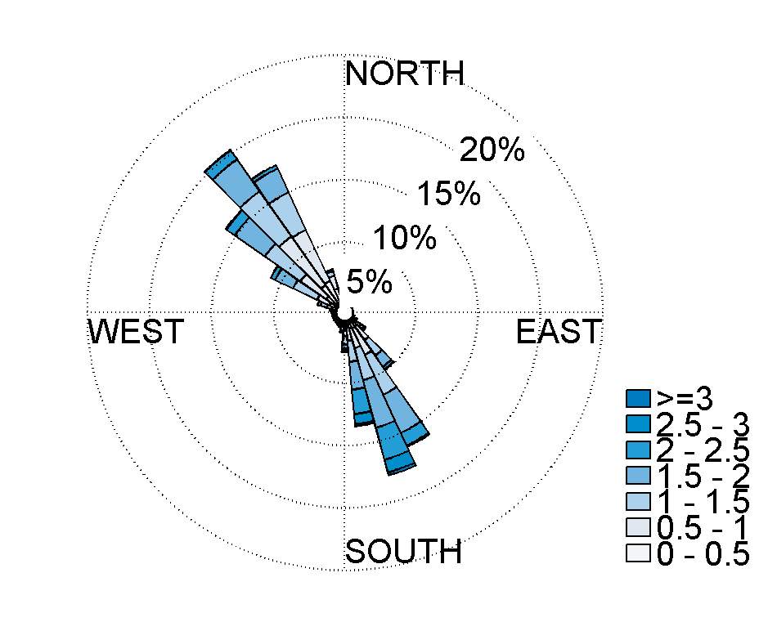
Marine Energy Sites
Ocean Currents
Admiralty Inlet,
Puget Sound, WA
Pacific Northwest
Newport, Oregon
North Energy Test Site
Tidal Currents
Notes:
-Inlet to Puget Sound
-Example of site conditions

Slide 5
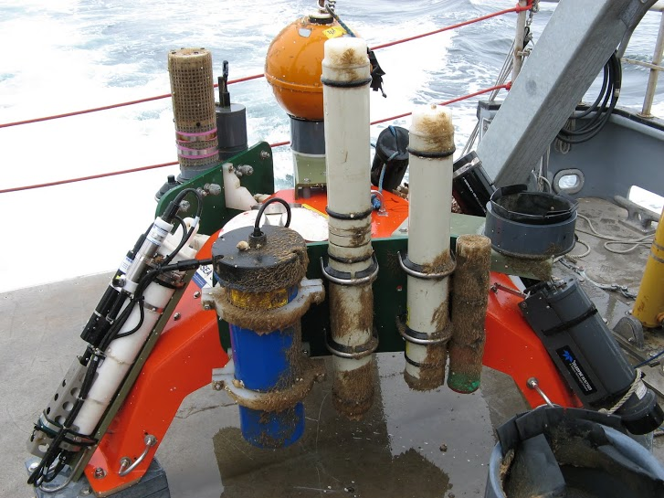
Sea Spider Instrumentation Package
Sea Spider after recovery in August 2011
Notes:
Cabled
Fixed instruments
No divers
Winching spool

Slide 6
Design Constraints
Constraint
Solution
Instrument Power and Bandwidth
Cabled
Sensor Maintenance and Adaptability
Recoverable
Low Cost
Independent of Turbine
Site Conditions
Shrouded for Low Drag and Maneuverability

Slide 7
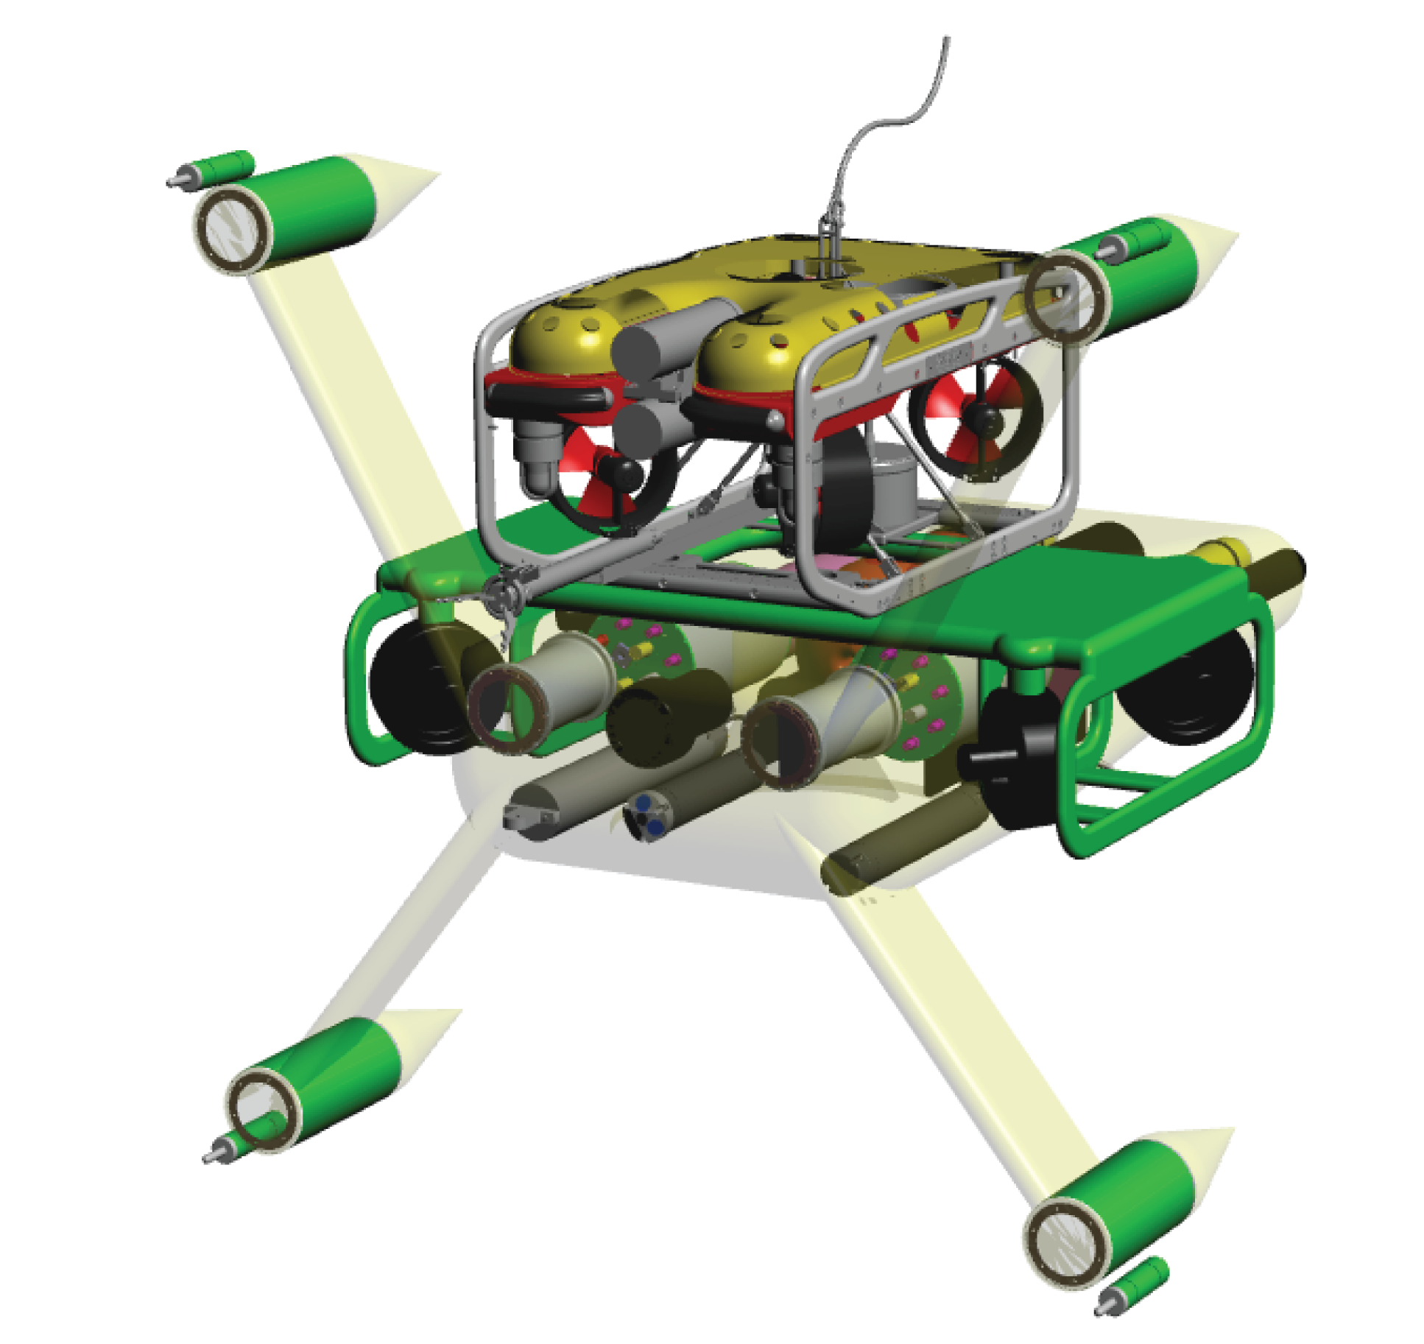
System Description
Saab SeaEye Falcon ROV
Lightweight inspection class ROV
Dimensions: 1.0 m x 0.5 m x 0.6 m
Weight: 60 kg in air
Thrust: 50 kgf forward and 13 kgf vertical
Current AMP and Millennium Falcon
Design Geometry
Notes:
Show geometry of the current AMP model and the two simplified geometries used.

Slide 8
System Description
Saab SeaEye Falcon ROV
“Millennium” Tool Skid
Augmented thrust capacity
Custom manipulators for deployment and docking operations
Current AMP and Millennium Falcon
Design Geometry
Notes:
Show geometry of the current AMP model and the two simplified geometries used.

Slide 9
System Description
Saab SeaEye Falcon ROV
“Millennium” Tool Skid
Adaptable Monitoring Package
Monitoring instrumentation
Wet-mate power and fiber connector
Body shroud for reduced drag
Current AMP and Millennium Falcon
Design Geometry
Notes:
Show geometry of the current AMP model and the two simplified geometries used.

Slide 10
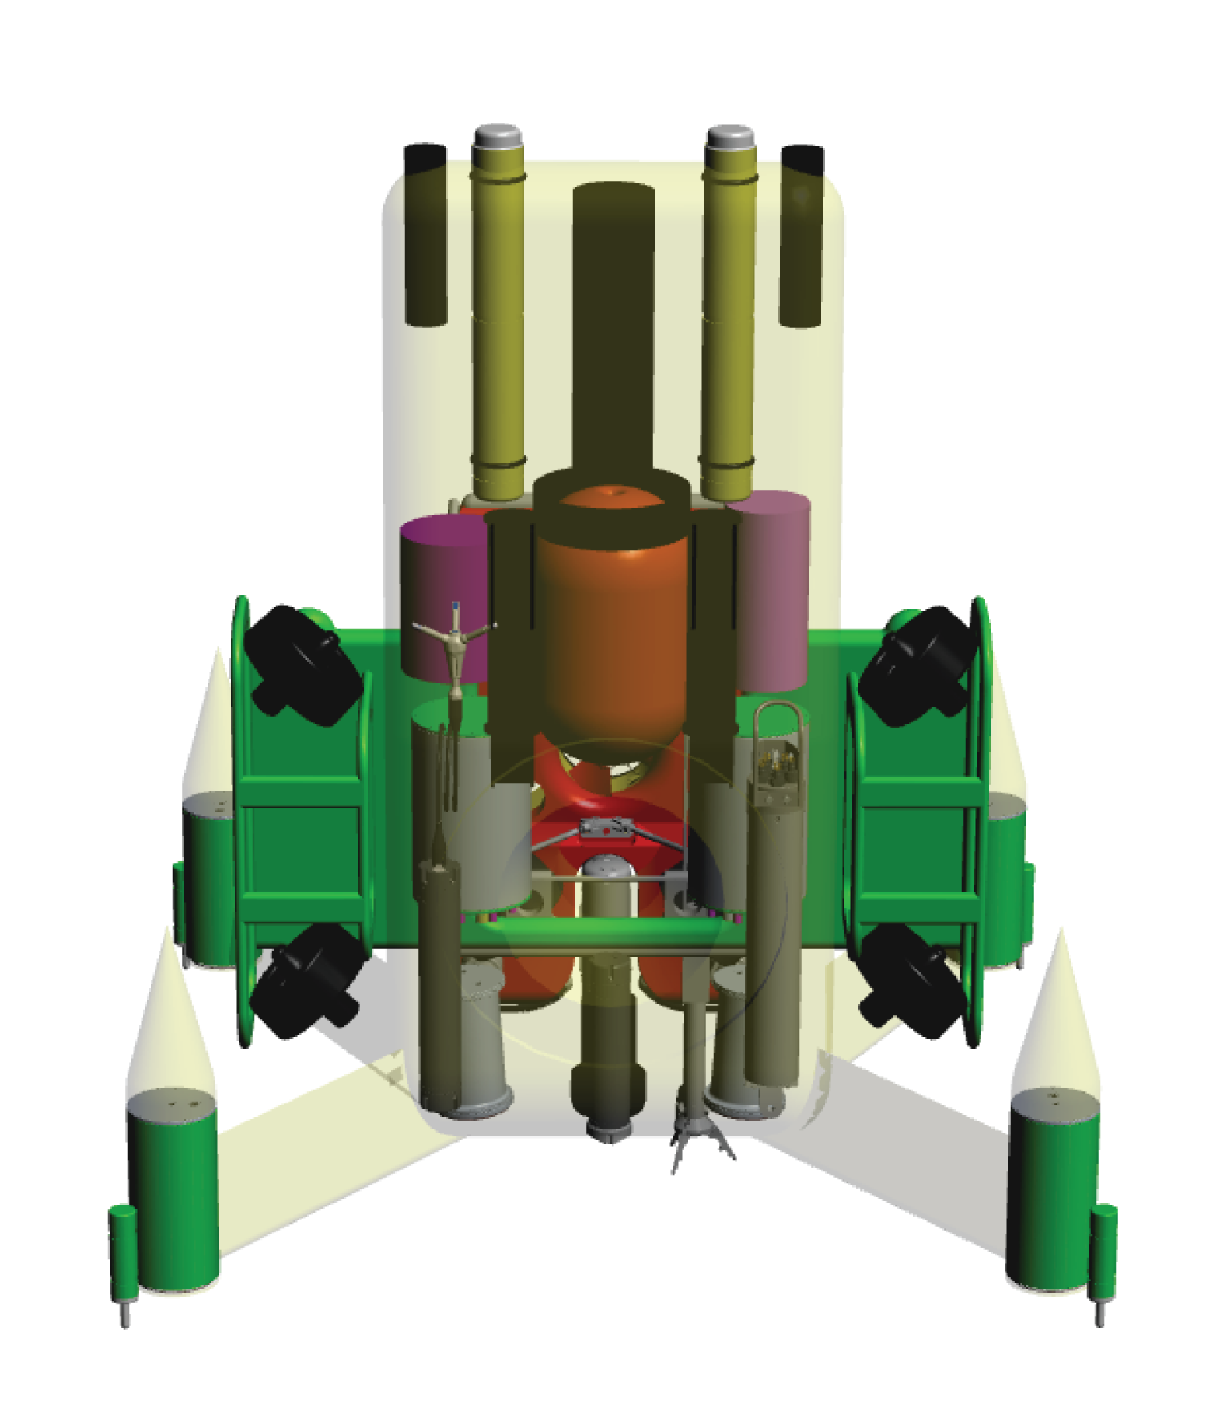
AMP Instrumentation
Cameras
Stereo-optical 2mpx cameras
BlueView P900/2500 acoustical camera
Current AMP Instrumentation Layout
Notes:
Constraints on packaging for each instrument
What each instrument is used to monitor

Slide 11
AMP Instrumentation
Cameras
Strobes
Current AMP Instrumentation Layout
Notes:
Show geometry of the current AMP model and the two simplified geometries used.

Slide 12
AMP Instrumentation
Cameras
Strobes
Hydrophones
Current AMP Instrumentation Layout
Notes:
Show geometry of the current AMP model and the two simplified geometries used.

Slide 13
AMP Instrumentation
Cameras
Strobes
Hydrophones
ADCP
Current AMP Instrumentation Layout
Notes:
Show geometry of the current AMP model and the two simplified geometries used.

Slide 14
AMP Instrumentation
Cameras
Strobes
Hydrophones
ADCP
ADV
Current AMP Instrumentation Layout
Notes:
Show geometry of the current AMP model and the two simplified geometries used.

Slide 15
AMP Instrumentation
Cameras
Strobes
Hydrophones
ADCP
ADV
CTDO
Current AMP Instrumentation Layout
Notes:
Show geometry of the current AMP model and the two simplified geometries used.

Slide 16
AMP Instrumentation
Cameras
Strobes
Hydrophones
ADCP
ADV
CTDO
Vemco Fish Tag Receivers
Current AMP Instrumentation Layout
Notes:
Show geometry of the current AMP model and the two simplified geometries used.

Slide 17
AMP Instrumentation
Cameras
Strobes
Hydrophones
ADCP
ADV
CTDO
Vemco Fish Tag Receivers
C-PODs
Current AMP Instrumentation Layout
Notes:
Show geometry of the current AMP model and the two simplified geometries used.

Slide 18
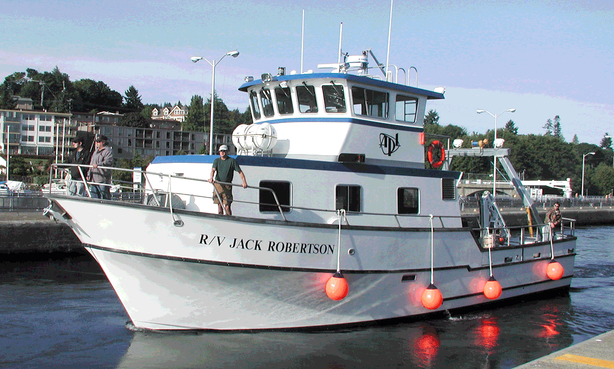
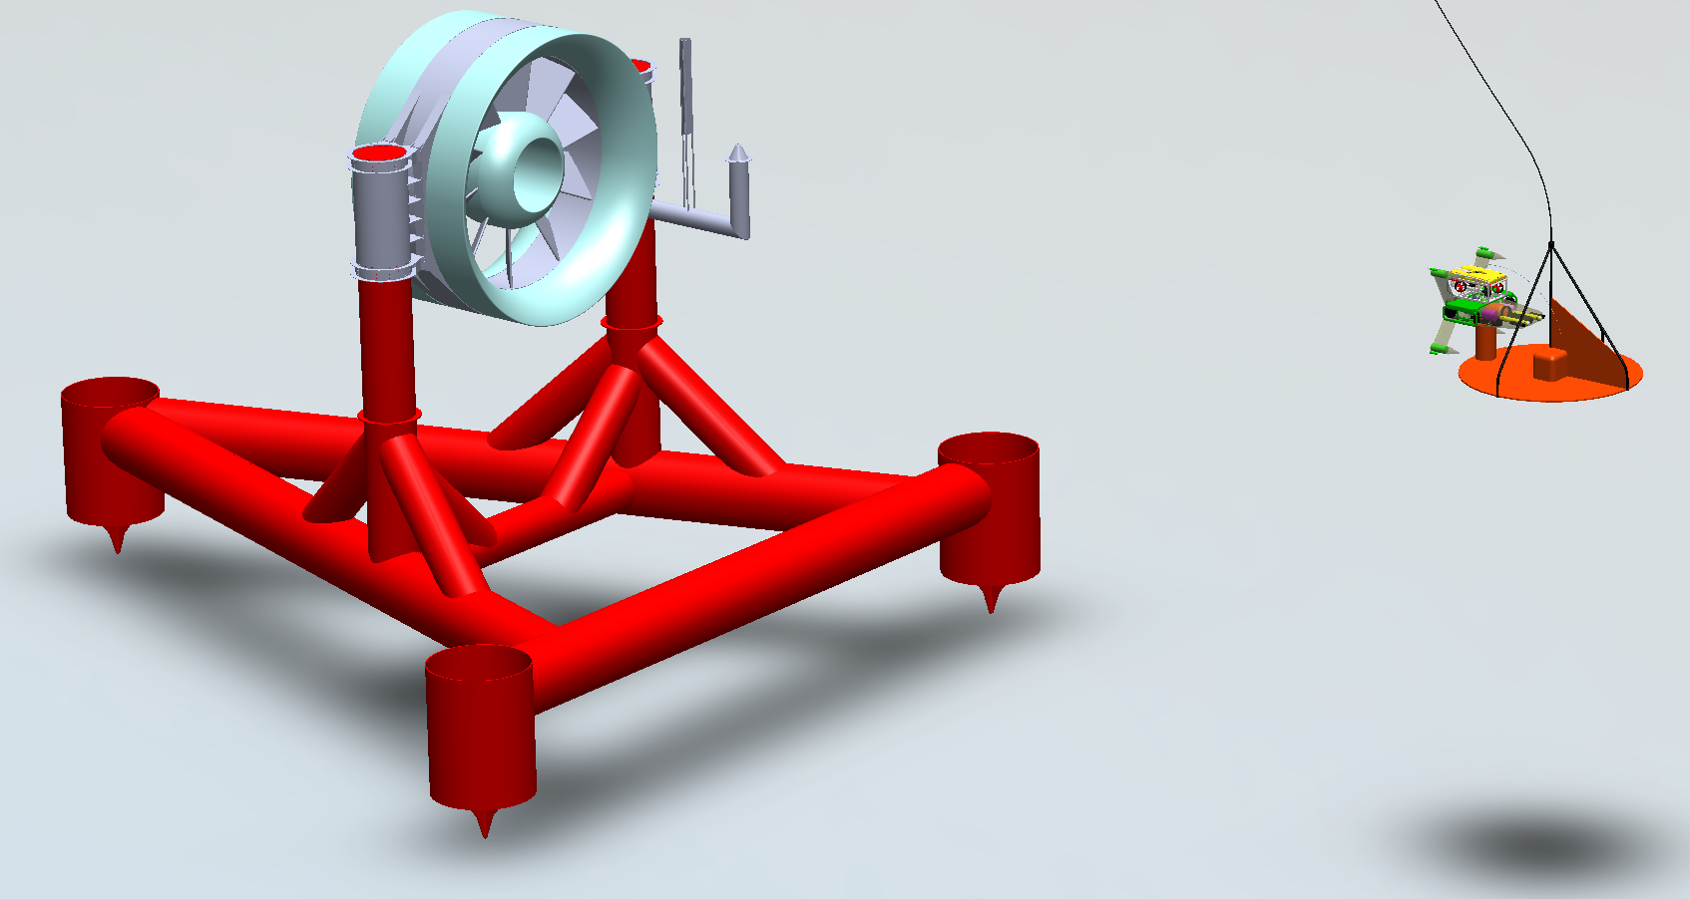
AMP Deployment Operations
RV Jack Robertson
Current
AMP with Millennium Falcon on “garage” style launch platform during deployment operations
Notes:
Show geometry of the current AMP model and the two simplified geometries used.

Slide 19
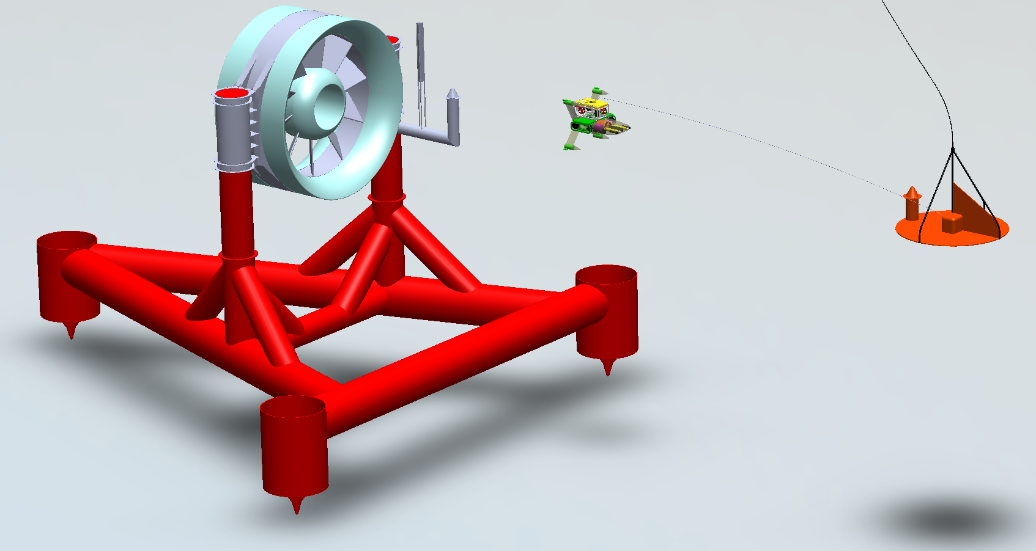
AMP Deployment Operations
RV Jack Robertson
Current
AMP with Millennium Falcon flying from launch platform to docking station
Notes:
Show geometry of the current AMP model and the two simplified geometries used.

Slide 20
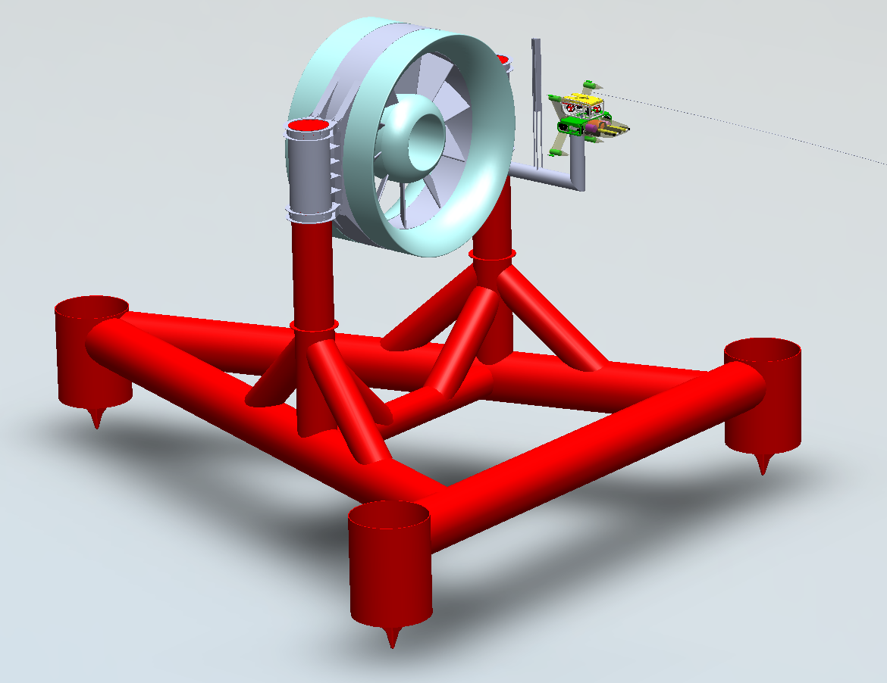
AMP Deployment Operations
Current
AMP with Millennium Falcon docking station mounted to a turbine
Notes:
Show geometry of the current AMP model and the two simplified geometries used.

Slide 21
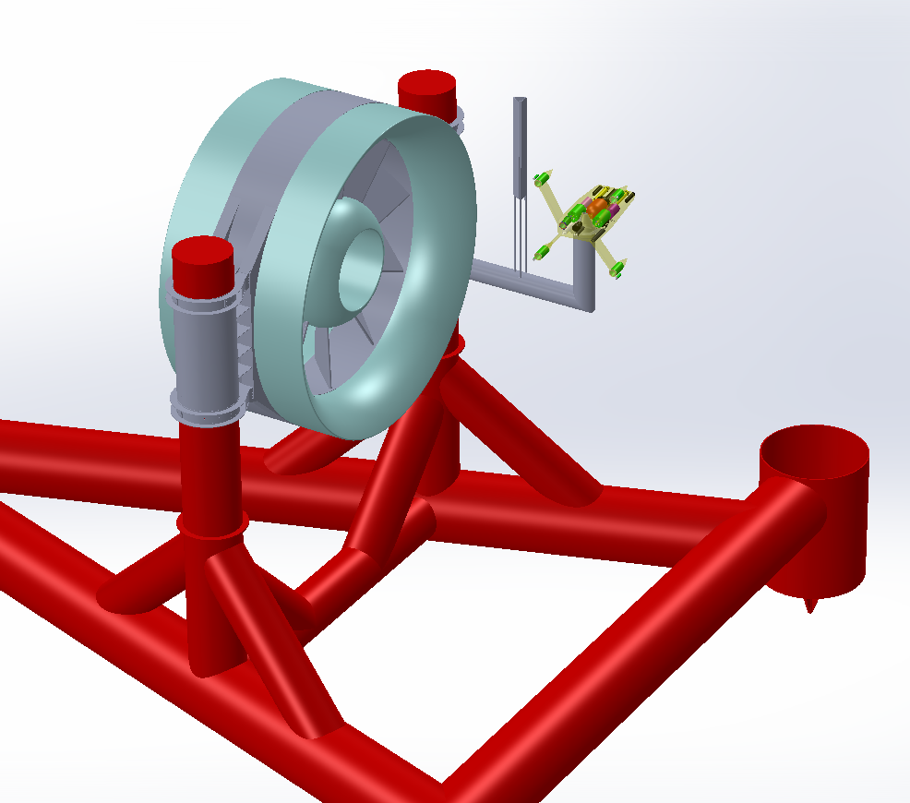
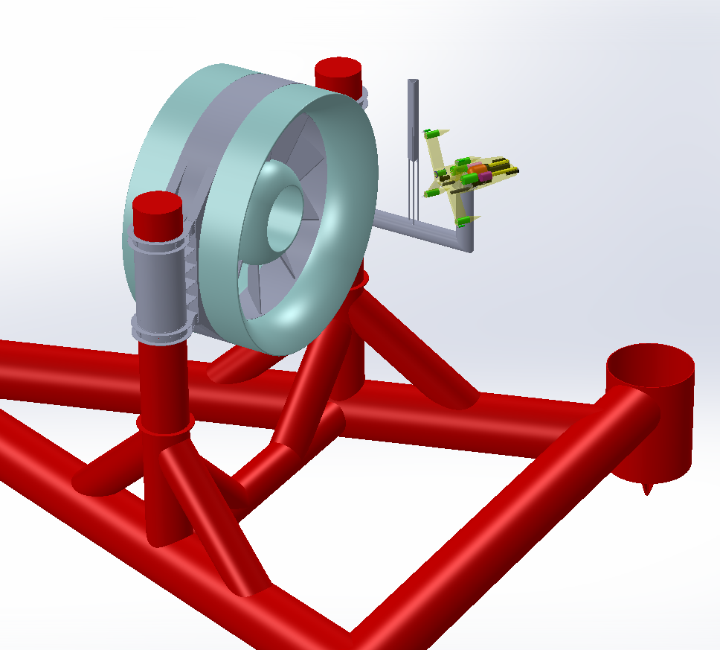
AMP Deployment Operations
AMP oriented for viewing turbine wake
AMP oriented for viewing support structure
AMP oriented for viewing turbine rotor
Notes:
Pause slide to transition from design description to optimization needs

Slide 22
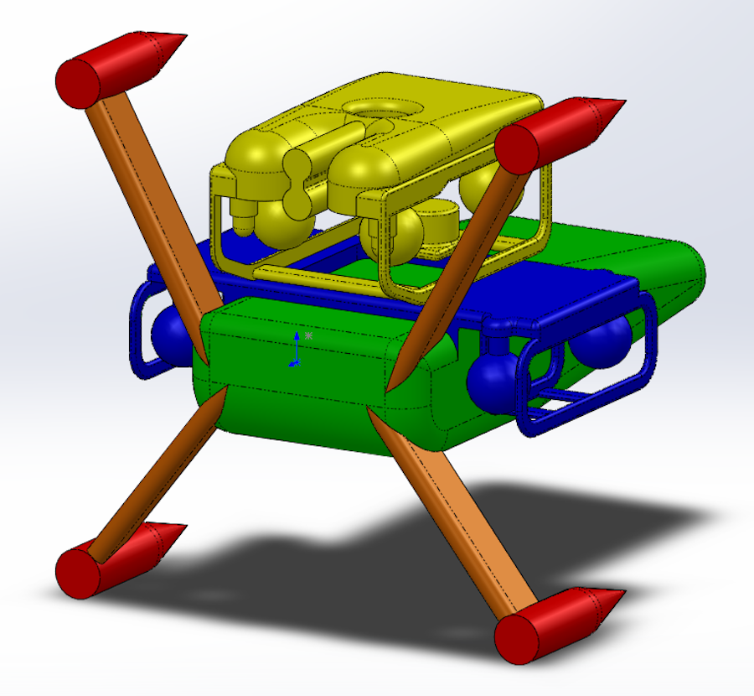
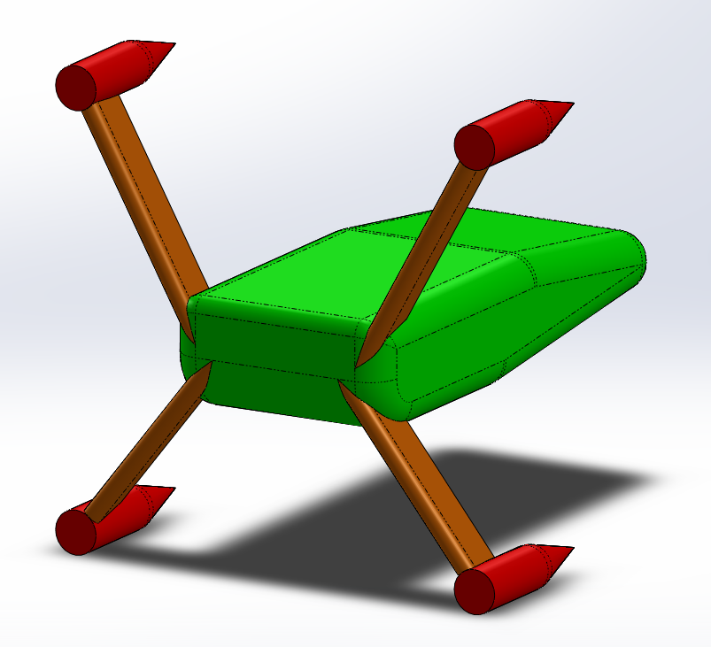
AMP Design Analysis
Two design cases considered:
During deployments with the “Millennium” Falcon: mean currents < 1 m/s from ahead
During long term docked operations: mean currents < 5 m/s from the side
Modeled in ANSYS Workbench and Fluent for 3D CFD simulations
CFD model for deployments
CFD model for docked operations
Notes:
Two design cases: Deployments and mounted operations

Slide 23
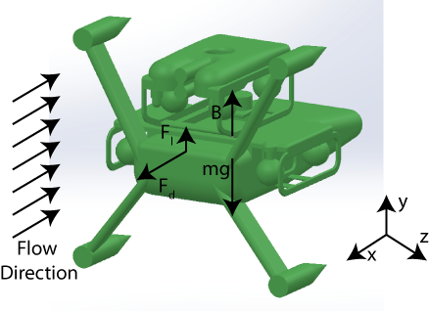
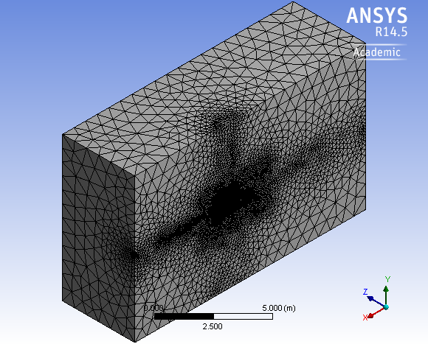
AMP Design Analysis
- Methods
CFD results analysis:
Cross-sectional area normal to flow, A [m^{2]}
Lift and drag coefficients of full system and subcomponents:
Center of pressure, (x, y, z) coordinates
CFD sensitivity studies:
Meshing refinements: Coarse, Medium, and Fine
Input velocity: 0.5 m/s, 1.0 m/s, and 1.5 m/s
Experimental and field validation
Model free body diagram
ANSYS fluid domain meshing
Notes:
Show the meshing

Slide 24
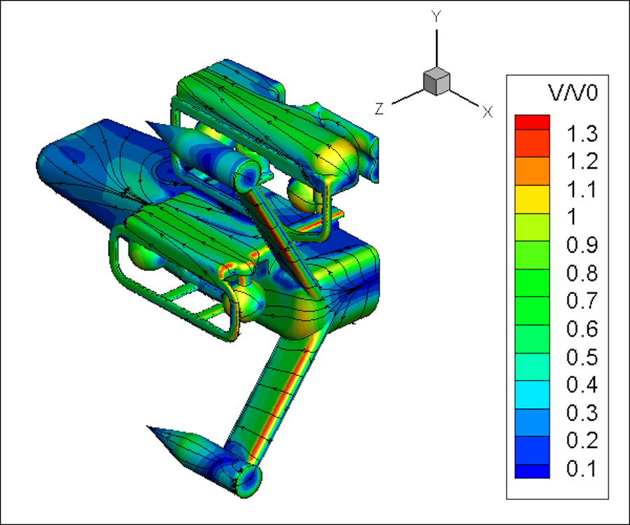
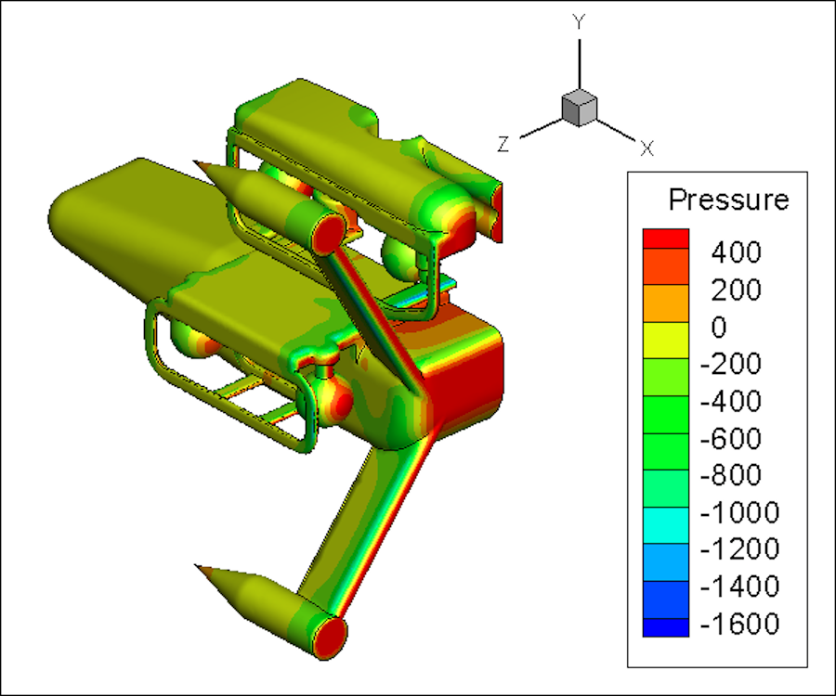
AMP Design Analysis
- CFD Results
Sensitivity study variability in drag force:
Grid dependence: < 3.50%
Velocity dependence: < 1.1%
Normalized velocity with streamlines over the body surfaces
Total pressure [Pa] on the body surfaces
Notes:
Show the meshing

Slide 25
AMP Design Optimizations
Drag forces on AMP and “Millennium” Falcon in a head-on current of 1 m/s.
C_{d} ≅ 0.67
AMP components
Drag forces and coefficients of the AMP by component
Notes:
Overall drag coefficient and what it compares to.
Available thrust vs. required thrust for manueverability
Available thrust: 0.98 kN

Slide 26
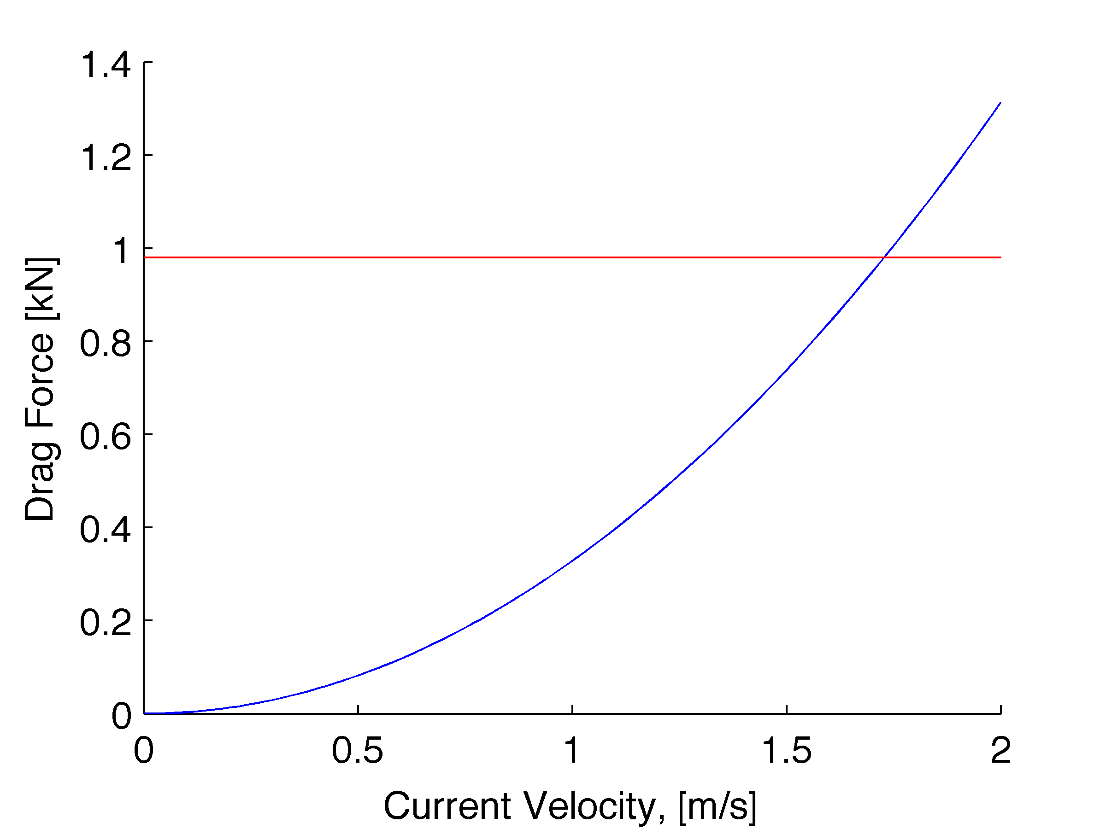
AMP Design Optimizations
Maximum current with combined thrust of 100 kgf = 1.8 m/s
Drag force vs. current with maximum available thrust (red line)
Notes:
Overall drag coefficient and what it compares to.
Available thrust vs. required thrust for manueverability
Available thrust: 0.98 kN

Slide 27
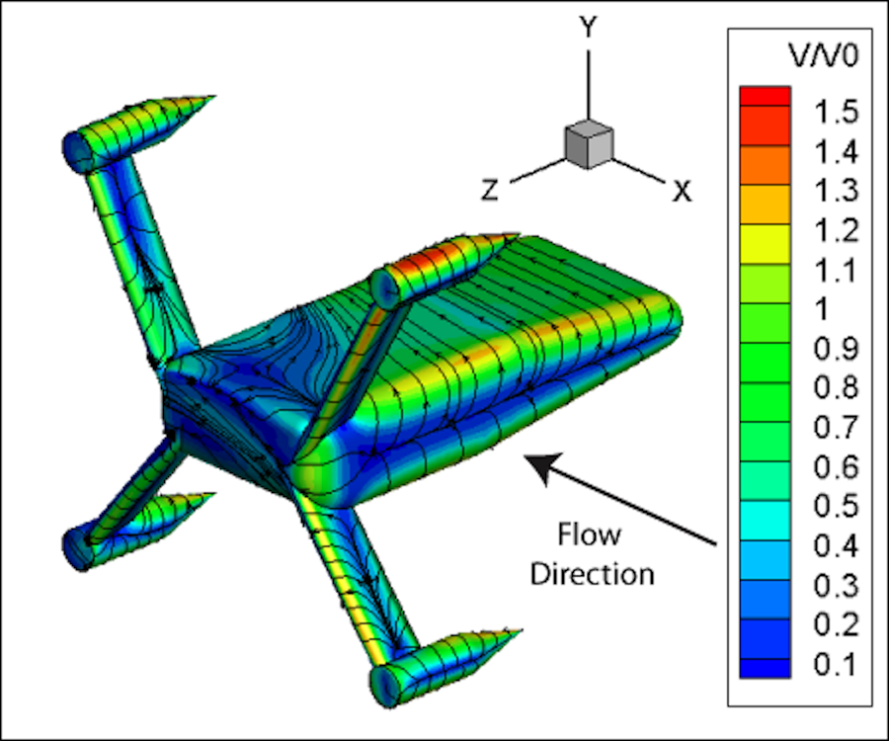
AMP Design Optimizations
Case study of design improvement analysis through CFD:
Drag forces in 5 m/s side-on currents: up to 3150 lbf!
AMP with rotating strut fairings
Drag forces and coefficients on AMP Components
Notes:
Two slides with problem solution format…

Slide 28
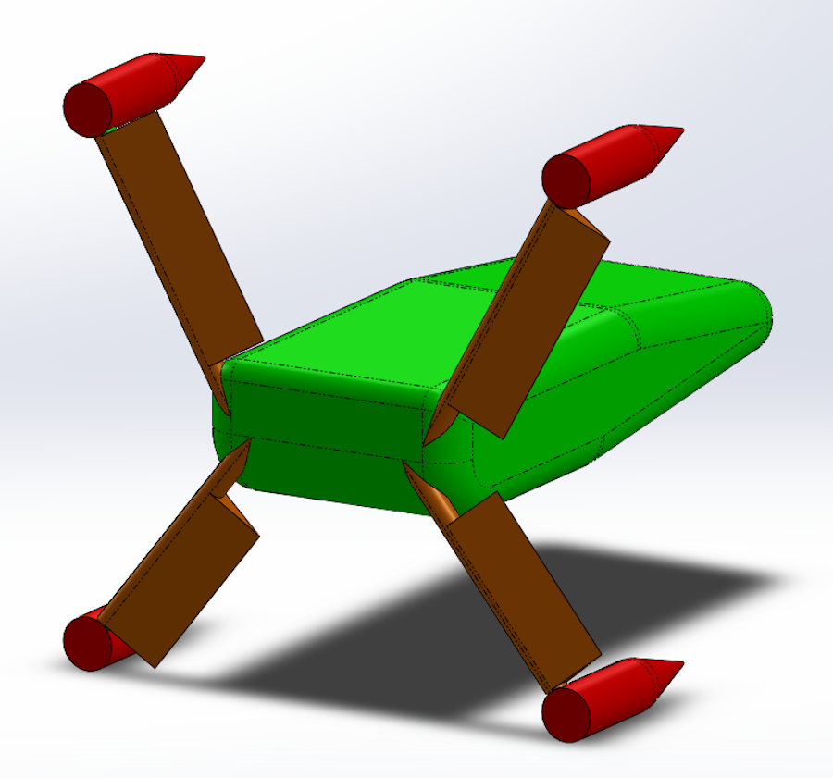
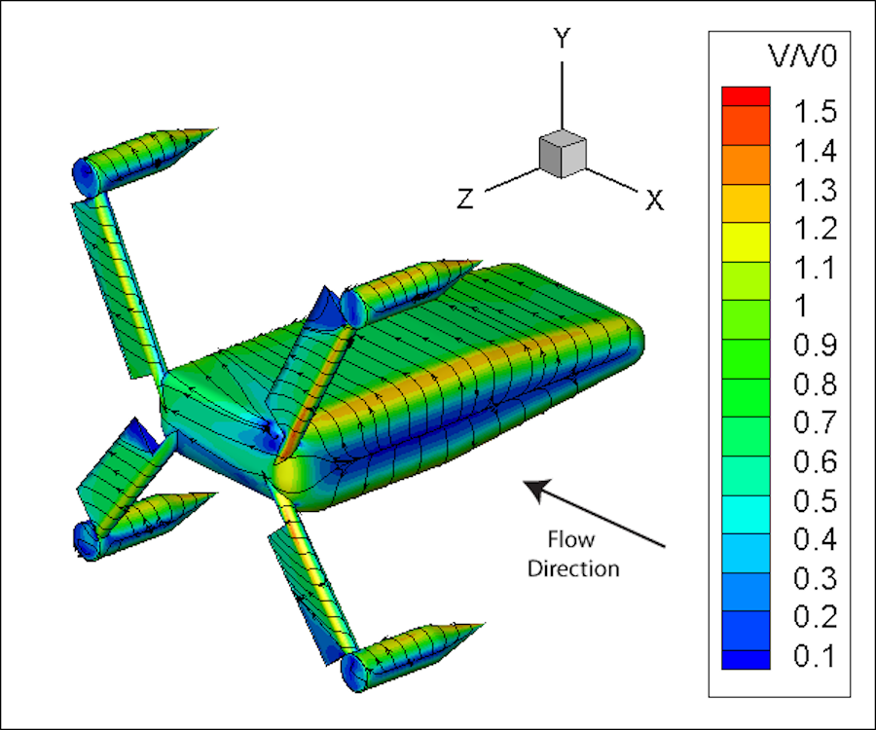
AMP Design Optimizations
Case study of design improvement analysis through CFD:
Rotating struts reduces drag forces by 54% (1400 lbf)
AMP with rotating strut fairings
Drag forces and coefficients on AMP Components
Notes:
Two slides with problem solution format…

Slide 29
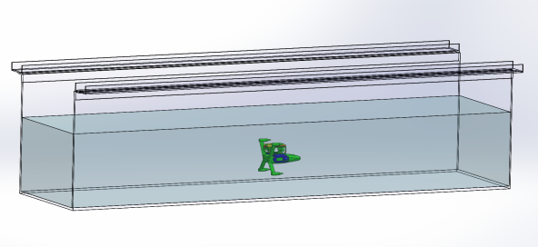
Next Steps
AMP and “Millennium” structural design
Stability analysis
Subscale modeling for flume and wind tunnel experiments
Full scale open water testing
1/8 th Subscale Model in Flume

Slide 30
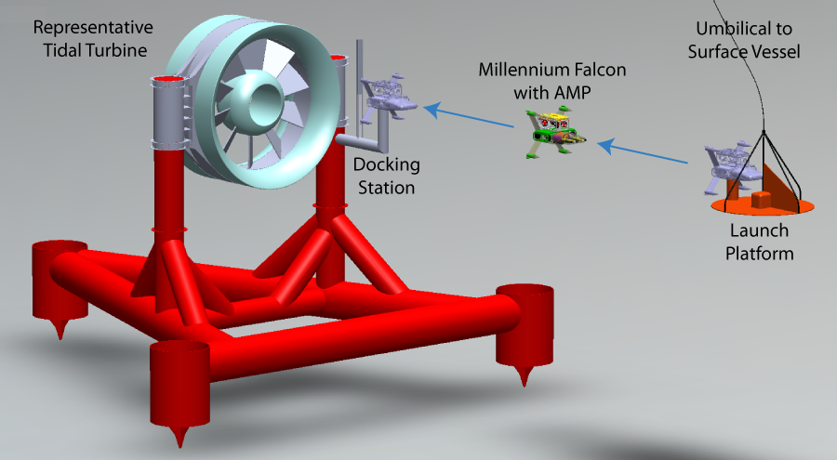
Summary
AMP design for monitoring marine renewable energy projects
“Millennium” Falcon deployment ROV for operations in moderate (<1 m/s) currents
CFD design analysis and optimization:
Current design should be able to overcome currents up to 1.8 m/s
Drag reduction for side-on currents of up to 54% by allowing strut fairings to rotate.
AMP deployment sequence
Notes:
Show the meshing

Slide 31
Questions?
Funding for this project is provided by the US Department of Energy and Public Utility District No. 1 of Snohomish County.
We would also like to thank:
From APL: Russ Light, Vern Miller, Eric Boget, Trina Litchendorf, Ben Rush, Dave Dyer
Danny Miles and Eric Schneider (SnoPUD), Geoff Cook (SeaView), Jack Roberts (Symphotic Tii)

Slide 32
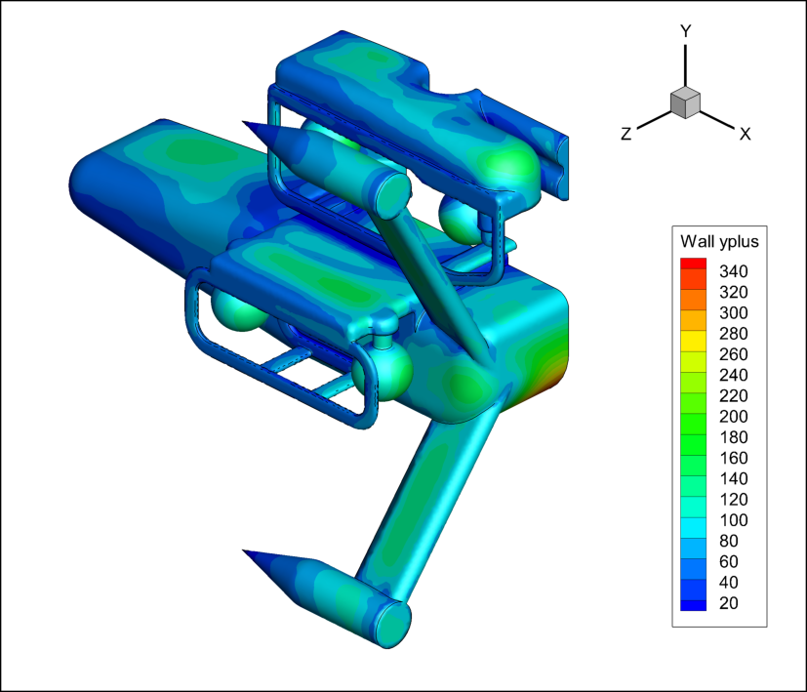
Evaluating CFD Results
Wall Y+ Values
Non-dimensional distance from a wall bounded flow.
Comparison to Literature
Run simulations with the same configuration as similar studies that have been validated.
Experimental Evaluation
Subscale testing in the flume.
Full scale testing in open water.
$$y^{+}=\frac{u_{∗}y}{v}=\sqrt{\frac{ρuy}{μ}}$$
Wall Y+ Values on AMP Body
Notes:
Show the meshing

