Slide 1

An Investigation into Blockage Corrections for Cross-Flow Hydrokinetic Turbine Performance
Robert J. Cavagnaro and Dr. Brian Polagye
Northwest National Marine Renewable Energy Center University of Washington
APS DFD Meeting
Pittsburgh, November 24, 2013

Slide 2
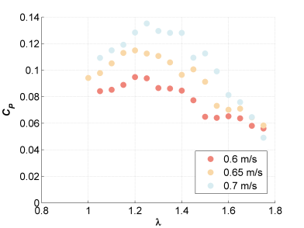
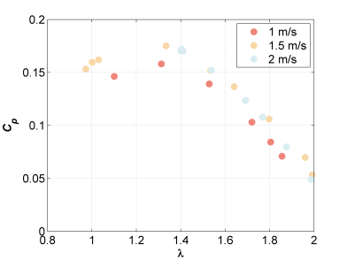
Motivation
Understand hydrodynamics of a full-scale vertical-axis cross-flow turbine by testing at lab scale
Explain variable turbine performance at different testing facilities
Lab-scale – high variability of performance with velocity and faclity
Field-scale – limited variability of performance with velocity

Slide 3
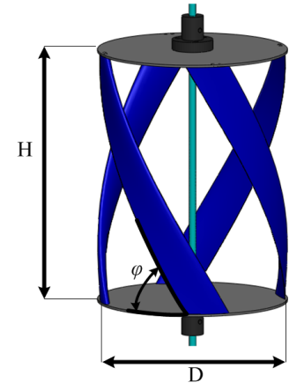
Micropower Rotor Parameters
High-Solidity, Helical Cross-flow turbine
N: Number of blades (4)
H/D: Aspect Ratio (1.4)
φ: Blade helix angle (60º)
σ: Turbine solidity (0.3)
Lab scale
  H = 23.4 cm, D = 17.2 cm
Field Scale
  H = 101.3 cm, D = 72.4 cm

Slide 4
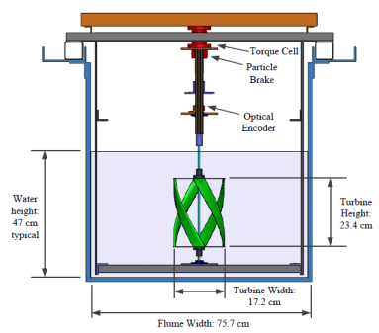
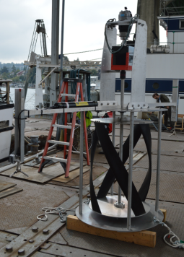
Performance Characterization Experiments
Torque control
Torque measurement
Angular position measurement
Inflow velocity measurement
  Upstream ADV
Thrust measurement
Niblick, A.L., 2012, “Experimental and analytical study of helical cross-flow turbines for a tidal micropower generation system,” Masters thesis, University of Washington, Seattle, WA.

Slide 5
Experimental Facilities
Bamfield Flume
UW Aero Flume
Cross Section (m²)
Cross Section (m²)
Flow Speed (m/s)
Flow speed (m/s)
Reynolds Number
Reynolds Number
Blockage Ratio
Blockage Ratio
Froude number
Froude number
Turbulence Intensity
Turbulence Intensity

Slide 6
Blockage Corrections
Corrections rely on various experimental parameters
T

Slide 7
Blockage Corrections: Glauert (1933)
Becomes unstable for C_{T} ≤ -1
T

Slide 8
Blockage Corrections: Maskell (1965)
Relies on knowledge of wake expansion or empirical constant
T

Slide 9
Blockage Corrections: Pope & Harper (1966)
“… for some unusual shape that needs to be tested in a tunnel, the authors suggest”
T

Slide 10
Blockage Corrections: Mikkelsen &
Sørensen (2002)
Extension of Glauert’s derivation
T

Slide 11
Blockage Corrections: Bahaj et al. (2007)
Iterative solution of system of equations, incrementing U₃/U₂
T

Slide 12
Blockage Corrections: Werle (2010)
Approximate solution
Also reached by Garrett & Cummins, 2007
T

Slide 13
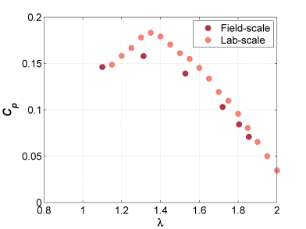
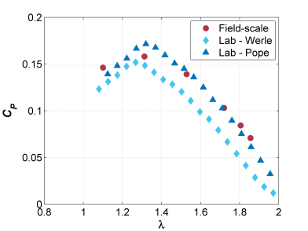
Case 1: Lab to Field Comparison
Same flow speed (1 m/s), different blockage
Field
Lab
Case 1 RSSE
Uncorrected | Werle | Pope & Harprer
0.034 | 0.074 | 0.021
No thrust measurements for lab test case

Slide 14
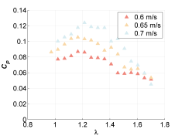
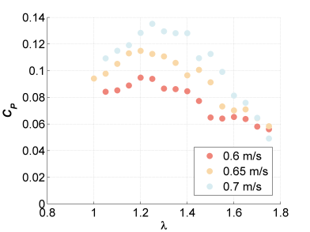
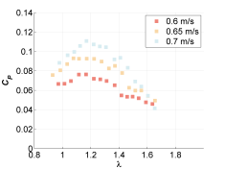
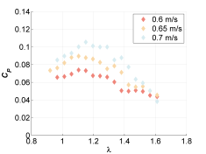
Case 2: Performance at Varying Speed
Same blockage ratio and facility
Indicates strong dependence on Re_{c} at low velocity
Pope & Harper
Bahaj
Werle
Case 2 Total RSSE
Uncorrected | Werle | Pope & Harper | Bahaj
0.983 | 0.717 | 0.883 | 0.938

Slide 15
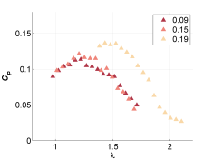
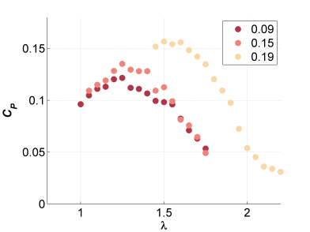
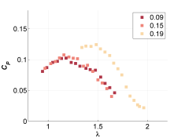
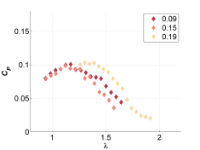
Case 3: Performance with Varying Blockage
Same flow speed (0.7 m/s) at different facilities
Pope & Harper
Bahaj
Werle
Case 3 Total RSSE
Uncorrected | Werle | Pope & Harper | Bahaj
0.4618 | 0.2157 | 0.3582 | 0.3265

Slide 16
Conclusions
Determining full-scale, unconfined hydrodynamics through use of a model may be challenging
All evaluated corrections reduced scatter of lab scale performance data
Thrust measurements may not be needed to apply a suitable blockage correction
No corrections account for full physics of problem
Caution is needed when applying blockage corrections
  Especially for cross-flow geometry

Slide 17

Acknowledgements
This material is based upon work supported by the Department of Energy under Award Number DE-FG36-08GO18179.
Adam Niblick developed the initial laboratory flume data.
Funding for field-scale turbine fabrication and testing provided by the University of Washington Royalty Research Fund.
Fellowship support for Adam Niblick and Robert Cavagnaro was provided by Dr. Roy Martin.
Two senior-level undergraduate Capstone Design teams fabricated the turbine blades and test rig (and a third is developing a prototype generator).
Fiona Spencer at UW AA Department and Dr. Eric Clelland at Bamfield Marine Sciences Centre for support and use of their flumes

Slide 18
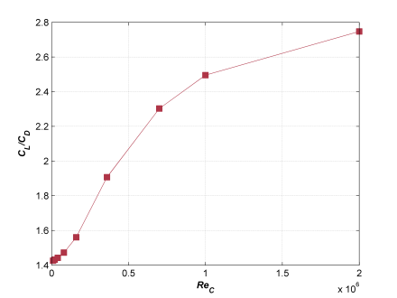
Re Dependence
Lift to drag ratio for static airfoil NACA 0018 at 25˚ angle of attack
Effect of blockage raises local Reynolds number by increasing flow speed through turbine
Effect less dramatic at higher Re

Slide 19
Bahaj Velocity Correction (2007)
Linear Momentum Theory, Actuator Disk Model, thrust and rpm same in flume and free-stream
Where U₁ is the water speed through the disk
Solved iteratively by incrementing ratio of bypass flow velocity to wake velocity (U₃/U₂)
Free-stream performance and λ derived from velocity correction
Depends on inflow velocity, blockage ratio, and thrust
Bahaj, a. S., Molland, a. F., Chaplin, J. R., & Batten, W. M. J. (2007). Power and thrust measurements of marine current turbines under various hydrodynamic flow conditions in a cavitation tunnel and a towing tank. Renewable Energy, 32(3), 407–426. doi:10.1016/j.renene.2006.01.012

