Slide 1
Analysis of Hydrokinetic Turbines in Open Channel Flow
Arshiya Hoseyni Chime
University of Washington
Northwest National Marine Renewable Energy Center
MSME Thesis Defense
December 10th, 2013
Notes:
----- Meeting Notes (12/9/13 17:08) -----
What do I want to tell in each slide!
make a conclusion for each slide!

Slide 2
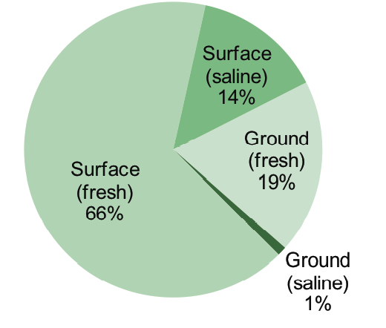
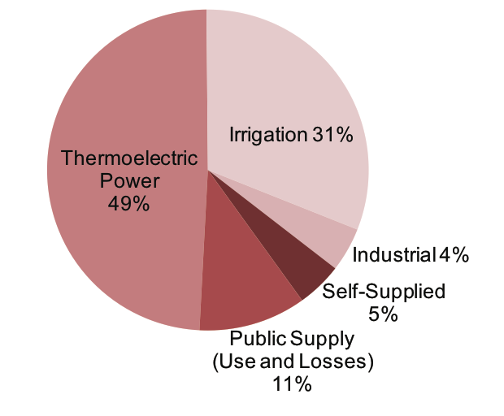
US Water Resources & Usage
Water Resources
Water Usage
Notes:
As a nation we are using 410 billion gallons of water per day. 80% of the water resources that we have is from
We use most of this water resources for thermoelectic power generation
Thermoelectric power-→ generate electricity with steam driven turbines
Irrigation-→ move water from water reservoir to farms
In 2005, total water use in the US was estimated to be 410 billion gallons per day
Thermoelectric power and irrigation accounted for the larges withdrawals
Surface sources account for 80% of all water withdrawals
----- Meeting Notes (12/9/13 17:08) -----
Irrigation(definition)
Thermoelectic power
`
----- Meeting Notes (12/9/13 17:43) -----
Thermoelectic power (steam power plants, cooling,…) Look up definition
Irrigation (using waterways for farming purposes)

Slide 3
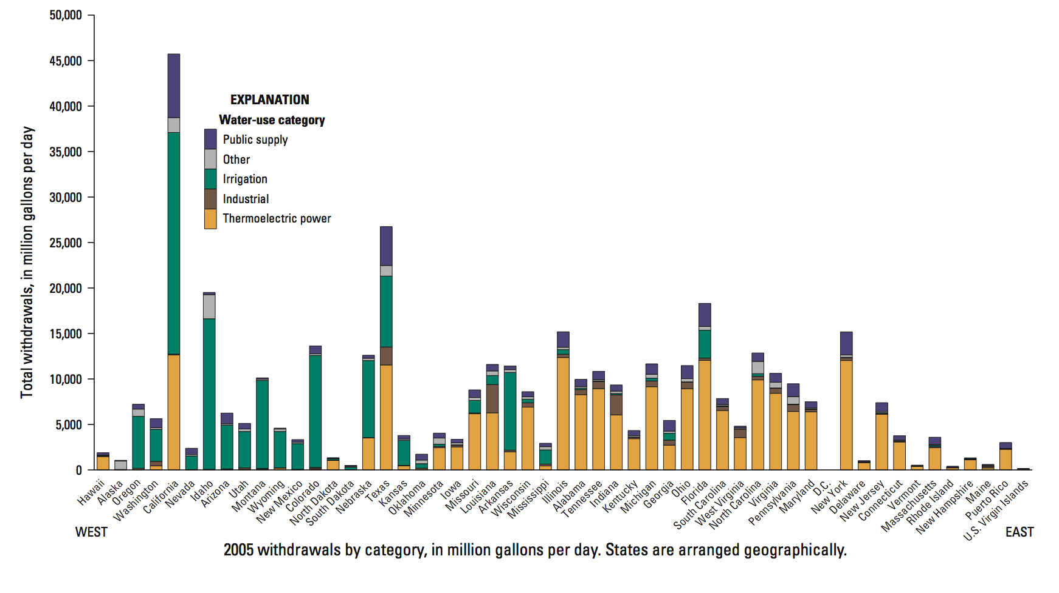
US Water Usage & Distribution
Notes:
In 2005, total water use in the US was estimated to be 410 billion gallons per day
Thermoelectric power and irrigation accounted for the larges withdrawals
Surface sources account for 80% of all water withdrawals

Slide 4

US Water Usage & Distribution
Washington
Notes:
On the west coast,

Slide 5
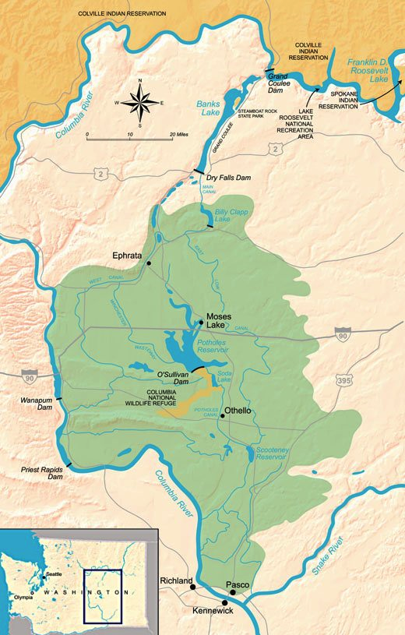
Columbia Basin Project
US Bureau of Reclamation manages more than 47,000 miles of canals, drainages, and tunnels
Columbia Basin Project
  6,000 miles of channels
  671,000 acres of farmlands
300 miles of main channel
  High flow rate capacity
Notes:
, is a federal agency under the U.S. Department of the Interior, which oversees water resource management, specifically as it applies to the oversight and operation of the diversion, delivery, and storage projects that it has built throughout the western United States for irrigation, water supply, and attendant hydroelectric power generation.
The Columbia Basin Irrigation System is formed when water is diverted from the Columbia River into the Banks Lake Reservoir at the Grand Coulee dam. The water from this reservoir is then channeled through the Dry Falls Dam and into the Main Canal. The Main Canal then runs south before splitting between the East and West Canals near Soap Lake, Washington
300 miles of main channel with 3,400 to 19,300 cfs flow rate capacity
Ephrata, WA
High hills gates

Slide 6
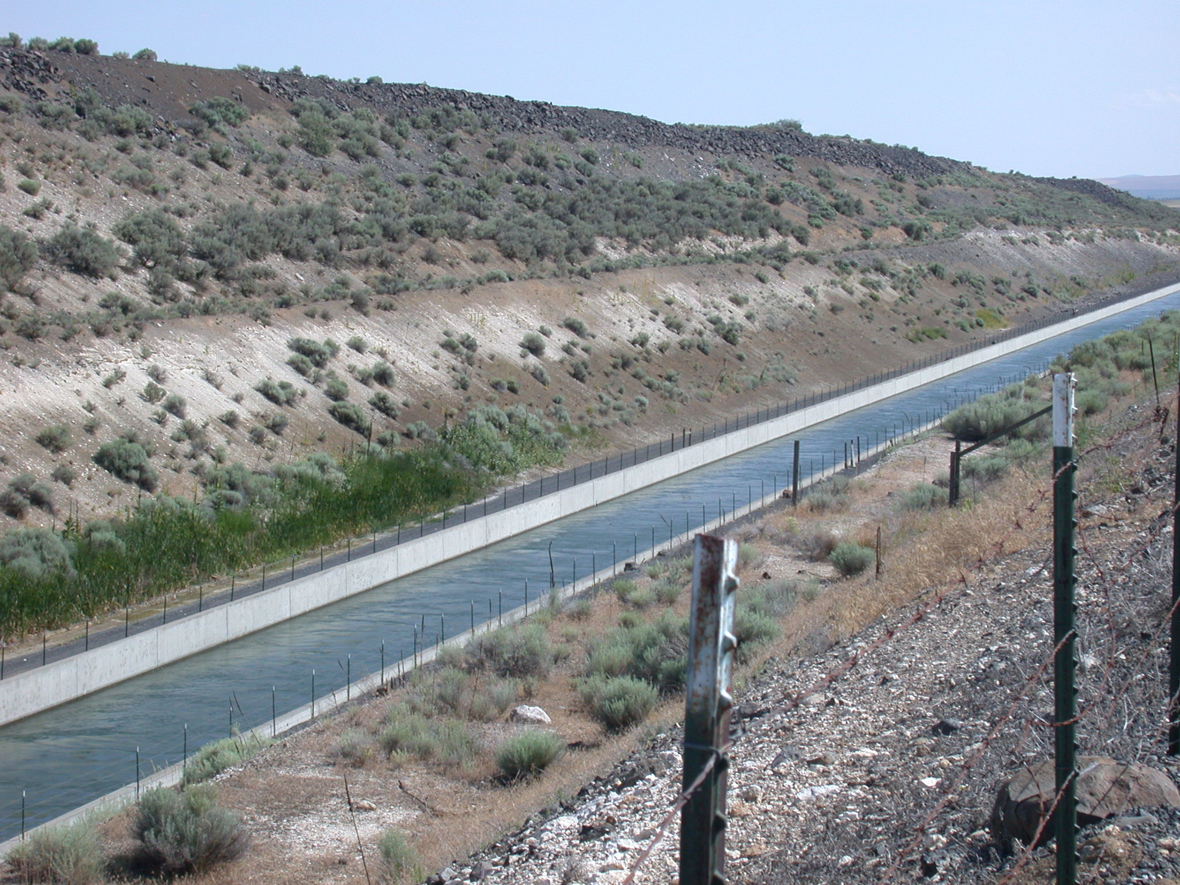
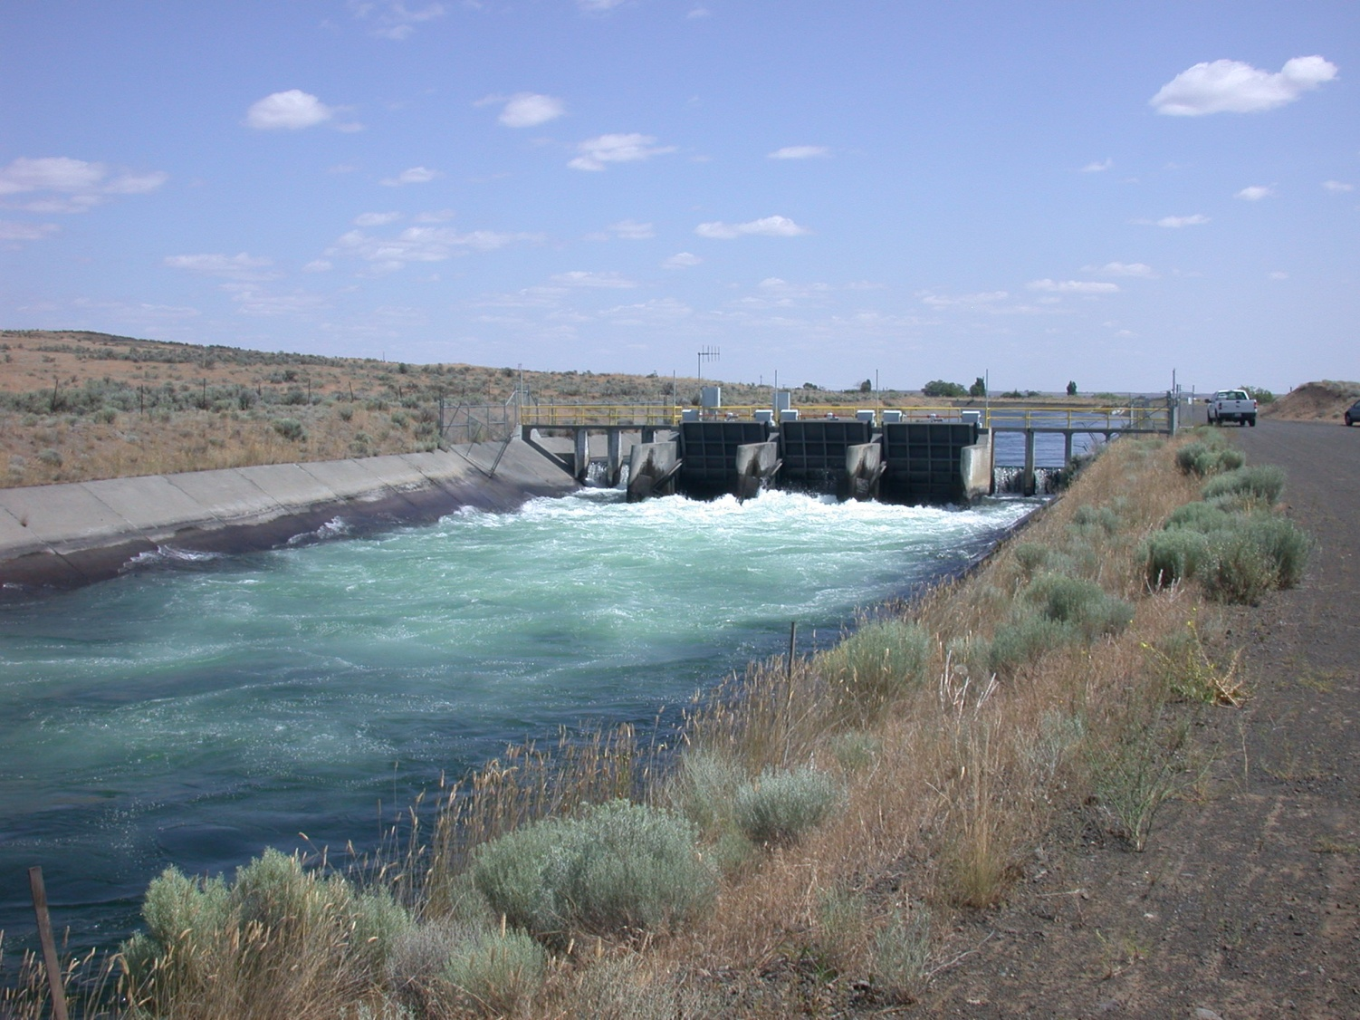
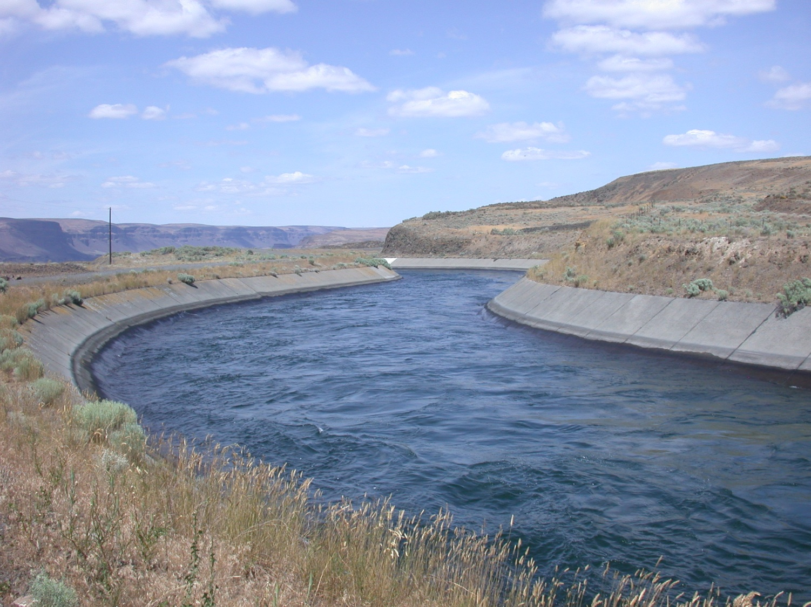
Flow Control
Tainter Gates
Courtesy of Professor Malte
High Hills Gates
Notes:
focus on high hills gate---→ 3 gates in a row
They dissipate the energy of water to control the flow
Farmers need certain head or energy of water going to their farms. WHY ARE THE GATES USED?

Slide 7
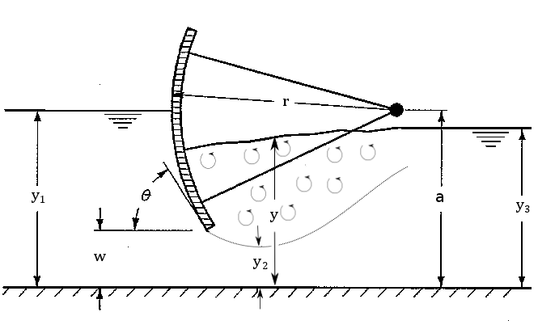



Open Channel Flow Analysis
CV1
CV2
Conservation of energy
Conservation of Momentum
Fr₂ >1 => Supercritical Flow => Hydraulic Jump
Notes:
Tainter gates move up or down to
ratio of a characteristic velocity to a gravitational wave velocity
Head=y+v^2/2g

Slide 8
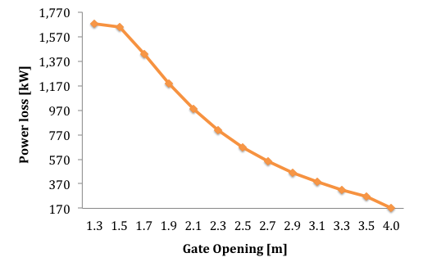
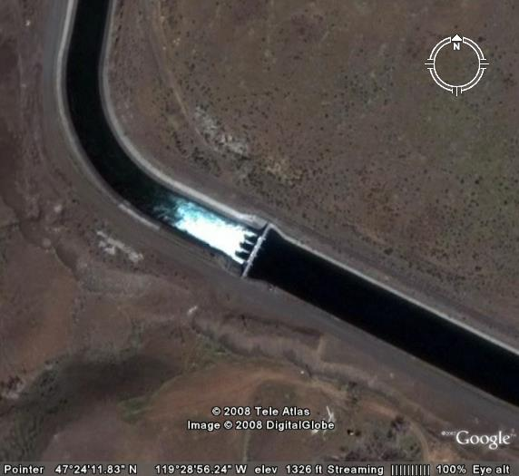
Motivation
Opportunity: Hydrokinetic turbines for flow control and power generation
Notes:
Upstream Flow Depth is 5m
Hydraulic jump for w < 2.2m
At gate opening of 2m, 1MW of power is lost due to hydraulic jump and mixing of turbulent rollers with the free surface
Given that this dissipated power is wasted using this traditional method, it is desirable to capture this energy. Hydrokinetic turbines are possible candidates for replacing traditional gates to not only control the flow, but also to generate power

Slide 9
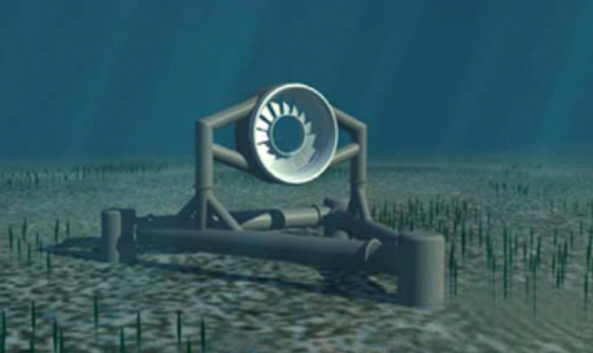
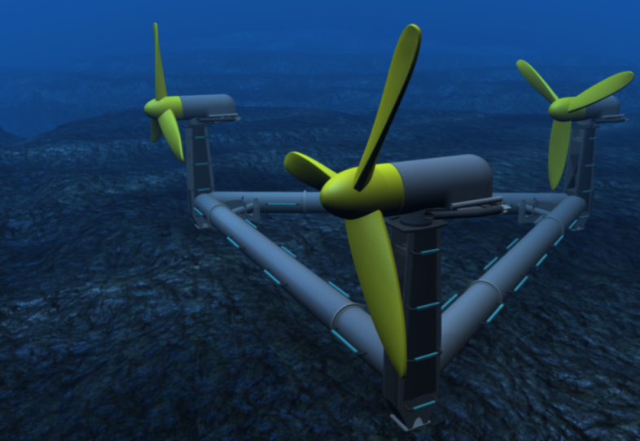
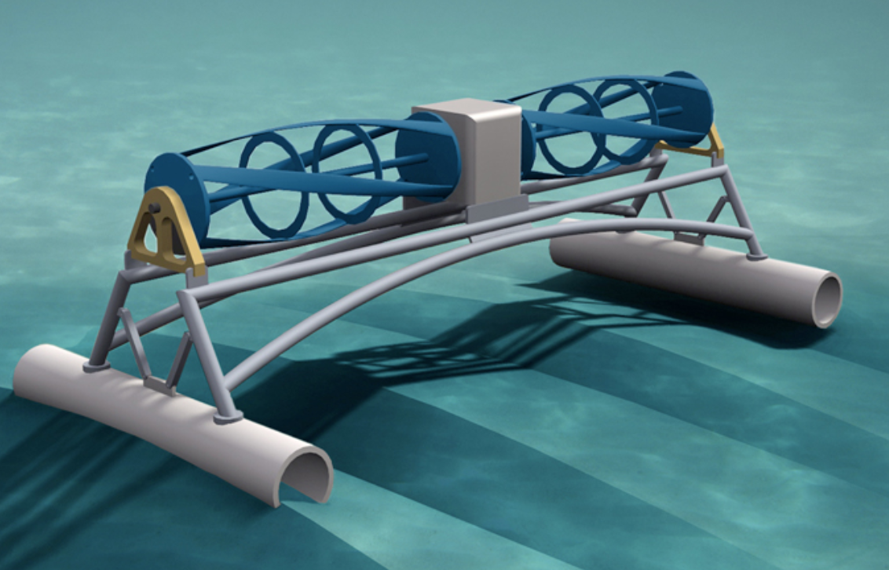
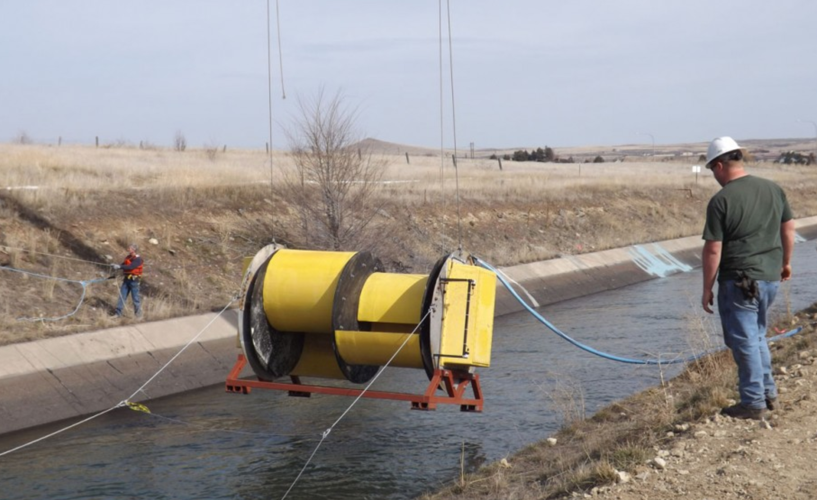
Motivation
Pros
  Unidirectional Flow
  Cheaper than traditional hydropower (Dams)
  Easier permitting than tidal turbines
Cons
  Small-scale power generation
  Farmers may not like the change from traditional control to new control
Notes:
traditional hydropower uses a dam or diversion structure to supply a combination of hydraulic head and water volume to a turbine to generate power.
Cheaper than building dams
Unidirectional----→ no yaw control flood and ebb

Slide 10
Approach
1-D theoretical modeling
3-D CFD modeling
  Turbines
    Actuator Disc Model
    Virtual Blade Model
Comparison between models

Slide 11
Approach
1-D theoretical modeling
3-D CFD modeling
  Turbines
    Actuator Disc Model
    Virtual Blade Model
Comparison between models

Slide 12
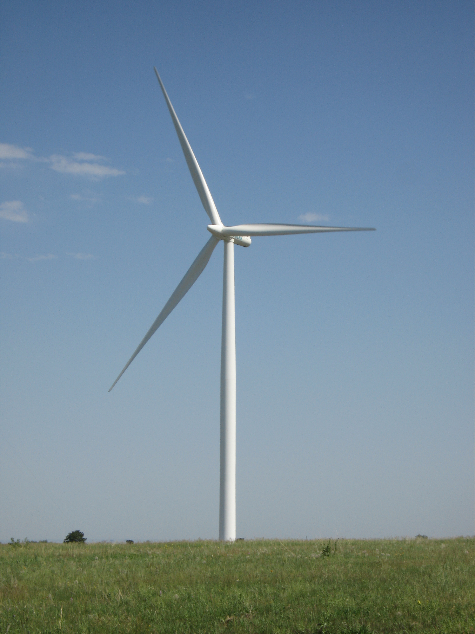
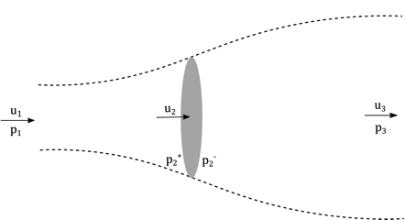
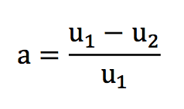
1-D Theory- Linear Momentum Theory
Unconstrained Channel
  Power Coefficient
Betz limit
Notes:
TRANSITION!!!
Wind turbines
an infinite volume of air, where the streamtube is allowed to fully expand, to analyze and design wind turbines
Control volume analysis
The actuator disc approximates a real turbine by uniformly distributing the forces acting on the individual blades over the rotor swept area (A2)
when the free-stream mixes with the wake, significant energy is lost to turbulence.
Dissipation coefficient--→ total power dissipated due to extracted power by turbine and mixing of of wake by the flow passing around the turbine (bypass flow)
As flow reaches the turbine in slows down, and expands in terms o

Slide 13
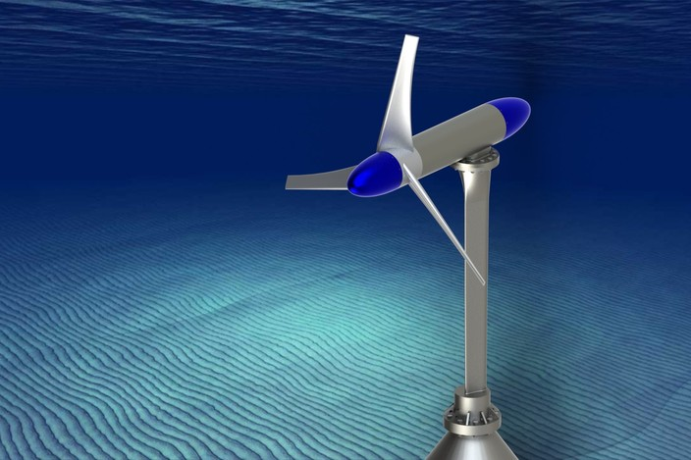
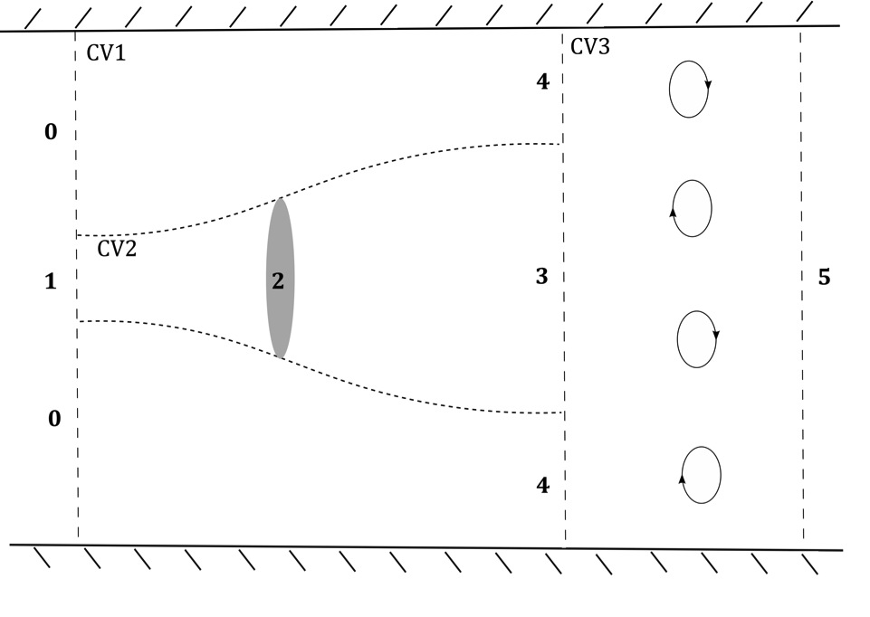

1-D Theory-Linear Momentum with blockage effects
Constrained Channel
Blockage Ratio
Top View
Notes:
Increase velocity at 4
Mixing between slow moving water and fast water
as the swept area increases, the confinement of the free surface and channel walls becomes dynamically significant and the velocity adjacent to the streamtube increases. Therefore, the shear between the wake and adjacent free-stream may be highe
----- Meeting Notes (12/9/13 17:43) -----
make a transition---> in Channels flow is constrained that brings up
Linear momentum theory with blockage effects

Slide 14
1-D Theory-Linear Momentum with blockage effects
Constrained Channel
Assumptions:
  No wake rotation
  No drag force
  No friction loss
  Uniform water depth at 3,4 and 5
4 Equations, 4 Unknowns
(u3, u4, h3, h5)
Notes:
Control Volume analysis
Efficiency can go higher than betz limit
As BR increases, the extraction coefficient (efficiency) increases for a given induction factor due to the confining effects of the water channel. It is, therefore, possible for a turbine to extract far more energy than is predicted by the classical Lanchester-Betz limit.
for a turbine operating at the maximum theoretical efficiency, as 􏰃 increases wake losses rise from 1/3 of the total dissipation to more than 1/2
----- Meeting Notes (12/9/13 17:43) -----
Linear momentum theory with blockage

Slide 15
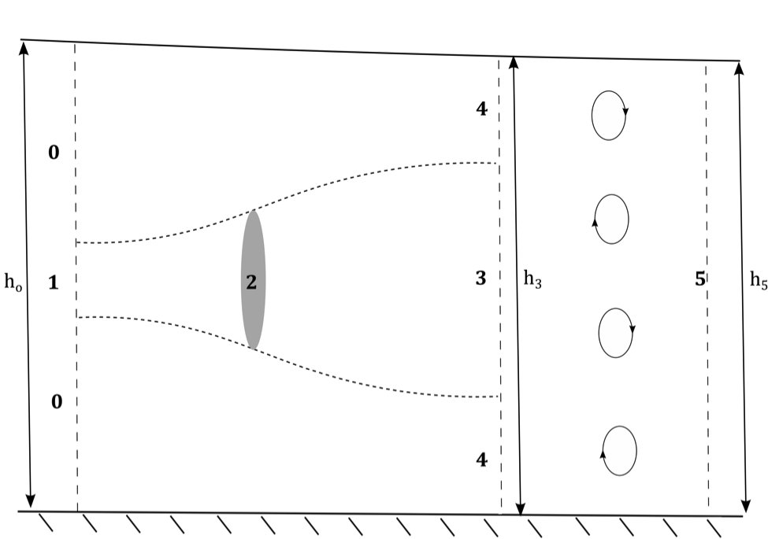
1-D Theory-Linear Momentum with blockage effects
Constrained Channel
Assumptions:
  No wake rotation
  No drag force
  No friction loss
  Uniform water depth at 3,4 and 5
4 Equations, 4 Unknowns
(u3, u4, h3, h5)
Notes:
Control Volume analysis
Efficiency can go higher than betz limit
As BR increases, the extraction coefficient (efficiency) increases for a given induction factor due to the confining effects of the water channel. It is, therefore, possible for a turbine to extract far more energy than is predicted by the classical Lanchester-Betz limit.
for a turbine operating at the maximum theoretical efficiency, as 􏰃 increases wake losses rise from 1/3 of the total dissipation to more than 1/2
----- Meeting Notes (12/9/13 17:43) -----
Linear momentum theory with blockage

Slide 16
1-D Theory- Channel Constriction
26 m
Flow rate is constant
5.1 m
BR=0.36
4m
5 m
Blockage Ratio is increased
21 m
BR=0.48
4m
4.937 m
16 m
Notes:
Trapezoidal cross section
Mention 3 turbines 4 meters in diamter
----- Meeting Notes (12/9/13 17:43) -----
In order to simlify the theoridical and numerical calculations, we converted the trapezoidal channel to rectangular cross-section.

Slide 17
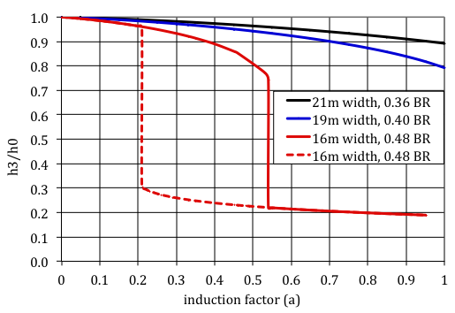
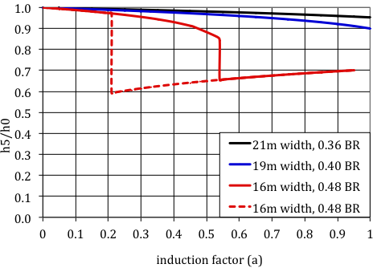
Effect of Channel Constriction on Water Depth
Notes:
Decreased channel width, to increase blockage ratio
Equations became non-linear as blockage ratio got to about 0.5
we got subcritical and super critical solutions for a given width
Normalized surface elevation at minimum depth after the turbine
As blockage ratio increases, more surface drop
Normalized water depth down stream
Overall head loss due to power extraction, mixing of high and low velocity flow, and in the super critical case, head loss due to hydrolic jump
----- Meeting Notes (12/9/13 17:43) -----
Change the scale of the graphs.
near wake and far wake
----- Meeting Notes (12/9/13 18:01) -----
deliver the point (3 more details)
-
-
-

Slide 18
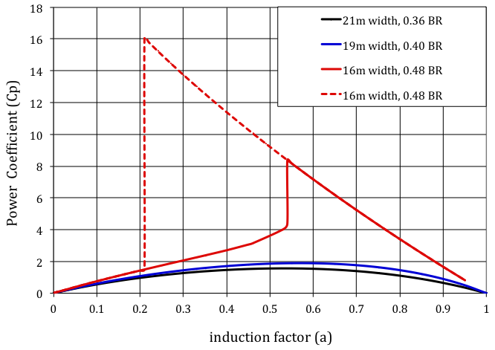
Effect of Channel Constriction on Power Generation

Slide 19
Approach
1-D theoretical modeling
3-D CFD modeling
  Turbines
    Actuator Disc Model
    Virtual Blade Model
Comparison between models

Slide 20
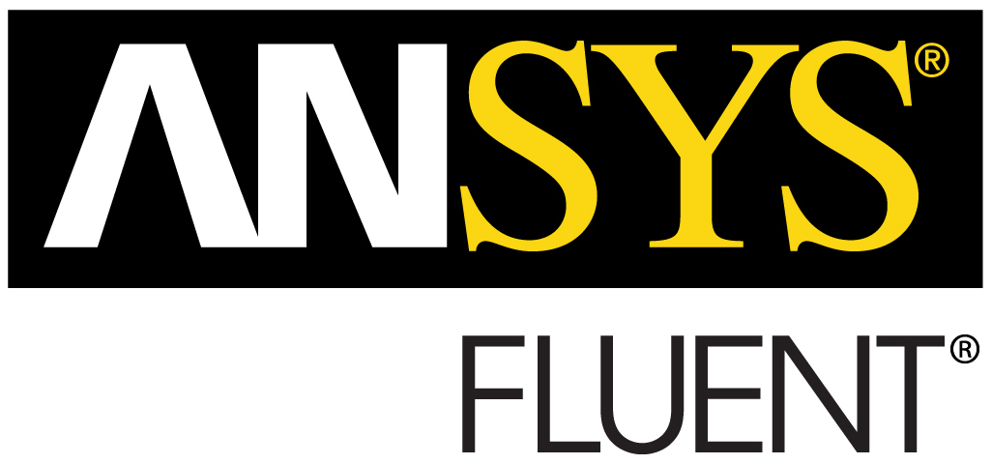

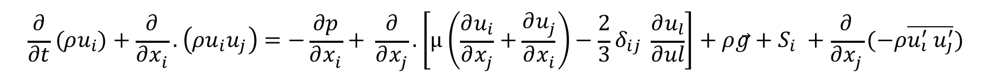



CFD- ADM, VBM
ANSYS Fluent14.0
RANS Equations
SST turbulence model
Coupled Pseudo-Transient Solver
Volume of Fluid Model
Free surface is at VF=0.5
Notes:
The domain is divided into discrete control volumes using a grid (mesh)
Governing equations are integrated over the individual control volumes to construct algebraic equations for the dependent variables (unknowns) such as velocity, pressure.
The discretized equations are linearized and the system of linearized equations is solved to yield updated values of the dependent variables.
Where subscript nb refers to neighboring cell, ϕ is the scalar variable at cell center, b is the net flow rate into the cell, ap and anb are the linearized coefficients for ϕ and ϕnb respectively.
Coupled algorithm: solves system of momentum and pressure-based continuity equations simultaneously.
This method is known to improve convergence speed compared to a segregated algorithm. However, it uses more memory since the system of equations needs to be stored in every iteration
# of iterations cut by a factor of 8, and time to converge was lowered 5 times
VOF importance: power is under predicted by 12% when BR=0.48 and 7% when BR=0.36
Where ui from now on are time averaged velocity in this equation. This equation has an extra term compare to the Navier-Stokes equations, -ρui' uj', which is referred to as Reynolds stress tensor and represents the turbulence transport effects on the mean flow.
k-w SST (Shear-stress transport)
The model used in this thesis is k-ω Shear-Stress Transport (SST) because it’s a robust model as well as it is widely used in hydrokinetic turbine CFD simulations. In addition to this, k-ω SST is known to perform better than the Spalart-Allmaras model and k-ε in situations with adverse pressure gradients and separated flow

Slide 21
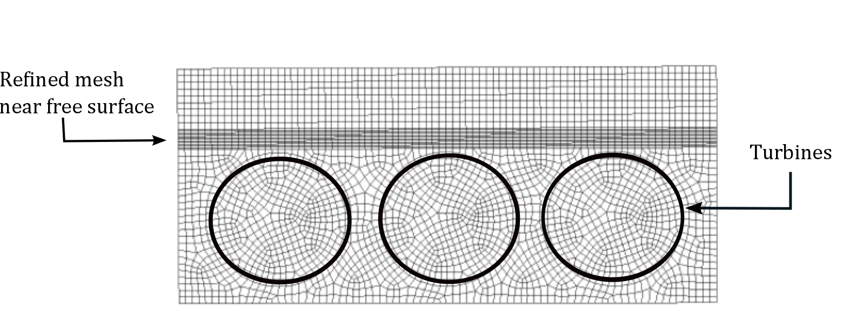
CFD-Meshing
Number of cells
16m wide channel | 3.3 million
21m wide channel | 4.2 million
Notes:
A fine structured rectangular mesh was the preferred meshing scheme near the free surface. This allowed for the resolution of small variations in the free surface height.
This grid is refined near the free surface in order to capture free surface deflections that occur due to power extraction of the turbines and avoid numerical instability for volume fraction.
mesh is refined where volume fraction varies between 0.4 and 0.6. This procedure is continued until the solution is independent of the mesh resolution.
Quality of the mesh plays an important role in accuracy and stability of the solution. One of the indicators of a good mesh is orthogonal quality, which varies between 0 and 1, where values close to 0 correspond to low quality. This value was 0.8 for both channels’ mesh, which indicates that the domains are well discretized.
----- Meeting Notes (12/9/13 18:01) -----
message:

Slide 22
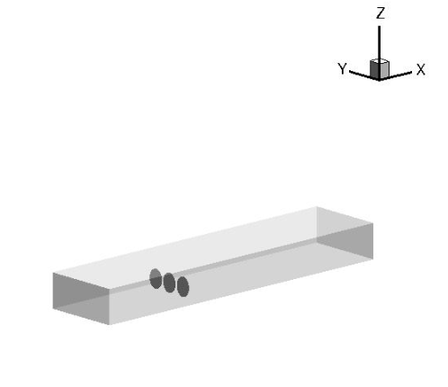


CFD-Boundary Conditions
Mass flow inlet
Pressure outlet
No slip at walls
3 turbines(4m diameter)
50 kg/s
2.5 m
air
water
132,850 kg/s
D=4 m
t= 0.2 m
5 m
2.5 m
30 m
60 m
Turbulence BC:
Notes:
Turbulence at the inlet and outlet is defined by introducing turbulence intensity, I, and hydraulic diameter, DH. These terms define k and ω at the boundaries.
Hydraulic diameter is defined as four times the cross-sectional area of the channel over its wetted perimeter
Hybrid initialization is used to create a velocity field in the computational domain and a pressure field that smoothly connect high and low-pressure values. In this method, Laplace equation is solved with appropriate boundary condition to create the velocity field. An additional Laplace equation is solved to produce initial pressure values for all cells. Volume fraction is patched to the secondary phase, which is the heavier fluid (water), in the section of the domain containing water.

Slide 23
Approach
1-D theoretical modeling
3-D CFD modeling
  Turbines
    Actuator Disc Model
    Virtual Blade Model
Comparison between models

Slide 24

CFD-Actuator Disc Model
Porous Media Model
C2 is inertial resistance of the porous media
ΔP is based on 1-D theory at a given induction factor
Notes:
Porous Media Model to define resistance across the turbine (ΔP based on 1-D theory)
Neglect viscous losses(darcy’s equation for laminar flows where inertial losses can be neglected) are neglected which is a good assumptions since the term is Super small compare to inertial losses
Alpha is the permeability of the porous media….its infiinite so 1/alpha is very small

Slide 25
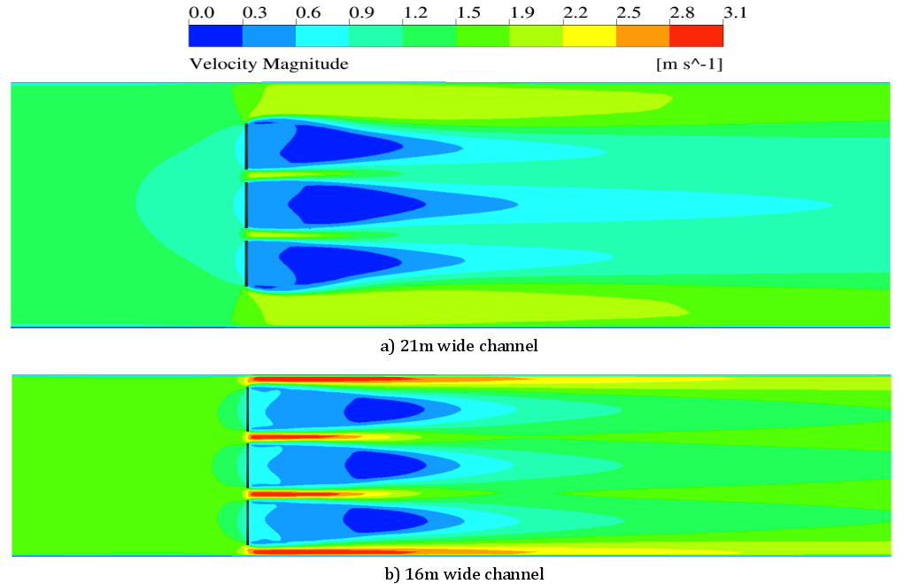
ADM- Velocity Contours
BR=0.36
Fr=0.18
BR=0.48
Fr=0.24

Slide 26
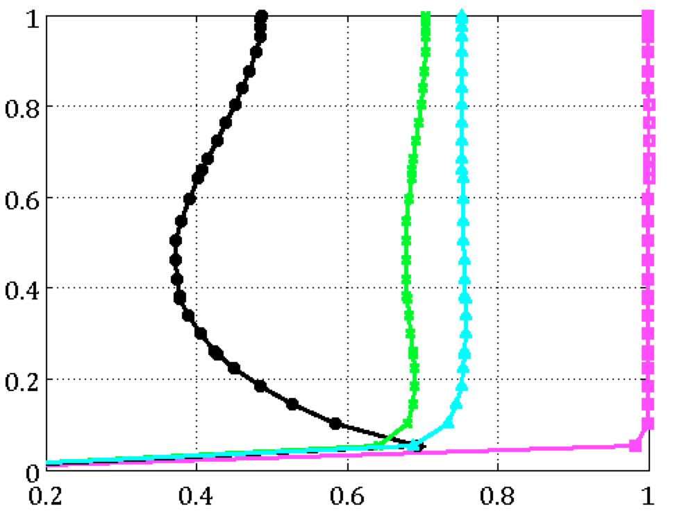
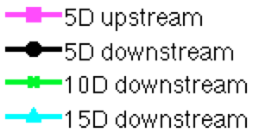
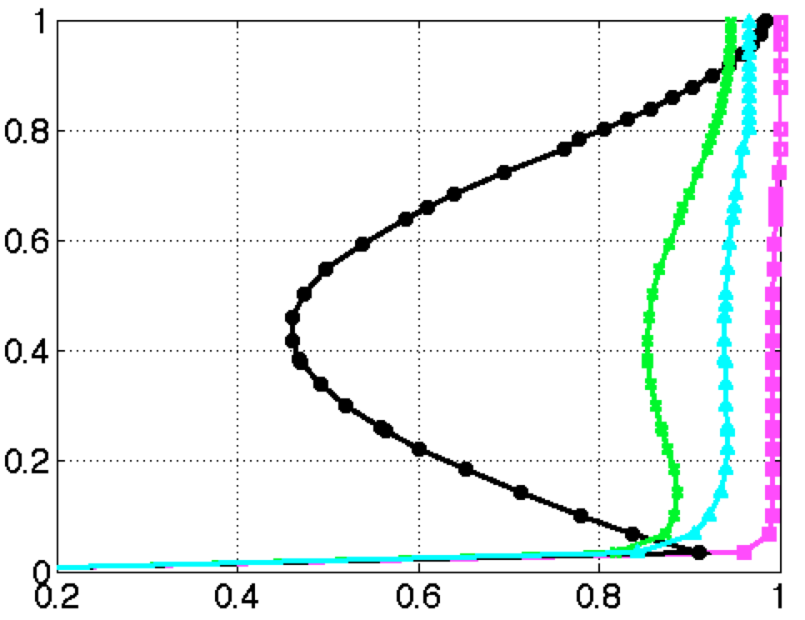
ADM- Normalized Velocity
BR=0.36
Fr=0.18
Normalized water depth
BR=0.48
Fr=0.24
Normalized Velocity
Notes:
Add a plot of where you’re plotting

Slide 27
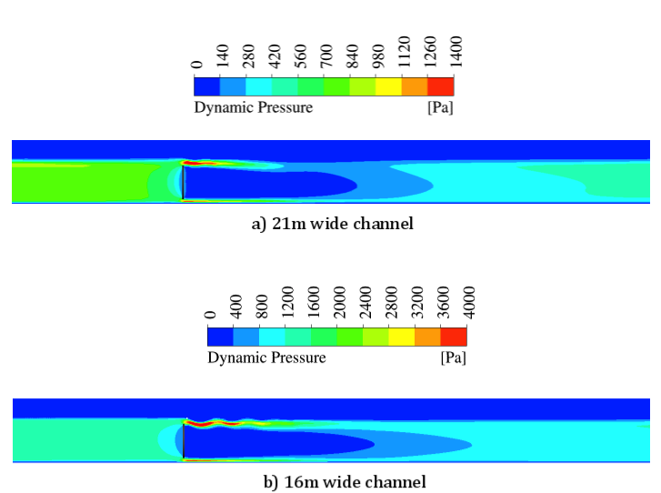

ADM- Dynamic Pressure
BR=0.36
Fr=0.18
BR=0.48
Fr=0.24

Slide 28
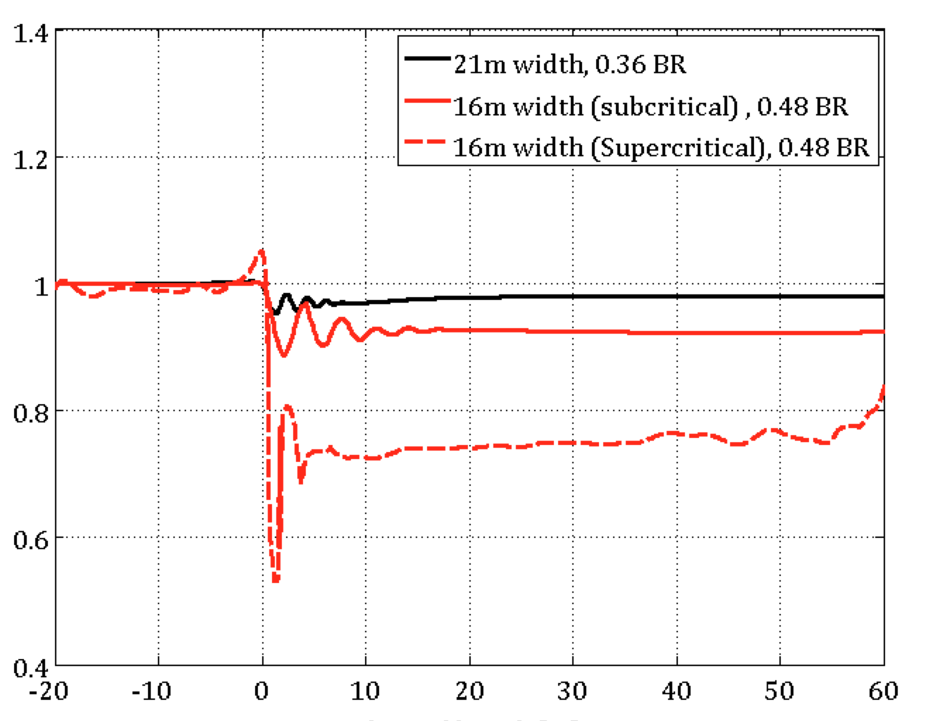
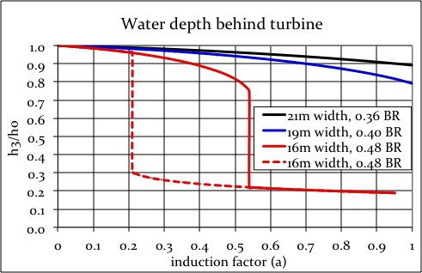
Free Surface Elevation-Subcritical
Normalized Surface Elevation
Channel Length [m]
Notes:
Induction factor=0.5 for 21m case
Induction factor=0.4 for 16 m
----- Meeting Notes (12/9/13 18:10) -----
title for the 1D / ADM
message --->

Slide 29
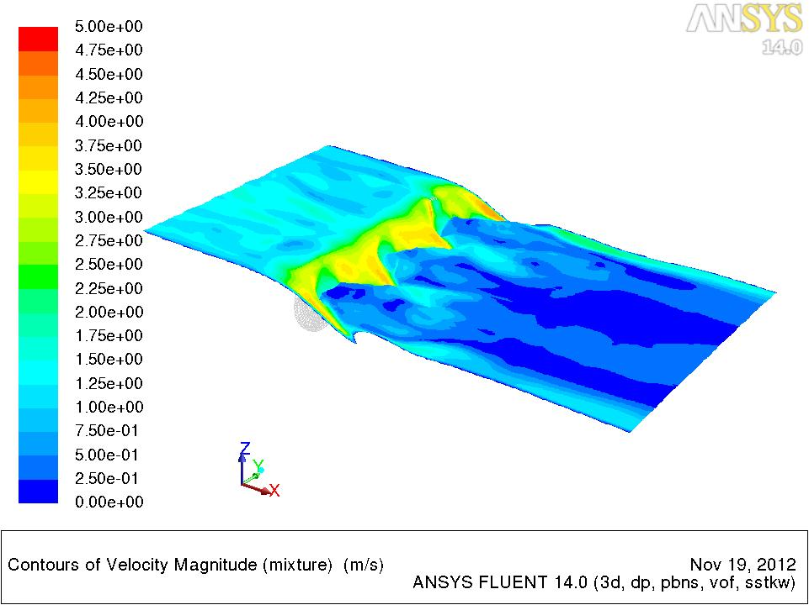
Supercritical(16m)
Induction factor=0.6
Outlet depth and Inertial Resistance from 1-D theory
Velocity [m/s]

Slide 30
Approach
1-D theoretical modeling
3-D CFD modeling
  Turbines
    Actuator Disc Model
    Virtual Blade Model
Comparison between models
Notes:
Only with the higher blockage ratio case

Slide 31
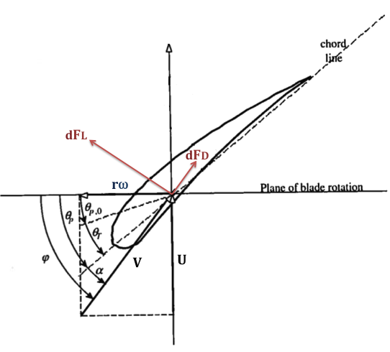
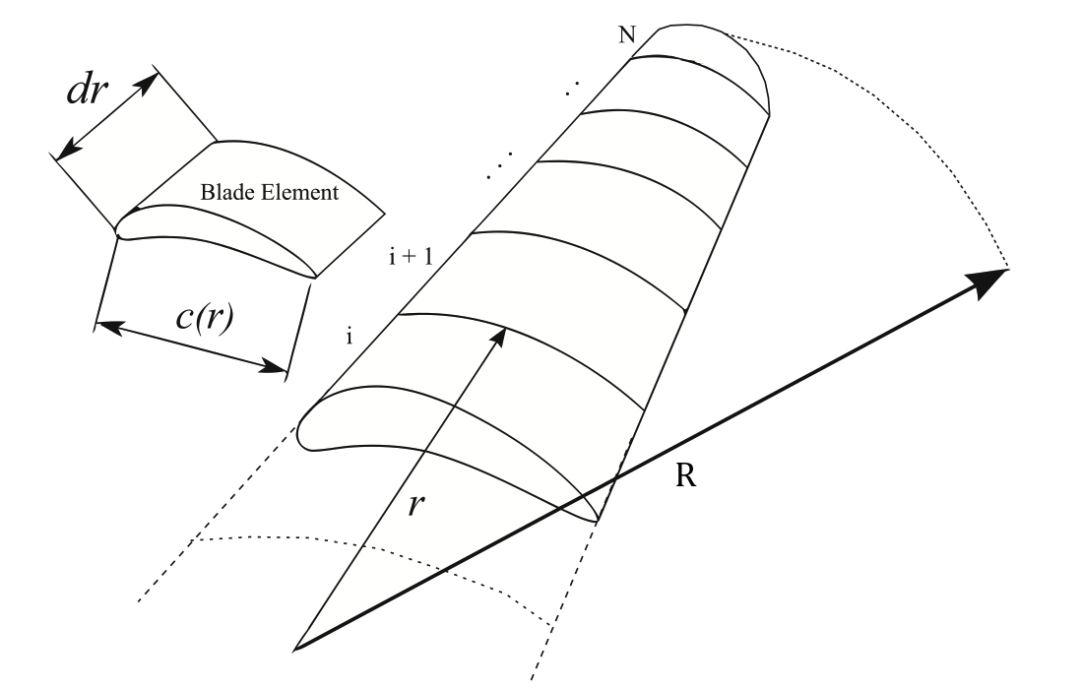
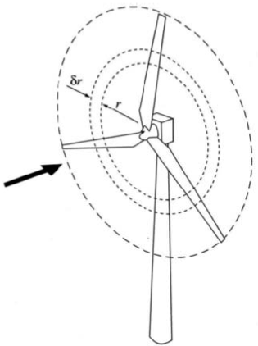




CFD-Virtual Blade Model
Blade Element Theory
Tip effect=96%
  VBM Input:
Notes:
This approach uses a momentum source term that implicitly represents the rotor. Therefore, blades are taken into account in the simulation without being physically present in the computational domain. This simplification reduces the computational memory and time required to perform the analysis compared to the simulations where the actual rotating blades are modeled, due to number of mesh cells, which would be required to resolve the blades.
solve for the magnitude of the momentum source term in the RANS equations based on local angel of attack and velocity at the rotor for each iteration. Velocity field is then determined for the rest of the domain using the RANS equations. Iteration is continued until solution is converged.
the tip effect is set to 96%, which means only 96% of blade span’s lift force is taken into account and the remaining (tip region) lift force is set to 0. Alternatively, drag force is assumed to be present along the entire blade. Therefore, flow is assumed to recirculate around the region surrounding the last 4% of the blade’s surface area.

Slide 32
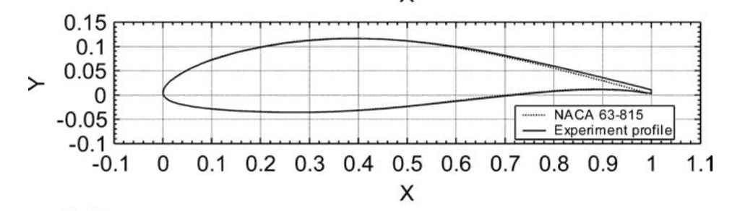
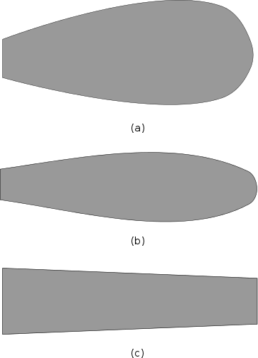
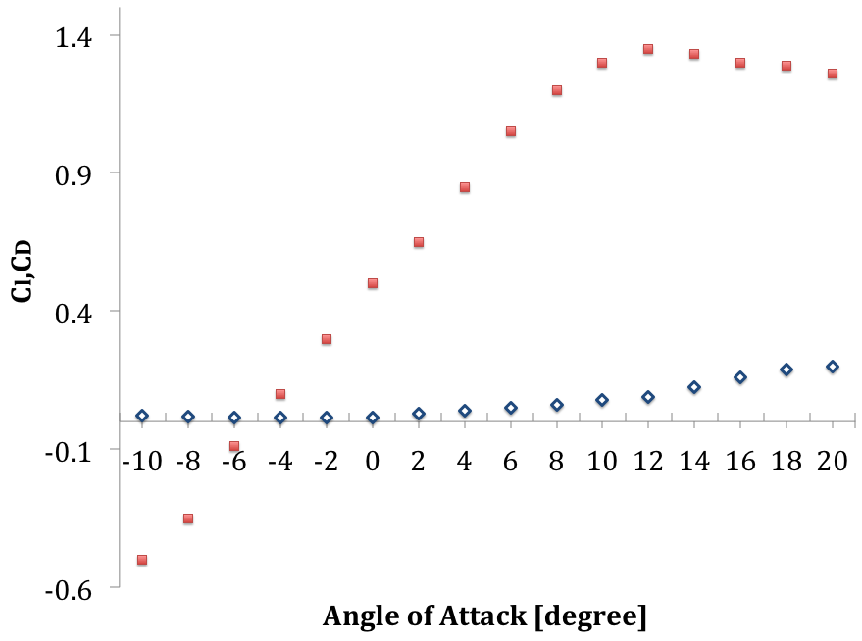
VBM- Blade Design
Bahaj, 2004
c=50cm
c=40cm
Chord Distribution
Notes:
All software available to optimize a blade geometry is designed for wind turbines or turbines in unconfined channels. In our case, blockage highly affects the flow and optimization is handled manually.
POINT-→ Blade design at high blockage ratios should be specific channel that turbine is designed for…
Once we had the blade geometry, we had to find out the operating limits for the rotor.
non-dimensional blade geometry, such as was published by Bahaj et al. [30], was used for cavitation analysis and VBM simulations [30]. However, running the VBM model with this geometry resulted in insufficient power for a turbine consisting of 3 blades. Following this discovery, a spreadsheet BET calculation was used in an iterative manner to find twist angles along the blade that produced maximum possible power. However, the calculated chord distribution for this analysis was found to be unrealistic (c >1m); therefore, several different chord distributions were developed and tested with VBM
However, since flow is highly affected by the blockage, there is always a high range of angles of attack from root to tip.

Slide 33
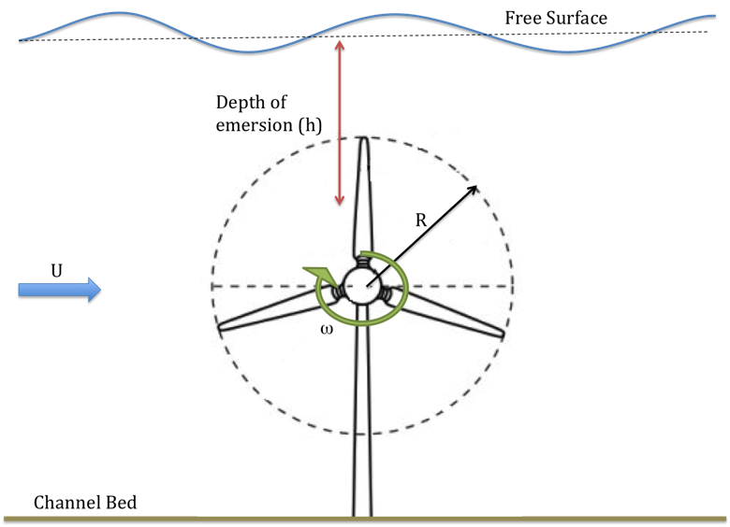


VBM-Cavitation Analysis
Cavitation occurs when local pressure is lower than vapor pressure
Notes:
Cavitation is the formation of vapor bubbles within a flowing fluid, and occurs when the pressure of the fluid falls below the vapor pressure
When cavitation occurs in the presence of an airfoil, it decreases the lift force acting on the airfoil, and increases the drag force. Therefore, it is essential to assure that the turbine operates in a cavitation-free environment.
Considering that turbines operate in channels with high blockage ratios, where the free surface is near the turbine blades, it is important to perform cavitation analysis in order to understand the limits of turbine operating conditions.

Slide 34
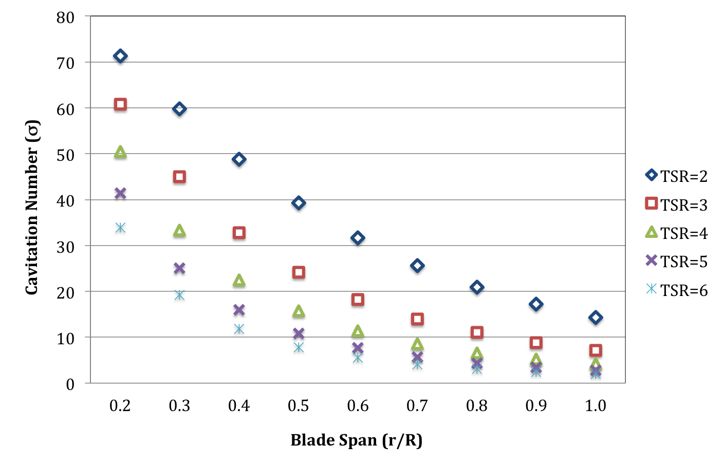
VBM- Cavitation Analysis
Notes:
should cavitation occur at a particular TSR, it will occur within the tip section of the blade
Low cavitation number means the section of blade is more prone to cavitate--→ only

Slide 35
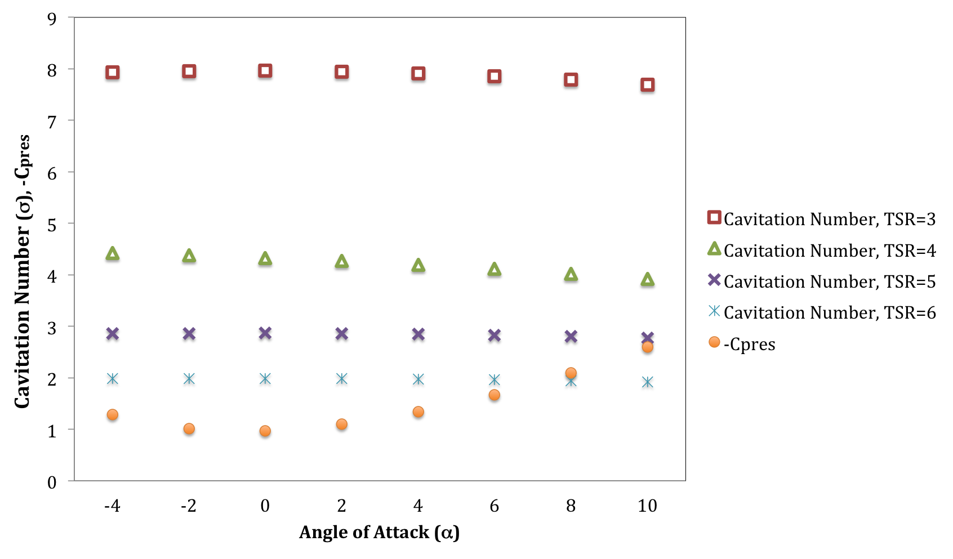
VBM- Cavitation Analysis
Cavitation number < -Cpres => Cavitation occurs
Notes:
the angle of attack at the tip reaches above 10 degrees at a TSR of 5, cavitation is likely to occur.
Minimum negative pressure coefficient

Slide 36
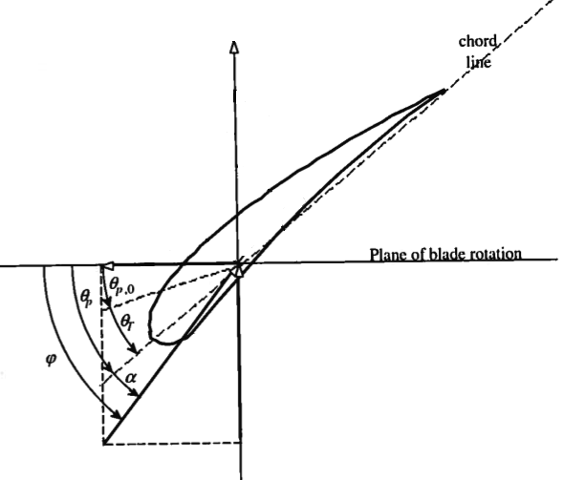
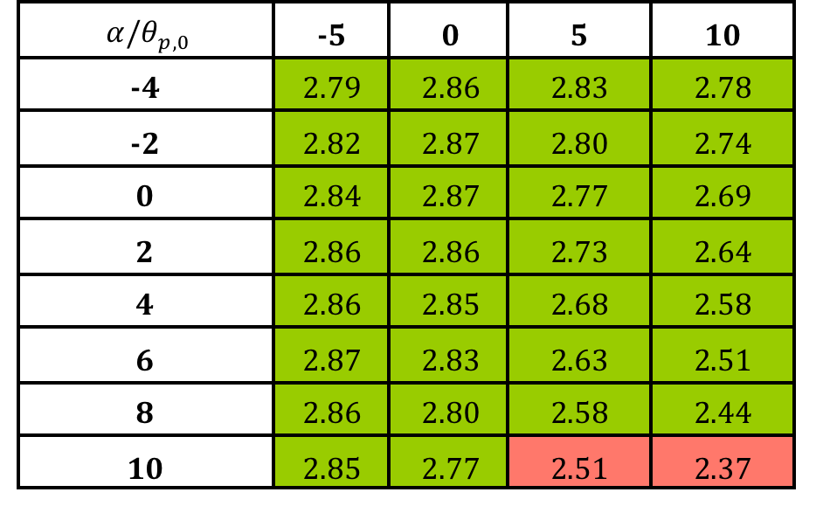
Cavitation- Pitching limit
Cavitation Number at the tip
TSR=5

Slide 37
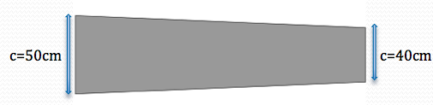
Operating Condition
TSR=5
Pitch the blades from -5 to 10 as long as AOA <8
4 Blades
Hub (D=80cm)

Slide 38
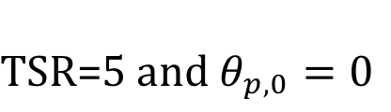
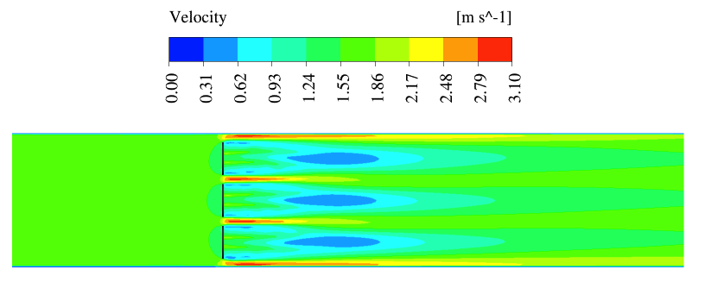
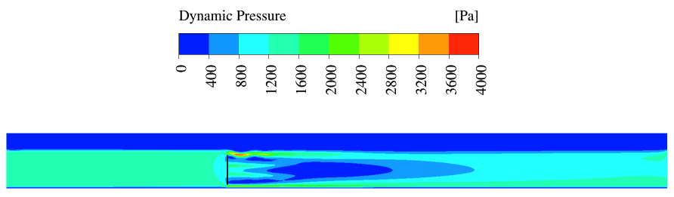
VBM-Results
BR=0.48
Fr=0.24
Notes:
Wake is affected by the free surface drop

Slide 39


VBM- Power Coefficient
93 kw
75 kw

Slide 40


VBM- Dissipation Coefficient
360kw
270 kw
Useful power extraction by the turbines
Mixing
Wake rotation
Notes:
A few arrays of turbines are needed to dissipate the 1MW requirement

Slide 41

Replacing Gates by Turbines
15D
15D
15D
Goal: Dissipate 1 MW
Notes:
4 arrays of turbines to operate in design condition, of turbines are needed to dissipate the 1MW requirement

Slide 42
Approach
1-D theoretical modeling
3-D CFD modeling
  Turbines
    Actuator Disc Model
    Virtual Blade Model
Comparison between models

Slide 43
Comparison between models
 | Computation Time | Turbine Inputs
1-D Theory | Instant | a
ADM | 6 hours | C2=f(a, ∆p)
VBM | 2 days | TSR, θp,0
Notes:
At a given BR and FR--→

Slide 44
Comparison to VBM
VBM
a
a,Δp
1-D theory
ADM
BR=0.48
Notes:
POWER ---VBM--→ Torque[rxF]* w [rad/s]
--- ADM -→ dp*A*ut
1D theory -> power dissipation due to useful power extracted by the turbines, mixing of high velocity bypass flow with wake
ADM -> useful power extracted by the turbines+mixing of high velocity bypass flow with wake+and wake rotation of the turbines
VBM-> useful power extracted by the turbines+mixing of high velocity bypass flow with wake+and wake rotation of the turbines+drag of the turbines

Slide 45
Conclusion
At higher BRs, higher power extraction by turbines and higher power dissipation of the flow
Turbines must be designed for the specific channel geometry to be optimized
Cavitation Analysis is important to find out operating limits of the turbines
4 arrays of turbines are required to replace an array of gates
At high BRs, 1-D theory and ADM over predict extracted power and under predicts the dissipated power

Slide 46
Acknowledgement
Professor Malte
Professor Riley
Dr. Novosselov
Megan Karalus and Shazib Vijlee
Northwest National Marine Renewable Energy Center
Department of Energy

