Slide 1

An Evaluation of Blockage Corrections for a Helical Cross-Flow Turbine
Robert J. Cavagnaro and Dr. Brian Polagye
Northwest National Marine Renewable Energy Center (NNMREC)
University of Washington
Oxford Tidal Energy Workshop
April 7, 2014

Slide 2
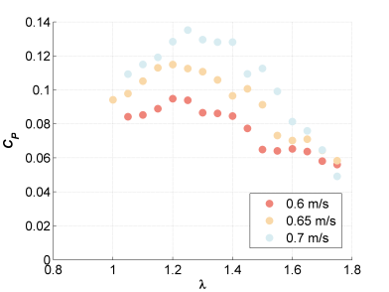
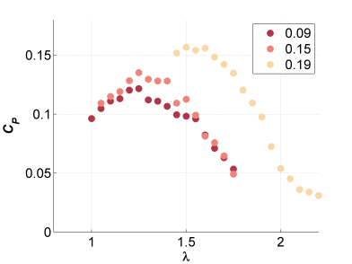
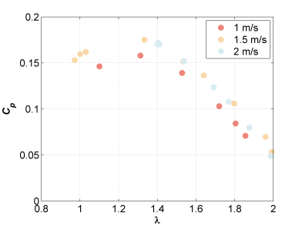
Motivation
NNMREC has developed a “micropower” turbine for providing power to co-located oceanographic equipment
Understand hydrodynamics of the full-scale turbine by testing at lab scale
Determine if corrections rectify variable turbine performance at different testing facilities
Blockage Ratio
Lab-scale – high variability of performance with velocity and facility
Field-scale – limited variability of performance with velocity

Slide 3
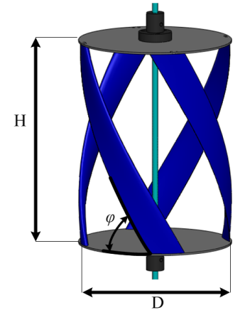
Micropower Rotor Parameters
High-Solidity, Helical Cross-flow turbine
N: Number of blades (4)
H/D: Aspect Ratio (1.4)
φ: Blade helix angle (60º)
σ: Turbine solidity (0.3)
Hydrofoil: NACA-0018
Lab (1/4) scale
  H = 23.4 cm, D = 17.2 cm, c = 4.0 cm
Field Scale
  H = 101.3 cm, D = 72.4 cm
  c = 17.3 cm

Slide 4
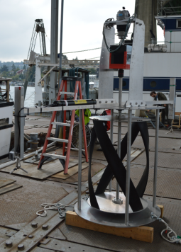
Performance Characterization Experiments
Tow vessel
Tow line (~100 m)
Skiff
(w/ load bank)
Skiff attachment
Adjustable resistive load bank and power monitoring
Direct rotor torque measurement
Angular position measurement
Inflow and wake velocity measurement
  Upstream & downstream Acoustic Doppler Velocimeters
Thrust measurement
Generator & gearbox
Torque sensor & encoder
Upstream ADV
Rotor

Slide 5
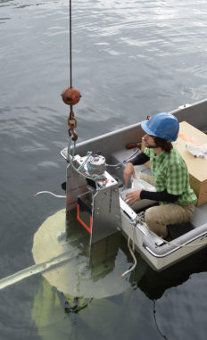
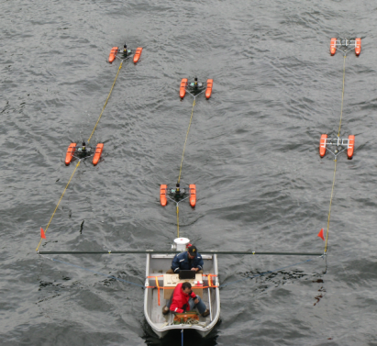
Field Experiment Implementation
Turbine Integration with Skiff
Wake Characterization Experiment

Slide 6
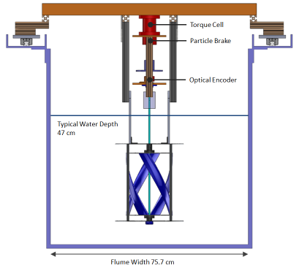
Performance Characterization Experiments
Load cell
Torque control with particle brake
Reaction torque measurement
Angular position measurement
Inflow velocity measurement
  Upstream ADV
Thrust measurement
UW Flume
Scale support cage

Slide 7
Experimental Facilities
Bamfield Flume
UW Aero Flume
Cross Section (m²)
Cross Section (m²)
Flow Speed (m/s)
Flow speed (m/s)
Reynolds Number
Reynolds Number
Blockage Ratio
Blockage Ratio
Froude number
Froude number
Turbulence Intensity
Turbulence Intensity

Slide 8
Blockage Corrections
Corrections rely on various experimental parameters
T

Slide 9
Blockage Corrections: Glauert (1933)
Becomes unstable for C_{T} ≤ 1
T

Slide 10
Blockage Corrections: Pope & Harper (1966)
“… for some unusual shape that needs to be tested in a tunnel, the authors suggest…”
T

Slide 11
Blockage Corrections: Mikkelsen &
Sørensen (2002)
Extension of Glauert’s derivation, constrained channel LMADT
T

Slide 12
Blockage Corrections: Bahaj et al. (2007)
Iterative solution of system of equations, incrementing U₃/U₂
Assumes U₁, ω, T are same in tunnel and open water
T

Slide 13
Blockage Corrections: Werle (2010)
Constrained channel LMADT
Also reached by Garrett & Cummins, 2007 and Houlsby et al., 2008
T

Slide 14
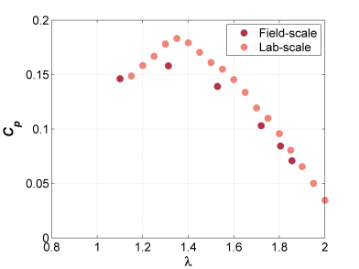
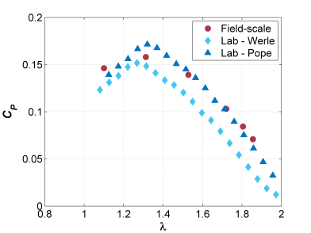
Case 1: Lab to Field Comparison
Same flow speed (1 m/s), different blockage
Field
Lab
No thrust measurements for lab test case at 1 m/s

Slide 15
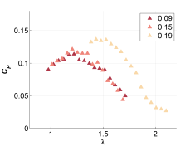
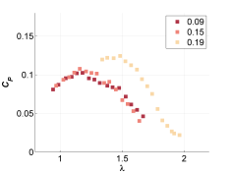
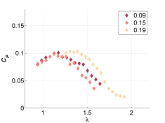
Case 2: Performance with Varying Blockage
Same flow speed (0.7 m/s) at different facilities
Pope & Harper
Bahaj et al.
Werle

Slide 16
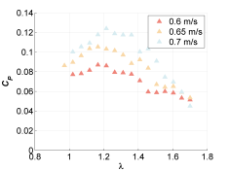
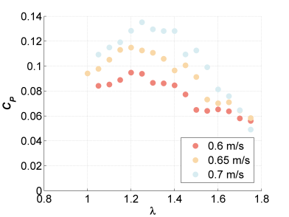
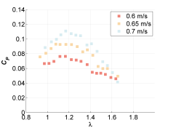
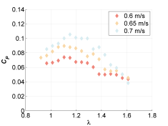
Case 3: Performance at Varying Speed
Same blockage ratio and facility
Indicates strong dependence on Re_{c} at low velocity
Pope & Harper
Bahaj et al.
Werle

Slide 17
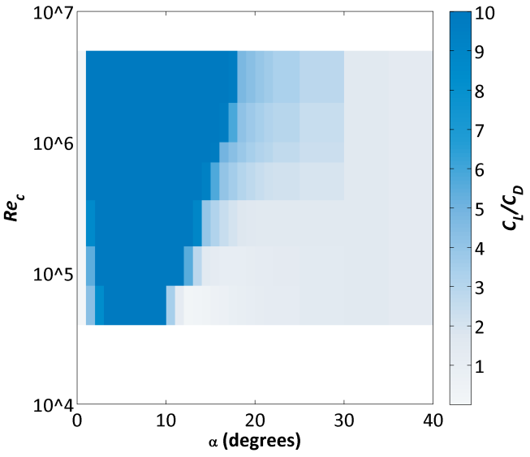
Reynolds Number Effect
Approximate Local Velocity
Sheldahl, R. E. and Klimas, P. C., 1981, “Aerodynamic characteristics of seven airfoil sections through 180 degrees angle of attack for use in aerodynamic analysis of vertical axis wind turbines,” SAND80-2114, March 1981, Sandia National Laboratories, Albuquerque, New Mexico.

Slide 18
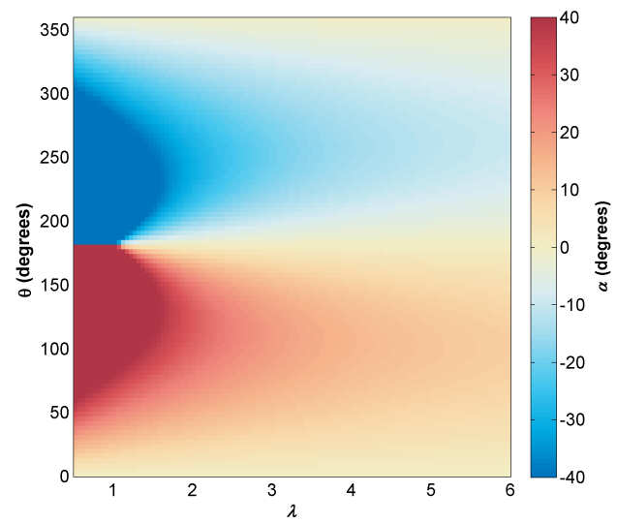
Angle of Attack Variation
Angular Position
Tip Speed Ratio

Slide 19
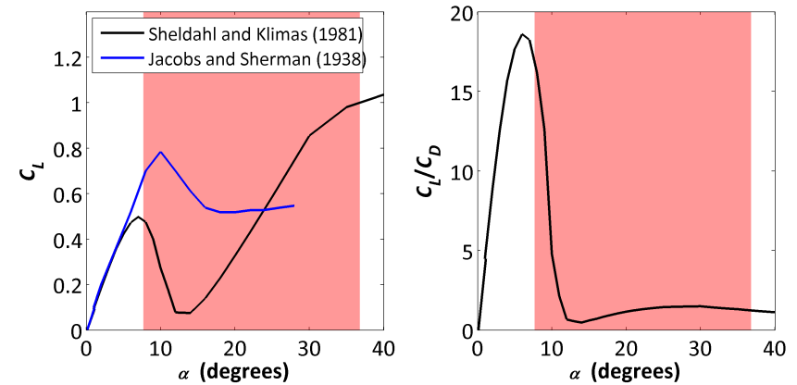
Significance of Dynamic Stall
Range of α at position of maximum torque along each blade

Slide 20
Conclusions
Determining full-scale, unconfined hydrodynamics through use of a model may be challenging
All evaluated corrections reduced scatter of lab scale performance data
Thrust measurements may not be needed to apply a suitable blockage correction
No corrections account for full physics of problem
Family of performance curves at low speed likely due to performance at low Reynolds number and dynamic stall
Caution is needed when applying blockage corrections
  Especially for cross-flow geometry

Slide 21

Acknowledgements
This material is based upon work supported by the Department of Energy under Award Number DE-FG36-08GO18179.
Funding for field-scale turbine fabrication and testing provided by the University of Washington Royalty Research Fund.
Fellowship support was provided by Dr. Roy Martin.
Two senior-level undergraduate Capstone Design teams fabricated the turbine blades and test rig.
Fiona Spencer at UW AA Department and Dr. Eric Clelland at Bamfield Marine Sciences Centre for support and use of their flumes.
Robert Cavagnaro is supported by the Department of Energy (DOE) Office of Energy Efficiency and Renewable Energy (EERE) Postdoctoral Research Awards under the EERE Water Power Program administered by the Oak Ridge Institute for Science and Education (ORISE) for the DOE. ORISE is managed by Oak Ridge Associated Universities (ORAU) under DOE contract number DE-AC05-06OR23100. All opinions expressed in this presentation are the author's and do not necessarily reflect the policies and views of DOE, ORAU, or ORISE.

Slide 22
Blockage Corrections: Bahaj et al. (2007)
Linear Momentum Theory, Actuator Disk Model
Where U₁ is the water speed through the disk
Solved iteratively by incrementing ratio of bypass flow velocity to wake velocity (U₃/U₂)
Free-stream performance and λ derived from velocity correction
Depends on inflow velocity, blockage ratio, and thrust
Bahaj, a. S., Molland, a. F., Chaplin, J. R., & Batten, W. M. J. (2007). Power and thrust measurements of marine current turbines under various hydrodynamic flow conditions in a cavitation tunnel and a towing tank. Renewable Energy, 32(3), 407–426. doi:10.1016/j.renene.2006.01.012

Slide 23
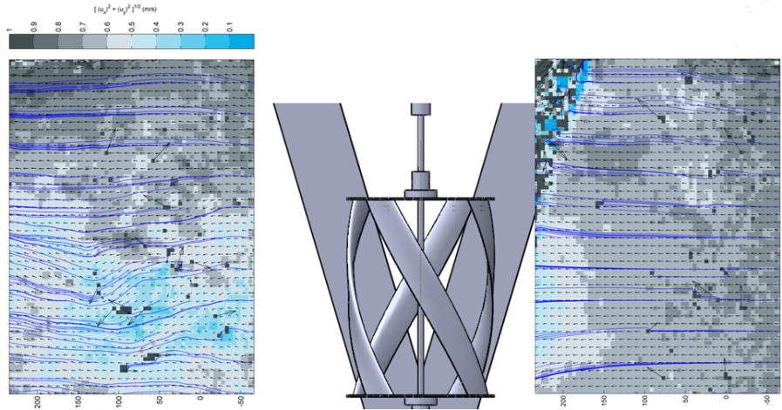
Induction & Wake
Flow direction

