Slide 1
Control of a Helical Cross-flow Current Turbine
Rob Cavagnaro, Brian Fabien, and Brian Polagye
Department of Mechanical Engineering
University of Washington
Northwest National Marine Renewable Energy Center
Current Energy: Design and Optimization I
April 16, 2014

Slide 2
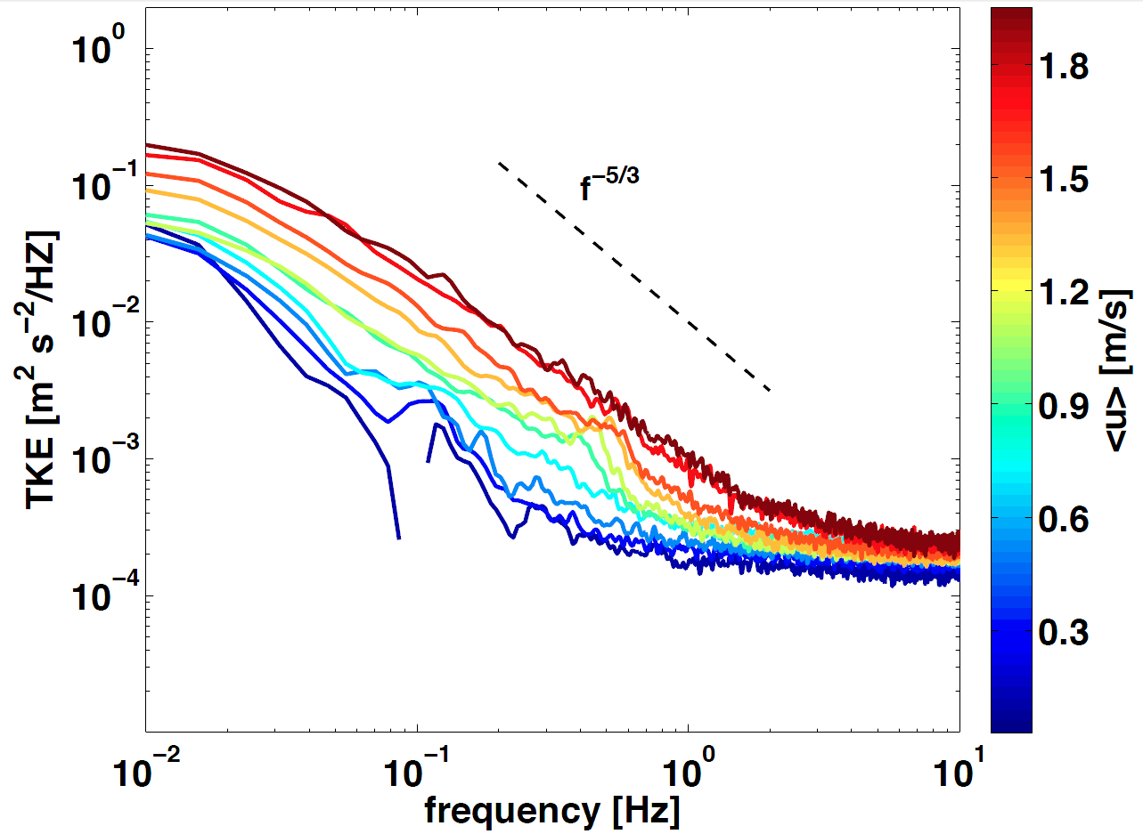
Motivation
Current energy systems operate in turbulent flows
Below rated speed: track turbulent perturbations
Above rated speed: reject turbulent perturbations
Thomson et al. (2013) Tidal turbulence spectra from a compliant mooring, 1st Marine Energy Technology Symposium

Slide 3
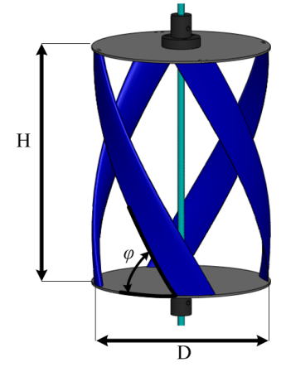
Experimental Cross-flow Turbine
Cross-flow turbine
Helical blades
NACA 0018 profile
N: Number of blades (4)
H/D: Aspect Ratio (1.4)
φ: Blade helix angle (60º)
σ: Turbine solidity (0.3)
Polagye, B., R. Cavagnaro, and A. Niblick (2013) Micropower from Tidal Turbines, ASME Fluids Division Summer Meeting, July 8-11, 2013, Incline Village, NV.
Notes:
Diameter of 17.2 cm, Height of 23.4 cm, Blade chord length of 4.05 cm

Slide 4
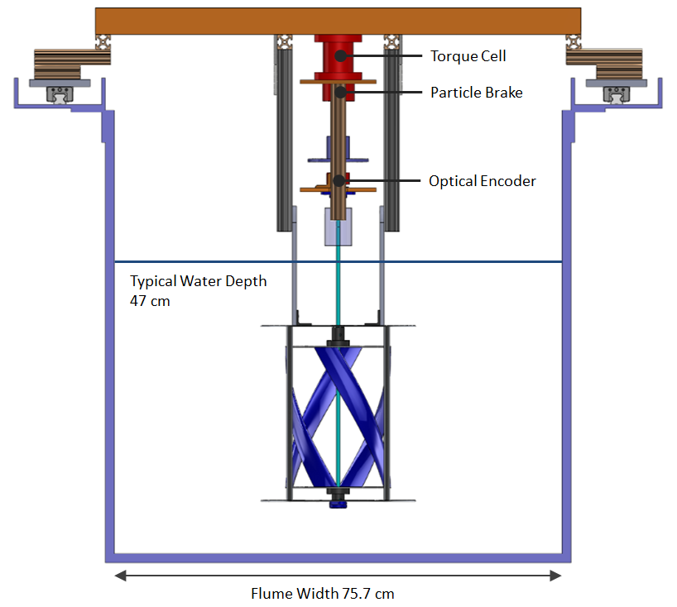
Experimental Testing
Chord Length Re
Blockage Ratio
Froude number
Turbulence Intensity
Notes:
Supporting cage similar to field trials – no significant performance difference between operation with cage and with larger open frame
Velocity measured by upstream ADV (Nortek Vectrino profiler)
Turbulent spectrum - relatively flat (not typical of field conditions, where spectrum is typically “red”)

Slide 5
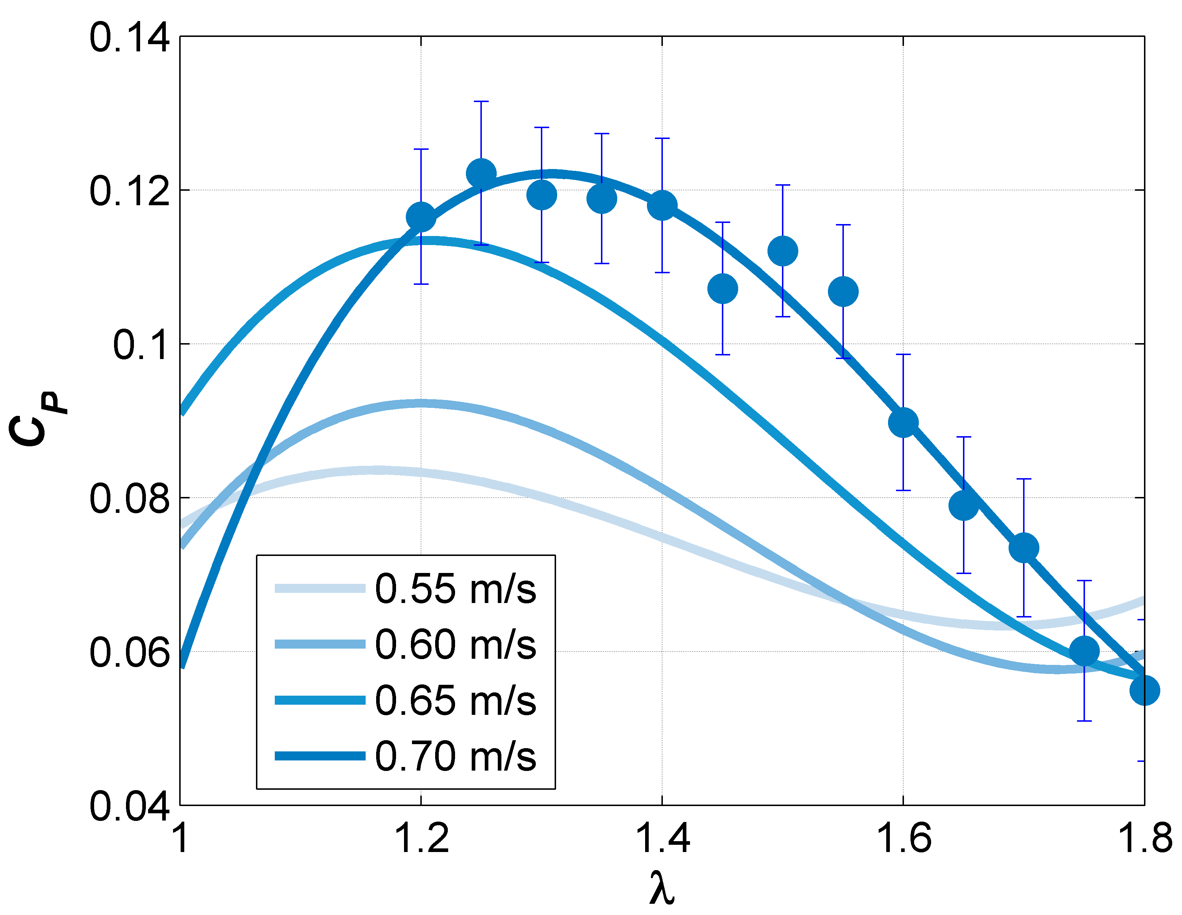
Experimental Performance
Notes:
Peak performance at a TSR of 1.3
Peak Cp on the order of 10% - not exactly unexpected, given the low Re and high solidity
Family of performance curves:
- Consequence of experimental blockage (primary) and Reynolds number (secondary – relatively small increases, but hard to precisely evaluate given importance of dynamic stall)
Lines are 3rd order polynomial fits
Experimental data and uncertainty shown for reference for one velocity
Curves to the left of experimental data are artifacts of the fit (can’t operate there without stalling)

Slide 6
Nonlinear Torque Control
Experimental Performance Curves
Control Torque
(Generator)
ω² term dominates
Rotational Moment of Inertia
(0.011±0.002 kg-m²)
Johnson, K.E., L. Pao, M. Balas, and L.J. Fingersh (2006) Control of Variable-Speed Wind Turbines: Standard and Adaptive Techniques for Maximizing Energy Capture, IEEE Control Systems Magazine
Notes:
J characterized by analyzing acceleration to a step change in control torque
Hydrodynamic torque depends on where one is operating on the Cp-TSR curve
Control torque depends on rotation rate (non-linear term) and gain that is a function of optimal point on Cp-TSR curve
Rotational term dominates in experiments

Slide 7
Nonlinear Torque Control
For perturbations about optimum, controller will “nudge” turbine back to optimal conditions
Exception required for start-up (ω = 0)
Question: Is it possible to harness more power if the system has “preview” information about the inflow?

Slide 8
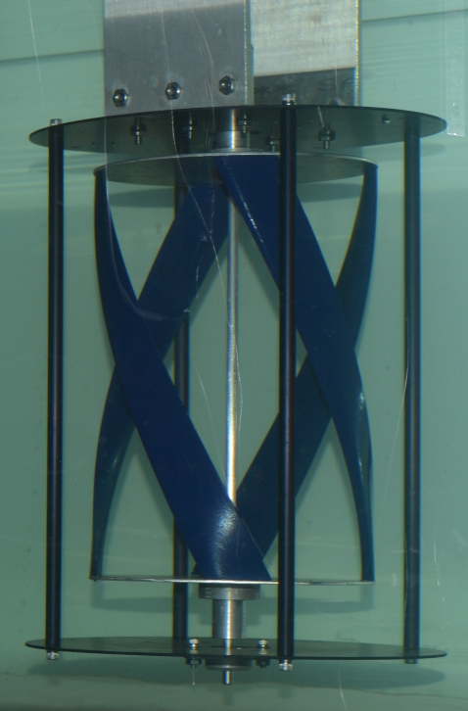
Experimental Implementation
Brake Power Supply
Control and Acquisition Computer
NI DAQ
Data archiving and control torque calculation
(LabView VI)
Acoustic Doppler Velocimeter
Torque Cell and Encoder
Nortek Vectrino Profiler
Notes:
Power supply for brake saturates at 4 V – non-linear control that inherently damps noise in measured rotation rate

Slide 9
Controller 1: Constant K
Inflow
(Controller)
(Generator)
U∞
Kω²
Brake
Turbine
V (τ_{c})
τ_{c}
V
Power
Encoder
ω
ADV
Monitoring Only

Slide 10
Controller 2: Adaptive K
Inflow
(Adaptive Gain)
U∞
K(U∞)
ADV
K
Kω²
Brake
Turbine
V( τ_{c})
τ_{c}
V
Power
Encoder
ω

Slide 11
Controller 3: Adaptive K with Feedback
Inflow
U∞
K(U∞)
ADV
K
Kω²
+
Brake
Turbine
Σ
V(Δτ)
τ_{c}
Power
-
PI Feedback Control
Torque Cell
τ
Encoder
ω
Notes:
Here, we’ve added a feedback controller to compare the command and actual torque.

Slide 12
Experimental Test Cases
Effectiveness Metric
Controller 1: Constant K
U_{guess} = 0.63 m/s (actual <U>)
U_{guess} = 0.5 m/s (bad guess)
Controller 2: Adaptive K
Controller 3: Adaptive K with Torque Feedback

Slide 13
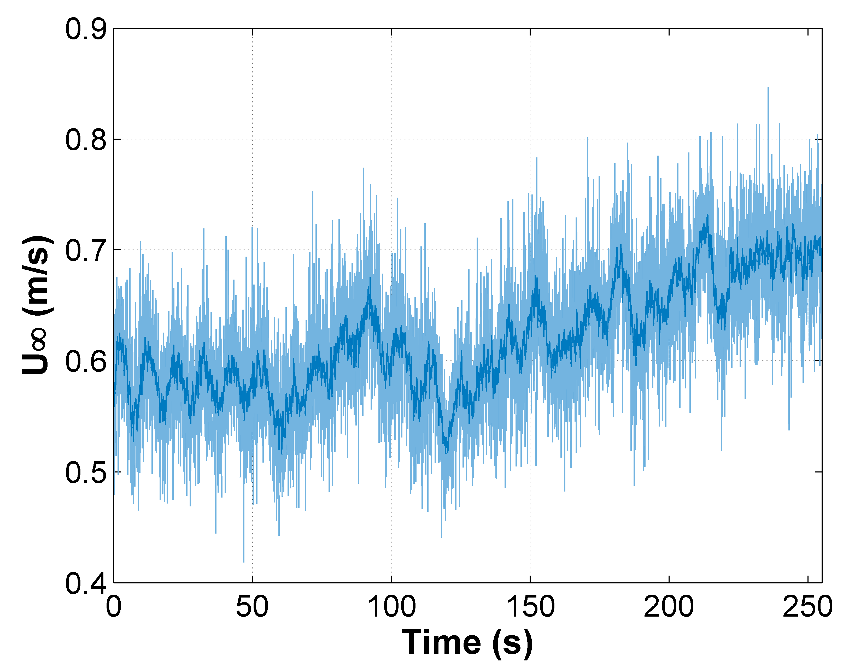
Turbulent Inflow
Notes:
Light blue is ADV measurement at 100 Hz, dark blue is smoothing to 10 Hz (post-processing).
Manual changes in pump frequency based on outcome of “coin toss” random walk algorithm.
Would be preferable to be able to run pump with a user-defined frequency time series.

Slide 14
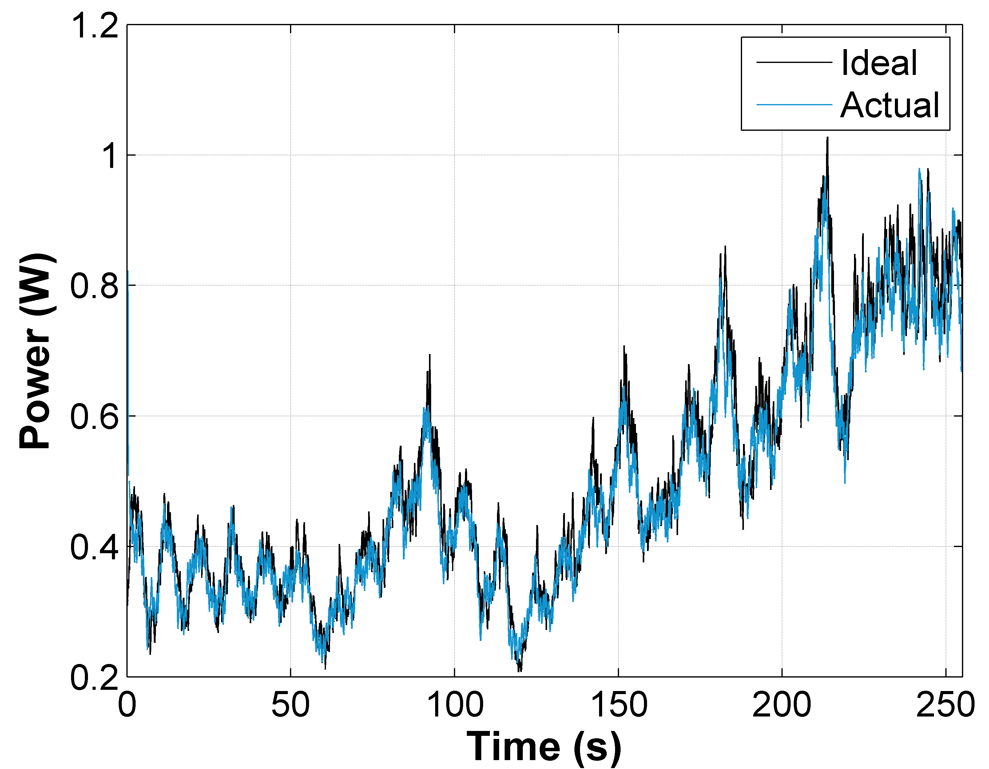
Controller Performance
Nonlinear torque control w/ preview and feedback
Notes:
Visually – tracks the perturbations quite well – though “ideal” is a bit questionable on a point-by-point basis

Slide 15
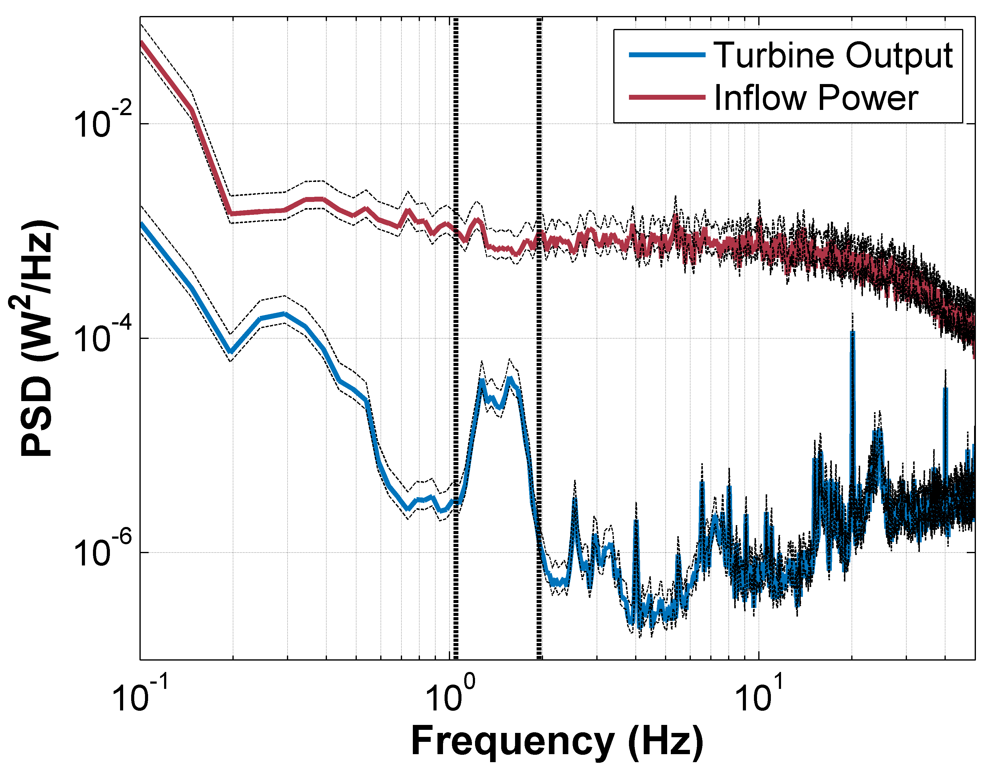
Dynamic Response
Notes:
System non-responsive to fluctuations faster than a half-second – controller update rate needs only to be 10-20 Hz (100 Hz in prototype)
Hypothesis that broad peak around 2 Hz is associated with control actions – broader peak than seen for power spectra of uncontrolled turbine.

Slide 16
Analytical Simulation
Discrete time simulation (Matlab)
Use velocity input from single experiment
Both performance and control based on idealized performance curves
Simulation Cases
Constant speed (ω = constant, based on optimal λ for U₀)
Constant K (good and bad guess)
Adaptive K
Notes:
“Perfect” model – both hydrodynamic performance and MPC based on same idealized performance curves (3rd order polynomial fit)
No run-to-run variation in inflow.
Can also test constant speed case – which is difficult for us to achieve experimentally with the torque control implementation via particle brake (rather than speed control via a stepper motor).

Slide 17
Performance Comparison
Controller | P_{loss} Experiment | P_{loss} Simulation
Constant ω | - | 21%
Constant K
U_{guess} = 0.63 m/s | 11% | 3%
U_{guess} = 0.5 m/s | - | 5%
Adaptive K | 12% | 2%
Adaptive K with Torque Feedback | 4% | -

Slide 18
Future Work
In-situ system identification algorithms
Adapt to changing performance over time
Move away from characteristic performance curves (not reflective of instantaneous performance)
Rejection of turbulent perturbations above rated speed
“Region 3” torque control
Poor option for axial flow turbines due to high torque associated with large moments of inertia
Possible for cross flow turbines with low moments of inertia?

Slide 19
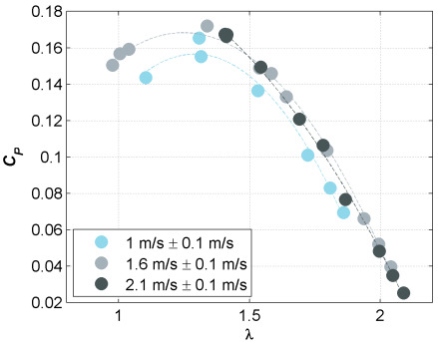
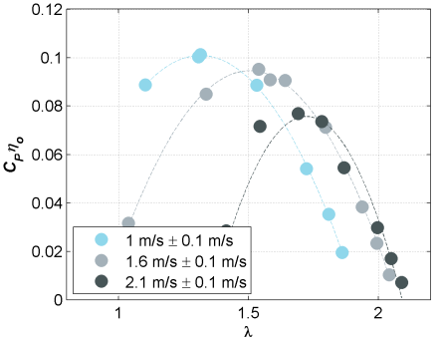
More than a “Toy” Experiment?
Rotor Performance
System Performance
Field-scale (4x scale-up) rotor performance and system performance
Notes:
Also relevant for high-blockage tidal array performance where Cp is likely to vary based on local blockage considerations.
Also relevant for community-scale power systems (e.g., 1-100 kW) where systems would operate at transitional Re.

Slide 20
Conclusions
Laboratory experiments with control helpful to understand aspects of field-scale systems that are not easy to simulate
Rotor stall
Blockage
Operation around transitional Reynolds number
Noisy sensor data for control decision making
Most significant improvement relative to constant speed control (turbine and flow dependent)
Limited performance benefit from preview information in laboratory experiments – small J and “flat” turbulence?

Slide 21
Acknowledgements
This material is based upon work supported by the Department of Energy under FG36-08GO18179-M001.
Thanks also to Fiona Spencer (UW AA Department) for assistance with flume testing, Alberto Aliseda for the loan of the controllable power supply, the University of Washington Royalty Research Fund, and Dr. Roy Martin for his generous financial support of Rob Cavagnaro’s doctoral studies.

