Slide 1
Simulation of Marine Energy Converters in Unsteady Flow using Vortex Particle Methods
Danny Sale and Alberto Aliseda
Northwest National Marine Renewable Energy Center
Dept. of Mechanical Engineering
University of Washington
­­­Proceedings of the 2nd Marine Energy Technology Symposium
METS2014
April 15-18, 2014, Seattle, WA

Slide 2
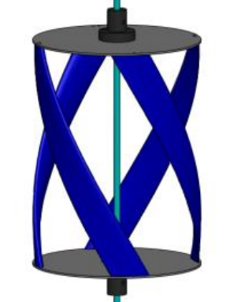
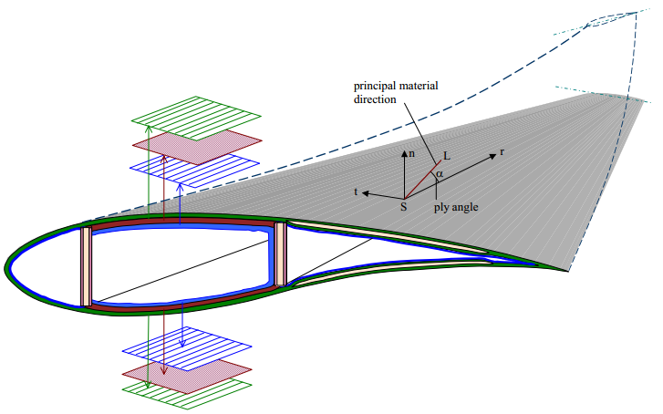
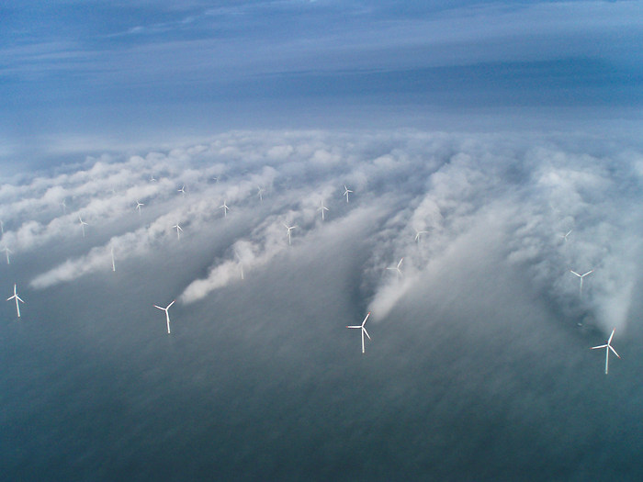
Introduction
  Design & analysis tool for single MEC devices
    capture unsteady forces caused by atmospheric turbulence & rotor-wake interaction
    recover pressure distribution for structural analysis
    blades with complex geometry (built-in curvature, winglets, bio-inspired)
  Scalable computational framework
    should run on laptops/desktops, up to distributed-memory computers
    eventual capability to model farm-scale hydrodynamics

Slide 3









Methods: Viscous Vortex Particle Methods
  Velocity-Vorticity formulation of Navier-Stokes equations
  Particle Discretization
  ODEs for Particle Trajectories & Strengths
  Helmholtz Decomposition
$$\begin{matrix}\frac{Dω}{Dt}≡\frac{∂ω}{∂t}+u⋅∇ω=ω⋅∇u+ν∇^{2}ω\end{matrix}$$
$$ω=∇×u$$
$$∇⋅u=0$$
$$ω\left(x,t\right)\begin{matrix} \\ =\sum_{p}{α^{p}\left(t\right)ζ_{σ}\left(x−x^{p}\left(t\right)\right) }\end{matrix}$$
$$α^{p}={vol}^{p}ω^{p}$$
$$\frac{dx^{p}}{dt}=u\left(x^{p}\left(t\right), t \right)$$
$$\frac{dα^{p}}{dt}=α^{p}⋅∇u(x^{p},t)+ν∇^{2}α^{p}$$
$$\begin{matrix}u= u_{ω}+u_{Φ}+\end{matrix}U_{∞}$$
$${∇^{2}u}_{ω}=−∇×ω$$
[1] Cottet and Koumoutsakos, Vortex methods: theory and practice, Cambridge University Press, 2000.

Slide 4
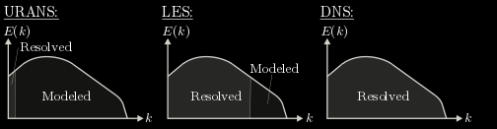

Methods: Viscous Vortex Particle Methods
$$\begin{matrix}\frac{Dω}{Dt}=ω⋅∇u+ν∇^{2}ω\end{matrix}$$
Resolve the RHS of vorticity transport at scales relevant to Marine Energy Converters
Particle Strength Exchange (PSE) algorithm [2]
  “mesh free” method
  RHS transformed into integral approximations (Green’s functions – leads to more Particle-Particle interactions)
  velocity calculated by Particle-Particle interactions -- Biot-Savart O(N²) but accelerated by GPGPU
Vortex-in-Cell (VIC) algorithm [3,4]
  combines particles and meshes
  RHS calculated w/ finite difference methods on mesh
  velocity calculated by Poisson Equation -- long range interactions on mesh via FFT solver reduces to O(NlogN)
  particles and mesh communicate w/ M2P, P2M interpolation -- high order and conservative
[2] Winckelmans and Leonard, “Contributions to Vortex Particle Methods for the Computation of Three-dimensional Incompressible Unsteady Flows,” Journal of Computational Physics, vol. 109, no. 2, pp. 247–273, Dec. 1993.
[3] Rasmussen, Cottet, and Walther, “A multiresolution remeshed Vortex-In-Cell algorithm using patches,” Journal of Computational Physics, vol. 230, no. 17, pp. 6742–6755, Jul. 2011.
[4] Hejlesen, Rasmussen, Chatelain, and Walther, “A high order solver for the unbounded Poisson equation,” Journal of Computational Physics, vol. 252, pp. 458–467, Nov. 2013.

Slide 5
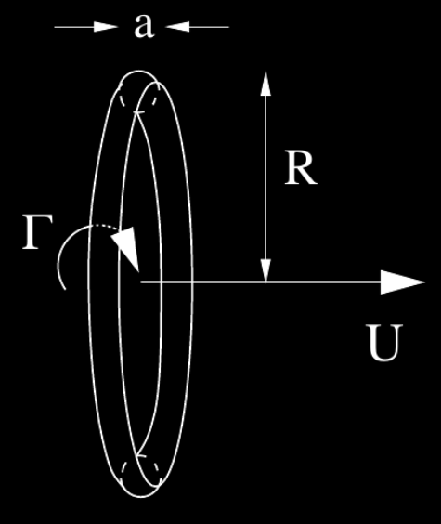
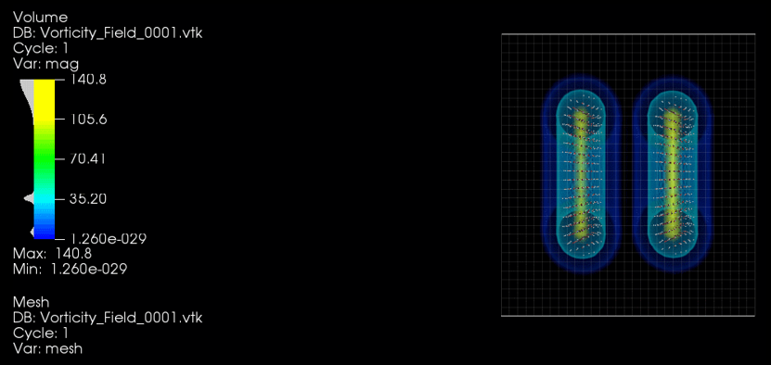
Vortex Rings
Benchmark problems
  Comparison with analytical solutions & experiments
  Verify accurate treatment of stretching & viscous terms
  Develop mesh & “mesh free” visualization techniques
  Fun to watch

Slide 6
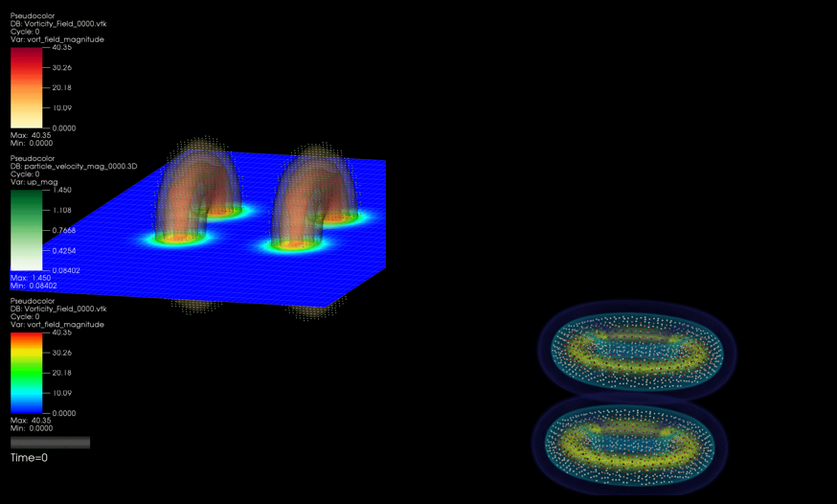
Vortex Rings
  (LEFT) Solid boundaries modeled by ‘image particles’, satisfying “wall-slip” Neumann BC
  (RIGHT) Testing breakup and decay of concentrated vorticity

Slide 7
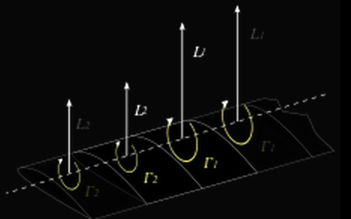
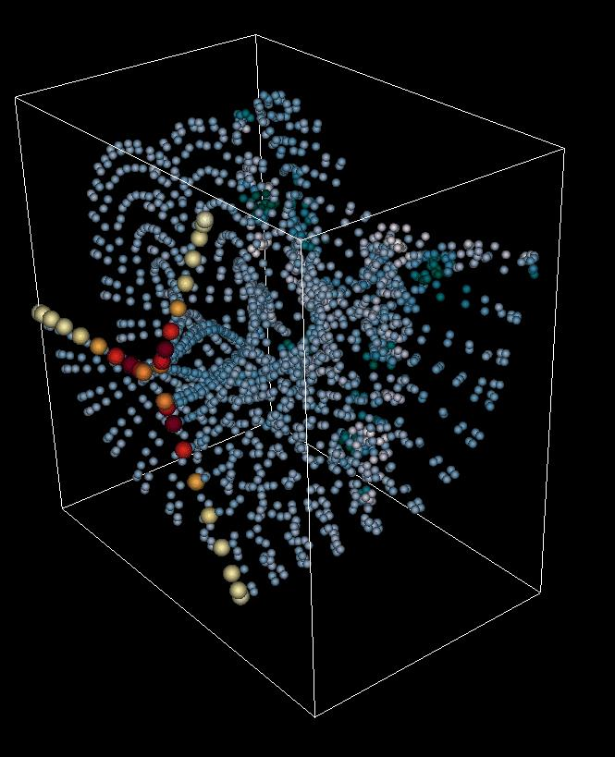
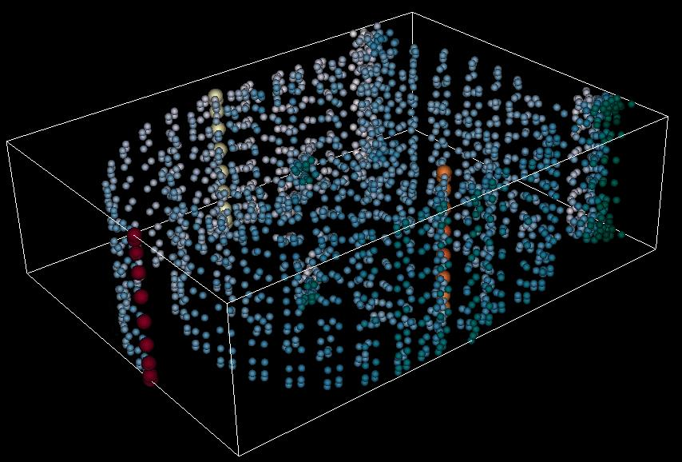



Simulation of Hydrokinetic Turbines
Added lifting-lines to PSE code
  Turbine specifications based on DOE Reference Models
  Basic rotor speed and pitch control capability
  Relies on lookup of 2D airfoil data (Cl, Cd, Cm, Cp_min)
$$u_{ω}$$
$$U_{∞}$$
$$U_{∞}$$

Slide 8
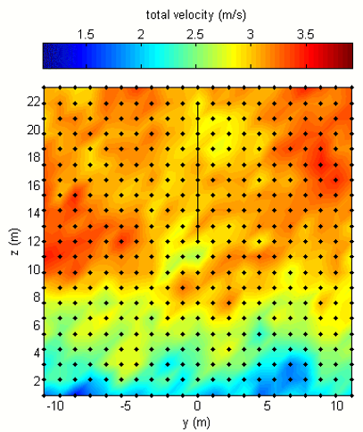
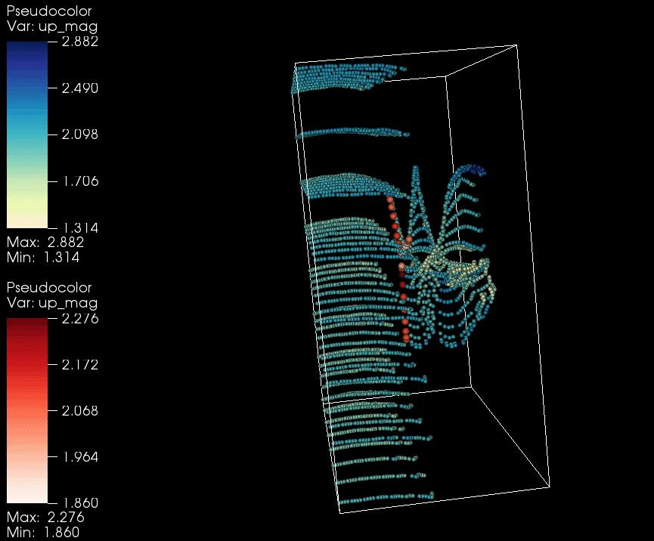


Synthetic Turbulence
  Inject vortex particle representation of synthesized turbulent velocity field
  Energy spectrums characteristic of oceanic flows (pyTurbSim code tidal version)
  Key assumption: “Taylor's frozen turbulence”
$$u_{ω}$$
$$U_{∞}$$

Slide 9
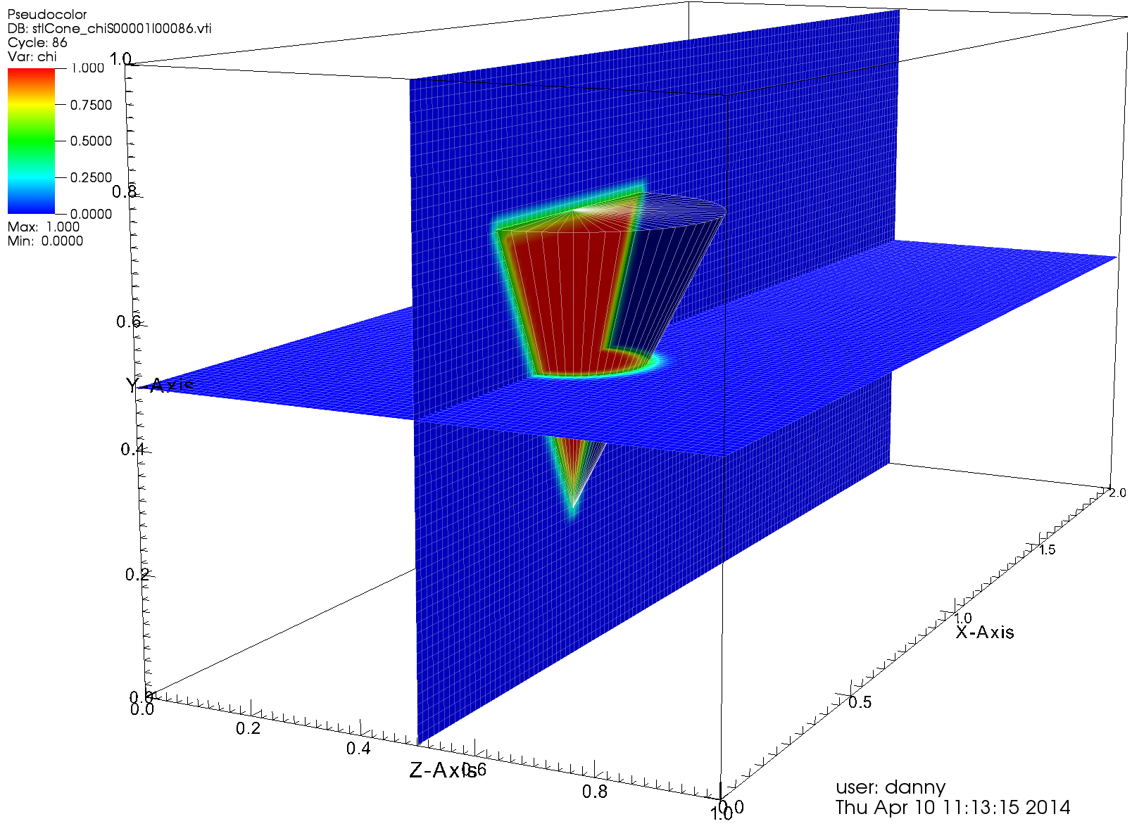

Immersed Boundary Method
  Add Brinkman penalization term to Vorticity Transport Equation
    Brinkman penalization models solid boundaries ‘in the limit’ of zero porosity
    Satisfies “no-slip” boundary conditions at fluid-solid interface
    Immersed boundary greatly simplifies dealing with meshing
$$\begin{matrix}\frac{Dω}{Dt}=ω⋅∇u+ν∇^{2}ω+λ∇×\left[χ\left(u_{s}−u\right)\right]\end{matrix}$$
[3] Rasmussen, Cottet, and Walther, “A multiresolution remeshed Vortex-In-Cell algorithm using patches,” Journal of Computational Physics, vol. 230, no. 17, pp. 6742–6755, Jul. 2011.

Slide 10
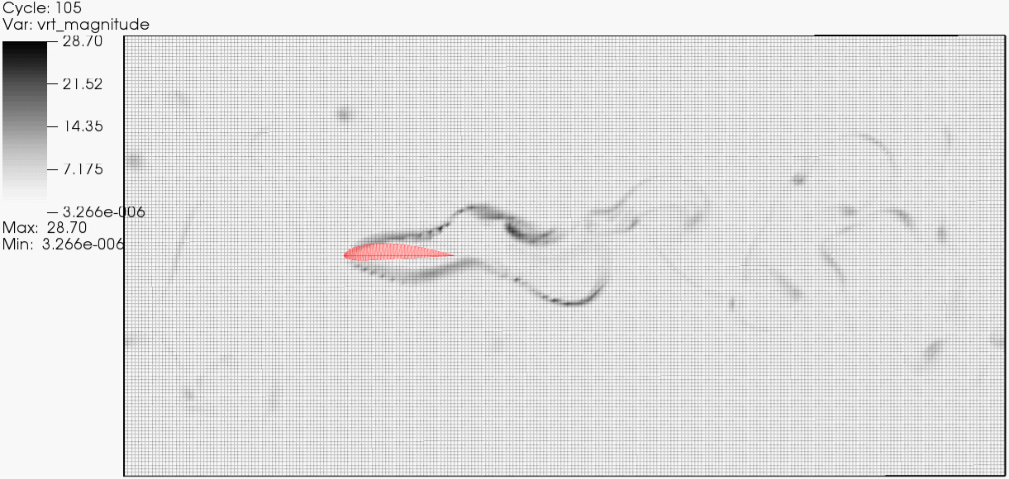
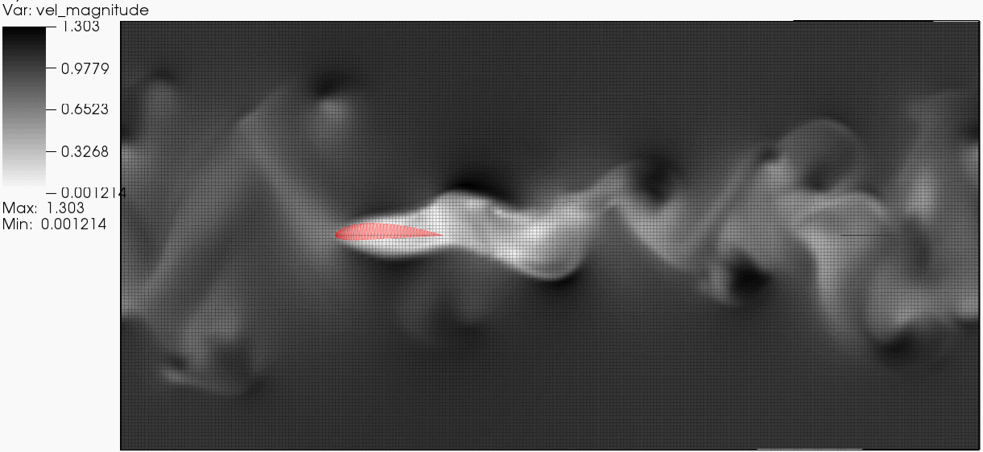
Immersed Boundary Method
  NACA 4415 wing using 3D VIC method with Brinkman penalization

Slide 11
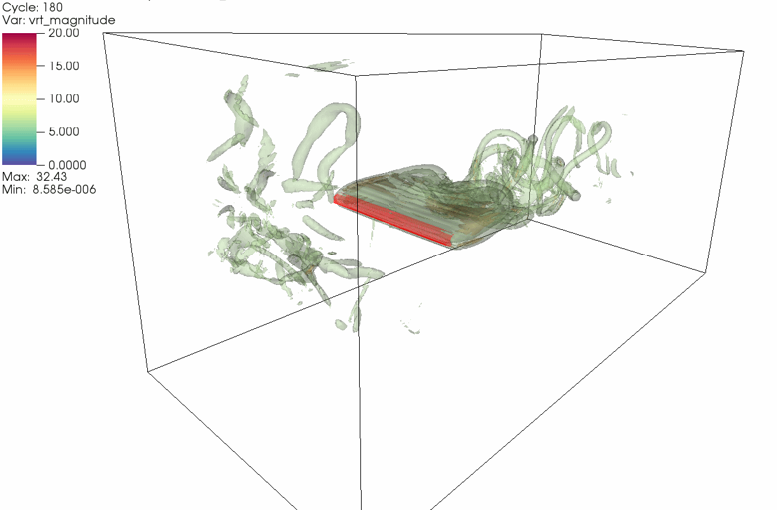
Immersed Boundary Method
  NACA 4415 wing using 3D VIC method with Brinkman penalization
    chord Reynolds = 2000, 256 x 128 x 128 mesh, simulate 20s physical time, dt=0.1s
    Run on single CPU, ~8 hour runtime, ~30 GiB data (velocity & vorticity fields)

Slide 12
Summary & Conclusions
Progress to Date
  Developing viscous vortex particle methods (PSE and VIC algorithms)
  Matlab and Fortran + PPM Library implementations
  Benchmark problems (vortex rings, lifting lines, bluff body flows … )
  HAWT and VAWT with basic rotor/pitch control & synthetic turbulence
  Immersed boundary method allowing generalized 3D geometry
Future Enhancements
  Add moving 3D geometry in immersed boundary method (IBM)
  Need to achieve flow with higher Reynolds
  Continue with massively parallel version based on MPI and OpenCL
  Combine PSE and VIC methods to include more flexible boundary conditions
  Need more efficient resolution in near field of immersed boundaries

Slide 13
Thank you!
Questions? Suggestions?
This work has also been made possible by:
  National Science Foundation Graduate Research Fellowship under Grant No. DGE-0718124
  University of Washington, Northwest National Marine Renewable Energy Center
  Department of Energy, National Renewable Energy Laboratory
Special thanks to Johannes Tophøj Rasmussen and Mads Mølholm Hejlesen for guidance with PPM Library code and FFT Poisson solver

