Slide 1
Development of an Adaptable Monitoring Package for Marine Renewable Energy Projects
Part 2: Hydrodynamic Performance
James Joslin, Brian Polagye, Andy Stewart, and Ben Rush
University of Washington
Northwest National Marine Renewable Energy Center
MECs and the Environment: Monitoring
April 17, 2014
Notes:
Thank you Brian for the introduction.
-Talking about the hydrodynamic analysis of the AMP and MF

Slide 2
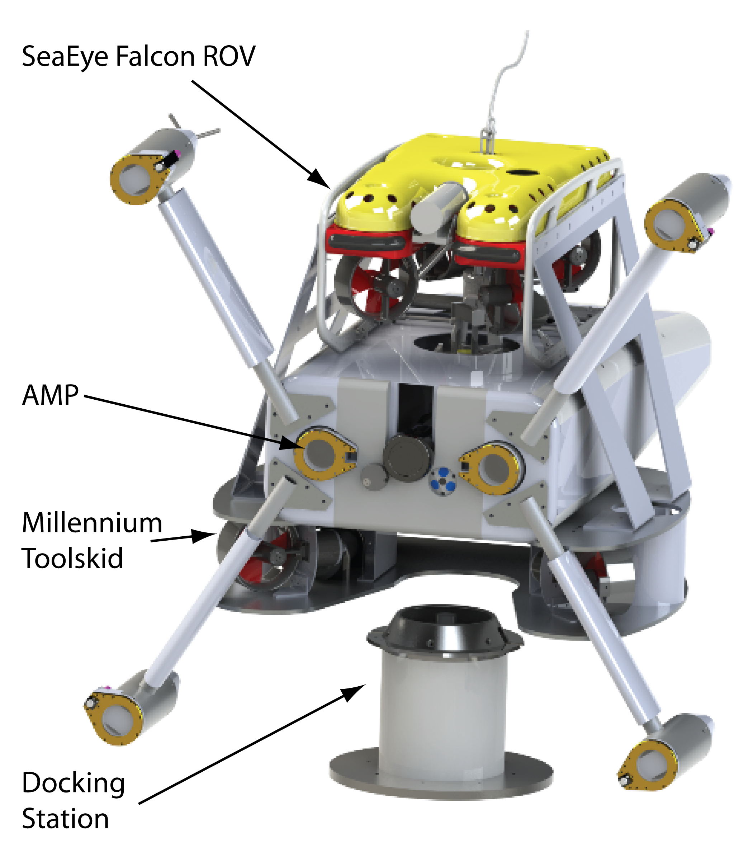
Project Motivation
Inform component and system design at an early stage
Develop methods to rapidly evaluate design changes
Enable future simulation and controller implementations
AMP and Millennium Falcon Design by Andy Stewart, Ben Rush and Paul Gibbs of APL
Notes:
Inform system design at an stage of the development
Can we get away with using a small inspection class ROV to deploy this system?

Slide 3
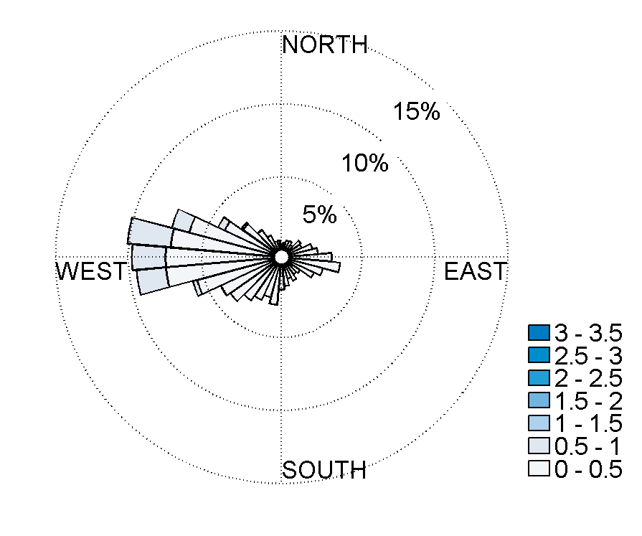
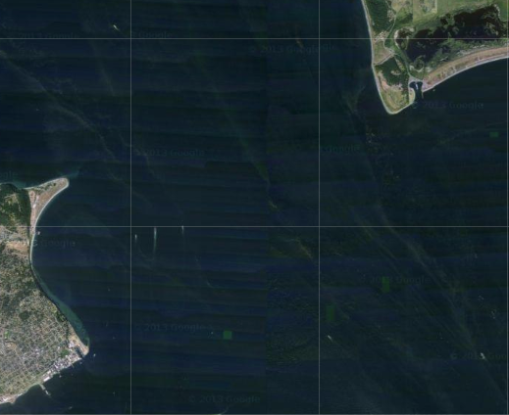
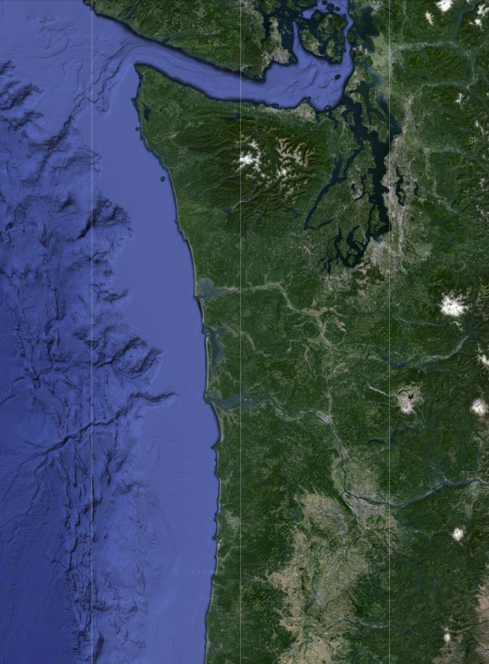
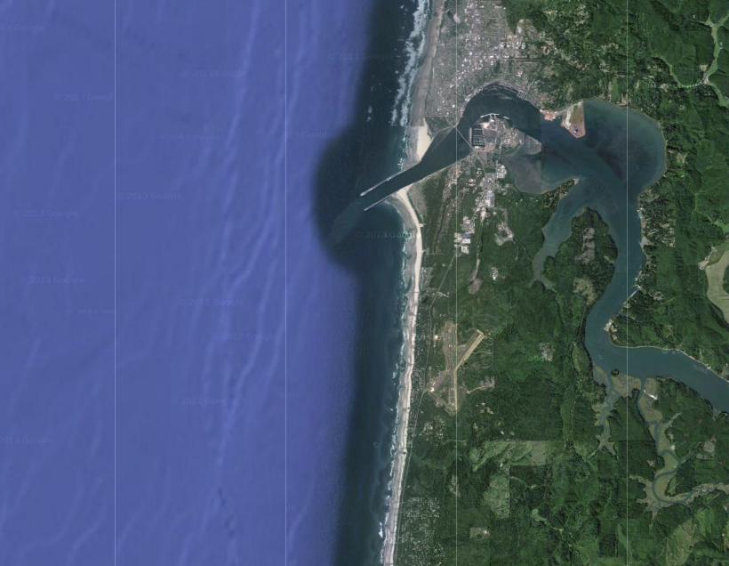
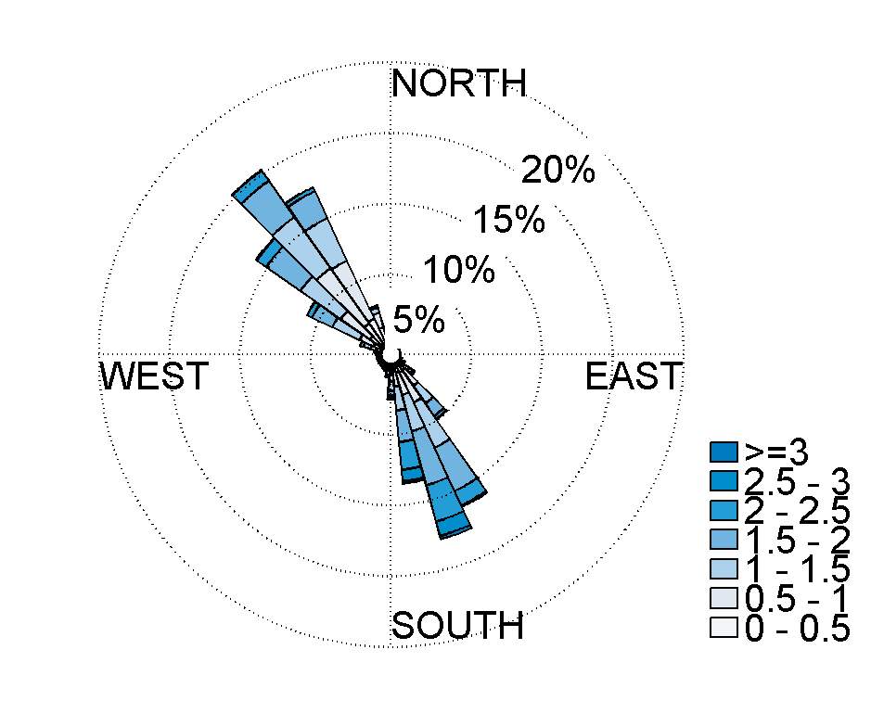
Marine Energy Sites
Ocean Currents
Admiralty Inlet,
Puget Sound, WA
Pacific Northwest
Newport, Oregon
North Energy Test Site
Tidal Currents
Notes:
Where this system will be used first.
Currents and wave forces determine the design loads.

Slide 4
Design Loads
Design loads determined from site current and wave forces:
Operational peak currents: 5.4 m/s
Deployment current limit: 0.7 m/s
 | Admiralty Inlet | Newport, Oregon
Currents | mean x storm surge x turbulence ≤ 5.4 | mean x turbulence ≤ 1.3
Waves | ≈ 0 | ?
Notes:
Looking at the conditions at these two different sites
Determined the maximum currents by considering the peak mean, storm surge, and turbulence.
These led to …
Then the two conditions that we are interested in analyzing are during deployments of the AMP with the MF and during mounted operations

Slide 5
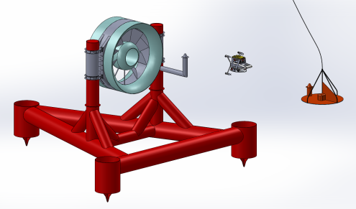
Loads During Deployments
Umbilical
AMP and “Millennium” Falcon
Launch Platform
Current Direction
Question: What is the current limit for maneuverability?
Notes:
- As Brian described, during deployments the MF will be used to fly the AMP from the LP to the docking station on the turbine

Slide 6
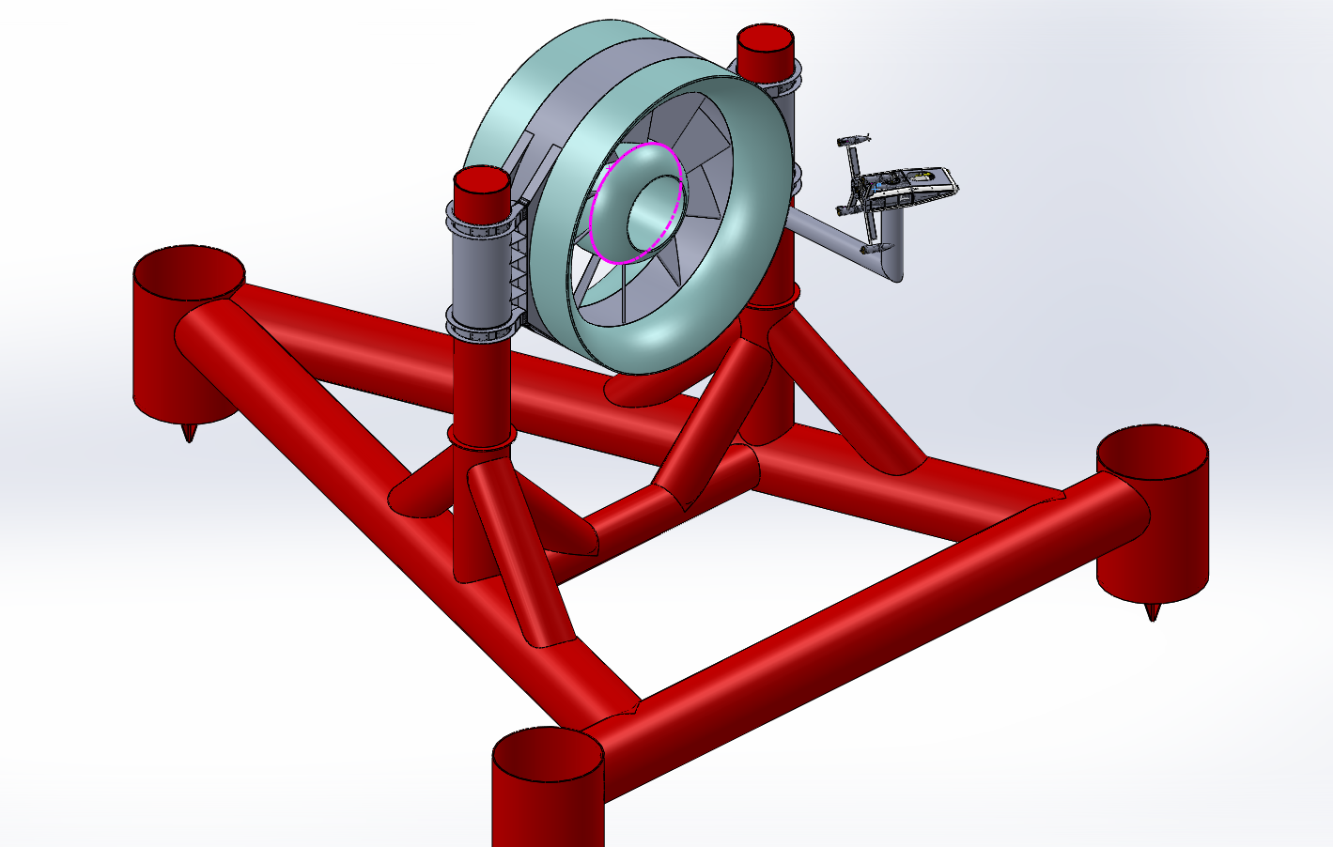
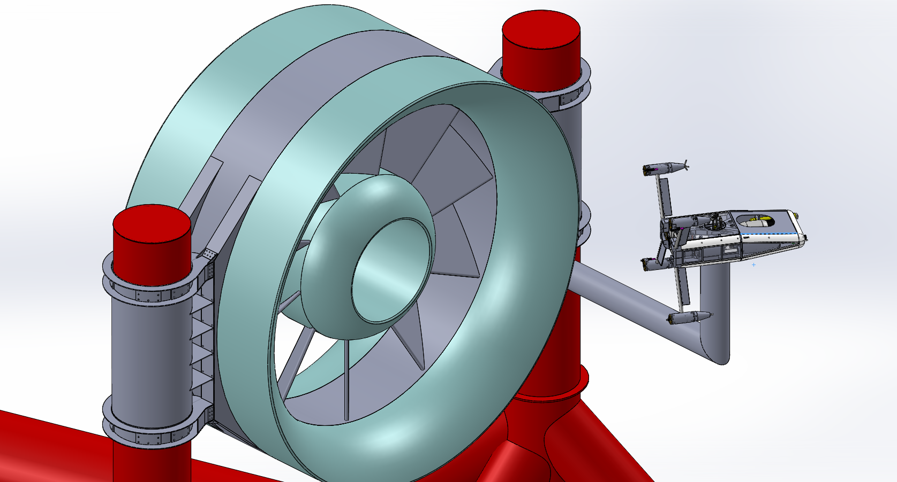
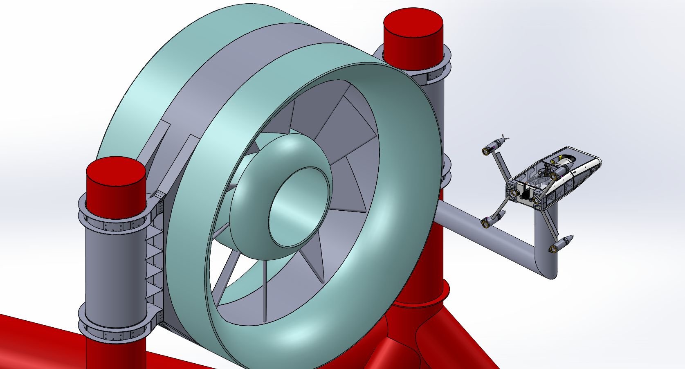
Loads in Operational Orientations
AMP prototype model on OpenHydro 6 meter turbine
AMP angled to face the turbine rotor
AMP facing the turbine wake
AMP facing the support structure
Question: What are the structural loads on the AMP?
Notes:
During mounted operation, the AMP will be exposed to the peak currents at the site.
Considering the lateral loading to be the worst case for these currents.

Slide 7
ROV Equations of Motion
Dynamic equation of motion for marine robotics:
Inertial Forces
Drag
Thrust
Coriolis and
Centripetal
Gravity and
Buoyancy
Notes:
-To get into a little of the math behind this analysis, you can start with the basic dynamic equation of motion for an ROV.

Slide 8
ROV Equations of Motion
Dynamic equation of motion for marine robotics:
Inertial Forces
Drag
Thrust
Coriolis and
Centripetal
Gravity and
Buoyancy
Simplified equation for translation on a single axis:
Notes:
Considering simple translational motion on one axis, the equation simplifies to…
-Need to determine values for the added mass term and drag coefficient.

Slide 9
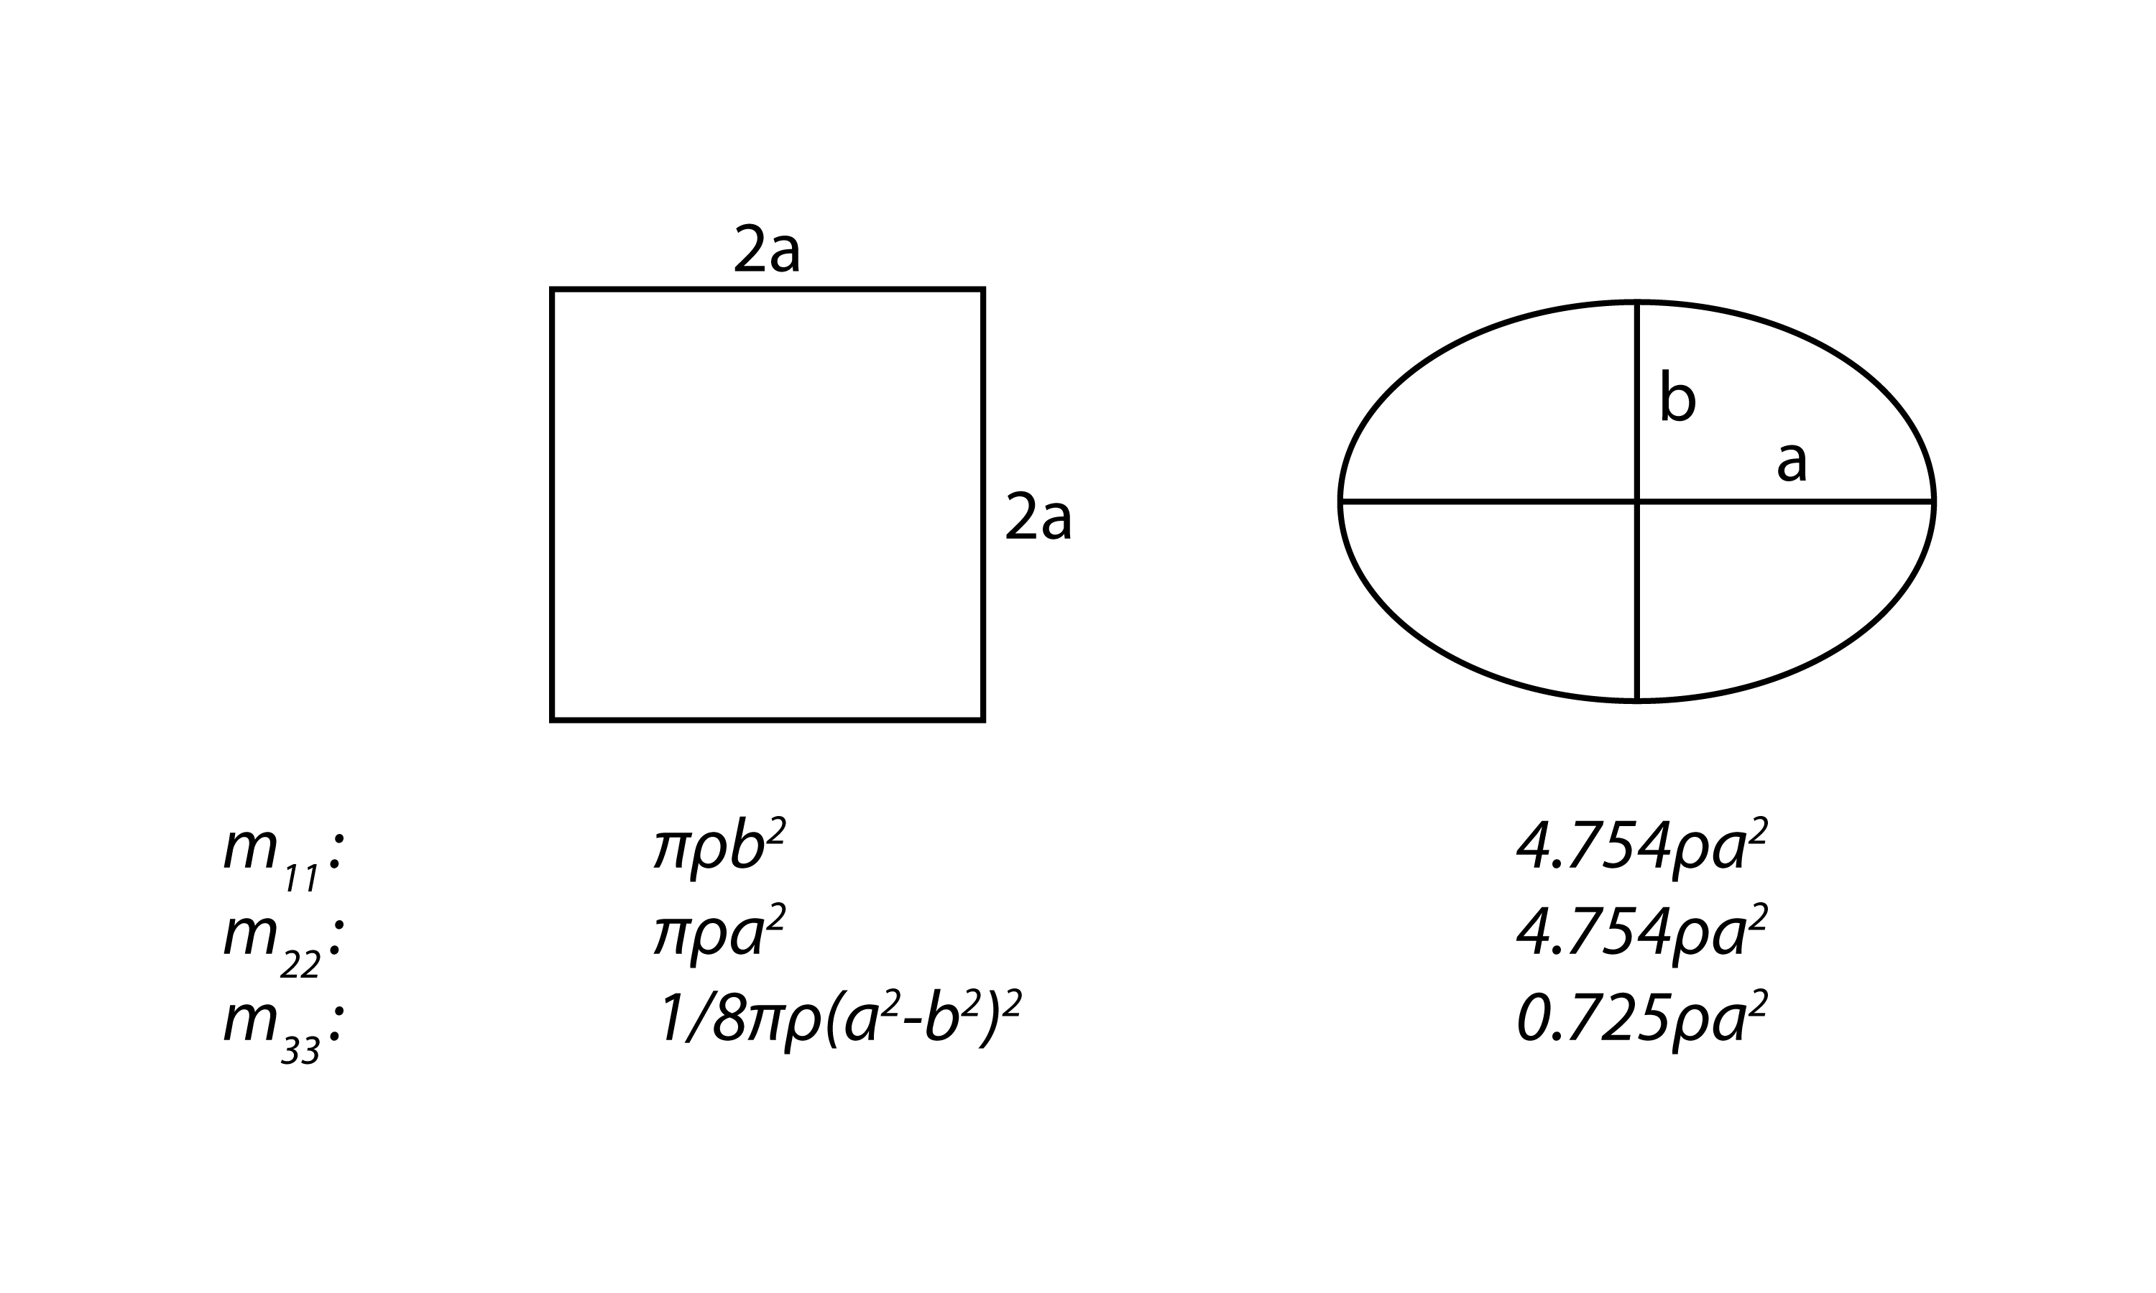
“Added Mass”
Definition: The inertia added to a body during acceleration or deceleration due to the fluid volume that moves with it.
Volume of Added Mass
ROV
Analytical equations for added mass of simple geometries (Lamb, H., 1932)
Direction of Acceleration
Complication: Enclosed mass vs. added mass for open framed vehicles.
Notes:
There are some analytical solutions and numerical software that can be used to estimate these values.
Unfortunately, they do not do well for the complicated geometry of partially open framed ROVs.
Need to measure these values experimentally.

Slide 10
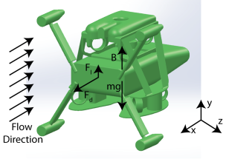
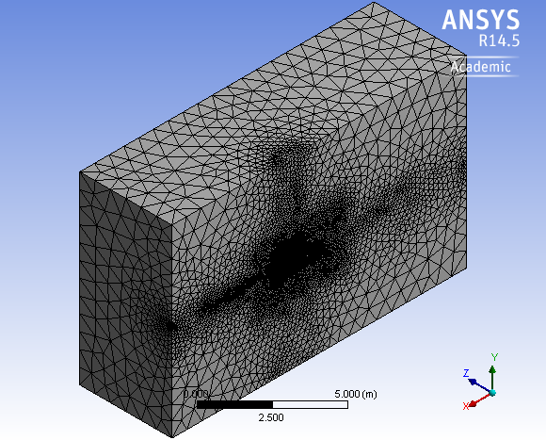
CFD Motivation
Steady-state simulations to determine lift and drag coefficients and center of pressure
Unstructured tetrahedral mesh with the k-ω SST turbulence model.
CFD sensitivity studies:
Meshing refinements: Coarse, Medium, and Fine
Input velocity: 0.5 m/s, 1.0 m/s, and 1.5 m/s
Model free body diagram
ANSYS fluid domain meshing
Notes:
Use CFD simulations to determine the coefficients of lift and drag and the center of pressure.
3D simulations performed in Ansys Fluent with unstructured tetrahedral mesh.
-Sensitivity studies were performed to evaluate the variation in drag with velocity and mesh resolution.

Slide 11
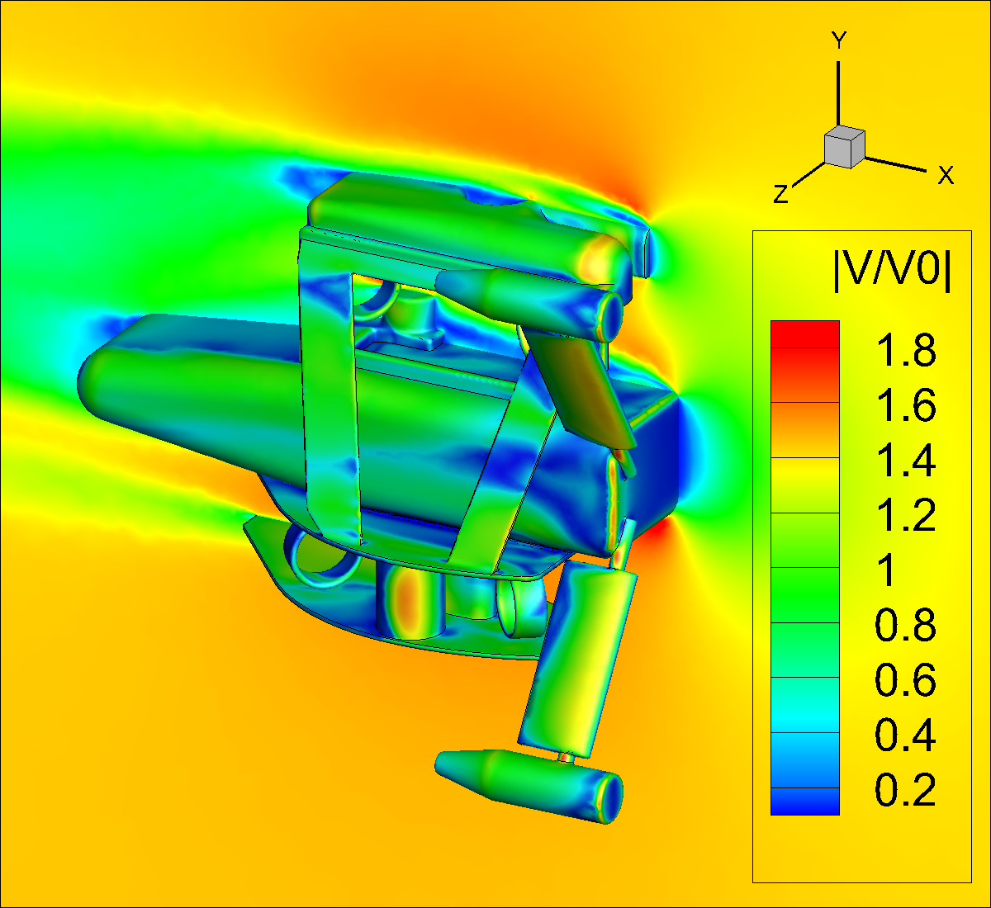
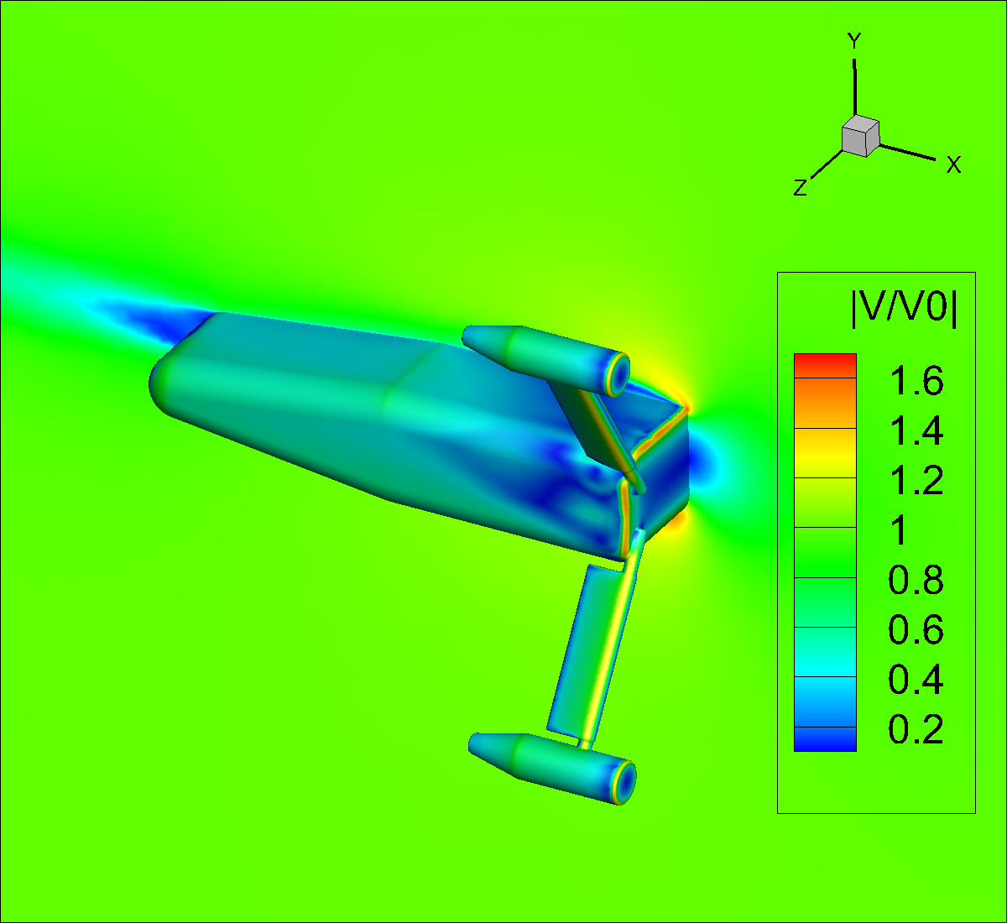
CFD Simulation Results
Sensitivity study variability in drag force:
Grid dependence: < 3.50%
Velocity dependence: < 1.1%
Normalized velocity around the “Millennium” Falcon and AMP during deployments
Normalized velocity around AMP during mounted operation
Notes:
The sensitivity studies showed small dependence on both the mesh resolution and velocity.

Slide 12
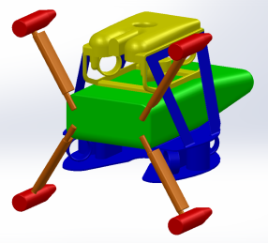
CFD Drag Force Results
Drag coefficient during deployments: C_{d} ≅ 0.67
Peak loads during mounted operations:
Horizontal: 7,880 N
Vertical: 608 N
AMP components
Drag forces and coefficients of the AMP by component
Notes:
During deployments this drag coefficient should allow us to maintain maneuverability in currents beyond our design spec. of 0.7 m/s
For mounted operations, the results helped to specify the design loads for the securement system of the AMP.
We wanted to verify these results through experimentation.

Slide 13
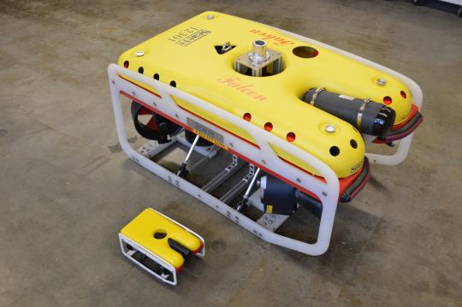
Quarter Scale Model
Scale model rapid protyped on a Stratasys 3D printer.
Weighted with lead to achieve desired pendulum velocities > 0.8 m/s
Future testing with printed models of AMP and Millennium components
Falcon ROV with 3D printed quarter scale model
Notes:
Chose to start by looking at the Falcon ROV because we had already received the full scale ROV

Slide 14
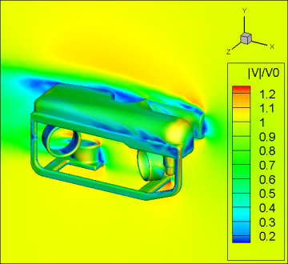
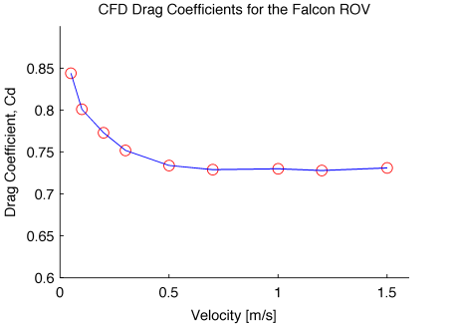
Falcon ROV Simulations
Drag coefficient approximately constant at velocities > 0.2 m/s
Limit scale model results analysis to velocities > 0.8 m/s for Reynolds number matching.
ROV simulation results with normalized flow velocity
ROV drag coefficient velocity dependence
Notes:
Performed similar CFD simulations of the ROV, in particular to look at the dependence of drag on velocity to allow for reynolds number matching between the scale model and ROV.
-Consider experimental velocities greater than 0.2 or 0.8 m/s

Slide 15
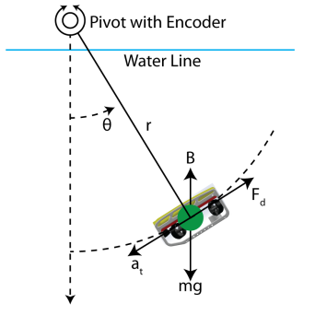
Free-Decay Pendulum Motion
Damped pendulum equation of motion:
With quadratic drag:
And for rotational motion:
The equation of motion may be written as:
With:
Pendulum free body diagram
Least squares regression to estimate α and β from ten swings of the pendulum

Slide 16
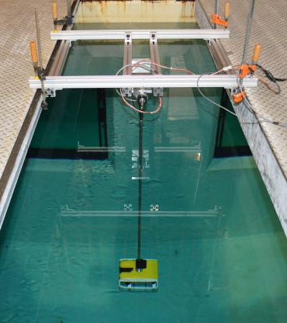
Pendulum Testing
¼ scale model mounted to pendulum arm
Incremental angular encoder to measure pendulum position
Data filtering to calculate angular velocity and acceleration through the finite differencing method
Pendulum test setup in the Oceanography test tank
Notes:
Show geometry of the current AMP model and the two simplified geometries used.

Slide 17
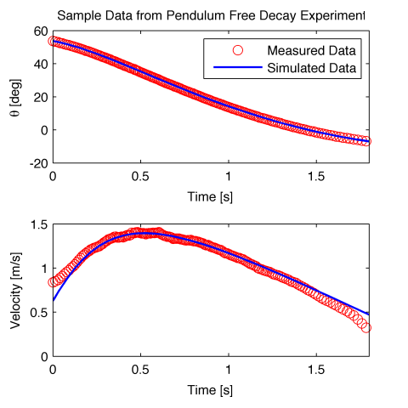
Pendulum Test Results
Estimated added mass term [kg]:
¼ Scale Model: 2.95 ± 0.4
Falcon ROV: 114.9 ± 14.4
Estimated drag coefficient:
CFD Simulations: 0.67
¼ Scale Model: 0.77 ± 0.009
Falcon ROV: 0.83 ±0.057
Simplified equation for translation on a single axis:
Sample data from individual scale model swing

Slide 18
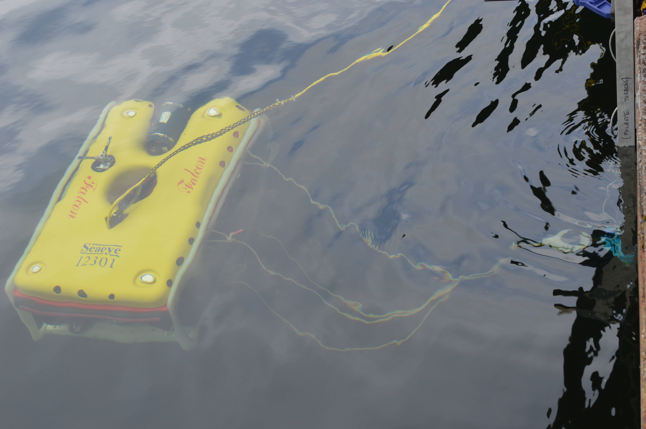
Bollard Thrust Measurements
Thrust measurements on primary axes in kgf
Axis | Manufacturer Specified | Measured
Surge, x | 50 | 44
Sway, y | 28 | 30
Heave, z | 13 | 17
Measured thrust in surge direction
Falcon with load ring and harness for abeam measurements
Measured thrust in sway direction

Slide 19
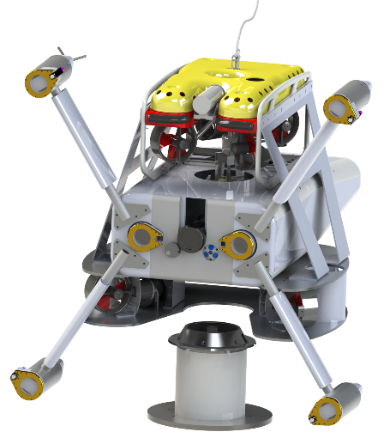
Big Picture Summary
Initial testing indicates that the system meets the design requirements.
Deployment capabilities in currents with mean velocity < 0.7 m/s.
Drag loads during operation used to design the docking securement system.
CFD and pendulum testing are effective tools for measuring hydrodynamic coefficients.
Notes:
Still need to change this slide

Slide 20
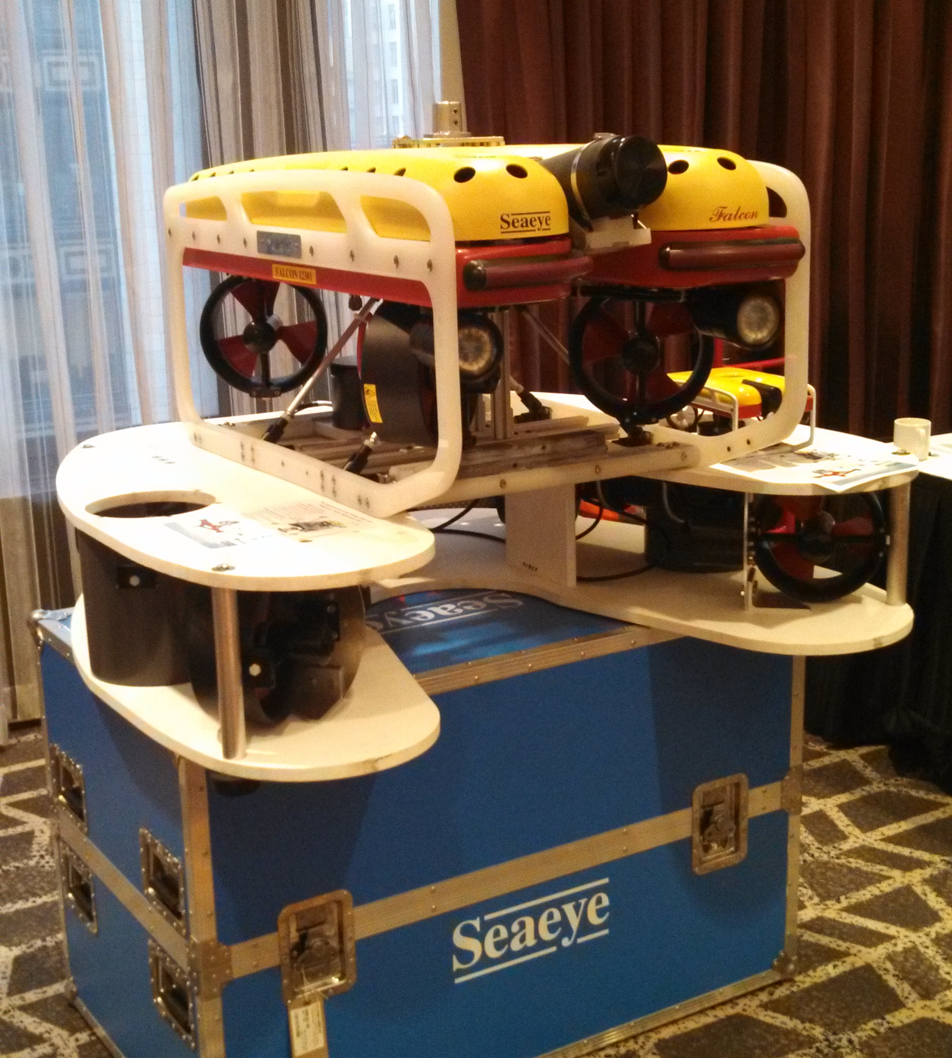
Future Testing
Free-decay experiments with AMP and Millennium components
Dynamic simulations for deployments
Full scale component testing
Initial stability testing in oceanography tank, Spring
Open water testing on Lake Washington, Summer
Current testing in Puget Sound, Summer
“Millennium” Falcon components in exhibit hall at GMREC-METS
Notes:
Two design cases: Deployments and mounted operations

Slide 21
Acknowledgements
This material is based upon work supported by the Department of Energy under FG36-08GO18179-M001 and Snohomish Public Utility District.
This project represents the engineering efforts of the authors, as well as a broader team including Paul Gibbs (APL), Chris Siani (APL), Trina Lichtendorf (APL), Tom Jackson (Jackson Engineering), and Danny Miles (Snohomish PUD).

