Slide 1
Development of an Adaptable Monitoring Package for Marine Renewable Energy Projects
Part 1: Conceptual Design and Operation
Ben Rush, James Joslin, Andy Stewart, and Brian Polagye
University of Washington
Northwest National Marine Renewable Energy Center
MECs and the Environment: Monitoring
April 17, 2014

Slide 2
Motivation: Environmental Risk Uncertainty
Uncertain Risks
Monitor
Significant Risk
Mitigate
Discountable Risk
Monitoring Outcomes
Identified Risks
“Retired” Risks
Reduced Uncertainty
Notes:
On one end of the spectrum, discountable environmental risk – risks that we do not need further information to evaluate: Example: the volume of water displaced by a WEC raising coastal sea levels
On the other end of the spectrum, known significant environmental risk – risks that we know we need to mitigate against: Example: fuel release due to vessel collision with a MEC during maintenance – procedures and practices to prevent occurrence
In between – uncertain risks – might be discountable, might be significant. These are the risks that monitoring plans should be chipping away at.

Slide 3
Risk Uncertainty Categories
Risk
Frequency of Occurrence
Severity of Outcome
=
X
Category X
Common Occurrence
? Severity ?
Severe Outcome
Category Y
? Occurrence ?
Notes:
Category X: population consequences of acoustic disturbances (not MHK specific – general research problem)
Category Y: collision with an MEC – obviously MHK specific

Slide 4
Reducing Category Y Risks
Category Y risks (unknown occurrence, severe outcome) are likely to be infrequent
Spatial comprehensive and temporally continuous monitoring of converters requires the least time to resolve risk
Data bandwidth for “brute force” approaches to this is problematic – “data mortgages”
Stereo-optical Cameras (2 Mpx @ 10 fps)
80 MB/s
3 months observations
600 TB of storage
X
X
=
Example: Continuous stereo-optical monitoring for a single camera pair. Comprehensive monitoring would require multiple pairs.

Slide 5
Avoiding Data Mortgages
Neither pure hardware nor pure software solutions are likely to prevent data mortgages
Split-beam Echosounder
Processing in near real-time
Tracking capability at ranges beyond 100 m
Passive Acoustic Detection
Processing in near real-time
Omni-directional coverage at ranges on the order of 1 km
MEC
Optical Camera
Requires archival processing
Short range and limited field of view
Example: Detection, tracking, and identification of a marine mammal approaching a MEC

Slide 6
Instrumentation Package Constraints
Data and Power Bandwidth
Cabled Package
MEC Export Cable
Close Coupling to MEC
and
Maintenance and Adaptability
Recoverable Package
Plug & Socket Approach

Slide 7
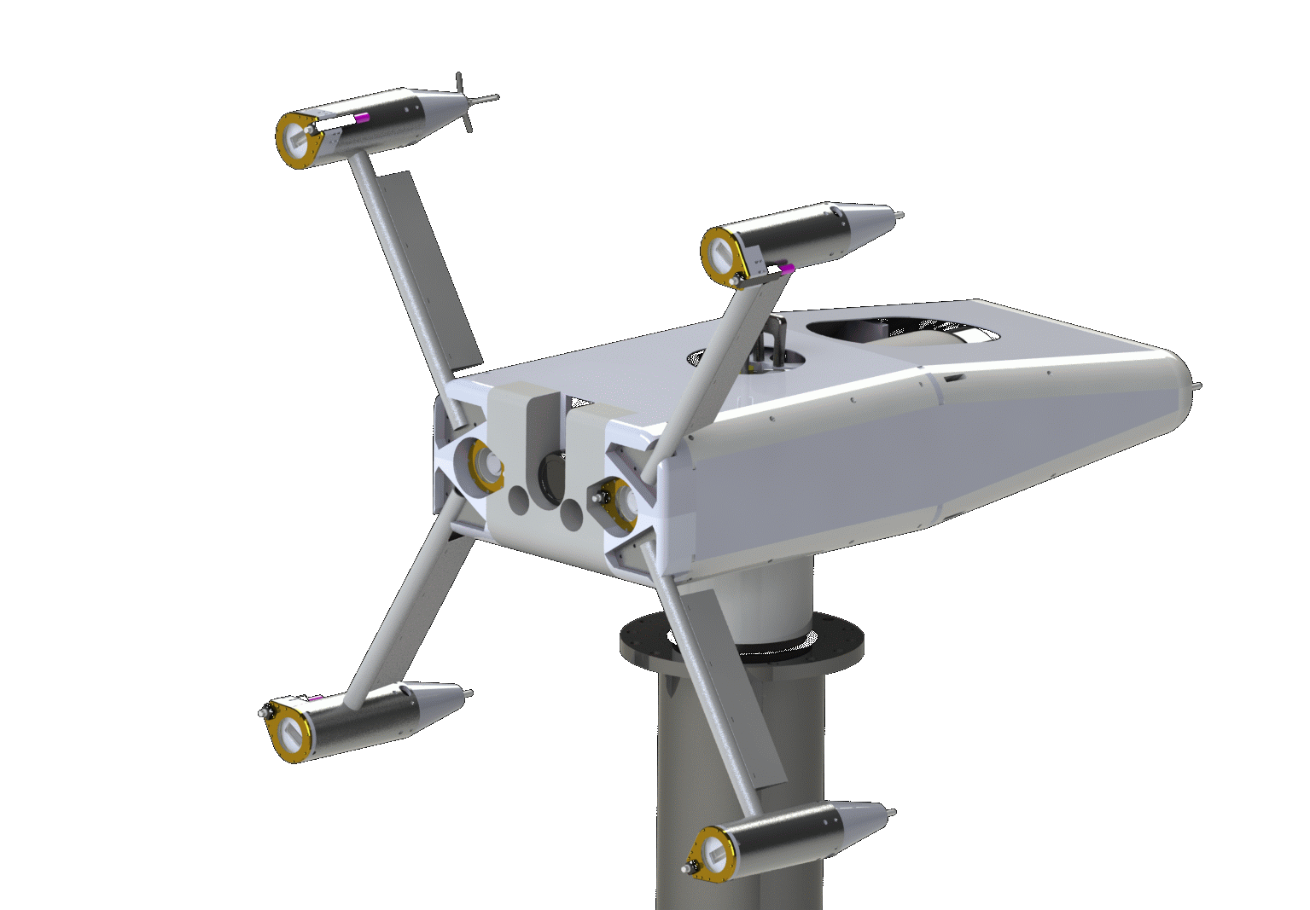
Adaptable Monitoring Package (AMP)
“Plug”
“Socket”

Slide 8
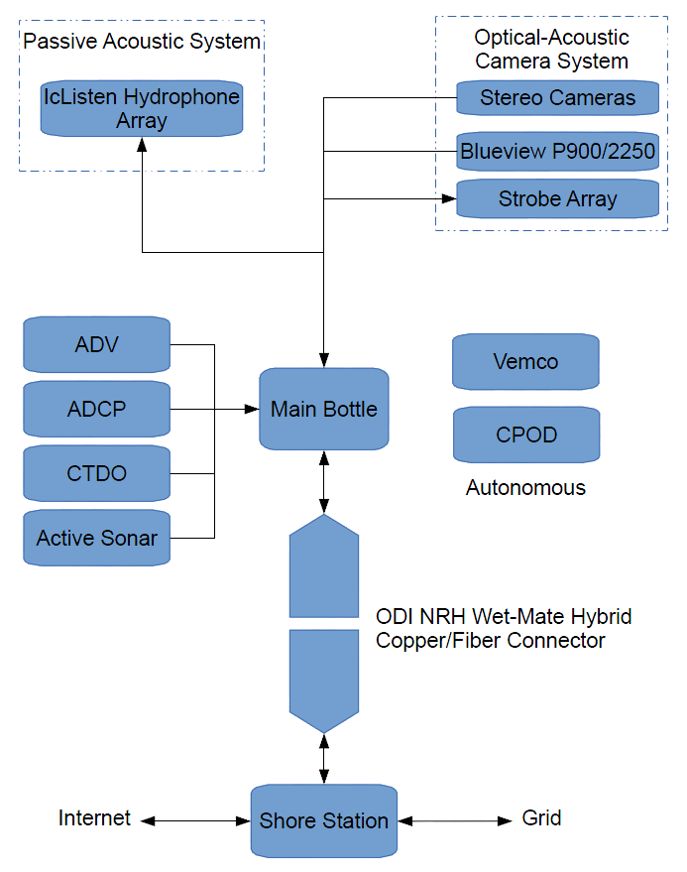
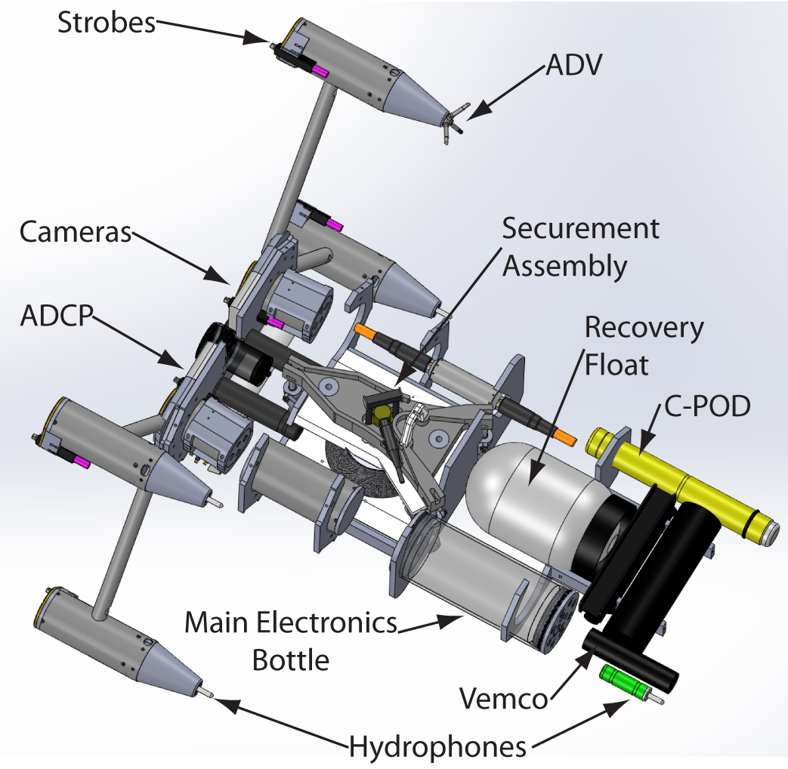
Instrument and Infrastructure Payload
Notes:
Talk through each instrument and constraints

Slide 9
Body Mechanical Design
Hull and Frame
Engineered plastics (no corrosion risk and near-neutrally buoyant)
Longitudinal stiffening
Modular, swappable bulkheads
Strobe Strut
Welded aluminum
Anodized as single piece
Fairing (not shown)

Slide 10
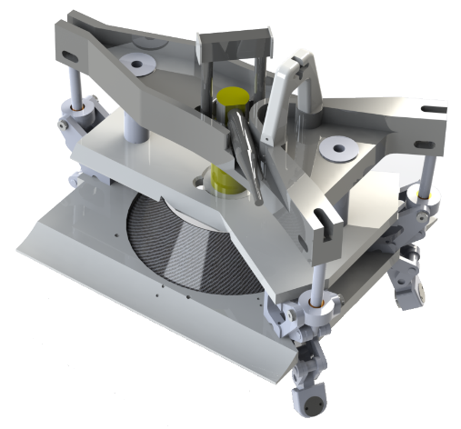
Securement System
Mechanical securement (over-center toggles) – no power to stay engaged
For deployment, secure mechanically, then insert wet-mate connector
Resists currents > 5 m/s broadside to AMP

Slide 11
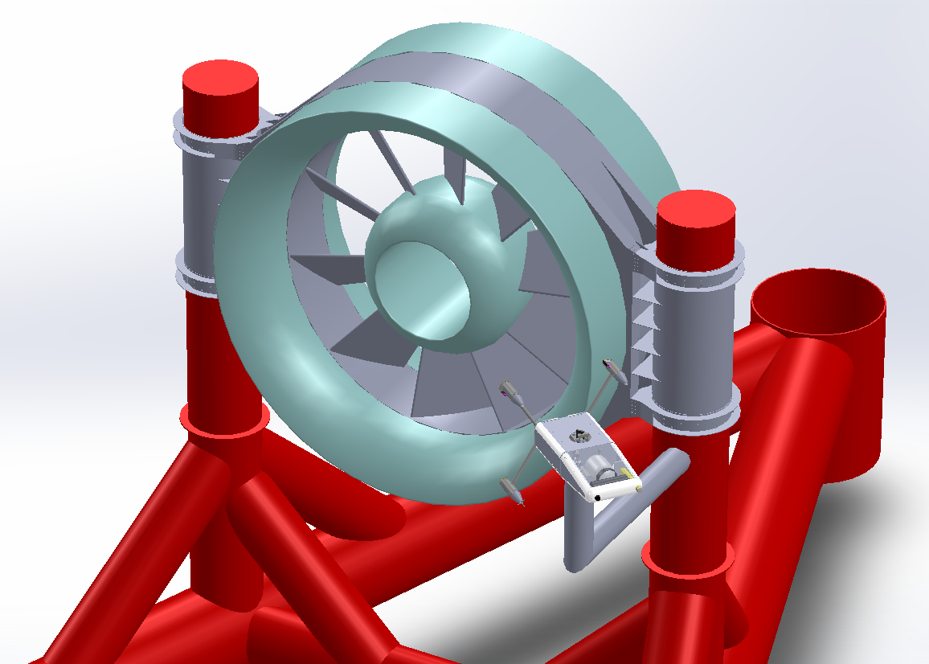
AMP Integration: Tidal Energy
AMP
OpenHydro Open Centre turbine
(6 m diameter)
Notes:
Now, how do we maintain it?

Slide 12
Recovery/Deployment Options
Divers
ROV Servicing
Short work windows
Human safety risk
Short work windows
Minor modifications only
Subsea Winch
Converter Recovery
Moving parts in the ocean
Winch failure can cause catastrophic system failure
Can be expensive and risky

Slide 13
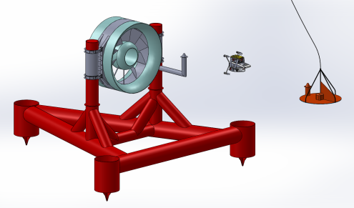
AMP Operations Concept: Tidal Energy
Umbilical
AMP and Deployment ROV
Launch Platform
Current Direction
Notes:
Why umbilical and launch platform? Don’t have the ROV fight drag its umbilical in the upper water column – reserve thrust to deploy package
Why against currents? Passive safety

Slide 14
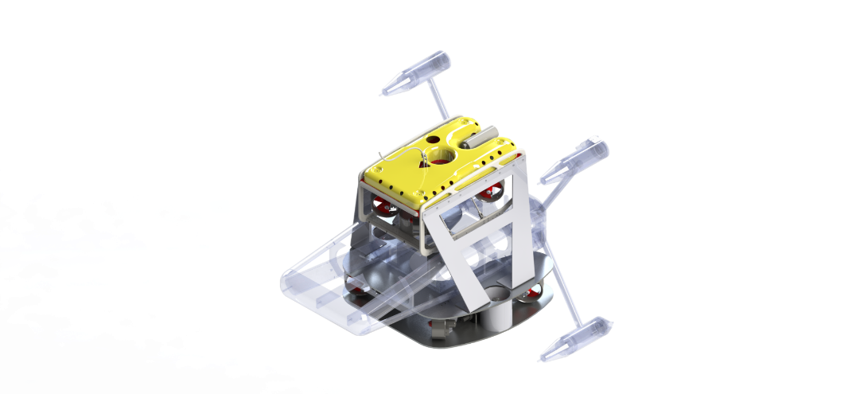
“Millennium” Falcon Deployment System
SAAB Seaeye Falcon
Inspection-class ROV
4 Vectored Thrusters
“Millennium” Skid
6 Thrusters
4 Vectored
2 Vertical
Docking alignment
Securement actuators
Power and comms (SeaView)
Notes:
Objective: provide work-class thrust capabilities with simplicity of deployment for an inspection-class ROV
“Stock” ROV + custom skid – stock system has insufficient thrust and provides none of the functions needed to facilitate docking and securement
Discuss vectored thrusters – sideways parking job + rotation
SeaView “Raptor” skid

Slide 15
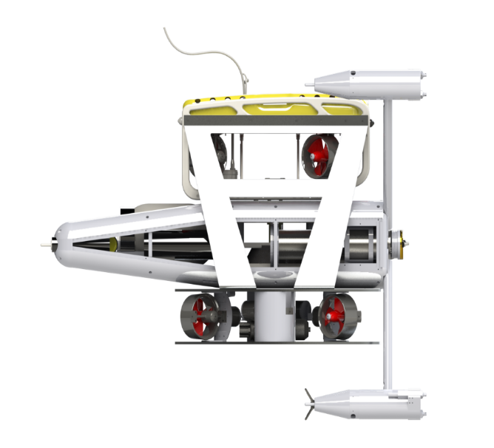
System Stability
Center of Thrust and Center of Pressure
Vertical alignment to prevent pitching
Horizontal separation may be undesirable
Center of Mass and Center of Buoyancy
Vertical separation for stability
Horizontal alignment by trimming
Axis of rotation
Center of Thrust
Axis of Rotation
Center of Pressure
Notes:
Identifying center of pressure requires detailed hydrodynamic analysis – James up next

Slide 16
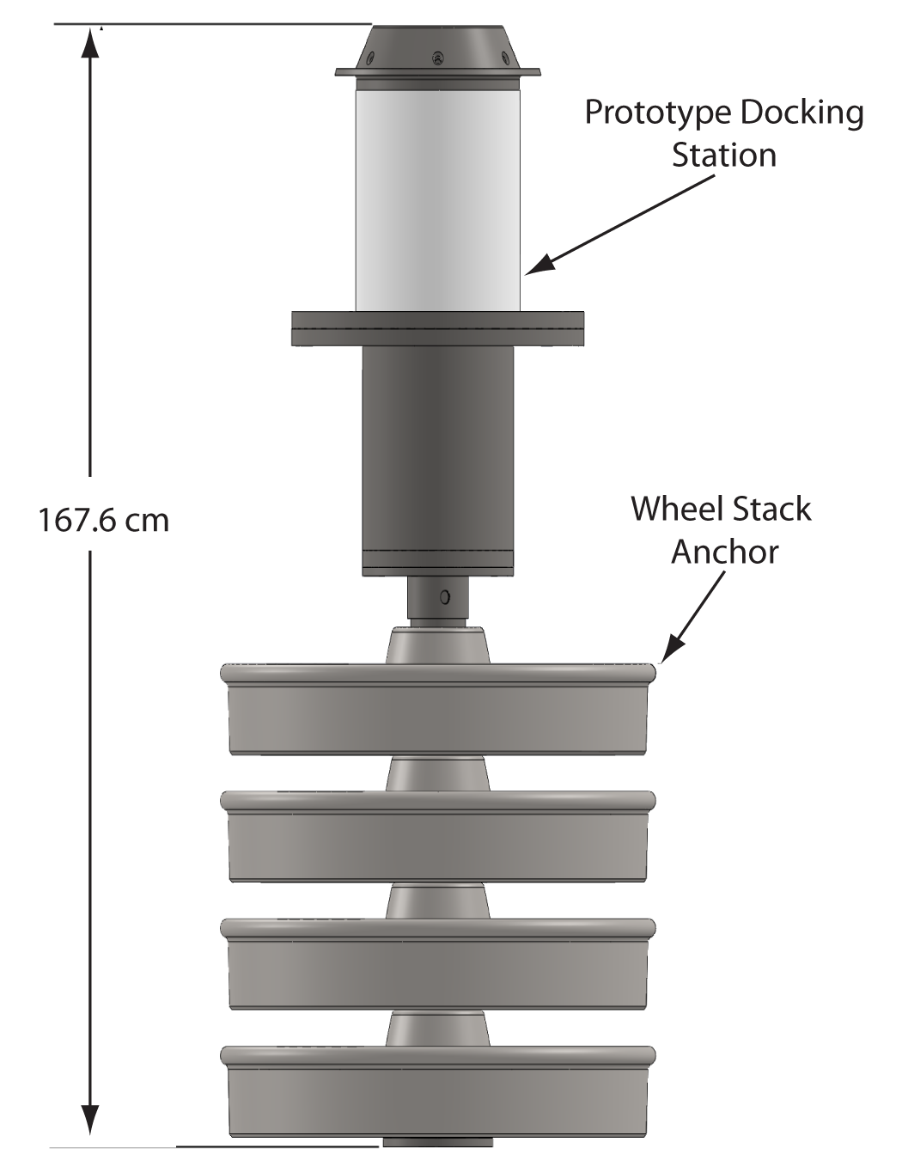
System Testing
Testing progression
Tank tests (late spring)
Lake field tests (mid-summer)
Open-ocean field tests (fall)
Rehearse operations and make engineering corrections
Package trim
Stabilizer fins
ROV umbilical management

Slide 17
Discussion
Integration with WEC monitoring missions
AMP and Millennium Falcon are critical infrastructure for PMEC-SETS
Non-monitoring applications
“Plug and socket” architecture for maintenance of critical undersea components
Docking enhancement
ROV piloting force feedback

Slide 18
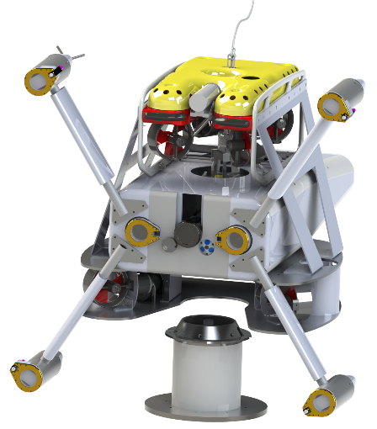
Summary
Integrated instrumentation packages will play a critical role in reducing environmental risk without incurring large data mortgages
Package design requires a significant systems engineering effort
Notes:
Plug Andrea’s session on “Big Data”

Slide 19
Acknowledgements
This material is based upon work supported by the Department of Energy under FG36-08GO18179-M001 and Snohomish Public Utility District.
The AMP represents the engineering efforts of the authors, as well as a broader team including Paul Gibbs (APL), Chris Siani (APL), Trina Lichtendorf (APL), Tom Jackson (Jackson Engineering), and Danny Miles (Snohomish PUD).
Thanks also to Andrea Copping (PNNL) for many productive discussions about environmental risks.

