Slide 1


On The Interaction of Tidal Power Extraction and Natural Energy Dissipation in an Estuary
Mitsuhiro Kawase and Marisa Gedney
Northwest National Marine Renewable Energy Center /
School of Oceanography
University of Washington
Seattle WA 98195 United States
AWTEC 2014, Tokyo, Japan, July 2014
Notes:
OK

Slide 2
Acknowledgment
Funding for this project was provided by
  U.S. Department of Energy Award Number DE-FG36-08GO18179
  U.S. National Science Foundation Grant CHE-1230426
Notes:
OK

Slide 3
“Take-home” Messages
Energy of the tide drives important natural processes in the estuary.
Tidal power generation causes change (reduction) in the amount of energy available for these processes.
Conversely, the level of natural energy dissipation affects the amount of power an array of given capacity can extract.
Notes:
OK

Slide 4
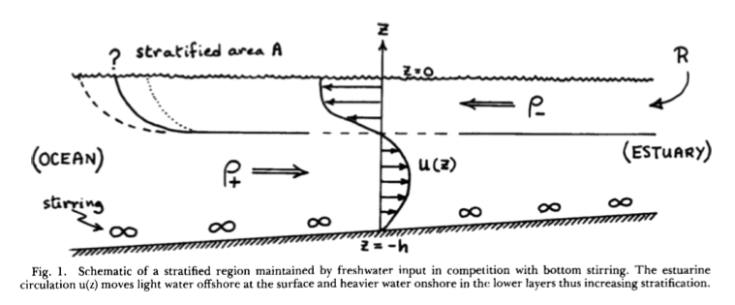
Why should we care about reduction in natural dissipation due to tidal energy development?
Tide is a source of energy for physical processes in the estuary.
Turbulence
Simpson, et al. (1990)
Turbulence generation
(Simpson and Bowers 1981)

Slide 5

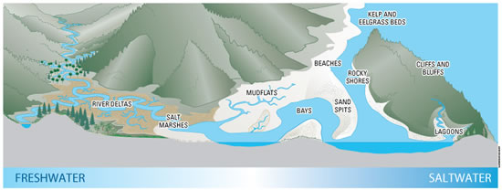

Why should we care about reduction in natural dissipation due to tidal energy development?
Tide is a source of energy for physical processes in the estuary.
Turbulence
Ventilation and Water Quality
Sediment Transport,
Deposition, Resuspension
King County, Washington
Washington Dept. of Ecology

Slide 6
Research Questions
How does tidal power extraction affect tidal energy driving natural processes in the estuary?
How does the level of natural energy dissipation (not necessarily known for any given estuary) affect the size of the tidal resource?
  Explore these questions with a numerical model whose energetics we can control.
Notes:
OK

Slide 7
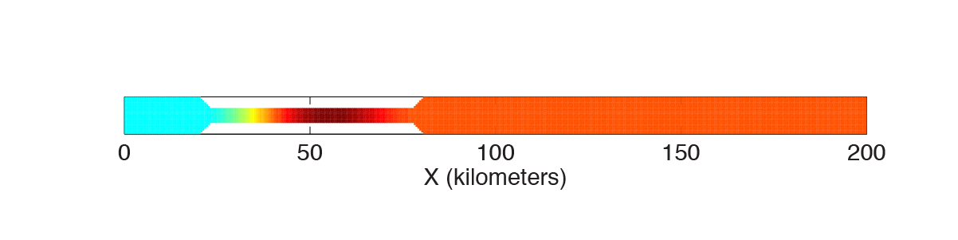
Approach: Construct an idealized numerical model of an ocean-estuary tidal system
Ocean with 4000m-deep basin and 200m-deep, 500km-wide continental shelf
Tide is forced astronomically by tide-generating force (TGF, lunar tide, 20° declination)
200km-long, 10km-wide silled “fjord” is appended at the northeastern corner.
  Tidal energy is extracted over the sill (locally enhanced quadratic drag).
  Background drag coefficient is varied to simulate levels of natural dissipation
Notes:
OK

Slide 8
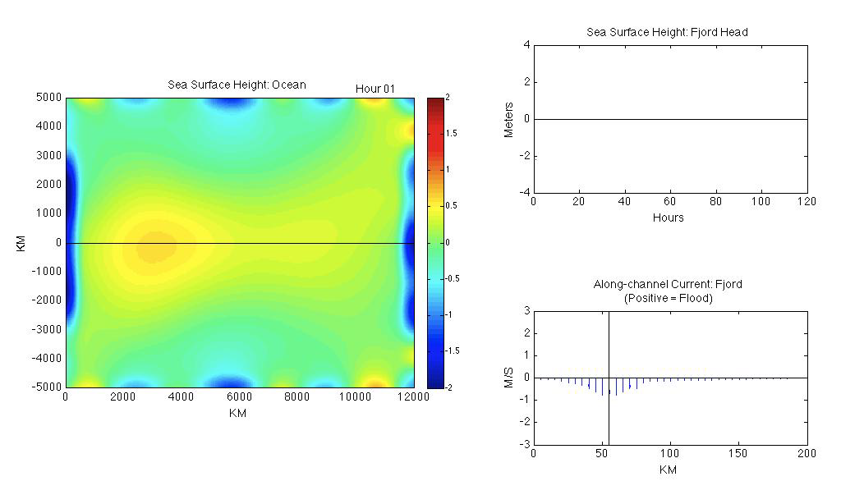
Model Tidal Response in the Ocean and the Fjord
Notes:
OK

Slide 9
Energy Balance Equation
For equilibrium, average over tidal period,
Influx at the Boundary
Natural Dissipation
Energy Extraction
Gain from TGF
Notes:
OK

Slide 10
Results

Slide 11
Power Extraction and Tidal Range
818MW at C_{E} = 0.1
63% of Natural Range
Extracted Power (MW)
Array Capacity
Tidal Range (meters)
Low
High
HIGH
LOW
Notes:
OK. Be sure to bring the cover for the right panel (4) to front and make it opaque.

Slide 12
Power extraction reduces amount of energy going into natural processes in the estuary.
Total (Natural + Extracted)
Power (MW)
Natural Dissipation without Extraction
Extracted Power
Natural Dissipation
78% Reduction in Natural Dissipation
Percent
Natural Dissipation
Extracted Power
77% of Energy entering Fjord is extracted
Array Capacity
Low
High
Notes:
OK

Slide 13
Does the level of natural dissipation influence how much power can be extracted? – Yes.
Extracted Power (MW)
C_{N} = 0.003 (standard)
Natural Dissipation 1106MW
C_{N} = 9.5 x 10⁻⁴
Natural Dissipation 669MW
C_{N} = 0.0095
Natural Dissipation 1184MW
Array Capacity
Low
High
Notes:
OK

Slide 14
Conclusions
Tidal power extraction affects energy going into natural processes in the estuary.
Natural dissipation can be used as a primary metric of large-scale environmental effects of tidal power extraction.
Extractable power is sensitive to the level of natural dissipation – effort must be made to determine the latter when site development is considered.

