Slide 1
Why do Cross-Flow Turbines Stall?
Robert J. Cavagnaro*, Benjamin Strom, Alberto Aliseda, Brian Polagye
^{University of Washington}
^{NNMREC}
rcav@uw.edu
Notes:
Stall defined as inability to rotate

Slide 2
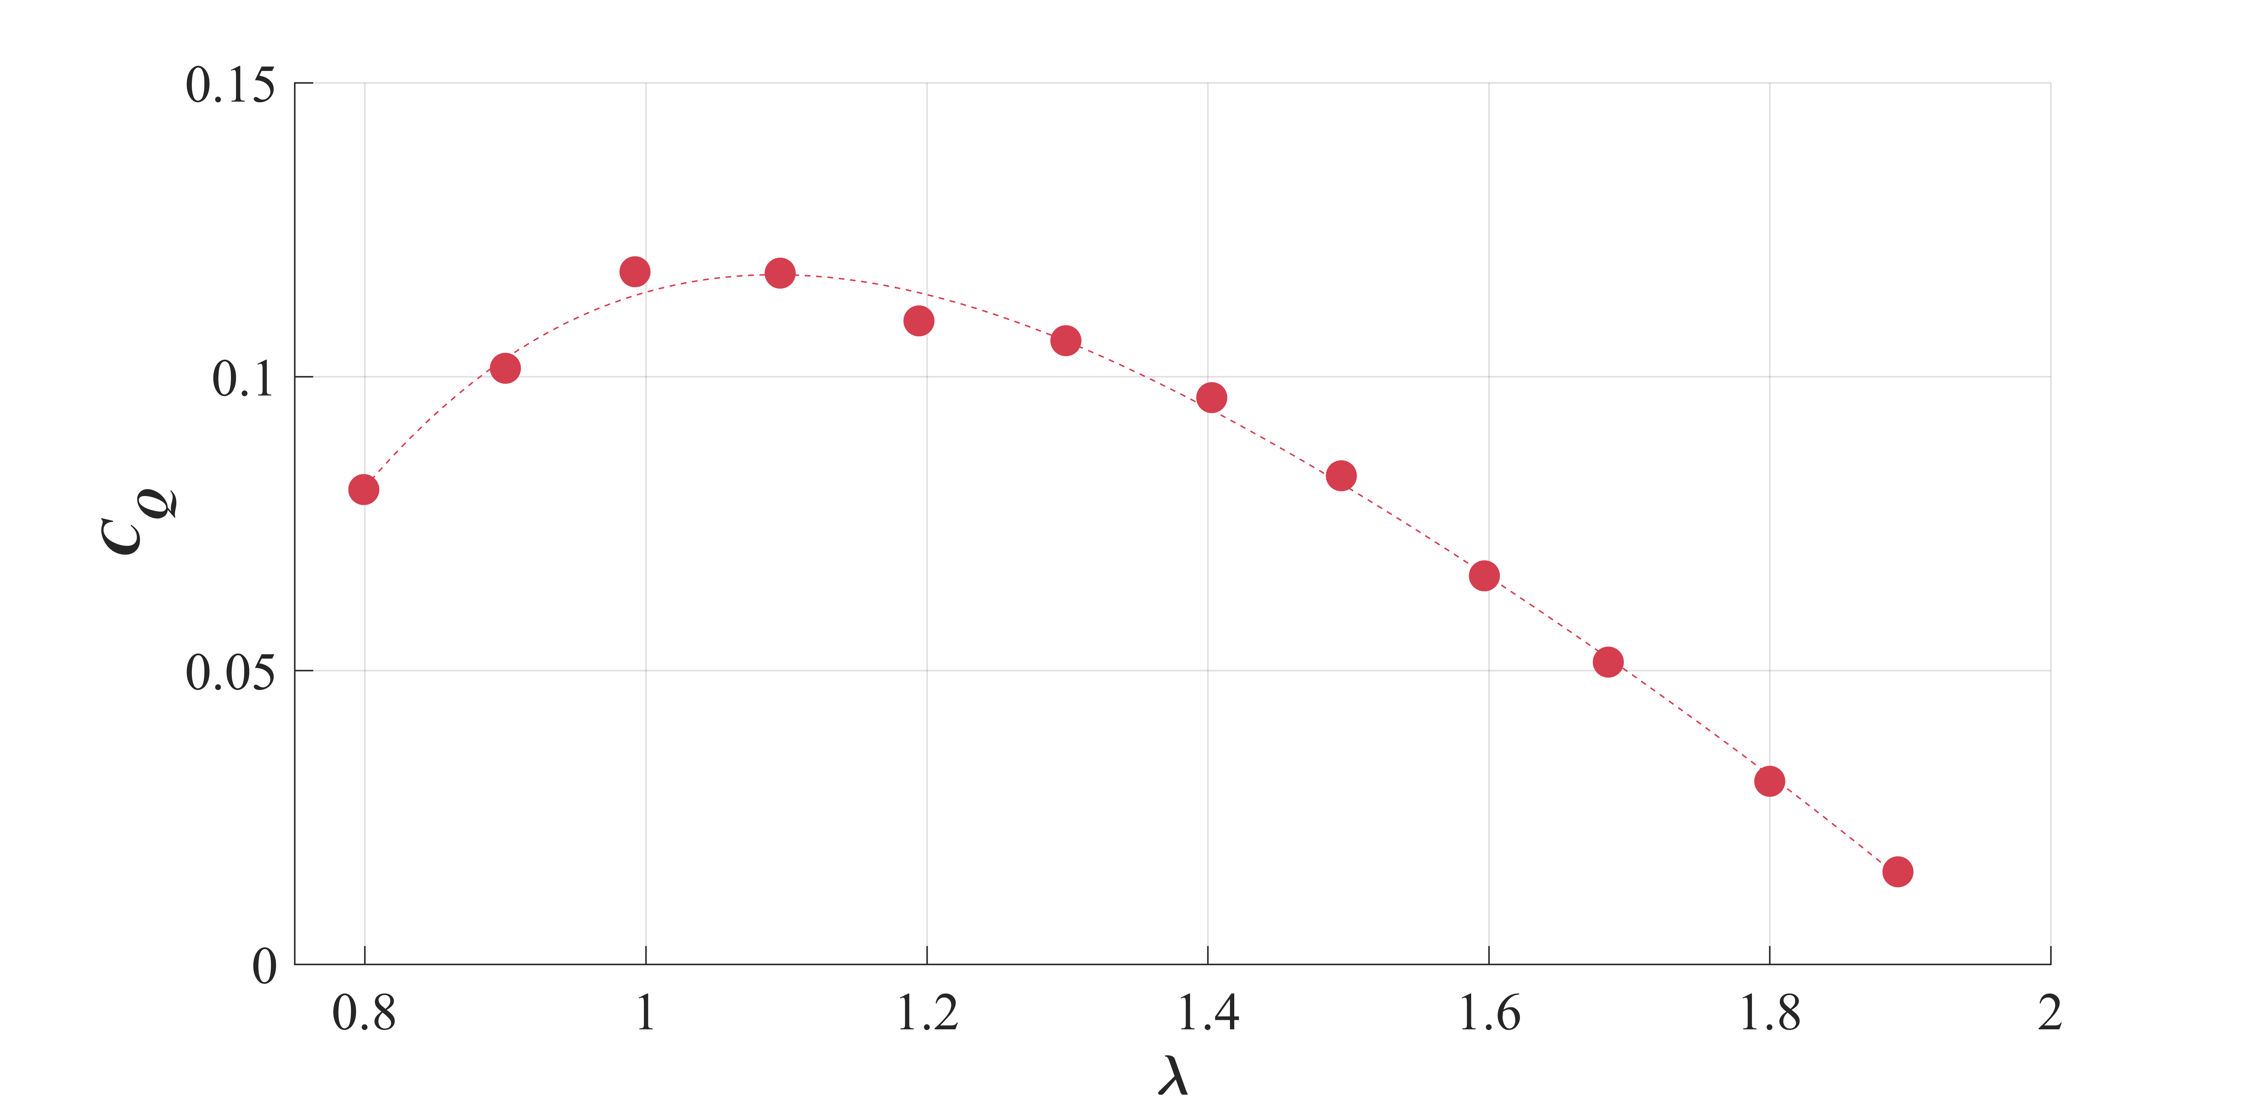
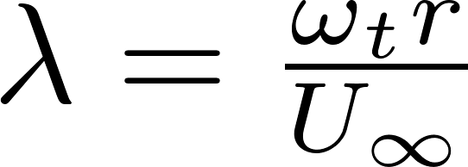
Motivation
Stalls under torque control
Stable
Critical λ
Does stall occur immediately at critical TSR?
Does turbulence play a role?
Notes:
Split in two – torque(theta) speed(theta): Show Cq(tsr) with shaded regions or arrows under torque control
Motivations: Peaks of the Cq curve is the limit of stable operation for this type of turbine – point at which a fluctuation of a sizeable enough intensity will cause ‘catastrophic stall’, not to be confused with dynamic stall. Under torque control, turbine will stall here, but it’s close to the peak power performance point. We’d like to understand why the turbine stalls at this point for several reasons: 1. to build more robust torque controllers capable of stable operation near peak Cq point (there is some uncertainty in peak Cp point, can change over time) 2. to be able to more accurately simulate or emulate the dynamics of such a turbine operating near stall. 3. for Region 3 control – shedding power moving to the left of the MPP may be desirable to avoid a stopping scenario in which you’d have to shed power past the MPP

Slide 3
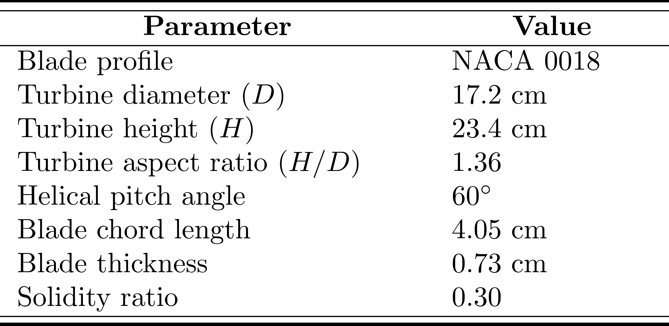
Experimental Method
Allow turbine to freewheel in recirculating flume
Bring turbine to critical TSR under torque control
Allow turbine to rotate until it ceases (stall event)
Repeat (many times)
Analyze conditions using turbine sensor data, classification algorithm, and PIV
Servo motor with encoder
6-axis load cells

Slide 4
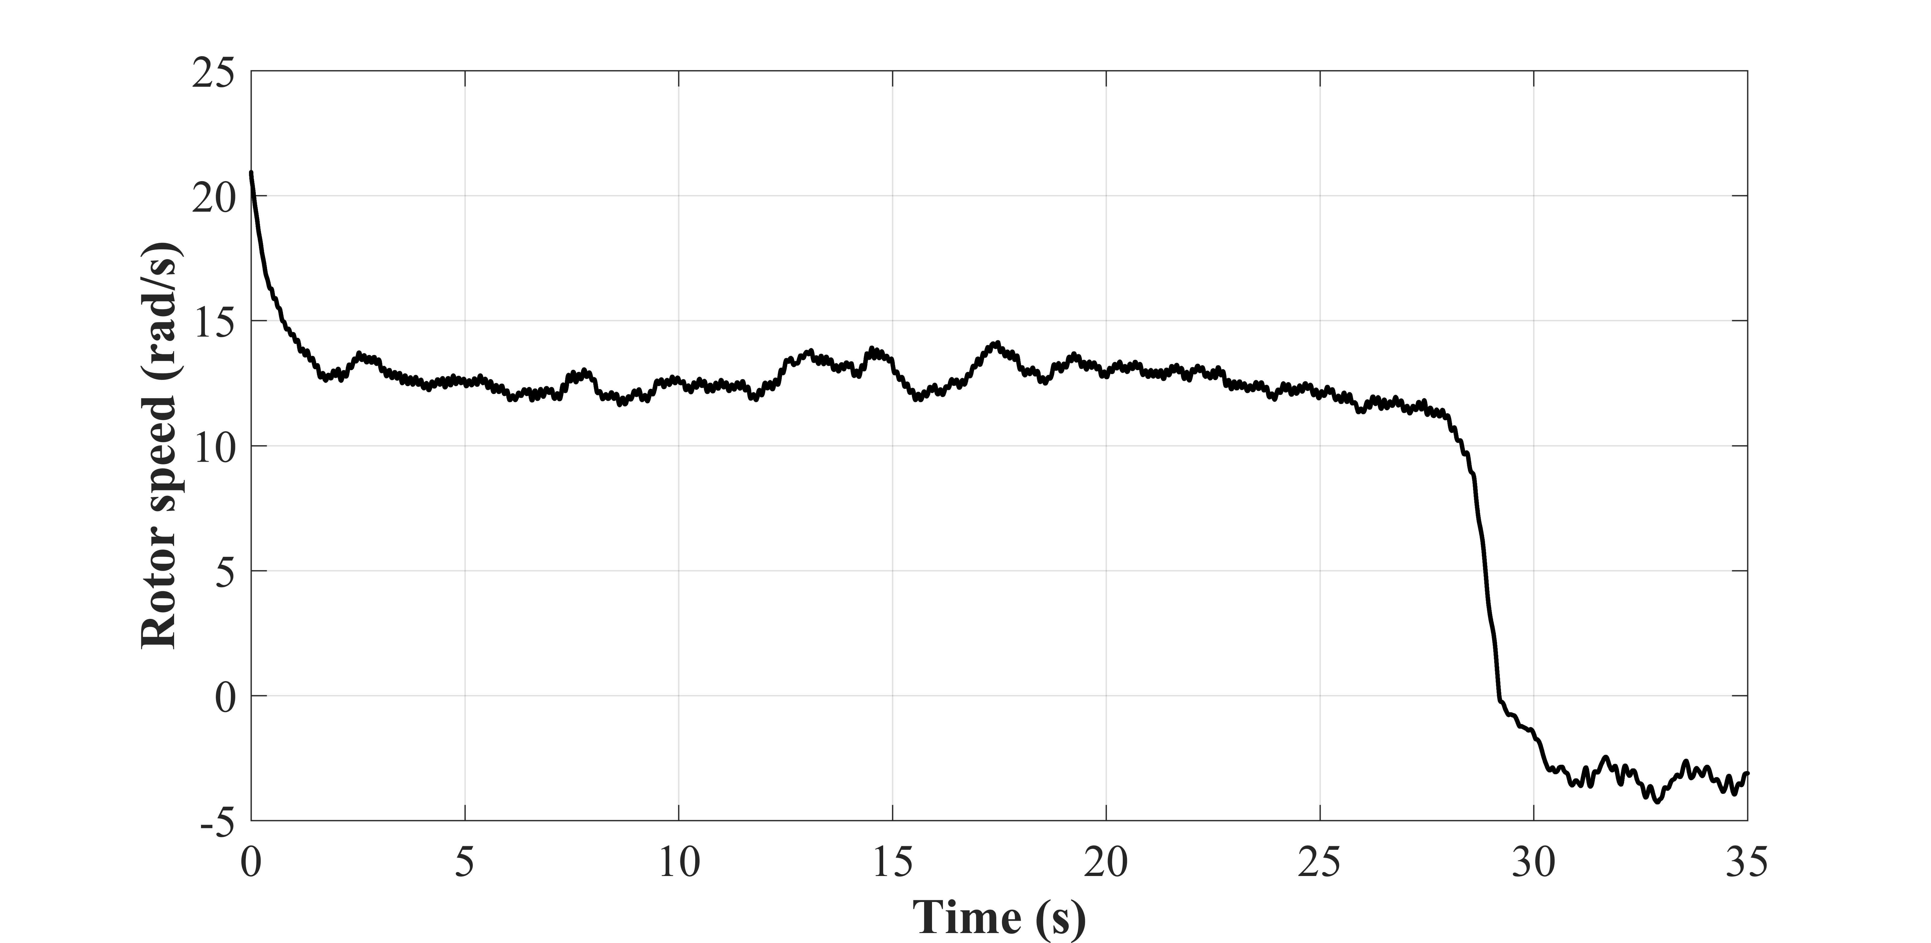
Characterizing a Stall Event
Notes:
K-means: Method used to robustly identify modes of turbine operation
User specifies number of distinct clusters
Inputs are turbine rotational speed and acceleration
Assigns points into groups such that points are most similar to each other and most dissimilar from points in other groups
Number of groups, inputs, and degree of smoothing iterated to maximize distance between distinct groups
Five clusters ultimately identified for characterizing stall events

Slide 5
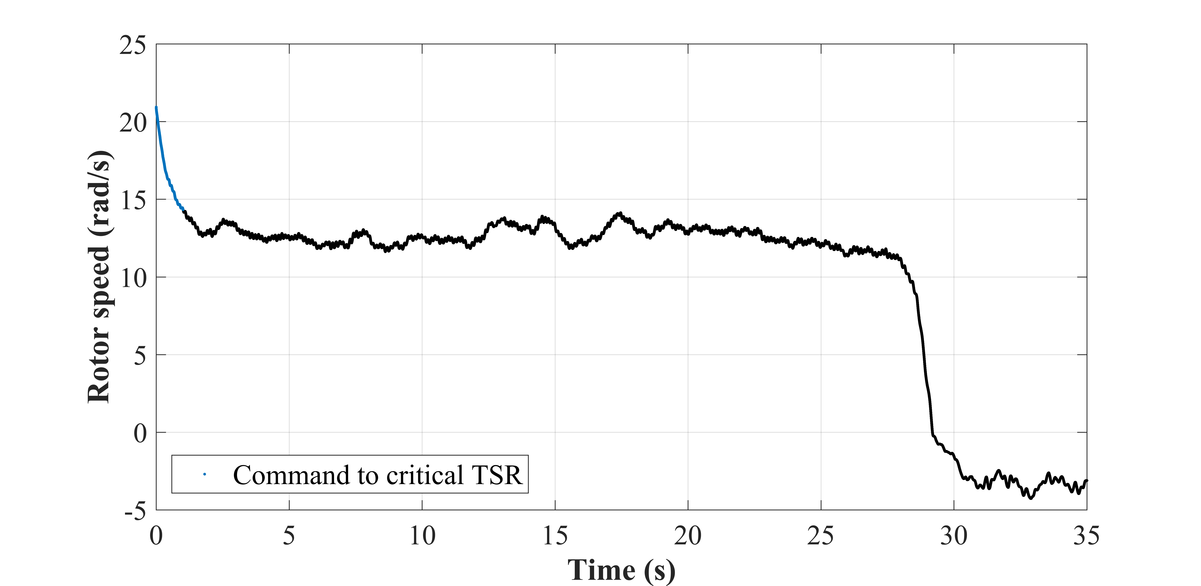
Characterizing a Stall Event

Slide 6
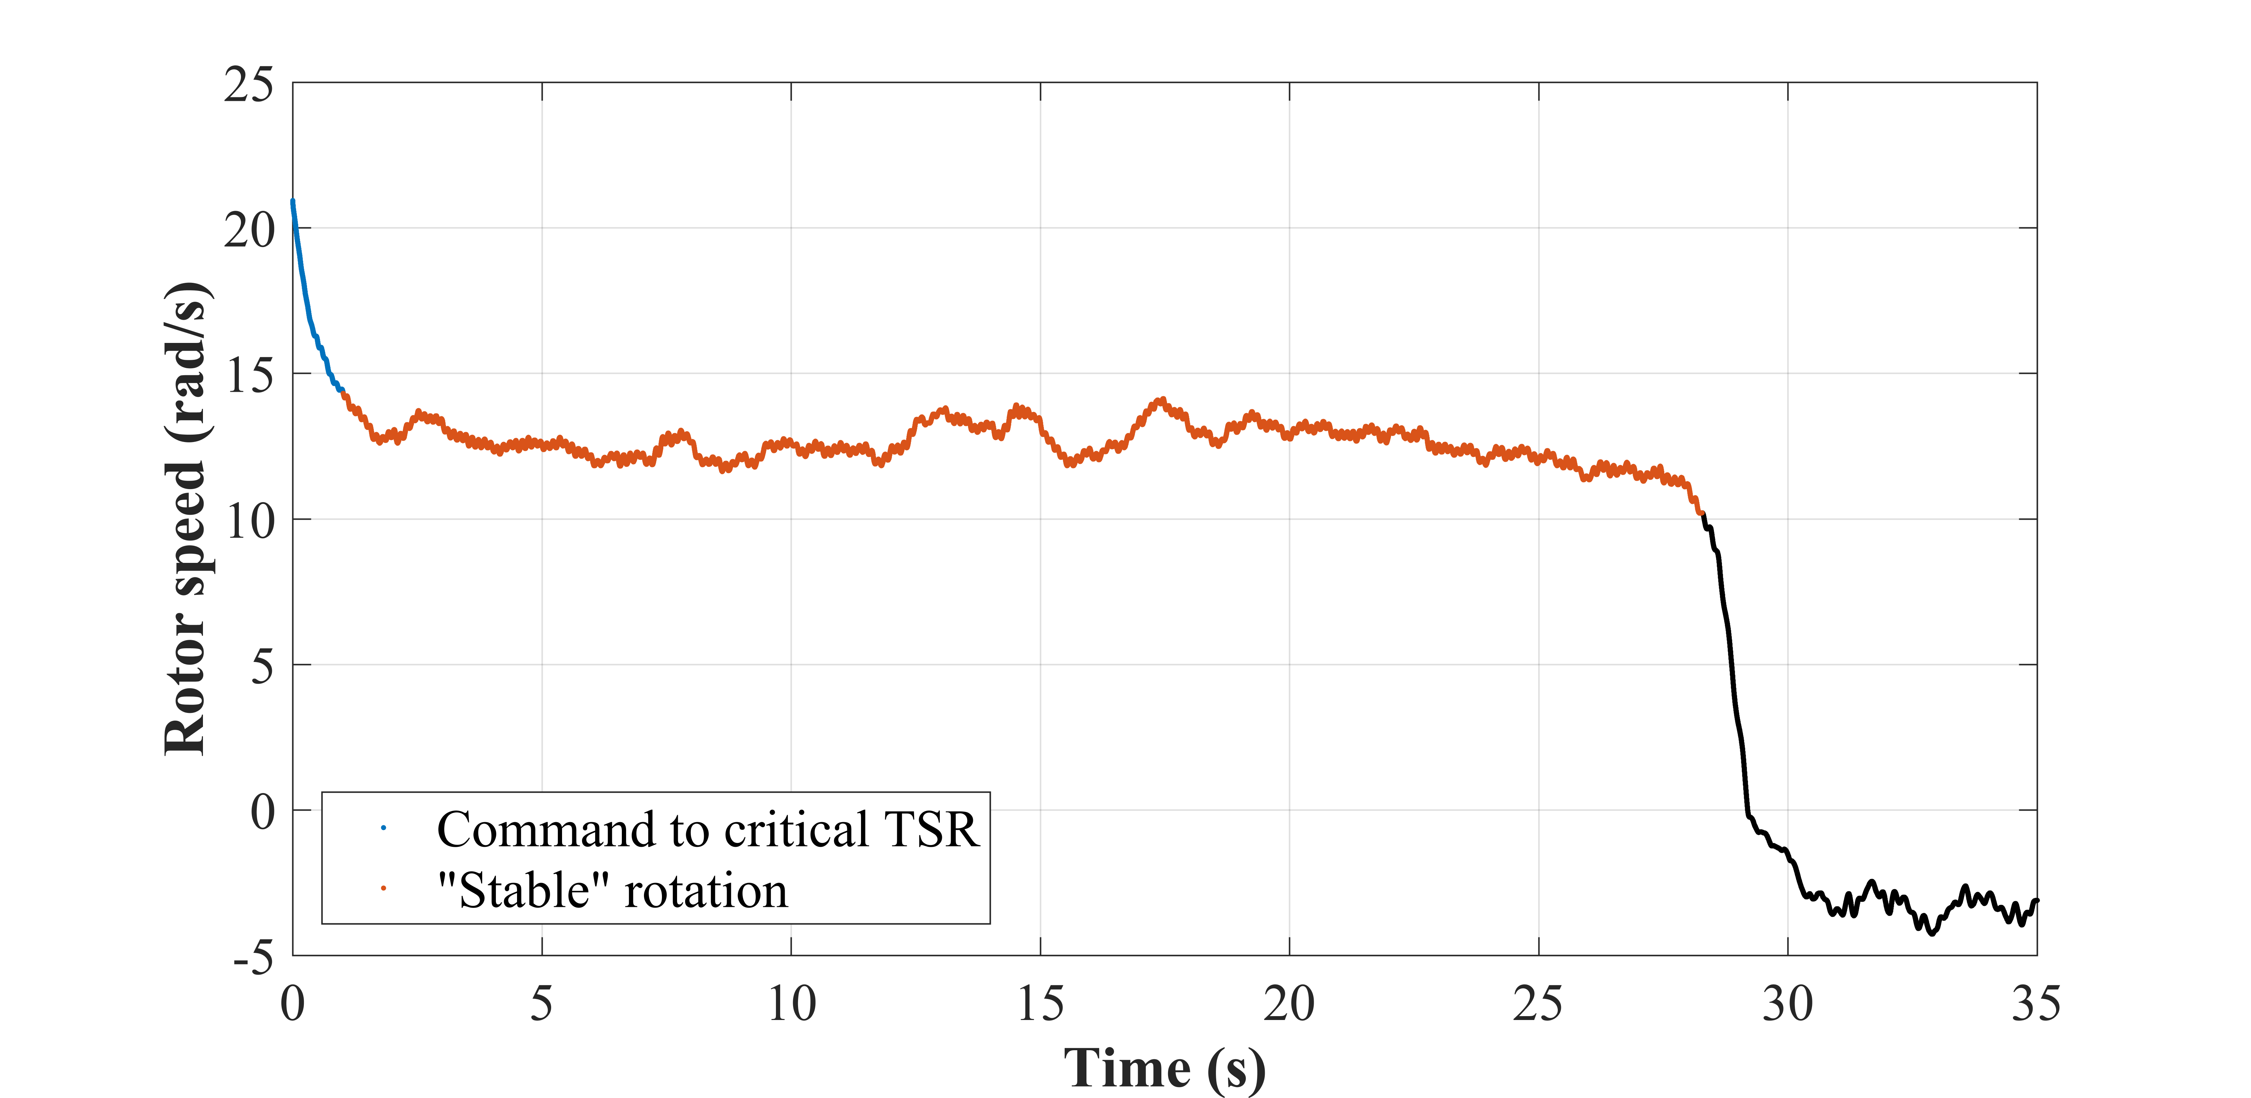
Characterizing a Stall Event
Notes:
Increase legibility of legends, increase all font sizes

Slide 7
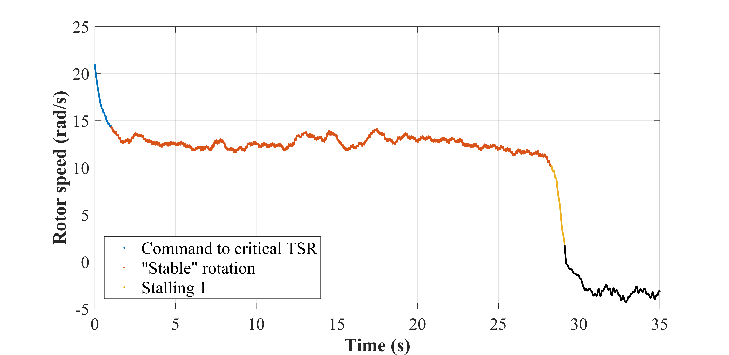
Characterizing a Stall Event

Slide 8
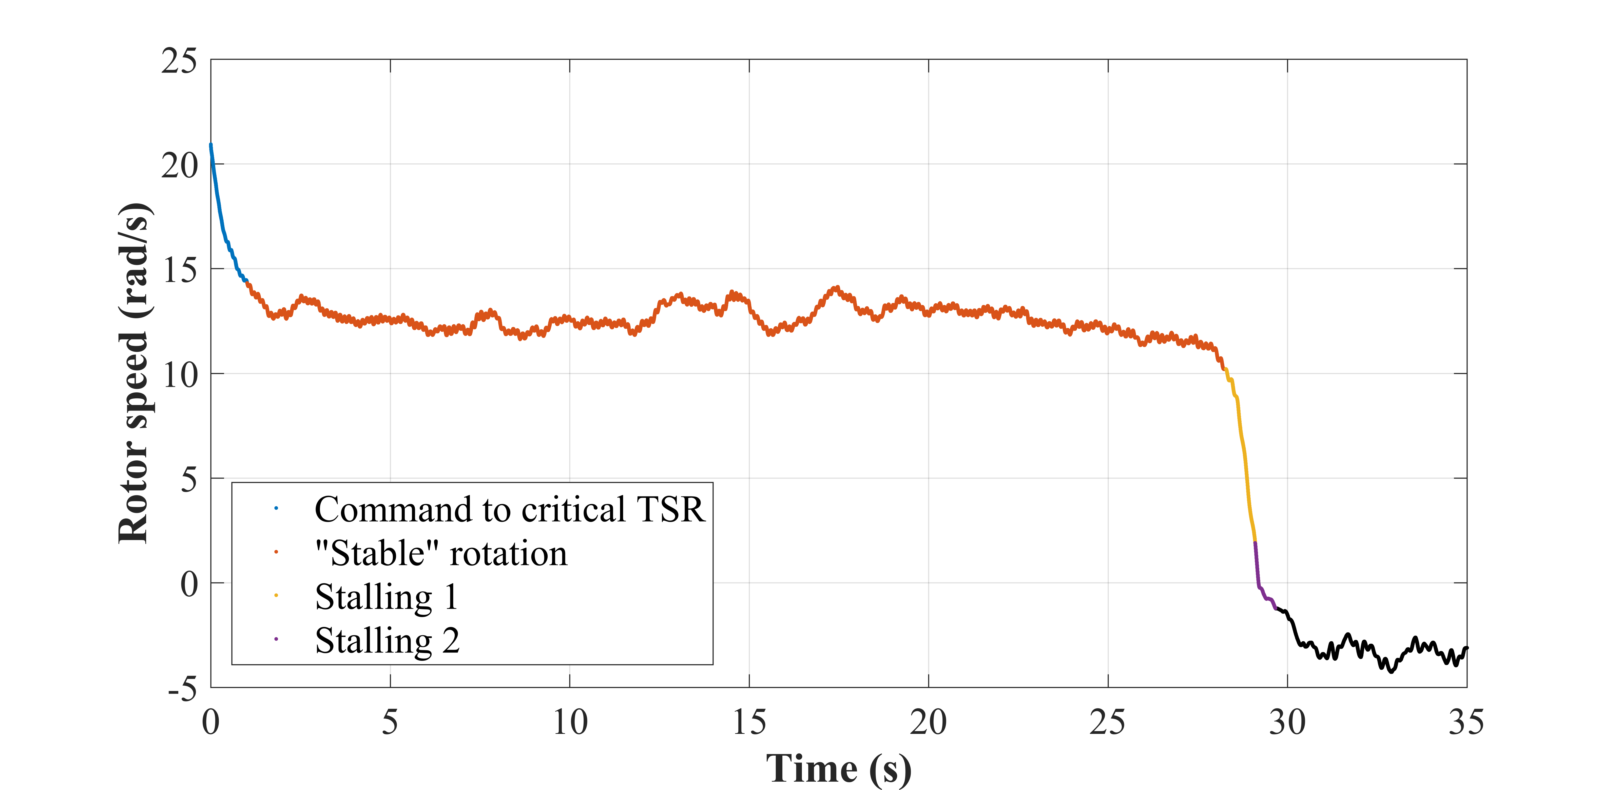
Characterizing a Stall Event

Slide 9
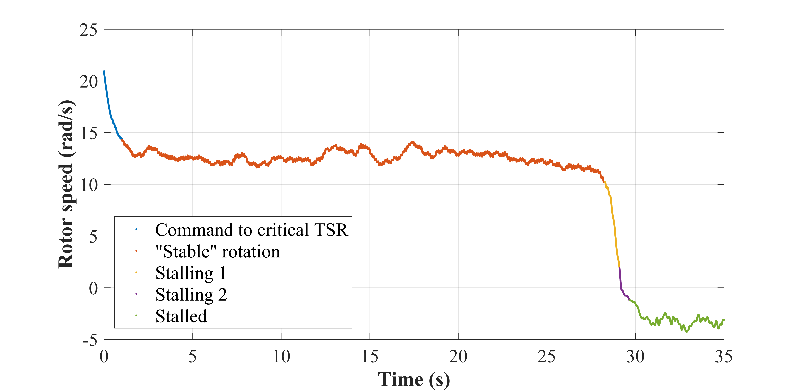
Characterizing a Stall Event

Slide 10
Characterizing a Stall Event

Slide 11
Stall Event Statistics
n = 288
>
Notes:
Change last bar to >60s

Slide 12
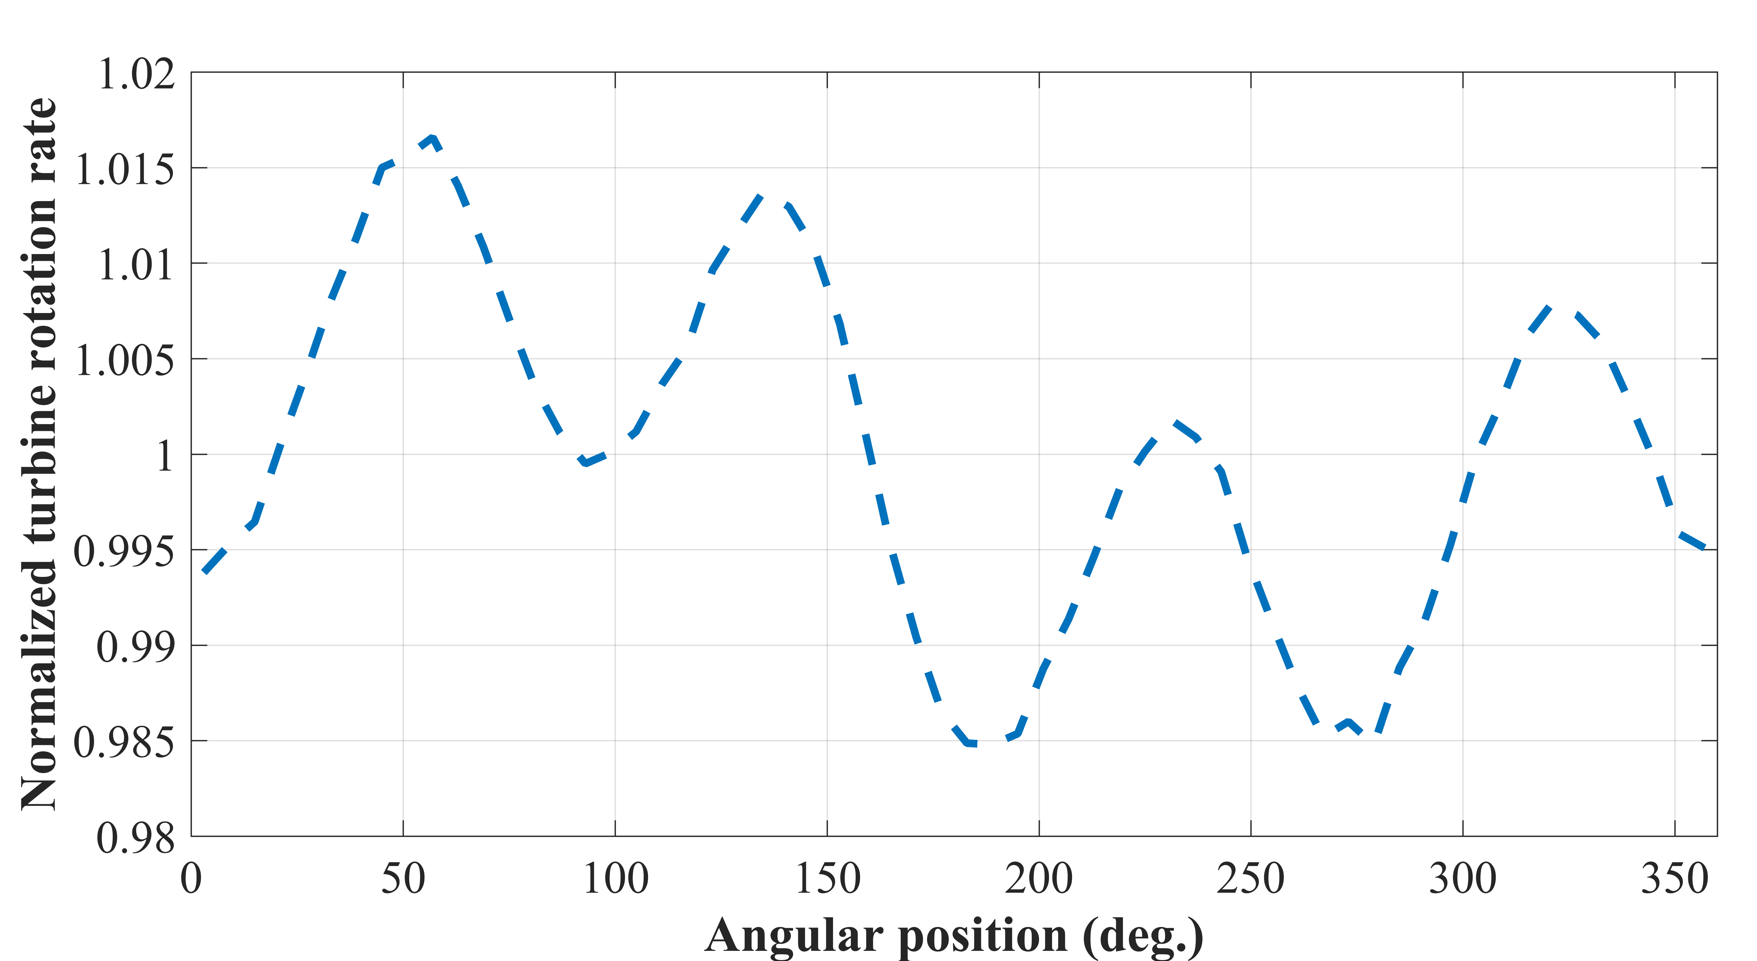
Stall Event Statistics
n = 288
Notes:
Fill bars, add phase averaged plot showing stall point identified

Slide 13
PIV of Upstream Conditions during Stall Event

Slide 14
Conclusions
When:
After range of time, empirical distribution
Where:
At the same angular position
Why:
Prolonged turbulent inflow speed deficit, loss of momentum
Notes:
Stall events occur after a range of time that can be described by an empirical statistical distribution
Identified point at which turbine has stalled corresponds to same angular position for majority of iterations
Stall events likely occur due to hysteresis of turbine momentum: stall occurs after prolonged inflow speed deficit without turbulent gust at critical TSR

Slide 15
Acknowledgements
Experiments conducted with the assistance of Danny Sale, Dominic Forbush, and Michelle Hickner of UW
Experiments conduced at Bamfield Marine Sciences Centre, Bamfield, BC
Funding from US DOE & NAVFAC
Questions?

Slide 16
Bubble Visualization of Stall Event
Straight-bladed turbine, 2 blades

