Slide 1
Complete Energetic Analysis of Tidal Power Extraction
Elizabeth Brasseale
February 17, 2016
Masters Defense
Advised by Mitsuhiro Kawase

Slide 2
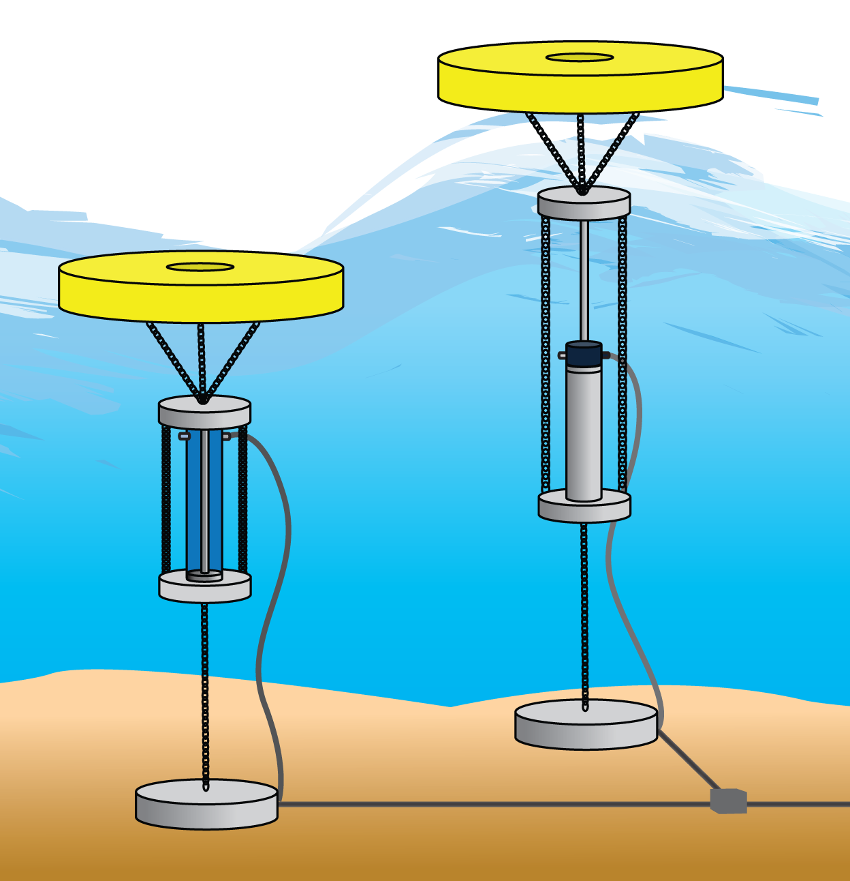
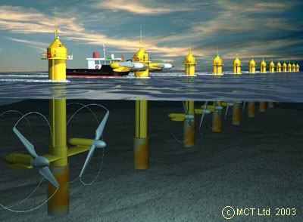
Marine Renewable Energy
Part of the ongoing effort to find clean energy sources and lower carbon emissions
Wave Energy
Tidal Energy
Offshore Wind Energy

Slide 3
Why study marine renewables with oceanography?
Maybe you want to know…
How much tidal energy is present at a location?
What do flow conditions look like in the field, and how can that impact power extraction?
How will device installation and power extraction change the environment?
Will the currents slow?
Will it lower the tidal range?
Do marine devices mix the water column or stratify it?

Slide 4
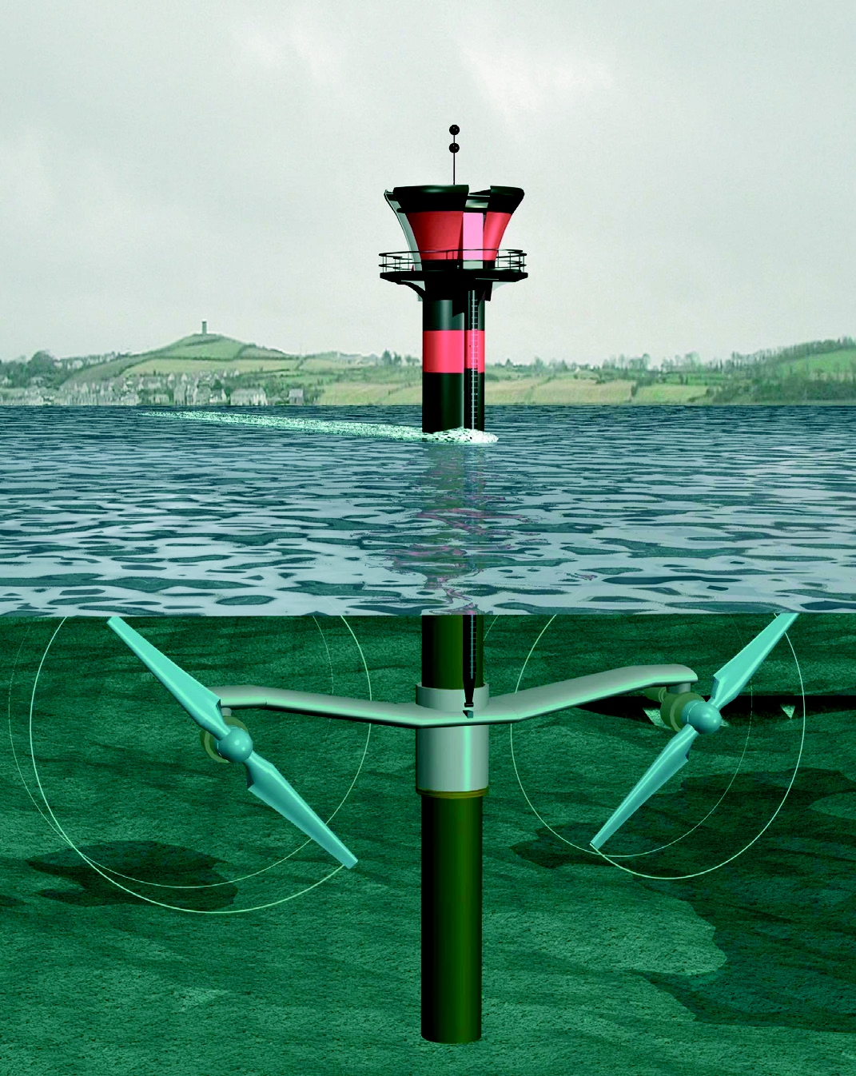
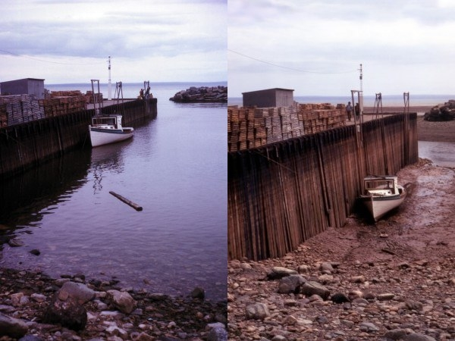
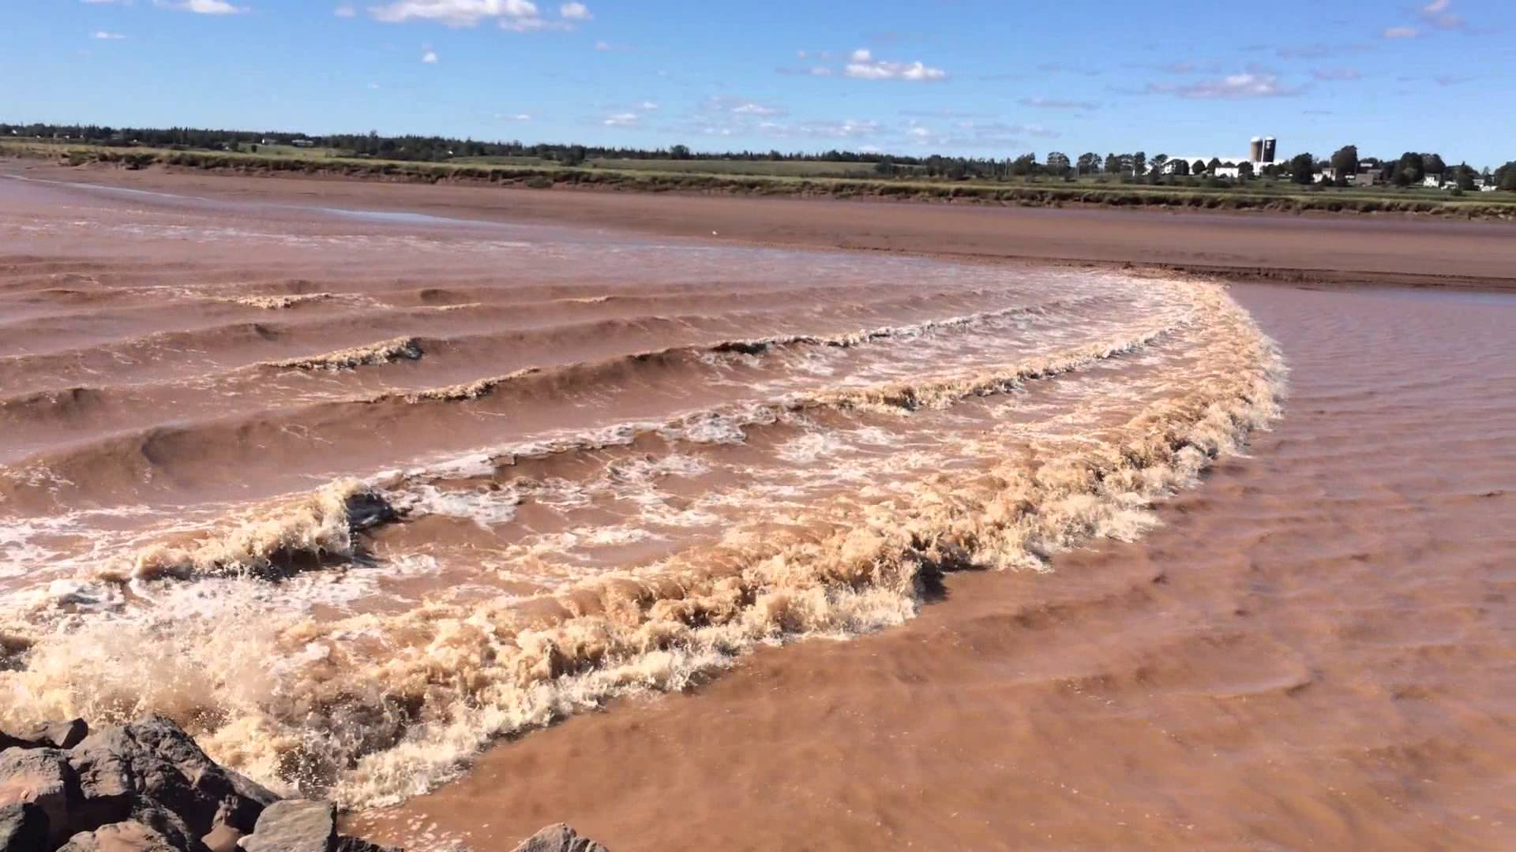
Tidal current power
Bay of Fundy, Nova Scotia, Canada
Largest tidal range in the world with a 14.5 m spring tide
115 billion metric tons of water!
Notes:
115 billion metric tons of water in and out of the bay each day

Slide 5
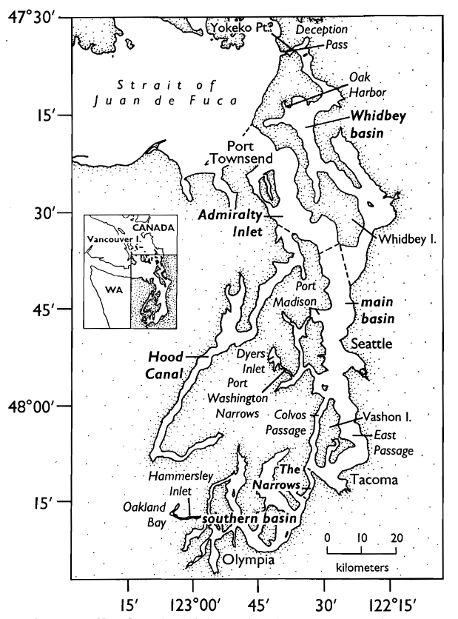
Admiralty Inlet

Slide 6
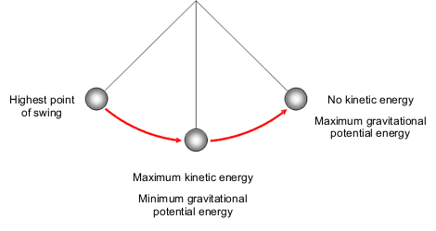
How much energy is in the tides?
Max Potential Energy
Max Potential Energy
Max Kinetic Energy
Low tide
t = 0 hr
High tide
t = 12 hr
Flood current
t = 6 hr
Notes:
The tides are like a pendulum. Tidal energy oscillates between a state of max potential energy (when the tidal level is at its most low or high) and a state of max kinetic energy (when the tidal current is at its maximum).
If this were a simple harmonic oscillation, this conversion between potential and kinetic energy would be complete and the tidal current could be calculated from the tidal head.

Slide 7
How much energy is in the tides?
Friction works in two ways
Stresses along the surfaces of the channel
Mixing within the channel volume
Friction
Low tide
t = 0 hr
Flood current
t = 6 hr
High tide
t = 12 hr

Slide 8
How much energy is in the tides?
Friction
Low tide
t = 0 hr
Flood current
t = 6 hr
High tide
t = 12 hr
Tidal turbines must share a potential energy source with currents and friction

Slide 9
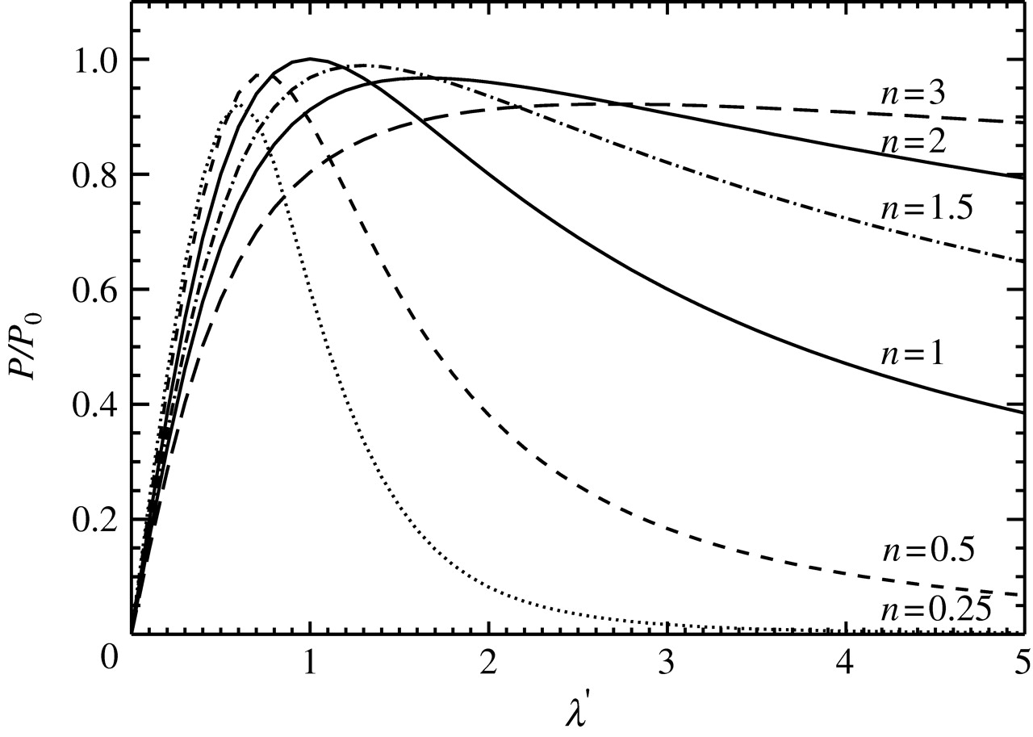
How much energy is in the tides?
Friction
The more power extracted, the less there is to extract
“...the maximum average power available is approximately 0.22ρgQ_{max} with Q_{max} denoting the peak volume flux in the undisturbed state.” (Garrett & Cummins, 2005)
For Admiralty Inlet, 0.22ρgQ_{max} = 1000 MW

Slide 10
Problem
Most environmental impact studies are reduced to 1D or 2D problems
3D, hi-res models only model small regions of interest
Ideal is to model a region and resolve individual turbines
Also include all physics – account for all energy gained and lost to see holistic impact of turbines on environment

Slide 11
Objectives
Validate my physical reasoning: Build a 3D model of a flow channel and budget the changes in energy through time
Apply analysis to an experiment: Integrate validated turbine model into flow channel and show that the budget still closes and accounts for the extraction
Explore the results: Take the difference between the model with and without turbines to show how impact is distributed
Expand the parameter space: Add more turbines and see how that impacts the changes to the environmental state

Slide 12
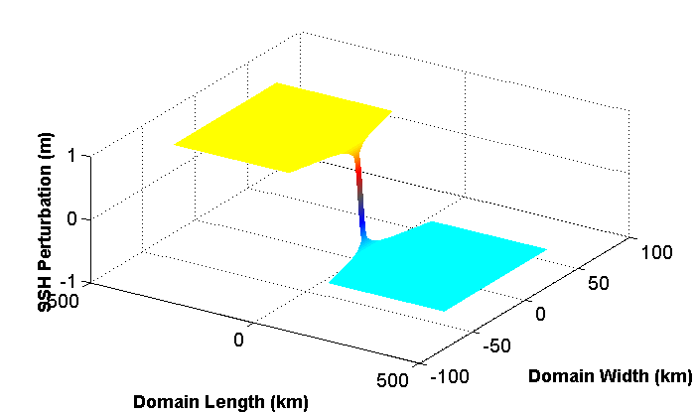
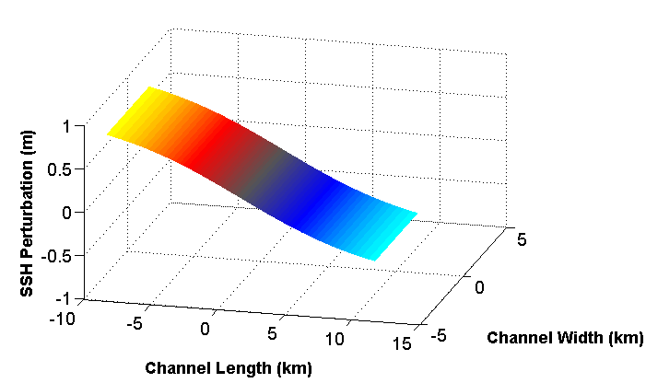
Experimental Setup
3D model is built in ROMS as a closed domain initial value problem
Depth is 125m, resolution in the channel is 50m x 50m x 2.5m (lower resolution in basins)
Entire model domain
Simulated tidal channel

Slide 13
Experimental setup cont.
Change in kinetic energy in time
Internal dissipation
Pressure work
Advected kinetic energy
Surface stresses
Simplifying Assumptions: pressure is hydrostatic and there is no wind stress
Notes:
How much to include?

Slide 14
Integrate the energy equation over the volume to produce the power balance
Notes:
If there were no friction, current might speed up because of Bernoulli. But because there is friction, often the current slows down instead

Slide 15
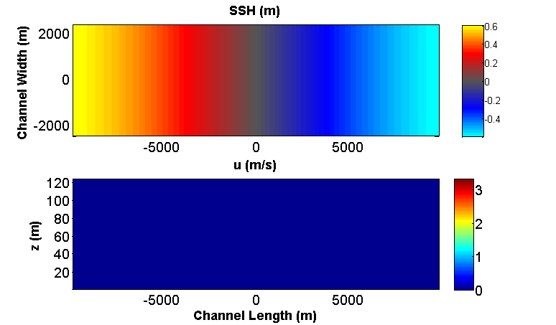
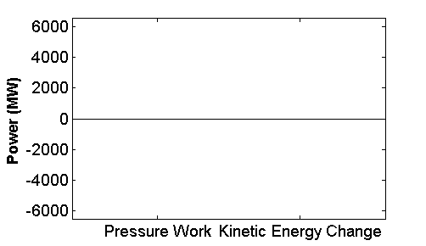
Channel flow, t = 0 hr

Slide 16
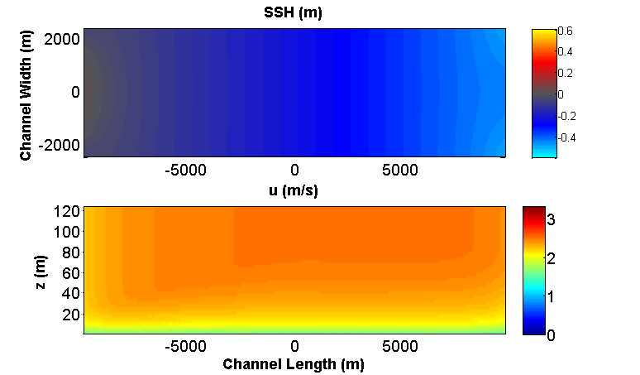
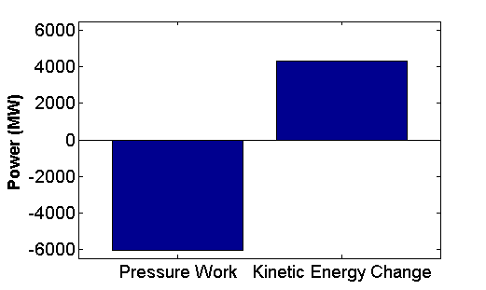
Channel flow, t = 2 hr 15 m

Slide 17
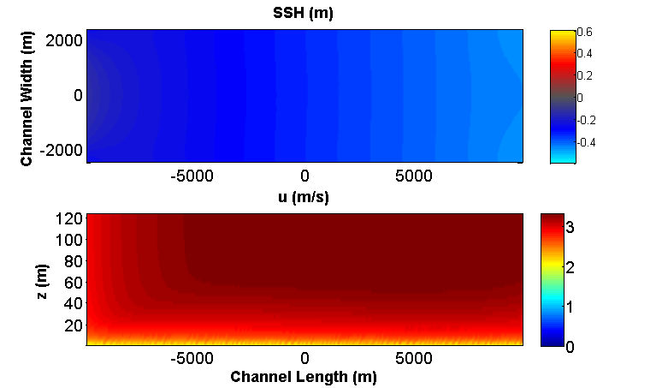
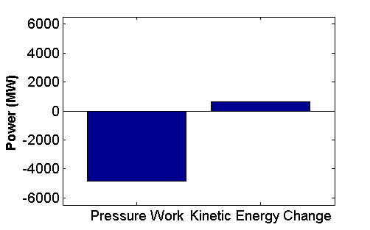
Channel flow, t = 4 hr 45 m

Slide 18
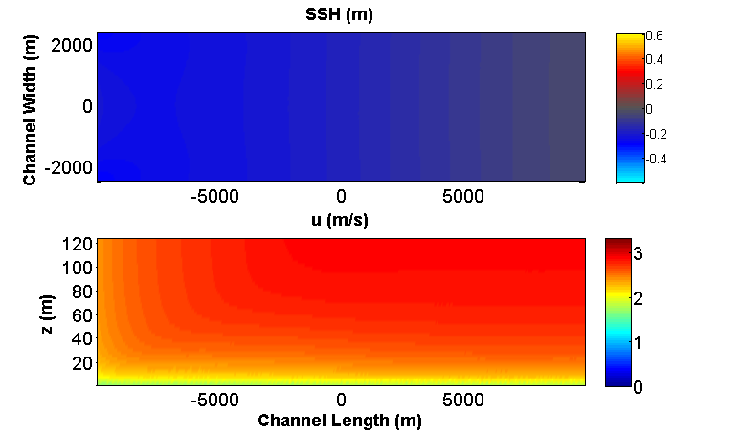
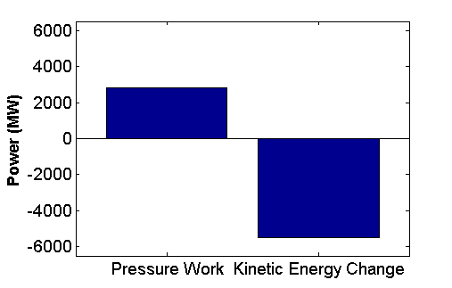
Channel flow, t = 7 hr 15 m

Slide 19
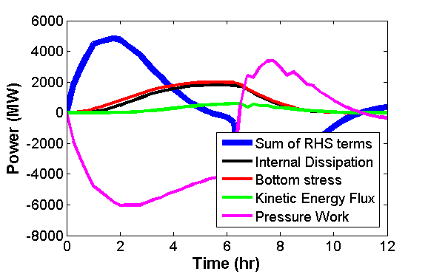
Evolution of power budget in time

Slide 20
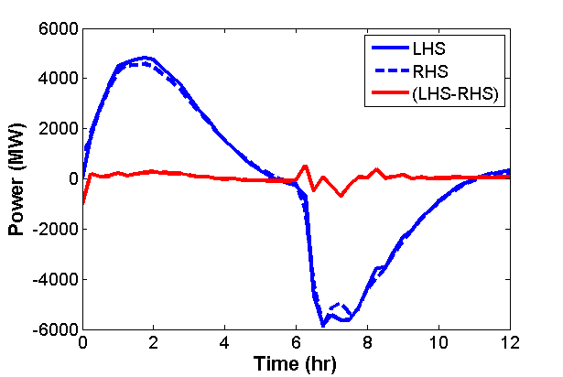
Does my equation balance?
Yes!
With about 5% error

Slide 21
Summary of power budget
Notes:
Pause to note that your analysis has been validated

Slide 22
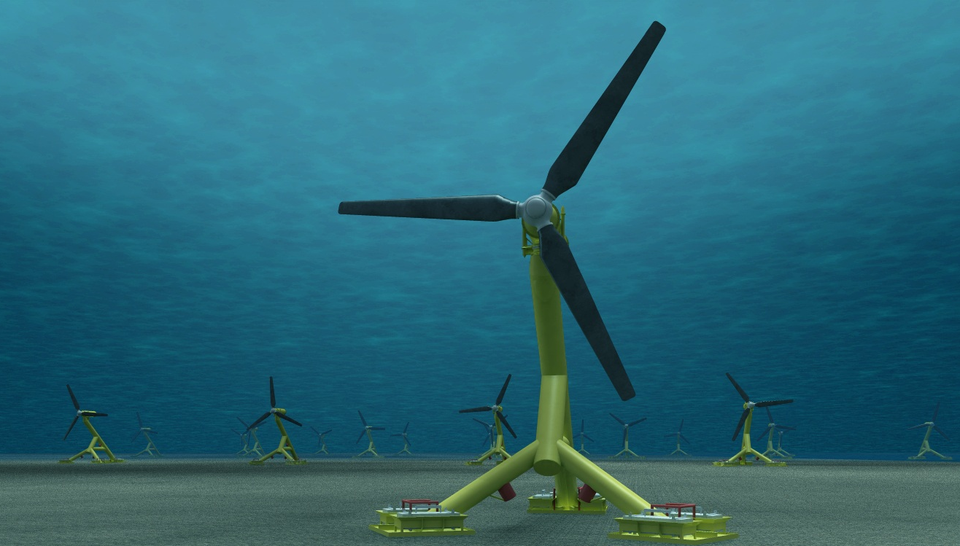
Let’s install some turbines!
Initial case: 9 rows of 9 turbines
Each turbine is 101m in diameter

Slide 23
Modeling turbines
Turbines are modeled as momentum discontinuities. The momentum sink due to turbines is represented mathematically as a pressure jump across a grid cell wall equal to
Which means the rate of energy loss to the channel due to a turbine within a cell is equal to
To represent the spinning of the turbine blades, an extra turbulence production term is included in the turbulence generation scheme. The added dissipation helps the wake recover more quickly.
(Roc, 2013)

Slide 24
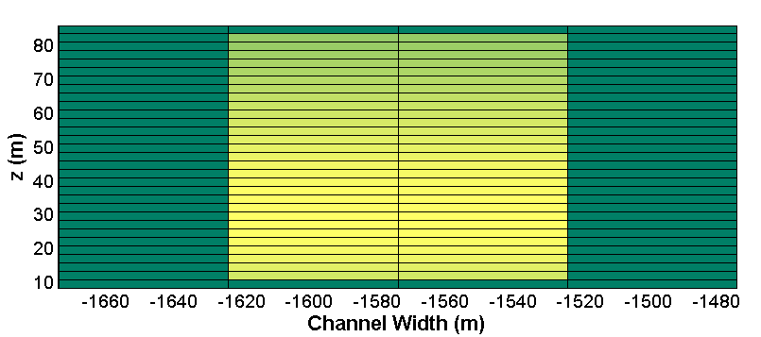
Turbines in action!
Z-Y cross section view of a turbine row
Notes:
Note not 101m high, but the actual area of the square is equivalent to the area of a 96m in diameter turbine circle approximated into a square, which is probably the closest you can get

Slide 25
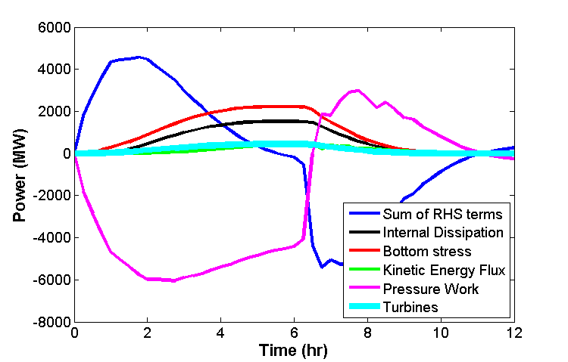
Power Budget with Turbines
Turbines dissipate 442 MW of energy, about 10% of total dissipation
Admiralty Inlet naturally dissipates 415 MW (Lavelle, 1988)

Slide 26
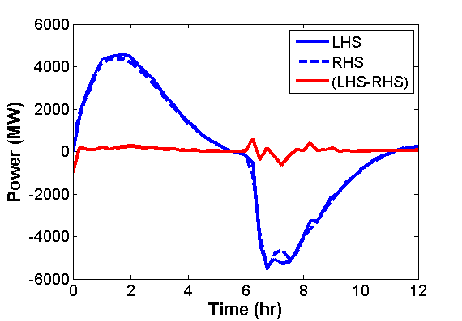
Turbine Power Budget Balance
It still balances!
Error is still at around 5%

Slide 27
Where is that energy being pulled from?
Power budget with 81 turbines
Power budget in empty channel
These don’t look that different….

Slide 28
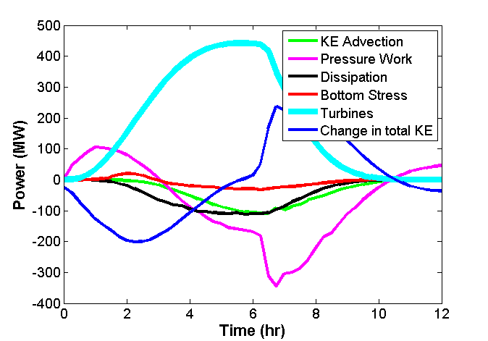
Where is that energy being pulled from?

Slide 29
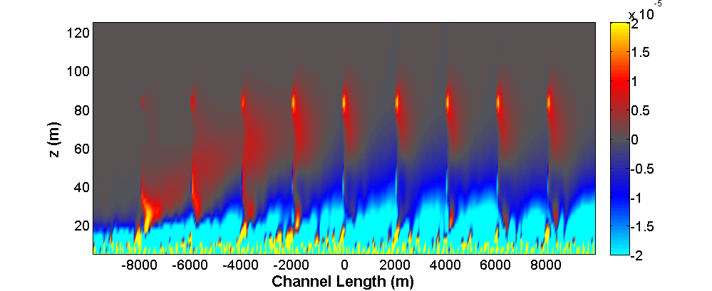
Case study: Internal Dissipation impact
Diss_{T} – Diss₀

Slide 30
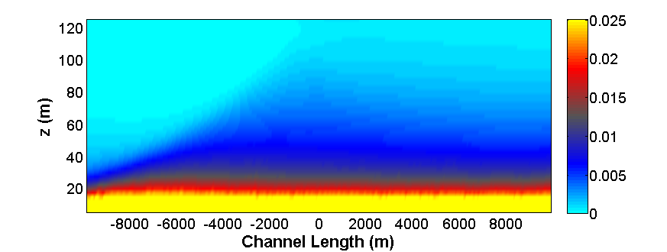
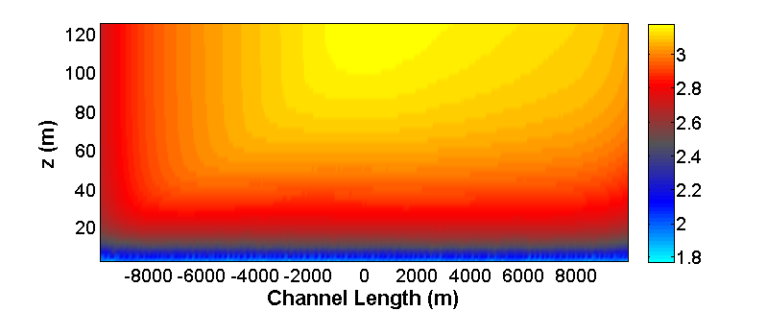
Case study: Internal Dissipation Impact
So let’s look at the background state for velocity shear…
…which is derived from the background field for u.
Empty Channel
Empty Channel
Critical region is boundary layer in 20m from bottom

Slide 31
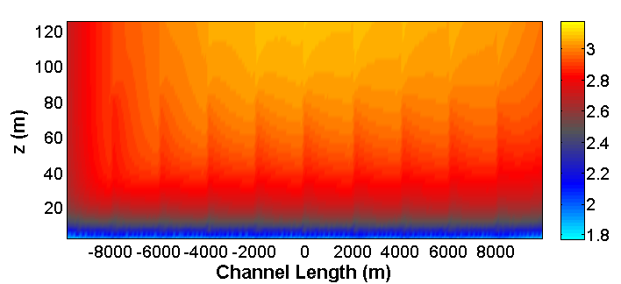
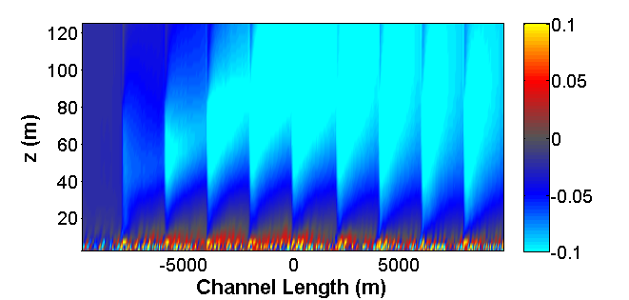
Case Study: Internal Dissipation Impact
81 Turbines
Overall increased effective thickness of the boundary layer

Slide 32
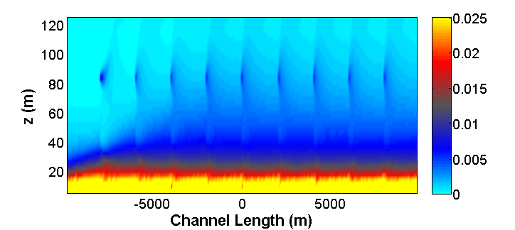
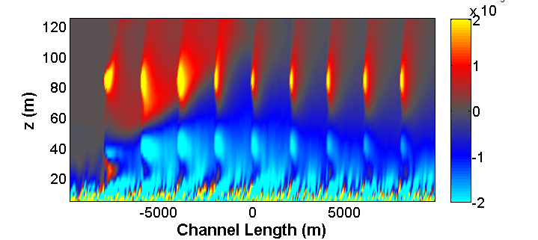
Case Study: Internal Dissipation Impact
81 Turbines
-3

Slide 33
Case Study: Internal Dissipation Impact
Diss_{T} – Diss₀

Slide 34
Summary of Physical Interpretation
Integrated values summarize impact, but do not explain impact. Local changes and far field changes may be opposite in sign!

Slide 35
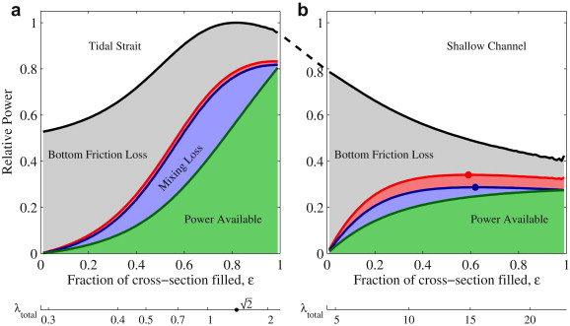
What happens if we add more turbines?
Theory predicts impact from larger turbine arrays depends on the natural state
A channel with high natural dissipation will have lower available energy, and vice versa
Vennell (2012)
Notes:
Change this picture

Slide 36
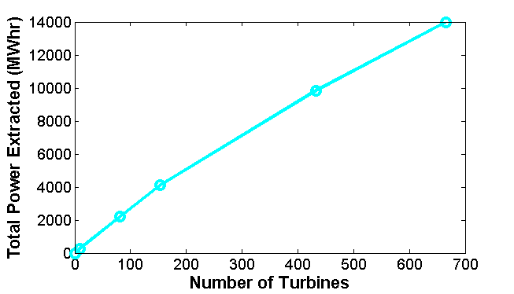
Let’s add some more turbines and see!

Slide 37
Changes in energy as more turbines are installed

Slide 38
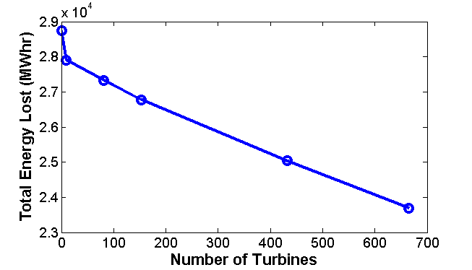
Changes in energy as more turbines are installed

Slide 39
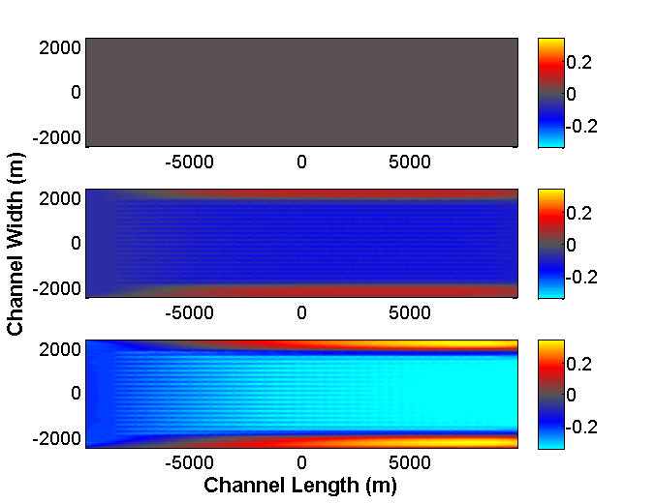
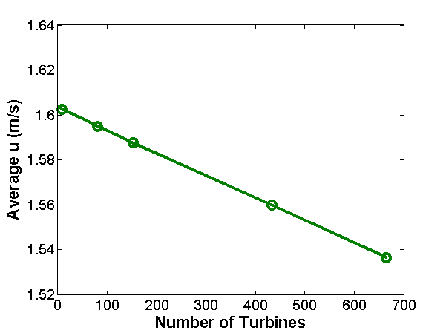
Changes in energy as more turbines are installed
t = 0 hr
t = 2 hr
t = 4 hr

Slide 40
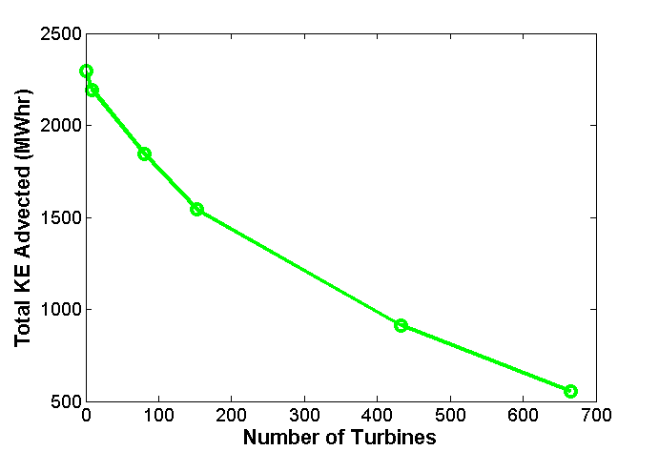
Changes in energy as more turbines are installed

Slide 41
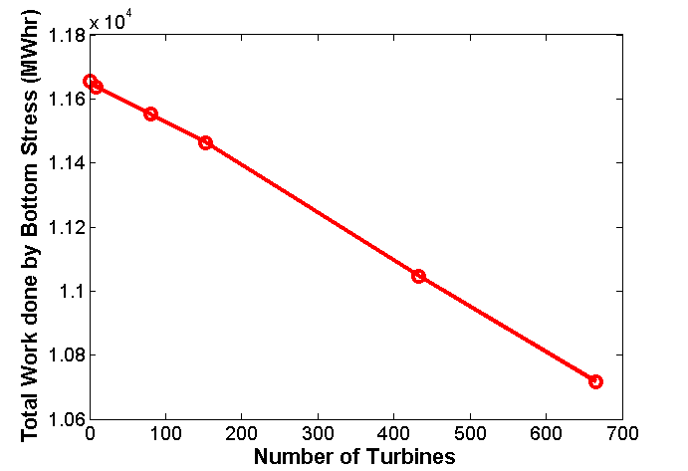
Changes in energy as more turbines are installed

Slide 42
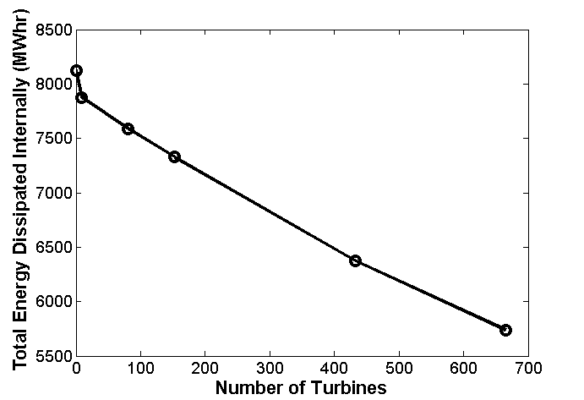
Changes in energy as more turbines are installed

Slide 43
What’s balancing turbine extraction then?
?

Slide 44
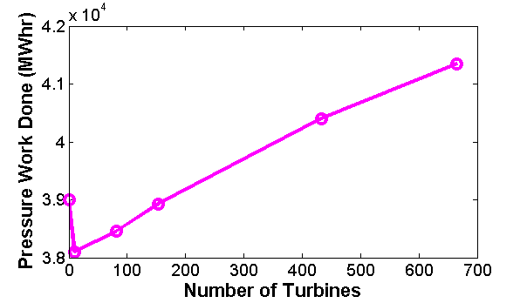
Pressure work increases to balance turbines!

Slide 45
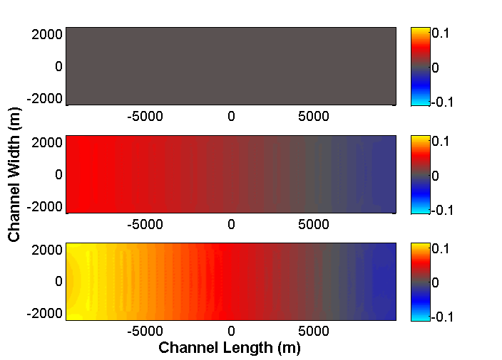
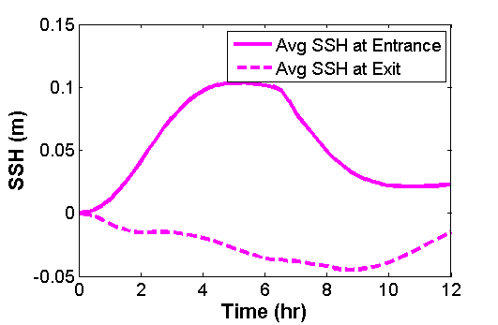
Visualizing pressure work increase
t = 0 hr
t = 2 hr
t = 4 hr

Slide 46
Objectives
Validate my physical reasoning: Build a 3D model of a flow channel and budget the changes in energy through time
Apply analysis to an experiment: Integrate validated turbine model into flow channel and show that the budget still closes and accounts for the extraction
Explore the results: Take the difference between the model with and without turbines to show how impact is distributed
Expand the parameter space: Add more turbines and see how that impacts the changes to the environmental state

Slide 47
Summary
High resolution 3D models are now possible which can represent both environments and turbines
If the energy in a model can be budgeted, the physical interpretation is validated
Many environmental impacts switch signs when looked at on different spatial scales. Thus, good resolution is necessary in understanding impact!
Increasing the turbine array matches hypothesis from theory for highly dissipative channels

Slide 48
Acknowledgments
Thanks to NSF for funding this research!
Thank you to Mitsuhiro, for advising me.
Also thank you to Brian Polagye, Parker MacCready, and Danny Grünbaum for being on my committee.
Thank you to my main collaborator, Thomas Roc, for designing the turbine model for ROMS.
And finally, to all my friends, especially Shirley and Elisa for presenting the week before me.

