Slide 1
Dominic Forbush
Performance Characterization and Control of Cross-flow Turbines in Shear Flows
Dominic Forbush, Brian Polagye, Jim Thomson, Brian Fabien, Jarlath McEntee, James Donegan
University of Washington
Northwest National Marine Renewable Energy Center
Marine Energy Technology Symposium
4/28/15
Notes:
Co-authors: Dr. Brian Polagye, Dr. Jim Thomson, Dr. Brian Fabien, ORPC James Donegan, Jarlath McEntee

Slide 2
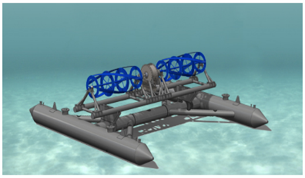
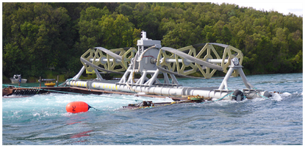
Introduction
Turbine Description
Ocean Renewable Power Company RivGen ®
Designed for community-scale power (10⁴ W) as an alternative to diesel in remote areas
Turbine Specifics:
Horizontal cross-flow 4-blade helical turbine
Rotor length = 4.1 m (each)
Rotor radius = 0.7 m
Rotor gap = 2.8 m
Pontoon deployment/recovery
Secured with upstream mooring anchors
Notes:
Objective: to develop a performance curve for this turbine. A reliable performance curve allows for controls strategies to be accurately simulated and performance generalized to other flow conditions.

Slide 3
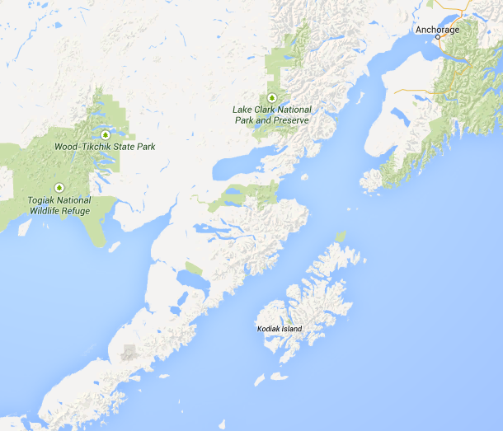
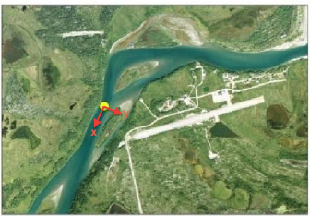
Introduction
Site Description
Kvichak River, near Igiugig, Alaska
Deployed 15-25th Aug, 2014
River ~150m wide, ~5 m deep, U≈2.5 m/s at center
Coordinate system at turbine nominal center: +X downstream, +Y cross-stream towards village, +Z upwards (0 at river surface)

Slide 4
Introduction

Slide 5
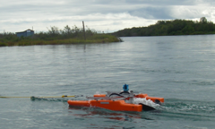
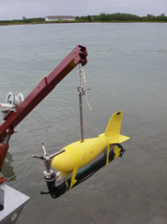
Introduction
Flow Measurement
Inflow velocities measured upstream from turbine using ADCP “Doppcats”
1 Hz flow data, 5 Hz GPS position
10-min station-holding (anchors failed)
Turbulence characterized from ADV platform (“Turbulence Torpedo”) from davit of skiff.
16 Hz flow data
Platform motion corrected with on-board strain gauges
10-min data sets
Notes:
Doppcat is down looking ADCP on a catamaran raft

Slide 6
Introduction
Flow Characteristics
Results gridded to 5 m, grids with too few samples discarded.
In turbine vicinity:
Large spatial variations in mean velocity
Turbulence Intensity ~ 10% upstream of turbine
Spatial patterns synoptic on the order of days to weeks
Notes:
Results gridded to 5 m resolution

Slide 7
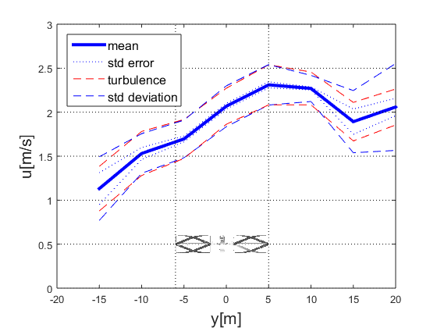
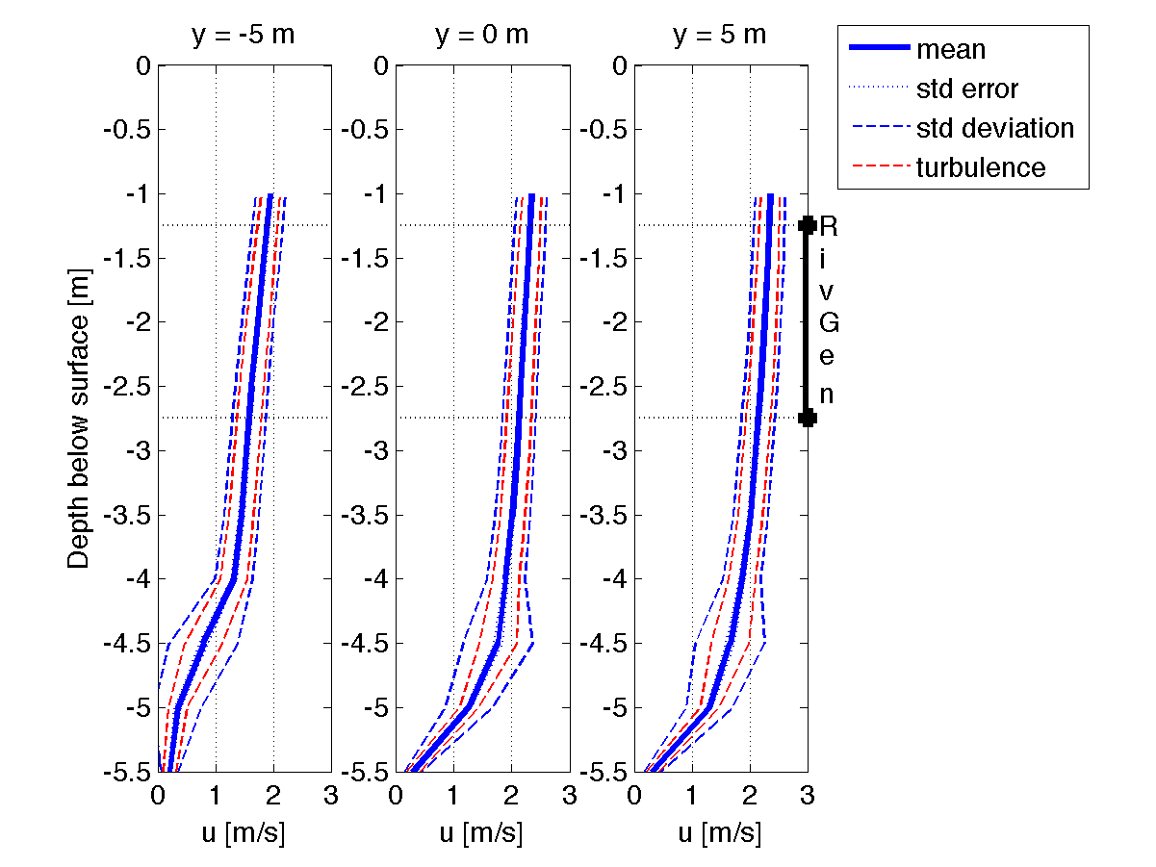
Introduction
Spatial Patterns
Lateral shear is significant
Vertical shear is comparably negligible.
Synoptic on the order of days to weeks.
Notes:
Consider the turbine form factor: it is a lot longer than it is tall. 200% increase in power density across the rotor

Slide 8
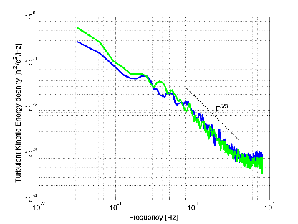
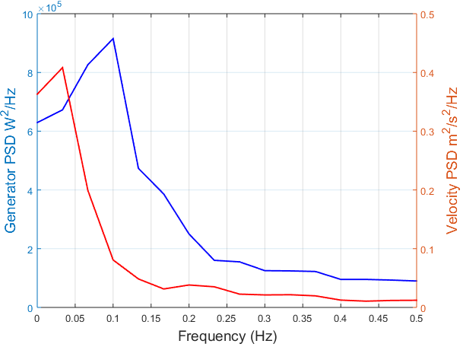
Introduction
Frequency Content
Expected f^{-5/3} power law at high frequencies.
Consistent turbulence characteristics.
Low frequencies (< 0.2 Hz) contain the majority of the energy. Turbine also unresponsive to higher frequencies.
Notes:
From High resolution ADV data (16 Hz)
Consistent turbulence characteristics in this area of the river

Slide 9
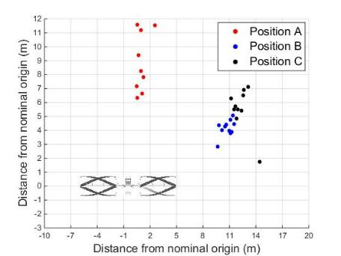
Methods
Measured Quantities:
Angular velocity
Free-stream velocity
Generator current/voltage
Generator torque
Controlled Variables:
Resistance across generator
ρ - fluid density (1000kg/m³)
A - turbine swept area
ω - turbine angular velocity
I,V - generator current and voltage
U∞ - free-stream velocity
Notes:
Performance was characterized using upstream Doppcat velocity synchronized to generator electrical output measurements. The generator was stepped through a range of resistive load settings, varying its angular velocity. Repeated at three locations.

Slide 10
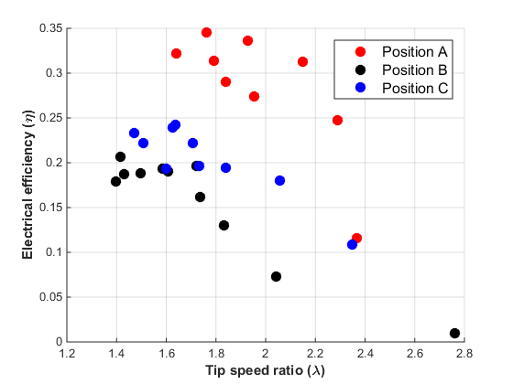
Motivation
Lateral shear across rotor results in a spatially-varying performance curve unhelpful for turbine characterization.
Significant Doppler noise in instantaneous Doppcat data: significant uncertainty.

Slide 11
Methods
Synoptic stream profile means parameters re-formulated as averages will be viable estimates.
Time average across rotor (x, z fixed):
Spatial average:
Average λ:
Average η:
ρ - fluid density
A - turbine swept area
ω - turbine angular velocity
I,V - generator current and voltage
U∞ - free-stream velocity
Empirical correction factor (α=1.03) corrects difference in mean of cubes to cube of means.

Slide 12
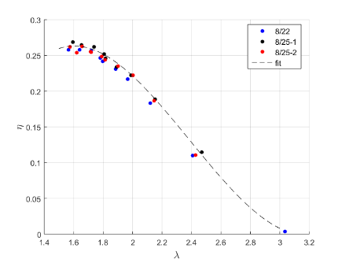
Results-Performance Curves
Using averaged U∞ and electrical output data across batches of resistive load settings, spatially varying curves converge to a single performance curve.

Slide 13
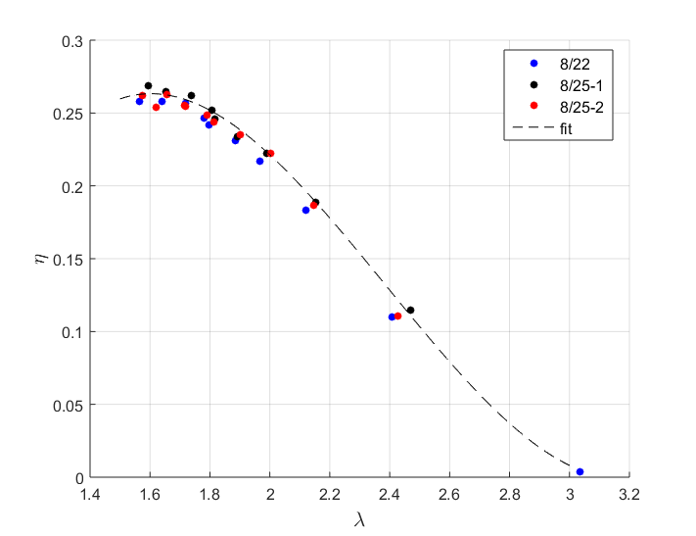
Results-Performance Curves
Some scatter is present, likely indicating that the flow was not completely time-invariant. However, lack of significant spread indicates synoptic assumption is acceptable.

Slide 14
Implications-Resource Assessment
Turbine performance in river far exceeds previous tow-trial characterization attempts for which η_{max}=20%.
Blockage unlikely: $B=\frac{A}{A_{r}−A_{s}}<3\%$
Assuming η_{max}=20%, turbine power output of 12.4 kW requires uniform 2.3 m/s.
Turbine power output is not represented by superimposed turbine in free-stream measured velocity
Visible surface deformation downstream of turbine

Slide 15
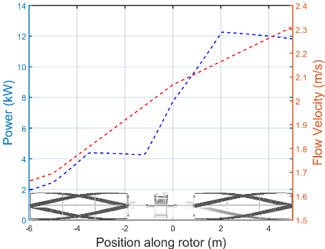
Results- Shear Flow Model
Using this performance curve, a model of RivGen operating in steady shear flow was developed. Peak power output was 12.4 kW, matching observed performance.
Model Description
Rotor subdivided into 10 cm increments
Set point λ_{s} prescribed, ω determined for each increment from local U∞
Total aggregate rotor power output determined via η-λ curve as a function of rotor increment used to define ω for entire turbine.

Slide 16
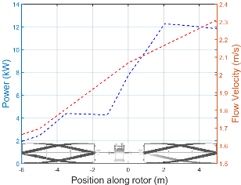
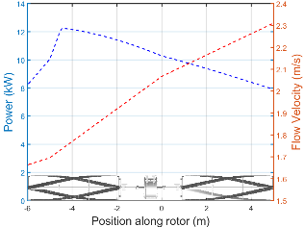
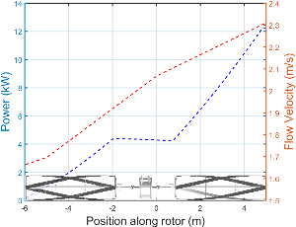
Implications- Shear Flow Model
Ideal point to define ω is a function of:
Shape of performance curve
Rotor geometry
Inflow profile
Set point λ_{s} can be adjusted to accommodate:
Unknown/changing shear profiles
Restricted sampling locations
λ_{s}= λ*=1.6
λ_{s}=2.00
λ_{s}=1.50
Notes:
For controllers that depend on knowledge of free-stream velocity, the ideal point to define ω depends on shape of performance curve, geometry of turbine, and shape of the inflow profile. Set point λ_{s} can be adjusted to accommodate unknown or changing shear profiles and/or restricted velocity sampling locations.

Slide 17
Results- Controls Simulation
Simulink model constructed using performance curve.
Turbine dynamic equation:
Where

Slide 18
Results- Controls Simulation
Proportional-Integral Tip Speed Ratio (PI-TSR) control and non-linear Kω² control were explored.
PI-TSR Control:
Where
Kω² Control:
Where
Notes:
Control was affected by changing the command torque on the generator, maintaining a set point λ_{s} .

Slide 19
Results- Controls Simulation
Controller performance metric: E_{loss}
Notes:
Results gridded to 5 m resolution

Slide 20
Implications- Controls Strategies
Performance curve is flat and asymmetric:
λ* =1.6
Stall regime λ < 1.5
→ Turbulence can stall turbine if set point λ_{s} ≤ λ*
Impact of Torque Command Update Rate for RivGen Turbine in Kvichak River
Command Torque Update Rate | Kω² (K*=140) Lowest Stable E_{loss} | PI-TSR (1.6= λ*) Lowest Stable E­_{loss}
1/3 Hz | 28-31% (K_{s}=0.3 K*) | 64-90% (λ_{s}=1.5-1.6 λ*)(Stalls)
1 Hz | 5-8% (K_{s}=0.6 K*) | 15-21% (λ_{s}=1.3 λ*)
10 Hz | ~0-3% (K_{s} ~ K*) | 0-3% (λ_{s} ~ λ*)
Notes:
The asymmetric and flat performance curve places ideal λ* =1.6 near turbine stall regime λ < 1.5. This can lead to turbine stall from turbulence if set point λ_{s} ≤ λ*, particularly if the controller update rate is limited.

Slide 21
Implications- Controls Strategies
Simulations also conducted on larger but geometrically similar TidGen® with ADV flow velocity time series of tidal cycles Admiralty Inlet, the site of test deployment.
Parameter | RivGen Turbine | TidGen Turbine
Rotor Swept Area (m²) | 11.48 | 59.1
Moment of Inertia (kg*m²) | 277.5 | 2721.6
Rotor Radius (m) | 0.7 | 1.4
Damping coefficient estimate (N*m*s) | 0, 10, 20 | 50, 100, 150
K* value | 140 | 5750

Slide 22
Implications- Controls Strategies
Controls experiments carried out at 2000 Hz for TidGen turbine in Admiralty inlet do not match predicted level of performance (E_{loss}~0%).
Impact of Angular Velocity Noise Addition for TidGen Turbine in Admiralty Inlet
Rotation Rate Noise Variance (rad²/s²) | Non-linear Controller (K* ~ 5700) Lowest Stable E_{loss}
0 | ~0-1% (K_{s}~K*)
0.05 | 8-9% (K_{s} = 0.6 K*)
0.1 | 13-16% (K_{s} = 0.4 K*)
0.5 | 36-37% (K_{s} = 0.2 K*)
1.0 | 42-43% (K_{s} = 0.2 K*)
2.0 | 60-61% (K_{s} = 0.1 K*)
Matches field experience
Reducing ω noise could dramatically improve turbine performance.

Slide 23
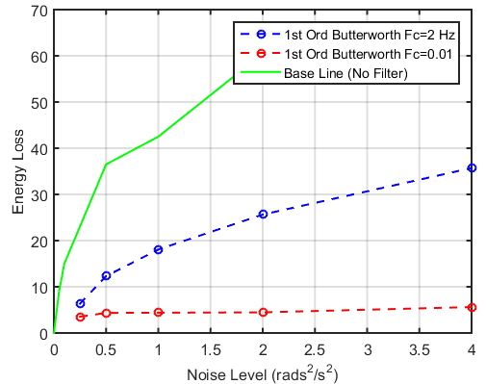
Ongoing and Future Work
Filtering strategies for reducing angular velocity noise were explored in simulation over a range of mean inflow velocities from Admiralty Inlet tidal cycles.
Filter Performance Comparison for TidGen Kω² in Admiralty Inlet Flow
Promising strategies will be applied to scale-model turbine in flume testing.
Notes:
Filters a balance between attenuation rate and phase shift Ideal place in this balance depends on turbine type and control type. PI-TSR more sensitive to phase shift, as are turbines with less inertia.

Slide 24
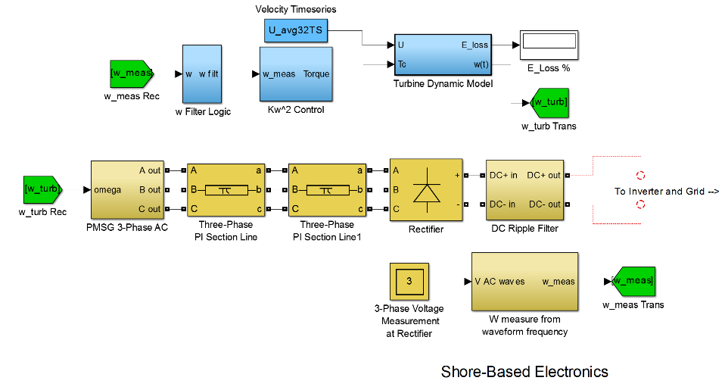
Ongoing and Future Work
Simulink model expanded to include shore electronics
Eventually, grid as well
Simulates ω signal acquisition and turbine dynamics
Notes:
Simulink model expanded to include shore-based electrical machinery. More accurately simulates ω signal acquisition and turbine dynamics.
The model will be expanded to include Igiugig, AK grid emulation and more accurately represent turbine stall events.

Slide 25
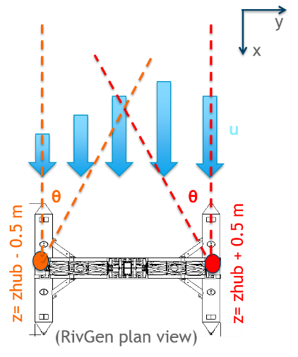
Ongoing and Future Work
Revised deployment strategy will resolve lateral shear profile evolution in time.
Pre- and post-installation velocity measurements to explain performance boost.
CFD simulation of shear flow to see turbine effect on flow profile and free surface.
Turbine control and grid integration will be attempted during turbine re-deployment (July 2015).

Slide 26
Acknowledgements
This material is based upon work supported by the Department of Energy under DE-EE0006397
Alaska field crew (Joe Talbert, Alex deKlerk, Curtis Rusch, Ryan Tyler, Monty Worthington) ILC camp, D’nina Air Taxi, and the village of Igiugig.

