Slide 1

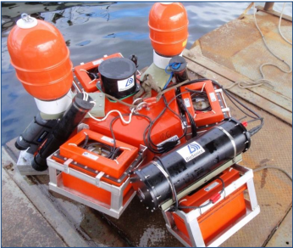
Evaluating Statistical Models for Baseline Characterization and Measuring Change in
Environmental Monitoring Data
Hannah Linder
MS Thesis Defense
August 18, 2016
Advisor: John Horne
Committee Members: Tim Essington, Eric Ward, Andrea Copping

Slide 2
Environmental Monitoring
Objective: To detect and measure environmental change
To meet objective must:
Characterize baseline conditions of the environment
2. Measure change from baseline conditions, including:
  Detect change
  Quantify size (magnitude) and shape (direction) of change
  Predict future change

Slide 3

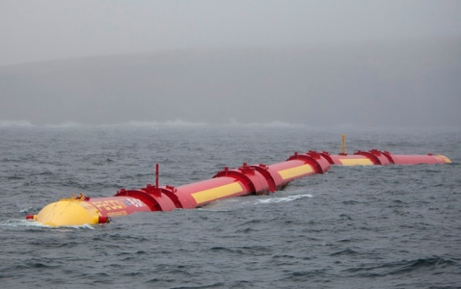
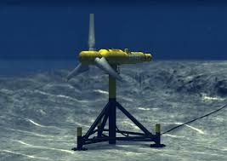
Monitoring Case Study:
Marine Renewable Energy (MRE)
Offshore Wind
Generate sustainable power via wind, wave, or tidal energy
Environmental monitoring (biological, physical, chemical) required for MRE project licenses
Monitoring guidelines recommending data collection and study design methods exist
No standard data collection, study design, or analysis methods
Limited comparisons of analytic models used in MRE monitoring
A robust model evaluation is required to establish best practices for analyzing monitoring data
Wave
(Hauschildt Marine)
Wave
(Scottish Government Flickr)
Tidal
(Alstom)
Notes:
Timely monitoring case study that illustrates use and importance of monitoring
Monitoring is requires for licenses to prevent any harm to the environment
Expediting MRE permitting benefits: 1. developers (costs of developing project →better for investors, greater job market) 2. US citizens (decreases dependence on foreign energy) 3. Regulators (meeting RE mandates and goals)
3. Effects of MRE are more certain (satisfy local residents, Native American communities, etc)

Slide 4
Example Guidelines for MRE Monitoring
Data Collection and Processing
Energy Generating Device
Marine Mammals
Habitat
Seabirds
Fish
Abundance
Metric(s)
???
Distribution
Metric(s)
???
Behavior
Metric(s)
???
???
Metric(s)
Diversity
Stressor
Receptors
Indicators
Metrics
Models
Notes:
Metrics may be a directly collected or in-direct (index estimate or something calculated from data collected)
Stressor: Change in the environment is caused by a stressor (i.e., natural or anthropogenic disturbance of pre-existing natural conditions)

Slide 5
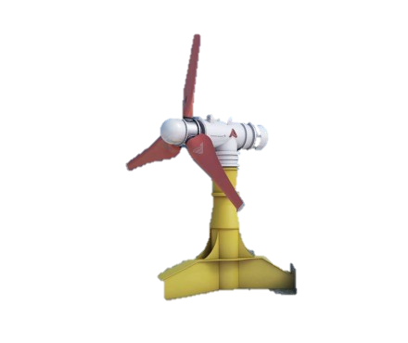

Recommended Before-After
MRE Monitoring Study Design
BEFORE
AFTER
Notes:
It may be difficult to find control sites that match the characteristics of impact sites due to high environmental variability at MRE device sites (Polagye et al. 2011, Copping et al. 2014).

Slide 6
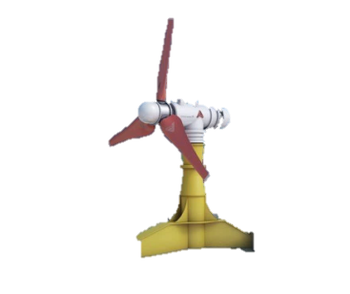
Analyzing Monitoring Data
Statistical models used for:
1. Baseline (“Before”) Characterization:
    Measure pre-disturbance trends, environmental relationships, and natural variability
    Used to develop operational (“After”) monitoring plans
2. Measuring Change in Operational (“After”) Monitoring:
    Detect change from baseline conditions
    Quantify size and shape of change
    Predict future change
→ Best practice statistical models ensure accurate and consistent analysis of monitoring data
Notes:
Reiterate on this slide and the next that this need is general for environmental monitoring, I’m just applying this to one timely case study

Slide 7

Thesis Objectives
Develop and execute an evaluation of statistical models used for:
1. Baseline Characterization
2. Measuring Change in Environmental Monitoring Data
To recommend best practices for analyzing monitoring data
Applications:
  Reduce costs associated with monitoring
  Enable comparison within and between sites
  → Reduce uncertainty of environmental effects
  → Expedite MRE permitting process

Slide 8
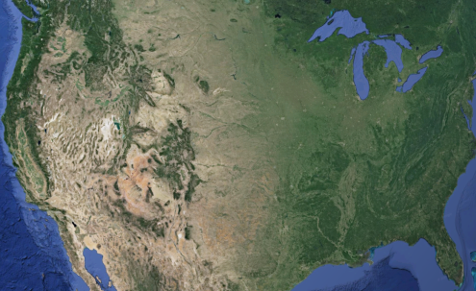
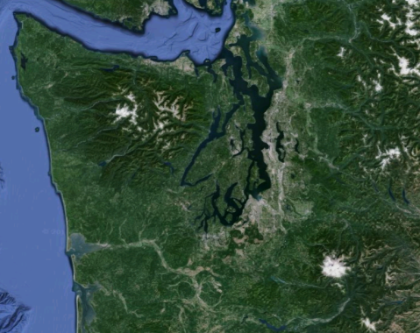
MRE Baseline Case Study Data
Proposed tidal turbine site: Admiralty Inlet, Washington, USA
Stationary acoustic echosounder (Biosonics 120 kHz)
Acoustic backscatter is reflected energy from animals (e.g., fish) in water → Proxy for biomass
Data sampled at 5Hz for 12 minutes every 2 hours
May 11th - June 8th 2011
Baseline Covariate Data:
  Julian day count
  Tidal Speed
  Tidal Range
  Fourier Series (Accounts for 24-hour cycle)
Notes:
Backscattering = Amount of acoustic power scattered by a target into the direction of the transmitting transducer.
Fourier Series are flexible in terms of length of season and different periods of fluctuation within the season, and can easily alter the smoothness of the seasonal pattern
Data is representative because: highly variable environment, pilot study (common current state of project), acoustic data shown to be similar in other sites (Fall of Warness), stationary acoustic data is commonly recommended for MRE sites, and can be long term monitoring method (less expensive and requires anthropogenic input)
The properties of these datasets are common for monitoring time series data (i.e., temporally continuous, autoregressive, normal and non-normal data) (Chandler and Scott 2011, Gitzen 2012).

Slide 9
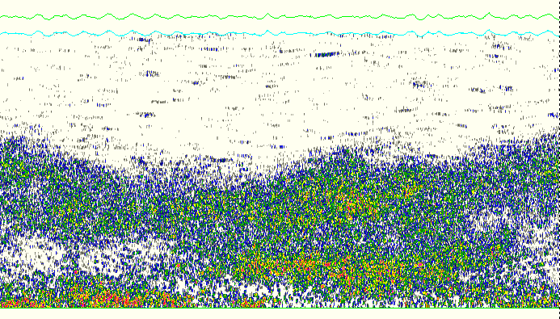
MRE Case Study- Data Metrics
Density
Center of Mass
Mean volume backscattering strength (S_{v}).
Units: dB re 1 m⁻¹
Depth mean weighted center.
Units: m
Depth (m)
Depth (m)
Time (s)
Time (s)
Dispersion
Aggregation Index
Variance of biomass around center of mass
Units: m²
Patchiness, on a scale of 0 to 1
Units: m⁻¹
Depth (m)
Depth (m)
Time (s)
Time (s)
Slide Credit: Lauren Wiesebron
Notes:
Echograms visually display estimated backscatter in water column
For all intents and purposed of this talk I will call backscatter “fish”
Center of Mass: weighted average location of backscatter
Dispersion: Spread of backscatter around that center of mass
AI: how aggregated the backscatter is, 1 being highly aggregated, 0 being very patchy

Slide 10
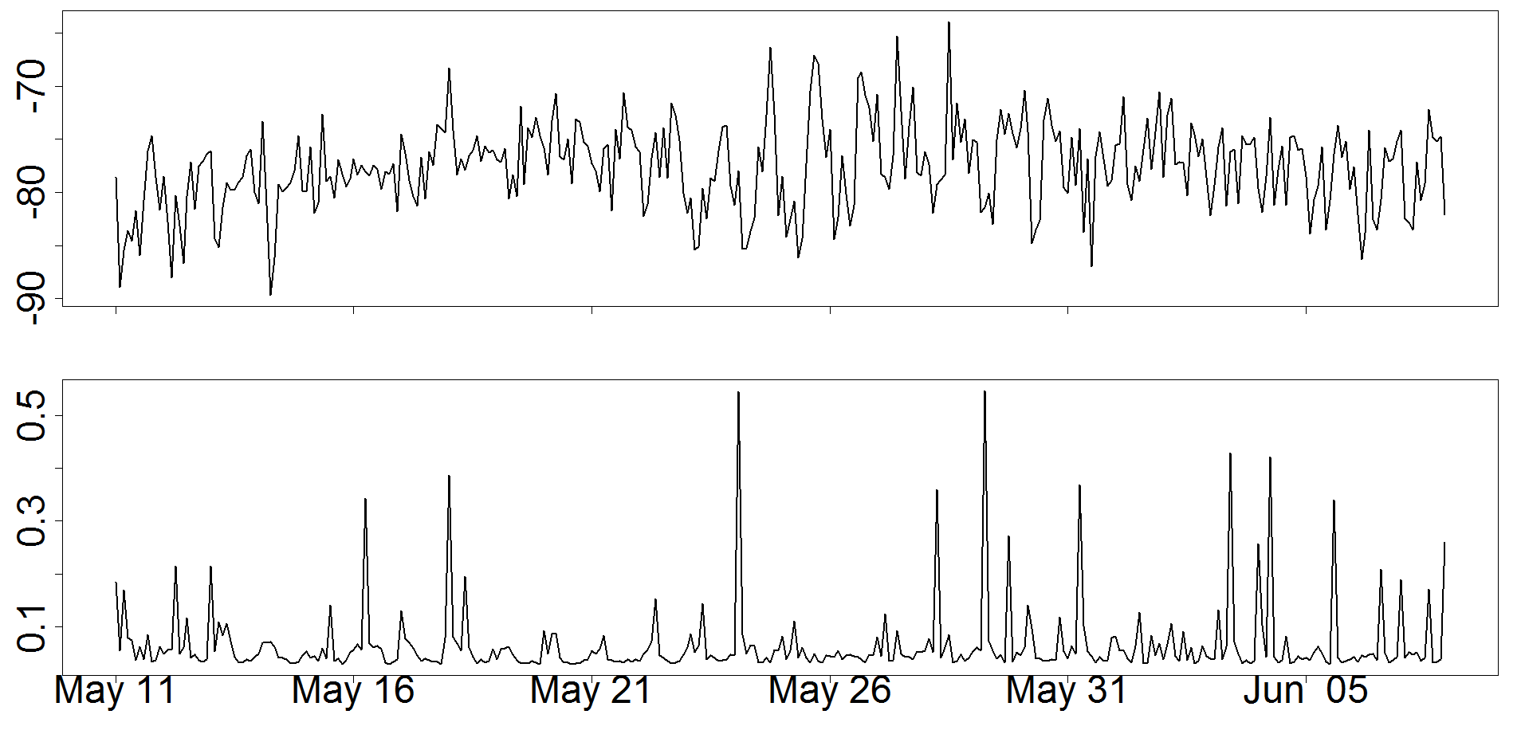
Case Study Metric Data
Density (Sv)
Sv (dB)
Aggregation Index (AI)
AI (m⁻¹)
Spikes of high-state AI
Low-state AI
Time (Days)

Slide 11
Representative Metric Data Properties
Human Intervention in Ecosystem
Abundance
Distribution
Behavior
Sv
(dB re 1 m-1)
Center of Mass (M)
Inertia (m2)
Aggregation Index (m-1)
???
???
???
???
Fish
Stressor
Normal, continuous series, autocorrelated
→ Sv
Non-normal (spiky), continuous series, autocorrelated
→ Aggregation Index
Receptor
Indicator
Metric
Model

Slide 12
Candidate Models
Model | Form | Parametric/ Nonparametric | Variance | Autocorrelation Structure | Error Distribution
Linear Regression | Linear | Parametric | Observation error only | None | Normal
Generalized Least Squares (GLS) | Linear | Parametric | Observation error only | Residual correlation | Normal
Generalized Linear Model (GLM) | Linear | Parametric | Observation error only | None | Exponential family
Generalized Linear Mixed Model (GLMM) | Linear | Parametric | Observation error only | Residual correlation | Exponential family
Generalized Additive Model (GAM) | Non-linear | Semi-parametric | Observation error only | None | Exponential family
Generalized Additive Mixed Model (GAMM) | Non-linear | Semi-parametric | Observation error only | Residual correlation | Exponential family
Regression + Auto-Regressive Moving Average (ARMA) | Linear | Parametric | Observation error only | Lagged error | Normal
Reg-ARMA + Generalized Auto-Regressive Conditional Heteroskedasticity (GARCH) | Linear | Parametric | Observation error only | Lagged error and conditional variance | Generalized extensions of normal
Multivariate Auto-Regressive State-Space (MARSS) | Linear | Parametric | Observation and process error | AR-1 lagged process variable | Normal
Random Forest | Nonlinear | Non-parametric | N/A | Lagged dependent variables | None
Support Vector Regression | Nonlinear | Non-parametric | N/A | Lagged dependent variables | None
Generalized
Regression
Models (n=6)
Time-series
Models (n=3)
Non-parametric
Models (n=2)
Notes:
Generalized Regression Models most often used in MRE studies
Parametric vs Semi-parametric vs non-parametric:
Parametric → assumption of functional form of model and data distribution
Nonparametric → no predetermined function form, relationships are constructed based on data no pre-determined form
Semiparametric → mix of the two

Slide 13
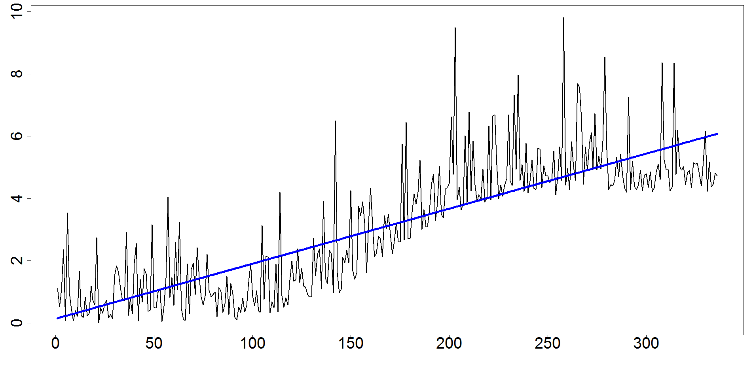
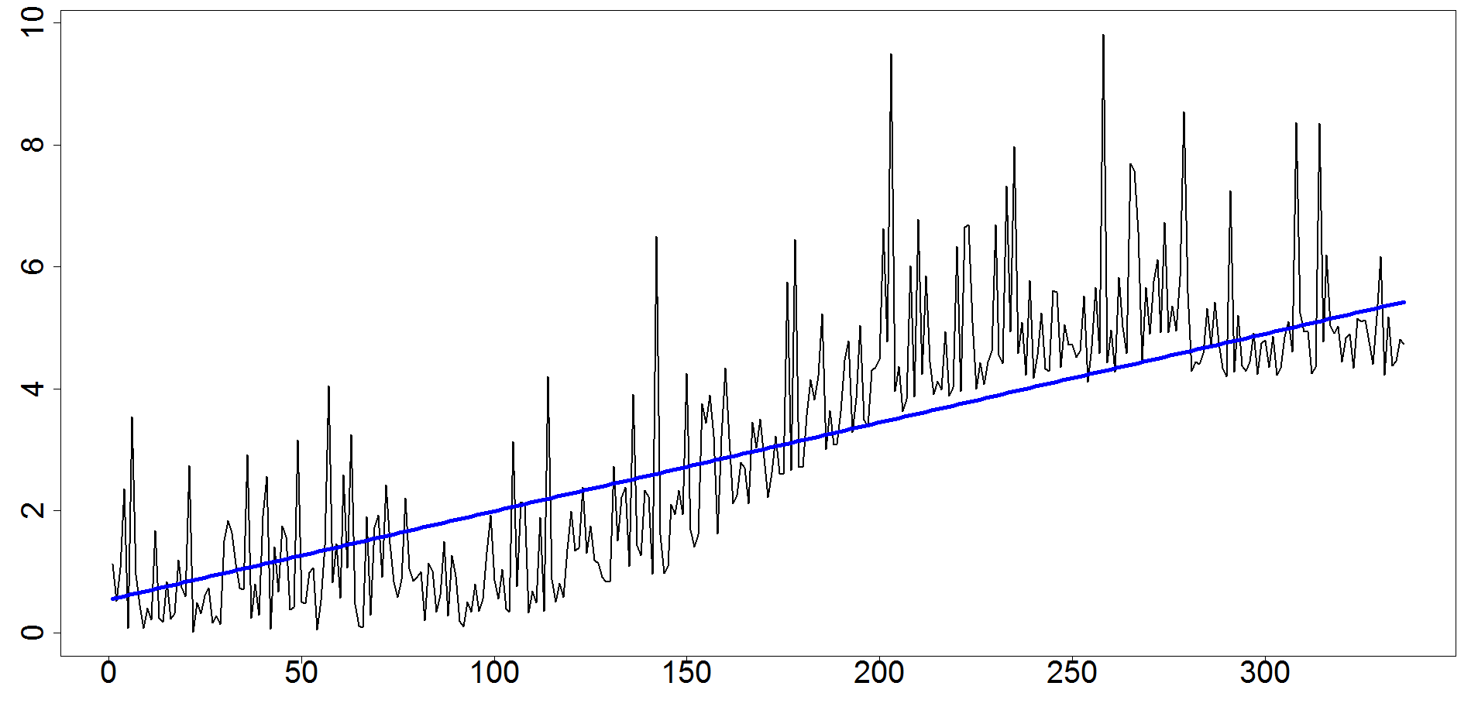
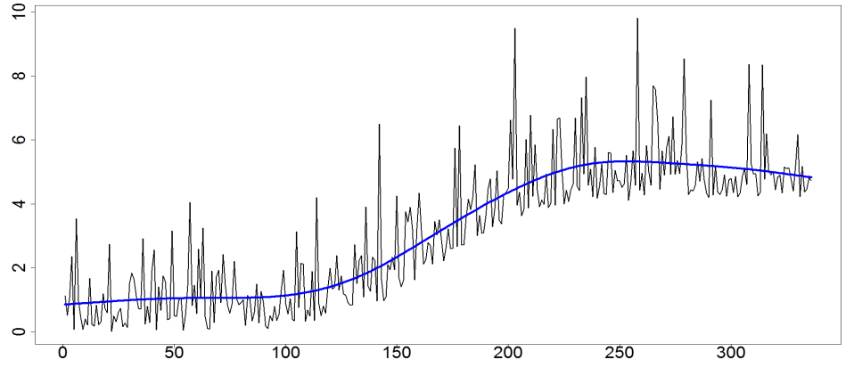
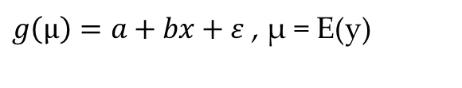


Candidate Models: Generalized Regression
Monitored
Metric (y)
Linear Regression
$$y=a+bx+ε, ε\sim Normal(0, σ)$$
Time Index
Generalized Linear Model (GLM)
$g\left(µ\right)=a+bx+ε$ , µ = E(y)
Generalized Additive Model (GAM)
$$g\left(µ\right)=a+bx_{1i}+s_{1}\left(x_{2i}\right)+ε$$
Notes:
GLS is similar for linear regression but for the purpose of my study it is important to note that it can account for autocorrelation in the data through its residual correlation structure
GLM: link function transforms expected value (observations not transformed), g() is the link function;
Gamma was chosen because assumption of constant CV is appropriate because sampled over full lunar cycle w/ same equipment so can assume consistent error. Also, lognormal commonly used for similar population abundance ecology data and also assumes constant CV (identity link over log link, because log back-transformation can cause inappropriate change in amplitude when applied to intervention model w/ incremental effects in addition to other covariates). In R rate is linear function of covariate, where shape is kept constant
GLMM used to account for autocorrelated error. Must estimate a random effect with GLMM, in this case it is the 24-hr count variable (based on acf plot that identified correlation at 24-hr marks → used to create blocks of population) random effect accounts for variability between groups, so reisudal autocorrelation accounts for within group variability (in this case, between days). Random effects assume sub-groups are independent, and within-groups are correlated
GAMM: thin plate regression splines do not require knots, and can be used on any number of predictors, better than TE for multiple predictors w/ same units
ti() best to have interpretable and stable separate main effects from interactions, but no need to use ti() instead of s() for main effects
Gavin Simpson "That we are fitting it via mixed effects software is really just because that is what is available. The random effects are only used here for the penalty terms on the smooths; there is no clustering in the response"

Slide 14
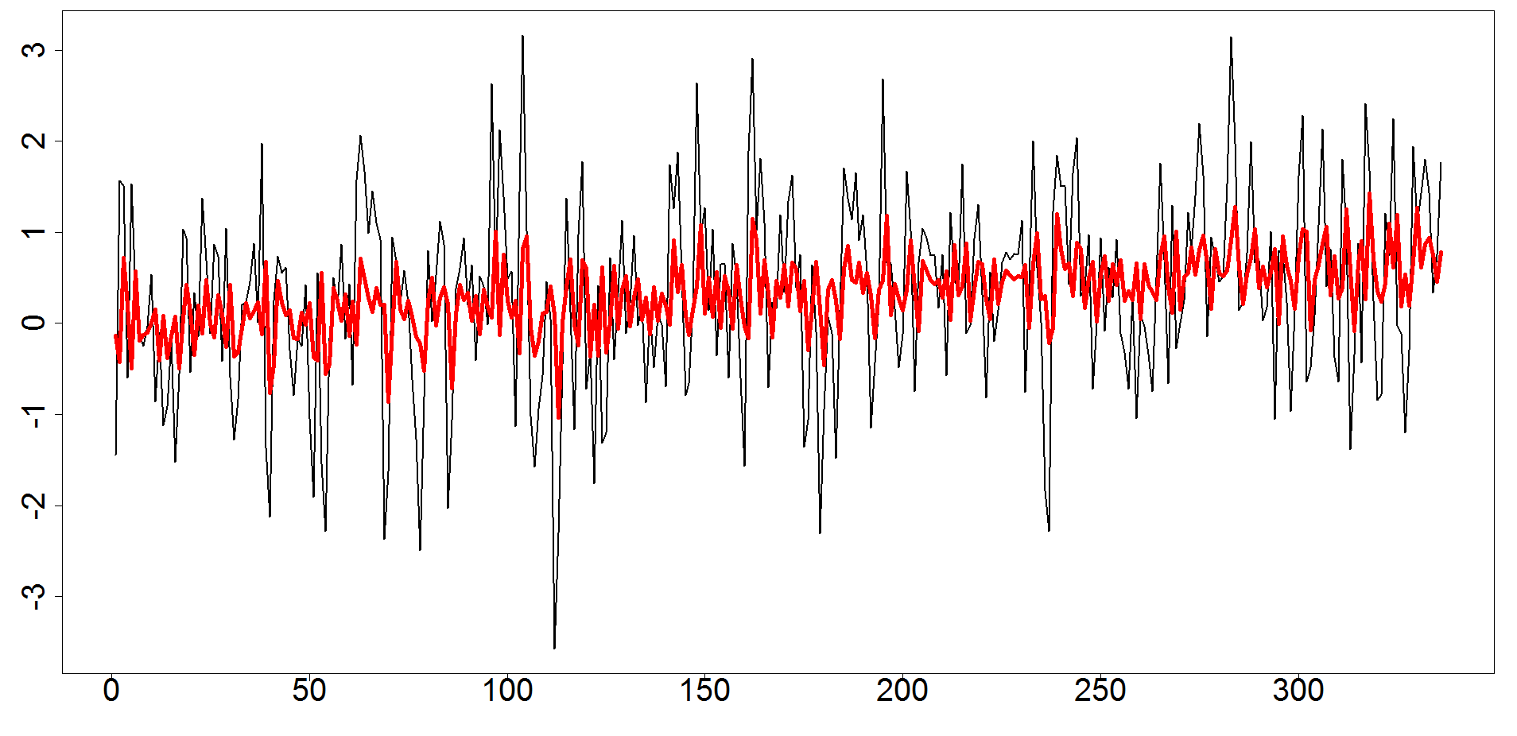
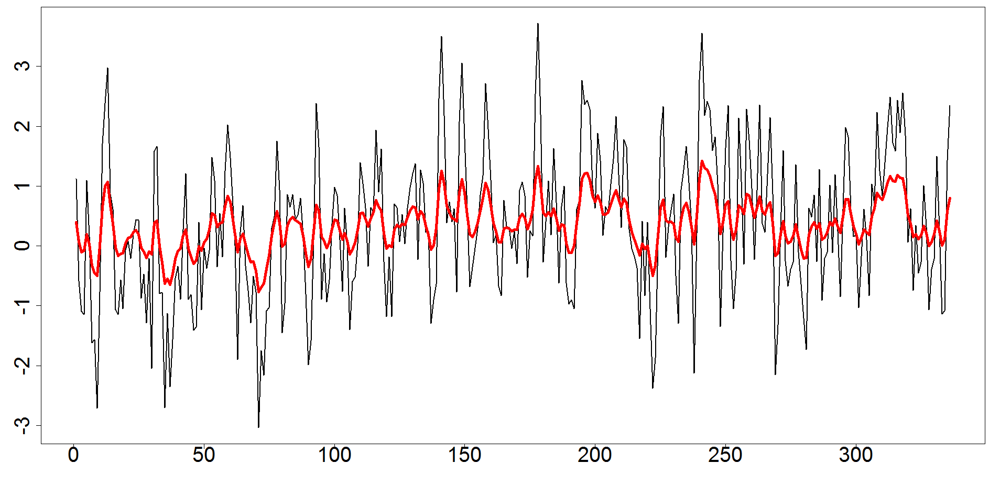
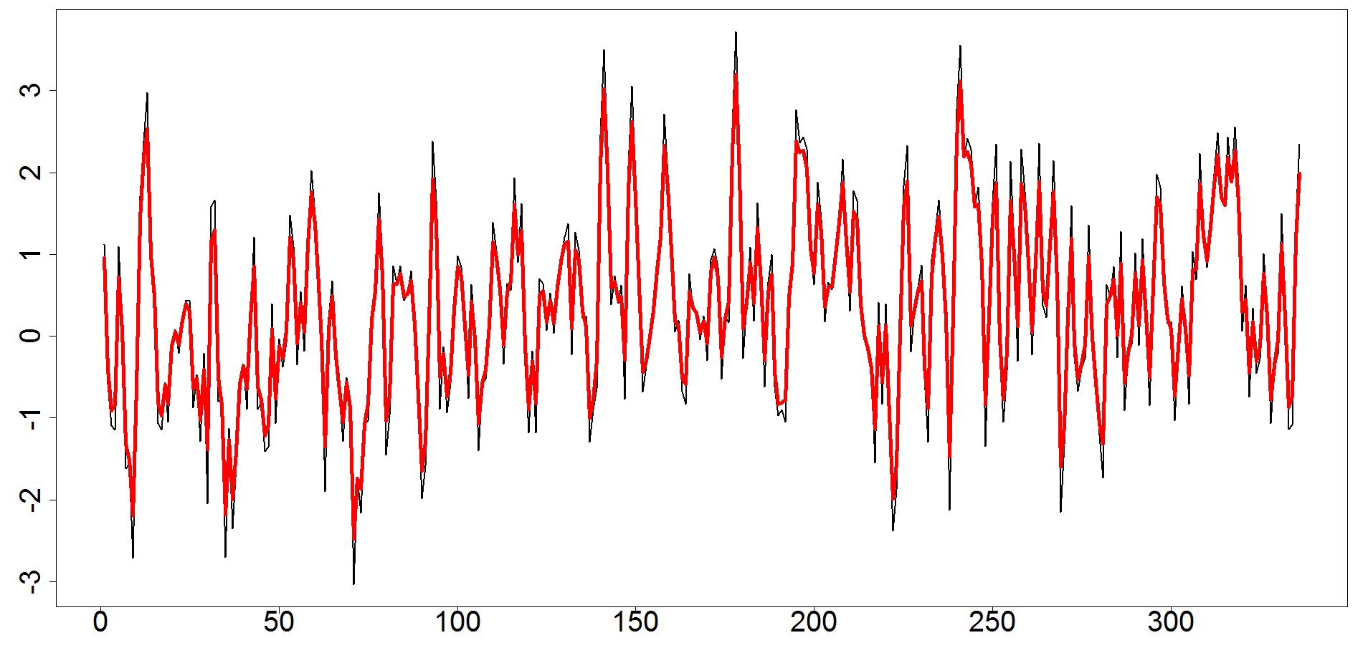

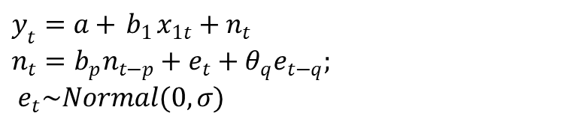
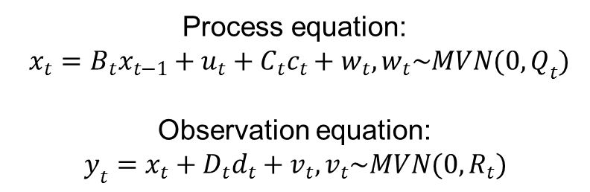
Candidate Models: Time Series Models
Regression- Autoregressive Moving Average
(Reg-ARMA)
Multivariate Autoregressive State-Space Model (MARSS)
$y_{t}=a+{ b}_{1}x_{1t}+n_{t}$ $n_{t}=b_{p}n_{t−p}+e_{t}+θ_{q}e_{t−q};$
$e_{t}\sim Normal(0,σ)$
High Observation Error (R)
→ MARSS-M
High Process Error (Q)
→ MARSS-P
Reg-ARMA-Generalized
Autoregressive Conditional
Heteroskedasticity
(Reg-ARMA-GARCH)
Process equation:
$x_{t}=B_{t}x_{t−1}+u_{t}+C_{t}c_{t}+w_{t}, w_{t}\sim MVN(0,Q_{t})$
Observation equation:
$y_{t}=x_{t}+D_{t}d_{t}+v_{t}, v_{t}\sim MVN(0,R_{t})$
$$σ_{t}^{2}=w+ α_{q}ε_{t−q}^{2}+β_{p}σ_{t−p}^{2}$$
Notes:
Reg-ARMA: The autoregressive (AR) component regresses a process on past values, and the moving average (MA) component models the error using previous values of that error. The ARMA model was formatted as a Regression-ARMA (Reg-ARMA) to model dependent data using environmental predictors in addition to lagged dependent values. A reg-ARMA is structured as a linear regression, but the error term in the regression is modeled using the ARMA structure (Hyndman 2015).
Reg-ARMA-GARCH: GARCH model to estimate autoregressive conditional variance values of the ARMA residuals (Engle 2001, Zivot 2009, Ruppert 2011). When independent predictor variables are included in an ARMA-GARCH model, then the model becomes a linear regression, with errors modeled using an ARMA model, and the variance of the residuals modeled using the GARCH model (Ruppert 2011).
The skewed-student-t distribution can be represented as normal mean-variance mixture model with an Inverse Gamma mixture distribution (Hu and Kercheval 2008). This distribution aligns most closely with the structure of the AI data and the Gamma distribution chosen for the non-normal generalized regression models.
MARSS: state that this model explicitly includes an equation for modeling the underlying state of the population and observed estimates that partition total error into observed and process

Slide 15
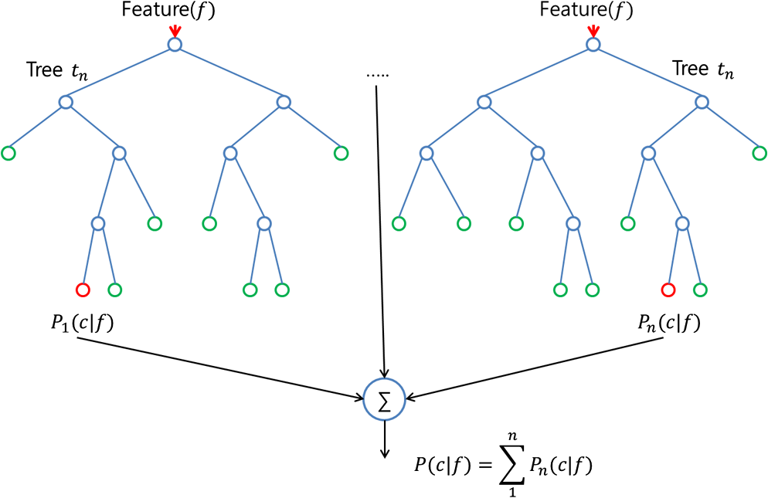
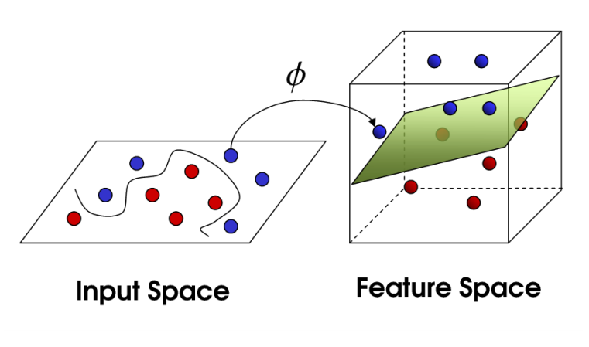
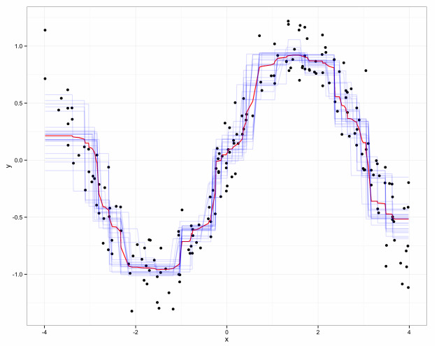
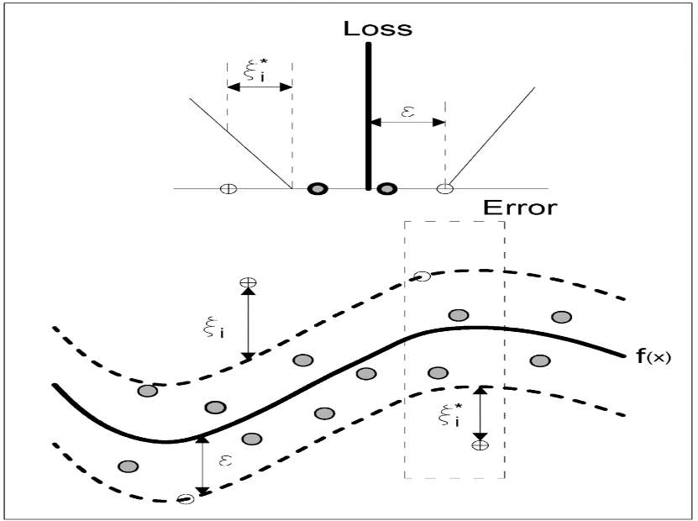
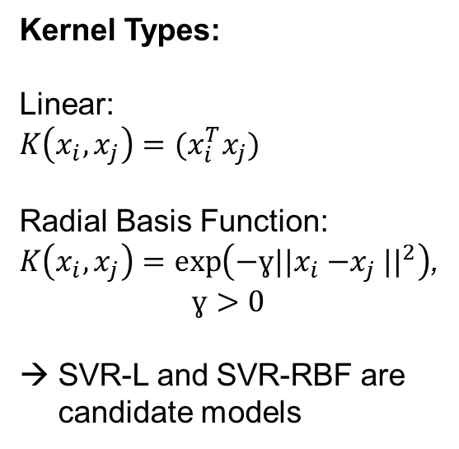
Candidate Models: Nonparametric Models
Random Forest Regression
Support Vector Regression
Kernel Types:
Linear:
$K\left(x_{i},x_{j}\right)=(x_{i}^{T}x_{j})$
Radial Basis Function:
$K\left(x_{i},x_{j}\right)=\exp\left(−ɣ{{||x}_{i}{−x}_{j}||}^{2}\right)$,
$$ɣ>0$$
→ SVR-L and SVR-RBF are candidate models
(Liao 2015)
(Srivastava 2015)
(Jones and Linder 2015)
(Granata 2016)
Notes:
RF: regression built from iteratively estimating expected mean value at each point and averaging across these values
SVR: regression that uses a specified kernel, or algorithm, to transform the data and fit any nonlinear relationship to the data
Random Forest:Within each tree, a randomly chosen subsample of the predictor variables ($m_{try}$) are used to fit the data. The predictor variable and split of the data based on the predictor variable that produce the best estimate of the dependent variable based on Mean-Squared-Error (MSE) are calculated. This process is repeated until 5 data points remain in each node of the tree. The final predicted values are based on the average of the individual tree predictions.
Support Vector: Cost affects the penalization of estimation error and the smoothness of the estimated regression. A high cost indicates a low tolerance for error and can potentially overfit the data. The gamma value controls the width of the kernel (Thissen et al. 2003). A high gamma indicates a smaller width that increases the localized fit of the model and potentially overfits the data.

Slide 16
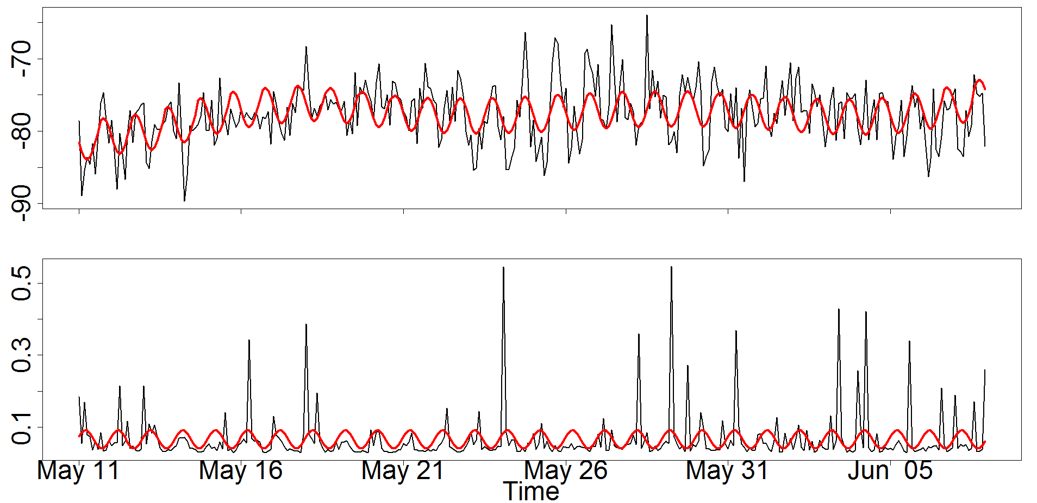
Baseline Characterization
Characterization: Measure natural variability, pre-disturbance trends,
and environmental relationships
Residual
Variability
Sv (dB)
Sv = -78 + 0.073*Day + 2.2e-04*Range +-2.2*Sin+1.2*Cos – 2.6e-04*Day:Range
Environmental Predictors
Trend
Pattern Variability

Slide 17
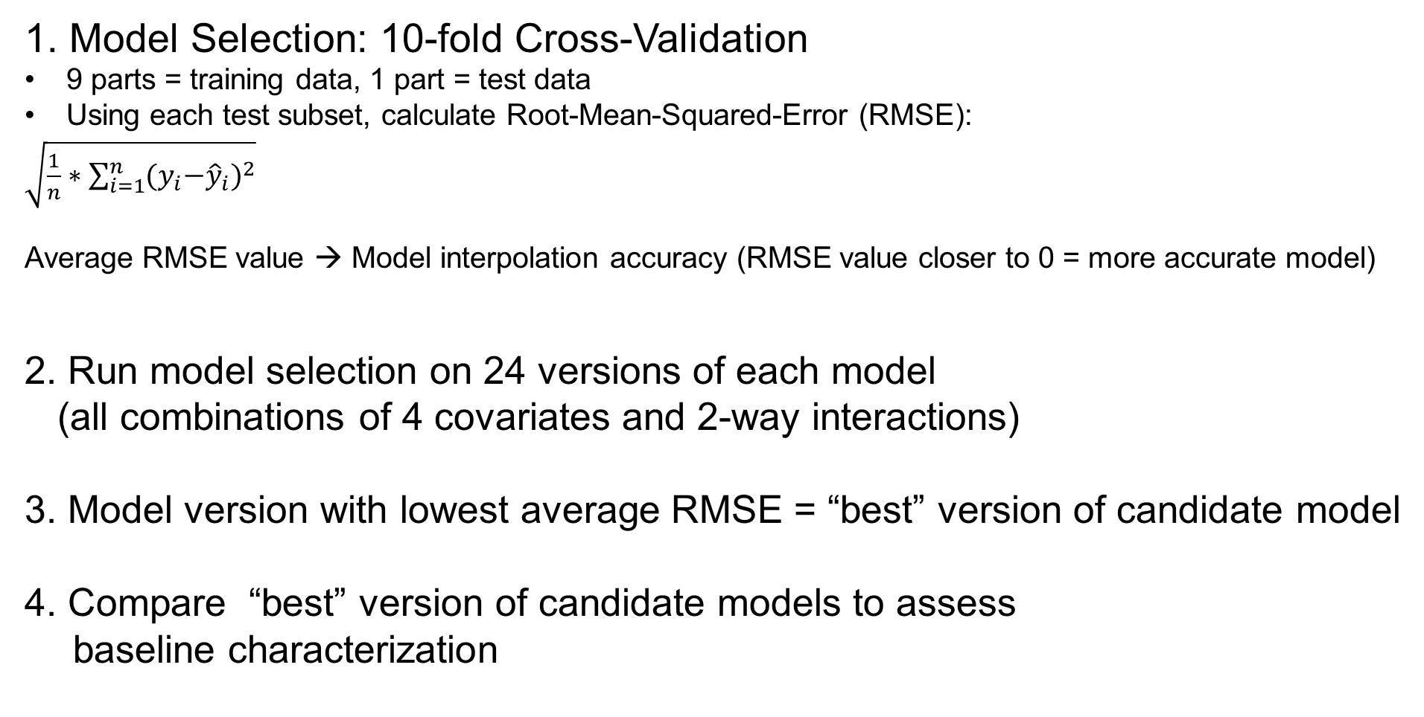
Model Evaluation
1. Model Selection: 10-fold Cross-Validation
9 parts = training data, 1 part = test data
Using each test subset, calculate Root-Mean-Squared-Error (RMSE):
$\sqrt{\frac{1}{n}∗\sum_{i=1}^{n}{{{(y}_{i}−{\hat{y}}_{i})}^{2}}}$
Average RMSE value → Model interpolation accuracy (RMSE value closer to 0 = more accurate model)
2. Run model selection on 24 versions of each model
(all combinations of 4 covariates and 2-way interactions)
3. Model version with lowest average RMSE = “best” version of candidate model
4. Compare “best” version of candidate models to assess
baseline characterization
Notes:
dont say "first" 90% and last "10%" because it was random

Slide 18
Normal Metric (Sv) Ranked Results
Model | Environmental Predictors | Auto-correlation Structure (AR,MA) | Average RMSE | Residual Auto-correlation
SVR-RBF | Day, Fourier Series, Tidal Range, Tidal Speed | (1,0) | 3.05 | Yes
RF | All Environmental Predictors | (14,0) | 3.16 | No
SVR-L | Fourier Series | (13,0) | 3.22 | No
MARSS-P | Process Eq: Day, Fourier Series, Tidal Range Observation Eq: Day, Tidal Range, Day:Tidal Range | (1,0) | 3.30 | Yes
MARSS-M | Process Eq: Tidal Range, Tidal Speed, Tidal Speed:Tidal Range Observation Eq: Day, Fourier Series, Tidal Speed | (1,0) | 3.34 | Yes
GAM | Day, Fourier Series, Tidal Range*, Day:Tidal Range* | NA | 3.43 | Yes
GAMM | Day, Fourier Series, Tidal Range* | (1,0) | 3.45 | Yes
Reg-ARMA-GARCH | Mean Eq: Day, Fourier Series, Tidal Range, Day: Tidal Range Variance Eq: Day, Fourier Series, Tidal Range, | ARMA:(1,0) GARCH:(2,3) | 3.53 | Yes
Reg-ARMA | Day, Fourier Series, Tidal Range, Day: Tidal Range | (1,0) | 3.54 | Yes
GLS | Day, Fourier Series, Tidal Range, Day: Tidal Range | (1,0) | 3.54 | Yes
LM | Day, Fourier Series, Tidal Range, Day: Tidal Range | NA | 3.54 | Yes

Slide 19
Normal Metric (Sv) Ranked Results
Model | Environmental Predictors | Auto-correlation Structure (AR,MA) | Average RMSE | Residual Auto-correlation
SVR-RBF | Day, Fourier Series, Tidal Range, Tidal Speed | (1,0) | 3.05 | Yes
RF | All Environmental Predictors | (14,0) | 3.16 | No
SVR-L | Fourier Series | (13,0) | 3.22 | No
MARSS-P | Process Eq: Day, Fourier Series, Tidal Range Observation Eq: Day, Tidal Range, Day:Tidal Range | (1,0) | 3.30 | Yes
MARSS-M | Process Eq: Tidal Range, Tidal Speed, Tidal Speed:Tidal Range Observation Eq: Day, Fourier Series, Tidal Speed | (1,0) | 3.34 | Yes
GAM | Day, Fourier Series, Tidal Range*, Day:Tidal Range* | NA | 3.43 | Yes
GAMM | Day, Fourier Series, Tidal Range* | (1,0) | 3.45 | Yes
Reg-ARMA-GARCH | Mean Eq: Day, Fourier Series, Tidal Range, Day: Tidal Range Variance Eq: Day, Fourier Series, Tidal Range, | ARMA:(1,0) GARCH:(2,3) | 3.53 | Yes
Reg-ARMA | Day, Fourier Series, Tidal Range, Day: Tidal Range | (1,0) | 3.54 | Yes
GLS | Day, Fourier Series, Tidal Range, Day: Tidal Range | (1,0) | 3.54 | Yes
LM | Day, Fourier Series, Tidal Range, Day: Tidal Range | NA | 3.54 | Yes
Notes:
Model comparison provides a method to increase confidence in environmental predictors
SVR-RBF was affected by kernel choice and tuning, and black-box so cant interpret environmental predictor relationships

Slide 20

Non-Normal Metric (AI) Ranked Results
Model | Environmental Predictors | Auto-correlation Structure (AR,MA) | Error Distribution | Average RMSE
SVR- RBF | Day, Fourier Series, Tidal Speed, Day: Tidal Speed, Tidal Speed: Fourier Series | (13,0) | NA | 0.0667
MARSS- P | Observation Eq: Fourier Series | (1,0) | Normal | 0.0673
GLM | Day, Fourier Series | NA | Gamma (identity) | 0.0674
GLMM | Day, Tidal Range | (1,0) | Gamma (identity) | 0.0674
GLS | Fourier Series | (1,0) | Normal | 0.0675
LM | Fourier Series | NA | Normal | 0.0675
Reg-ARIMA | Fourier Series | (1,2) | Normal | 0.0675
Reg-ARMA-GARCH | Mean Eq: Day, Fourier Series, Tidal Range Variance Eq: Fourier Series | ARMA: (1,0); GARCH: (2,0) | Skewed-student-t | 0.0675
GAM | Fourier Series, Tidal Speed | NA | Gamma (identity) | 0.0677
GAMM | Fourier Series | (2,0) | Gamma (identity) | 0.0677
MARSS-M | Process Eq: Day Observation Eq: Day, Fourier Series | (1,0) | Normal | 0.0677
RF | Fourier Series, Tidal Speed | (2,0) | NA | 0.0681
SVR-L | Day, Fourier Series, Tidal Range, Day: Tidal Range, Tidal Range: Fourier Series | (1,0) | NA | 0.0689

Slide 21
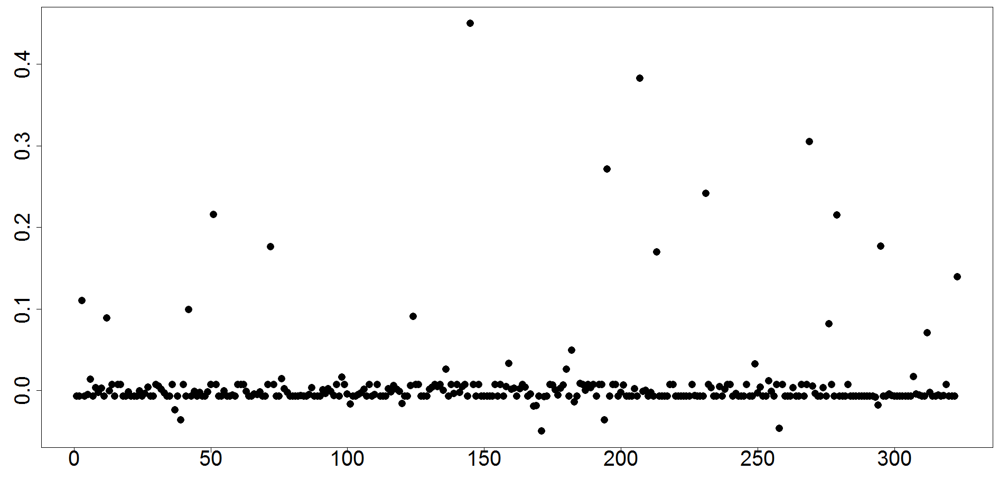
Non-Normal Metric (AI) Results
Model Inability to Fit Aggregation Spikes
SVR-RBF Residuals
Time
Notes:
Highlight residuals here

Slide 22
Model Evaluation Summary
Notes on SVR Models:
SVR models may be accurate predictive models
“black-box” quality makes them poor descriptive models
Normal (Sv) Monitoring Data:
RF is most accurate model following SVR
  Provides Variable Importance Measure
MARSS-P is most accurate parametric model
  Partitions error into process and observation
Non-normal (AI) Monitoring Data:
MARSS-P is most accurate parametric model
  Attributes aggregation spikes to process error
No model accurately fits aggregation index spikes
Notes:
See and Holmes 2015 illustrate that estimate of process vs error variability can help in designing frequency and duration of monitoring programs to increase precision of estimates
(when ratio of two is high, increased number of observations improves precision, because improves observation error)

Slide 23
MRE Baseline Model Recommendations
Abundance
Distribution
Behavior
Sv
(dB re 1 m-1)
Center of Mass (M)
Inertia (m2)
Aggregation Index (m-1)
RF (exploratory) and MARSS-P
RF (exploratory) and MARSS-P
Two State State-Space Model
RF (exploratory) and MARSS-P
Fish
Notes:
None of these models are common in MRE monitoring work currently, but have been shown to be most accurate and thorough in characterizing baseline data

Slide 24

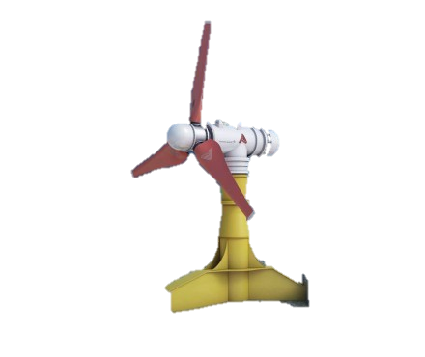
Thesis Objectives
Develop and execute an evaluation of statistical models used for:
1. Baseline Characterization
2. Measuring Change in Environmental Monitoring Data
Including:
Detect change from baseline conditions
Quantify size and shape of change
Forecast future change

Slide 25
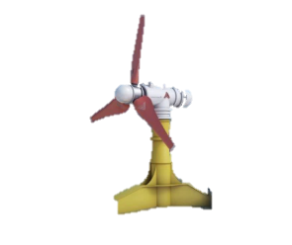
Developing Change Scenarios from Predicted Effects of MRE Development
BEFORE
AFTER
Notes:
Be clear that don’t have “after” data, so we are simulating various change

Slide 26
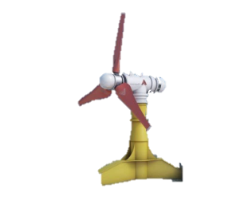
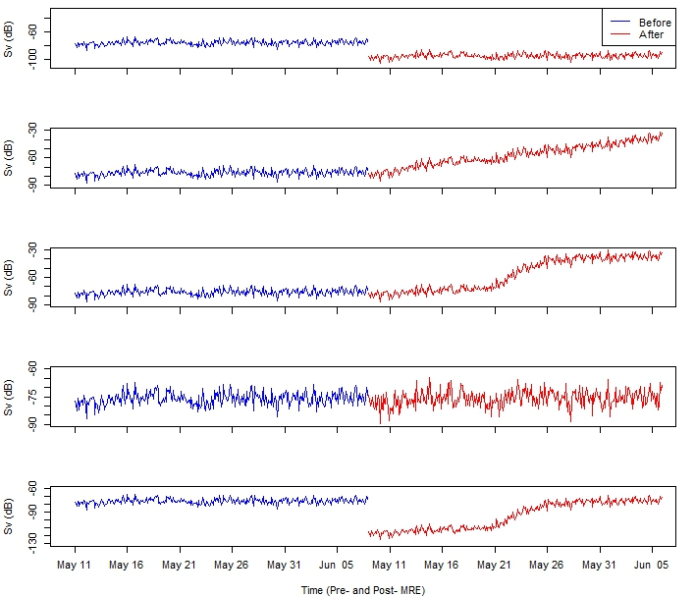
Change Scenarios
Change Shape
Sv (dB)
Effect Size
10%
95%
25%
Lag
No lag
2 weeks
Step
(Noise)
Linear
(Static Device)
Nonlinear
(Static Device)
Periodic
(Device
Movement)
Simulation Models:
Sv → MARSS
AI → HMM
(Hidden Markov
Model)
Step + Nonlinear
(Chemical Spill)
Before
After
Notes:
Dynamic Note:
Equal periodic increase and decrease in mean based on give tidal speed causes a change in the variance rather than the mean
May see these changes due to other anthroprogenic stressors
Simulation Model HMM: observations are used to calculate hidden sequence of states (see AI observations, but state of AI is hidden), and probability of state only depends on previous state
. The HMM statistical package used to fit the AI data requires the input of observed values, Gamma distribution parameters for each data state, chosen covariates within each state, and a transition intensity matrix ($Q$) to estimate the expected AI data values. $Q$ estimates the rate of transitioning from states i to j, and is used to calculate the transition probability matrix that is needed to estimate the expected data state at time$t$:
$P\left(t\right)=exp⁡(tQ)$
where $Q$ is the transition intensity matrix at time $t$, and $P$ is the probability transition matrix.
The expected state of data at time $t$, either low-state or high-state aggregation, was estimated by applying the Viterbi algorithm (cf., Viterbi 1967) to the parameterized model. The expected states and the linear, parametric, Gamma distributed parameters and covariates within each state were used to simulate the expected AI values.

Slide 27

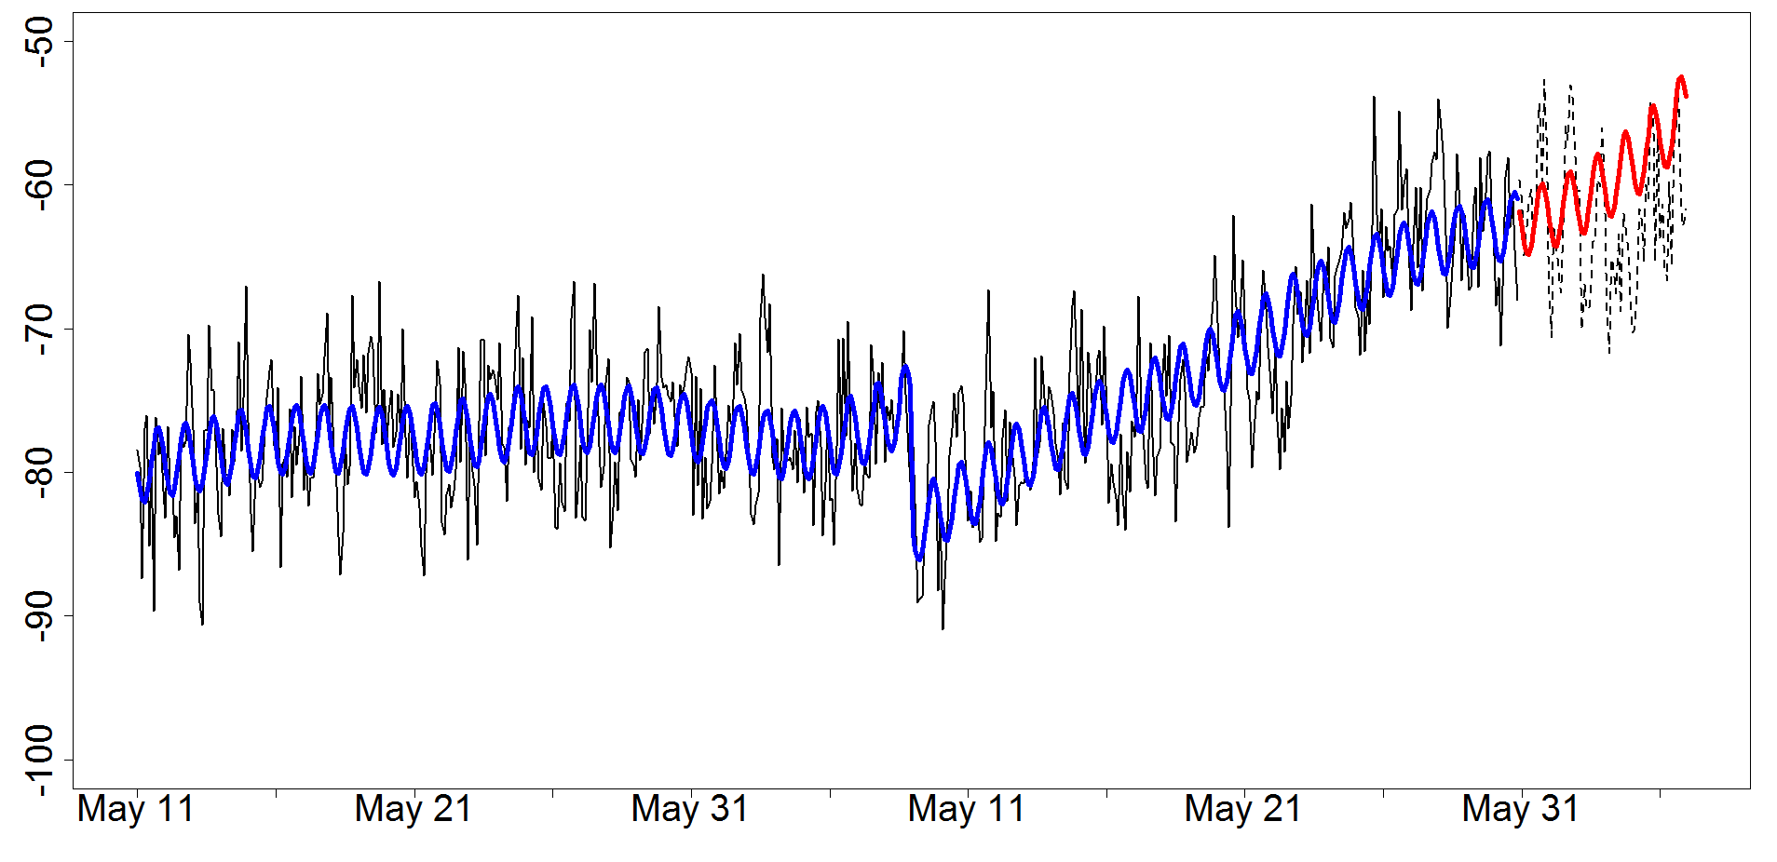
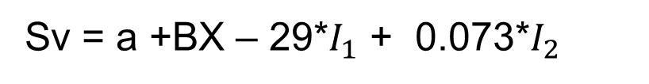
Measuring Change :
Intervention Analysis
= Fitted Model Estimate
= Forecasted Model Estimate
BEFORE
AFTER
Sv (dB)
Sv = a +BX – 29*$I_{1}$ + 0.073*$I_{2}$
Time (Days)
$I_{1}$ = Step Indicator Variable (0 Before, 1 After)
$I_{2}$ = Ramp Indicator Variable (0 Before, $t−n_{before}$ After)

Slide 28
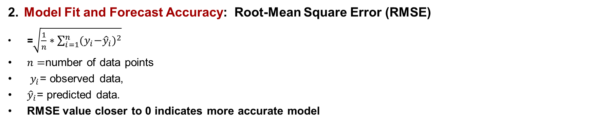
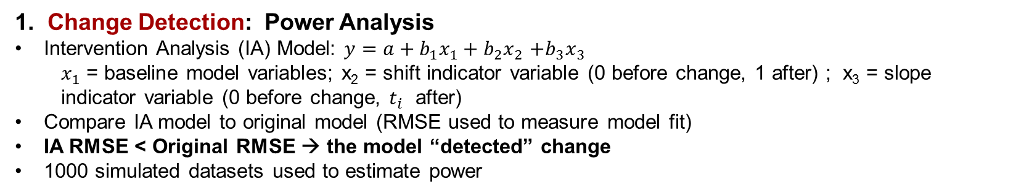
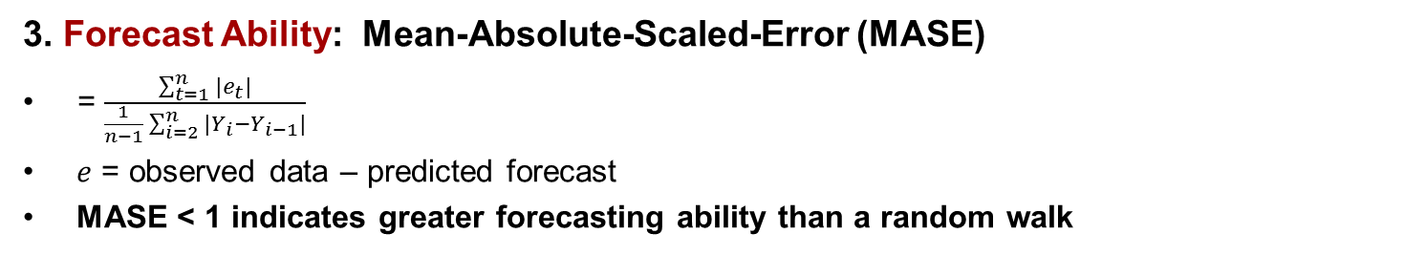
Model Evaluation
1. Change Detection: Power Analysis
Intervention Analysis (IA) Model: $y=a+b_{1}x_{1}+b_{2}x_{2}$ $+b_{3}x_{3}$
  $x_{1}$ = baseline model variables; x₂ = shift indicator variable (0 before change, 1 after) ; x₃ = slope indicator variable (0 before change, $t_{i}$ after)
Compare IA model to original model (RMSE used to measure model fit)
IA RMSE < Original RMSE → the model “detected” change
1000 simulated datasets used to estimate power
2. Model Fit and Forecast Accuracy: Root-Mean Square Error (RMSE)
=$\sqrt{\frac{1}{n}∗\sum_{i=1}^{n}{{{(y}_{i}−{\hat{y}}_{i})}^{2}}}$
$n=$number of data points
$y_{i}$= observed data,
${\hat{y}}_{i}$= predicted data.
RMSE value closer to 0 indicates more accurate model
3. Forecast Ability: Mean-Absolute-Scaled-Error (MASE)
= $\frac{\sum_{t=1}^{n}{{|e}_{t}|}}{\frac{1}{n−1}\sum_{i=2}^{n}{|Y_{i}−Y_{i−1}|}}$
$e$ = observed data – predicted forecast
MASE < 1 indicates greater forecasting ability than a random walk

Slide 29

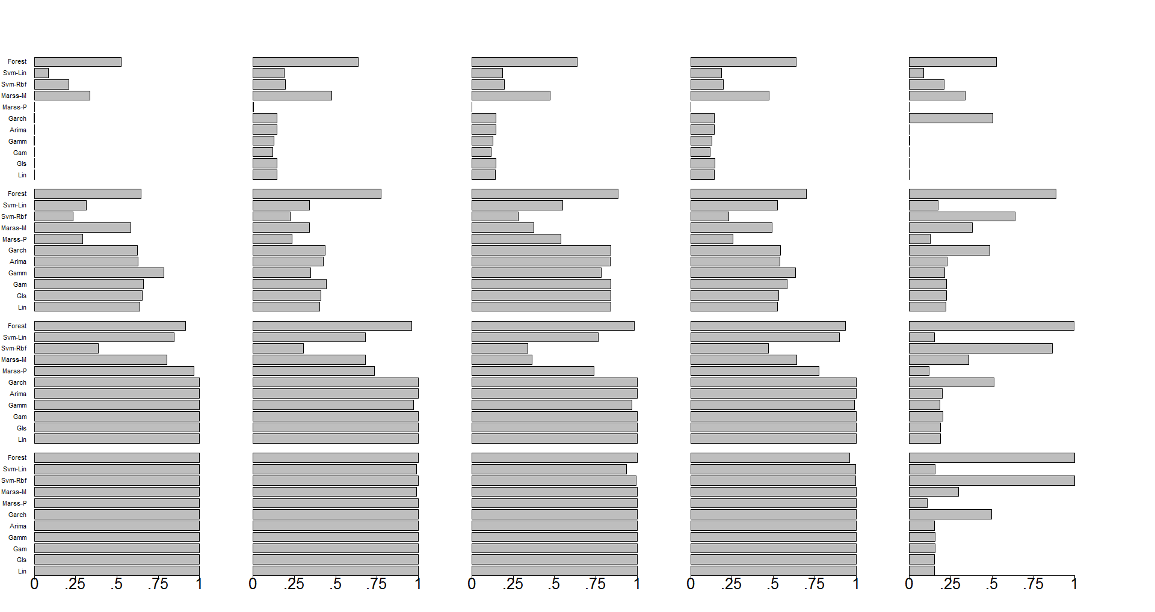
Power Results- Normal
Step
Linear
Nonlinear
Step + Nonlinear
Periodic
0%
10%
RF,
Svm-RBF
25%
Lagged variables (Nonparametric + MARSS)
95%
Only models detect variance change
Power (Probability)
Notes:
General statement: Normal data is highly variable which causes there to be some change-detection in the no-change scenario
The complex models are sensitive to high variance in data because of their ability to fit localized variability (the Marss-M sensitivity is most likely due to choice of predictor variables)
Less complex models may also have low power in the “no-change” scenario due to high variability of Sv data
The models that include a lagged variable (non-parametric models, and MARSS models) have lower power, because no need for indicator variable if lagged variables already fit trend
RF and SVM-RBF are only models that correctly detect change in variance

Slide 30

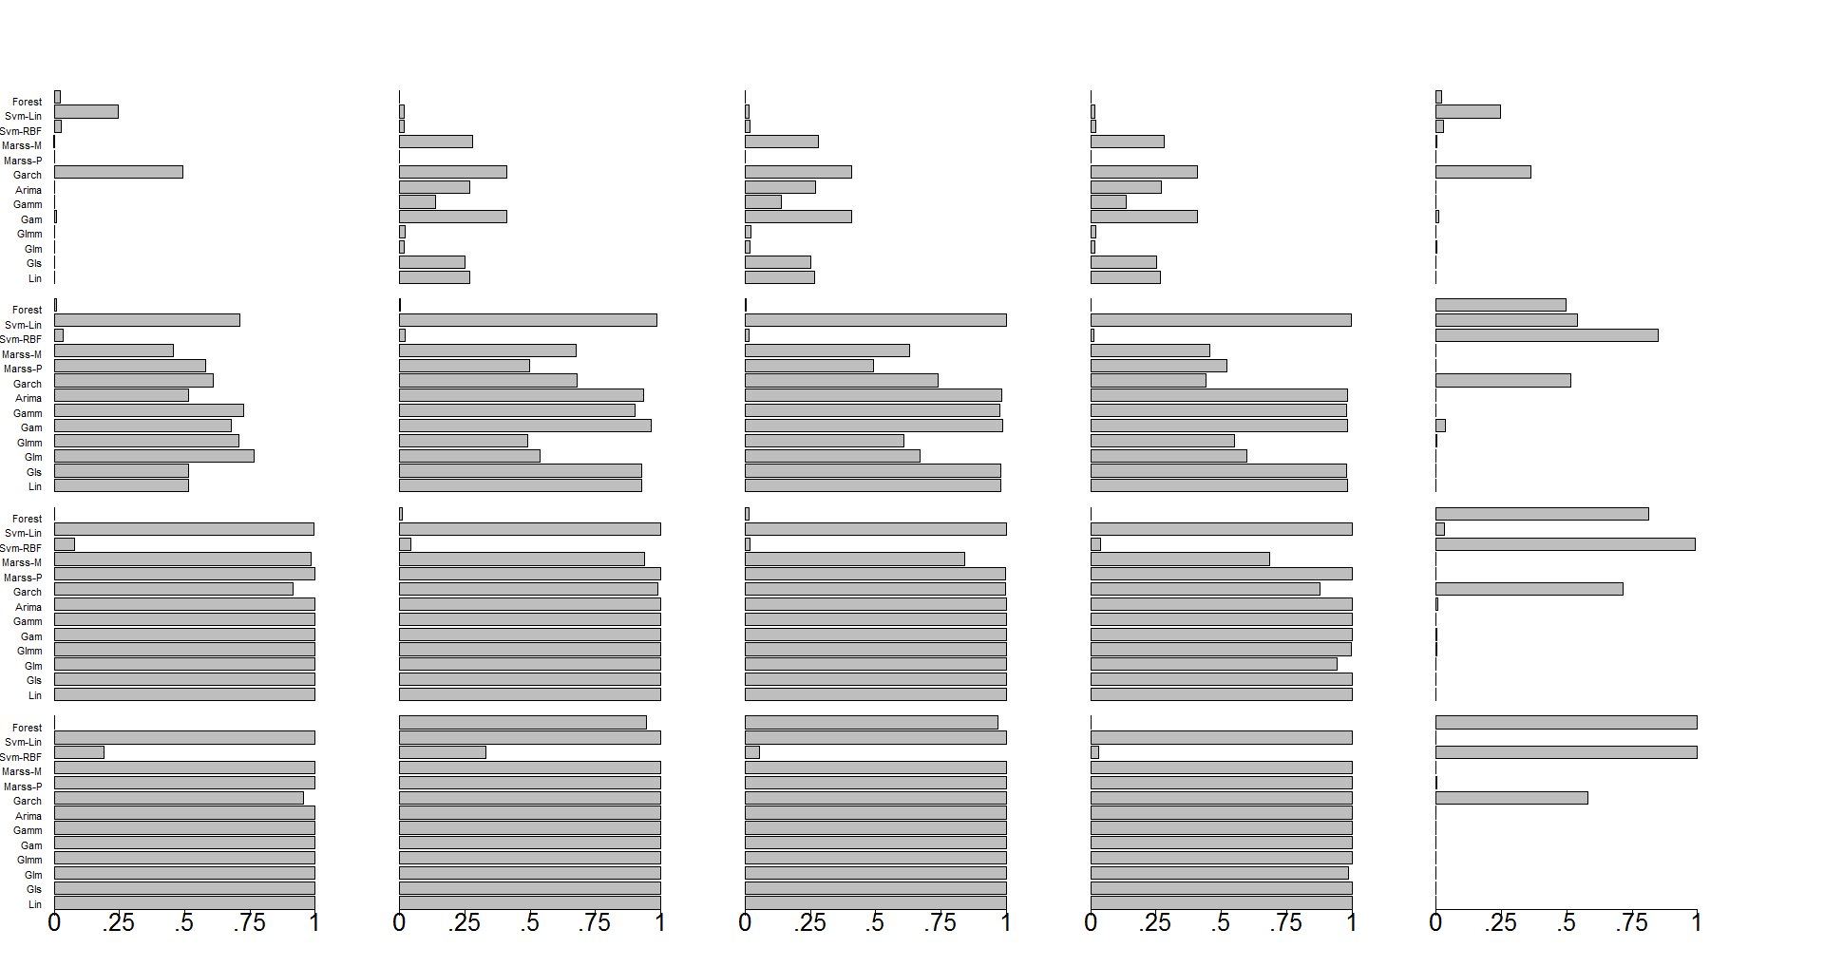
Power Results- Non-Normal
Step
Linear
Nonlinear
Step + Nonlinear
Periodic
Generalized Models with and without “Day” covariate
0 %
Glm(m)
10%
Glm(m)
25%
95%
Power (Probability)
Notes:
General Statements: Non-normal data has much less variability around the mean (models are not fitting to spikes, only low-state values which are not highly variable) → overall power is higher for the non-normal data
SVM-L fits very “tightly” to low-state of data, so over-sensitive to slight change
Garch is known to have biomodality with the inclusion of indicator variable (its ability to detect change is variable and can be wrong)
Day covariate affects ability of Generalized regression models to detect change
Model with lagged variables still have low power in this case.

Slide 31
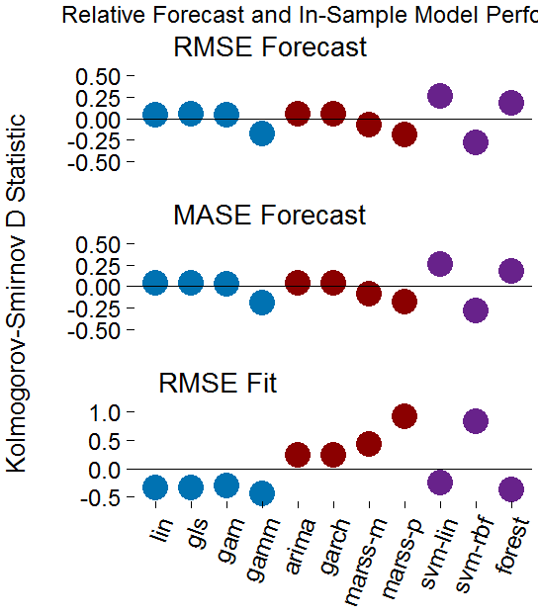
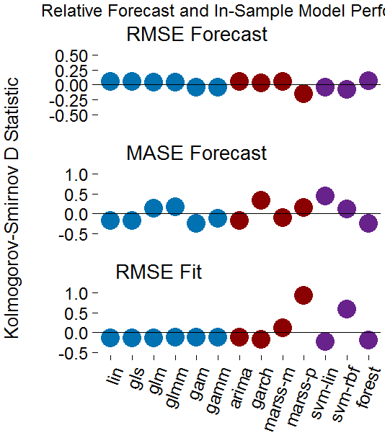
Trend Forecast and Fit
Normal Mean-Change
Non-Normal Mean-Change
better
Forecast- RMSE
Forecast- RMSE
SVM-L
RF
worse
Forecast- MASE
Forecast- MASE
GARCH
SVM-L
Kolmogorov-Smirnov D Statistic
MARSS
SVM-RBF
Trend Fit- RMSE
Trend Fit- RMSE
Generalized Reg.
Time-Series
Non-Parametric
Notes:
First point orient the color coding and axes

Slide 32

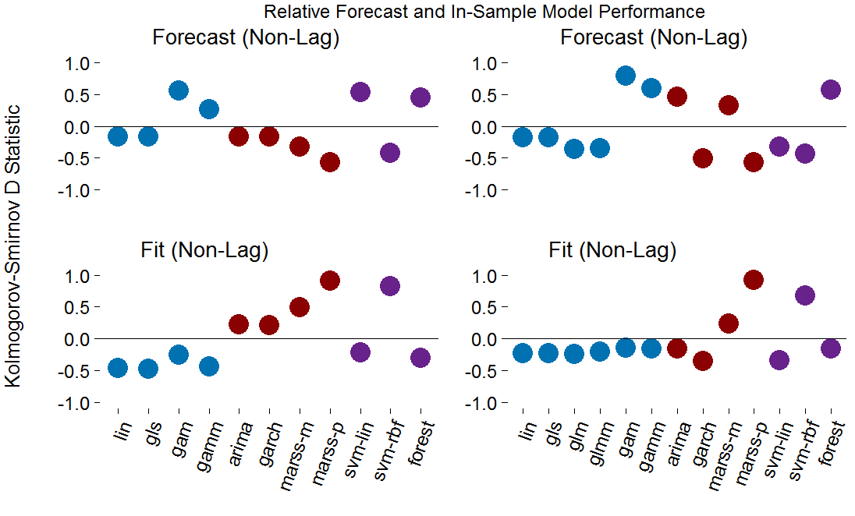
Lagged 95% Change-
Trend Fit and Forecast
Normal Data
Non-Normal Data
better
Forecast- MASE
Forecast- MASE
GAM(M)
GAM(M)
worse
Trend Fit- RMSE
Trend Fit- RMSE
Kolmogorov-Smirnov D Statistic
Generalized Reg.
Time-Series
Non-Parametric

Slide 33

Model Evaluation Summary
Mean-Change
Detect Change
Lagged dependent variables suppress detection of change
Baseline characterization affects Type I and Type II error
Quantify Change
Time-series models provide advantageous measure of stochasticity
  Note: MARSS models misspecify change in trend
GAM(M) excel in quantifying non-linear change
Forecast Change
Non-parametric models are most accurate (Note: RF can’t extrapolate)
GAM(M) useful for nonlinear scenarios, but have convergence difficulties
Variance-Change
Localized nonparametric models are only models capable of measuring change
Notes:
Detect change recs: Provide uncertainty and significance around estimate of change
Must include relevant baseline predictors and appropriate distribution and correlation assumptions
Quantify Change Recs: Combination provides linear measure of change and stationarity along with nonlinear estimate of form of change
Must include relevant baseline predictors and appropriate distribution and correlation assumptions

Slide 34
Recommended Model Use
Fish
Normal
Non-normal
Abundance,
Distribution,
Diversity
Behavior
Mean
Variance
Mean
Variance
Quantify
Detect
Forecast
Quantify
Detect
Forecast
Quantify
Detect
Forecast
Quantify
Detect
Forecast
ARMA and GAMM
ARMA
SVR-L
Forest
Forest
Forest
GARCH* and GAMM*
GLMM*
SVR-L*
(MASE)
Forest
Forest
Forest
Notes:
Results led to a series of recommendations
These recommendations come with caveats
MARSS has most flexible ability to fit to trend of data (but its assumption of stationarity prevents it from accurately forecasting trend)
Parametric models are needed to detect change, because they provide measurement of effect size and they do not suppress change with lagged variables
Non-parametric models are the most capable forecasting models
Random Forest is only model capable of accurately capturing change in variance (SVM-RBF can as well, but more fickle and no measure of variable importance)

Slide 35
Recommended Model Use
Example
Receptor
Fish
Indicator
Abundance
Metric
Distribution
Normal
Statistical Property
Mean
Monitoring Objective
Quantify Change
Statistical Model
Reg-ARMA and GAMM
Notes:
Results led to a series of recommendations
These recommendations come with caveats
MARSS has most flexible ability to fit to trend of data (but its assumption of stationarity prevents it from accurately forecasting trend)
Parametric models are needed to detect change, because they provide measurement of effect size and they do not suppress change with lagged variables
Non-parametric models are the most capable forecasting models
Random Forest is only model capable of accurately capturing change in variance (SVM-RBF can as well, but more fickle and no measure of variable importance)

Slide 36
Conclusions
Evaluation standard approach to compare models used to analyze
Before-After monitoring data
Recommended models best practices for the analysis of monitoring data
Standard use of best practice models:
→ enable accurate and comparable results within and among monitoring sites
→ reduce uncertainty associated with environmental effects of MRE development
Efficient and effective analytic monitoring methods:
→ Decrease costs of monitoring
→ Expedite MRE permitting process
Approach and insight on model classes applicable to all monitoring programs

Slide 37
Possible Evaluation Extensions
Investigate quantified amplitude and uncertainty of indicator variable(s) measuring change in parametric models
Extend work to real-time monitoring with unknown change points

Slide 38







Acknowledgments
Thanks to:
The Bureau of Ocean Energy Management
Department of Energy
The National Oceanographic Partnership Program
Sustainable Energy Pathways
School of Aquatic and Fishery Sciences (UW)

Slide 39
Acknowledgments
So many thanks to:
John Horne
All of my committee members (Tim Essington, Eric Ward, Andrea Copping)
The Fisheries Acoustics Lab, including: Lauren Wiesebron, Beth Phillips, Dave McGowan,Silvana González, Ross Hytnen, Mei Sato, and Dale Jacques
All the people that responded to my cries for help, especially Jim Faulkner
My fellow grad students
My family, including: Ian, Mary-Megan (Mom), Robert (Dad), Riley, Meggie, Shane, and Emmett

Slide 40
Questions?

Slide 41
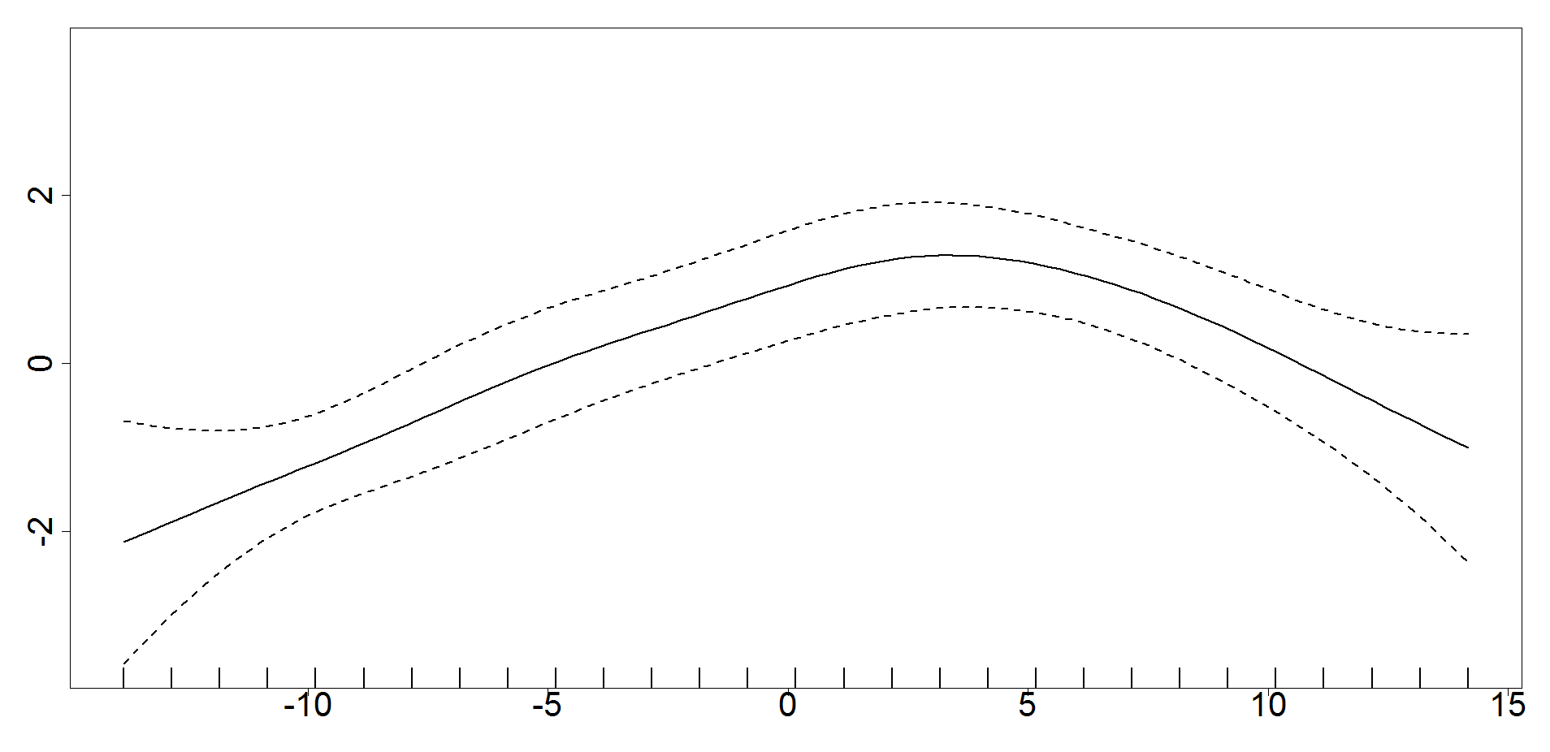
GAM(M) Day Smoother
edf = 2.74
s(Day, edf = 2.74)
Day

