Slide 1
Acoustic Characterization of Hydrokinetic Turbine
Brian Polagye & Paul Murphy
Department of Mechanical Engineering
University of Washington
September 9, 2015

Slide 2
Study Overview
Characterize sound from a river current turbine
Free-drifting hydrophone measurements
Minimize masking from flow noise
Evaluate three hypotheses:
The turbine will produce measureable sound
Turbine sound characteristics will vary with turbine operating state
Received levels will vary with spatial position on the river

Slide 3
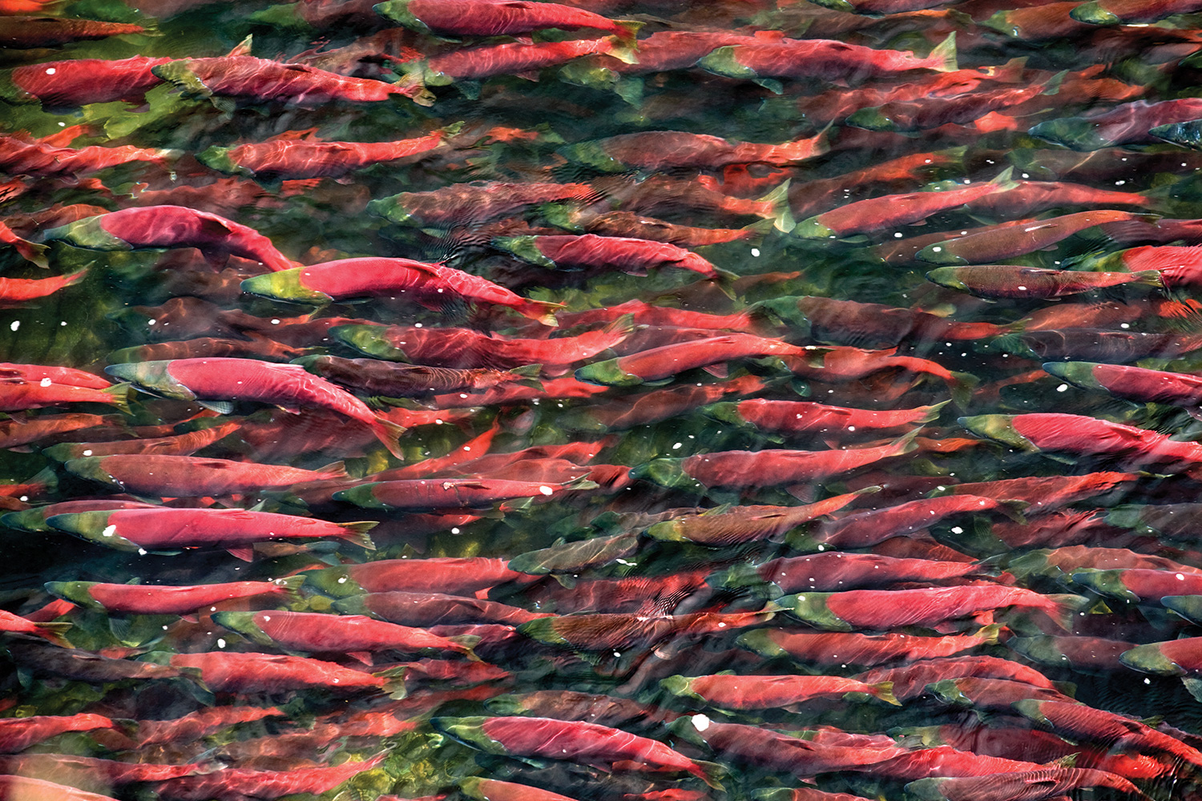
Study Motivation
Underwater sound produced by current turbines can affect marine animals
Acoustic injury unlikely
Behavioral modification possible
Few studies of sound characteristics from current turbines, including temporal and spatial variations
Sockeye Salmon migration

Slide 4
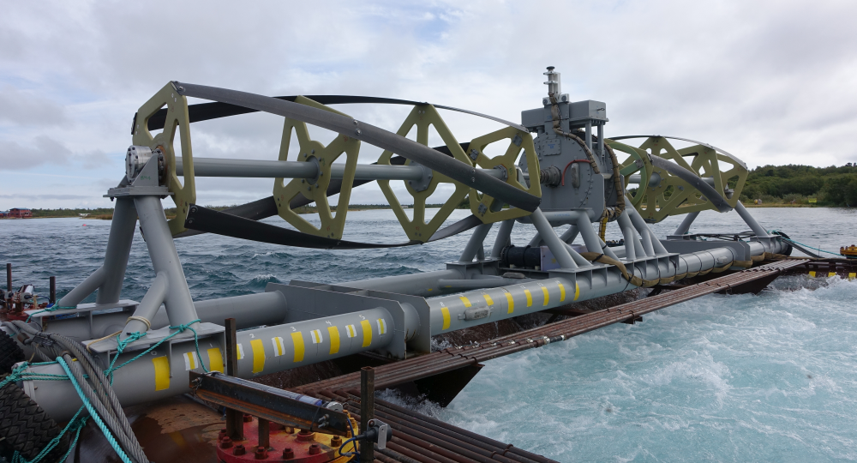
River Current Turbine
Direct-Drive Generator
Four-bladed Helical Turbine
Ocean Renewable Power Company RivGen ®
Notes:
11 m length, 1.4 m diameter, hub height of 2.5 m
Designed for community scale power – 15 kW at optimal TSR

Slide 5
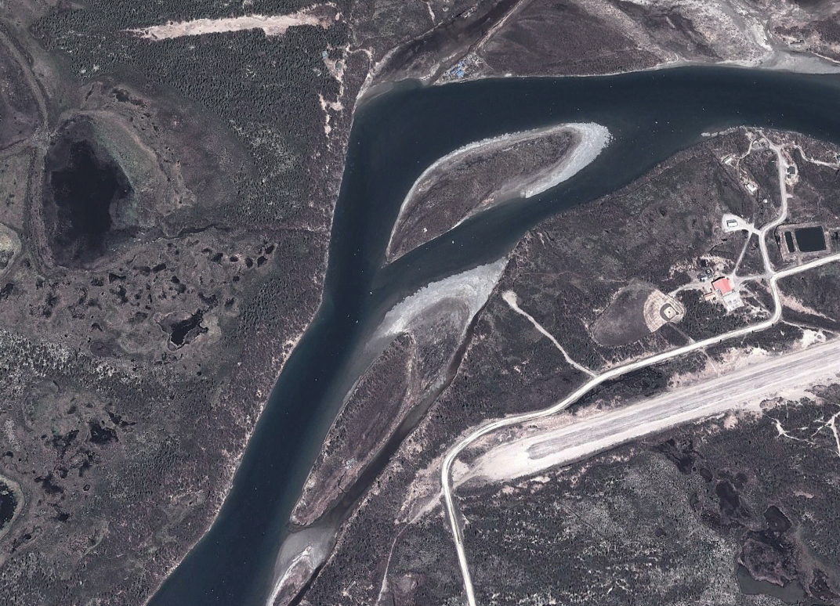
Study Location
y
x
Iguigig, Alaska
Source: Google Earth
Notes:
150 m wide, 5 m deep, average velocity ~ 2m/s 10-15% TI, cobbled bottom overlying unconsolidated sediments
Mode 1 cut-off of about 50 Hz

Slide 6
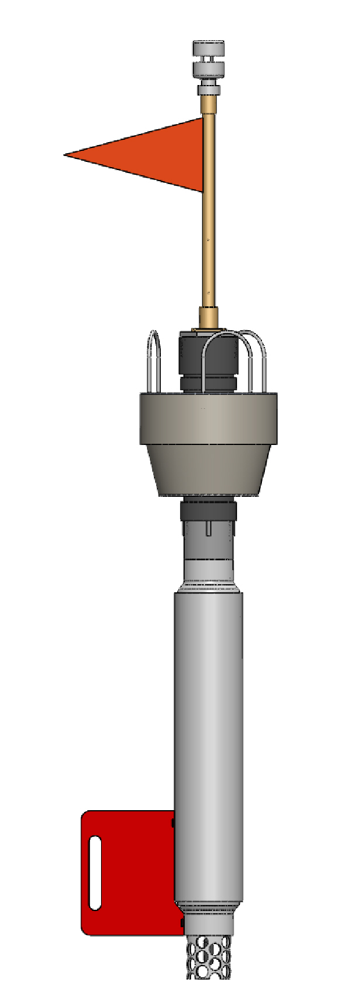
Measurement System
Met Station: Airmar PB200
1-2 Hz recording rate
Backup GPS
Spar attitude (heading, pitch, roll)
GPS: QStarz BT-Q1000eX
10 Hz recording rate
Surface Wave Instrumentation Float with Tracking (SWIFT)
1.15 m
Thomson, J. (2012). Wave breaking dissipation observed with “swift” drifters. Journal of Atmospheric and Oceanic Technology, 29(12), 1866-1882.
Hydrophone: Loggerhead DSG
50 kHz recording rate

Slide 7
Lagrangian Viewpoint

Slide 8
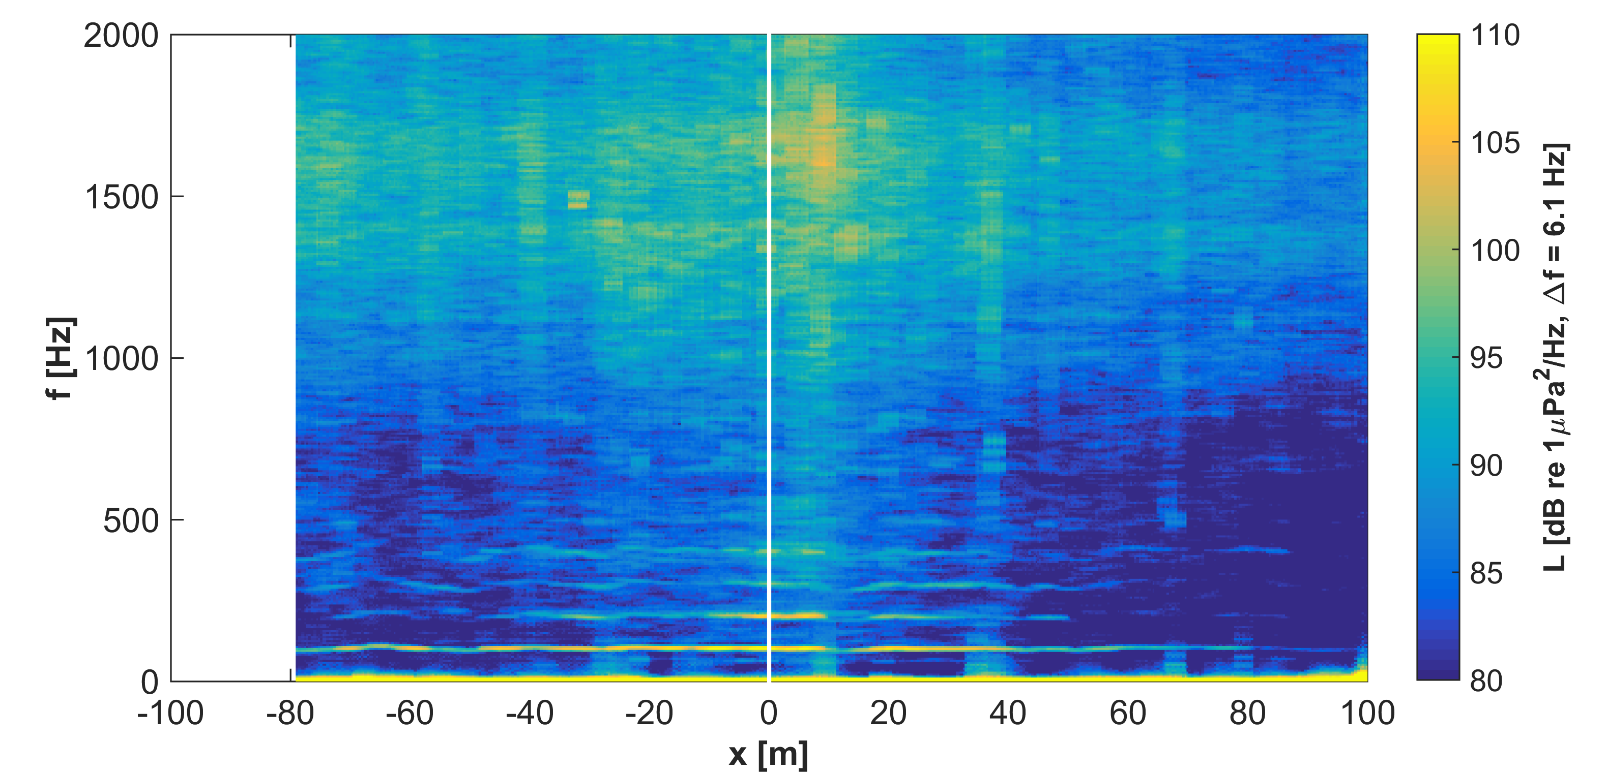
Sources of Turbine Sound
Misaligned Shaft Bearing
Blade Vibration
Generator Tones
Upstream
Downstream

Slide 9
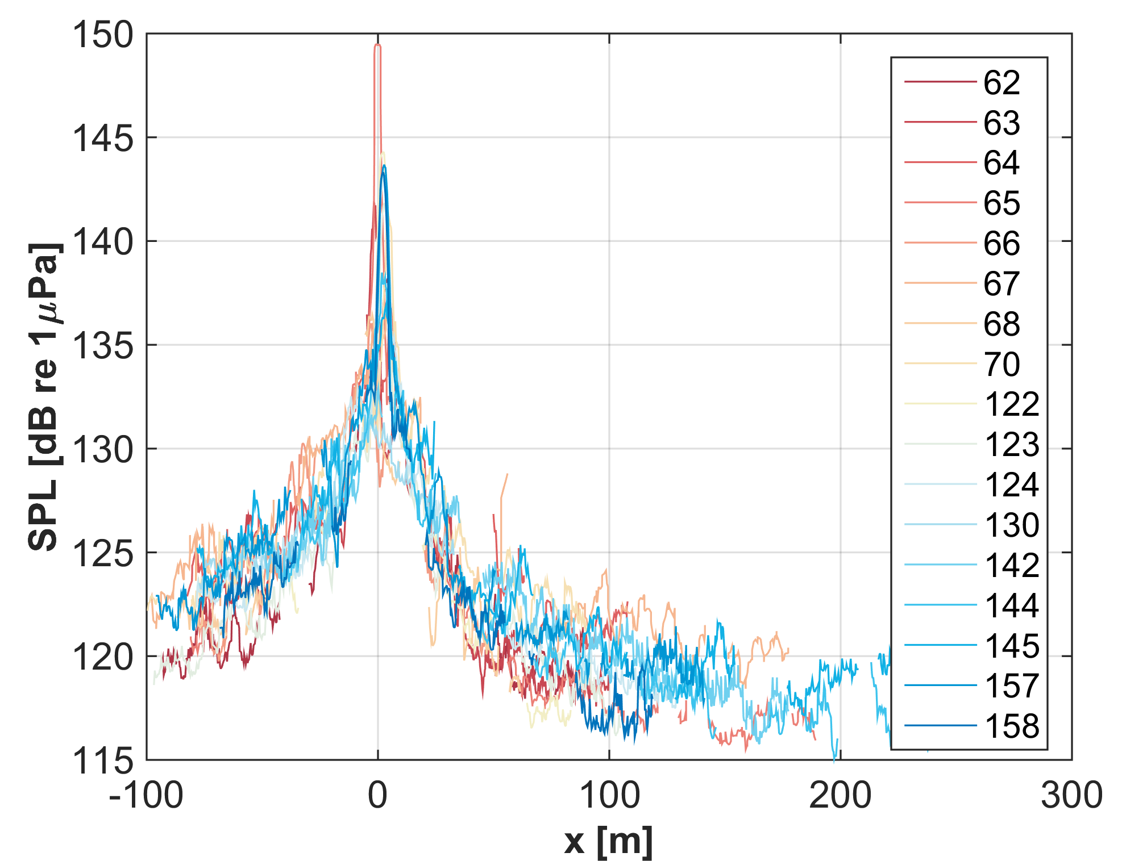
Drift Location Uncertainty
Poor GPS accuracy for ~ 20% of drifts
> 5 m separation between position recorded by GPS logger and met station GPS
Limited number of satellites at high latitude
Restricted sky view from river embankment
Notes:
Had trouble even determining the location of the turbine (original estimate was off by 10 m) – brought a GPS-RTK system for field work this past summer.

Slide 10
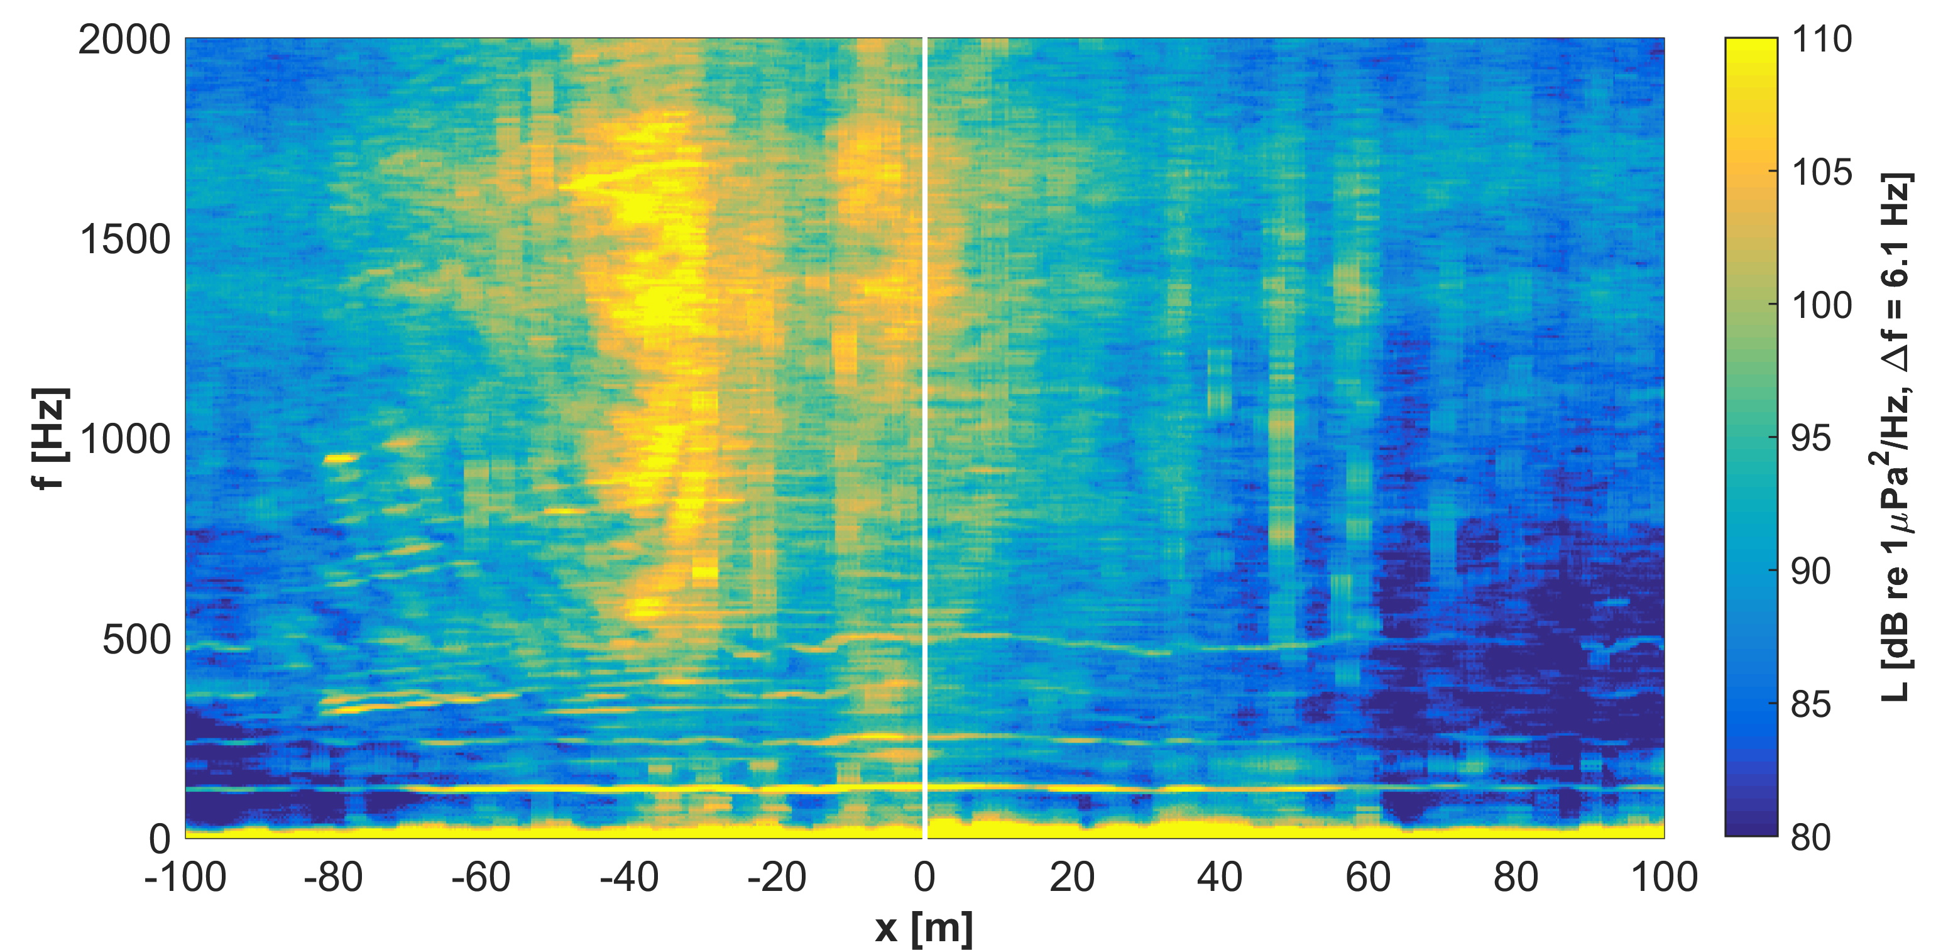
Sources of Contaminating Noise
SWIFT Bobbing
(splash + flow-noise)
Fishing Vessel Startup and Motoring Away
Manually review each drift and establish “quarantine zones”

Slide 11
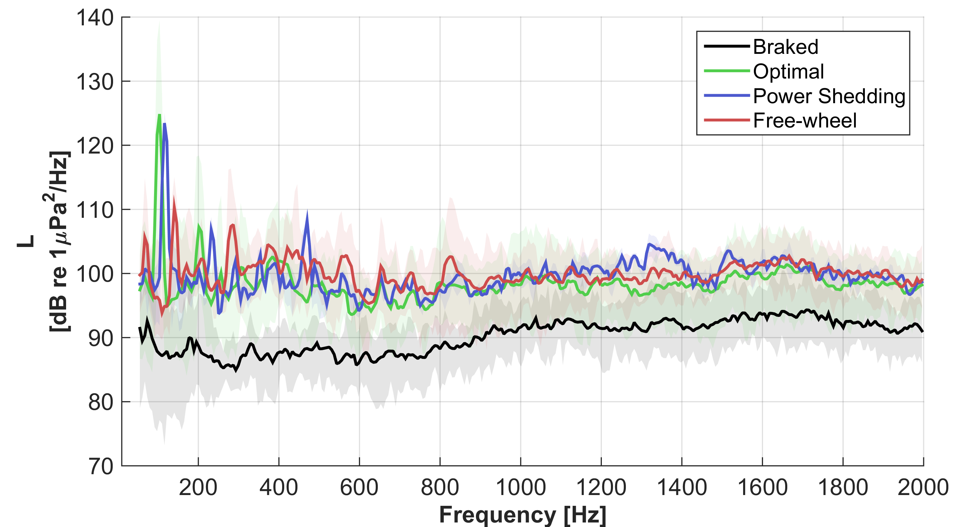
Dependence on Turbine State
Narrowband Spectra at Closest Point of Approach
Notes:
Variations in frequency of primary tone

Slide 12
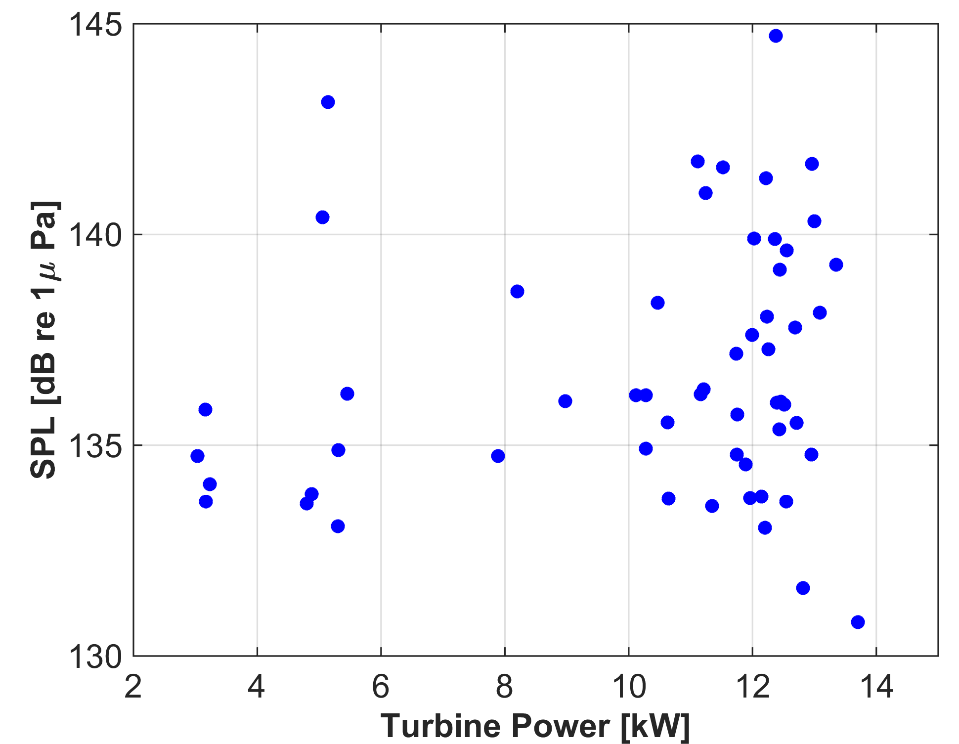
Dependence on Turbine State?
Broadband Sound Pressure Level at Closest Point of Approach
Notes:
Perhaps more subtle variations are present at specific frequencies, but not able to resolve broadband variations (at least with GPS accuracy)

Slide 13
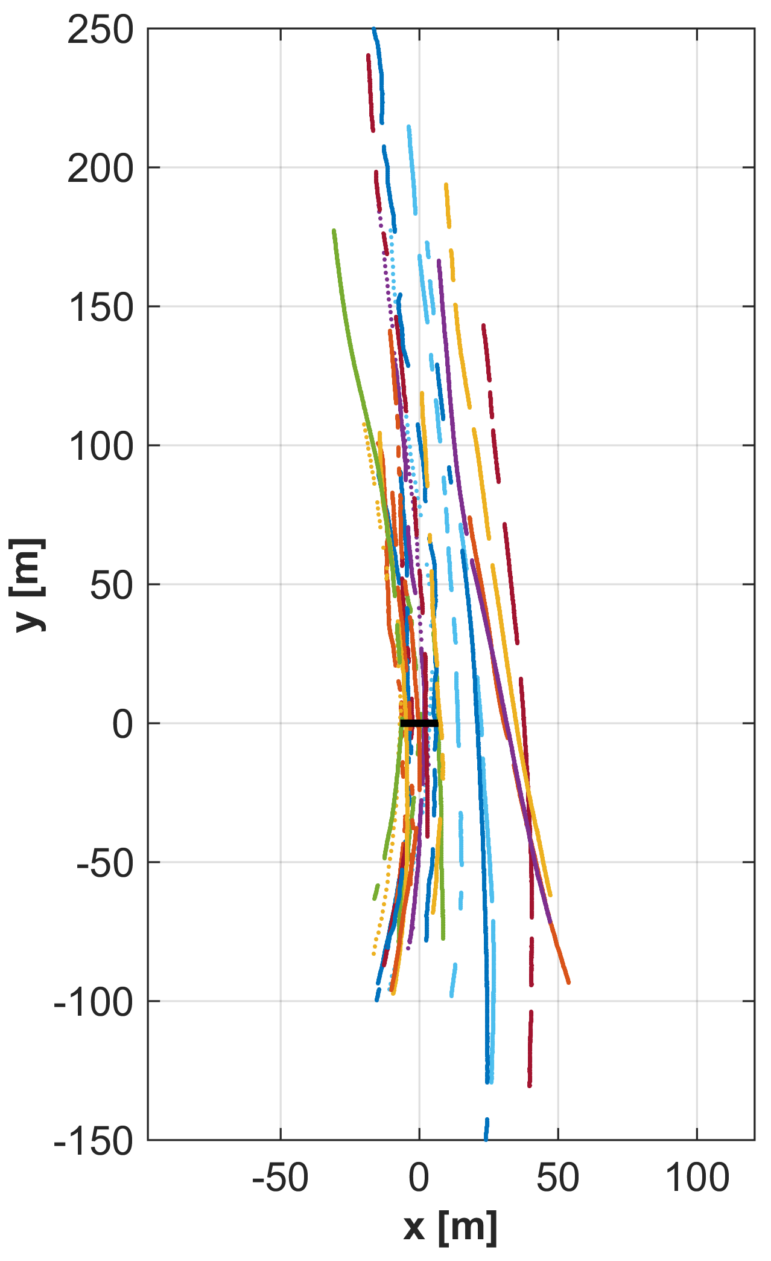
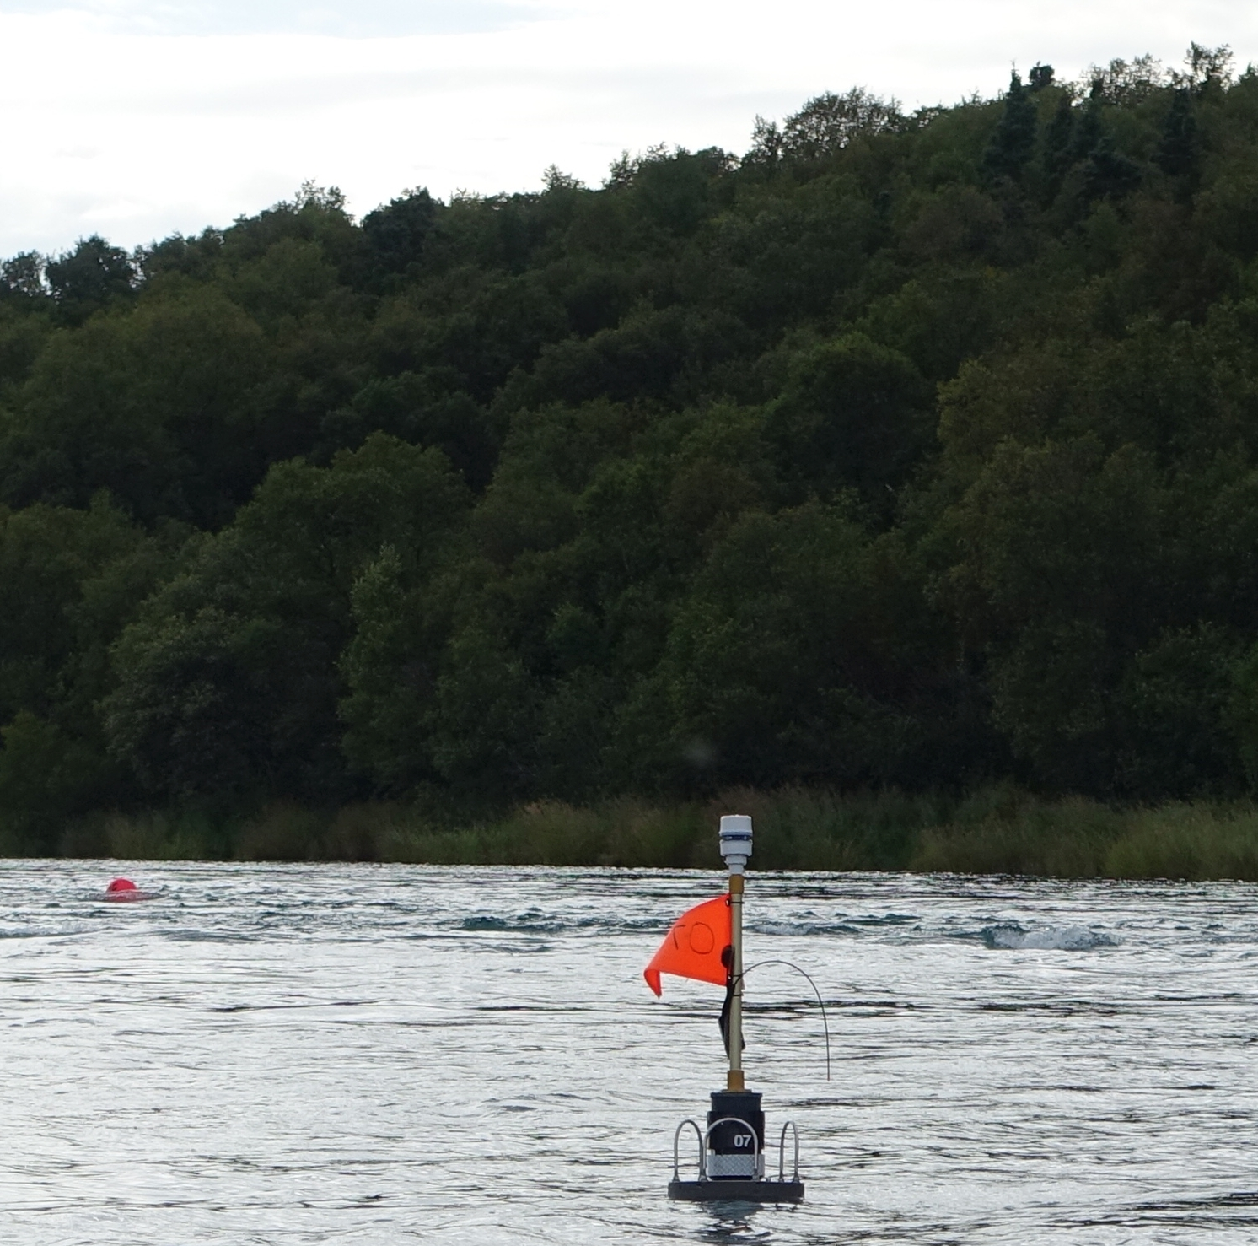
Spatial Extent of Drifts
SWIFT drifter and RivGen marker float
Notes:
Plot is showing number of drifts accepted after QA/QC process: approximately 3:1 effort to data ratio – many replicates possible in relative short time, particularly running 3 SWIFTs at a time

Slide 14
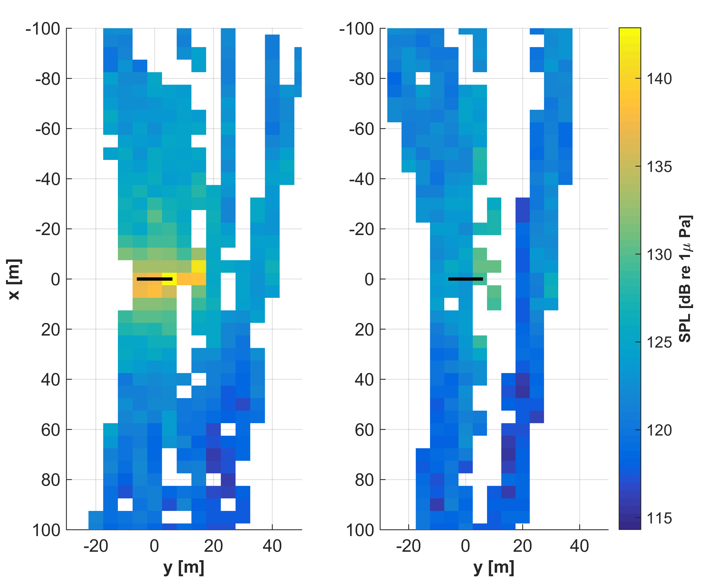
Spatial Variation in Turbine Sound
Optimal Power
Braked
RivGen
Notes:
Relatively indistinct from background (except 100 Hz tone) at a range > 50 m

Slide 15
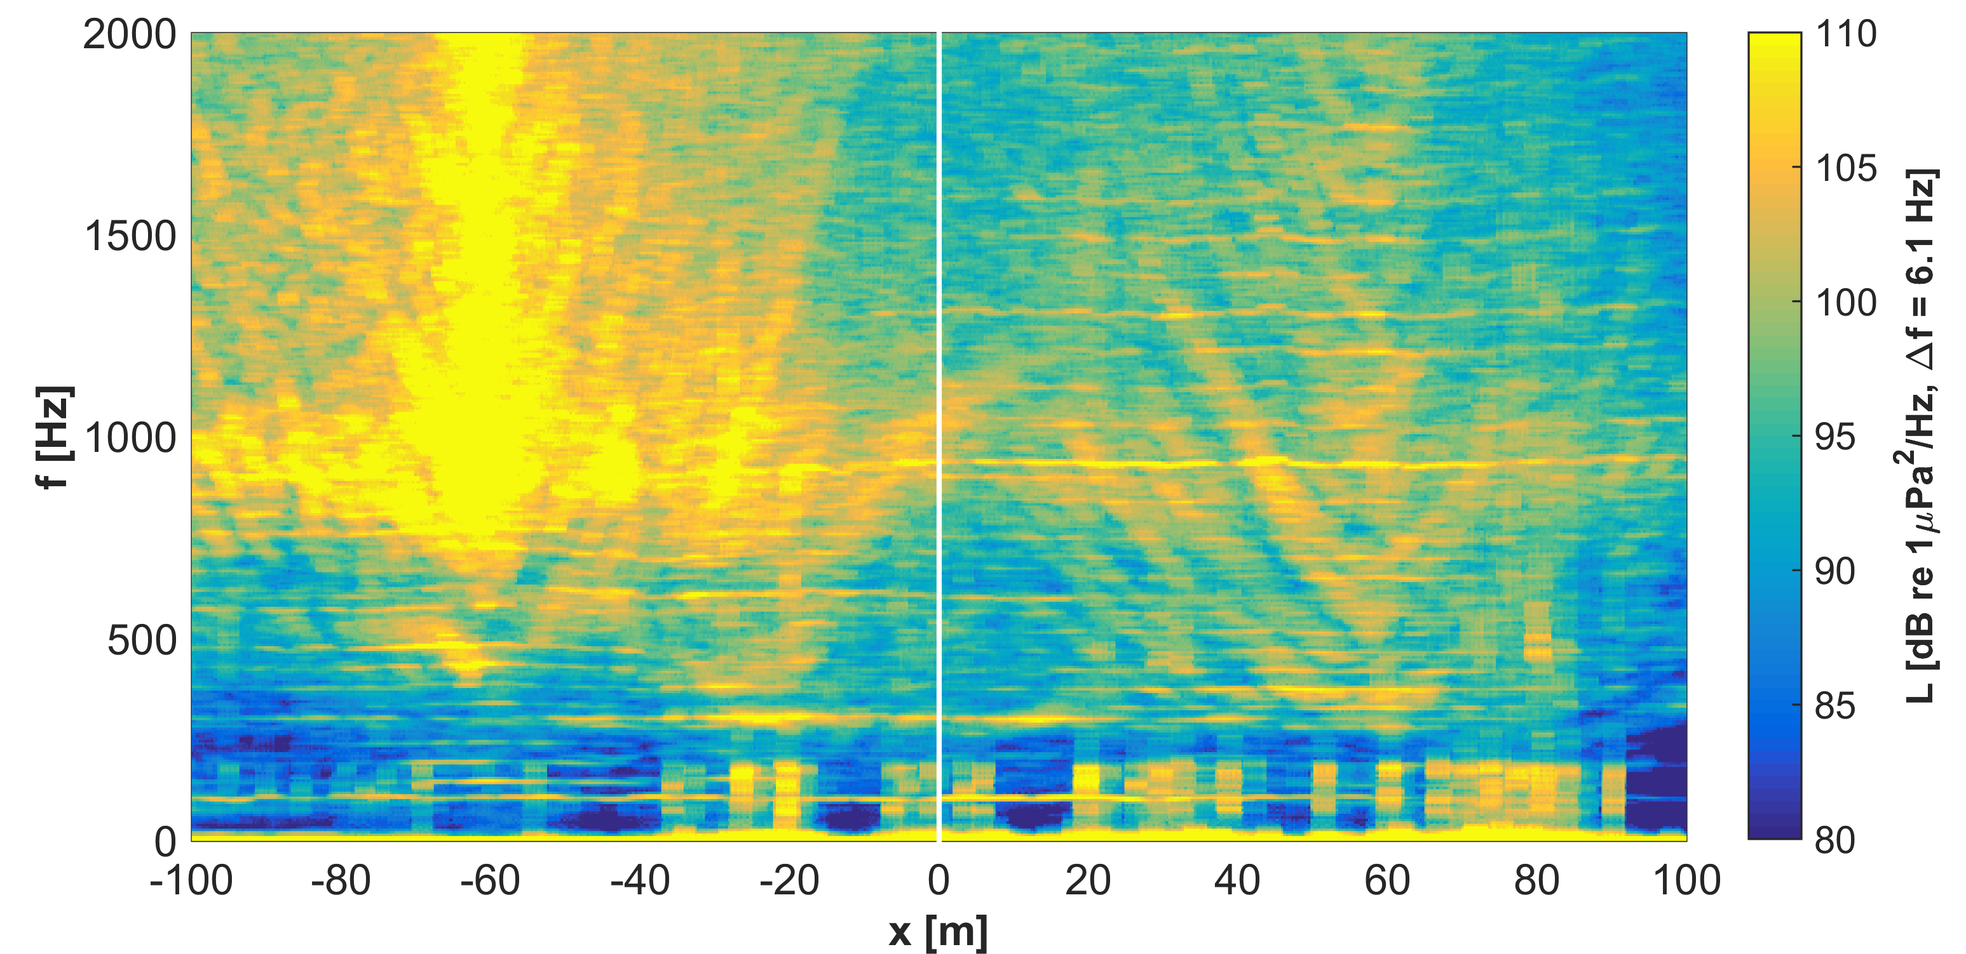
Context for Turbine Operation
Turbine at optimal operating point with fishing vessel nearby

Slide 16
Conclusions
Turbine produces sound at frequencies < 2 kHz
Likely audible to fish across the width of river
May have behavioral implications
Acoustic measurements can provide useful environmental and technical information
Drifting measurements useful, but challenges remain
Measurements of sound at < 50 Hz
Identification and removal of self-noise events

Slide 17
Acknowledgements
Financial support for this project is generously provided by the US Department of Energy under FG36-08GO18179-M001.
Many thanks to Monty Worthington & Ryan Tyler (Ocean Renewable Power Company) for providing the study turbine, the village of Iguigig, Peter Dahl (University of Washington) for helpful discussions, and Alex de Klerk, Emma Cotter, & Joe Talbert (University of Washington) for field support.

