Slide 1
Hydrodynamic Optimization of Cross-Flow Turbines with Large Chord-to-Radius Ratios
Benjamin Strom, Dr. Brian Polagye, and Dr. Steve Brunton
Dept. of Mechanical Engineering, University of Washington

Slide 2
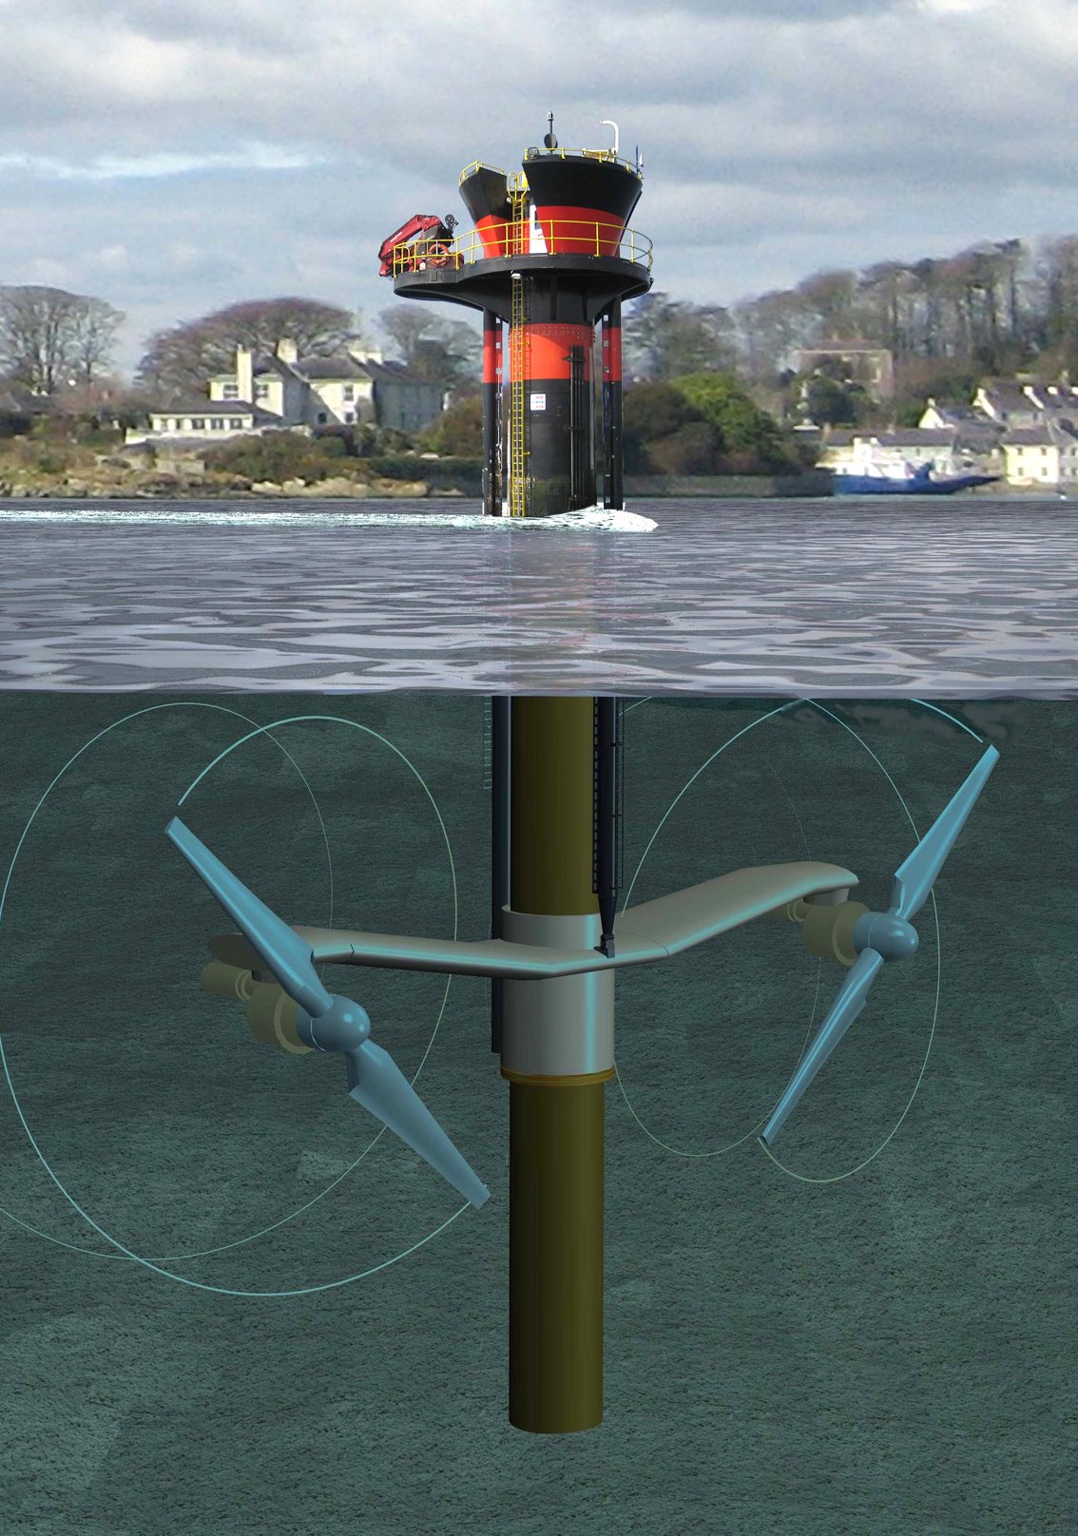
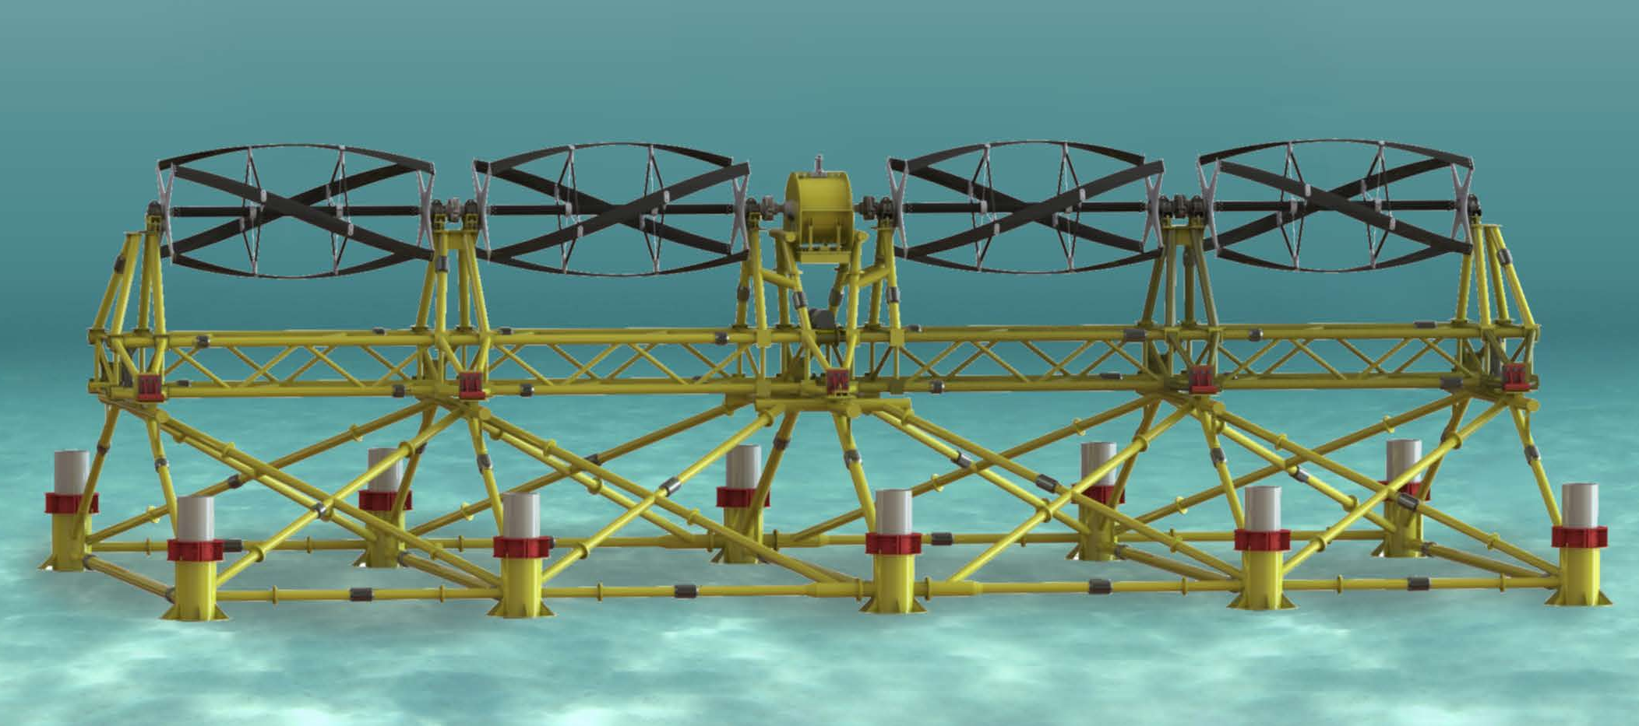
Advantages of Cross Flow Turbines
Ocean Renewable Power Company
Marine Current Turbines
Notes:
Advantages of cross flow turbines over axial flow ones
Rectangular cross section - amenable to shallow water channels, construction of high blockage ratio arrays
Lower tip speed ratio – cavitation, acoustics, chopping things up
Multiple turbines connected to a single generator
Bi directional if horizontal, omni directional if vertial – no yaw control necessary

Slide 3
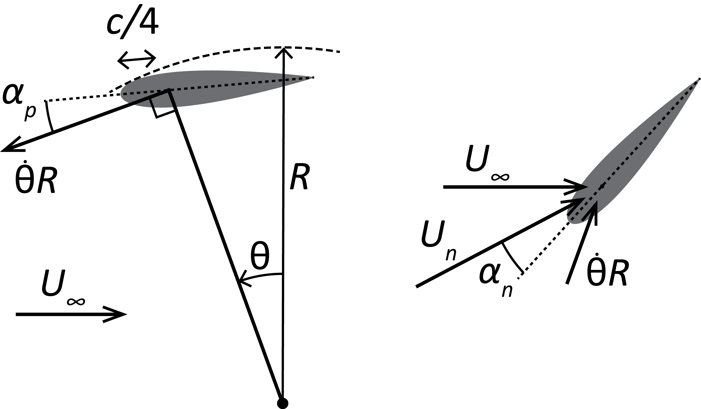
Parameter Space
Geometric
R | Turbine Radius | 8.5 cm
L | Turbine Height (Span) | 23.4 cm
c | Blade Chord | 4.06 cm
* N | Blade Count
* α_{p} | Preset Blade Pitch Angle
β | Blade Helix Angle | 90°
- | Blade Profile | NACA0018
- | Blade End Condition | Round Plate
Solidity
Chord to radius ratio
Aspect Ratio
(0.47)
(0.735)
Notes:
Define preset pitch angle
Helix angle is 90 (straight blades)
Primarily use naca0018 foil
End condition are circular end caps the same radius as the turbine
Chord is 4 cm
Radius is 8.6 cm
In these set of experiments we will focus on optimizing preset pitch angle (and the hydrodynamics resulting in the optimum)
Secondary focus on number of blades/ solidity

Slide 4
Parameter Space
Operational
τ | Torque
ω | Angular Velocity
U∞ | Free Stream Velocity
Tip Speed Ratio
Power Coefficient
Reynolds Number?
Notes:
Either hold torque or angular velocity constant.
Free stream vel is held constant
The important non-dimensionalizations we consider here are the tip speed ratio (ratio of blade speed due to ratio vs free stream vel) and the coeficient of power – mechanical power over that available in the swpet area of flow.
Reynolds number is not a focus of this study, and it remains an open questions as to what the appropriate velocity ang length scale is for these turbines.

Slide 5
High Chord to Radius Turbines
Benefits for hydrokinetic applications
  Structural
  Lower tip speed ratio (λ)
Added hydrodynamic complexity

Slide 6
Preset Pitch Hydrodynamics
Notes:
Definitio of oreset pitch, attatchment at ¼ chord, positive show

Slide 7
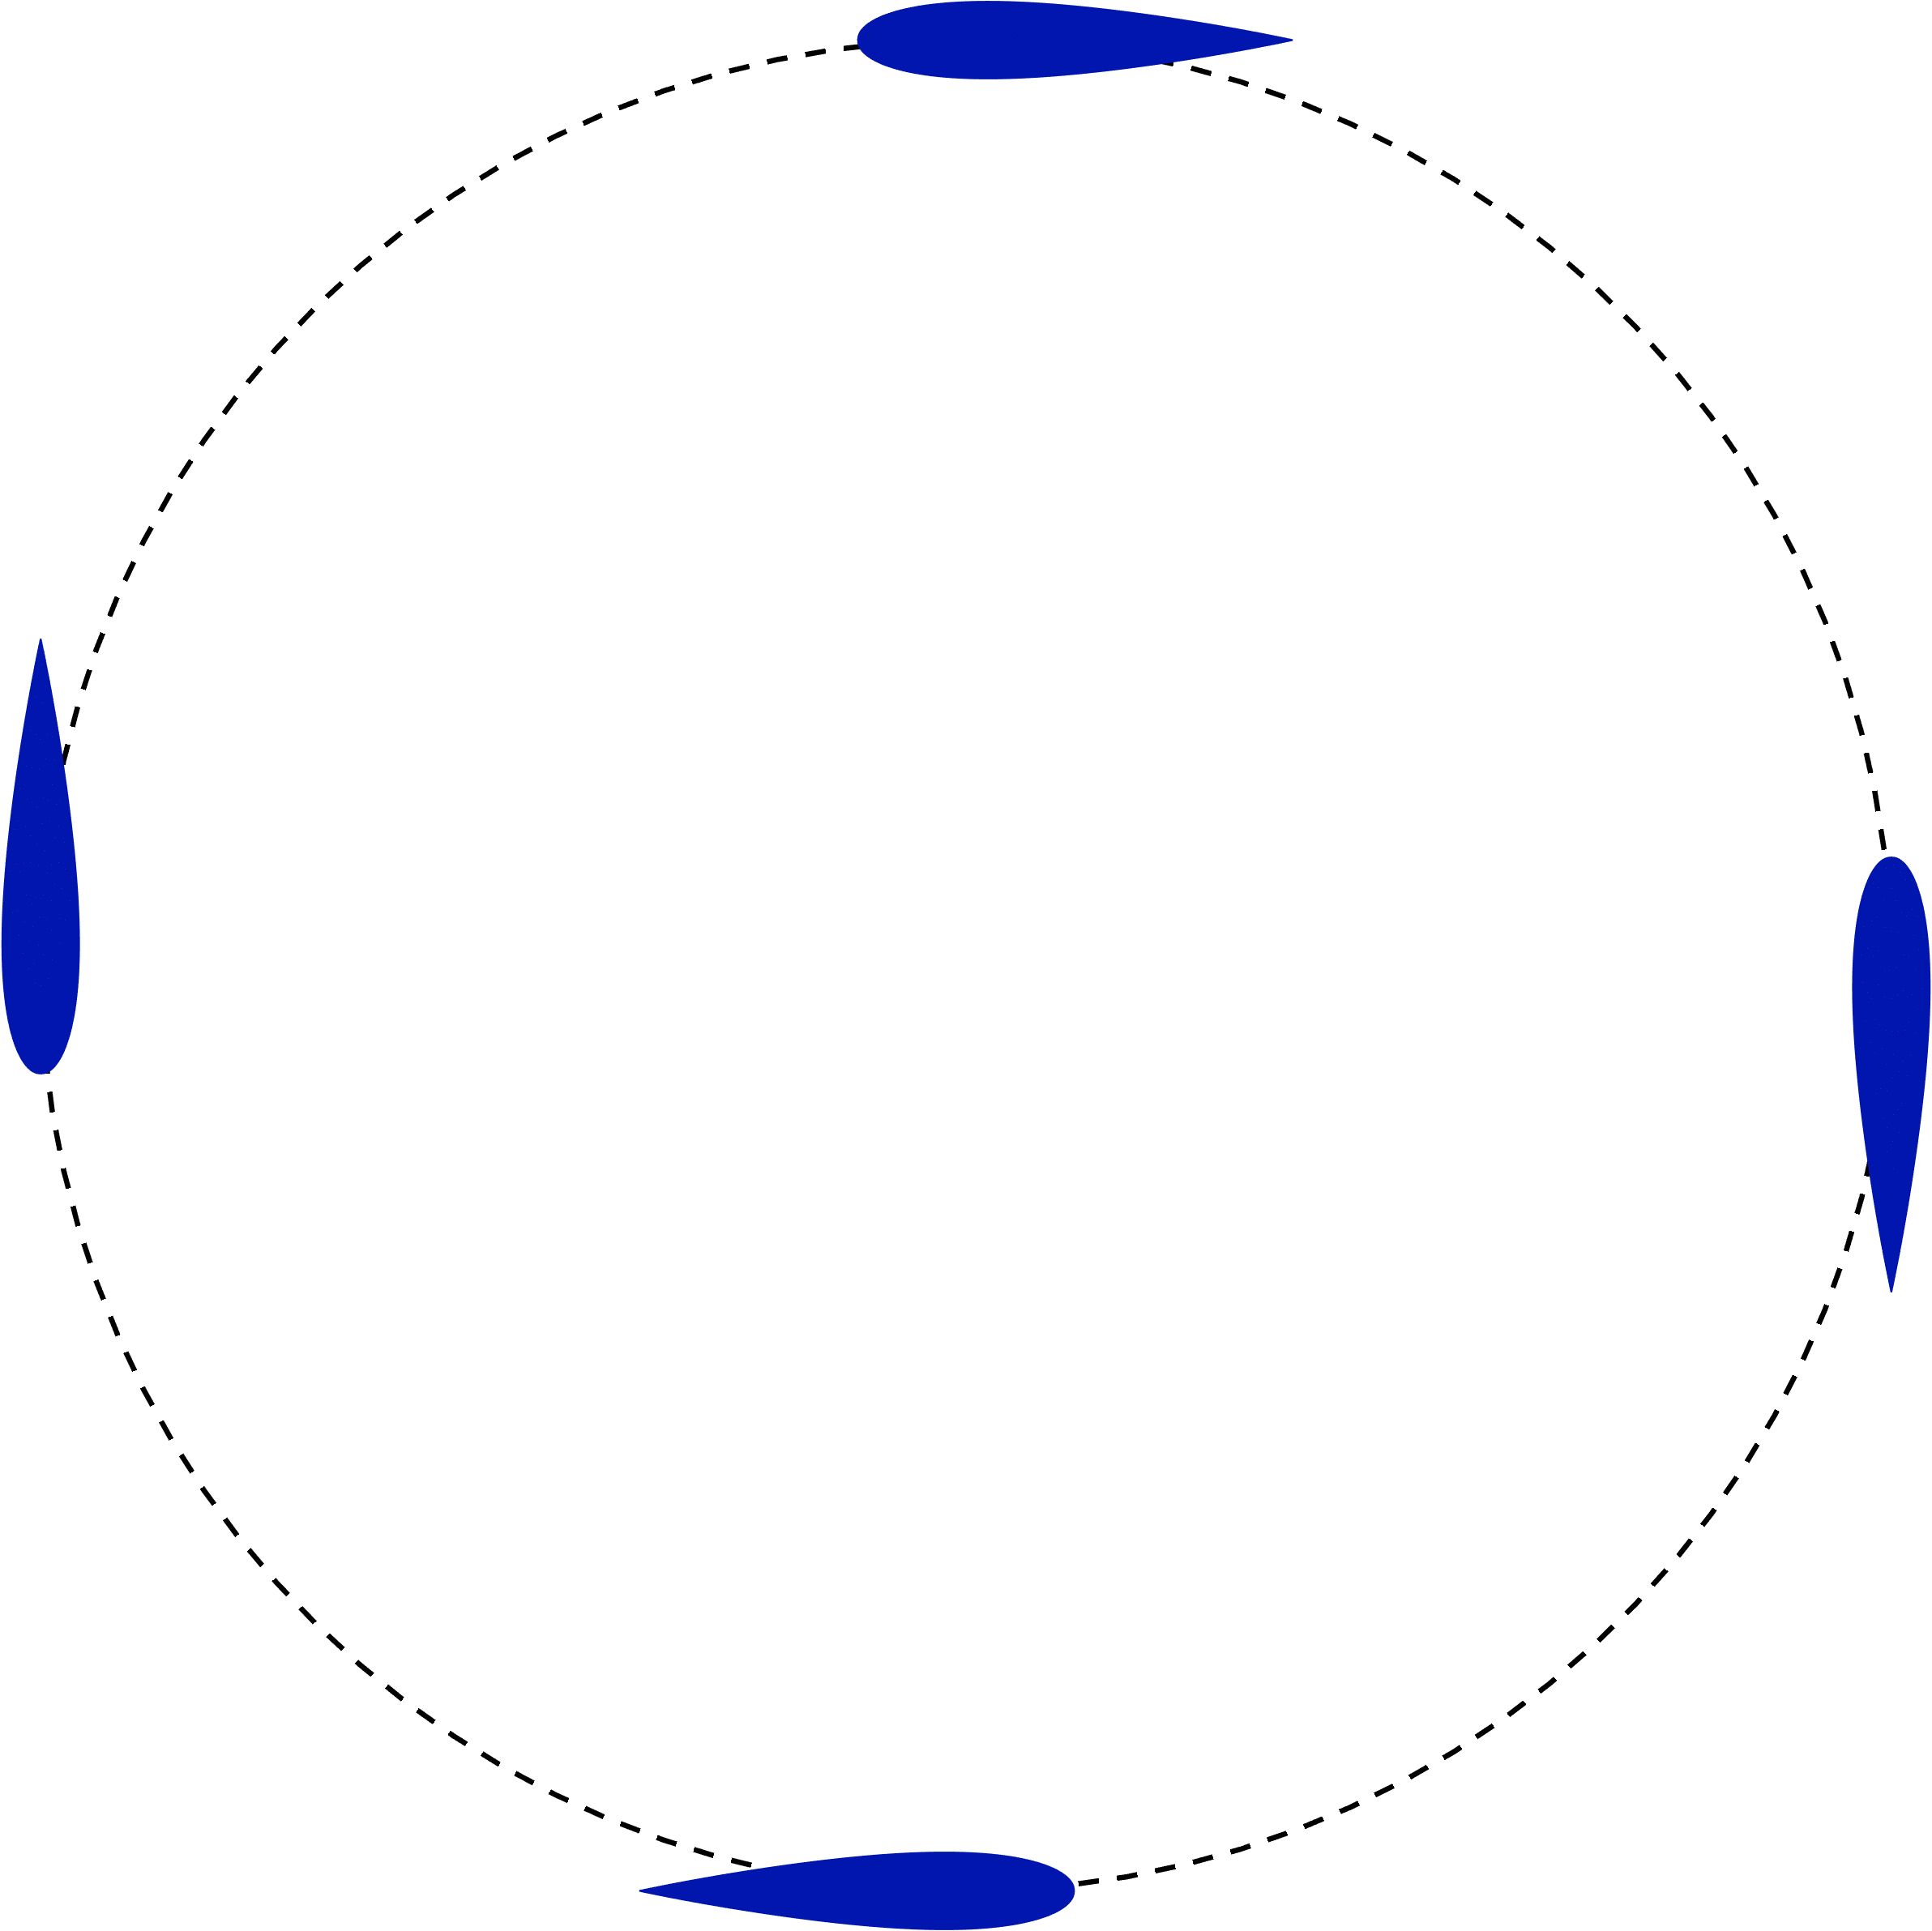
Preset Pitch Hydrodynamics
θ
0º
90º
270º
U∞
180º
Notes:
Definitio of oreset pitch, attatchment at ¼ chord, positive show

Slide 8
Prior Results for Preset Pitch Angle
c/R
Klimas and Worstell (1981)
  Small increase in C_{P,max} at 2° preset pitch
Klimas, Paul C., and Mark H. Worstell. Effects of blade preset pitch/offset on curved-blade Darrieus vertical axis wind turbine performance. No. SAND-81-1762. Sandia National Labs., Albuquerque, NM (USA), 1981.
6%

Slide 9
Prior Results for Preset Pitch Angle
c/R
Klimas and Worstell (1981)
  Small increase in C_{P,max} at 2° preset pitch
Rawlings (2005)
  Moderate increase in C_{P,max} at 3-5° preset pitch
Klimas, Paul C., and Mark H. Worstell. Effects of blade preset pitch/offset on curved-blade Darrieus vertical axis wind turbine performance. No. SAND-81-1762. Sandia National Labs., Albuquerque, NM (USA), 1981.
6%
Rawlings, George W. "Parametric characterization of an experimental vertical axis hydro turbine." (2008). Masters thesis, University of British Columbia, Vancouver, Canada.
14%

Slide 10
Prior Results for Preset Pitch Angle
c/R
Klimas and Worstell (1981)
  Small increase in C_{P,max} at 2° preset pitch
Rawlings (2005)
  Moderate increase in C_{P,max} at 3-5° preset pitch
Fiedler and Tullis (2009)
  29% increase in C_{P,max} at 8° preset pitch
Klimas, Paul C., and Mark H. Worstell. Effects of blade preset pitch/offset on curved-blade Darrieus vertical axis wind turbine performance. No. SAND-81-1762. Sandia National Labs., Albuquerque, NM (USA), 1981.
6%
Rawlings, George W. "Parametric characterization of an experimental vertical axis hydro turbine." (2008). Masters thesis, University of British Columbia, Vancouver, Canada.
14%
32%
Fiedler, Andrzej J., and Stephen Tullis. "Blade offset and pitch effects on a high solidity vertical axis wind turbine." Wind Engineering 33.3 (2009): 237-246.

Slide 11
Prior Results for Preset Pitch Angle
c/R
Klimas and Worstell (1981)
  Small increase in C_{P,max} at 2° preset pitch
Rawlings (2005)
  Moderate increase in C_{P,max} at 3-5° preset pitch
Fiedler and Tullis (2009)
  29% increase in C_{P,max} at 8° preset pitch
Current Experiments
Klimas, Paul C., and Mark H. Worstell. Effects of blade preset pitch/offset on curved-blade Darrieus vertical axis wind turbine performance. No. SAND-81-1762. Sandia National Labs., Albuquerque, NM (USA), 1981.
6%
Rawlings, George W. "Parametric characterization of an experimental vertical axis hydro turbine." (2008). Masters thesis, University of British Columbia, Vancouver, Canada.
14%
32%
Fiedler, Andrzej J., and Stephen Tullis. "Blade offset and pitch effects on a high solidity vertical axis wind turbine." Wind Engineering 33.3 (2009): 237-246.
47%

Slide 12
Experimental Setup
Turbine Control: Torque
ADV Free Stream measurements at 5D
Free Stream Velocity ~0.7 m/s
Turbulent Intensity: 1.8%
Flume blockage ratio: 11%

Slide 13
Performance Curves
Power Coefficient vs. TSR
N = 2 Blades
Power Coefficient vs. TSR
N = 4 Blades
λ_{optimal}
C_{p,max}
Notes:
Things to note
Max perfomance of 2B greater than 1B
Two bladed more suseptible to stall: due to large angular velocity fluctuations
Point out two operational regimes

Slide 14
Peak Performance
Maximum Power Coefficient
vs. Preset Pitch Angle
Optimal TSR
vs. Preset Pitch Angle
Notes:
Large increase in performance for 0-optimal preset pitch angle, consistent with prior work (280% increase for the two bladed case),
More blades = lower optimal tip speed ratio – consistent with actuator disk theory for axial flow turbines
Best angle is consistent

Slide 15
Why Does Preset Pitch Angle Help?
(Internal Wake Deficit)
θ
0º
U∞
90º
270º
180º
Upstream
Region
Downstream
Region
Notes:
Upstream blades take take energy out of flow such that downstream encouters a slower freestream vel
Here we have a negative half cosine induced velocity for the downstream
Equalization of angle of attack

Slide 16
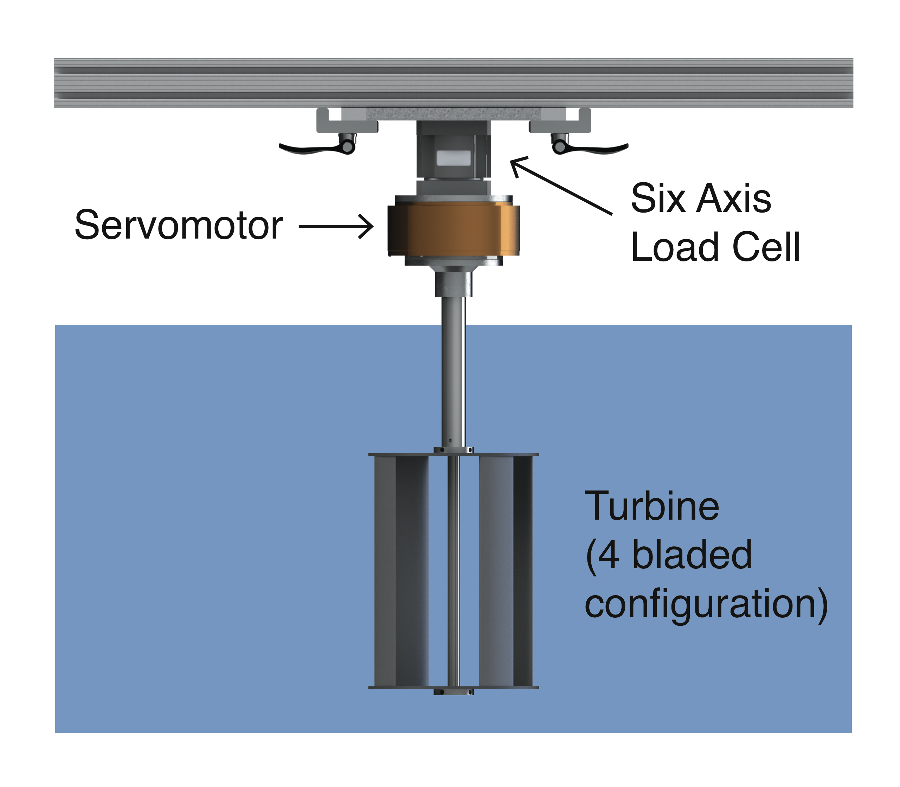
Experimental Setup, Revised
Motivation
  Constant Turbine velocity (isolates fluid forcing)
  Flow visualization

Slide 17
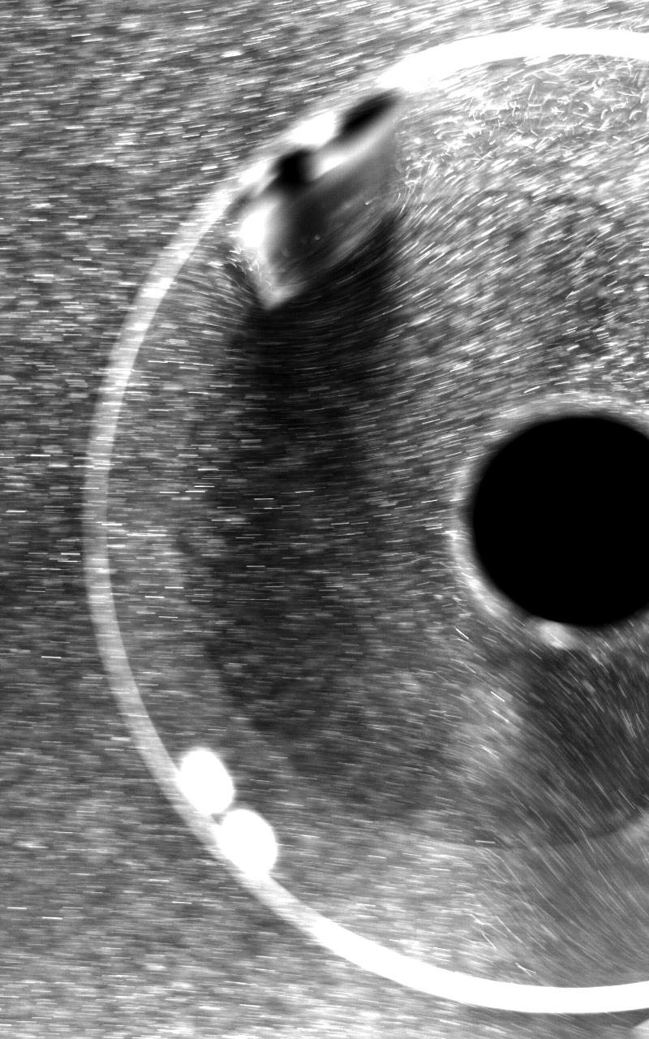
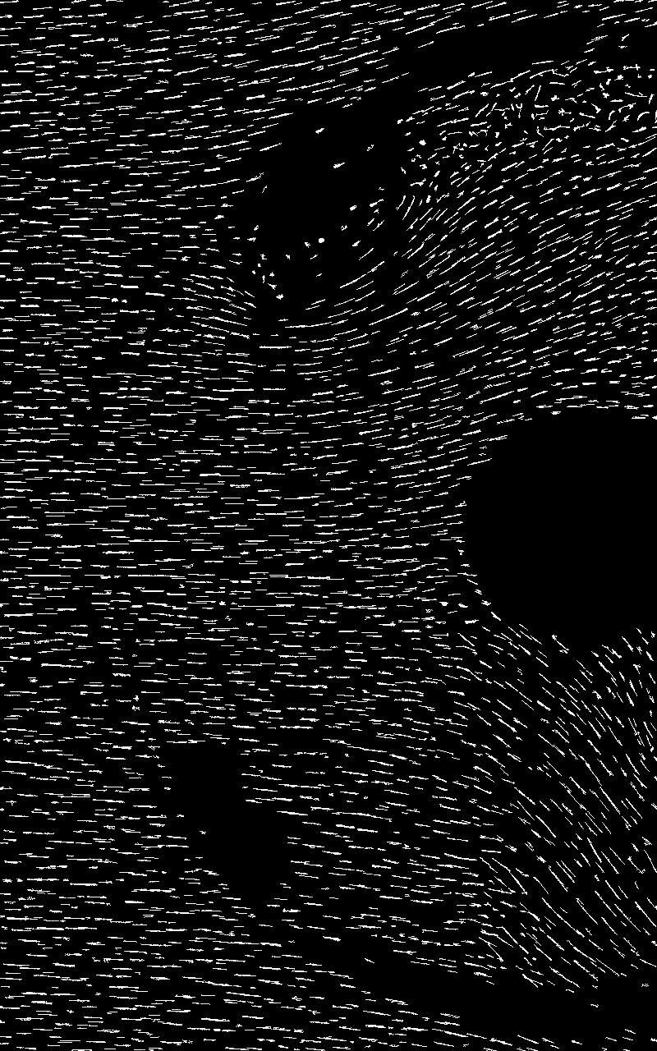
Flow Visualization

Slide 18
Performance Curves, ω Control
N = 2 Blades
N = 4 Blades

Slide 19
Angular Power Profiles
Notes:
Theorize two things: most of the power is coming from the upsstream blade – where the free stream hasn’t been slowed down
The peak of the instantaneous power curve corresponds to an important point in the dynamic stall process

Slide 20
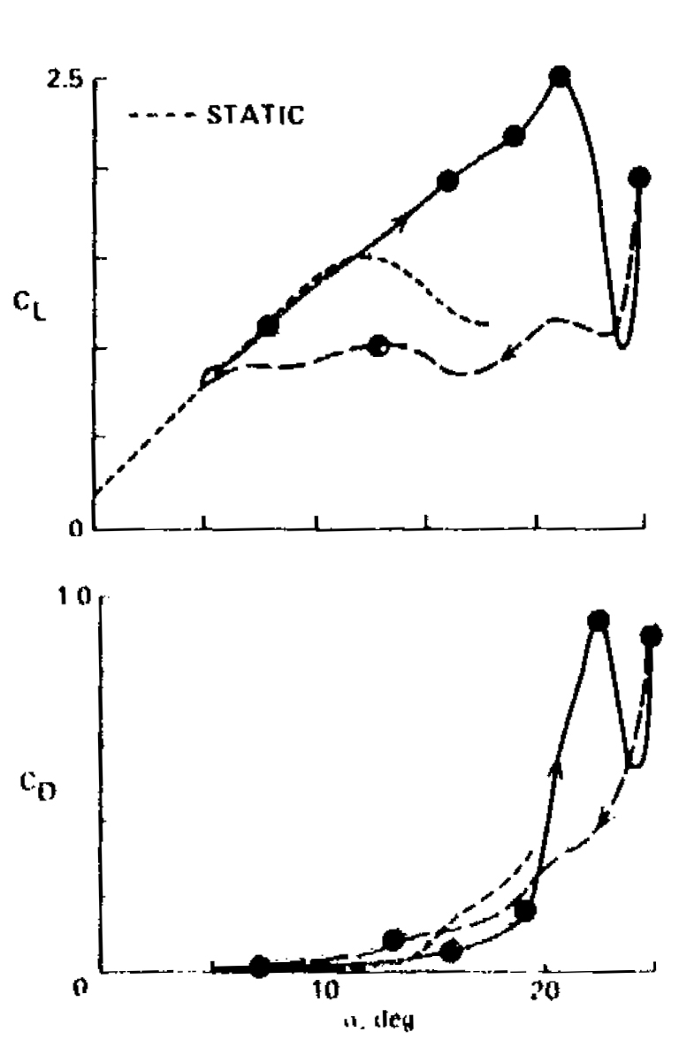
Dynamic Stall
W. McCroskey, “The phenomenon of dynamic stall.” National Aero- nautics and Space Administration Moffett Field CA, AMES Research Center, Tech. Rep., 1981.
Notes:
Lift linear
Drag cubic
Exists some point during process where lift benefit is overcome by drag detriment – this is corresponds with peak of power curve

Slide 21
Critical Nominal Angle of Attack?
TSR = 1.3
N = 2
Notes:
Is this angle consistent? Find azimuthal blade position of power curve peak, Identify nominal angle of attack at this point using analytical expression

Slide 22
Critical Nominal Angle Angle of Attack?
Notes:
Do for all points, discarding profiles where extrema of angle of attack never reaches the critical angle
Propose that optimal parameters are those for which this critical angle is reached and no further (maximize lift benefit, don’t get into region of large drag)
Find TSR for each preset pitch angle where this is true, somewhat predicts the right side peak of performance curve

Slide 23
Critical Nominal Angle of Attack?
TSR = 1.3
Preset Pitch = 0°
N = 2
U∞
θ=θ(α_{n}=α_{n,crit})
θ=θ(α_{n}=α_{n,crit})+15°
TSR = 1.3
Preset Pitch = 12°
N = 2
U∞
θ=θ(α_{n}=α_{n,crit})
θ=θ(α_{n}=α_{n,crit})+15°

Slide 24
Leading Edge Vortex Interaction
??
Notes:
But what is happening here?

Slide 25
Leading Edge Vortex Interaction
U∞
TSR = 1.3
Preset Pitch = 0°
N = 2
TSR = 1.8
Preset Pitch = 0°
N = 2
Notes:
Using flow visualization, we find that cases with a TSR = critical is where the LEV translates with the blade until it dissipates. Faster than this, the LEV translates towards the trailing edge of the foil. As it is a low pressure region, this is detrimental, thus the drop in efficiency over this TSR.

Slide 26
Future Directions
Near-term
  Reynolds number dependence/scalability
  Smaller/larger chord to radius ratios
  Solidity/blockage relation
  Torque control vs. velocity control
  Quantitative flow-field analysis
Long-term
  Blade profile optimization
  Helical blades
  High blockage arrays
  Array control

Slide 27

Acknowledgments
Funding:
University of Washington William E. Boing Department of Aeronautics and Astronautics and Fiona Spencer for use of their water flume
Prof. Alberto Aliseda for the loan of a high-speed camera

Slide 28
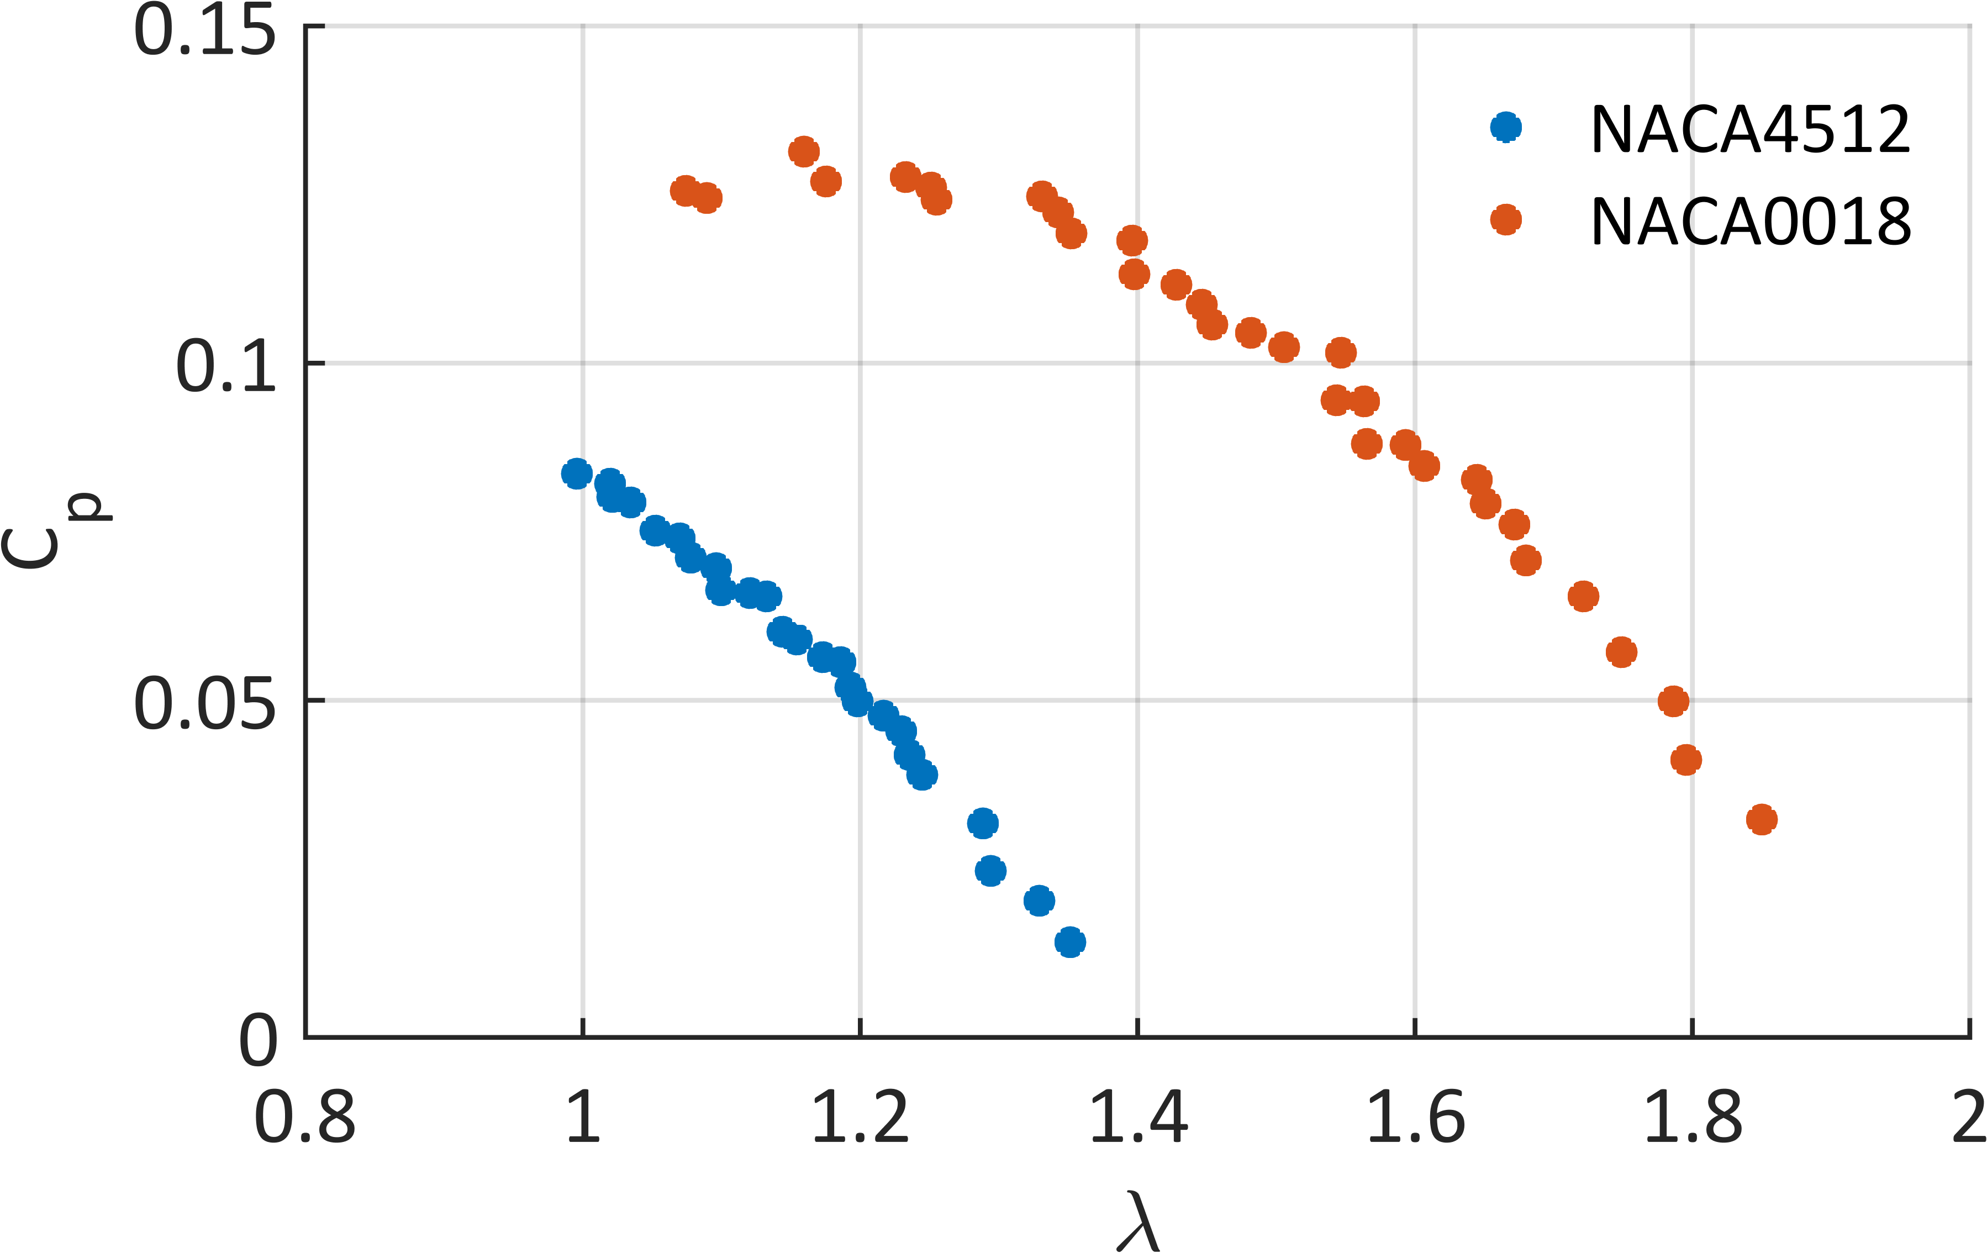
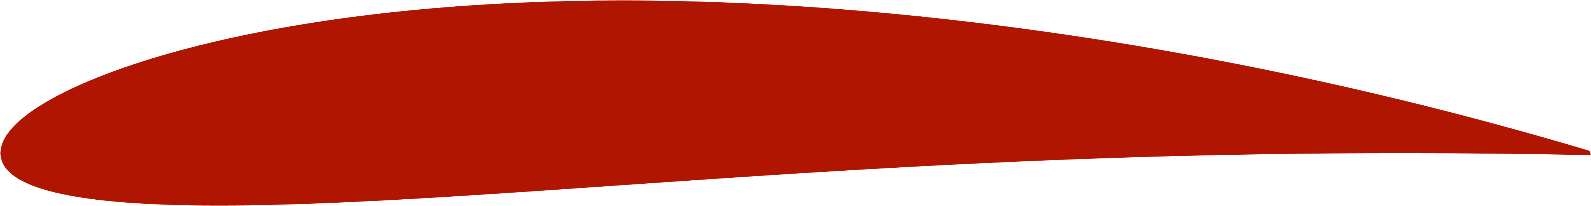
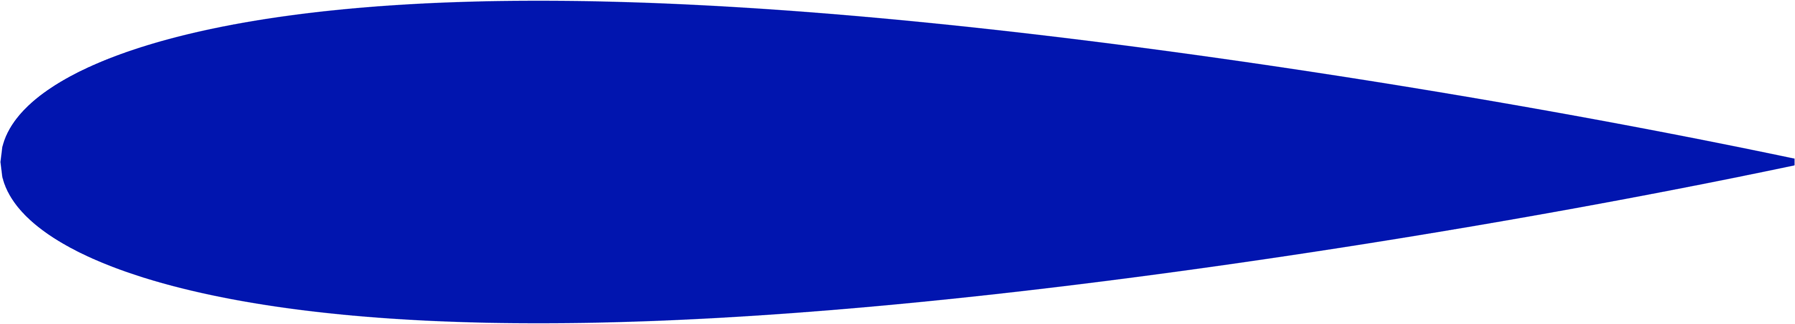
Blade Profile
N = 4
Preset Pitch angle = 6°

Slide 29
Effective Blade Profile
θ
0º
U∞
90º
270º
180º
 | Virtual Camber
λ ⬆ | ⬇
R_{c} ⬆ | ⬆
α_{p} ⬆ | ⬆
Conformal mapping à la: P. C. Klimas and M. H. Worstell, Effects of blade preset pitch/offset on curved-blade Darrieus vertical axis wind turbine performance. Sandia National Laboratories, 1981.

