Slide 1
Measurement of Acoustic Pressure and Particle Acceleration Near a River Current Turbine to Assess Disturbances To Fishes
A Masters Defense
by
Paul Murphy
Marine Renewable Energy Lab | Applied Physics Lab

Slide 2
Committee Members
Professor Peter H. Dahl
Mechanical Engineering and Applied Physics Lab
Professor Brian Polagye
Mechanical Engineering
Dr. David Dall’Osto
Applied Physics Lab

Slide 3
Motivations

Slide 4
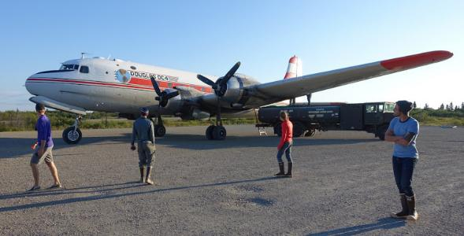
Powering Remote Alaskan Communities
Energy costs are high in remote areas of Alaska
Diesel fuel must be shipped by cargo plane

Slide 5
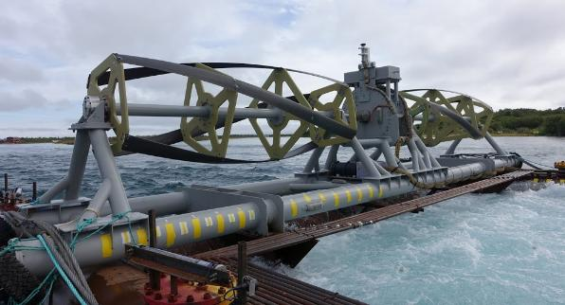
An Alternative Source of Power
Power from River Current Turbines may be an economically competitive alternative

Slide 6
Possible Environmental Effects
Sound from turbines may affect fish
Physical harm is unlikely
Behavioral changes could result in change to the overall fish population

Slide 7
Reliance on Fish Resource
Subsistence Based Riverine Communities
Commercial and Sport Fishing Industries
State of Alaska monitors Salmon populations closely, and sets catch limits accordingly

Slide 8
Sockeye Salmon (Oncorhynchus nerka)
Particle Motion (primary mode of sensation)
Otolith (located in inner ear)
Pressure (secondary mode of sensation)
Swim Bladder (not proximal to inner ear)

Slide 9
Fish Hearing Sensitivity

Slide 10
Particle Nature of Sound
Acoustic Particle – smallest volume of fluid with density equal to the mean fluid density.
[Animation courtesy of Dr. Dan Russell, Grad. Prog. Acoustics, Penn State]

Slide 11
Objectives
Measure acoustic pressure and particle acceleration near an operating river current turbine
Secondarily, test a drifting hydrophone system capable of determining source bearing with a fixed hydrophone array

Slide 12
Site and Measurement Methods

Slide 13
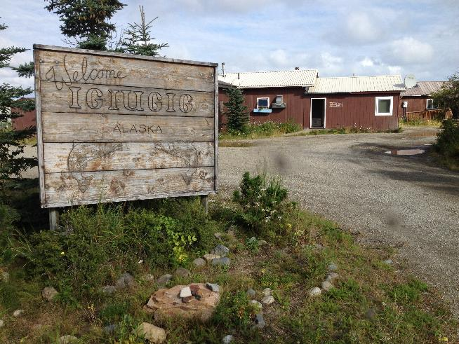
Study Site: Igiugig Alaska

Slide 14
Kviachak River, Lake Iliamna

Slide 15
River Domain
Depth (d) < Width (w) < Length (L)
“Across-channel” (perpendicular to bulk flow)
“Along-channel” (parallel to bulk flow)
“Thalweg” – line of greatest depth
Depth variation in both across- and along-channel

Slide 16
Site Characteristics
Current velocity often exceeds 2 m/s
Low turbidity, little debris (driftwood, etc), good visibility
Bottom: small cobble (D < 0.10 cm) over gravel, sand

Slide 17
Turbine Site
Current
Direction
Upstream Moorings
Shore Station
RivGen

Slide 18
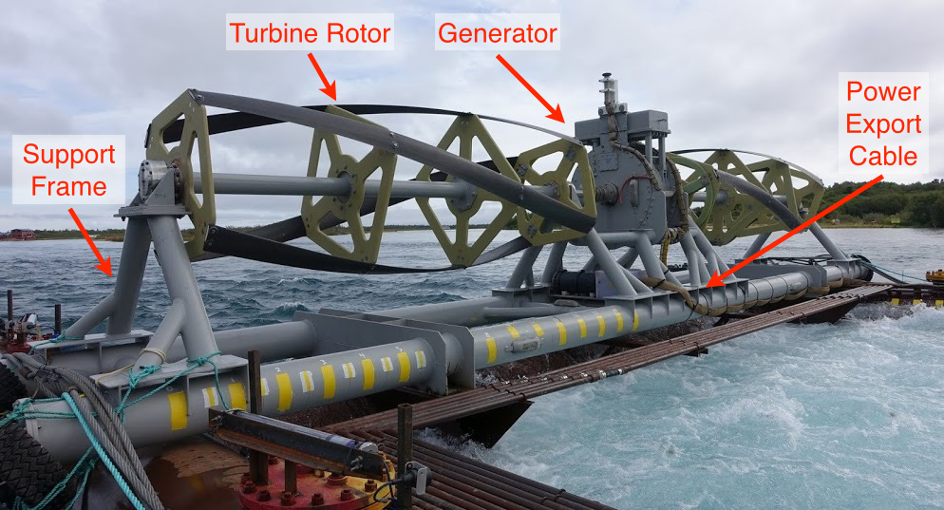
RivGen (ORPC)

Slide 19
River Turbine Sound Sources
Generator Vibration [rotation rate, gen. design]
Expected frequency ~ 50 Hz and harmonics
Blade Vibration [blade structural modes]
Blade Passing Frame [rotation rate, # of blades]
Expected frequency ~ 3-4 Hz and harmonics

Slide 20
Unlikely Sound Sources
Turbulent Noise [Quadrapole]
Cavitation [Monopole]

Slide 21
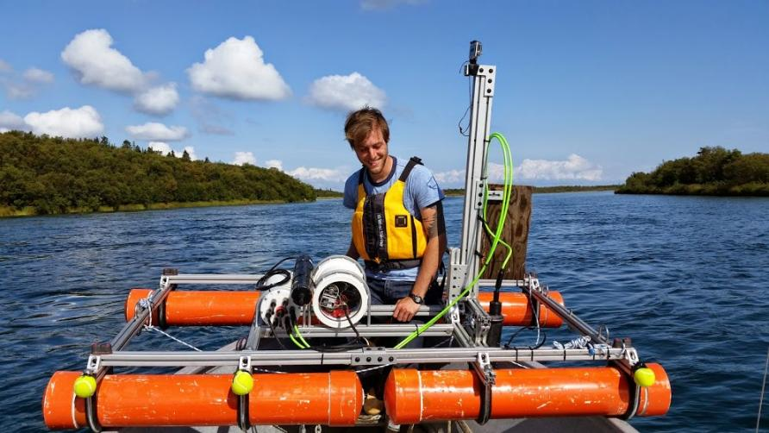
RivRaft Drifting Platform

Slide 22
Benefits of Drifting Platforms
Drifting platforms reduce fluid motion over the face of hydrophones
This reduces “flow noise”, a type of pseudo sound that can mask propagating sound

Slide 23
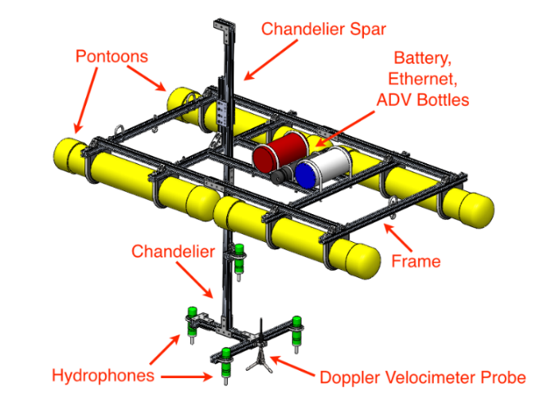
RivRaft Components

Slide 24
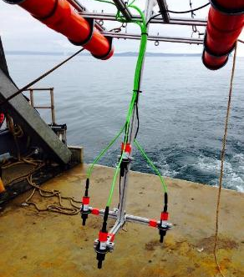
Chandelier Design Considerations
Designed to measure both particle acceleration and estimate source bearing
Following damage to hydrophones: ad-hoc two hydrophone vertical array was built on site

Slide 25
Measuring Particle Acceleration
Approximating the pressure gradient in the linearized Euler Eq.:

Slide 26
Measuring Particle Acceleration
Hydrophone spacing d must satisfy d < λ/8 for acceptable error

Slide 27
Measuring Particle Acceleration
Hydrophone separation of 20 cm for bandwidth up to 1000 Hz
Mean hydrophone depth of 50 cm

Slide 28
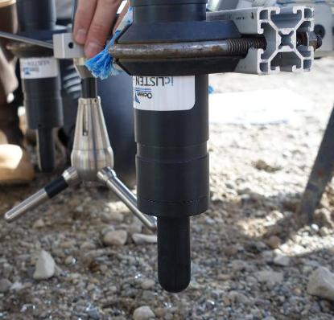
RivRaft Instrumentation
Hydrophones: icListen HF
10 - 200 kHz, -168 V/μPa
Up to 512 kS/sec
Perforated PVC shielding
Master/Slave Synchronization

Slide 29
RivRaft Instrumentation
ADV: Nortek Vector
Internal IMU
GPS: QStarz Racing Pro
GoPro 3 Hero (x2)

Slide 30
RivRaft Performance

Slide 31
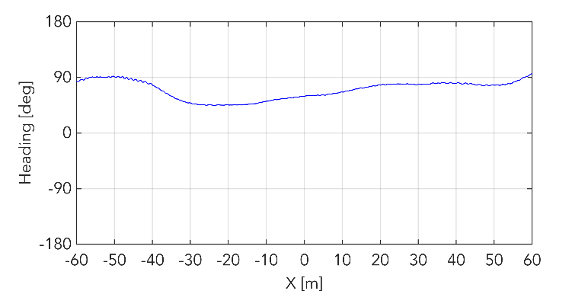
Raft Stability: Heading

Slide 32
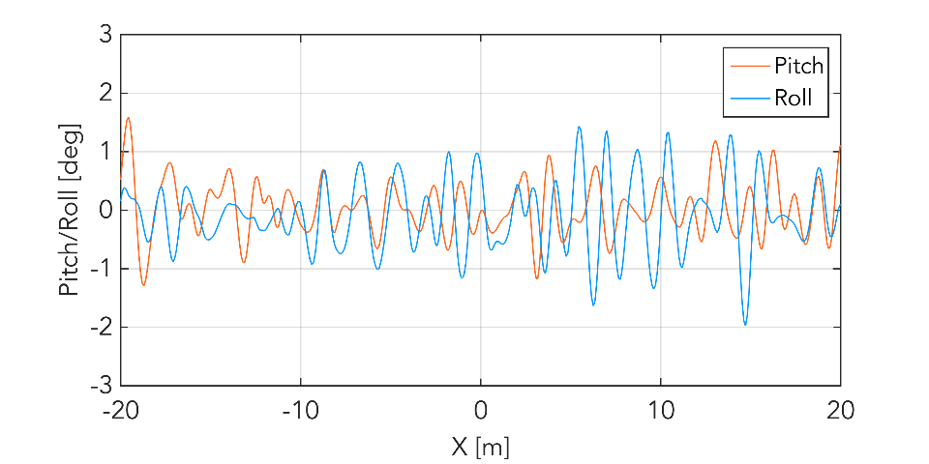
Raft Stability: Pitch and Roll
Measured by ADV probe at a depth of 50 cm

Slide 33
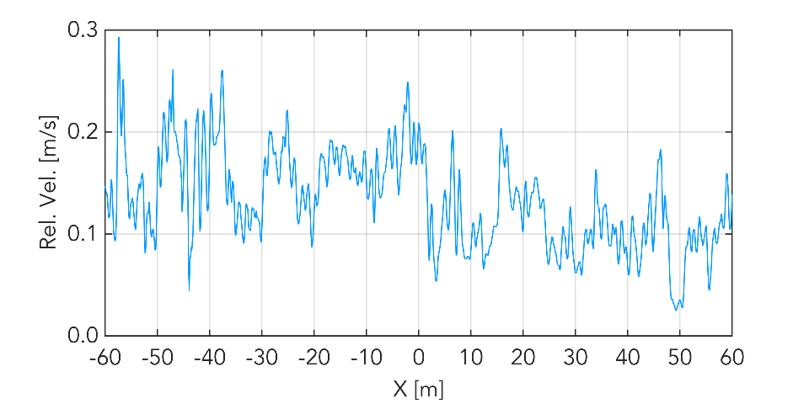
Raft Stability: Relative Velocity
Measured by ADV probe at a depth of 50 cm

Slide 34
Acoustic Measurements

Slide 35
Measurement Log (Abridged)
8/14 – Arrived. Raft assembled.
8/18 – Damage to three hydrophones
8/25 – Five drifts with vertical 2-hydrophone array
3 “Braked” (turbine stalled)
2 “Optimal” (turbine at optimal power output)

Slide 36
8/14 - Assembling the Raft

Slide 37
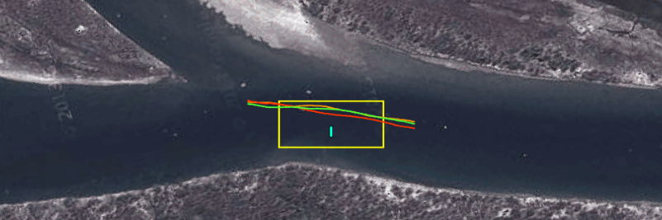
RivRaft Drift Paths

Slide 38
RivRaft Drift Paths (8/25)
Flow Direction

Slide 39
Ok, but what does it sound like?

Slide 40
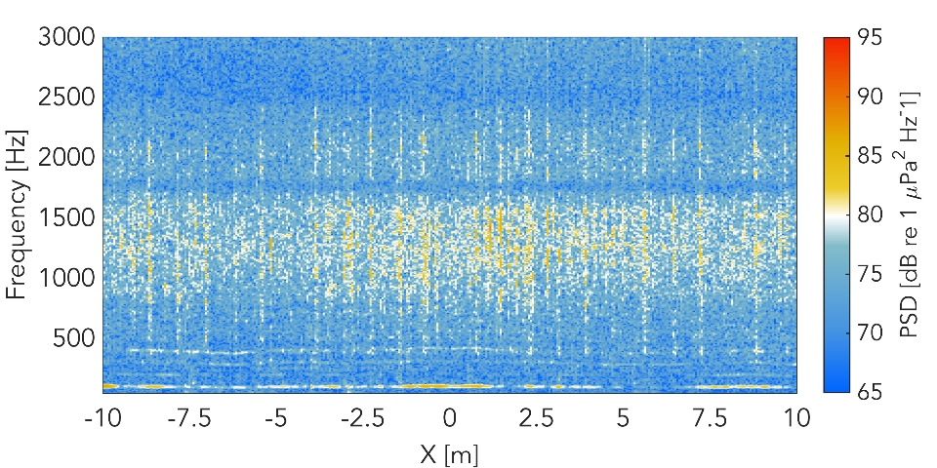
“Clicking” (Optimal 1)

Slide 41
RivRaft Drift Paths
Flow Direction

Slide 42
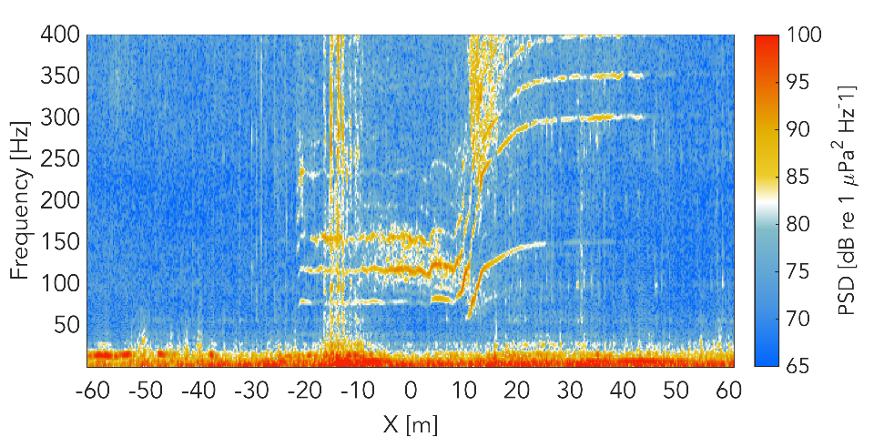
Braked 1 Pressure Spectrogram

Slide 43
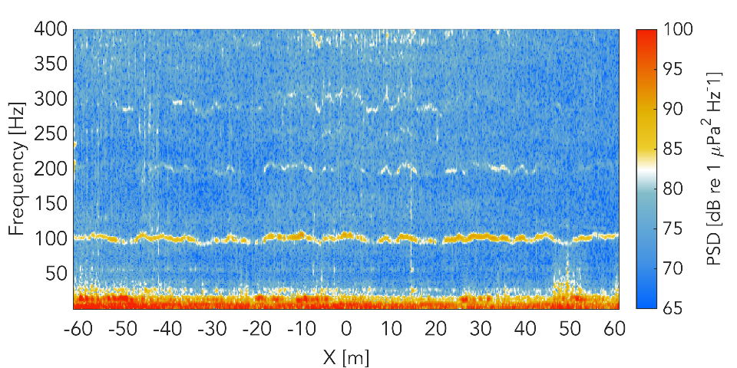
Optimal 1 Avg. Pressure Spectrogram

Slide 44
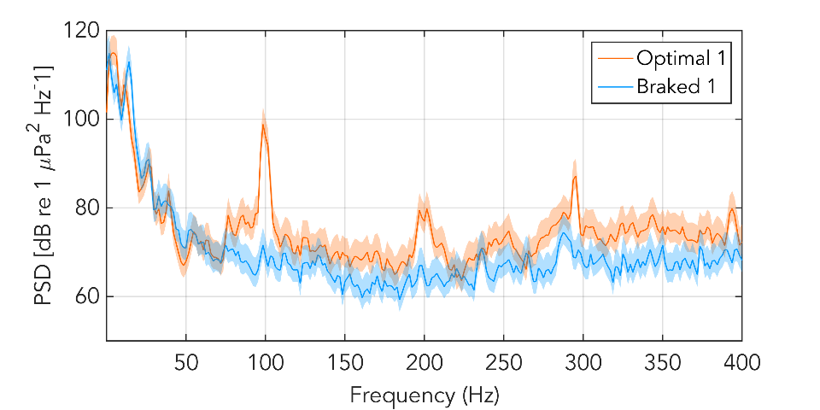
Pressure Spectra

Slide 45
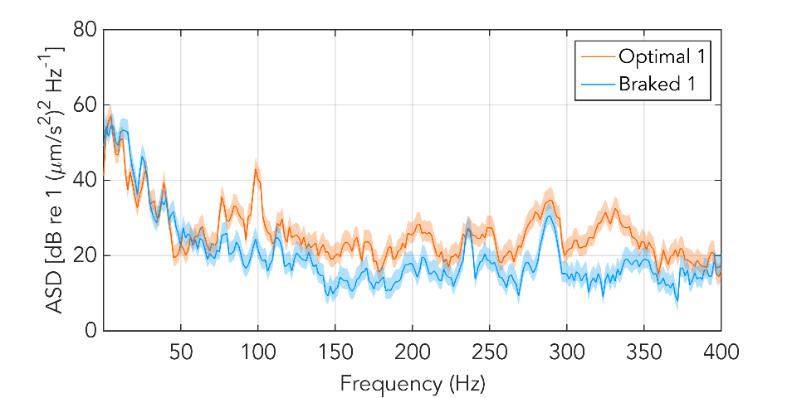
Acceleration Spectra

Slide 46
Tones at 100, 200, and 300 Hz
Harmonic structure with fundamental at 100 Hz.
For simplicity, they will be designated ‘H1’, ‘H2’, ‘H3’

Slide 47
Optimal 1 Avg. Pressure Spectrogram

Slide 48
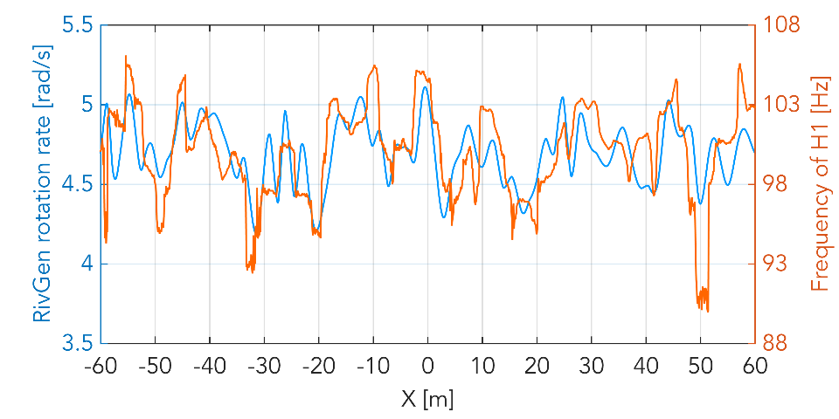
‘H1’ Frequency & RivGen Rotation Rate

Slide 49
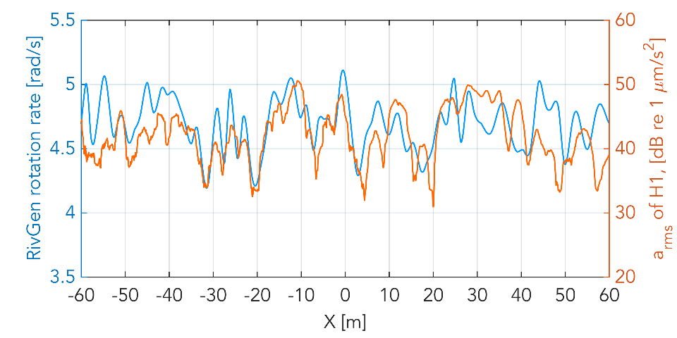
‘H1’ arms (vertical) & RivGen Rotation Rate

Slide 50
Possible Source of Tones
It is plausible that vibration from generator “cogging” is the source of the 100 Hz tone and harmonics
“Cogging” is caused by the periodic passing of magnetic poles and windings
Minimized by 3-phase designs, but still present

Slide 51
Relevance to Sockeye Salmon Hearing
The 100 tone is within the estimated hearing frequency range of Atlantic Salmon
Level of 100 Hz tone is within the same order as behavioral threshold levels
It is not clear if any of the tones would be sensed by fishes at the ranges measured

Slide 52
How does level vary with range?
r
Flow Direction

Slide 53
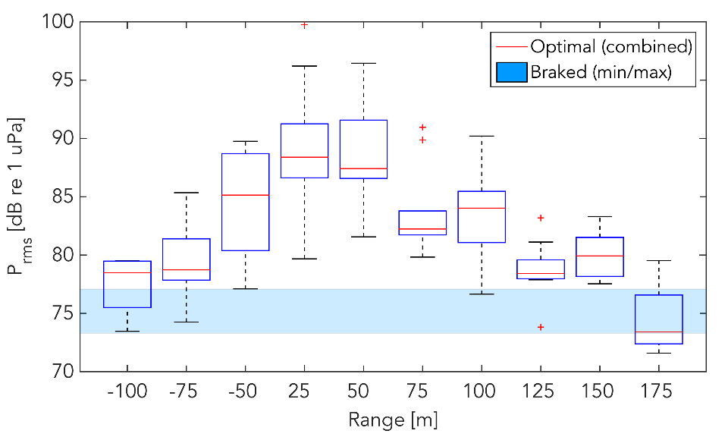
Level of ‘H1’ Tone with Range

Slide 54
Source Localization

Slide 55
Source Localization: Theory

Slide 56
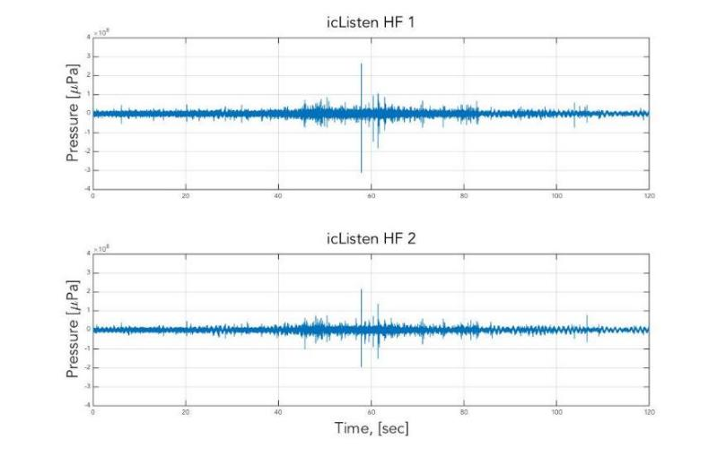
Estimating Time Delay

Slide 57
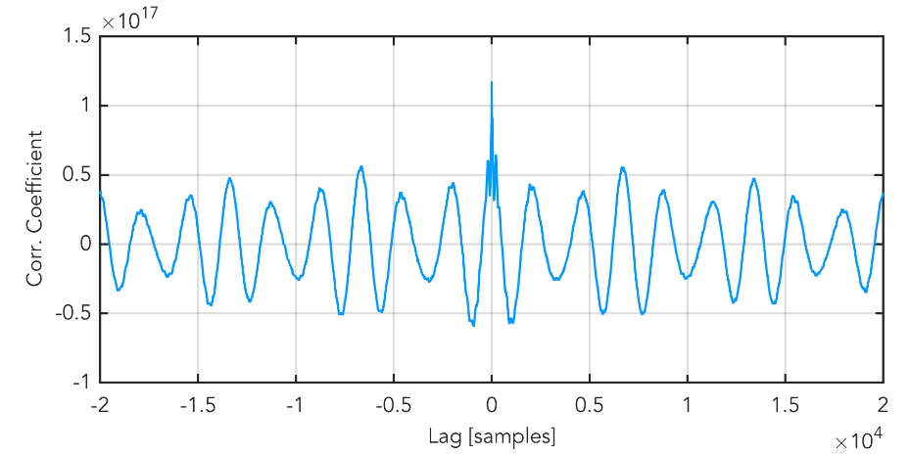
Estimating Time Delay

Slide 58
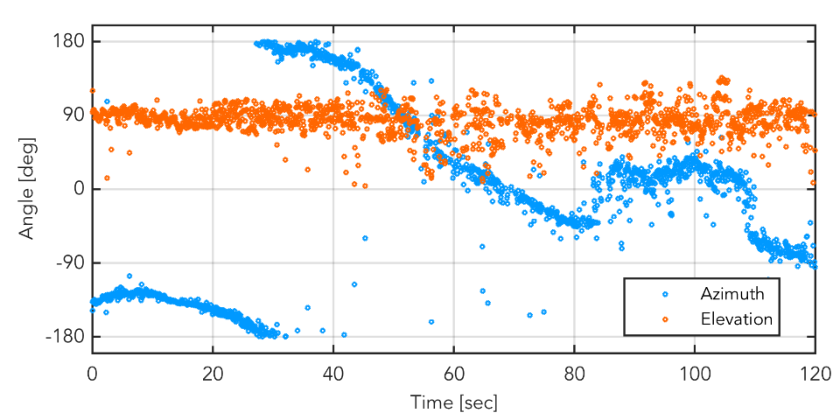
Tracking the R.V. Robertson (no IMU)

Slide 59
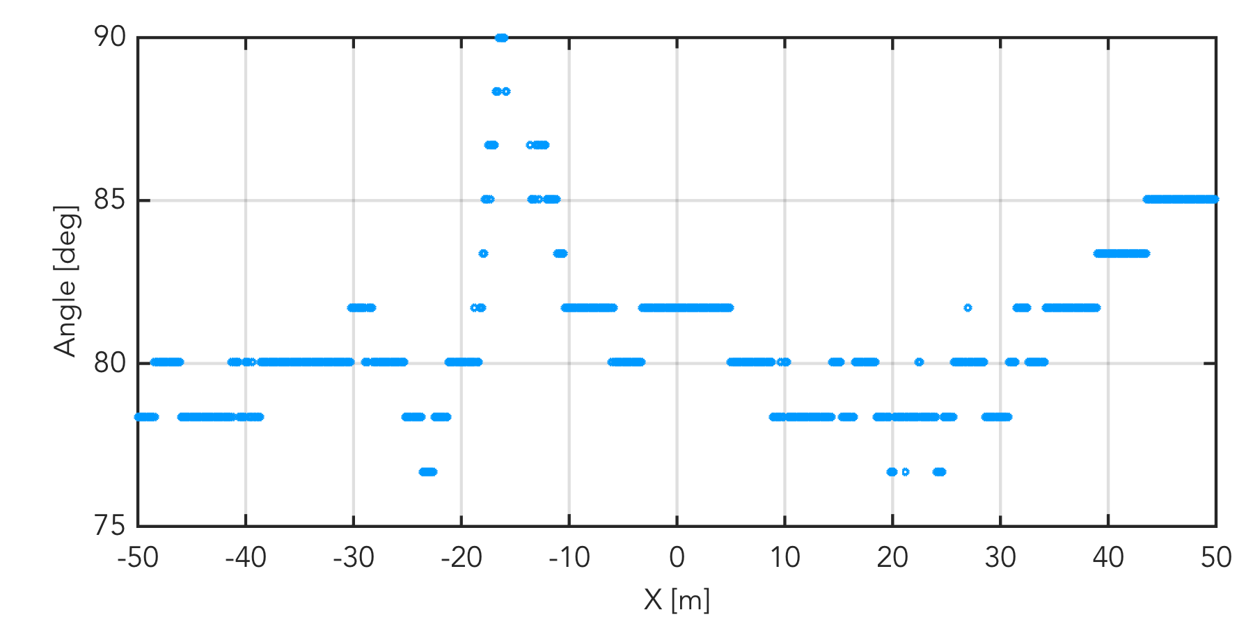
RivGen “Source” rel. to Vertical Array

Slide 60
Challenges

Slide 61
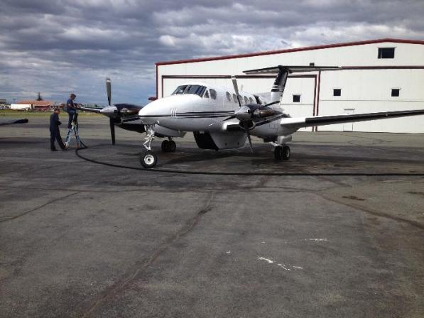
Logistical Constraints

Slide 62
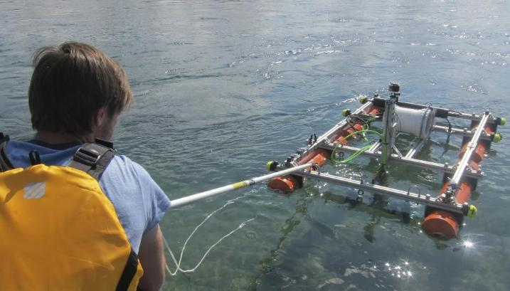
RivRaft Deployment

Slide 63
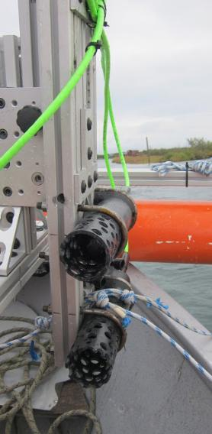
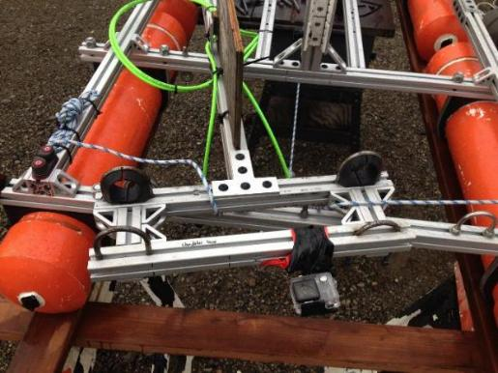
RivRaft Deployment

Slide 64
Summary of Findings

Slide 65
Summary
Tonal peaks appear only during operation
Fundamental and harmonics, approx. 100, 200, 300 Hz
Both frequency and level of the ‘H1’ (100 Hz) tone appear to vary with the rotation rate of the turbine
RMS level of the ‘H1’ tone decays to within 5 dB of ambient within 150 m of source

Slide 66
Summary
Broadband “Clicking” Sound
Operation only
Drifting platform is effective at reducing flow noise
A light and compact design is beneficial

Slide 67
Acknowledgements
The Applied Physics Lab, University of Washington
Joe Talbert, Alex de Klerk, Curtis Rusch
Mechanical Engineering, University of Washington
Brian Polagye and Emma Cotter
Ocean Renewable Power Company (ORPC)
Monty Worthington, Ryan Tyler, James Donegan

Slide 68
Masters Committee
Professor Peter H. Dahl
Professor Brian Polagye
Dr. David Dall’Osto

Slide 69
Additional thanks to members of
The Marine Renewable Energy Lab
and
The APL Underwater Acoustics Lab
for their support and guidance.

Slide 70
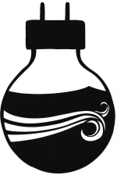
Research Sponsors
The Northwest National Marine Renewable Energy Center (NNMREC)
Sustainability of Tidal Energy (STE)

Slide 71
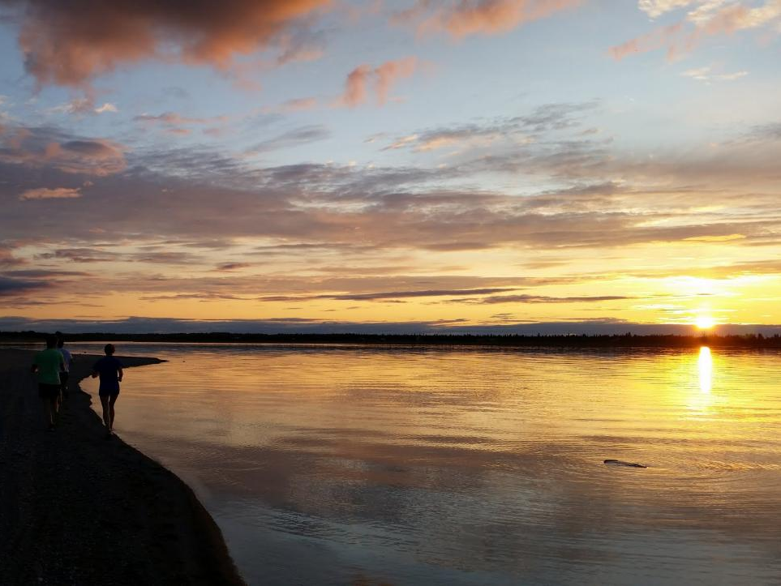
Questions

