Slide 1
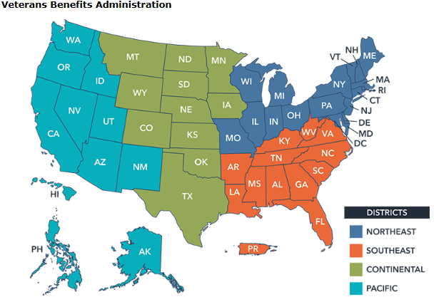
Start your Career With VA
Veterans Service Representative
U.S. Department of Veterans Affairs
Growth opportunities in
4 districts, nationwide
Starting salary of at least $47,380 with potential progression to $63,822 or higher after two years
Benefits of working for VA: Matching 401K program up to 5% Federal Retirement Pension Health, Dental, Vision and Life Insurance Benefits Professional & Personal Development Opportunities Work From Home Opportunities Paid Vacation and Sick Days Public Transit Benefits Casual Work Environment Flexible Work Schedules Employee Assistance Program Growth Potential to Other Positions Within VA Chance for you to make a positive difference
Analyze Evidence
Gather and evaluate evidence necessary
to make a disability determination
Communicate Decisions
Serve as the primary contact for the Veteran and communicate actions taken on their claim
Be Part of a Team
Work in a team environment to serve a specific population of Veterans and claimants
Who Are You? We are actively recruiting people with non-competitive appointment eligibility, including Veterans, persons with disabilities, and former Peace Corps/AmeriCorps volunteers. You must be organized, analytical, and possess a strong desire to serve our nation’s Veterans, Service members, and their families.
What Will You Be Doing? As a Veterans Service Representative, you will gather and evaluate evidence to make a determination on Veterans’ benefits claims. You will act as an advocate to ensure the appropriate evidence is received and will communicate with the Veteran to explain the reasons and basis for VA’s decision. The majority of the communication with the Veteran is by letter or telephone. Limited in person contact.
Interested?
Email a resume to RESUME.VBASEA@va.gov

