Slide 1
TALENs

Slide 2
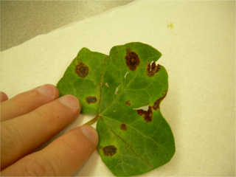
Transcription activator-like effectors (TALEs) are produced by plant pathogenic bacteria in the genus Xanthomonas
Target host cells via type III secretion system, modulate gene expression

Slide 3
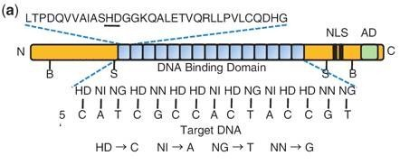
TALEs have remarkable specificity. Why?
Specificity conferred by “repeat-variable di-residues”, located within highly conserved amino acid repeats

Slide 4
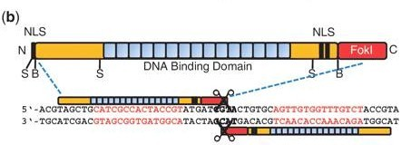
Specificity makes TALEs enticing for use in targeting DNA
Addition of FokI domains give nuclease activity, allows for manipulation of DNA via
creation of double stranded breaks
Breaks repaired by either Non-homologous end joining (NHEJ) or homologous
recombination (HR). In zebrafish, NHEJ is dominant.
Notes:
HR in zebrafish occurs less frequently than NHEJ

Slide 5
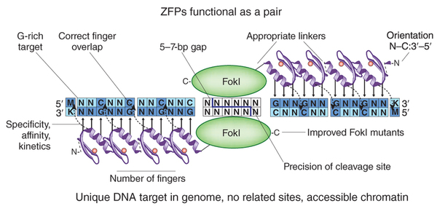
TALENs appear to match or out-perform Zinc Finger Nucleases relative to
mutagenesis frequency
Further, ZFNs have relatively constrained targeting abilities (Difficulty targeting AT rich sites)
TALENs therefore appear to provide more variable specificity without sacrificing efficacy

Slide 6
“These TALENs are cool. How do I make them?”

Slide 7
Guide for selecting a TALEN site:
1. Pick location in gene of interest
2. Sequence target site (don’t rely on reference genome)
3. Input sequence into online software (boglabx.plp.iastate.edu/TALENT/)
4. Select with unique restriction enzyme site

Slide 8
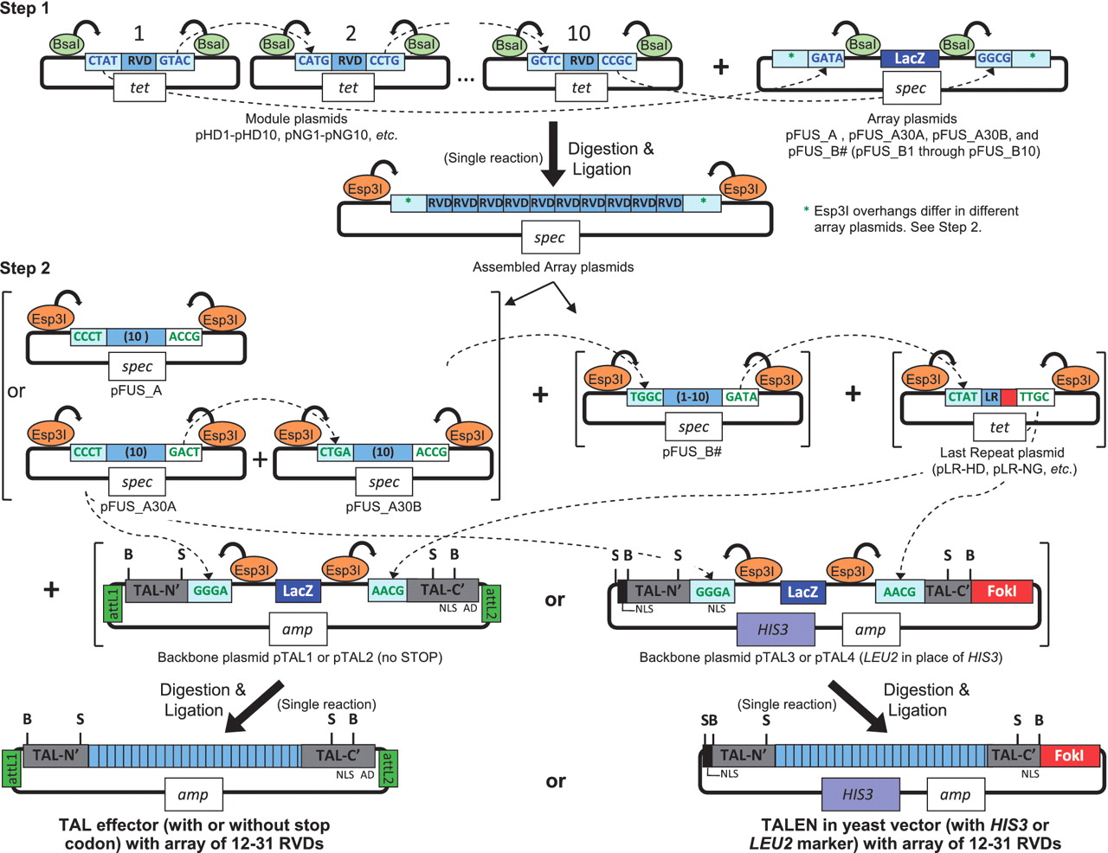
Golden Gate assembly of custom TAL effector and TALEN constructs using module, array, last repeat and backbone plasmids.
Cermak T et al. Nucl. Acids Res. 2011;nar.gkr218
© The Author(s) 2011. Published by Oxford University Press.

Slide 9
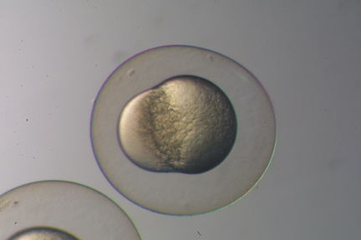
Once the TALEN has been cloned into the appropriate vector, linearize, transcribe,
and inject.
Injection occurs at 1 cell stage – lag
between injection and translation means
only some germ line cells will be
successfully mutated
Process of winnowing correct mutants,
in subsequent generations, takes 6 – 9
months

Slide 10
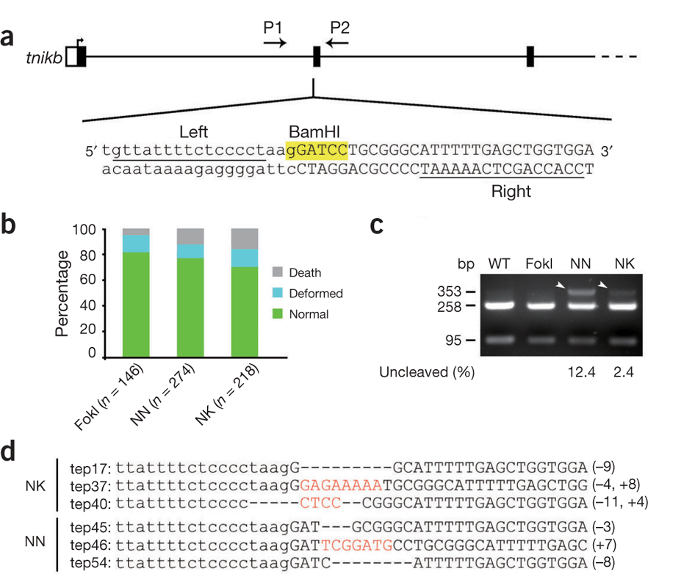

Slide 11
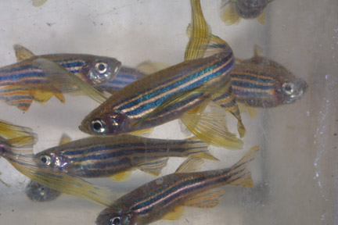
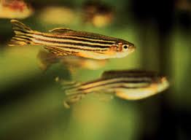
WT
Various KO
TALENs
+ time

