Slide 1

Safer Homes, Suicide Aware is a public health campaign
focused on simple steps to prevent suicide deaths and attempts
long before a crisis occurs.
Safer Homes is also relevant to mitigating the opioid crisis and
the prevention of accidental poisonings and firearm deaths.
This module was developed by public health experts and is intended
to be inserted into suicide & injury prevention trainings and firearms
safety courses.

Slide 2
SAFER HOMES HELP PREVENT TRAGEDIES IN U.S.
ACCIDENTAL DEATHS BY FIREARMS
SUICIDES BY FIREARMS & MEDS
MEDICATION OVERDOSES
CHILD
POISONINGS
27,224 deaths
31,029 deaths
767
deaths
489
deaths
Notes:
There is a lot of tragic news about opioid overdoses and accidental deaths by firearm by children. This slide shows deaths in the U.S. in 2015 by medications and firearms. If medical professionals work together to instruct patients to make their homes safer through locking and limiting access to medications and firearms, we can save many lives.
Prescription and over-the-counter medications serve many healing and life-saving functions, but in the hands of a person who is at-risk for suicide, they can have a deadly consequence. Similarly, firearms serve self-protection and recreational functions, but in the hands of a person who is at-risk for suicide, they, too, can have a deadly consequence.
[IF ASKED how we arrived at the number for medication overdoses–started with 52,404 – CDC’s 2015 number for total overdoses. Removed 10 percent that were suicides. Removed also 12,990 that were heroin-related.]
[SOURCE: https://www.cdc.gov/nchs/products/databriefs/db273.htm]

Slide 3
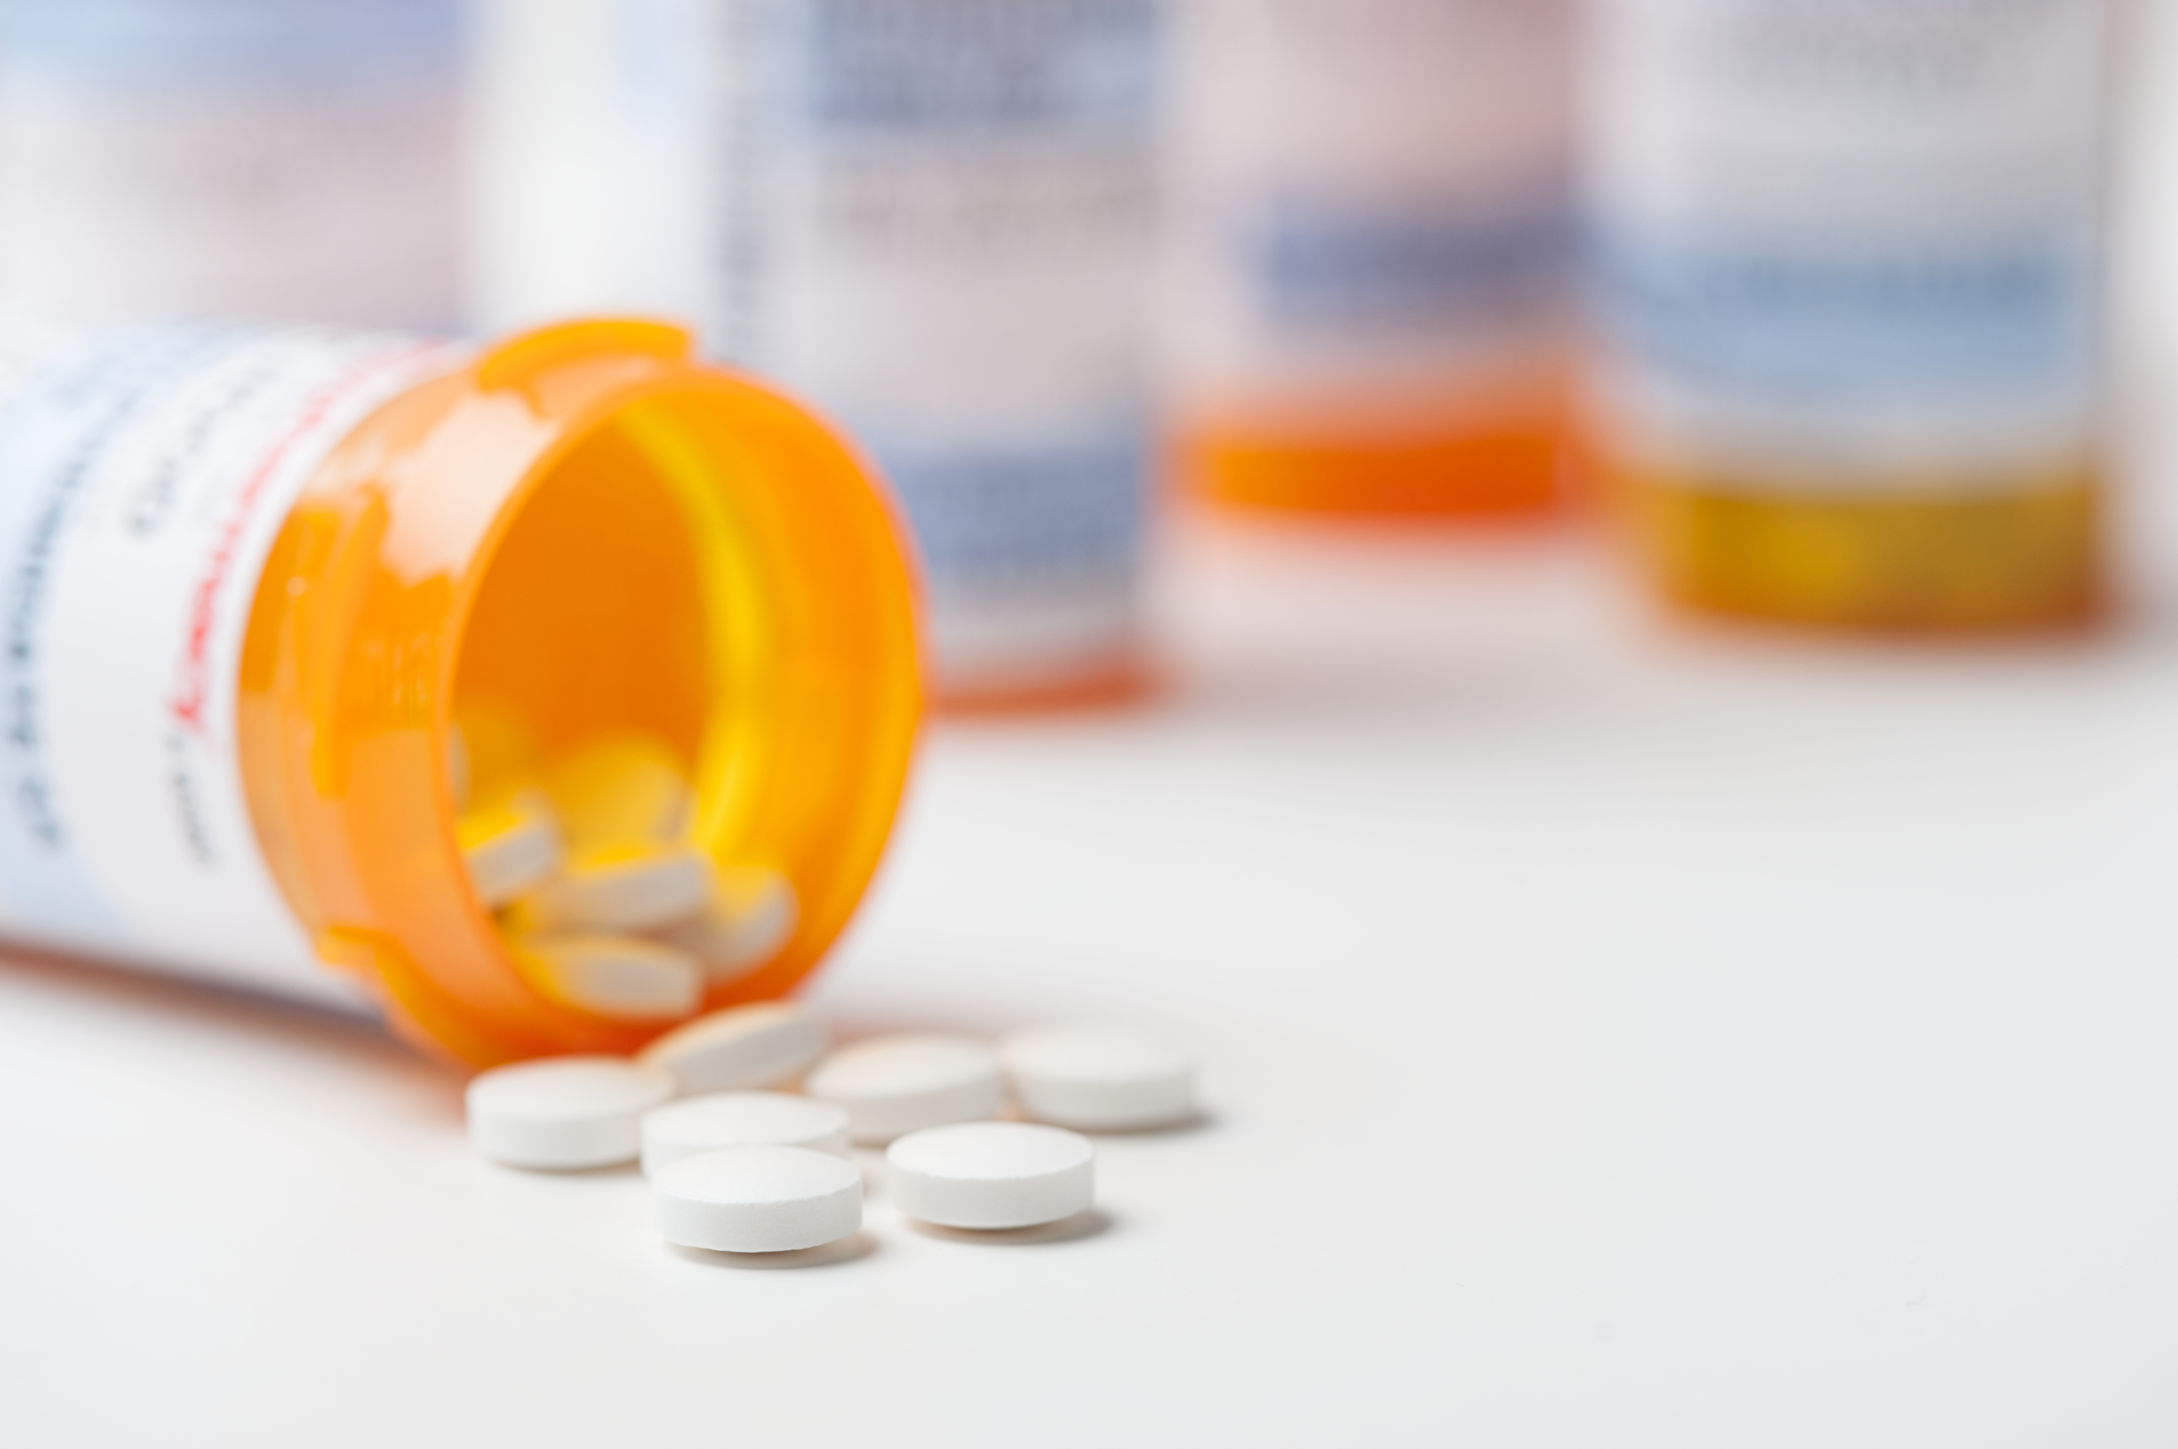
MEDICATION SAFETY
Lock
Limit Access
Take-Back
Dispose
Order materials at
SaferHomesCoalition.org
Notes:
First we will cover medication safety: specifically, what to say to patients about locking, limiting access, taking-back and disposing of medications.
This is practical information you can share with your patients.

Slide 4
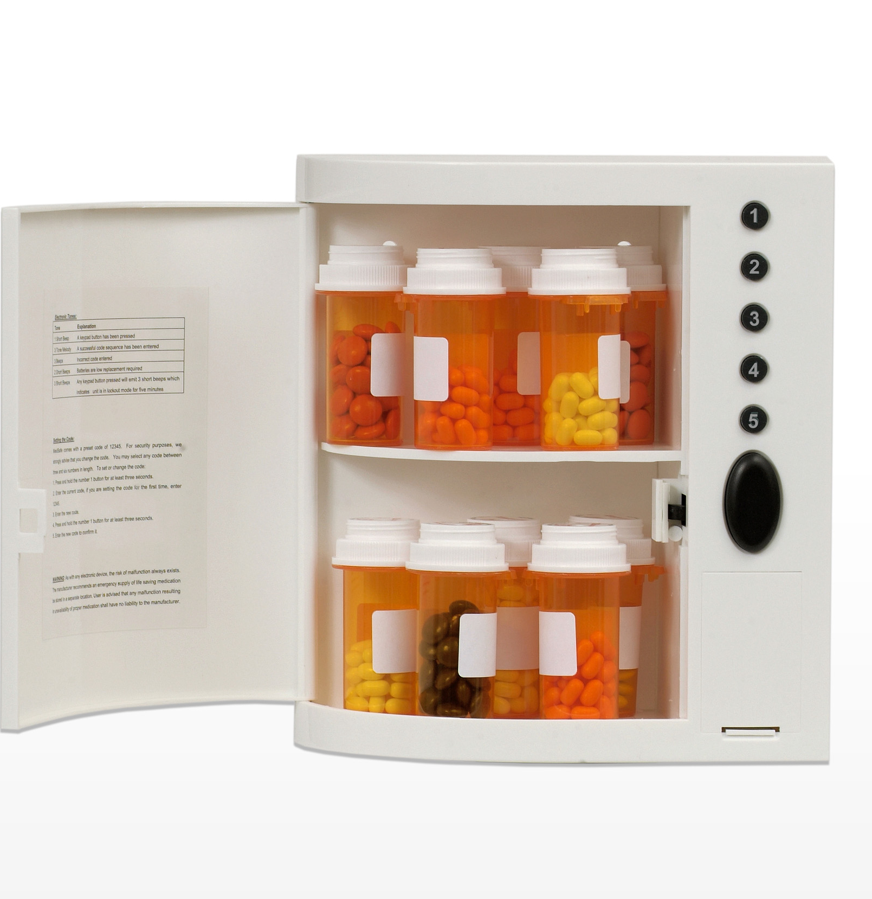
SAFER HOMES INITIATIVE
STEP 1
LOCK UP EXTRA MEDICATIONS
Lockable metal box
($25-$30)
Locking plastic container
($10-$15)
Travel lock bag
($15-$30)
Example: MedSafe Medications Electronic Lock Box Cabinet
Notes:
Step 1 involves encouraging patients to buy a locking storage container to keep medications safe. Later in the training we will discuss the dangers of medications when they are used improperly. This includes excessive quantities of prescription medications and over-the-counter medications, particularly pain relievers, which are dangerous when taken in high doses.
It is not sufficient to store medications up high and out of reach to protect children as has been the advice for a long time to prevent poisoning. Children and teens are crafty and can find medications. Also these substances can be a risk to someone considering suicide who is living in or visiting your home.
If the patient needs prescription medications on a daily basis, encourage the patient to stage dosing for 2-3 days, but to lock up excess prescription medications beyond that time frame.
There are many options for equipment to lock up medications. Increasingly, such containers are being sold at pharmacies and on-line outlets.

Slide 5
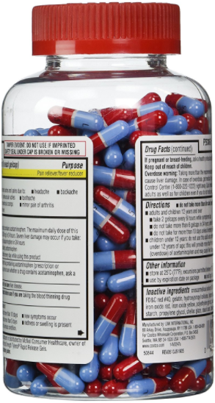
SAFER HOMES INITIATIVE
STEP 2
LIMIT THE AMOUNT OF OVER-THE-COUNTER MEDICATIONS
Notes:
Step 2 involves limiting or simply not purchasing or refilling prescriptions in large quantities. Limiting excessive quantities of over-the-counter medications and talking to your doctor about limiting refills to low doses on prescription medications is one of the simplest ways to protect against a medication-based tragedy.
Consider, for example, the oversized Tylenol bottles. Don’t buy them, and perhaps eventually stores will stop selling them… In 1998, England reduced the amount of acetaminophen (paracetamol) to be sold in a single package to 16 tablets in a grocery store, or 32 tablets in a pharmacy. Overdose and suicide by acetaminophen dropped by 43% over the next 11 years. Unless or until federal legislation here accomplishes the same thing, we need to educate our customers about the wisdom of limiting their amounts of over-the-counter medications at home.

Slide 6
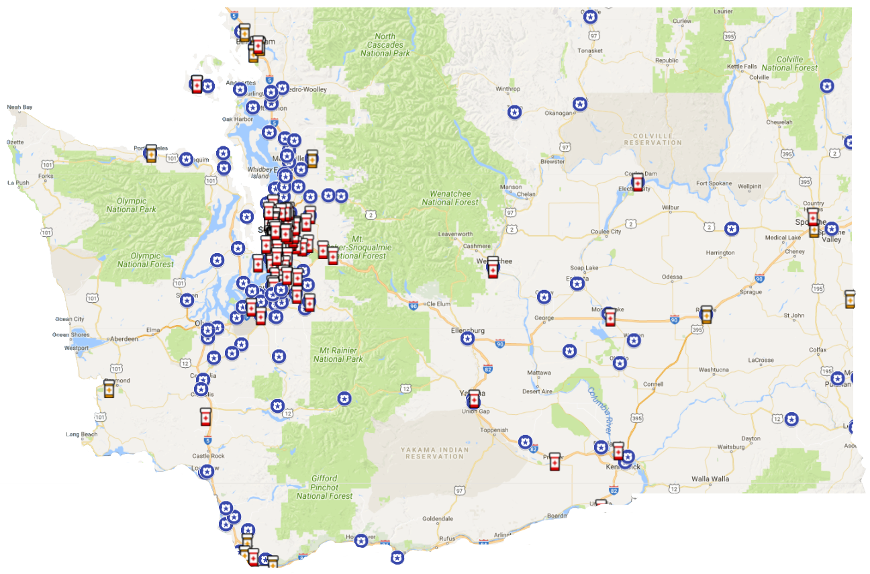
SAFER HOMES INITIATIVE
STEP 3
RETURN UNUSED MEDICATIONS
To find locations visit:
TakeBackYourMeds.org
Notes:
Step 3 is to locate your nearest drug takeback site and return your unused or expired medications.
Ideally, patients would take all medications as directed and use the full prescription. Encourage this, but also recognize this is not a perfect world.
Finding a drug takeback site should be a simple process, not a wild goose chase. As these sites become more common, this should evolve into a routine, every-so-often errand.
In Washington state, the Washington Poison Center’s TakeBackYourMeds.org website is a convenient way for residents to learn where their nearest drug takeback site is.
If you don’t already know how to dispose of medicines in your community, exploring resources is an important step today.

Slide 7
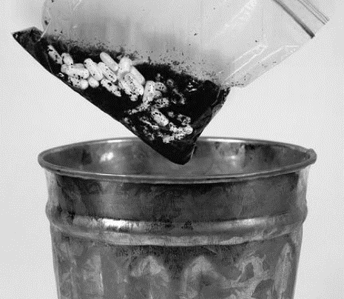
SAFER HOMES INITIATIVE
STEP 4
DISPOSE OF MEDICATIONS AT HOME
Mix into coffee grounds or kitty litter
Place in trash with covered container
Or, purchase a drug disposal kit online
Notes:
Step 4: If no other options are available, you can dispose of medications by mixing them in with coffee grounds, dirt or kitty litter in a baggie, then place them in a lidded trash can.
Also, drug disposal kits are available online. Typically these are pouches to which you add pills and warm water.
There are unknown environmental and public safety impacts from having traces of medication in our water supply. For this reason, you should encourage patients to avoid flushing unused and expired medications down the toilet. This disposal method should only be used as a last resort.

Slide 8
SAFER HOMES POSTCARD: MEDICATIONS
Notes:
Creating patient education materials is another way to help your patients. For example, you can emphasize this message, by distributing a postcard like this one to patients with their other paperwork. Or make it available in your waiting room.

Slide 9
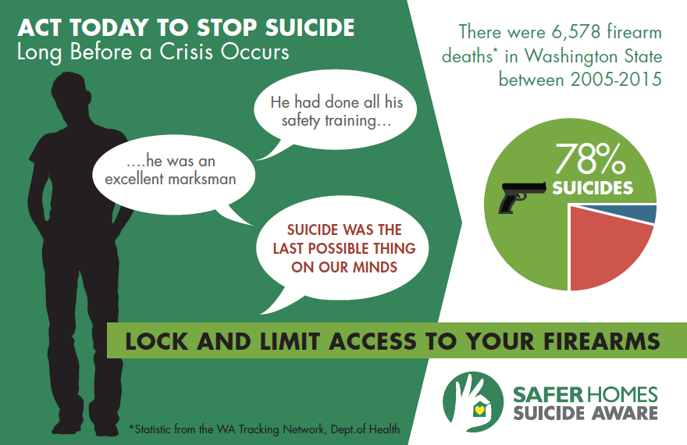
ACT BEFORE A CRISIS OCCURS
Notes:
Most people do not realize that the majority of firearm fatalities are suicides. In the U.S., roughly two-thirds of all deaths with a firearm are suicides. In WA state and other western states, that figure is closer to 80 percent.
Sharing this statistic with patients can be a wake-up call, as suicide is often not on our radar.

Slide 10


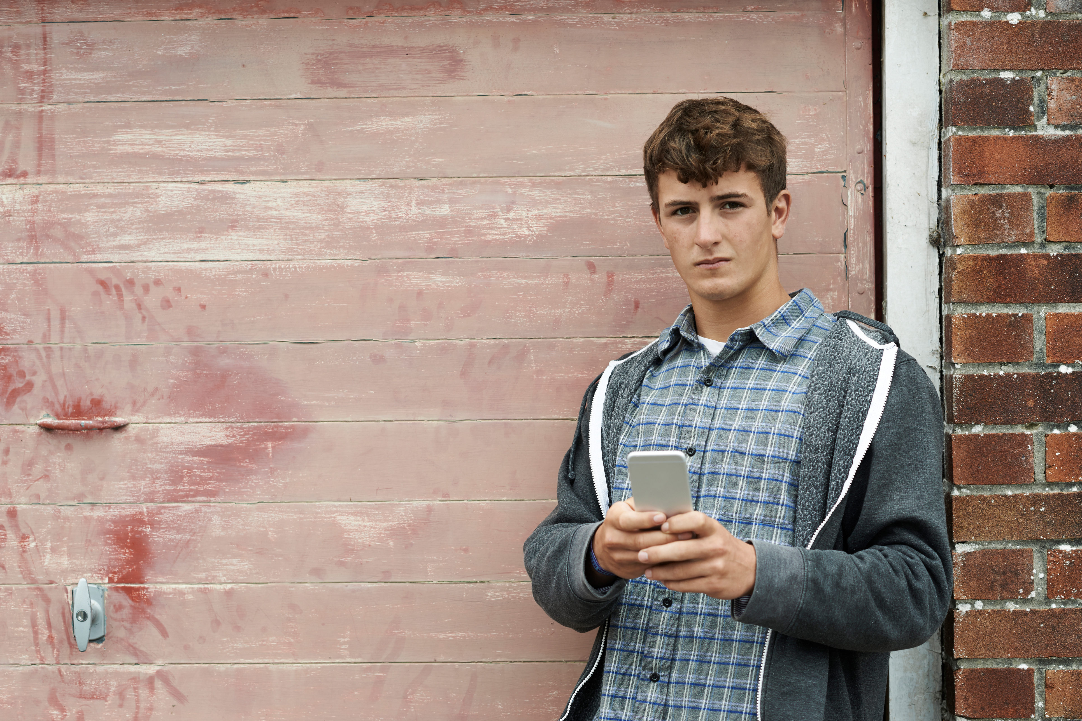
DO YOUNG PEOPLE LIVE IN
OR VISIT YOUR HOME?
My lovely but impulsive granddaughter
  My granddaughter was 16 when she ended her life with her grandfather’s firearm she found in his dresser drawer.
My 14 year old son
  My son was 14 when he used my gun to end his life. Suicide wasn’t on my radar.
My neighbor’s son
  Our neighbor and his friends used to fool around with the guns in the abandoned trailer near my home until he used one to end his life.
Notes:
These are three true stories of youth lost to suicide in Washington state. The difference in these is the relationship of the gun owner to the youth. To be clear, the gun did not cause the suicide. In each case, the youth was having a tough time, likely struggling with undiagnosed depression. In each case, an impulsive action ended their life without opportunity for rescue – because the firearm was accessible.
We often don’t think about suicide until it is too late. With this training, we are trying to change this.
Again, we want our patients to consider not only the safety of youth who live in the home, but those young people who might visit the home.

Slide 11
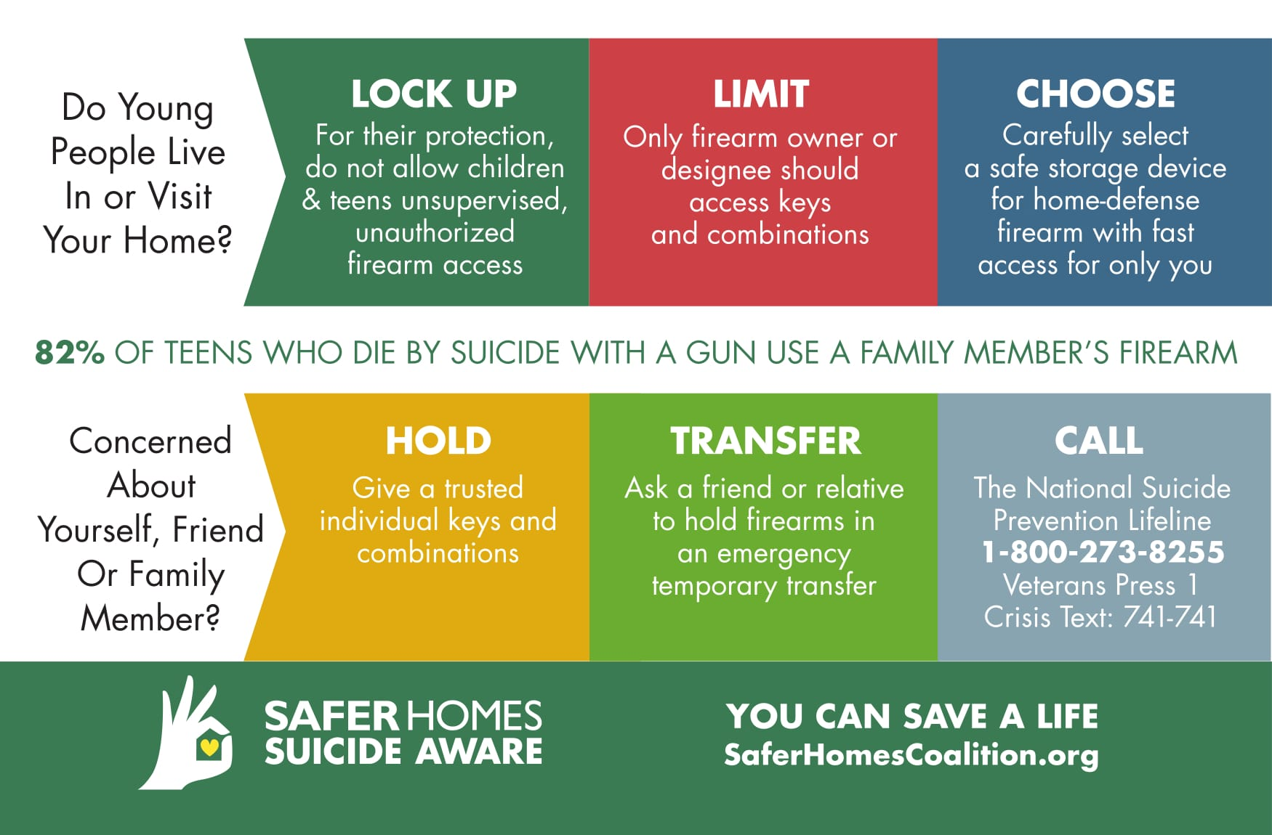
YOU CAN SAVE A LIFE
Notes:
For a long time, the conversation about safe firearm use and storage has not included suicide awareness. This is despite the fact that suicide is by far the leading type of firearm fatality in the U.S., as we just covered.
Again, over two-thirds of firearm deaths in the U.S. are suicides. In WA, nearly 80 percent of firearm fatalities are suicides. Most people are not aware of this fact.
The Safer Homes, Suicide Aware steps for locking and limiting access to firearms are informed by two questions.
Do young people live in or visit your home?
Are you concerned about yourself, a friend or a family member?
Consider talking to patients about safe storage of firearms in the same conversation you have about safe storage and disposal of medications.
To emphasize this message, you can distribute this postcard to patients with their other paperwork. Or make it available in your waiting room. This post card is available for download on line at www.saferhomescoalition.org. If you practice in Washington state, you may order free materials through the website.
Now let’s talk a little more about how to have these conversations.

Slide 12
LIMITING ACCESS
FOR YOUNG PEOPLE
For their protection, lock-up, do not allow children and teens unsupervised or unauthorized access
Limit access to the authorized gun owner ensuring only he/ she or a designee can access keys and combinations
Firearm for home protection? Choose and invest in a safe storage device that affords quick access for only you.
Notes:
Firearms are often used by youth and their families in constructive ways for recreation and sport especially, in rural communities. However, youth should not have unsupervised or unauthorized access to firearms. You can assure firearm owning patients this recommendation is supported by groups that support Second Amendment.
Youth can be impulsive, and research finds that kids know where keys are hidden. We recommend combination locks or double checking that keys to firearm storage devices are inaccessible to youth in the home.
For added protection, give the patient this information:
Lock firearms and ammunition separately. This should be the case for all firearms except those used for home protection.
2. If there is a firearm in your house that is used for home protection and there are youth who can access it, invest in a locking device that gives the authorized user fast and easy access. Hidden in the dresser or nightstand drawer or the closet is not safe storage.
According to multiple studies, the vast majority of young people who die by suicide with a gun, acquire that firearm from a family member.

Slide 13
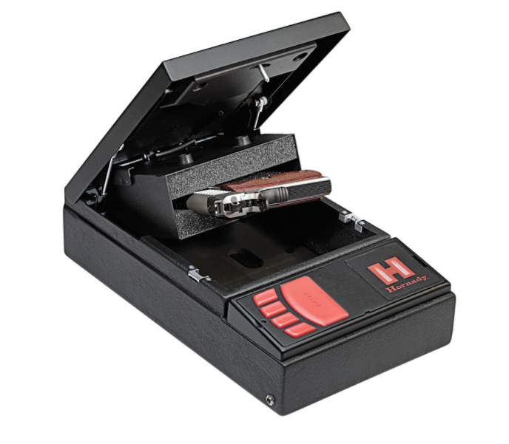
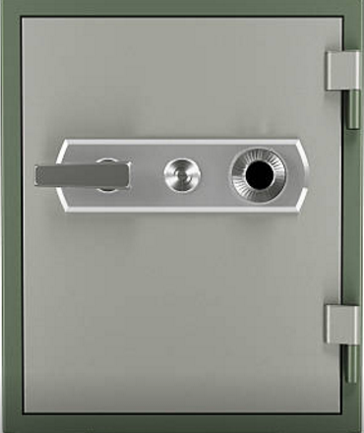
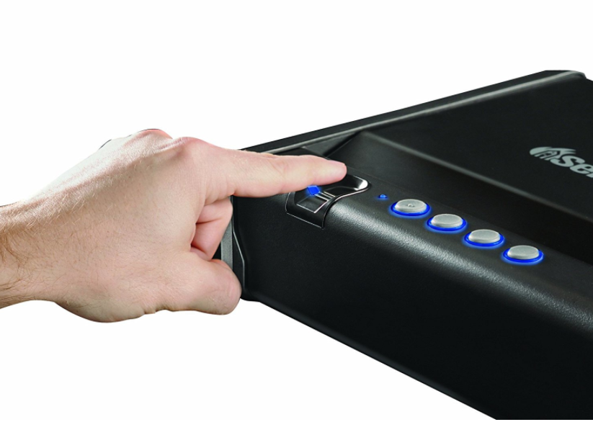
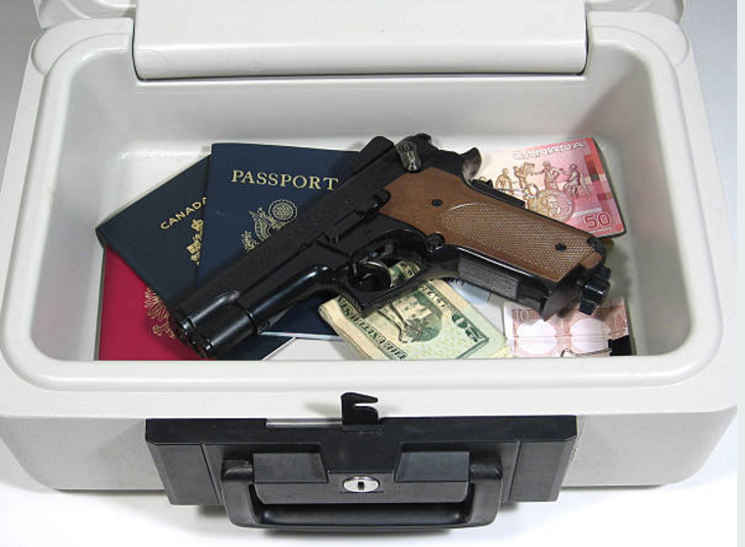
LOCK BOXES FOR SPECIFIC NEEDS
Life Jacket
$22 - $44
Depending on model
Lock Box
$23-$150 and up
Gun Safe
$169 - $2,291
SentrySafe Quick Access Pistol Safe Biometric Lock
$104-$199
Hornady RAPiD Safe
Access w/ RFID bracelet
$169
Notes:
There is a wide range of safe storage devices available for firearms. Encourage patients who own firearms to budget for and buy a locking device whenever they purchase a firearm.
Technology now allows for a variety of quick-access locking devices. These will be appropriate in particular for your patients who own a firearm for home protection.

Slide 14
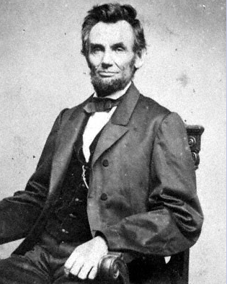
Concerned about yourself,
a friend or family member?
HOLD – Give a trusted individual
keys & combinations
TRANSFER – Ask friend, relative
to hold firearms in emergency
temporary transfer
CALL – National Suicide Prevention
Lifeline 800-273-8255
Veterans Press 1
Crisis Text Line 741-741
Notes:
While much attention around suicide is on teens and young adults, we must also focus on adults. That means literally you, me, friends and family. Right now, let’s focus on adults whose lives include firearms.
Consider Abraham Lincoln, for instance. He struggled repeatedly with clinical depression, and when he considered suicide, his friends removed his firearms and knives to keep him safe.
Today, reducing access to lethal means is considered crucial for patients at risk of suicide. For individuals who own firearms, we recommend these specific strategies:
Give a trusted individual the keys and (new) combinations to HOLD until the individual feels safer. For a suicidal crisis ask a trusted friend or relative to hold the firearms in an emergency temporary TRANSFER. In 2017, this type of transfer was made legal in Washington state. Also, CALL the National Suicide Prevention Lifeline, 800-273-8255. Non-emergency calls are welcomed.
It is always important to have excellent communication about when it is safe and appropriate to return access to a firearm.

Slide 15
Thank you!
For educational materials and more information, go to
SaferHomesCoalition.org

