Slide 1
The Implications of Shared Decision Making in Washington State
Summer Institute on Informed Patient Choice
David Arterburn, MD, MPH
Group Health Research Institute
Carolyn (Cindy) Watts, PhD
University of Washington

Slide 2
Outline
Motivation: The Washington legislation
SDM at Group Health Cooperative: Model and Lessons Learned
SDM in 3 Puget Sound Systems: Models and Lessons Learned
SDM in US health care reform
Discussion
Resolution and case

Slide 3
Legislation
E2SSB 5930; 2007
Purpose centered on informed decision making
Connection to informed consent

Slide 4
Mandated Demonstration
SDM with decision aids
1+ sites providing state purchased care
1+ preference sensitive conditions
Nationally certified DAs
Ongoing training of providers
Preference for sites with supporting IT

Slide 5
Mandated Evaluation
Patient understanding
Values concordance
Practitioner satisfaction
Expenditures on targeted services

Slide 6
Informed Consent
Proof of SDM constitutes informed consent
Informed consent must describe DA used

Slide 7
Decision Aid Must:
Guide values clarification
Provide up-to-date science about treatment
Describe risks and benefits of alternatives
Include non-treatment alternative
Be certified

Slide 8
State Funding
$O

Slide 9
Group Health
Shared Decision Making Demonstration Project

Slide 10
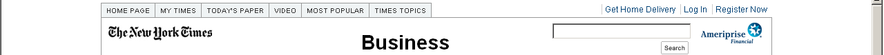
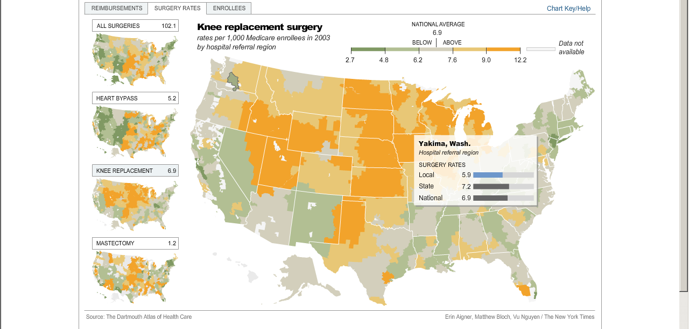

Unwarranted Variation in
Preference-Sensitive Care across the US

Slide 11
Unwarranted Variation in
Preference-Sensitive Care in WA State
15.2
GHC
Washington Inpatient Atlas Project (WIAP)

Slide 12
Trends in Age and Sex Adjusted Rates of Knee Replacement by Year at Group Health

Slide 13
Evidence for using decision aids
34 randomized controlled trials
Increased knowledge
More active patient participation
7 RCTs
Lower surgery rates
No evidence of harms from not having surgery
2 Group Health studies
Higher patient knowledge & satisfaction
Better alignment between values & choices
Lower surgery rates with similar outcomes
Notes:
What’s the current evidence regarding the outcomes of using decision aids such as brochures, DVDs, and online tools?
A systematic review of 34 randomized controlled trials revealed strong evidence that decision tools can improve the quality of patients’ decisions in these ways:
Increased knowledge
More active participation in the decision
Less feeling of conflict over the decision and a lower proportion of people who remain undecided
Better alignment between values and choices
More satisfaction with the decision
But the impact of patient decision tools on health care utilization, costs, and health outcomes is not so clear. Available evidence from seven randomized controlled trials suggests that decision aids may reduce the proportion who choose to undergo elective surgical procedures. In these seven studies, the rates of use of the most invasive surgical procedures declined by 23% in favor of more conservative surgical or medical options. There was no evidence of harms from missed opportunities for surgical procedures.
Two key studies of patient decision aids were performed at Group Health. The first assessed the impact of a video-based patient decision aid for benign prostatic hyperplasia versus an informational booklet among 227 men with that condition. Patients randomized to the decision aid had significantly better knowledge of their condition and satisfaction with the decision-making process, and overall they chose prostatectomy 26 percent less often. The second study assessed the impact of a video-based patient decision aid versus a booklet among 393 participants considering elective back surgery. Among patients with lumbar herniated discs, the decision aid group had a 22% lower rate of low back surgery than the control group, and both groups had similar symptomatic and functional outcomes.
More research is needed to confirm findings regarding use of shared decision making aids in larger populations and to determine if the related changes in health care translate into cost savings while not diminishing long-term health outcomes. Group Health is currently conducting research on patient decision aids to help answer these questions.
13

Slide 14
Conclusions by GH Leaders and Legislators
Significant variations exist in elective surgical procedures in our WA state and within Group Health.
Those variations are likely to be unwarranted.
The variations likely have a large impact on health care costs.
The impact on health outcomes is unknown.
Most importantly, they concluded that broad scale implementation of SDM with patient decision aids might help to reduce unwarranted variations, improve decision quality, and reduce health care costs.
Furthermore, use of SDM with decision aids could provide additional liability protection for providers.

Slide 15
Patient-centered care at Group Health
Shared electronic medical record
Medical home
pilot
Decision aids for shared decision making
Implementation
timeline
2009
2007
2005
Notes:
What is Group Health’s role in shared decision making?
Group Health has a long history of commitment to patient-centered care. This is most recently shown by its early adoption of shared electronic medical records and current promotion of the medical home model of primary care. Shared decision making is an integral part of these initiatives.
15

Slide 16
Research
System-wide implementation
2-year research project
Foundation support
Notes:
Group Health (GH) is currently undertaking a system-wide implementation of shared decision making (SDM) with video-based patient decision aids (DA) for 12 preference-sensitive health conditions related to elective surgical procedures.
Assessment of effectiveness of decision aids is funded by grants from The Commonwealth Fund, the Group Health Foundation and the Foundation for Informed Medical Decision Making. A company called Health Dialog is providing the decision aids to Group Health free of charge.
16

Slide 17
Treatment choices in 6 specialty areas
Orthopedics
Urology
Women’s health
Breast cancer
Back care
Cardiology
1
2
3
4
5
6
Notes:
In January 2009, Group Health began making shared decision aids systematically available to patients related to elective surgical procedures in 6 specialty areas.
17

Slide 18
12 preference-sensitive conditions
Orthopedics
Cardiology
Urology
Hip osteoarthritis
Knee osteoarthritis
Coronary artery
disease
Benign prostatic hyperplasia
Prostate cancer
Women’s Health
Breast Cancer
Back Care
Uterine fibroids
Abnormal uterine bleeding
Early stage
Ductal carcinoma
in situ
Breast reconstruction
Spinal stenosis
Herniated disc
Notes:
The decision tools address treatment choices in for 12 preference-sensitive conditions:
Orthopedic: hip and knee osteoarthritis
Cardiac: coronary artery disease
Urology: benign prostatic hyperplasia and prostate cancer
Women’s health: uterine fibroids and abnormal uterine bleeding
Breast cancer: early-stage breast cancer, breast reconstruction, and ductal carcinoma in situ
Back care: low back pain resulting from spinal stenosis and herniated disc
Group Health providers can discuss their patients’ options with the help of booklets, DVDs, and online videos on these topics.
18

Slide 19
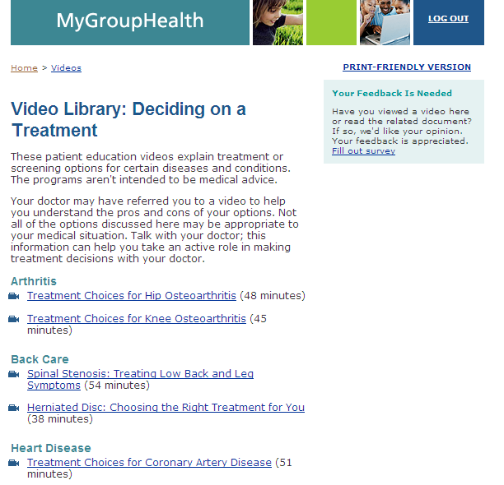
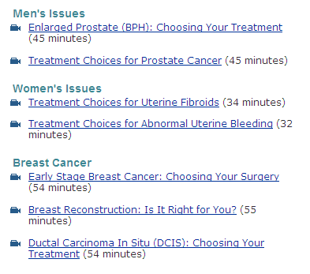
Distributing decision aids
DVDs can be ordered for mailing or viewed on the Web
Notes:
Patients get access to the videos through MyGroupHealth; they must have full, password-authenticated access to MyGroupHealth to view these videos. There patients can choose the video for their health condition and watch in the privacy of their home or office.
Alternatively, patients can also request to have a DVD copy of the video mailed to their home by calling the Group Health Resource Line
Videos can also be ordered through EPIC for delivery to patients by mail.
19

Slide 20
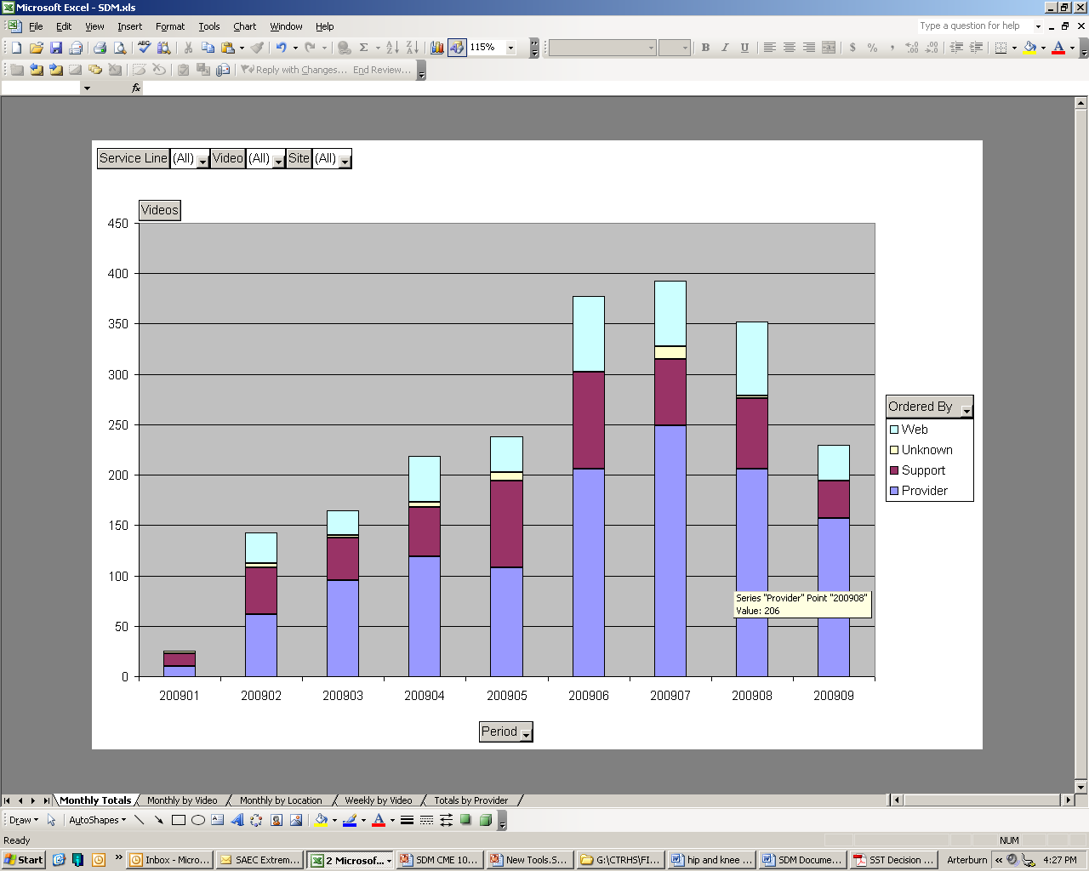
Feedback Reports to Providers
Twice monthly Excel-based report

Slide 21
New EPIC Smart Phrases to Document Informed Consent
1) Pre-Decision Aid Viewing Conversation
.SDMPREVIEWCONVERSATION
“The patient and I engaged in a shared decision making conversation. I recommended that the patient review a Health Dialog decision aid video and make an appointment with me to finalize a treatment plan.”
2) Post-Decision Aid Viewing Conversation
.SDMPOSTVIEWCONVERSATION
“The patient and I engaged in a shared decision making conversation. The patient had previously reviewed the Health Dialog patient decision aid. We discussed the content of the decision aid, clarified the patient’s treatment preferences, and I answered the patient’s questions. We agreed to the following treatment/services(s): *** and ***. The patient signed the applicable consent form.”

Slide 22
What are we learning about use of decision aids at Group Health?
Notes:
22

Slide 23
Outcomes that we’re tracking
Decision aid viewing on Web and DVDs mailed by Resource Line
Patient satisfaction with SDM videos
Procedure rates
Overall health care use of patients (# visits, hospitalizations, Rx)
Cost of health care for patients
Cost of decision aid implementation and delivery
Impact of SDM implementation on providers and staff

Slide 24
Decision aid distribution
Number of videos distributed, by month
Total: 5,682*
*does not include web data after Oct ‘09
Notes:
Decision Aid Use:
The figure shows the total volume of DAs delivered at GH since January 19, 2009. As of March 12, 2010, we had distributed a total of 4,271 DAs.
Because of changes in our data systems in November 2009, we don’t have data aggregated on videos viewed through the web from 11/09-3/10, but those data will be available to us by the end of the next quarter.
Through November 2009, approximately 80% of the DAs were distributed in DVD format via mail, and 20% were viewed on the web. The figure shows that our delivery of DAs has been generally stable since June.
The Orthopedic service line continues to lead the way among all specialties in distribution of the DAs, and they distribute about 170 DAs per month (140 knee osteoarthritis; 30 hip osteoarthritis). They are followed by Women’s Health (70 DAs per month) and Urology (50 DAs per month).
* RL – Phone = mailed DVD after phone request by member; Provider/Support/Unknown = mailed DVD ordered through Epic; WEB = view on MyGroupHealth website
24

Slide 25
Patient assessment
Overall rating of decision aid videos
Patient survey, March 2010, 400 responses
Helped you understand the treatment choices
Helped you prepare to
talk with provider
Notes:
25

Slide 26
Patient assessment
Overall rating of decision aid videos
Patient survey, March 2010, 400 responses
How important is it that providers make programs like this available?
Notes:
26

Slide 27
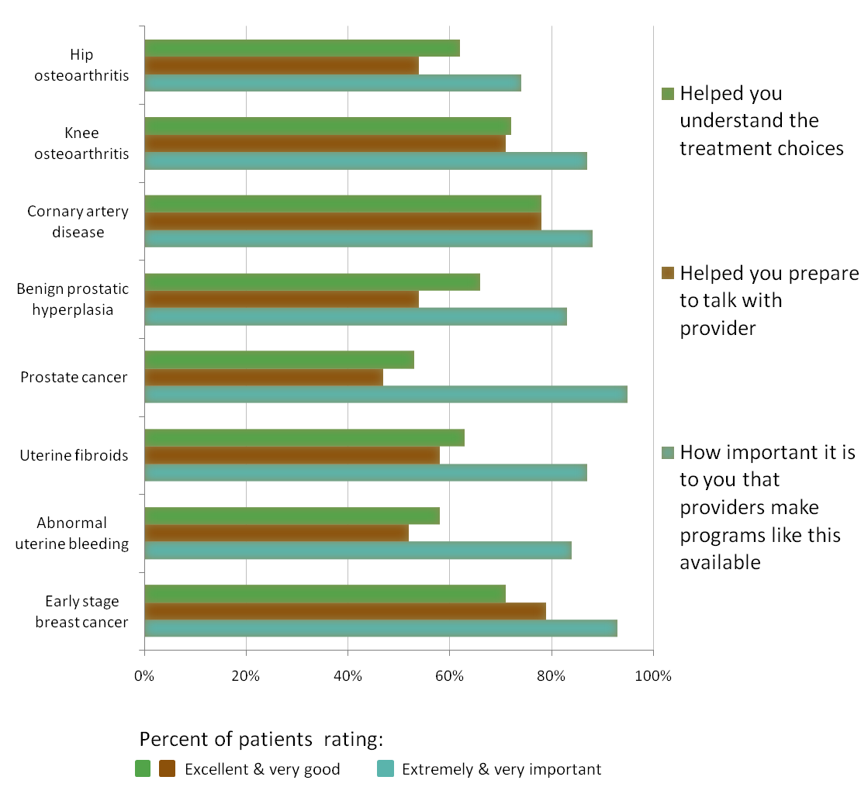
Patient assessment
Rating of decision aid videos,
by topic
March 2010
Notes:
27

Slide 28
Examples of Patient Feedback on Videos
“Excellent. Very informative. Made me very aware to give more thought to the surgery. To have it or not.”
“I'm puzzled why more Drs. don't use this program. Is it new?”
“The program was well done and informative for what it included, however I have also been doing research on line and that has been helpful as well.”
“I'm scheduled to consult with a hip surgeon and feel I am much better prepared after reading and watching the DVD.”
“The book and DVD were very helpful. The info in these two items helped me reach a decision.”

Slide 29
Key Conclusions
Data on local variations was an important driver of system change.
Buy-in from senior leadership was necessary but not sufficient – we needed support from FIMDM and Health Dialog to get moving.
Feedback on patient satisfaction maintained enthusiasm for the process until other outcome data became available.
Trends in elective surgery are encouraging, and although not clearly linked to SDM by causality, have yielded greater enthusiasm for our work among senior leaders.
Implementing SDM with patient decision aids appears to hit the elusive ‘sweet spot’ of both improving health care quality while improving satisfaction and having the potential to reduce surgical costs.

Slide 30
Puget Sound Demonstration
Response to E2SSB 5930
Foundation for Informed Medical Decision Making funding; DAs from Health Dialog
Partners:
  Group Health Cooperative
  Health Care Authority
  Puget Sound Health Alliance
Participants
  MultiCare Health System, Tacoma
  Virginia Mason Health System, Seattle
  The Everett Clinic, Everett
  (Carol Milgard Breast Center, Tacoma)

Slide 31
Conditions of Interest
Virginia Mason
  Early stage breast cancer
The Everett Clinic
  Knee osteoarthritis
  Hip osteoarthritis
MultiCare
  Back pain (acute and chronic)
  Depression
  Diabetes
  Colon cancer screening
  PSA testing

Slide 32
Progress
April 2009 start
Two sites active
30 DAs distributed
10 surveys received

Slide 33
Issues
Competing priorities
Human Subjects/IRB
Identification of patients
  Automatic by ICD-9
  Selected by staff
Process point
  Primary care setting
  Specialty care setting
  Post referral/pre-visit

Slide 34
The CONVERSATION
Follow up
  Surveys
  Provider feedback
Impact
  Measures
  Process

Slide 35
Lessons Learned
Champions matter
Context matters
Physician participation crucial
Staff engagement crucial
Some patients don’t want to know
Ultimately, incentives/reimbursement matters

Slide 36
SDM and US Health Care Reform
HR 3590 signed into law March 23, 2010
Creates SDM Program
Supports innovation
  Informed health care choices
  New measures to assess tools
Supports new tool development

Slide 37
Program to Facilitate SDM
Section 936
“…to facilitate collaborative processes between patients, caregivers …, and clinicians that engages the patient… in decision making, provides patients…with information about trade-offs among treatment options, and facilitates the incorporation of patient preferences and values into the medical plan.” (Sec. 936, p. 409)

Slide 38
SDM Program (Section 936)
Contracted entity to establish standards and certification process for DAs
  As soon as practicable
  Expert consensus
Grants to fund development and testing of DAs
DAs adapted for language and cultural differences
SDM Research Centers provide technical assistance
Grants to providers to develop, use, and assess DAs
No funds for uncertified DAs

Slide 39
Center for Medicare and Medicaid Innovation (Section 3021)
Test up to 18 models to reduce costs & enhance quality
SDM included
$5M FY 2010
$10B over 10 years

Slide 40
New Tool Development (Section 931)
Grants for quality measure development
Priority given to measures that include SDM

Slide 41
Issues
Funding
Sustainability
Role of existing DAs
Role of private entities (e.g., FIMDM)

Slide 42
Discussion

Slide 43
US Resolution
Be it resolved that the use of DAs should be a required component of the informed consent process for all elective surgical procedures.

Slide 44
US Case Study
The State of Washington aims to require shared decision making with decision aids as part of the informed consent process for all elective surgical procedures.
  What kind of certification process for DAs should be implemented to assure a uniform standard of quality across plans/providers?
  What are the implications of a required SDM process for the cost of elective surgeries?

