Slide 1
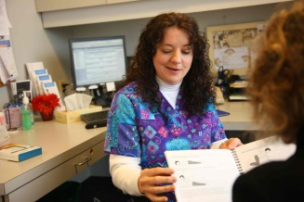
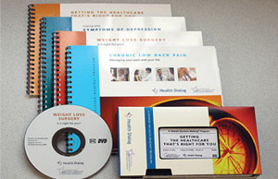
Stakeholder Perspectives Regarding Shared Decision Making and Decision Aids
Anne D. Renz, MPH ¹; Judy M. Chang, JD ¹; Douglas A. Conrad, PhD, MBA, MHA ¹; Megan A. Morris, PhC, CCC-SLP ^{1, 2}; Carolyn A. Watts, PhD ^{1, 3}
RESULTS
Eight themes arose:
Patient engagement
Barriers to implementation
Facilitators to implementation
Benefits of SDM and DAs
Payment and reimbursement structures
Effect of Washington State’s malpractice law
Perceived value of SDM and DAs
General observations about DAs
Conceptual support of SDM/DAs was strong and near universal, although different stakeholder groups focused on different aspects of SDM/DAs. Stakeholders’ perceptions of SDM depended in part on who introduced it and for what purpose.
When a clinical leader introduced SDM to providers as a means of increasing patients’ satisfaction and access to care, it was received well.
When a state agency proposed giving premium discounts to clinics that use SDM, medical malpractice insurers responded unfavorably because they preferred to base rates on actuarial projections.
INTRODUCTION
The use of and interest in shared decision making (SDM) and decision aids (DAs) in the clinical setting has increased in recent years. Stakeholder perspectives have a strong influence on whether SDM is implemented successfully (or at all). Considering stakeholder perspectives is particularly important at the pre-implementation stage and in evaluating the effectiveness of the program. Research on stakeholder perspectives was conducted as part of a demonstration of SDM implementation at three multi-specialty, fee-for-service sites.
PURPOSE
Explore the perceptions of stakeholders directly involved in implementing SDM/DA (clinical leadership, providers, and project managers) and stakeholders that are not directly involved but whose perspectives could influence uptake of SDM/DAs (medical malpractice insurers and health plans).
METHODS
15 semi-structured interviews with stakeholder groups
Interviews were coded and analyzed thematically
CONCLUSIONS
SDM and DAs may have greater or lesser appeal to different stakeholder groups depending on how they are introduced and explained. Stakeholders described the purpose and benefits of SDM differently.
Providers believed that SDM is very important and that DAs are helpful as educational materials.
Clinical leaders focused on SDM’s potential to improve quality, reduce costs, and increase patient satisfaction.
Project managers spoke most about the barriers and facilitators in the implementation process.
Malpractice insurers thought SDM would improve provider-patient communication but predicted that it would have little effect on the number of malpractice suits.
Health plans were interested in global incentives for quality and cost, and were indifferent as to whether improvements were achieved through SDM/DAs.
FUNDING SOURCES
Foundation for Informed Medical Decision Making
Health Dialog
Patient care coordinator engaging in shared decision making
Decision aid:
Booklet plus DVD or VHS
1) Department of Health Services, University of Washington; 2) Department of Rehabilitation Medicine, University of Washington; 3) Department of Health Administration, Virginia Commonwealth University

