Slide 1
Shared Decision Making The Everett Clinic Everett, WA
May 26, 2011
Seattle, WA

Slide 2
One journey… more than one path

Slide 4
In Our Backyard…

Slide 5
In Our Backyard…

Slide 6
In Our Backyard…

Slide 7
The Everett Clinic…
Established in 1924
Four surgeons
343 physicians & 81 Advanced Practice Clinicians
Largest physician-owned medical group practice in Washington State

Slide 8
The Everett Clinic…
16 practice sites throughout Snohomish County
Eight primary care sites with urgent care facilities
Two outpatient surgery centers
Patient base: 280,000 patients
Visits: > 800,000 annually

Slide 9
The Everett Clinic – Core Values
We do what is right for each patient.
We provide an enriching and supportive workplace.
Our team focuses on value: service, quality & cost.

Slide 10
Our journey in SDM began…
Steve Hill, HCA called TEC’s CMO, Dr. Al Fisk
Summer 2008
Became a stakeholder in the collaborative
Fall 2008

Slide 11
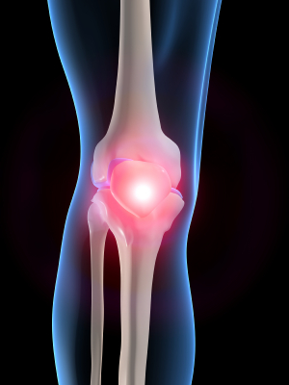
Orthopedics…
Six surgeons & 7 PA-Cs
Preference-sensitive
conditions
Knee and hip osteoarthritis
Competition for surgery blocks at community hospital
Long waits for surgeries

Slide 12
Preparation…
Identify key members of
team
Develop the process
Build tools in EMR
Develop patient letters/materials
Educate orthopedics providers and staff

Slide 13
Roll Out…
Dedicated internal referral queue
Receptionist sends cover letter, pre- and post-viewing surveys and PDA prior to initial consult
Distributed 1st PDAs
Feb 2010

Slide 14
There have been challenges…
Competing initiatives
Lack of organizational focus
Not a part of 2010 Balanced Scorecard
Providers have their feet in two different worlds
Fee for service vs capitation/at risk & gain sharing

Slide 15
Challenges…Part 2
Hard-wiring a new process
Even in a single department
Establishing with providers that SDM is more than handing out a PDA
Not unique to TEC

Slide 16
Conclusions
We did not “touch” every patient seen in orthopedics for Knee or Hip OA
Knee OA – 59 -- Hip OA - 20
Missed patients
Referred by an external provider
Self-referred
Condition not recognized as Knee or Hip OA at time of referral
Notes:
Penetration ~5.5%
Never intended to capture all patients.
This was a pilot.

Slide 17
The future is bright…
SDM is now an organizational priority!
SDM in orthopedics will continue beyond the Demonstration Project
Incorporating SDM into their Lean Process Improvement Value Stream work
Notes:
Design processes to increase percentages of patients with Hip and Knee OA who are engaged in SDM

