Slide 1
WWAMI Institute for Simulation in Healthcare (WISH)
Center for Research in Education and Simulation Technologies (CREST)

Slide 2
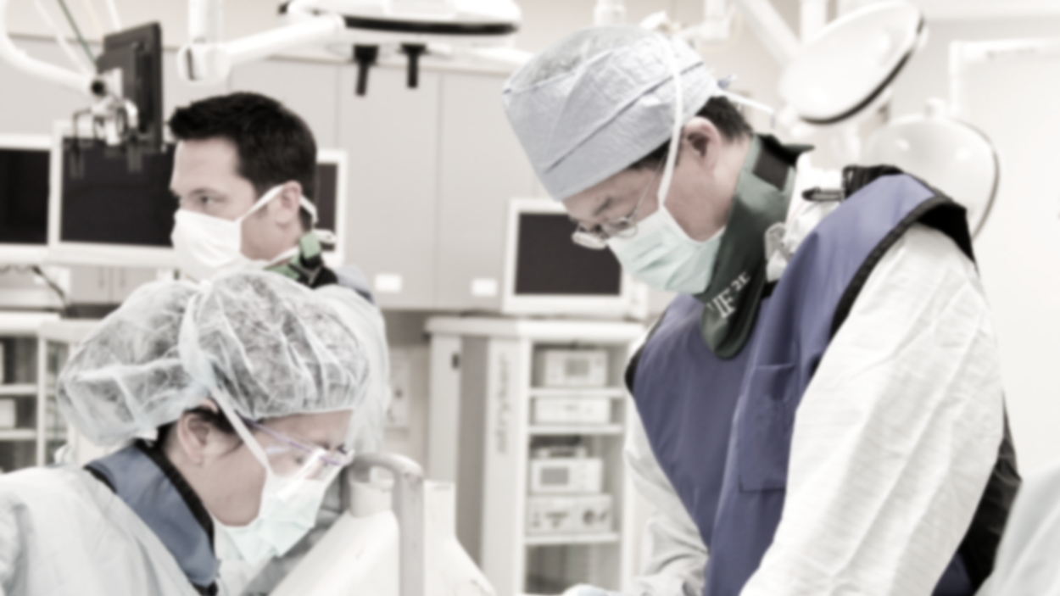
WWAMI Institute for Simulation in Healthcare
Mission Statement
Improving the health of the public through innovative programs for the development, application, and dissemination of simulation science.

Slide 3
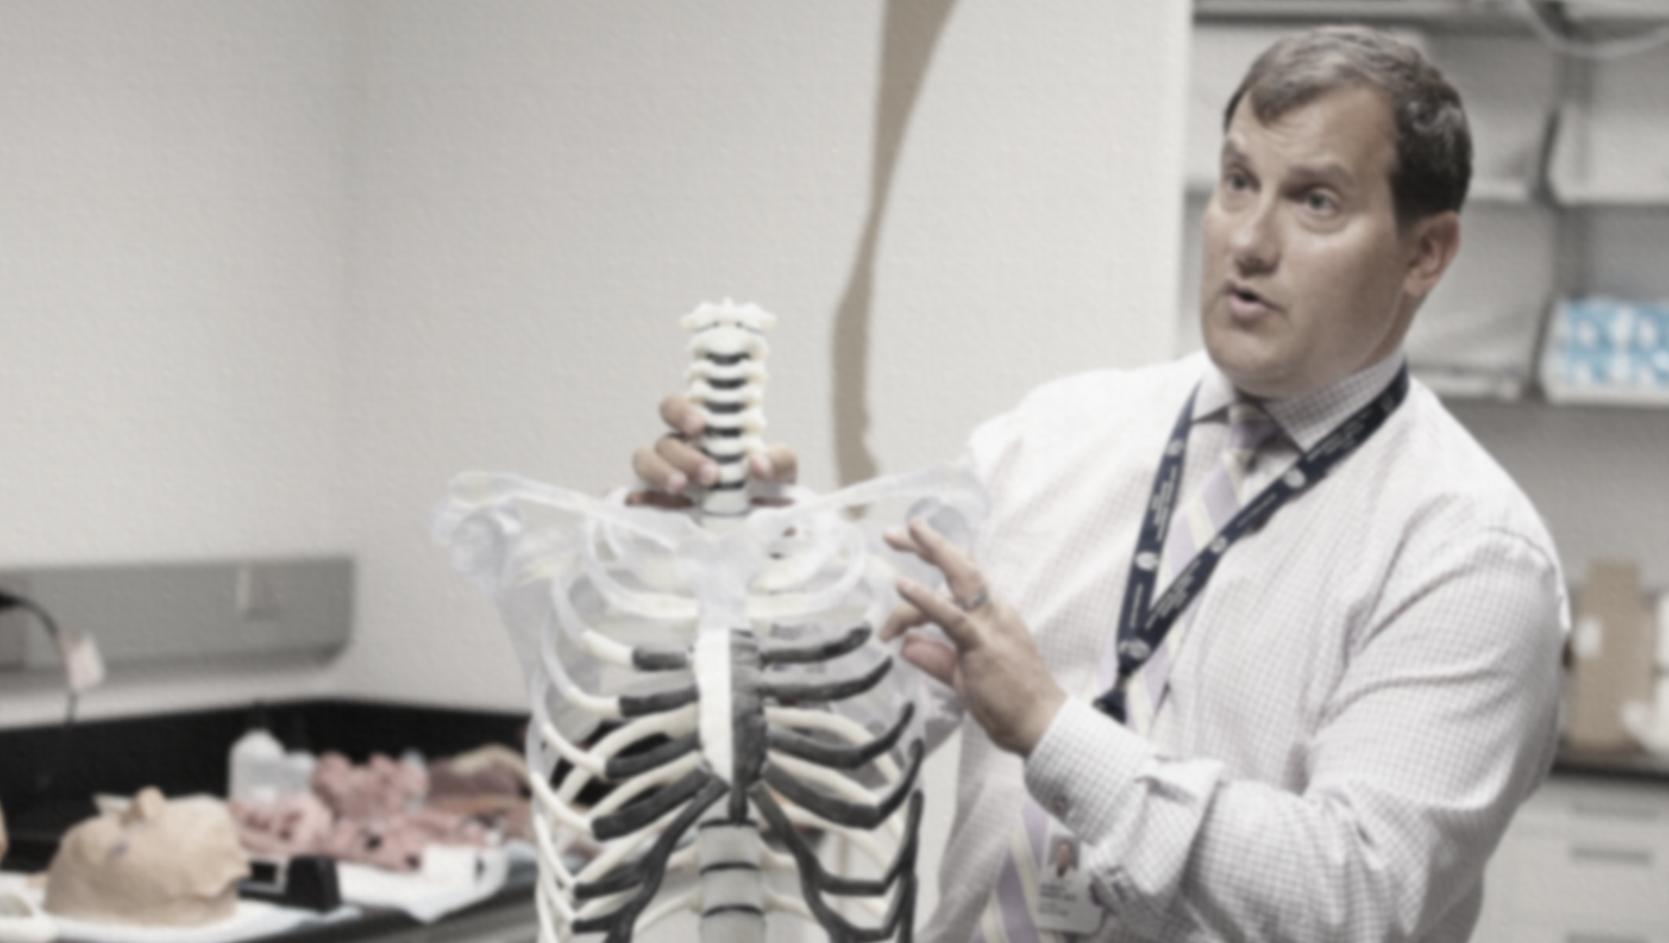
CREST is devoted to advancing the current state of medical training and patient education. The team’s creations include VR surgical trainers, educational software, clinical applications, and more.
Center for Research in Education and Simulation Technologies

Slide 4
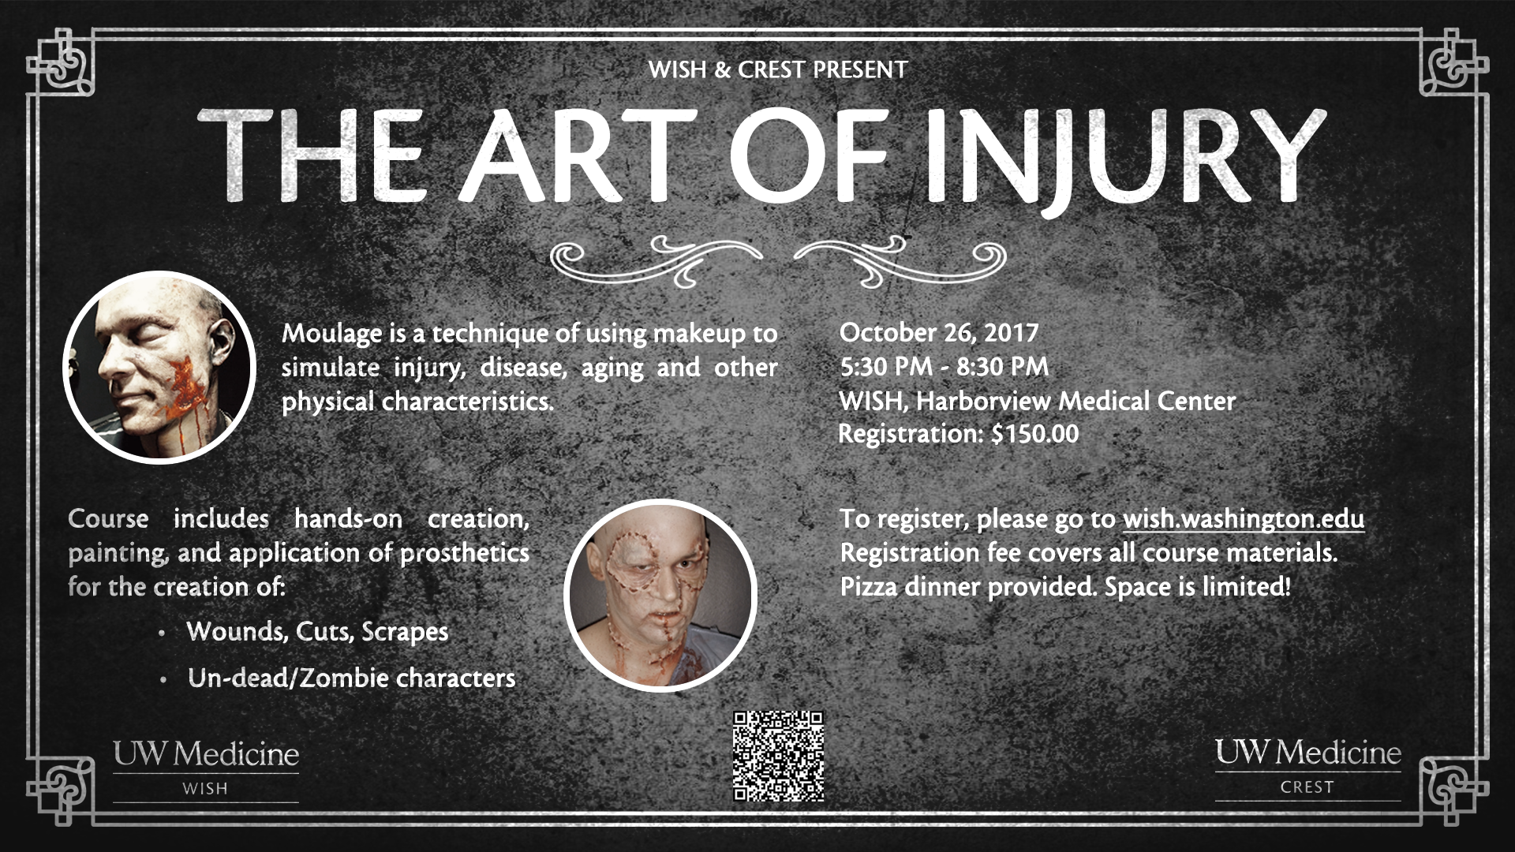

Slide 5
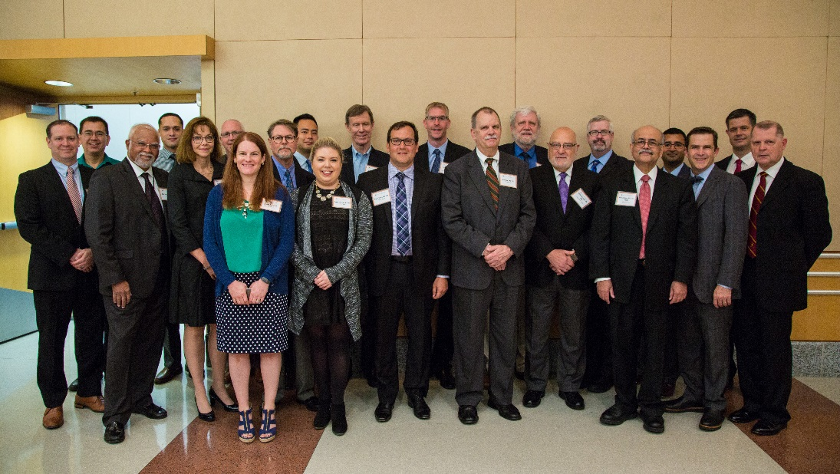
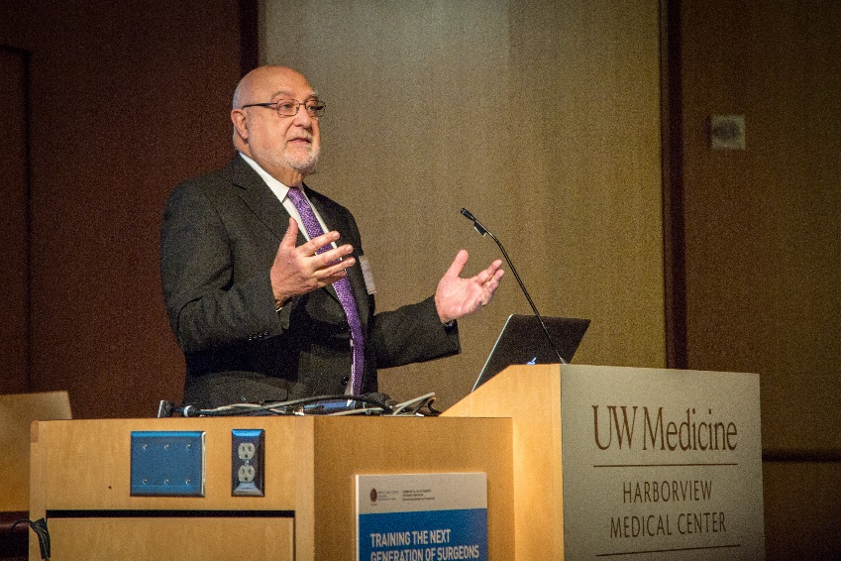
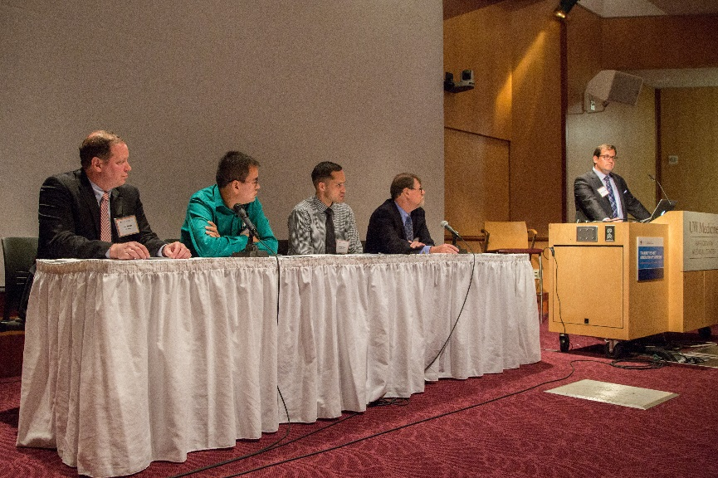
Training the Next Generation of Surgeons: Making it Stick, Making it Real, Making it Together
In June 2017, the American College of Surgeons: Division of Education and UW WISH brought together experts and stakeholders to explore important considerations for implementing modern simulation training in surgery.
Conference speakers and panelists.
Dr. Carlos Pellegrini, MD, FACS, Chief Medical Officer, welcomes forum attendees.
Dr. Robert Sweet, Executive Director of WISH, moderates panelists presenting about the next generation of simulation technology.

Slide 6
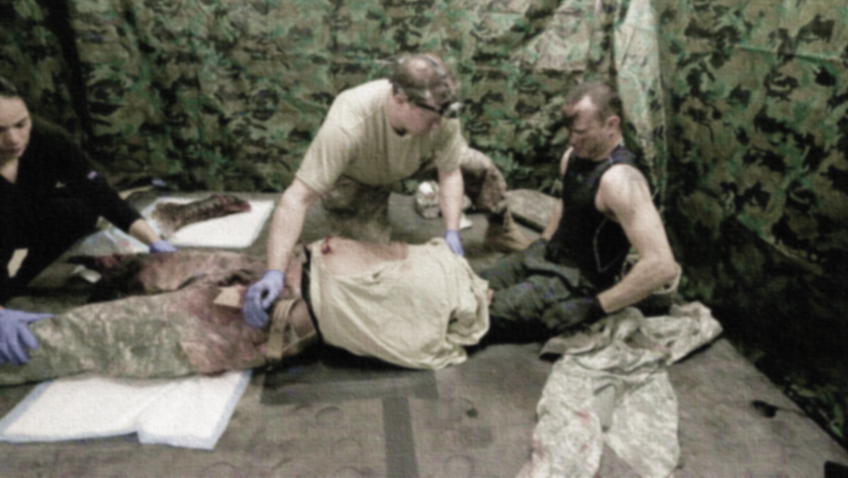
WISH & CREST in the news
“Next generation mannequin could prep combat medics at UW Medicine.”
Rozier, Alex. KING 5, 9 March 2017
“Horror in UW lab aims to save lives on battlefield and streets.”
Kerns, Josh. KIRO Radio, The Ron and Don Show, 9 March 2017
“Future combat medics to train on next-gen manikin that bleeds.”
Siegel, Jake. HS NewsBeat, 7 March 2017
“UW creating next-gen mannequins with warm skin, wet mouths to train battlefield medics.”
Young, Bob. The Seattle Times, 8 March 2017

Slide 7

WWAMI Institute for Simulation in Healthcare
WISH connects over 30 departments and programs throughout UW Medicine, School of Medicine, School of Nursing, School of Pharmacy, and Physician’s Assistant Training Program (MEDEX).

Slide 8
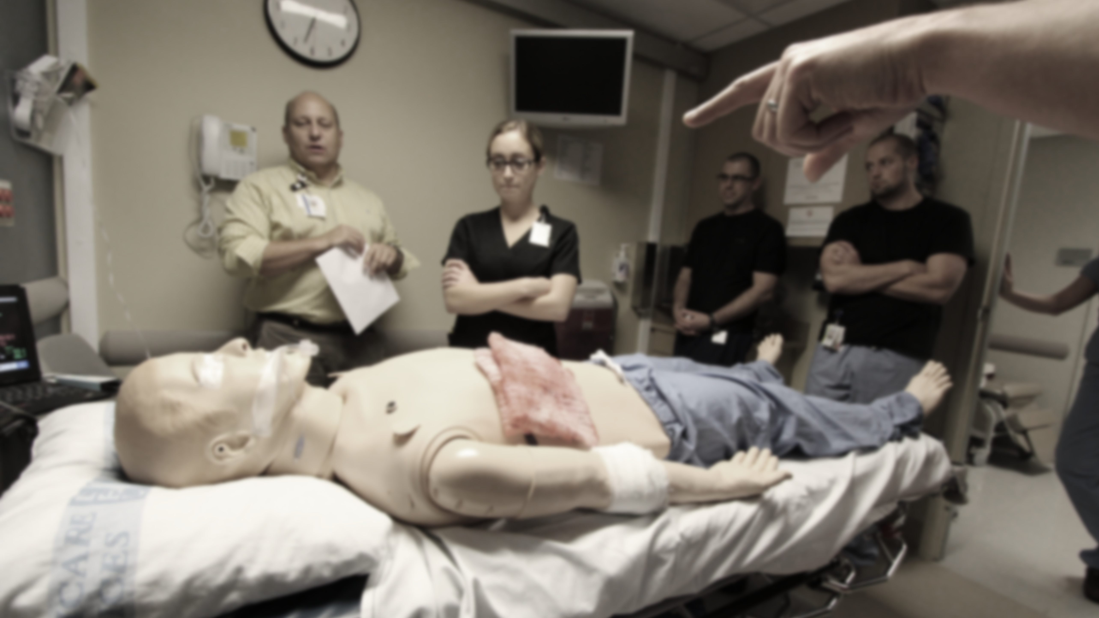
WWAMI Institute for Simulation in Healthcare
WISH strives to improve the quality of healthcare education through technology, providing learners with a safe training environment where they can learn and practice their skills before ever using them on a patient.

Slide 9
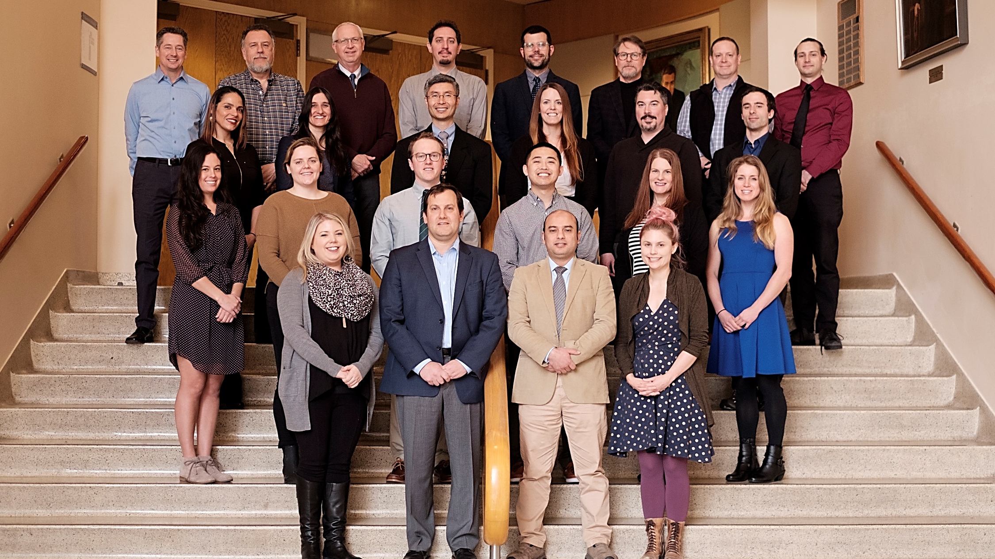
WISH & CREST Team

