Slide 1
Exploring Some of the Many Scientific and Leadership Contributions of Rafael Bras over Five Decades
Stephen J. (Steve) Burges
Professor Emeritus
Department of Civil and Environmental Engineering
University of Washington, Seattle, WA
106th AMS Annual Meeting
Rafael L. Bras Symposium
Paper 9.1
Hydrology: from Random Functions to a Geophysical Science
8:30 AM, January 28, 2026, Grand Ballroom

Slide 2
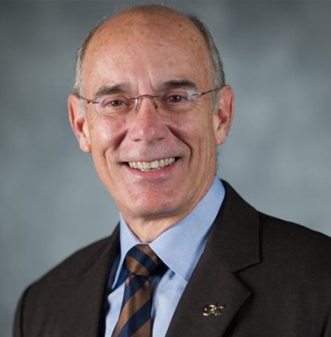

Slide 3
I have attempted to cover his contributions and to place those in the history of their times.
I have known Rafael (Rafa) for 51 years.

Slide 4
Topics:
MIT faculty who aided the development and nurturing of the hydrologic science program
Developments from 1950 through the present that provided the setting for Rafael’s career

Slide 5
Topics:
MIT faculty who aided the development and nurturing of the hydrologic science program
Developments from 1950 through the present that provided the setting for Rafael’s career

Slide 6
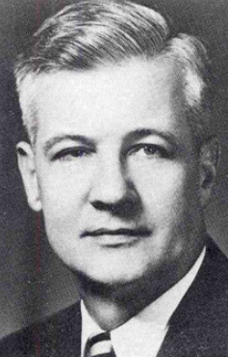
Arthur T. (Art) Ippen

Slide 7
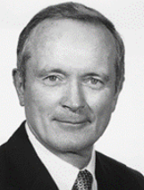
Peter S. (Pete) Eagleson

Slide 8
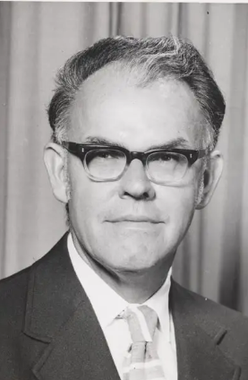
Donald R. F. (Don) Harleman

Slide 9
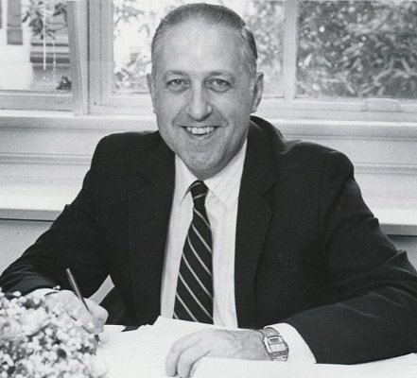
Frank E. Perkins

Slide 10
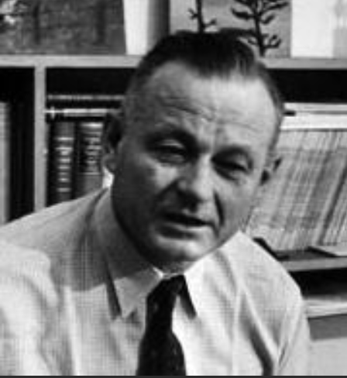
Gordon S. Brown

Slide 11
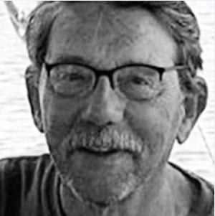
Lynn Gelhar

Slide 12
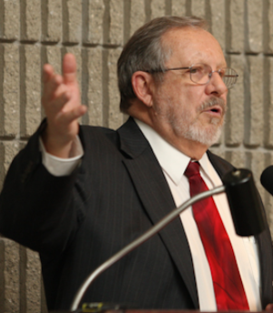
John Schaake

Slide 13
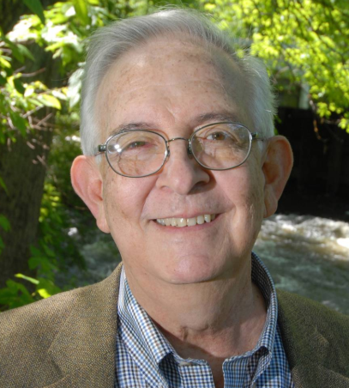
Ignacio Rodriguez-Iturbe

Slide 14
Topics:
MIT faculty who aided the development and nurturing of the hydrologic science program
Developments from 1950 through the present that provided the setting for Rafael’s career

Slide 15
1950 - Professor Arthur Ippen was appointed as the Director of the new Hydrodynamics Laboratory.
The expanded laboratory was renamed in 1970 as the Ralph M. Parsons Laboratory for Water Resources and Hydrodynamics.
He remained Director through 1972.
1973 - 1983 - Don Harleman served as Director.

Slide 16
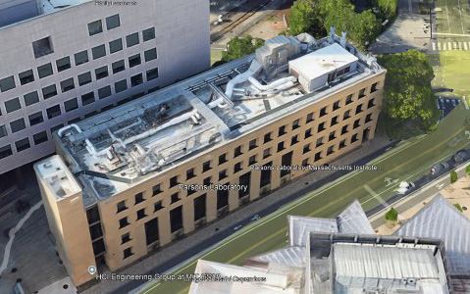
Ralph M. Parsons Laboratory for Water Resources and Hydrodynamics - Google Earth Image

Slide 17
Pete Eagleson, at the invitation of Art Ippen, joined the Hydrodynamics Lab in January 1952 for his ScD; completed in 1956.
Art became Pete’s long-time mentor, colleague, and friend.
Pete was appointed as:
Asst. Professor, July 1955; Professor, July 1965.

Slide 18
The work done in the Lab was published as Lab technical reports, the norm for industrial, government, and academic Labs.

Slide 19
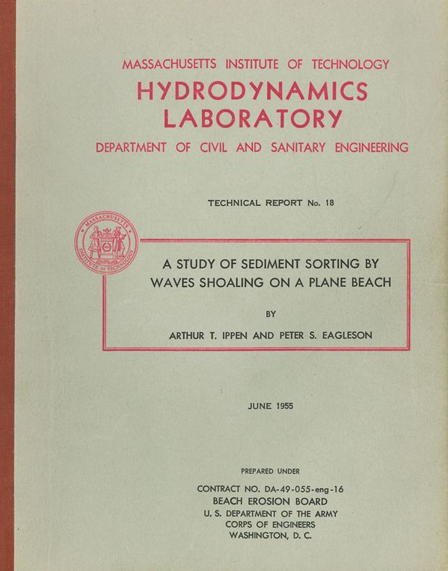

Slide 20
1959 - 1968
Gordon S. Brown served as Dean of the School of Engineering.
He was concerned by the speed of technological change and how students should be educated to remain effective.
He instituted a school-wide engineering science approach, with emphasis on fundamental science.

Slide 21
Two hires under this new emphasis were:
1963 - 1973 - Lynn Gelhar - ground water research
1968 - 1974 - John Schaake - hydrology and water resource management
Lynn joined New Mexico Tech
John became Deputy Director, of the Hydrologic Research Laboratory, Office of Hydrology, NWS

Slide 22
1964 - Pete Eagleson took up the challenge presented by Dean Gordon Brown and with his encouragement, and that of Art Ippen, taught himself hydrology.

Slide 23
Pete approached the field of hydrology as a geophysical science, integrating earth, atmospheric, and ocean processes, explicitly including their dynamic linkages and the relative strengths of deterministic and stochastic components.

Slide 24
This led to the publication of his path breaking book “Dynamic Hydrology”, 1970.
Pete’s work has defined much research effort that has followed.

Slide 25
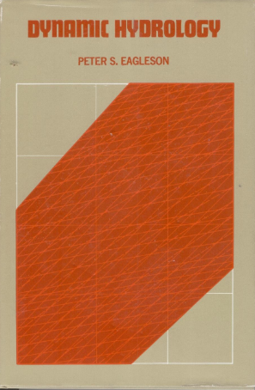
1970

Slide 26
Late 1960s - mid 1970s
Third generation mainframe computers, e.g. IBM 360/67, made possible detailed treatment of hydrologic information.

Slide 27
Research topics included:
Models of long-term persistence (Hurst effect)
Stochastic point precipitation models
Stochastic spatial rainfall fields
Spatial statistics e.g. Kriging
Combination of deterministic models with state estimation updating - Extended Kalman Filters

Slide 28
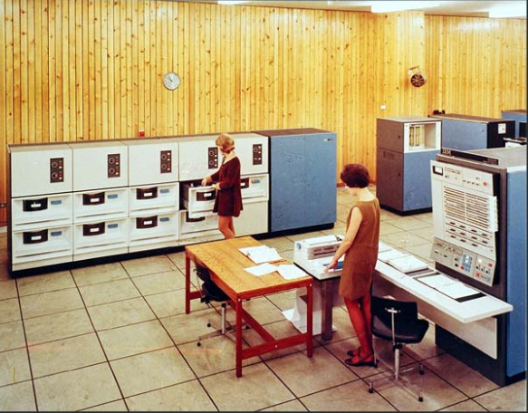
Room-sized IBM 360/67 Computer System

Slide 29
January 1970 - July 1975
Pete Eagleson served as Head, Department of Civil Engineering.
He sought to hire the most talented hydrologist who had an extensive background in stochastic processes.
He recruited Ignacio Rodriquez-Iturbe (Ph.D. 1967, Colorado State Univ.); Ignacio was then a faculty member at the Universidad del Zulia in Maracaibo.

Slide 30
Ignacio joined the MIT faculty in 1971 as an Associate Professor.
He became Rafa’s doctoral dissertation advisor and lifetime friend and colleague.
I first met Ignacio at a conference in Tucson Arizona in December 1972.
His extraordinary intellect and energy were on full display.
I welcomed all future chances to meet with him.

Slide 31
How did I get to know Rafa?
Ignacio brought Rafa to the December 1974 AGU meeting in San Francisco and introduced us.
I have stayed in touch with Rafa ever since.

Slide 32
Rafa’s MIT Education
B.S., Civil Engineering, MIT, February 1972
M.S., Civil Engineering, MIT, February 1974
Thesis: “Effects of urbanization on catchment response”; Frank Perkins, thesis advisor
Sc.D., (Water Resources and Hydrology), MIT, February 1975

Slide 33
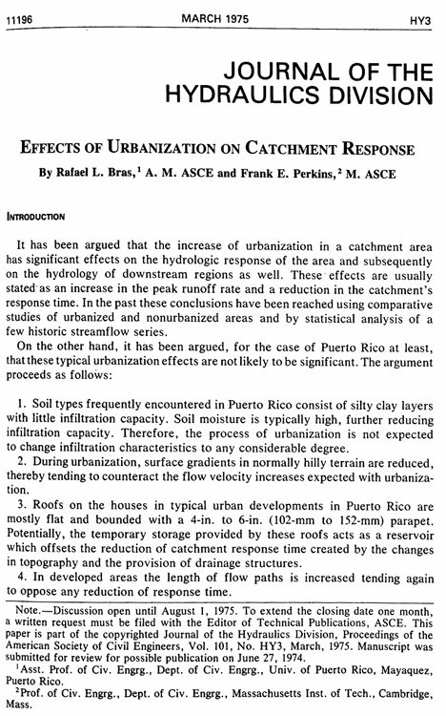
C
ASCE, 1975
C

Slide 34
Rafa’s MIT Education
B.S., Civil Engineering, MIT, February 1972
M.S., Civil Engineering, MIT, February 1974
Thesis: “Effects of urbanization on catchment response”; Frank Perkins, thesis advisor
Sc.D., (Water Resources and Hydrology), MIT, February 1975
Dissertation published as MIT Technical Report 196, then as 4 papers in WRR in 1976.

Slide 35
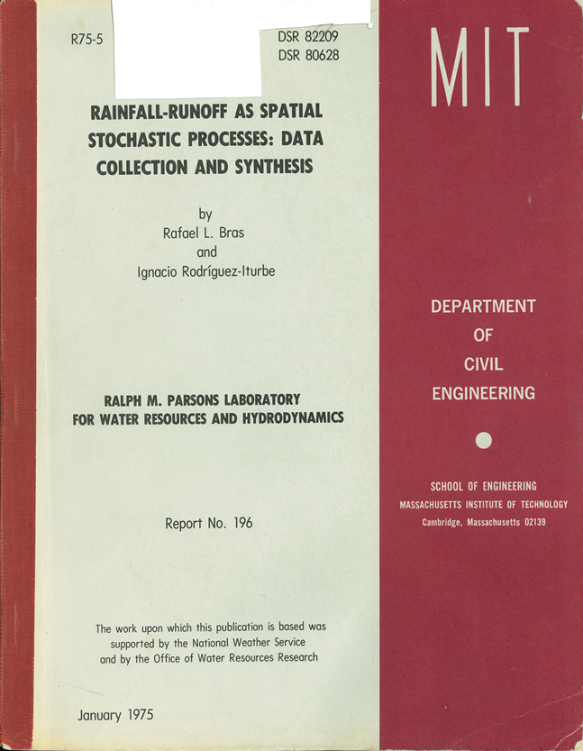

Slide 36
This highly original work was the start his exceptional career.
The promise it showed has been fulfilled!

Slide 37
February 1975 - July 1976
Rafa was an Assistant Professor of Civil Engineering, at the University of Puerto Rico, Mayaguez.
Rafa and Pat’s move to Puerto Rico was brief.
1975 - Ignacio left MIT for a professorship at Simón Bolívar University, Caracas.

Slide 38
1976 - 1980
Frank Perkins served as Head, Department of Civil Engineering.
Frank arranged Rafa’s appointment to the MIT faculty as an Assistant Professor of Civil Engineering in July 1976 to sustain the hydrologic science program.

Slide 39
June 1978
Peter Kitanidis was the first of Rafa’s graduate student colleagues to complete his doctorate.
The work was published as Parsons Lab Tech. Report 235, then as 3 WRR papers in 1980.

Slide 40
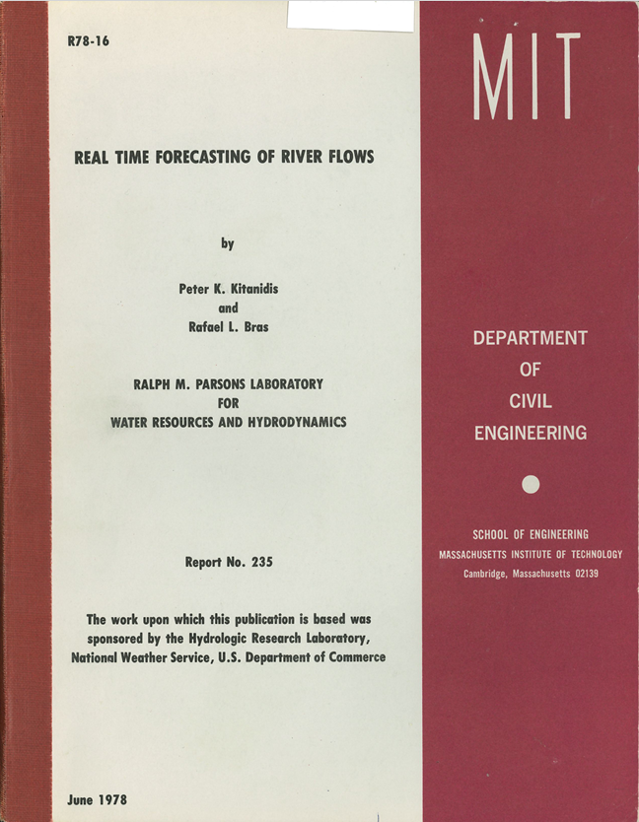

Slide 41
This work, sponsored by the NWS Hydrologic Research Laboratory, provided guidance for the team now led by John Schaake at NWS.
The NWS model (Sacramento model) was formulated in state-space mode to facilitate uncertainty analysis and to use real-time information for system state updates to improve streamflow predictions.
This was the first of a string of “firsts”.

Slide 42
Rafael’s published work covers a huge domain, unmatched for its diversity and depth by any other colleague in hydrology and water resources research.

Slide 43
He has always identified how emerging technologies, be they major advances in computer hardware or software, or space based observational systems, could be incorporated into our ways for describing and quantifying “earth system science”.

Slide 44
Rafa moved through the academic ranks quickly.
1990 - Pete Eagleson and Rafa had additional appointments as Professors of Earth, Atmosphere, and Planetary Sciences.
This cemented the commitment to defining hydrology as a geophysical science.

Slide 45
Rafael’s two books have provided essential guidance for numerous advanced scholars in hydrology and water resources.
Both remain valuable reading today.

Slide 46
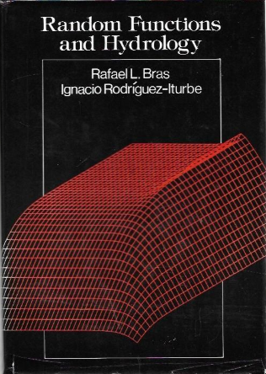
1985

Slide 47
“Random Functions and Hydrology” with Ignacio Rodriquez-Iturbe (1985)
They provided coherence for the developments over the preceding two decades of the probabilistic and stochastic treatment of hydrologic information, and particularly the propagation of uncertainties in hydrologic models.

Slide 48
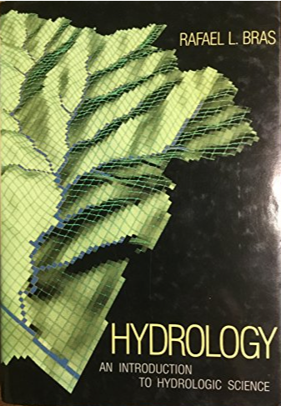
1990

Slide 49
“Hydrology an Introduction to Hydrologic Science” (1990)
Rafael built on the approach taken in “Dynamic Hydrology” (1970)
This updated and expanded book on scientific hydrology included valuable practical applications.

Slide 50
Rafael presented a comprehensive guide to much of his work in his 2020 Langbein Lecture:
“So Much Data and So Few Ways to Use It: The Era of Data Rich Hydrology”.

Slide 51
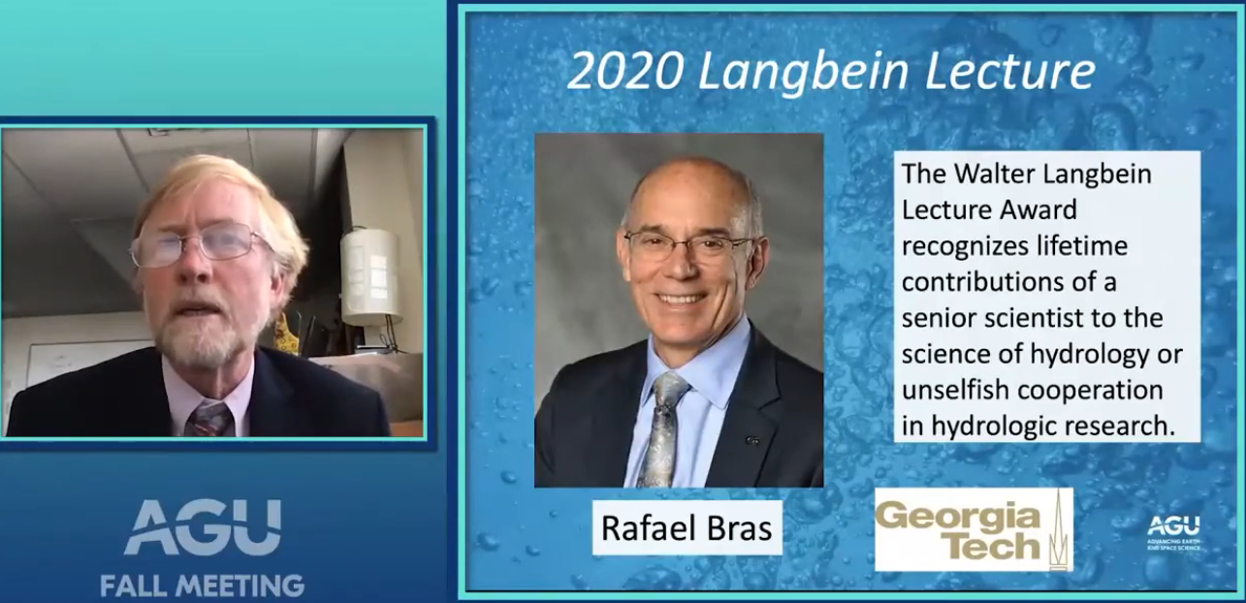
So Much Data and So Few Ways to Use It: The Era of Data Rich Hydrology
Recommended Viewing https://www.youtube.com/watch?v=vk5i2tRE-dc

Slide 52
I have selected two slides to highlight aspects of his work.

Slide 53
1. Advances in hydrologic modeling.

Slide 54
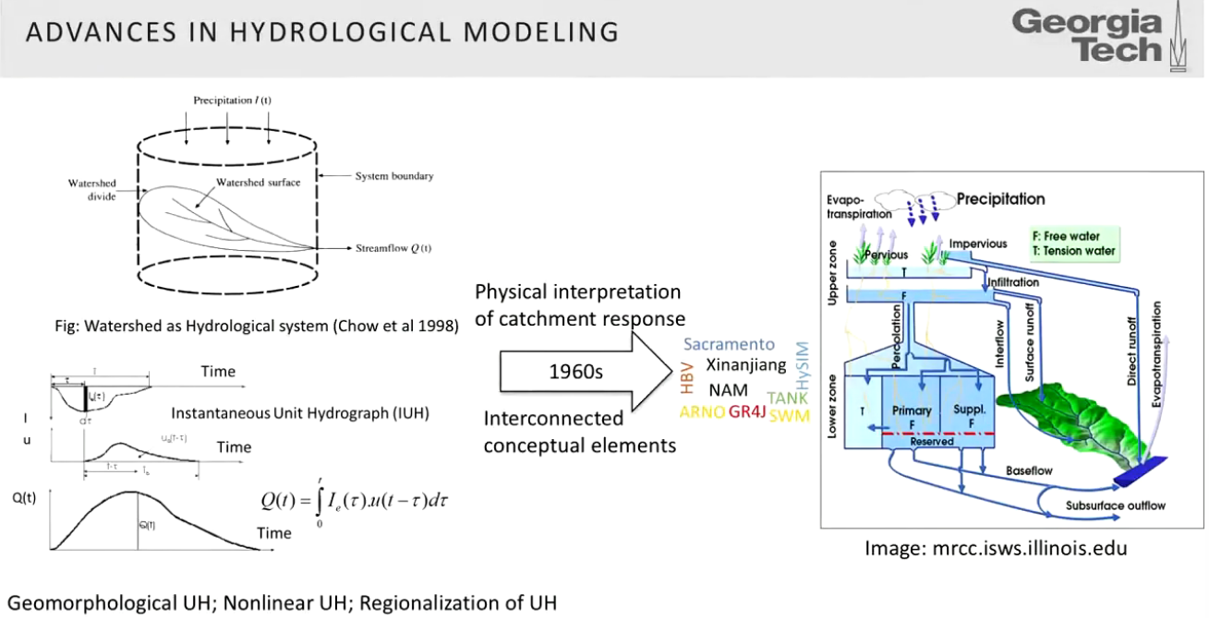
Conceptual - continuous simulation models – constrained by limited data

Slide 55
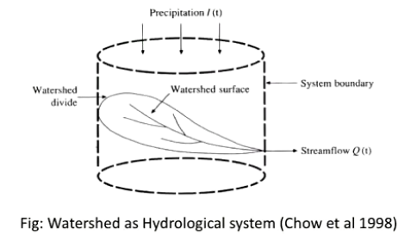
System boundary
Lumped catchment system

Slide 56
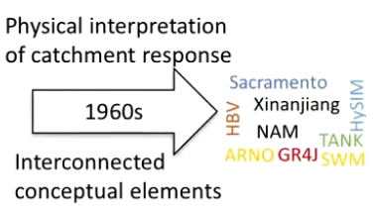
Sacramento model 1973 – NWS
Stanford model 1966 – HSPF 1974
Conceptual continuous simulation models –remain in use in professional practice

Slide 57
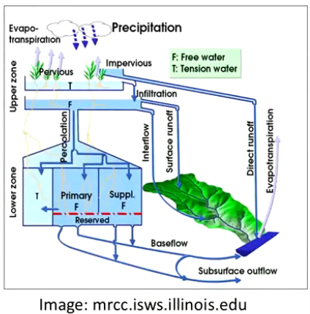
Conceptual storages, inputs, outputs – schematic of Sacramento model

Slide 58
The greatest improvement in the outputs from these models (and future models) depended on improved spatial – temporal precipitation inputs.
Rafael and colleagues have done major work in this domain.

Slide 59
2. Big Data Approach in Hydrology.
Extensive terrestrial data including LIDAR
Airborne and space based remote sensing

Slide 60
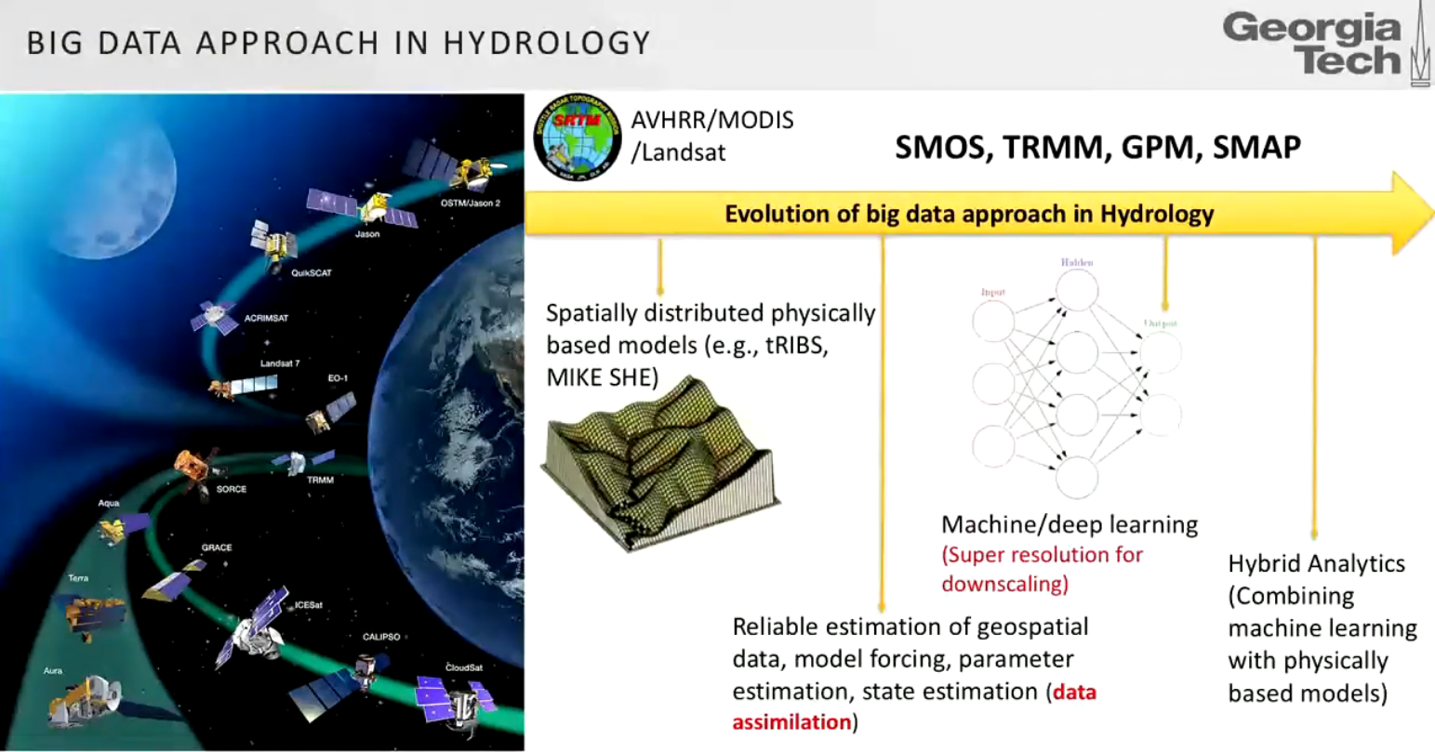

Slide 61
Rafael was early in recognizing the importance of modeling landscape evolution.
He and his colleagues constantly pushed the limits of computing capability and the increasing availability of higher resolution terrain data.

Slide 62
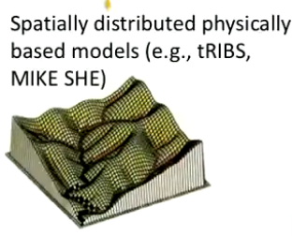
Model grid fit to topography
Start of development of data intensive distributed models

Slide 63
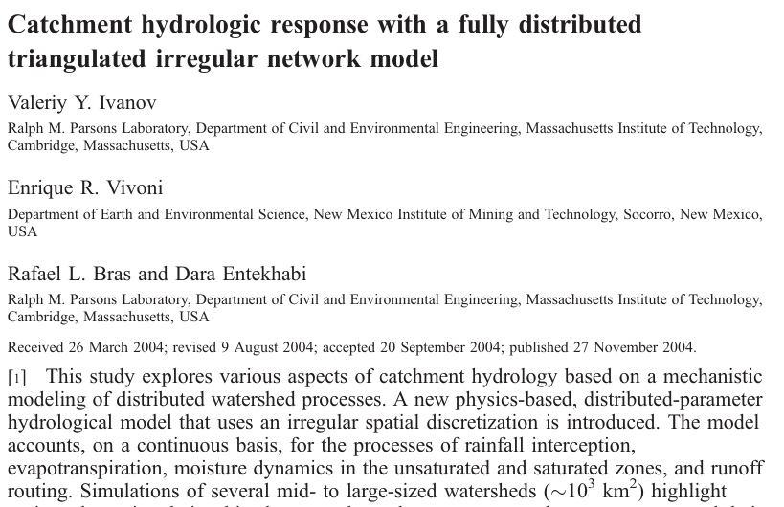
C
tRIBS, WRR, 2004
C

Slide 64
tRIBS, WRR, 2004
The model accounts, on a continuous basis, for the processes of rainfall interception, evapotranspiration, moisture dynamics in the unsaturated and saturated zones, and runoff routing.

Slide 65
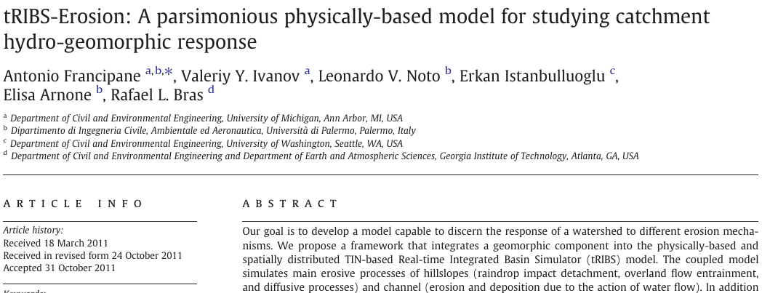
Major Extension:
Catena, 2012

Slide 67
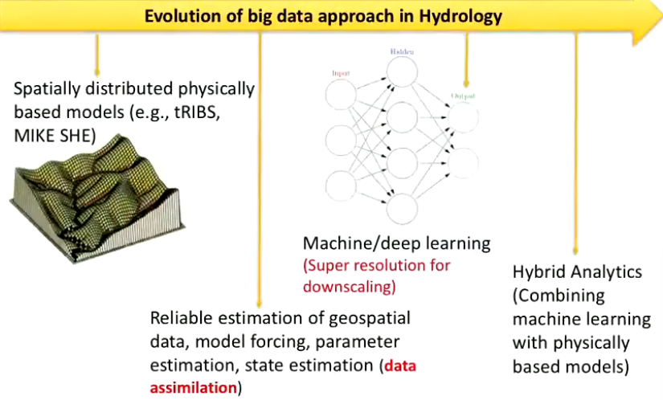
Major evolving research opportunities

Slide 68
Administrative, educational, scientific, and professional leadership
1983 - 1991 Director Parsons Lab
1992 - 2001 Head MIT CEE department
2002 - 2008 Director Freshman Alternate Program, MIT
2008 - 2010 Dean UC Irvine
2010 - 2020 Provost Georgia Tech

Slide 69
Extraordinary high-level consulting and extensive service on national and international advisory committees, and leadership of scientific societies.

Slide 70
International educational leadership:
March 20-21, 2000 - MIT - Convener of the “New Millennium Colloquium on the Future of Civil and Environmental Engineering”
250 attended, including industry leaders, university presidents, and CEE leaders from around the world.

Slide 71
International professional leadership:
1995 - 2014
Consultant and Chair of panel of experts that supervised the development and construction of tidal gates to protect the City of Venice and the Lagoon against flooding, Consorzio Venezia Nuova, Venice.

Slide 72
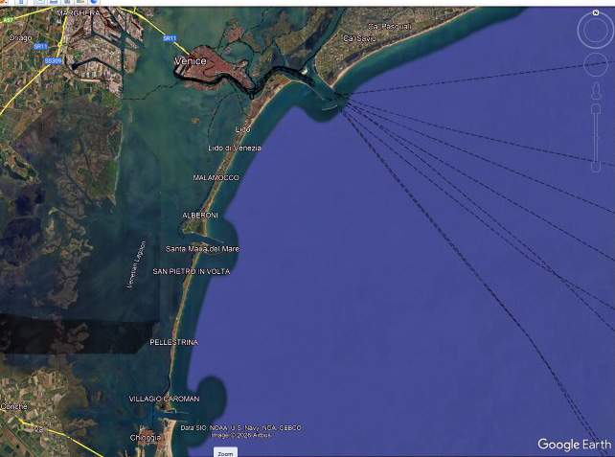
Venice

Slide 74
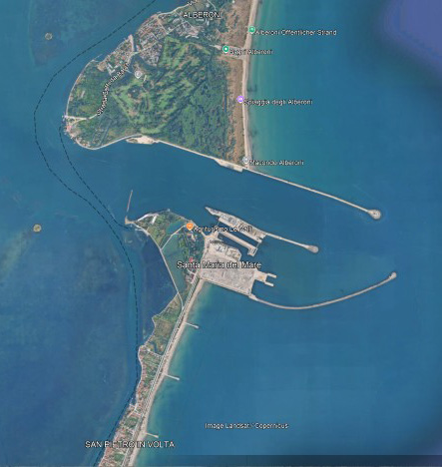
0.42 km

Slide 75
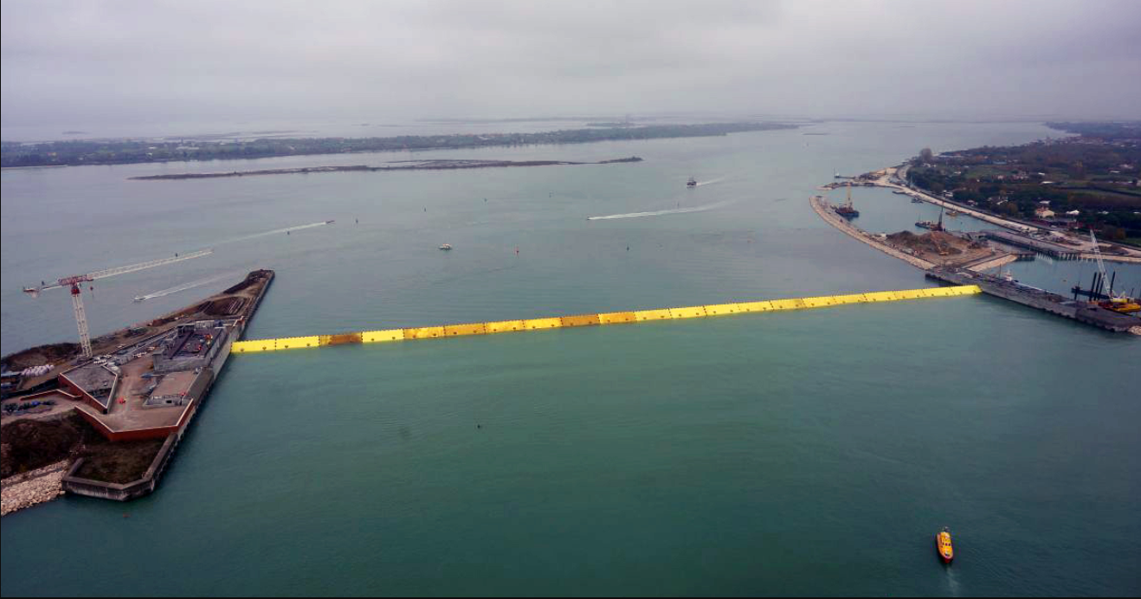
Tidal gates raised

Slide 76
Detailed coverage:
Evans Lecture, University of Washington, May 11, 2023
“The Venice Gates: A Short History of a Long, Successful (but Controversial) Project”

Slide 77
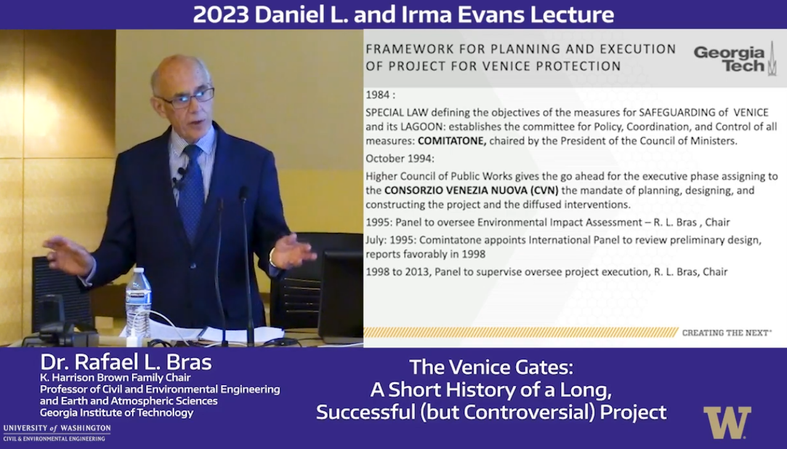
2023 Evans Endowed Lecture: The Venice Gates - Dr. Rafael L. Bras

Slide 78
Rafa has been, and remains:
A mentor and friend to many
Primary academic advisor to:
41 doctoral student colleagues
27 MS students
23 post doctoral fellows and visiting scholars

Slide 79
Rafa has received many honors and awards
He is a superb educator, a compliment I reserve for the best of my academic colleagues.

Slide 80
His latest recognition is the highest honor bestowed by ASCE, its OPAL award.
He was the 2025 recipient of the “OPAL Award in Education”, presented October 10, 2025, in Seattle.
Rafa and Pat invited Sylvia and me to join them for this memorable and uplifting award ceremony.

Slide 81
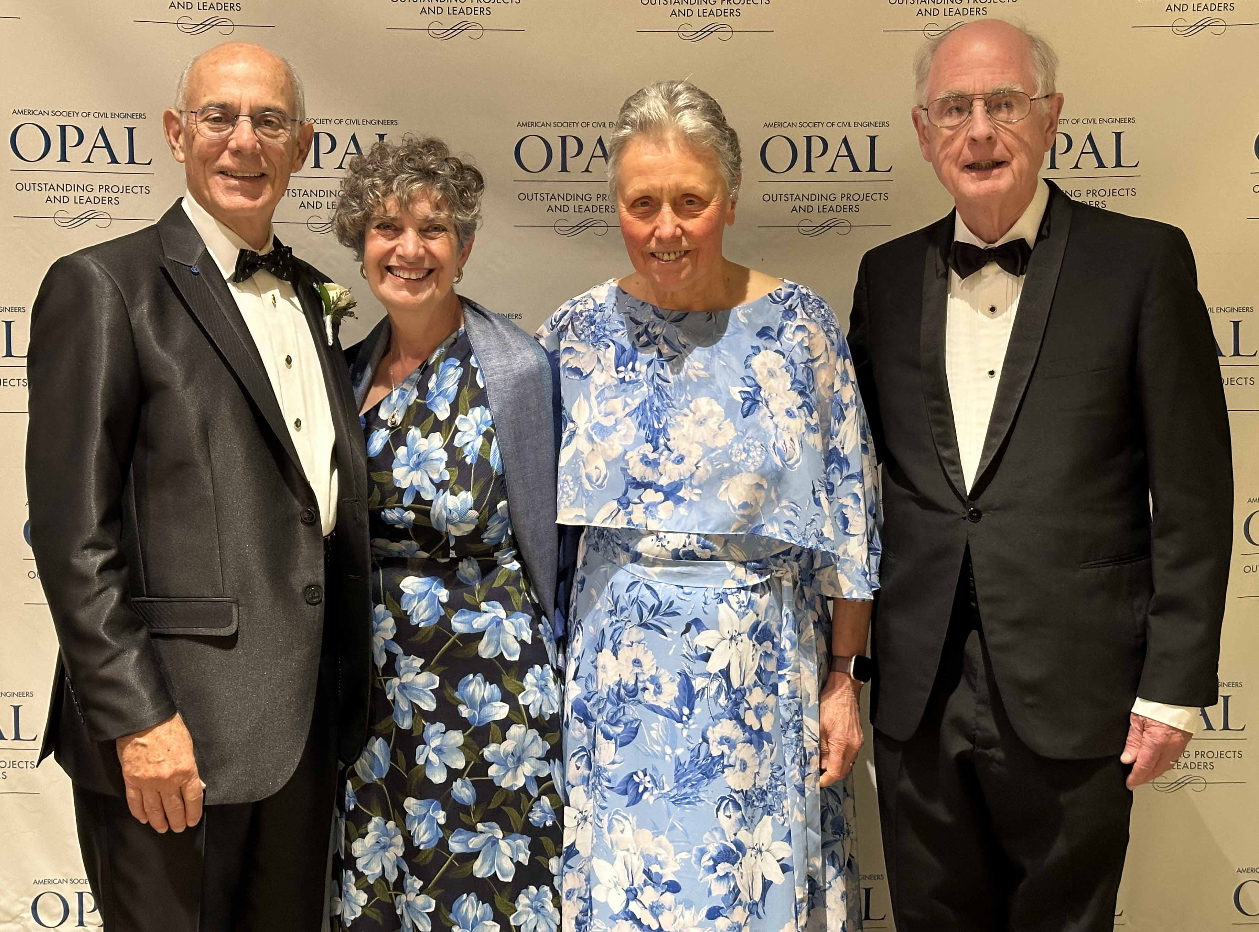
Two “5⁺ decade Teams” Rafa & Pat, Sylvia & Steve, OPAL Awards, October 10, 2025

Slide 82
Other dimensions:
An adventurer

Slide 83
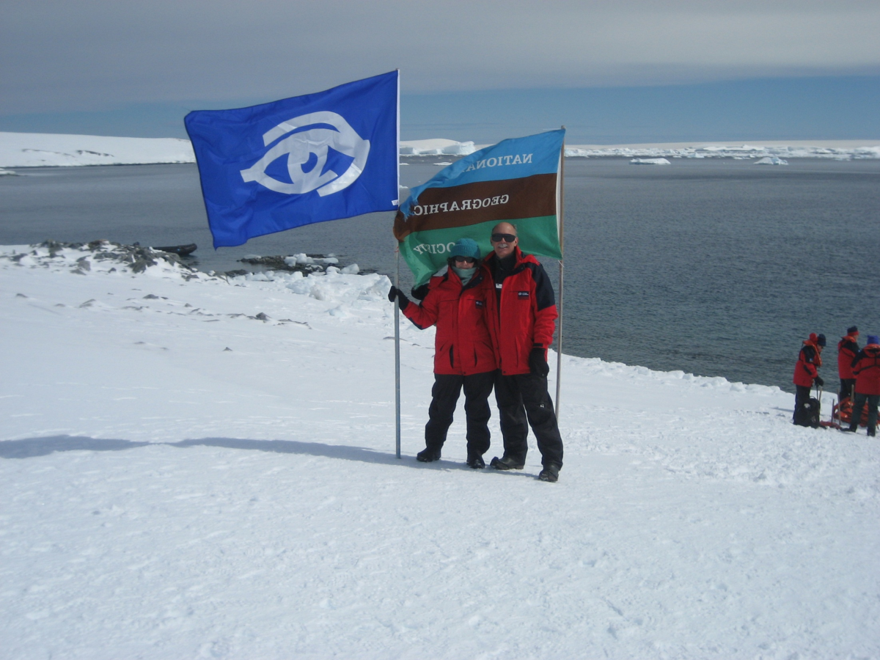
Exploring Antarctica with Pat, December 2007

Slide 84
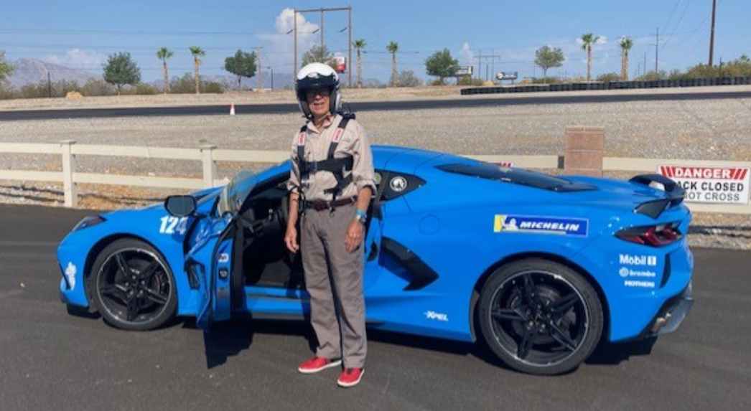
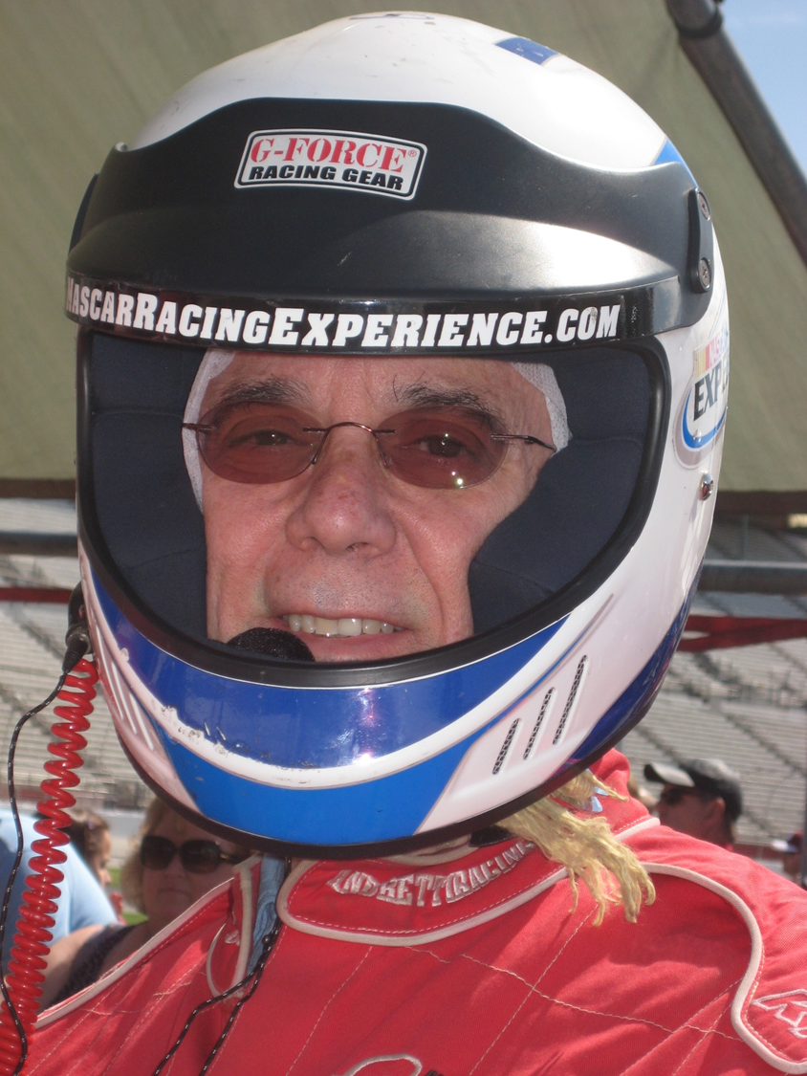
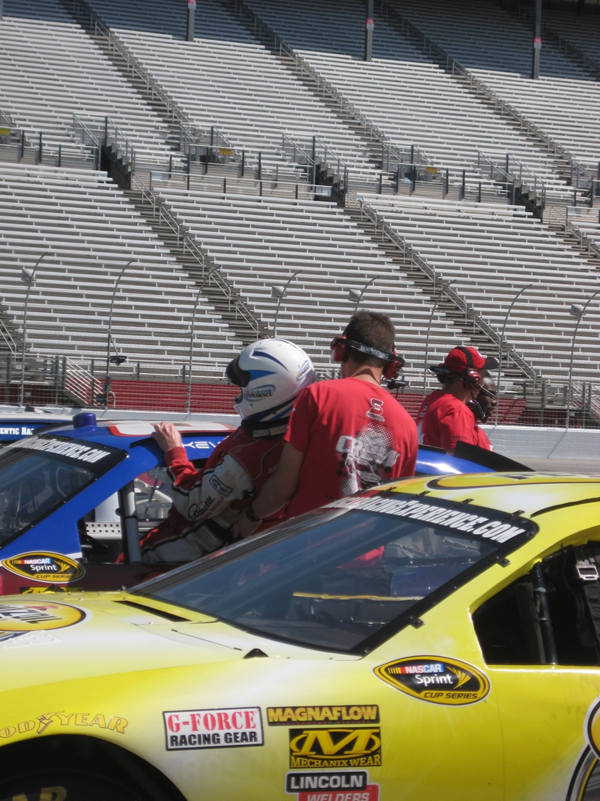
Developing fast driving skills
Corvette Racing

Slide 85
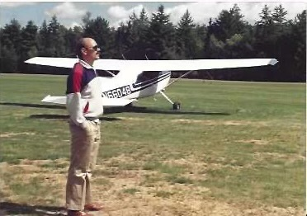
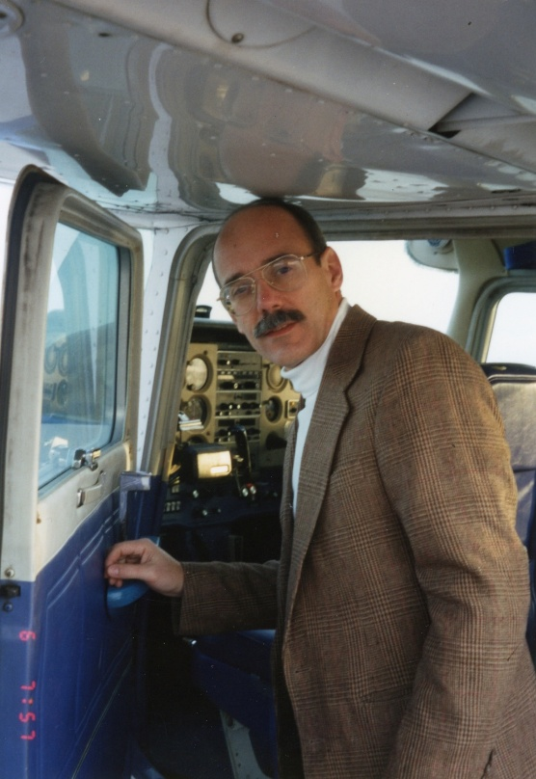
The joys of “hands on” flying
Light aircraft Private Pilot

Slide 86
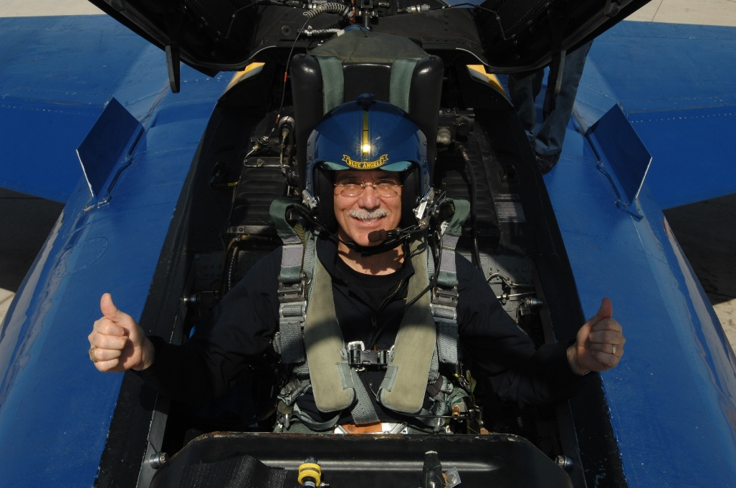
The joys of flying - “white knuckles”?
High speed “Thrill of a Lifetime”
2009 - Flight with US Navy Blue Angels.

Slide 87
Thank you!

Slide 88
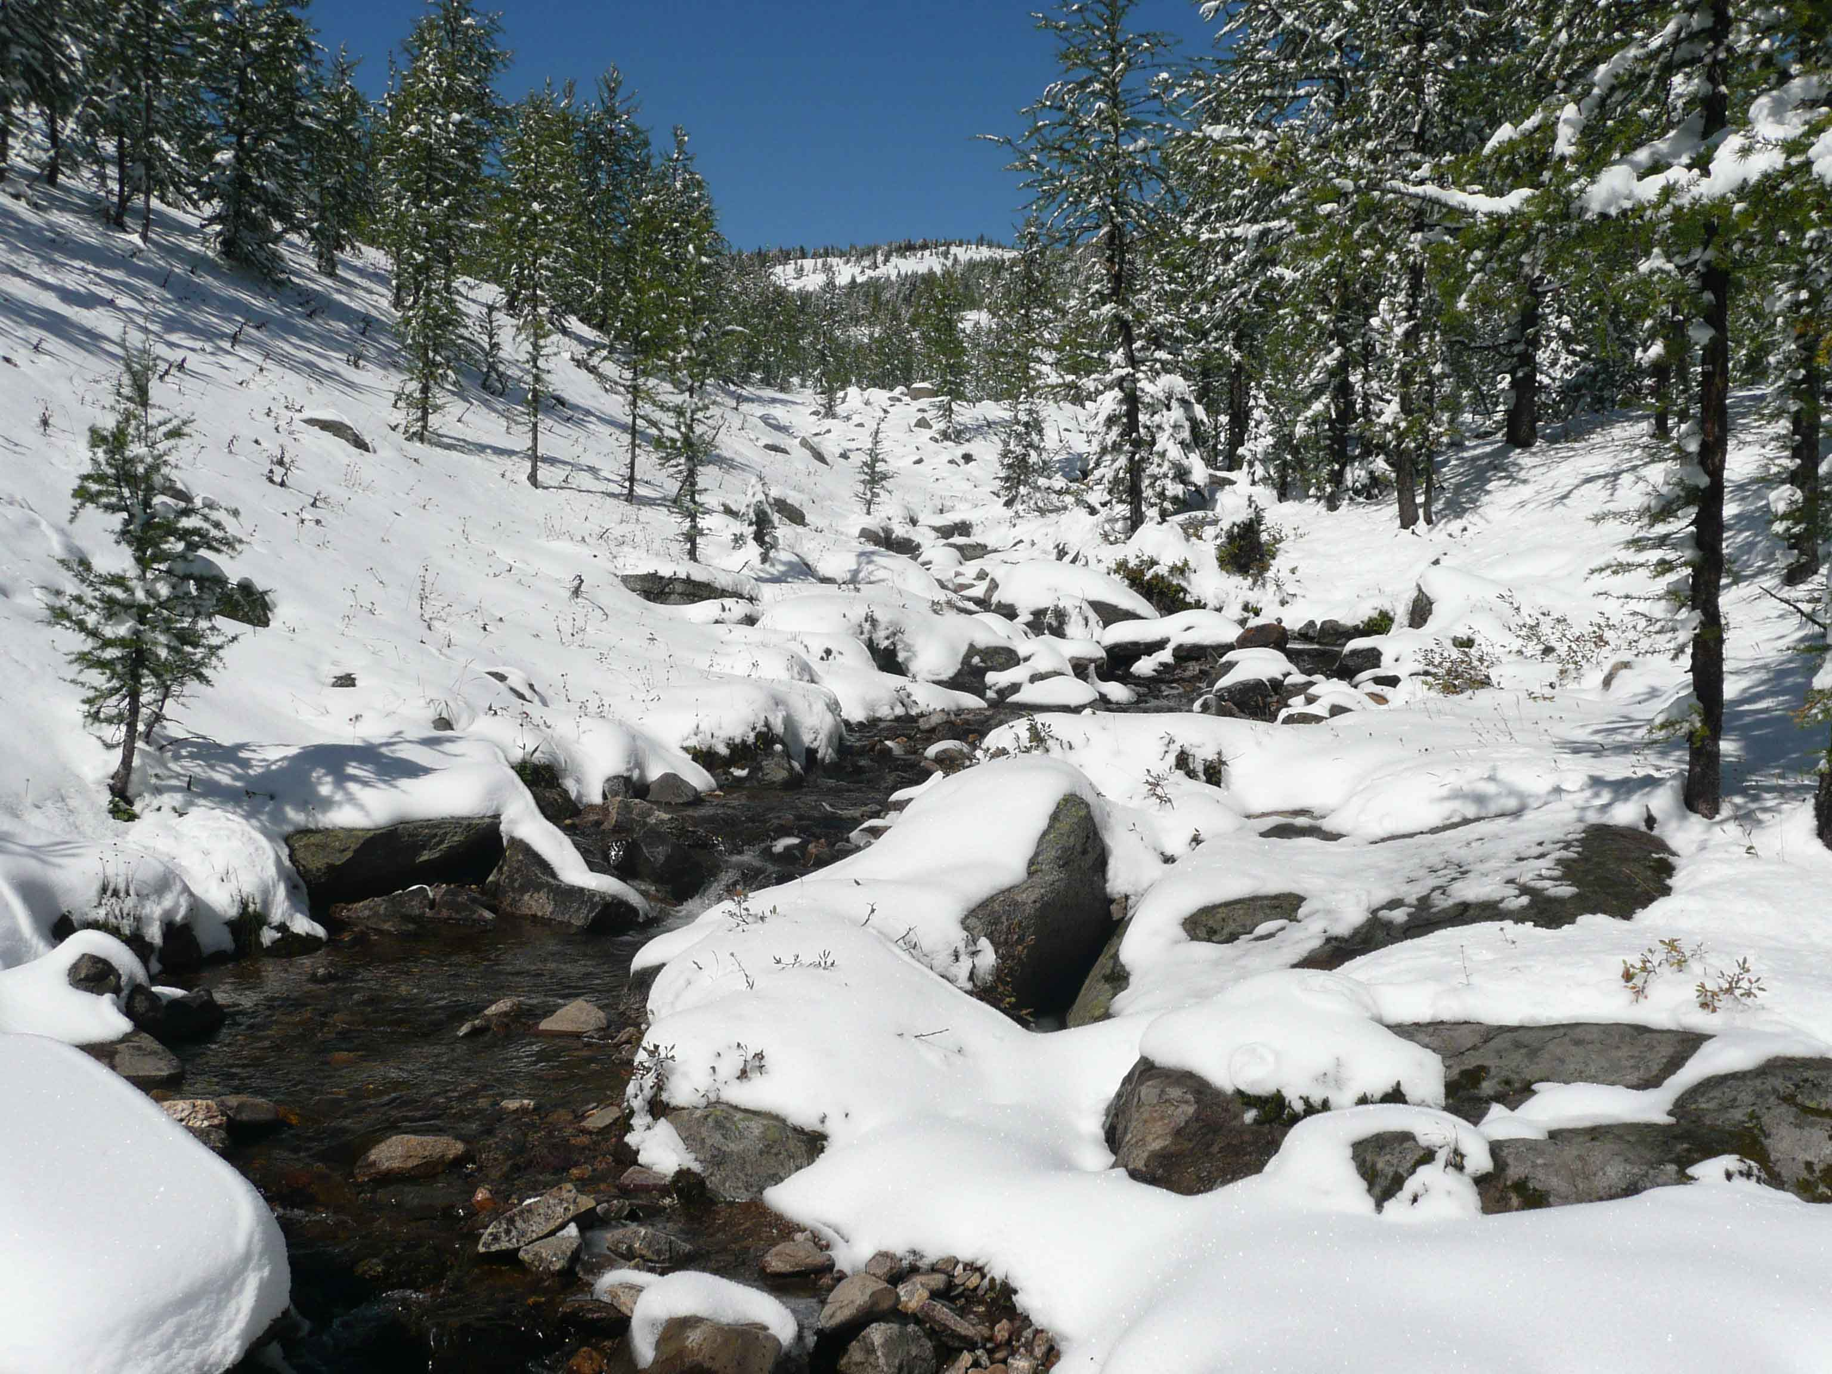
Near headwaters of Healy Creek, Banff National Park 9/11/2014

Slide 91
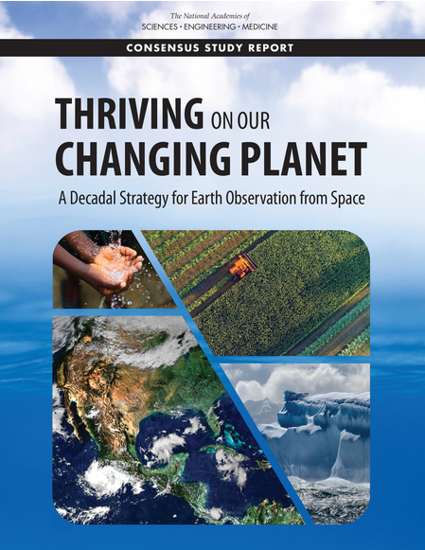
Thriving on Our Changing Planet
A Decadal Strategy for Earth Observation from Space (2018)
Chapter 6 Global Hydrological Cycles
and Water Resources

Slide 92
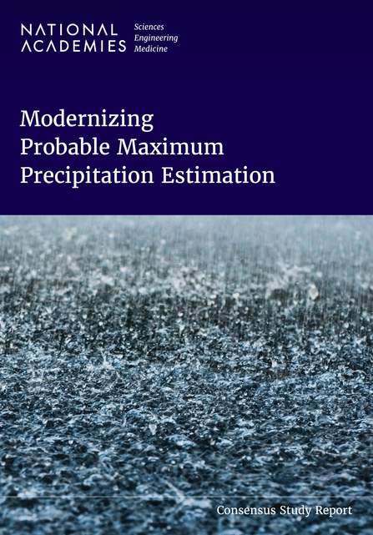
Modernizing Probable Maximum
Precipitation Estimation (2024)
Many needed research areas identified

Slide 94
Frank Perkins continued his administrative leadership as:
Associate Provost: 1980–1983, and
Dean of the Graduate School: 1983–1995

Slide 95
An extraordinary “Call to Action”
Editorial: Hydrology, The Forgotten Earth Science, Rafael Bras and Peter S. Eagleson, Eos, Vol. 68, No. 16, page 227, April 21, 1987.

Slide 96
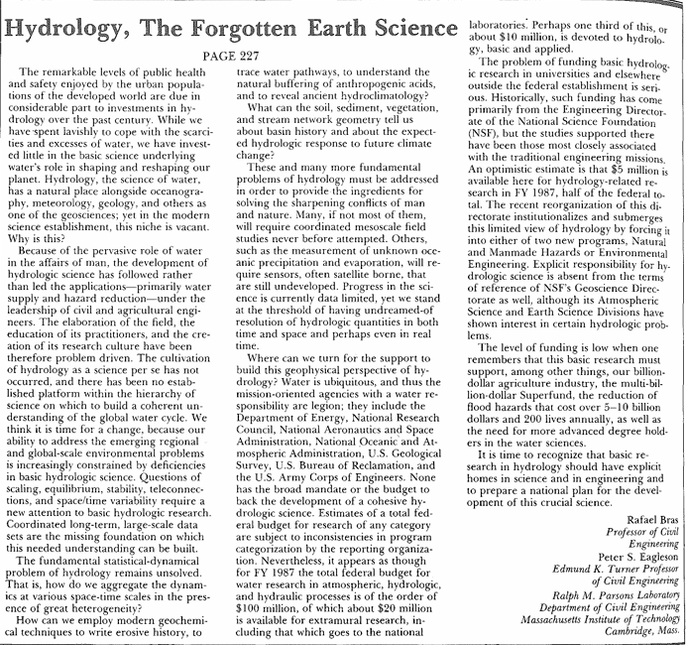

Slide 97
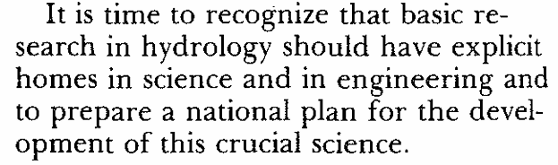

Slide 98
1970 - Brendan Harley developed and programmed MIT’s “Distributed Model of Catchment Dynamics”
The model incorporated many elements of Pete’s work.

Slide 99
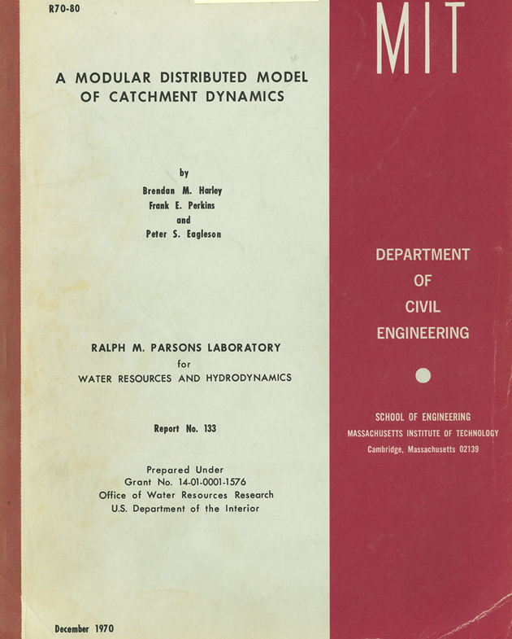

Slide 100
Geomorphic Unit Hydrograph – 1978

Slide 101
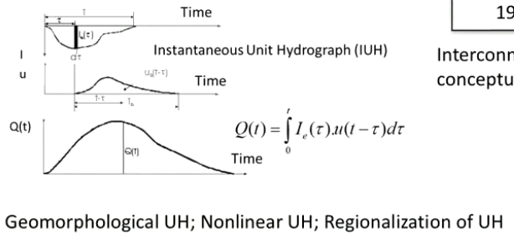
Considerable work done by Rafael and colleagues

