Slide 2
Two Water Resource System Examples: Australia, and California
Stephen J. (Steve) Burges,
P.E., P.H., D.WRE.
Professor Emeritus
Department of Civil and Environmental Engineering
University of Washington
CEWA 578 – Lecture for Professor Jessica Lundquist, April 18, 2023

Slide 3
Topics
Municipal Water Supply, Newcastle, Australia:
Chichester Dam, dam safety modifications
Water Supply in California:
Major dams, distribution network, infrastructure vulnerability – example Oroville Dam

Slide 4
My early years – Newcastle Australia:

Slide 5
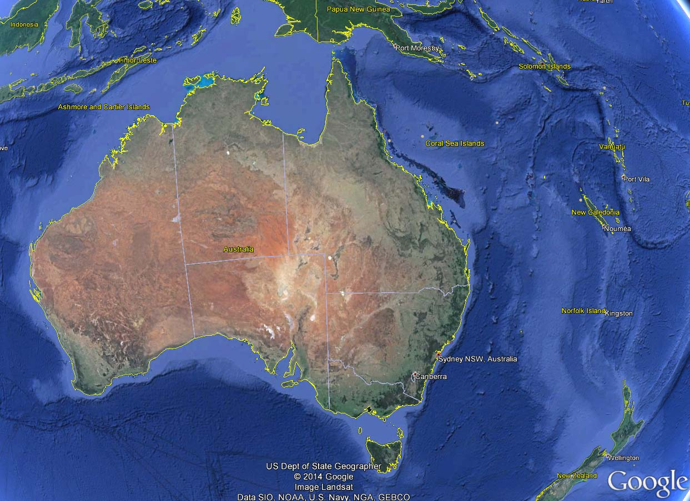
Born, Newcastle, 1944

Slide 6
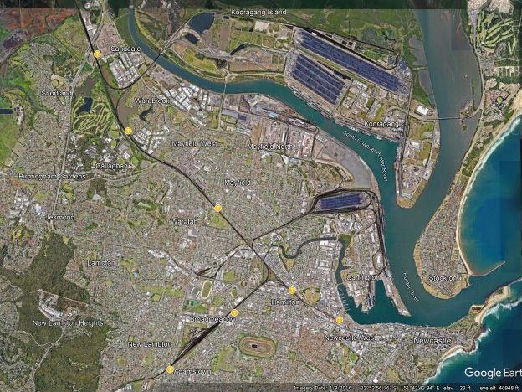
South Channel Hunter River
Hunter River
Coal Storage Yards
0.5 miles
Newcastle

Slide 7
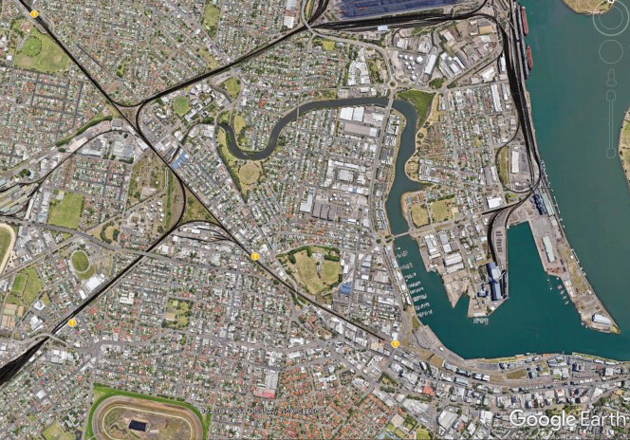
University of Newcastle 1962 - 1966
199 degrees granted in 1966
0.5 miles
Hunter Dist. Water Board

Slide 8
Summer internships – trainee civil engineer, Hunter District Water Board 1963 - 66:
Member of construction crews – sewers, water supply, treatment plants, pumping stations.
I gained huge respect for workers who do hard physical work.
Engineers must not waste any worker’s time!

Slide 9
Post- baccalaureate Construction Engineering Experience
Hunter District Water Board – (now, Hunter Water)
Nov 1966 - August 1967

Slide 10
Topics
Municipal Water Supply, Newcastle, Australia:
Chichester Dam, dam safety modifications
Water Supply in California:
Major dams, distribution network, infrastructure vulnerability – example Oroville Dam

Slide 11
Life-cycle issues in civil engineering infrastructure
Lowering spillway, Chichester Dam

Slide 12
Chichester Dam was constructed between 1915 and 1926 as the Hunter Valley’s first dedicated drinking water storage system.
Chichester Dam is one of the Hunter’s most important freshwater storage facilities contributing about 35 per cent of the Lower Hunter’s potable water supply.
The catchment for Chichester Dam is largely within the Barrington Tops National Park, which is a declared wilderness area. As a result, it is one of the most pristine catchments in Australia with large areas unaffected by human activity
https://www.hunterwater.com.au/Water-and-Sewer/Water-Supply/Dams-and-Catchments/Chichester-Dam.aspx

Slide 13
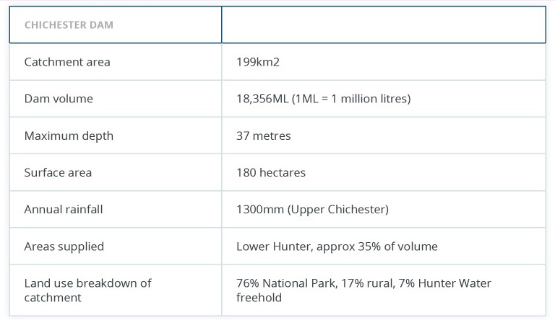

Slide 14
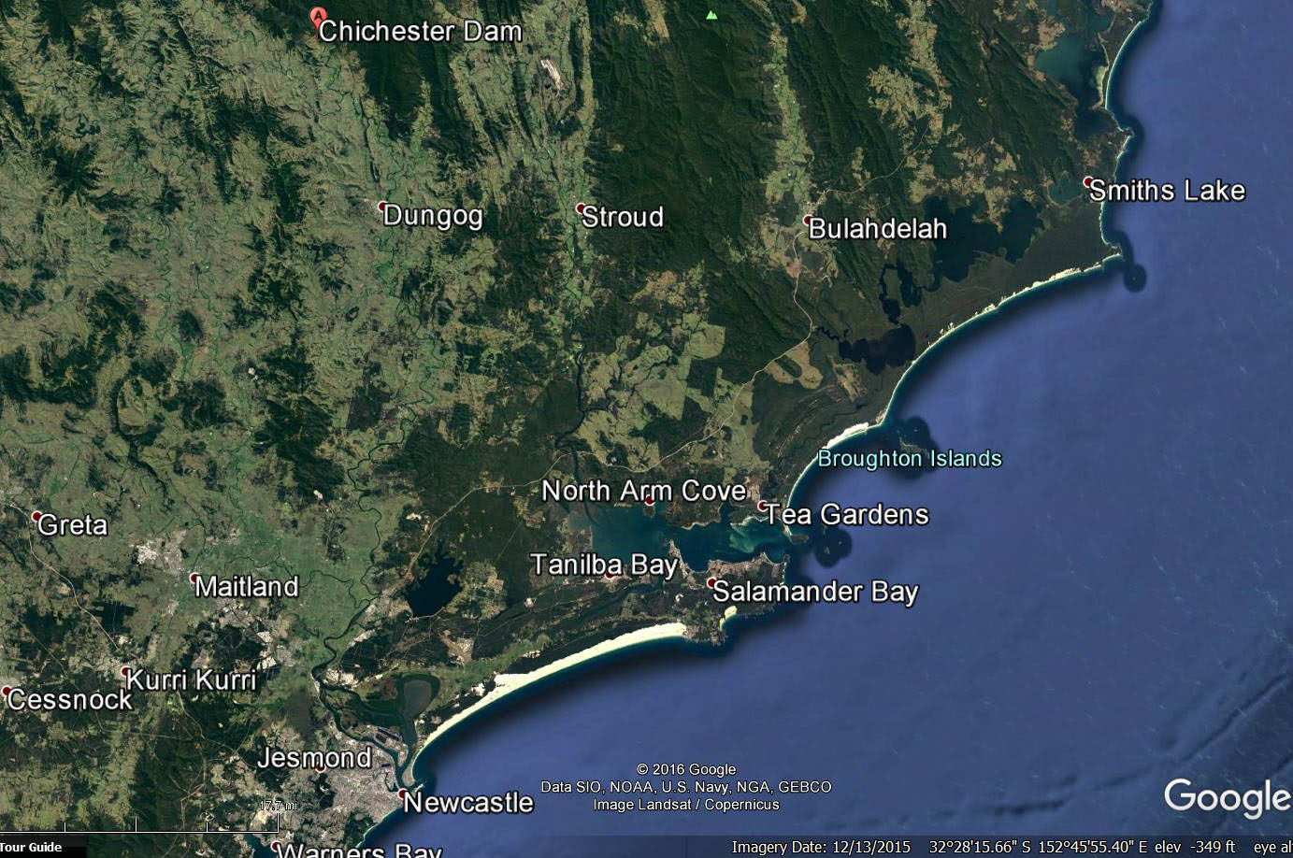

Slide 15
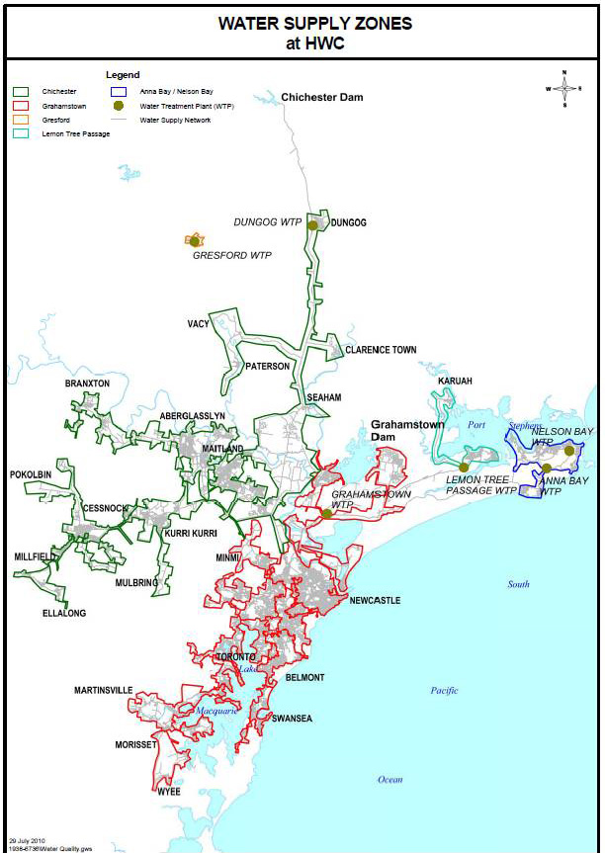
Pipeline route and supply region
~ 62 road miles

Slide 16
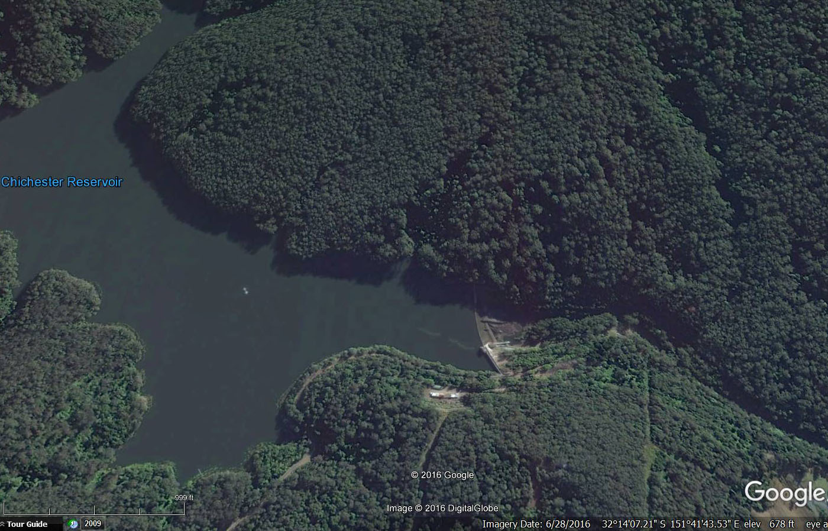
Spillway
Dam

Slide 17
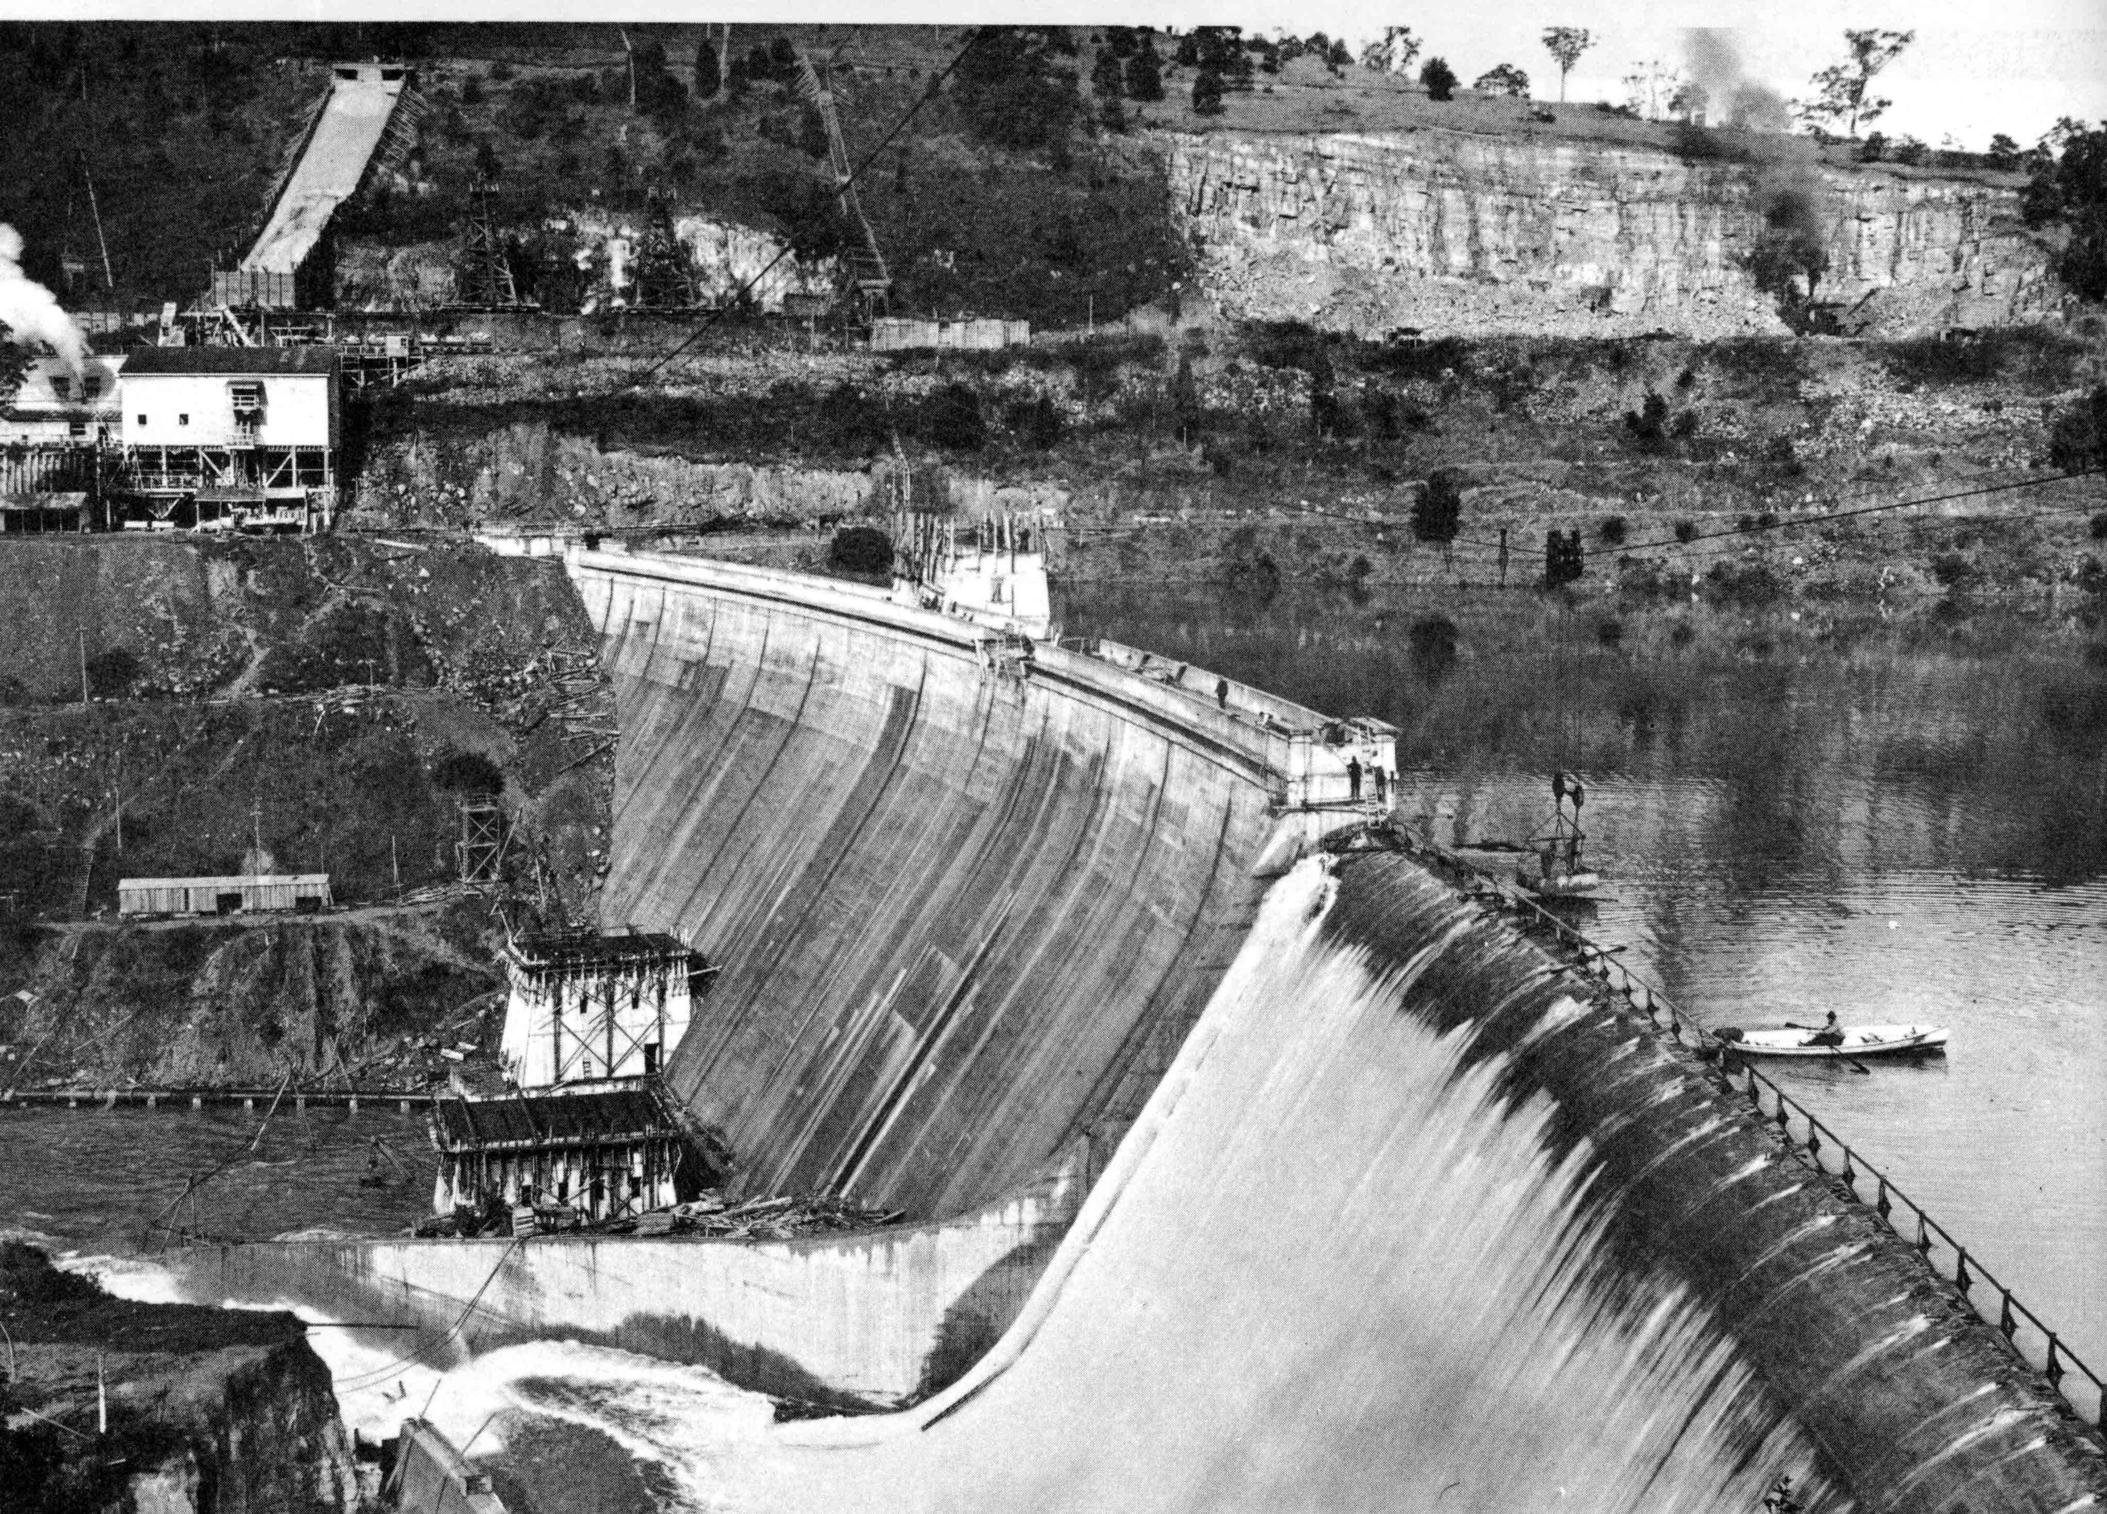
Dam constructed 1917-1927
Photo 1925 – reservoir filling
Wall height ~ 140 ft.
Spillway crest ~ 120 ft.
Active Storage 14,900 Ac. Ft.

Slide 18
Wall length ~ 550 ft.
280 ft. long “ogee” spillway
Top radius of curvature ~ 1200 ft.
safety fence

Slide 19
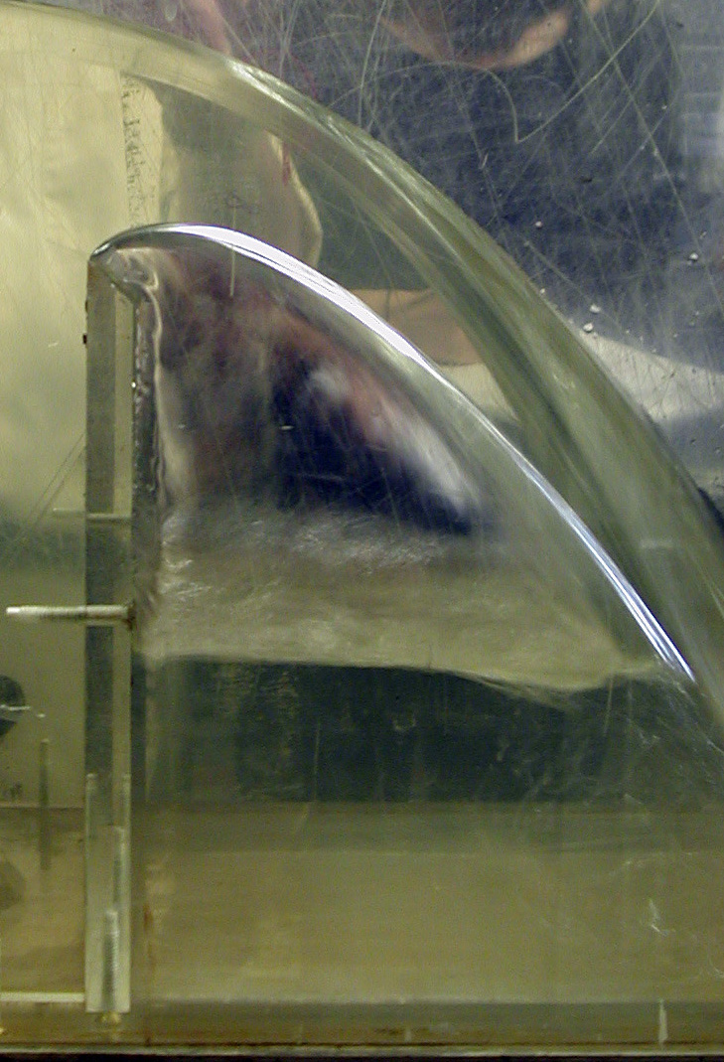
Sharp crested weir - free “Nappe”
Pressure is atmospheric
Ogee design emulates the free nappe to avoid negative pressures at water - weir interface
See pages 365-376 - U.S. Bureau of Reclamation, Design of Small Dams, Third Edition, Denver, Colorado, 1987, for details of discharge over an uncontrolled Ogee Crest

Slide 20
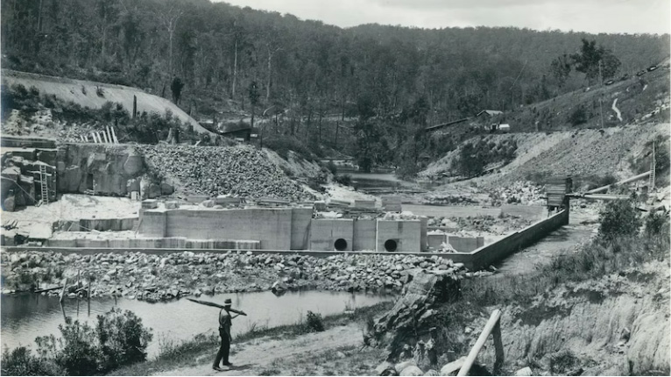
Excavated bedrock
Coffer dam
Scour pipes
Bypass channel
Looking downstream showing low-cost “coffer dam” and river bypass channel and scour pipes

Slide 21
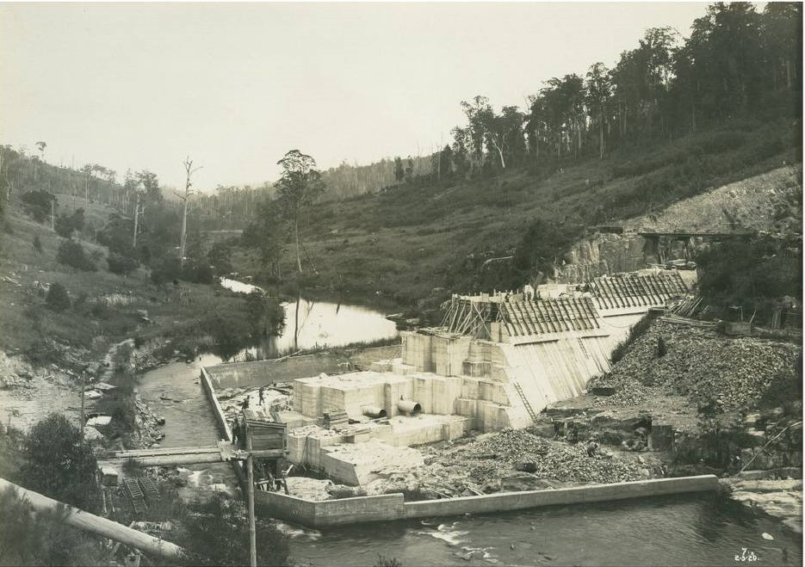
Scour pipes
Bypass channel
Work area access
Looking upstream showing construction progress - coffer dam, river bypass channel and scour pipes

Slide 22
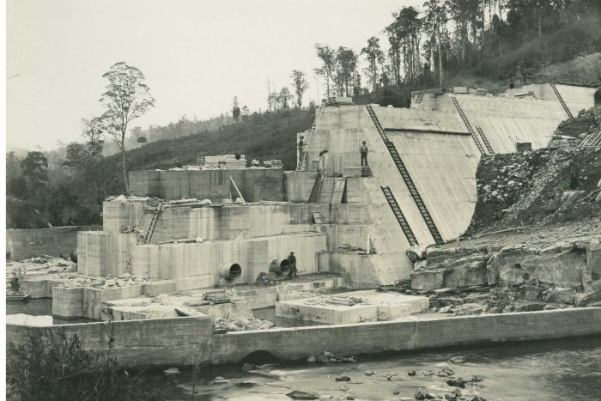
Scour pipes
View – 1919 ‘cyclopean’ system of interlocking concrete blocks and large boulders, each approximately 300 cubic yards – effective water blocking construction

Slide 23
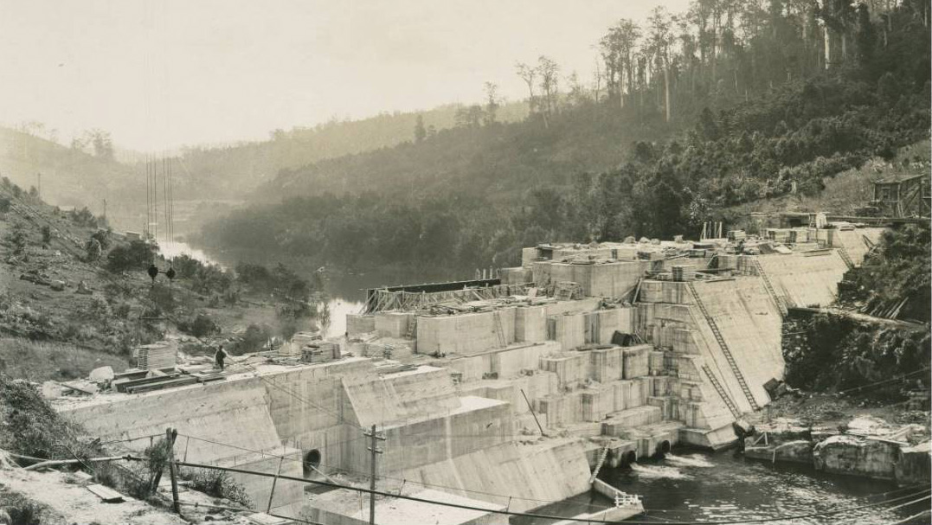
Cableway
Pipeline Feeder
Scour pipes – flow bypass

Slide 24
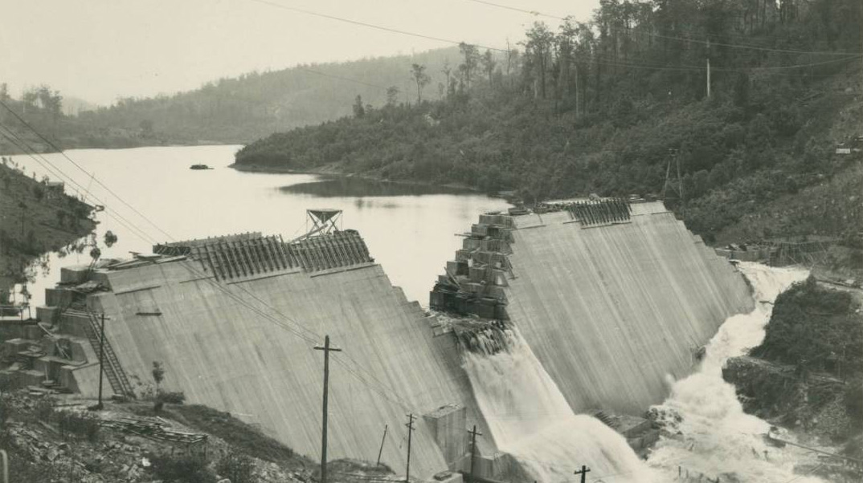
Dam serving as coffer dam

Slide 25
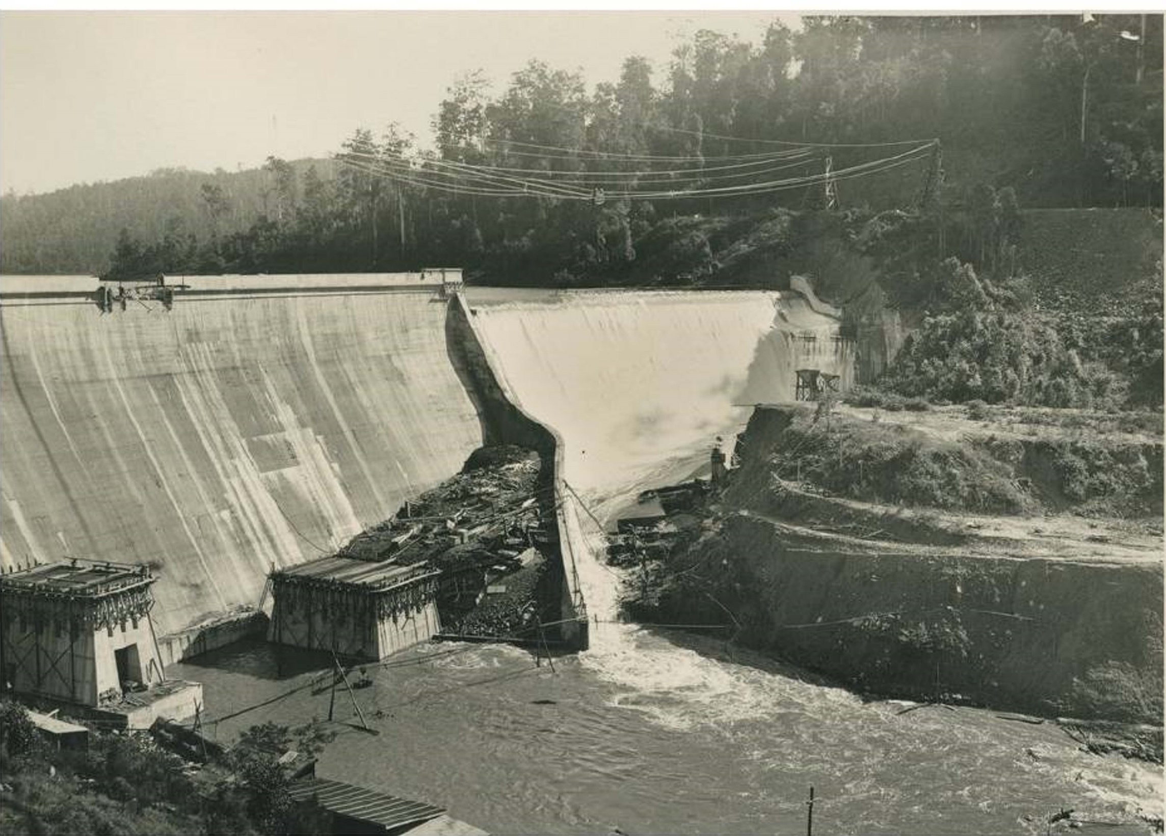
Cableways
Spillway under construction

Slide 26
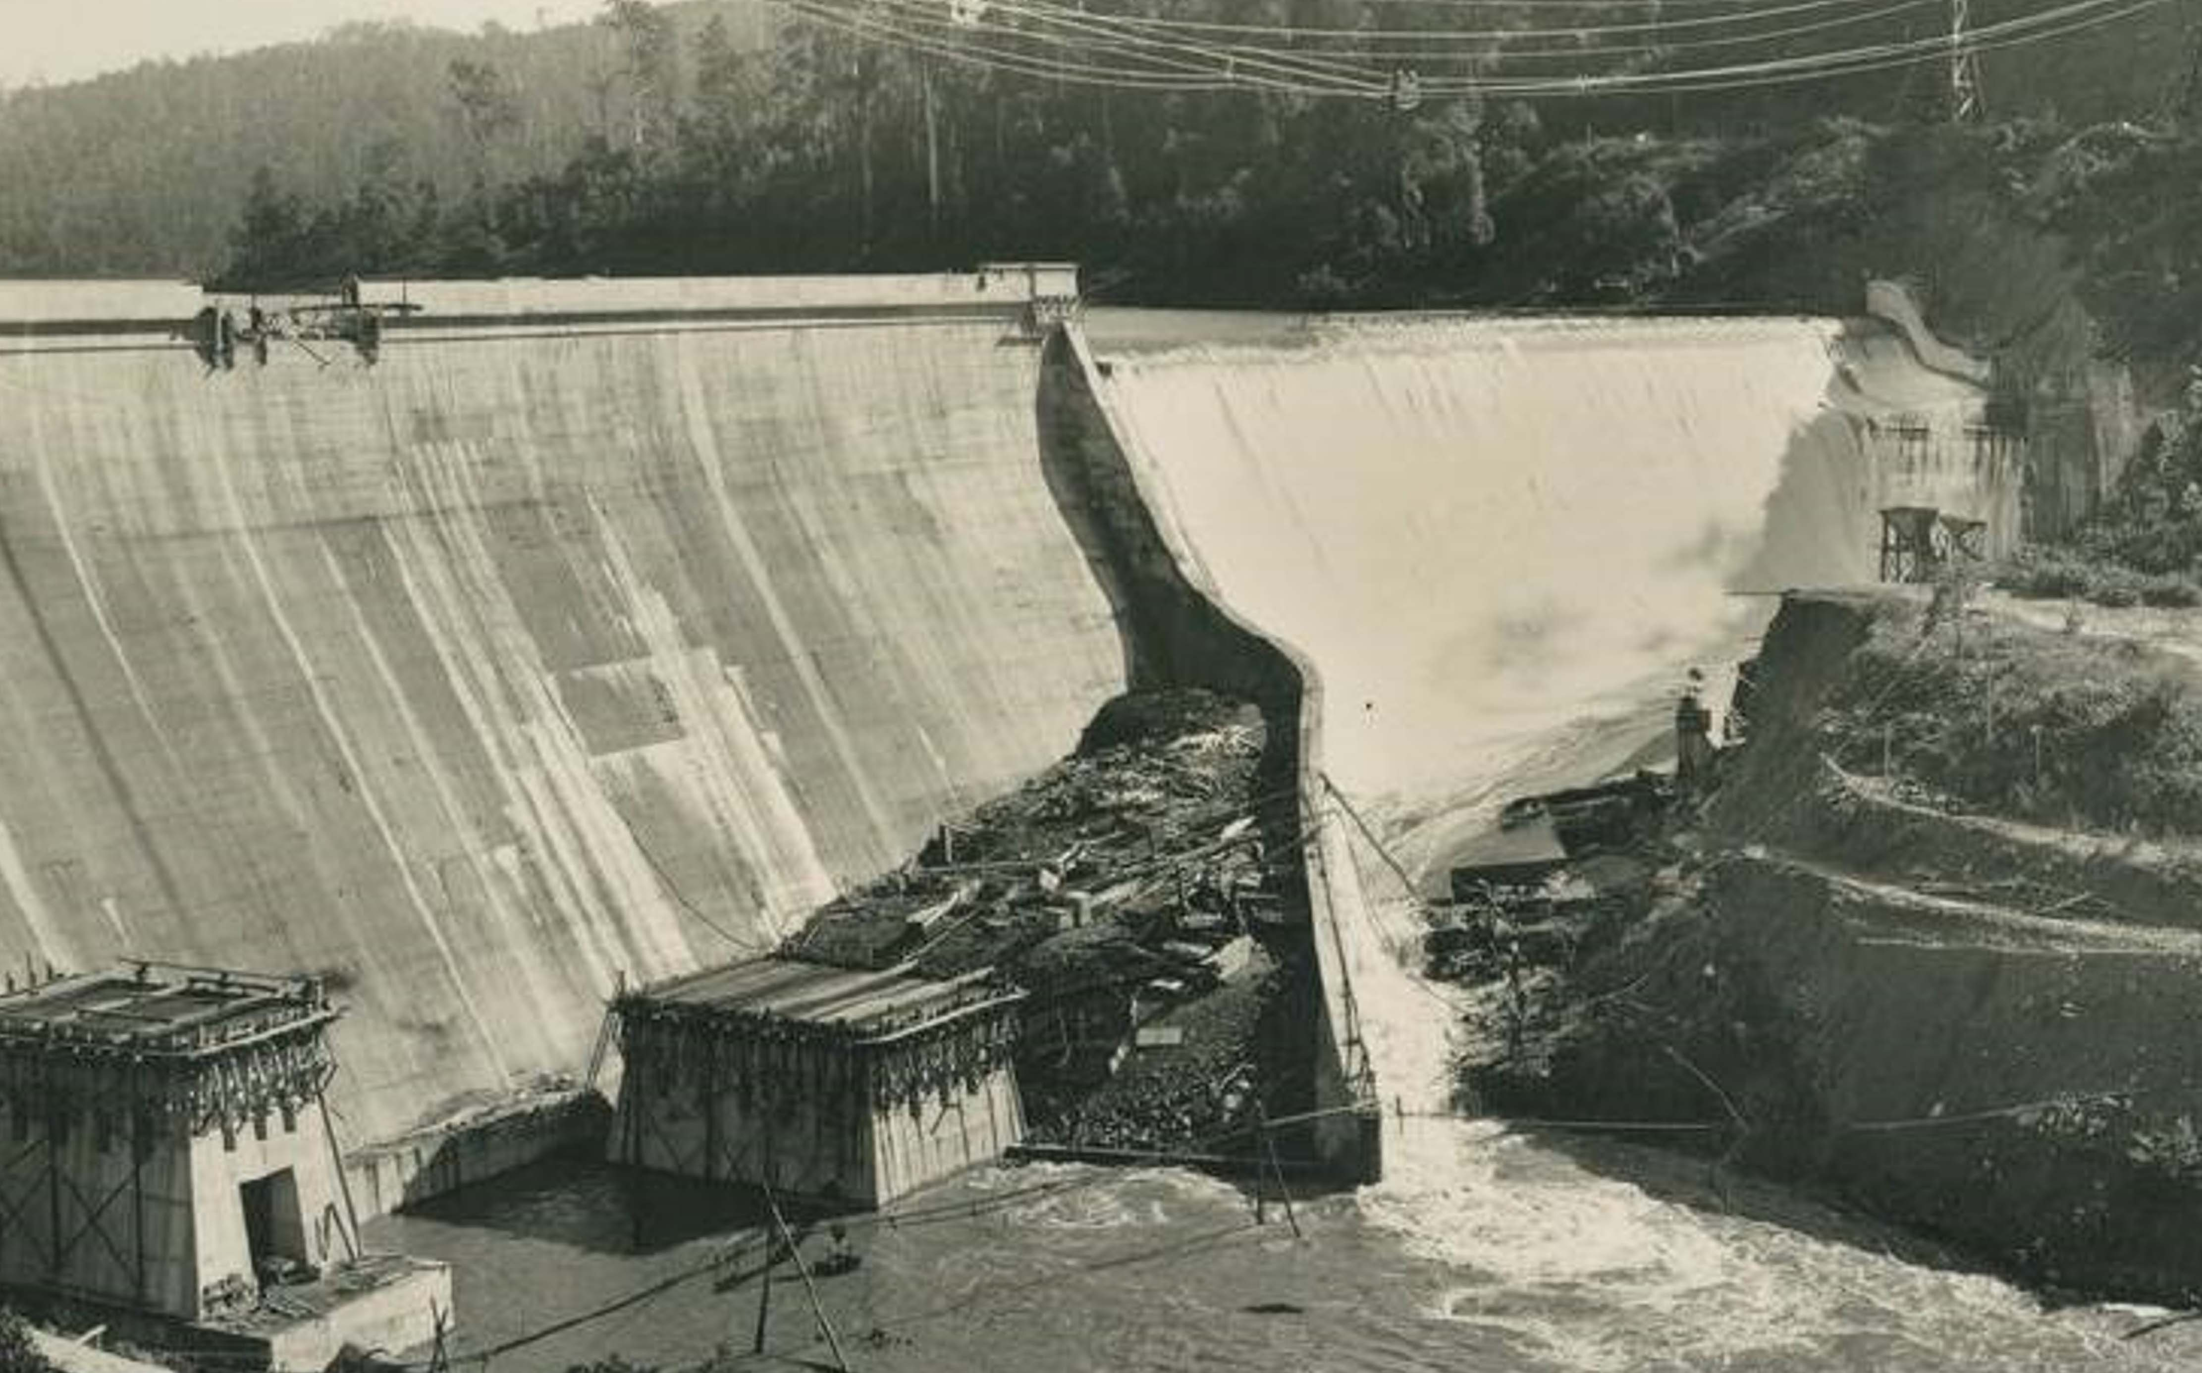
Max water level for spillway design flood
Lower spillway required for a larger flood - loss of water storage capacity
Dam safety – spillway must discharge largest flood – PMF – without overtopping dam wall

Slide 28
10.00 | 28,334 | 34,532 | 27,449
10.70 | 31,361 | 38,221 | 30,381 | Original Spillway _ Max Water depth
11.00 | 32,689 | 39,839 | 31,667 | Spillway modeled as broad crest
11.70 | 35,858 | 43,702 | 34,737
12.70 | 40,552 | 49,423 | 39,285 | Spilway lowered 2 ft. 1967
13.00 | 41,997 | 51,184 | 40,685
14.00 | 46,935 | 57,202 | 45,469
15.00 | 52,053 | 63,439 | 50,426
16.00 | 57,344 | 69,888 | 55,552
17.00 | 62,803 | 76,541 | 60,841
17.70 | 66,722 | 81,317 | 64,637 | Spillway lowered 9 ft.
 |  |  | Spillway Flow Rate
 |  | cfs |  | cms
Original Peak Flow |  | 32,000 | Original | 900
Capacity after lowering |  | 39,290 | Lowered 2 Ft | 1,113
 |  | 64,640 | Lowered (2 + 7) Ft | 1,830
1984 Estimated PMF |  |  |  | 2,400

Slide 29
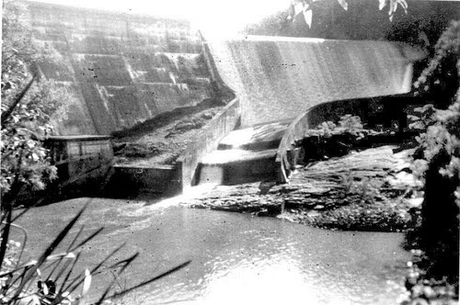
Flow over original spillway

Slide 30
Pipeline – 36 inch dia. -
gravity flow – mainly above ground
Minimum head 430 ft.
Receiving reservoirs El.
192 ft. and 301 ft.
9 miles wood-stave
53 miles - U.S. supplied rolled steel, fabricated in Newcastle

Slide 31
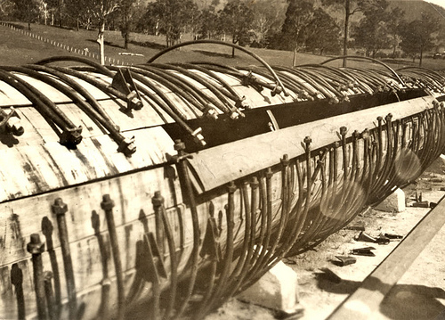
Steel hoop rings
Wood stave pipeline construction

Slide 32
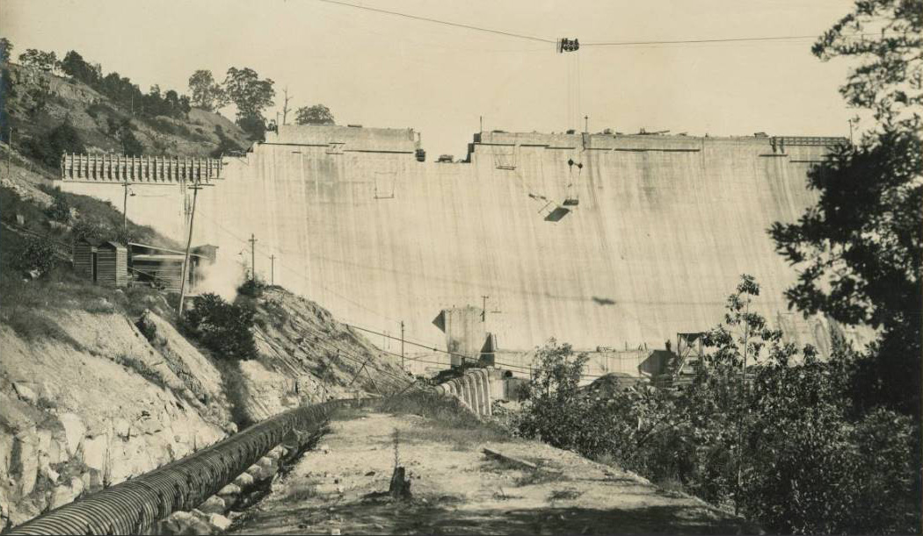
Wood-stave pipeline

Slide 33
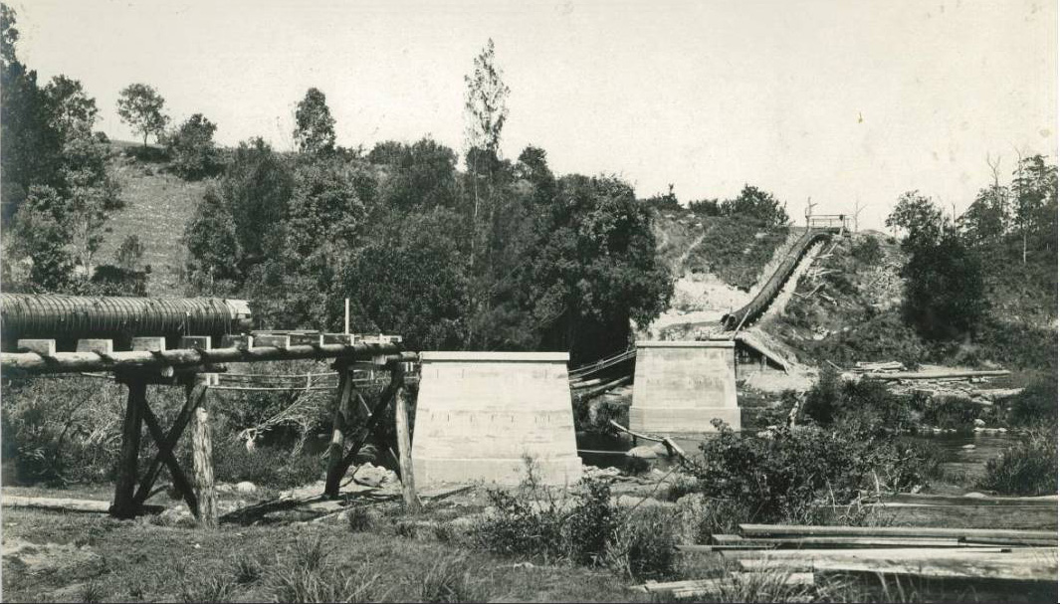
Wood-stave pipeline
Support piers
Support cradles
Pipeline river crossing

Slide 34
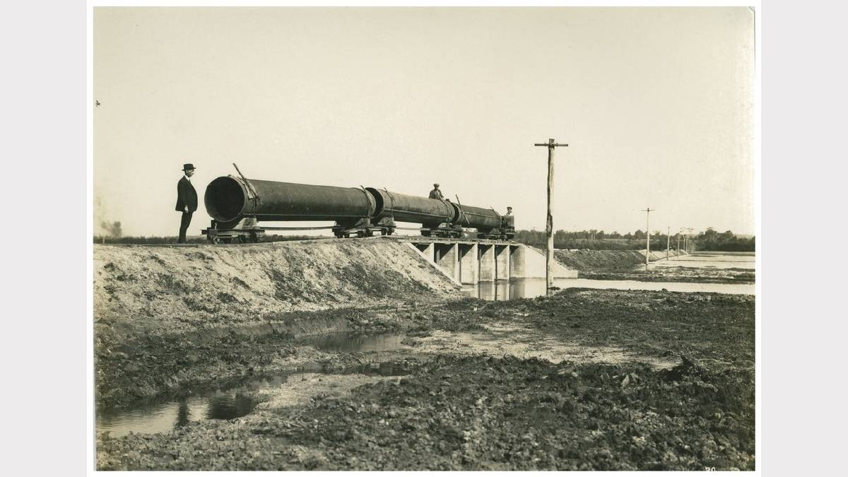
Pipe seams - welded
Steel pipeline construction

Slide 35
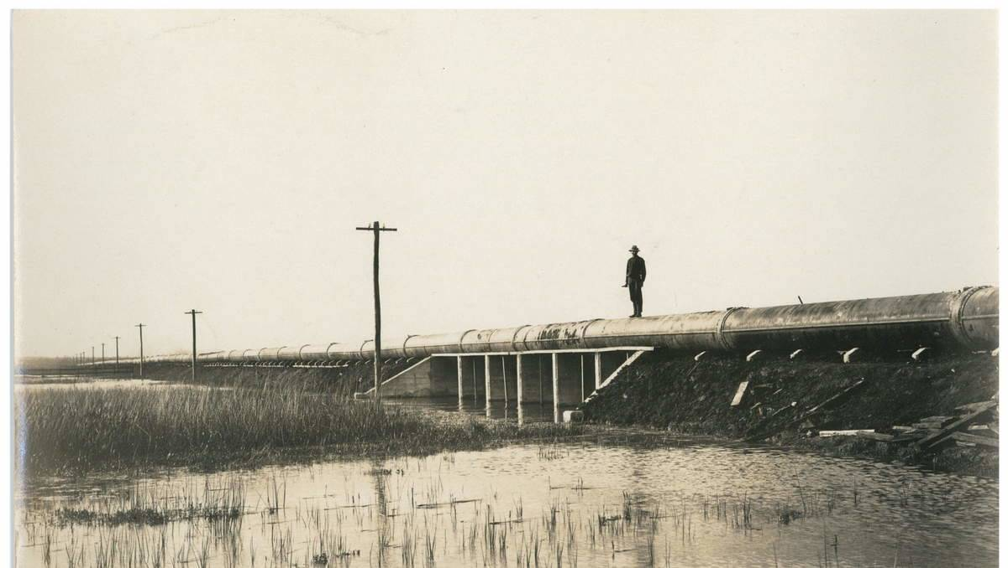
Steel pipe joint “steel bands” – lead seal
Portion of original steel pipeline – note joints

Slide 36
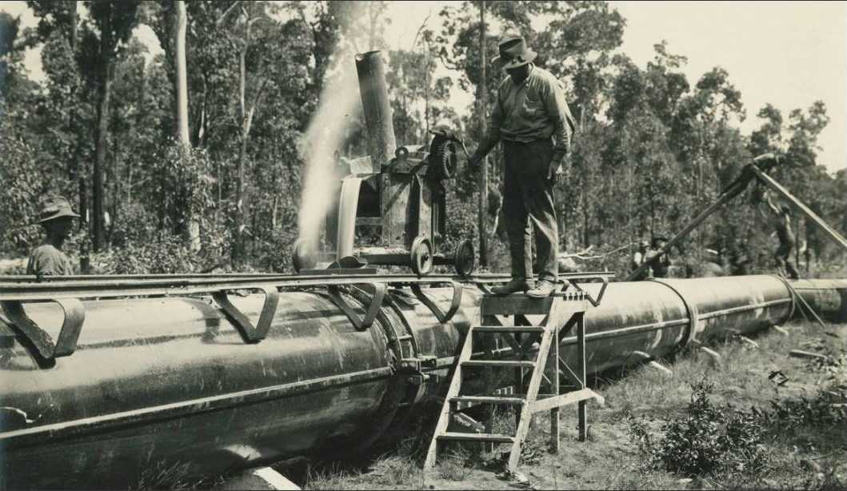
Pouring molten lead seal

Slide 37
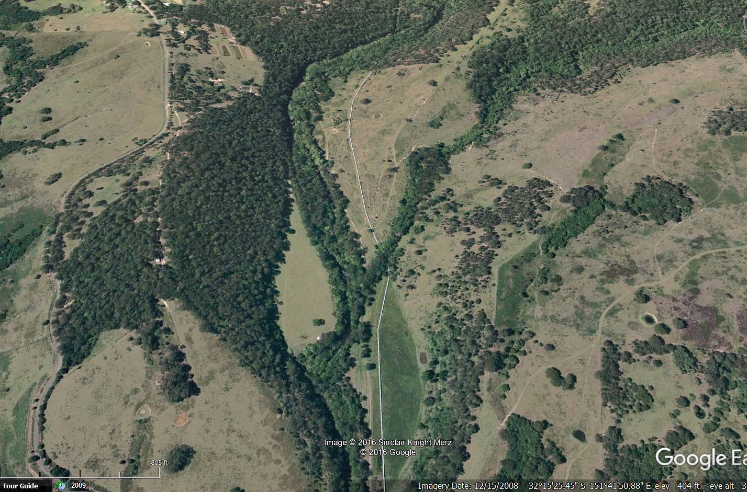
Modern steel pipeline
0.1 miles

Slide 38
Major Pipeline Systems – Complex Infrastructure
See e.g.
https://en.wikipedia.org/wiki/Trans-Alaska_Pipeline_System
Water System Design Manual
https://doh.wa.gov/sites/default/files/2022-02/331-123.pdf?ver=2019-10-03-153237-220
Pipeline design and maintenance:
Right of way, ground conditions, river crossings
Seismic
Structural integrity
Materials (corrosion and wear)
Thermal influences (expansion and contraction)
Access, air relief valves, shutoff valves, drainage valves
Physical, chemical, and biological security
Cyber security
Ongoing O & M and replacement

Slide 39
Major Dam Safety Upgrades – Chichester Dam
1967: spillway lowered by 2 feet and later by an additional 7 feet to increase flood capacity
1985: spillway relocated to center of the dam wall and returned to original height; dam post-tensioned with 93 cables.
1995: seepage potential reduced under the northern abutment
2003: improved drainage system for foundations installed and the left parapet wall raised to prevent overtopping in major flood.
Hunter Water S170 Register - SHI No 3630116; Name Chichester Dam.pdf

Slide 40
Major Dam Safety Upgrades – Chichester Dam
The NSW Government formed a regulator called the ‘Dams Safety Committee’(DSC) in 1976 and charged them with determining a set of rules for dam safety based on the concept of a dam’s site specific ‘Consequence Category’.
Chichester was its first case.
Original spillway capacity was about 900 m³/sec.
The 1984 PMF was determined at 2,400 m³/sec.
Post tensioning (P/T) and relocation of spillway to meet new PMF
Notes from Jeff Gleeson, Hunter Water, August 2017

Slide 41
Major Dam Safety Upgrades – Chichester Dam
From 1984 to 2017 the PMF has risen progressively from 2,400 m³/sec to 5,900 m³/sec.
Rated spillway capacity 3,300 m³/sec.
Conservative design worked to about 3,600 m³/sec.
P/T tendons had to be checked frequently.
The dam is “deficient” 2017 -.
Dams Safety Regulation 2019 – NSW Government
Annual reports from dam owner/operators required
https://legislation.nsw.gov.au/view/html/inforce/current/sl-2019-0506
Notes from Jeff Gleeson, Hunter Water, August 2017 – Updated with Dam Safety Report, April 2023, Steve Burges

Slide 42
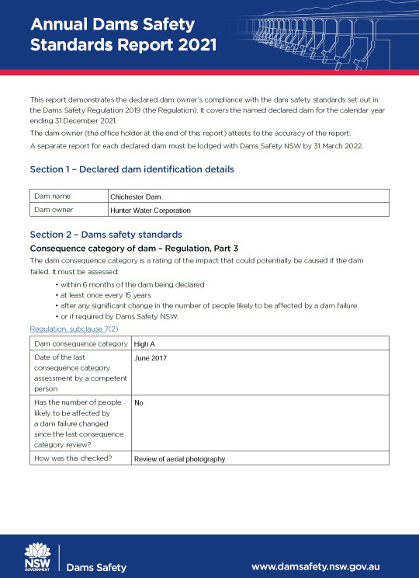

Slide 43
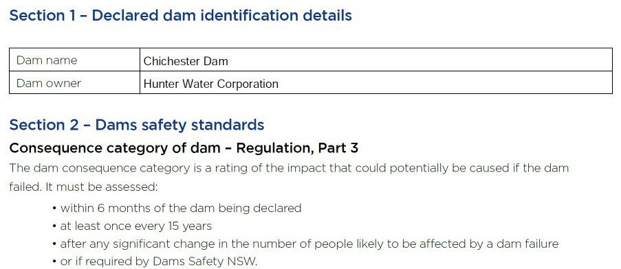
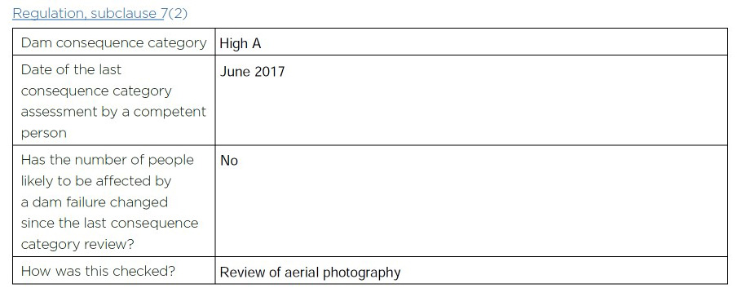
Report for December 31, 2021

Slide 44
- Davis, 1942

Slide 46
- Davis, 1942

Slide 50
Failure Modes
Overturning
Pivot
Sliding

Slide 51
Failure Modes
Overturning
Structural
Sliding
Subsurface erosion
Dam has to be safe for highest flow rate - PMF

Slide 52
Major Dam Safety Upgrades
1967: spillway lowered by 2 feet (Steve Burges site engineer) and later by an additional 7 feet to increase flood capacity.

Slide 53
Activities (site engineer) - Preparation for Chichester Dam Spillway lowering - Dec 1966:
Study “SAA Explosives Code” and train a “shot firer”
Plan all site safety and construction logistics
Design a safety fence and arrange for fabrication
Develop a blasting pattern and schedule.

Slide 54
Site engineer - Jan 1967 – Mar 1967
Use explosives (gelignite) to remove top 2 feet of spillway

Slide 55
Highest priority - safety for all crew and site visitors
Have materials and equipment ready for the crew – logistics!
I welcomed and used inputs from every crew member – mostly former under-ground coal miners
We developed drill and blast patterns after 1 week of trials -- one blast pattern per day

Slide 56
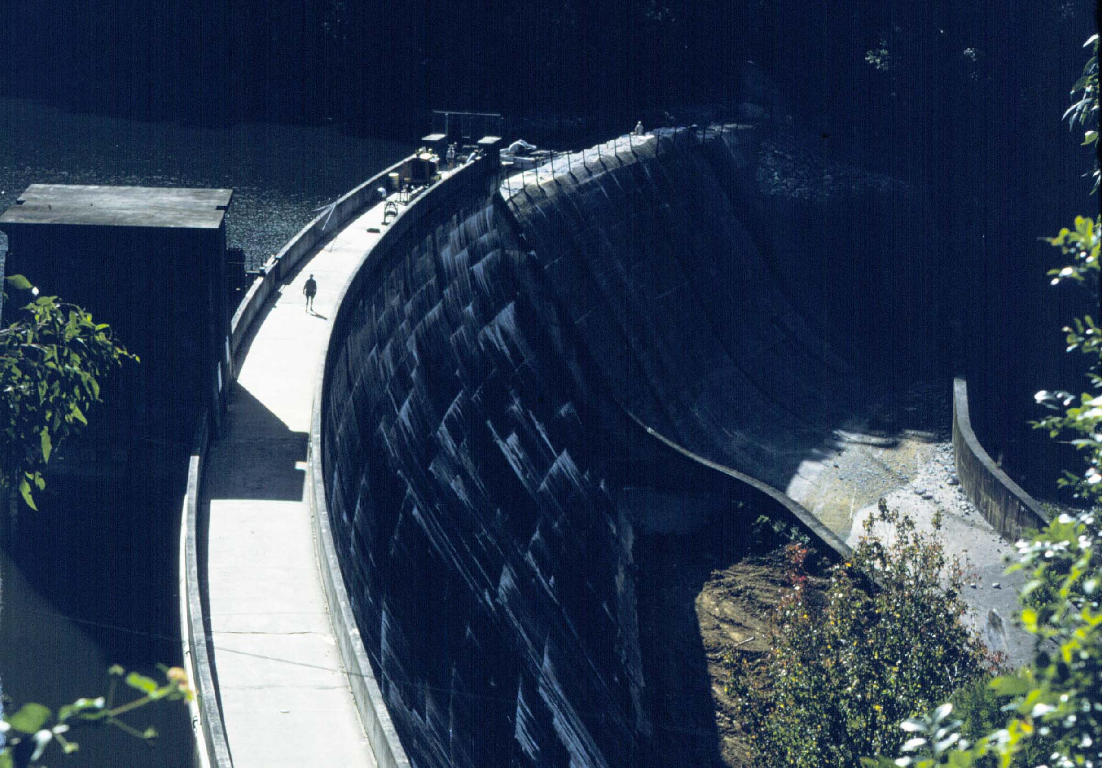
Safety fence - no design standards available
Work barge
Air compressor
March 1967

Slide 57
Major Dam Safety Upgrades
1967: spillway lowered by 2 feet and later by an additional 7 feet to increase flood capacity
1985: spillway relocated to center of the dam wall and returned to original height, dam post-tensioned with 93 cables.
The upgraded actions were made to minimize the possibility of water overtopping the main dam wall and against rotational failure.

Slide 58
Post Tensioning Cable Schematic

Slide 59
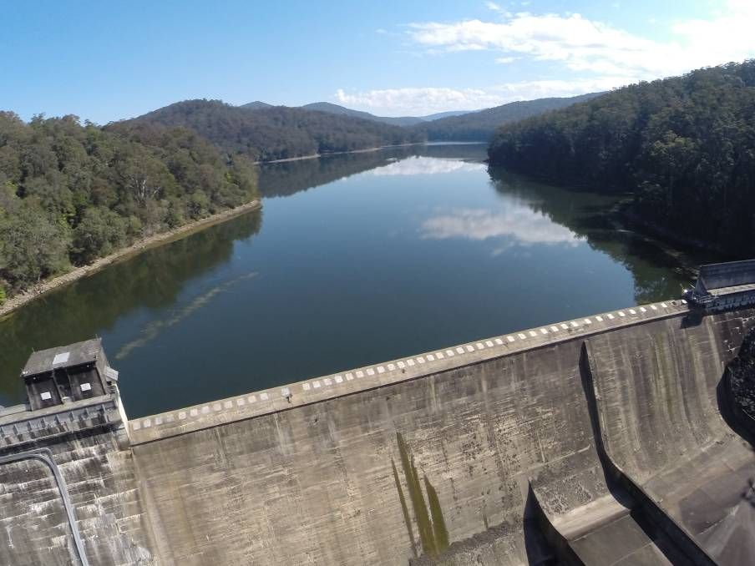
Post Tensioning Cable Locations - Spillway

Slide 60
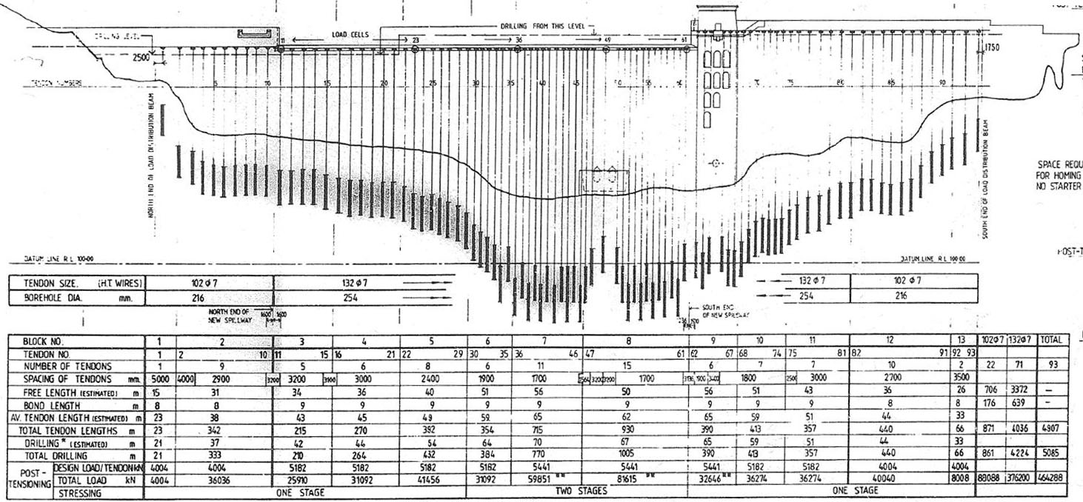
Anchor length
8 to 9 m
Post Tensioning Cable Placement

Slide 61
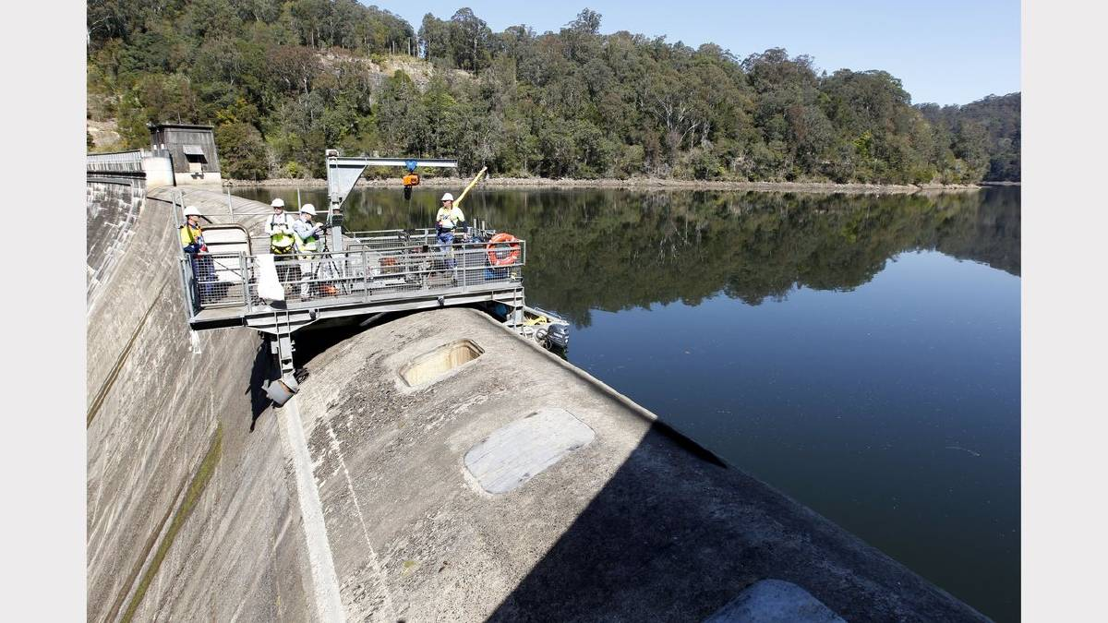
Post Tensioning Cable Inspection

Slide 62
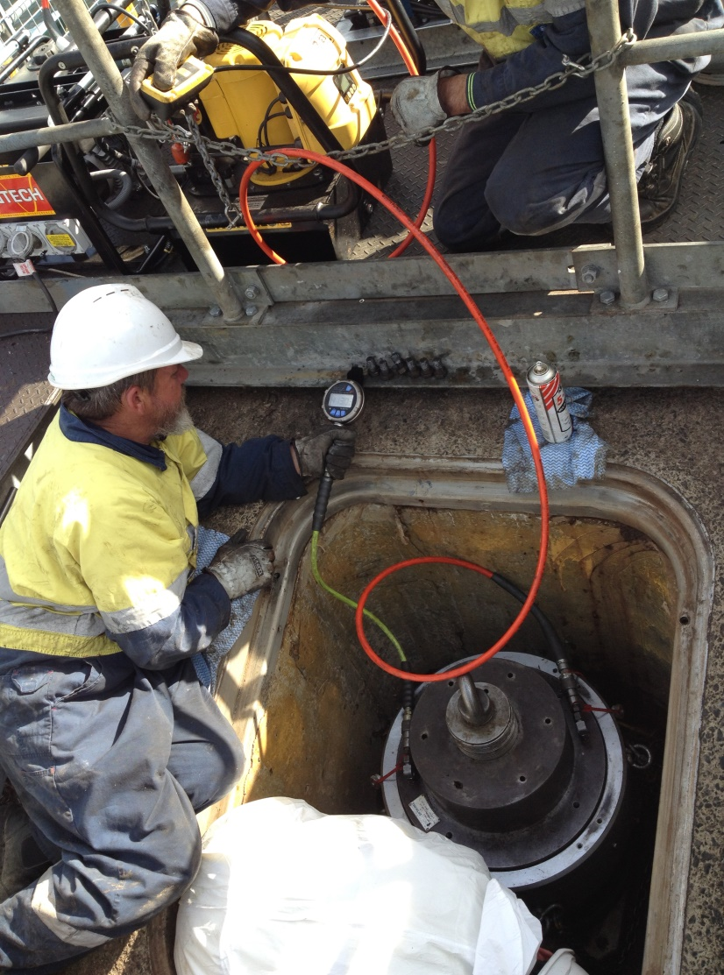
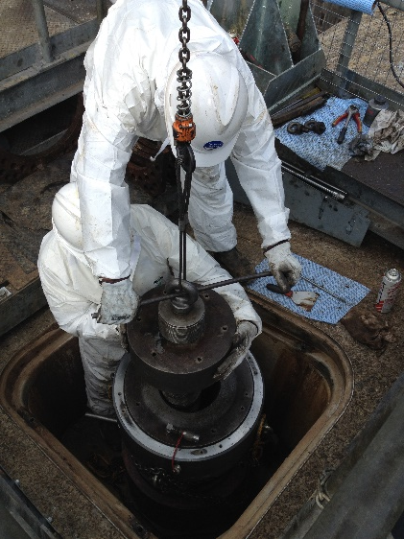
Post Tensioning Testing

Slide 63
Summary of P/T tendon “restressing” 2005 - 2015
Notes from Jeff Gleeson, Hunter Water, August 2017

Slide 64
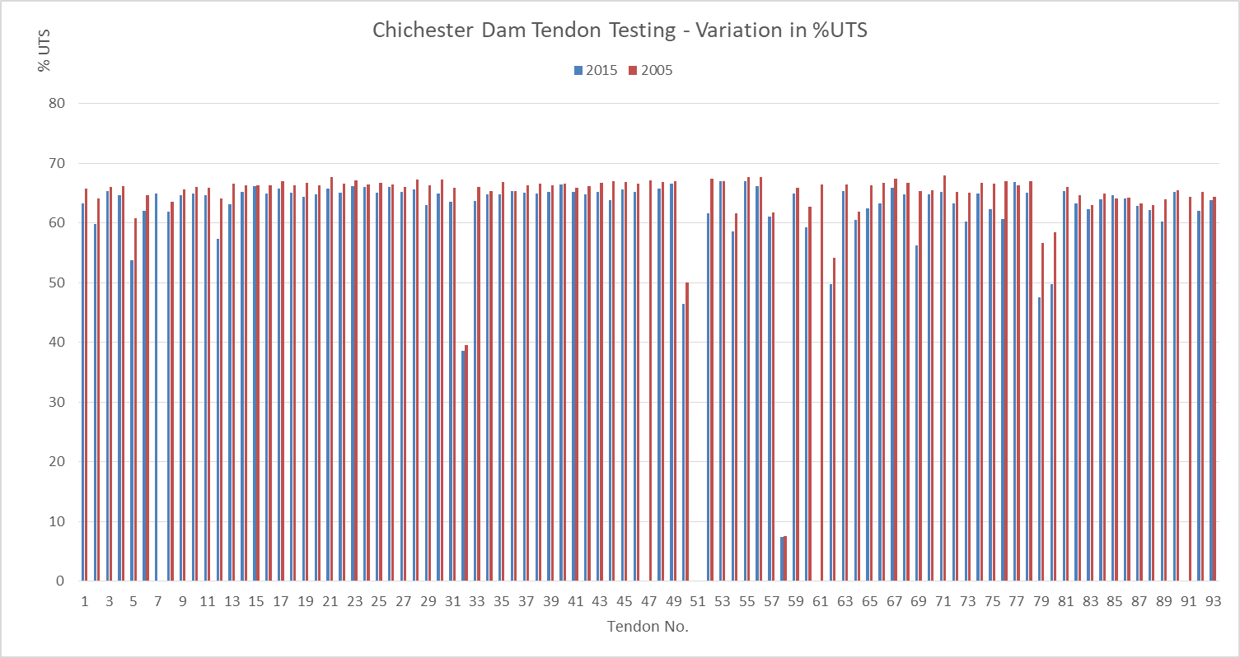
Figure B1 - % UTS (Ultimate Tensile Strength) Comparison of results for 2015 to 2005
Notes from Jeff Gleeson, Hunter Water, August 2017

Slide 65
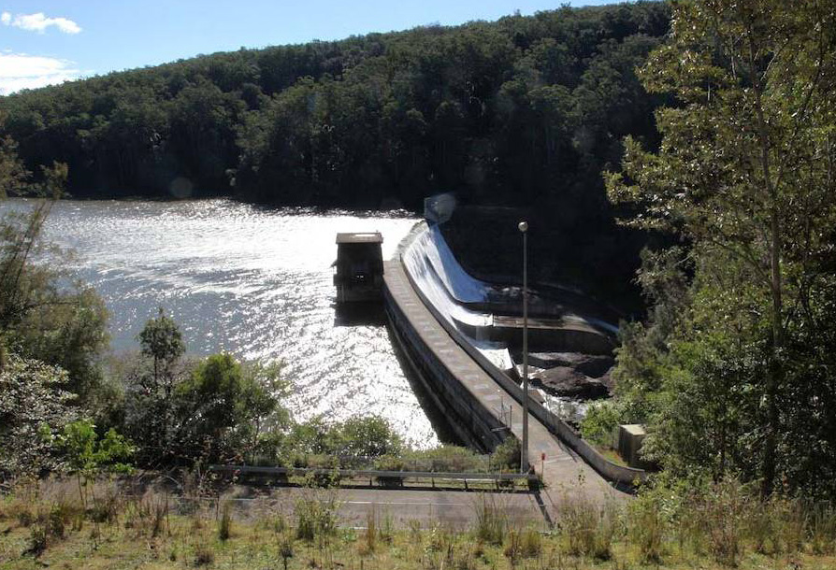
Photo - Futurepast Heritage Consulting Pty Ltd June 8, 2010

Slide 66
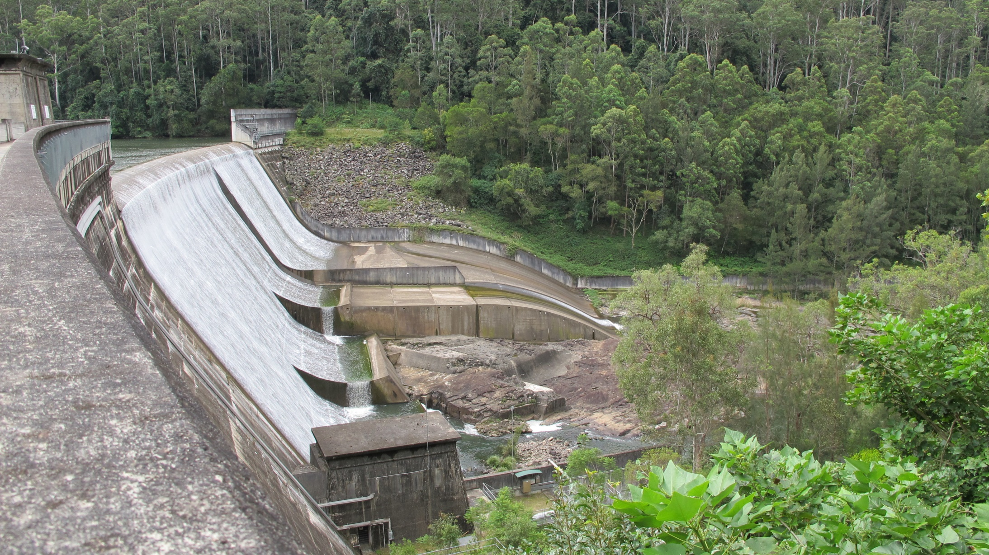
Hydraulic Jump Forming Structures
Competent Bedrock
Photo - Futurepast Heritage Consulting Pty Ltd June 8, 2010

Slide 67
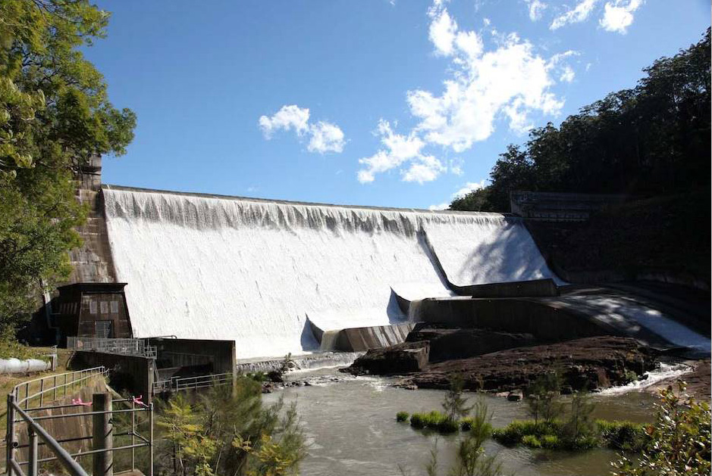
485 ft. long “ogee” spillway
Major design consideration: preventing cavitation damage
Photo - Futurepast Heritage Consulting Pty Ltd June 8, 2010

Slide 68
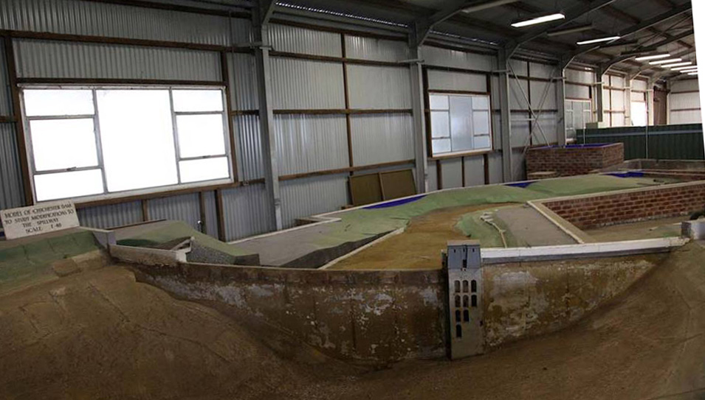
Spillway scaled for 485 ft. prototype
Multi-level water intake ports
Hydraulic model – 1:48 scale for replacement spillway design
Froude number scaling - 1967-1968
Futurepast Heritage Consulting Pty Ltd May 19, 2010

Slide 69
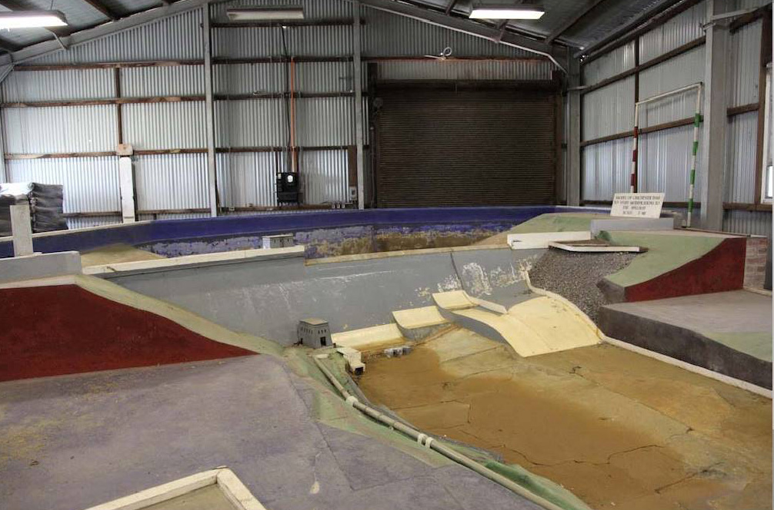
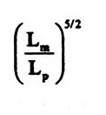

Hydraulic model
=
2 cfs model ~ 32,000 cfs,
~ 900 cms
Futurepast Heritage Consulting Pty Ltd May 19, 2010

Slide 71
Summary Observations
Engineering designs are made under uncertainty.
Supplies and labor availability have major influences on construction – World War I was a major disruption of the Chichester Dam and pipeline project.
Knowledge and observations gained with time may necessitate modification to design and operation of facilities; the economic life of infrastructure is ~40 yrs.
The changes to Chichester Dam and spillway occurred over three or more professional lifetimes. It is essential that Institutional Memory is retained.

Slide 72
Topics
Municipal Water Supply, Newcastle, Australia:
Chichester Dam, dam safety modifications
Water Supply in California:
Major dams, distribution network, infrastructure vulnerability – example Oroville Dam

Slide 73
Major reservoirs in California and distribution system

Slide 74
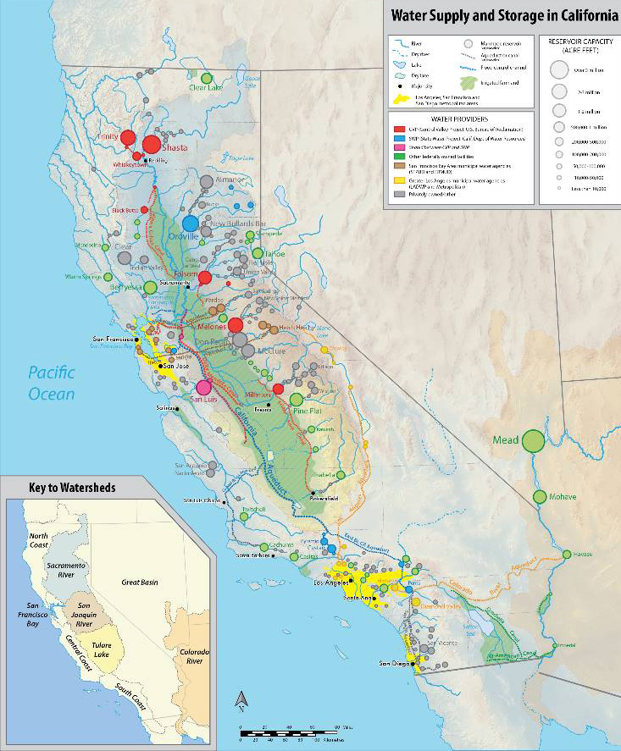
Map of California's interconnected water system, including all eleven reservoirs over 1 million acre feet (1.2 km³) and selected smaller ones (Wikipedia)
80 miles
https://en.wikipedia.org/wiki/List_of_largest_reservoirs_of_California#/media/File:Water_in_California_new.png

Slide 75
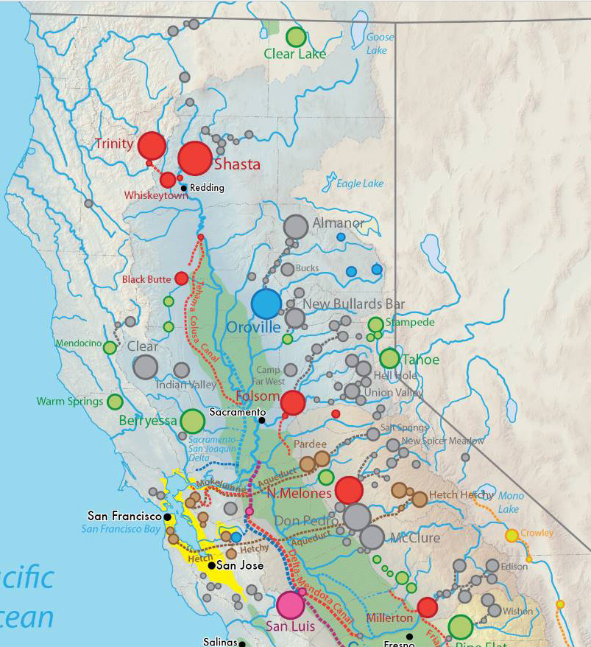
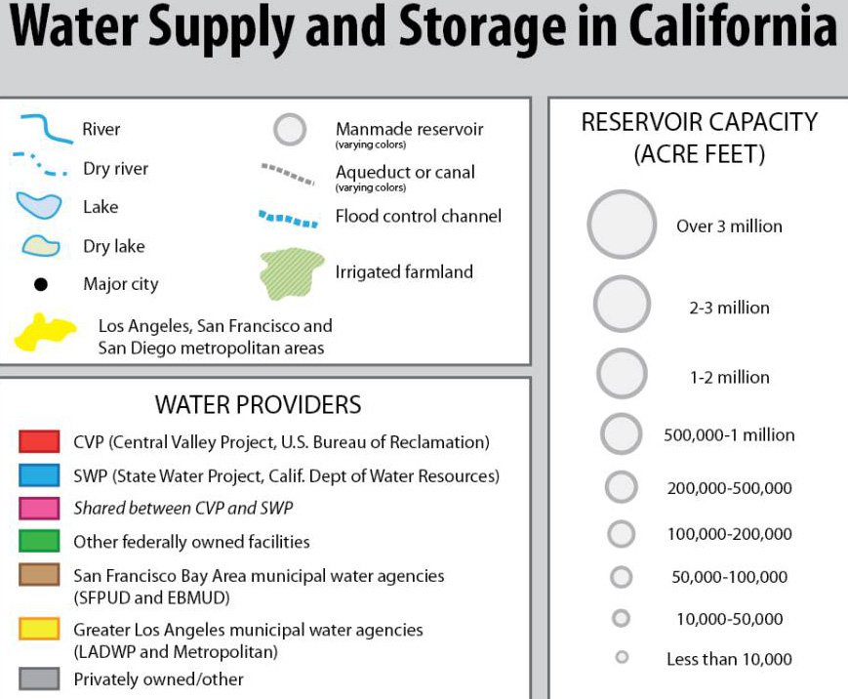
2.45 MAF, 1962
4.55 MAF, 1945
3.54 MAF, 1968
1.12 MAF, 1956
2.40 MAF, 1979
2.04 MAF, 1979

Slide 76
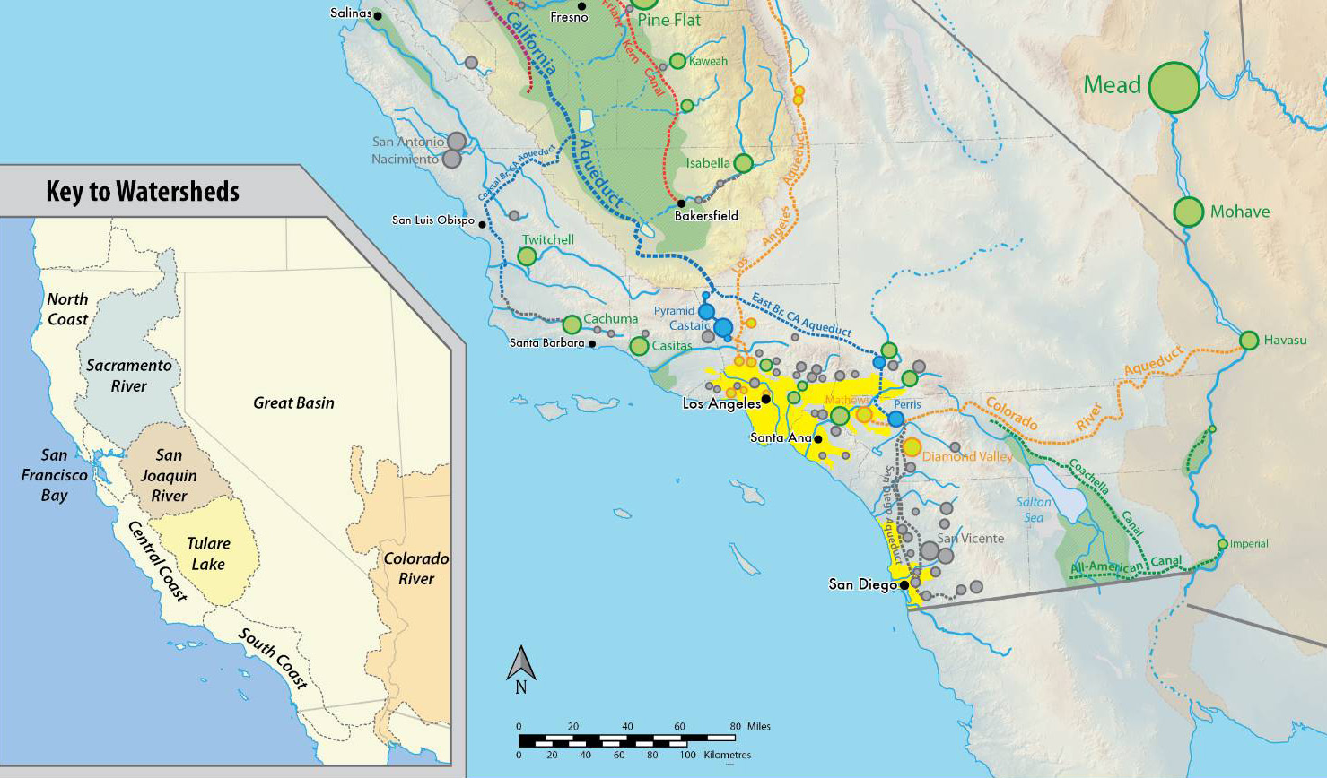
32 MAF, 1935-36, Actual 26.1 MAF
Los Angeles imports

Slide 77
Combined use of stored surface water and ground water
Cyclic storage:
multi - year to decadal time scales for aquifer recharge and pumping
D.P. Lettenmaier and S.J. Burges, "Cyclic Storage: A Preliminary Assessment," Groundwater, Vol. 20, No. 3, 278-288, 1982.

Slide 78
Use of ground water to mitigate against drought
Ground water reservoirs have known supply; there is considerable uncertainty about supply from surface reservoirs leading up to, and during drought
What is the time history of ground water use?

Slide 79
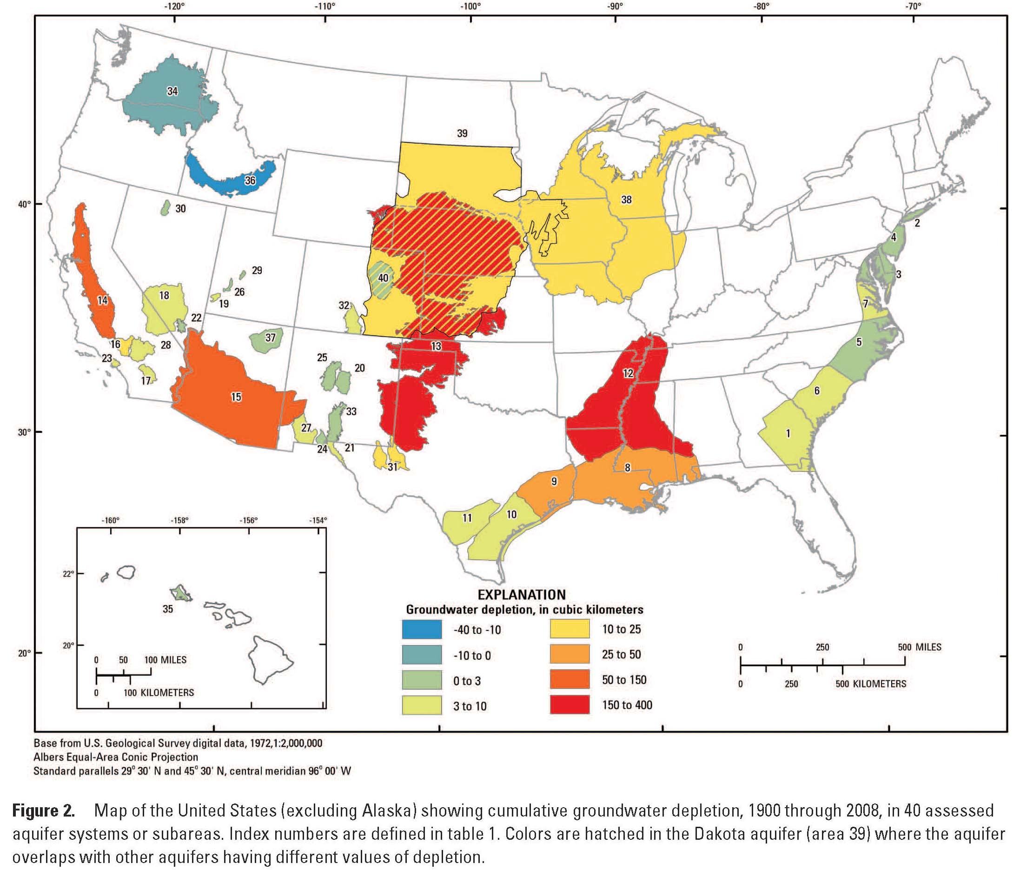
Leonard F. Konikow, Groundwater Depletion in the United States (1900−2008), USGS Scientific Investigations Report 2013−5079
145 cubic km = 117.6 MAF = 7.8 yr. crf.
Mean ann. flow Colorado R. = 15 MAF
113
145
259
341
118
182

Slide 80
We must not abuse our ground water resources!

Slide 81
California State Water Project – importance of Oroville Dam

Slide 82
The Sacramento River HR is the main water supply for much of California’s urban and agricultural areas.
Annual runoff in the HR averages about 22.4 maf, which is nearly one-third of the State’s total natural runoff. Major water supplies in the region are provided through surface storage reservoirs.
The two largest surface water projects in the region are USBR’s Shasta Lake (Central Valley Project) on the upper Sacramento River and Lake Oroville (DWR’s State Water Project) on the Feather River.

Slide 83
In all, there are more than 40 major surface water reservoirs in the region. Municipal, industrial, and agricultural supplies to the region are about 8 maf, with groundwater providing about 2.5 maf of that total.
Much of the remainder of the runoff goes to dedicated natural flows, which support various environmental requirements, including
in-stream fishery flows and flushing flows in the Delta.

Slide 84
2.45 MAF, 1962
4.55 MAF, 1945
3.54 MAF, 1968
1.12 MAF, 1956
Natural mean annual runoff – Sacramento R. = 22.4 MAF
Storage ratio > (2.45 + 4.55 + 3.54)/22.4 = 0.47
2.40 MAF, 1979
2.04 MAF, 1979

Slide 85
Sacramento River annual flow variability
Tree-ring index reconstructions

Slide 86
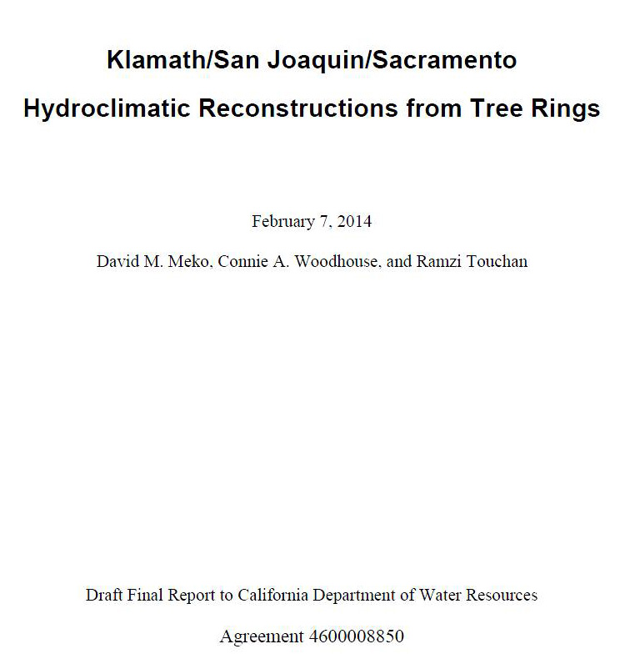
http://www.water.ca.gov/waterconditions/docs/tree_ring_report_for_web.pdf

Slide 87
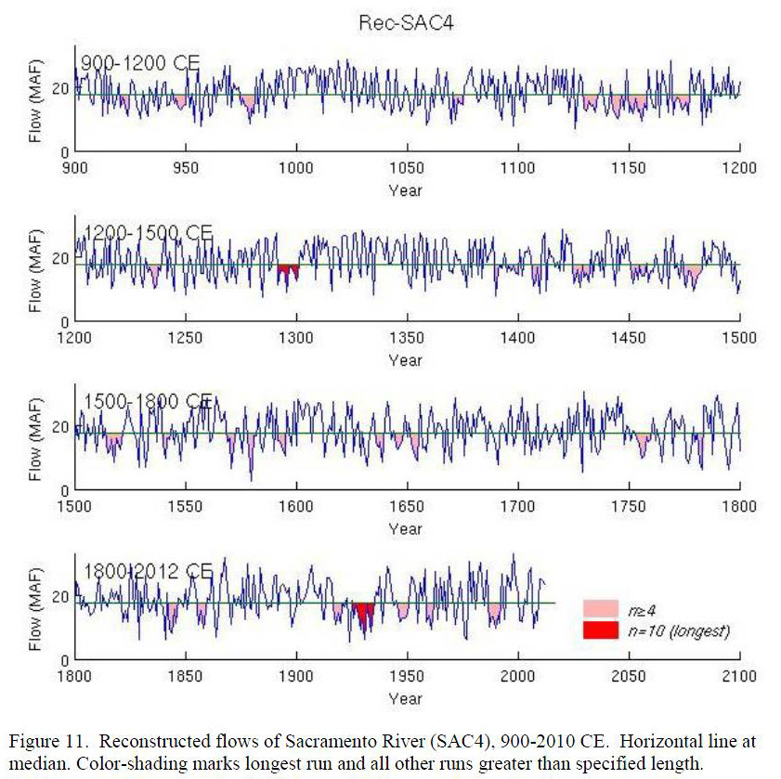

Slide 88
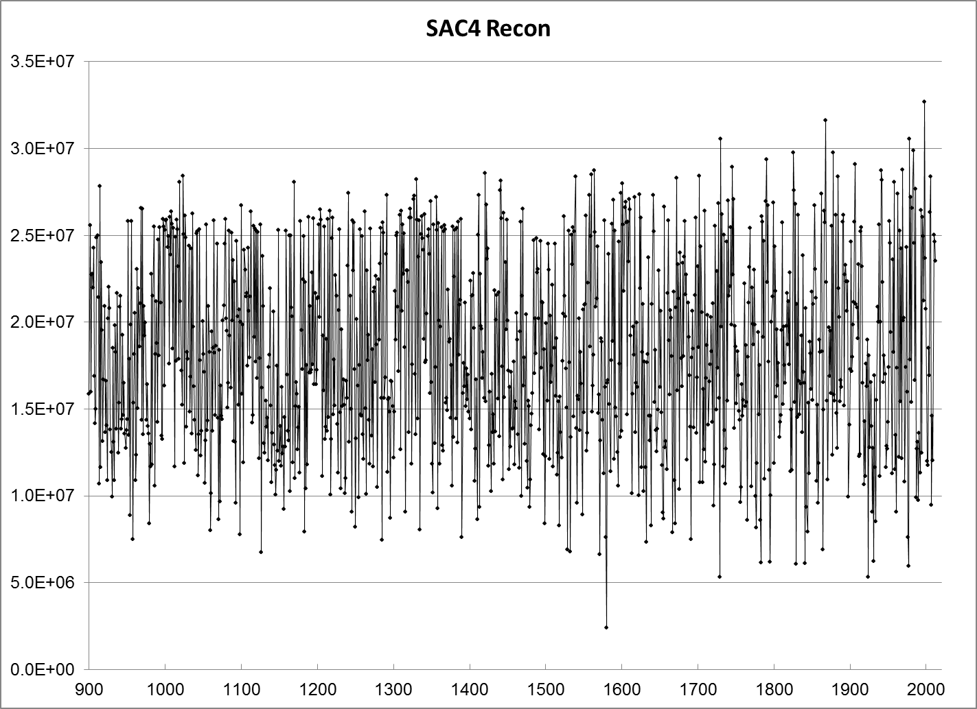

Slide 89
Oroville Dam – Importance to California State Water Project
Dam safety issues – 2017

Slide 90
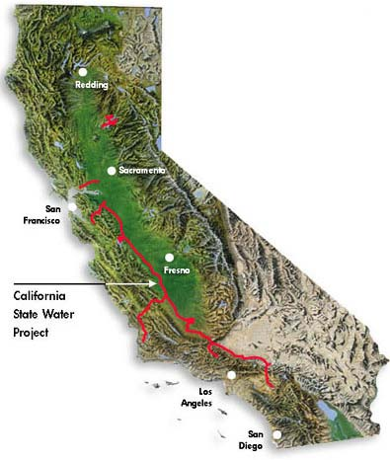
Oroville Dam
http://www.water.ca.gov/maps/state.cfm

Slide 91
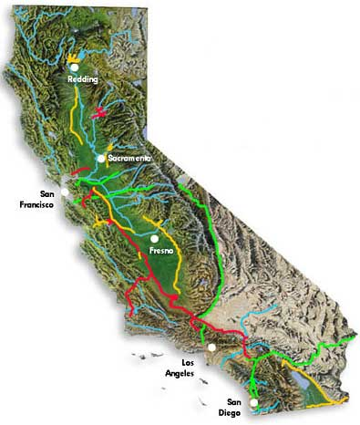
All water projects and rivers (blue)

Slide 92
Features of Oroville Dam

Slide 93

Cross-section earth-fill Oroville Dam

Slide 94
Failure mechanisms for an earth-fill dam
Multiple causes - erosion and slumping of upstream face
Reservoir overtopping and erosion of downstream face

Slide 95
Failure mechanisms for an earth-fill dam
“Piping” or seepage flow and erosion of downstream face

Slide 96
Failure mechanisms for an earth-fill dam
Structural instability and slumping – seismic - overtopping and erosion of downstream face

Slide 97
Failure mechanisms for an earth-fill dam
“Piping” or seepage flow failure preventative measures

Slide 98

Seepage flow path failure preventative measures
https://www.youtube.com/watch?v=Qp-YxXlMnlg&ab_channel=MillieKay

Slide 99

Could the main earth dam have failed?
Hydro power plant not at risk
Relatively flat part of 3000 ft. long chute spillway
Damaged spillway and major erosion path
March 2017

Slide 100

Main zoned-earth dam
~ 80 million cubic yards
Height 770 ft.
Highest in USA - 1968
Crest elevation – 922 Ft.
Emergency spillway flow starts at El. 901 Ft.
June 7, 2013

Slide 101

Upstream rip-rap wave protection
June 7, 2013

Slide 102

Normal spillway flow (roll waves)
Channel width 179 ft.
Energy dissipaters
June 7, 2013

Slide 103

https://en.wikipedia.org/wiki/Oroville_Dam#/media/File:Oroville_Dam_spillway_damage_27_Feb_2017.jpg
Feb 27, 2017

Slide 104

Reservoir: I – O = dS/dT
Earth dam – 6,920 ft. long
Hydro power plant
Main spillway for controlled reservoir release
March 2017

Slide 105
Emergency spillway -1,730 ft. long - for uncontrolled release of floods up to PMF: 800 ft “broad crest weir” + 930 ft “ogee.”
March 2017

Slide 106
Normal operation:
Releases from power plant and from a “bypass valve” for environmental flows (and power production)
When reservoir at spillway level, releases from power plant and spillway gates as appropriate.
Extreme flood conditions:
Release from controlled spillway and emergency spillway; hydro plant may be inoperable.

Slide 107

Spillway gates
Release through spillway control gates
http://www.smartbrief.com/s/2017/03/oroville-dam-spillway-repair-may-require-temporary-solution
March, 2017

Slide 108

Emergency spillway
Ogee section
Broad crest weir
Note location similarity to Englewood Dam (1922) emergency spillway, Miami Conservancy District, Ohio
Major difference – greater erosional potential at Oroville: longer hillside runout length to river. Runout domain rock stability critical to safe performance
June 7, 2013

Slide 109

Englewood Dam, Ohio – completed 1922
Outlet works
Emergency spillway
0.1 miles

Slide 110

Emergency Spillway
Existing rock with shallow soil cover
Overflow path
May 1984

Slide 111

Top of dam
Outflow armoring

Slide 112

Spillway overflow path
Engineered wing walls
May 1984

Slide 113

Oroville Emergency spillway
Flow path
June 7, 2013

Slide 114

Parking lot
Water overflowed the parking lot past the emergency spillway (in the background), while water continued to flow through the main spillway (in the foreground), on February 11, 2017.
https://en.wikipedia.org/wiki/Oroville_Dam#/media/File:Oroville_dam_spillover_2017-02-11.jpg

Slide 115

Water from the Oroville Dam flows over the Emergency Spillway at Lake Oroville on Sunday February 12, 2017.
https://en.wikipedia.org/wiki/Oroville_Dam#/media/File:Oroville_Emergency_Spillway_Carrying_Water.jpg

Slide 116


Slide 117

Back cutting at 10 ft/hour

Slide 118
Repair schedule:
March 17, 2017, report of Board of Consultants
Work scheduled July – October 2017
https://ferc.gov/sites/default/files/2020-04/03-17-17Orovilledam.pdf

Slide 119
Repair schedule (ctd):
The presented design criteria for spillway flows are as follows:
Restore both spillways to pass the Probable Maximum Flood (PMF) flows (646,000 cfs) without failing, and with damage below the Emergency Spillway to be expected.
These include the following estimated flows:
• Gated Spillway peak design outflow of 277,000 cfs
Emergency Spillway peak design outflow of 369,000 cfs (estimated - sjb - 16.0 to 16.6 ft water depth at spillway)

Slide 120
Repair schedule (ctd):
Operational maximum release goals are as follows:
• Operate the reservoir to limit the Gated Spillway maximum design release to 100,000 cfs
• Operate the reservoir to prevent spill over the Emergency Spillway.
It is the BOC’s understanding that peak outflows through the Gated Spillway will be limited to about 150,000 cfs, which is consistent with historic peak releases, and are designed to prevent overtopping of levees and flooding of communities downstream of the dam.

Slide 121


Slide 122

Reconstructed lower chute spillway Nov. 17, 2017

Slide 123

Emergency Spillway and overflow region before use
April 14, 2015

Slide 124

Emergency Spillway and overflow region after erosion damage
May 18, 2017

Slide 125

Emergency Spillway overflow region after extensive repair
Sep 21, 2020

Slide 126

Start
End
DWR Contract to Kiewitt to rebuild spillway $275 Million
Actual cost approx. $500 Million
Revised cost approx. $870 Million – Jan 26, 2018

Slide 127
Cost of replacement of spillway 2017-2018 and stabilization below emergency spillway – 2018, $1.2B (DWR Feb. 2021)
FEMA pays $630 Million
Oroville Dam, CA, failed spillway, Feb 27, 2017
https://en.wikipedia.org/wiki/Oroville_Dam#/media/File:Oroville_Dam_spillway_damage_27_Feb_2017.jpg

Slide 128
Two Oroville Spillway webinars:
Physical Aspects of the Oroville Dam Incident
https://www.youtube.com/watch?v=3JygTm8iiWQ
March 5, 2018, 2:00 PM EST
John W. France, PE, D.GE, D.WRE; Vice President, AECOM, Independent Forensic Team Leader
Lessons for Dam Safety from the Oroville Dam Incident
https://www.youtube.com/watch?v=YjgugkIfwWQ
March 14, 2018, 2:00 PM EST
Stephen J. Rigbey, Director Dam Safety at BC Hydro, Independent Forensic Team member

Slide 129


Slide 130


Slide 131
Questions?

Slide 132
Extras

Slide 133
Images of Oroville Dam March 2017
Source:
https://www.bing.com/images/search?q=oroville+dam+spillway&qpvt=oroville+dam+spillway&qpvt=oroville+dam+spillway&qpvt=oroville+dam+spillway&FORM=IGRE

Slide 134
Tolerable Risk Resources – US Army Corps of Engineers
https://www.rmc.usace.army.mil/Reference-Center/Tolerable-Risk/
1. FEMA
https://www.fema.gov/emergency-managers/risk-management/dam-safety/federal-guidelines
2. COE
U.S. Army Corps of Engineers (USACE) Dam Safety Policy and Procedures
https://www.publications.usace.army.mil/Portals/76/Publications/EngineerRegulations/er_1110-2-1156.pdf
(528 pages) – See particularly “Chapter 10. Dam safety Risk Communication”
Rationale Behind the U.S. Army Corps of Engineers Tolerable Risk Guidelines
Check all four Listings under “Tolerable Risk References
3. US EPA
Risk communication in Action - The Tools of Message Mapping, US EPA625R-06012, 200.pdf (51 pages)

Slide 135
Example of engineering failure due to lack of full knowledge of situation
Hunter District Water Board pipeline crossing of the South Channel Hunter River, 1965
Pressure test of fully charged new water pipeline
Blank flange failed during test
Faulty flange provided by an engineer from HDWB
What do you think happened?

Slide 136

Rectangular reinforced concrete portal frame supports damaged in 1965 during pipeline pressure “proof” test – created major repair problem
200 Feet
12/10/2006
Hunter Water Pipeline – Crossing South Channel Hunter River

Slide 137
Blank flanges installed isolating this section of pipeline
200 Feet
12/10/2006
Hunter Water Pipeline – Crossing South Channel Hunter River

Slide 138
Example of tragic engineering failure due to negligence
Kansas City Hyatt Regency walkway collapse, July 17, 1981
114 people killed, 216 injured
https://en.wikipedia.org/wiki/Hyatt_Regency_walkway_collapse#:~:text=On%20July%2017%2C%201981%2C%20the,killing%20114%20and%20injuring%20216.

Slide 144

March, 2017

Slide 145

March, 2017

Slide 146

March, 2017

Slide 147

March, 2017

Slide 148

March, 2017

Slide 149
https://en.wikipedia.org/wiki/Oroville_Dam#/media/File:Oroville_Dam_spillway_damage_27_Feb_2017.jpg
Feb 27, 2017

Slide 150

Emergency spillway
June 7, 2013

Slide 151
Tolerable Risk Resources – US Army Corps of Engineers
https://www.rmc.usace.army.mil/Reference-Center/Tolerable-Risk/
1. FEMA
https://www.fema.gov/emergency-managers/risk-management/dam-safety/federal-guidelines
2. COE
U.S. Army Corps of Engineers (USACE) Dam Safety Policy and Procedures
https://www.publications.usace.army.mil/Portals/76/Publications/EngineerRegulations/er_1110-2-1156.pdf
(528 pages) – See particularly “Chapter 10. Dam safety Risk Communication”
Rationale Behind the U.S. Army Corps of Engineers Tolerable Risk Guidelines
Check all four Listings under “Tolerable Risk References
3. US EPA
Risk communication in Action - The Tools of Message Mapping, US EPA625R-06012, 200.pdf (51 pages)

Slide 153

https://www.hunterwater.com.au/about-us/publications/annual-report

Slide 154


Slide 155


Slide 156


Slide 157


Slide 158

1 mile
Lake Oroville, the Oroville Dam, Thermalito Forebay and Thermalito Afterbay - Pumped Storage System

Slide 159

1 mile
Lake Oroville, the Oroville Dam, Thermalito Forebay and Thermalito Afterbay - Pumped Storage System

Slide 160
DESIGN EVOLUTION OF OROVILLE DAM 1956-68
J. David Rogers, Ph.D., P.E., P.G., F.ASCE, F.GSA
Professor & Karl F. Hasselmann Chair in Geological Engineering
Missouri University of Science & Technology
2017 AEG Annual Meeting, Colorado Springs
https://www.aegweb.org/assets/docs/1-Rogers_-_AEG_TS7-Oroville_.pdf

Slide 161
Orange County Ground Water Recharge Volume
Final expansion complete on world’s largest water reuse facility - Water Finance & Management - 4-17-2023.pdf
Volume = 130 mgd
Volume = 400 Acre Feet per day
Annual Volume = 146,000 Acre feet

