Slide 2
The Flood Damage Mitigation Works of the Miami Conservancy District, Ohio, 1922 -
Stephen J. (Steve) Burges
Professor Emeritus
Department of Civil and Environmental Engineering
University of Washington
Department of Civil and Environmental Engineering
University of Illinois Urbana-Champaign – November 27, 2023

Slide 3
Topics
Rain generated Super Floods
Flood Damage Mitigation:
Miami Conservancy District, Ohio

Slide 4
Topics
Rain generated Super Floods
Flood Damage Mitigation:
Miami Conservancy District, Ohio

Slide 5
Why super floods are important
They differ substantially from lesser floods,
are infrequent,
annual exceedance probability, p < 10⁻² ,
and cause greatest societal disruption and damage

Slide 6
Super flood – Essential Information
Domain
Meteorological context – storm sequence
Inundation details
Complete flood hydrograph – multiple locations

Slide 7
Super flood features - example
Great Flood of the Upper Mississippi River, May to September,1993
Extensive documentation and satellite images

Slide 8
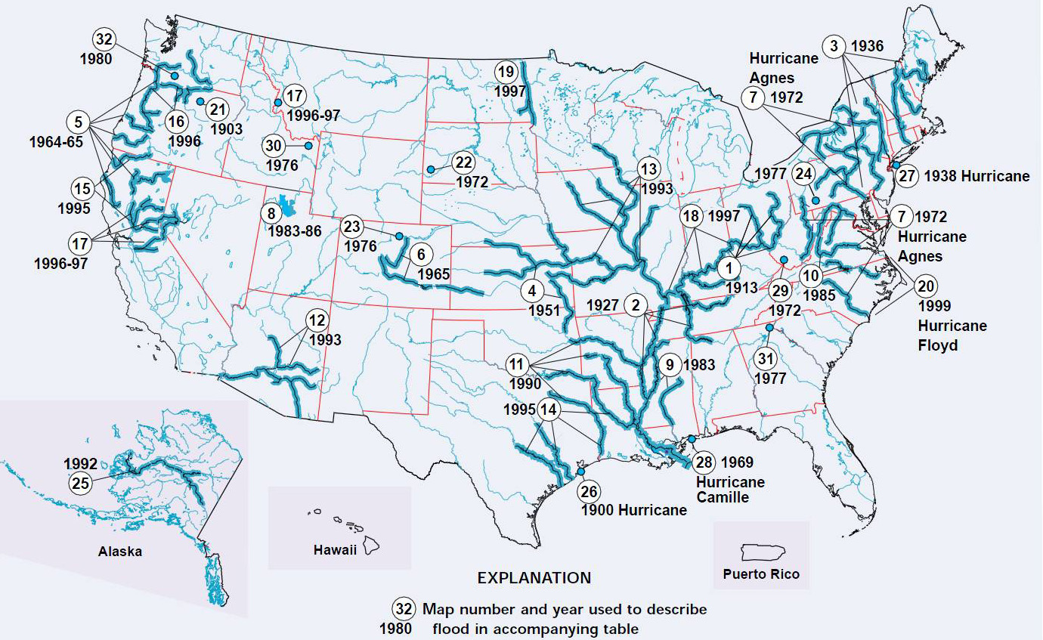
Upper Mississippi R. May – Sep 1993
Significant Floods in the United States During the 20th Century - USGS Measures a Century of Floods
USGS Fact Sheet 024–00 March 2000 - Charles A. Perry

Slide 9
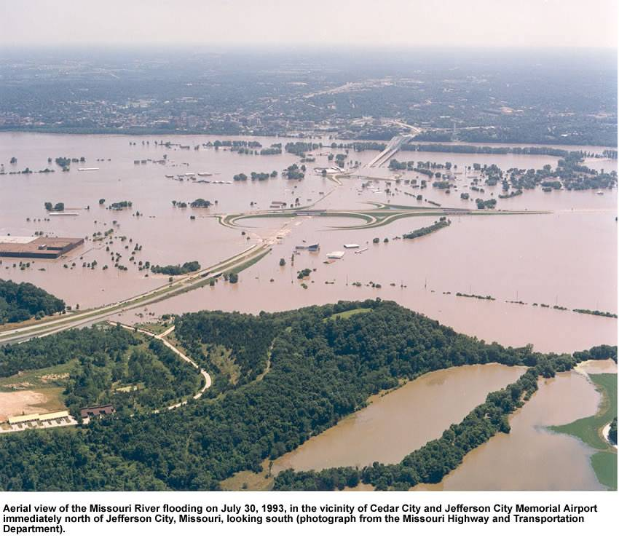
Super flood: May - Sep 1993 - Missouri River

Slide 10
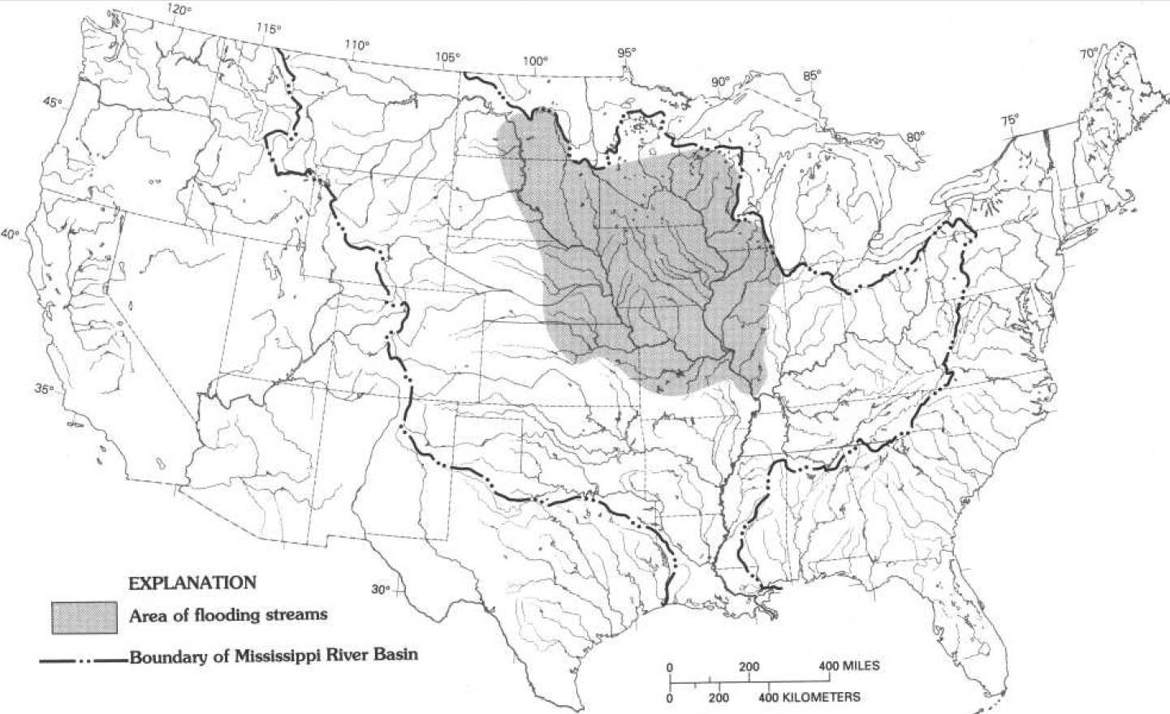
Flood Domain
St. Louis, MO
Fig 1. Flood Discharges in the Upper Mississippi River Basin—1993: U.S. Geological Survey Circular 1120-A

Slide 11
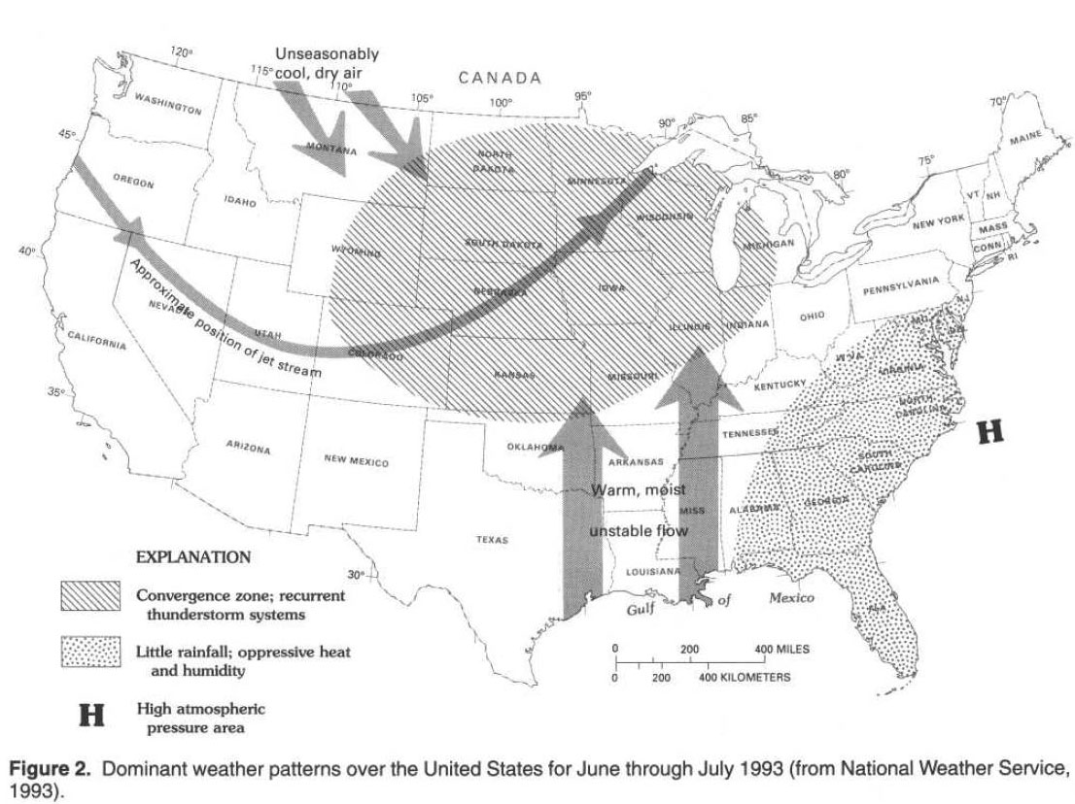
Meteorology
Storm sequence
Jet Stream
Precipitation in the Upper Mississippi River Basin—January 1 through July 31, 1993: U.S. Geological Survey Circular 1120-B

Slide 12
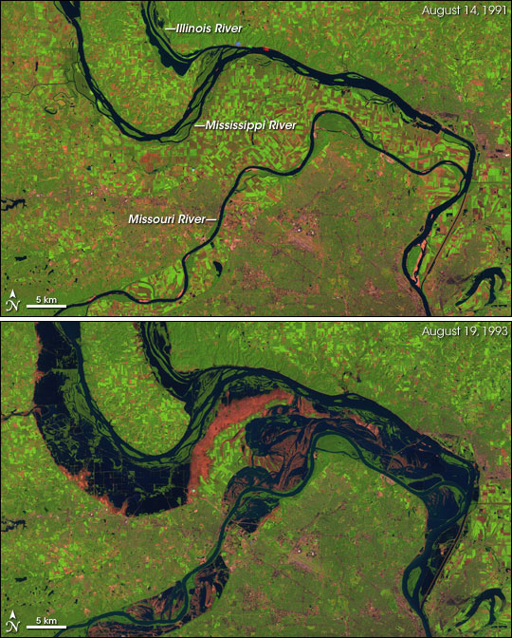
Resulting flooding extent near St. Louis, MO
Image August 14, 1991, no flood
St. Louis, MO
Image August 19, 1993, extensive flooding
65 km
NASA

Slide 13
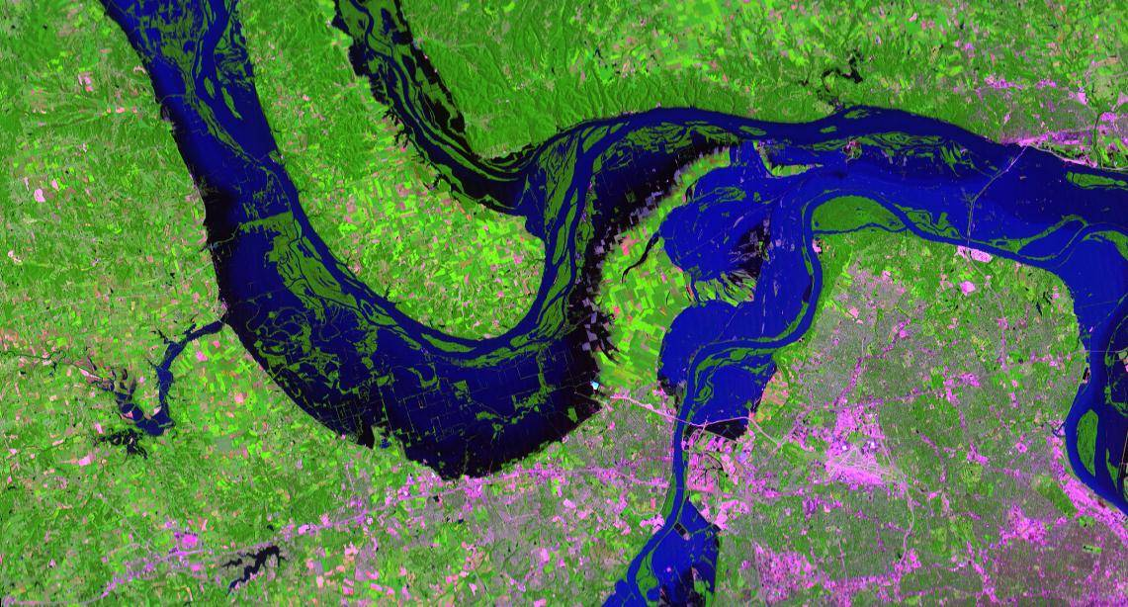
Higher resolution St. Louis, MO
NASA

Slide 14
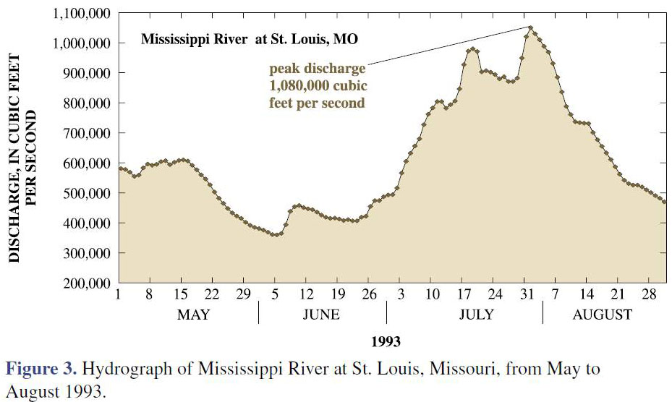
National Weather Service flood discharge
The Great Flood of 1993 on the Upper Mississippi River—10 Years Later, Gary P. Johnson, Robert R. Holmes, Jr., and Loyd A. Waite, USGS Fact Sheet 2004-3024, May 2004

Slide 15
Multi-month duration results from:
Sequence of storms
Upper basin hydrology
Operation of reservoirs
Failure of levees
The Great Flood of 1993 on the Upper Mississippi River—10 Years Later, Gary P. Johnson, Robert R. Holmes, Jr., and Loyd A. Waite, USGS Fact Sheet 2004-3024, May 2004

Slide 16
How should we design for flood damage mitigation?
This has been known for a long time.

Slide 17
Essential reading!
469 pp

Slide 18
Floods and ongoing national flood risk –
from pages 9-11,
Hoyt and Langbein, “Floods”, Princeton Univ. Press,1955
…. meteorologic and hydrologic conditions will combine to produce super floods of unprecedented magnitude.
We have every reason to believe that in most rivers past floods may not be an accurate measure of ultimate flood potentialities.
It is this super flood with which we are always most concerned. …

Slide 19
Flood Damage Mitigation
Floods are an act of God; flood damages result from acts of men.
House Document 465, 89th Congress, 2d Session
A Unified National Program for Managing Flood Losses, August 1966

Slide 20
Topics
Rain generated Super Floods
Flood Damage Mitigation:
Miami Conservancy District, Ohio

Slide 21
Example of flood protection works at the
river basin scale
to address
life-cycle societal resilience
against
rain caused “super floods”

Slide 22
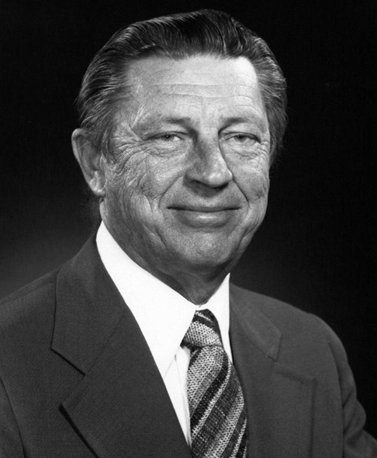
How did I learn about The Miami Conservancy District, Ohio?
Serendipity – subtle guidance by Professor Ray K. Linsley, doctoral adviser, precious mentor, and friend.
Ray K. Linsley, NAE, 1/13/1917 - 11/6/1990

Slide 23
Ray Linsley asked me in 1976 to write a paper on Water Resources Systems Planning 1776-1976 for the bicentennial. He suggested that I might find the works of “The Miami Conservancy District” informative. (See Burges 1979 – next slide)
Thus began my 47 years historical interest in this work and the work of Arthur E. Morgan.
I revisit it frequently for inspiration.

Slide 24
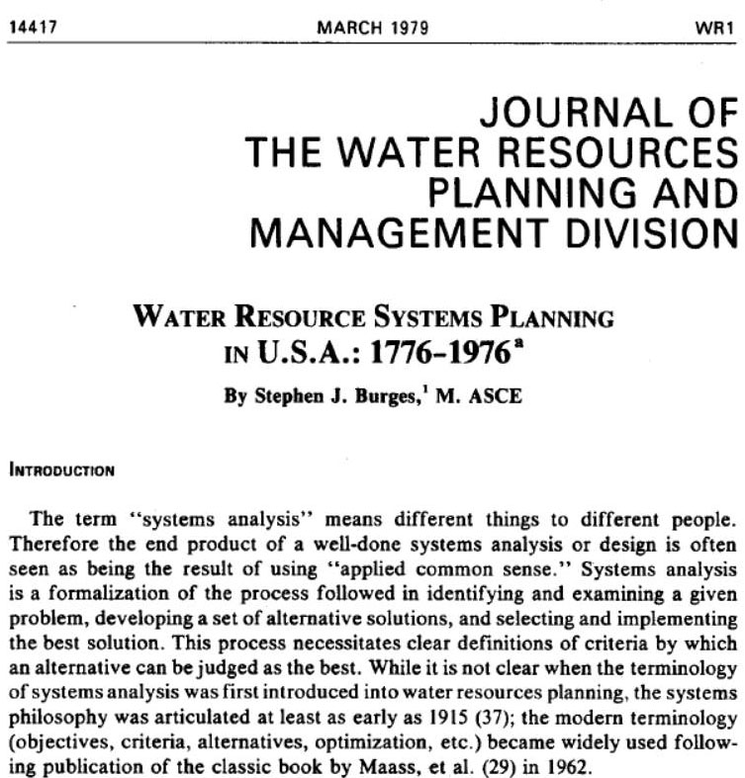
ASCE
Arthur E. Morgan
Chief Engineer,
Miami Conservancy District

Slide 25
What is Systems Engineering?
The systems approach (engineering and planning) requires formal identification of objectives, criteria (by which alternative solutions may be evaluated), and constraints.
These activities can be difficult to perform.
If improperly identified objectives are examined, the resulting system will fail to respond to the real problem that initiated the planning effort.

Slide 26
The generation of alternatives depends upon technological, human, and resource limitations;
alternative solutions to a problem are a function of time and place and societal structure.
Implementation of the preferred alternative is one of the most difficult planning activities when conflicts necessitate modifications to the community preferred alternative.

Slide 27
“Satisficing”, or satisfactory solutions, (proposed by future Nobel Laureate, Herbert A. Simon in 1947 - https://en.wikipedia.org/wiki/Satisficing ) rather than optimal solutions result.
Good system plans will be robust to changing demands or uses.

Slide 28
U.S. Legislation for Flood Damage Mitigation
U.S. Flood Damage Mitigation and Dam Safety Legislation:
Extensive Federal Legislation over a century
Summarized in Tables C.1 and C.2 from:
Dam and Levee Safety and Community Resilience – a Vision for Future Practice, NRC 2012

Slide 29


Slide 30
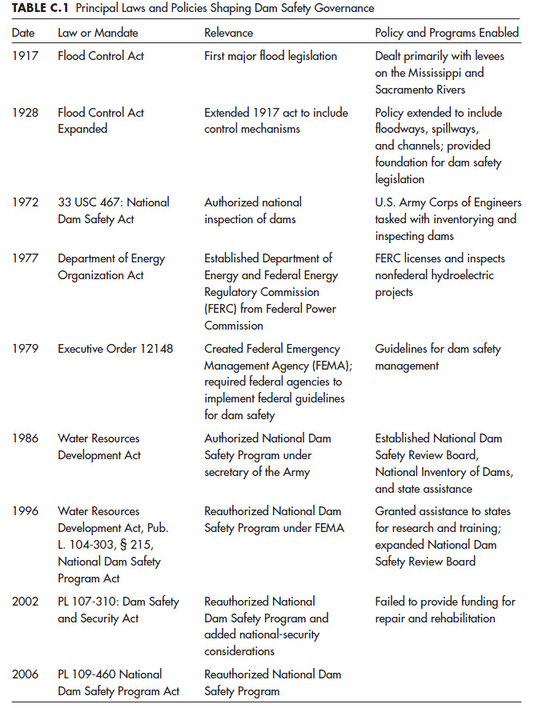
Table C.1 – Dam Safety
Dam and Levee Safety and Community Resilience – a Vision for Future Practice, NRC 2012

Slide 31
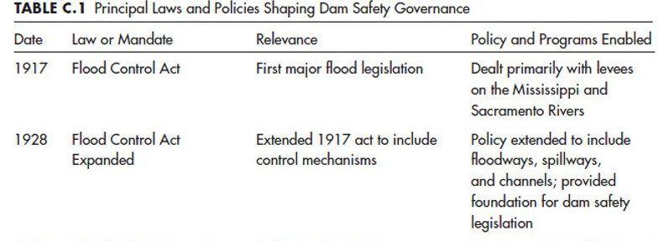
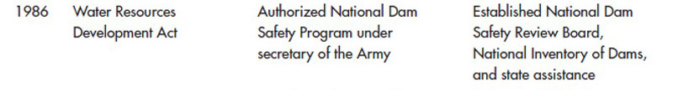
Federal – local cost sharing legislated

Slide 32
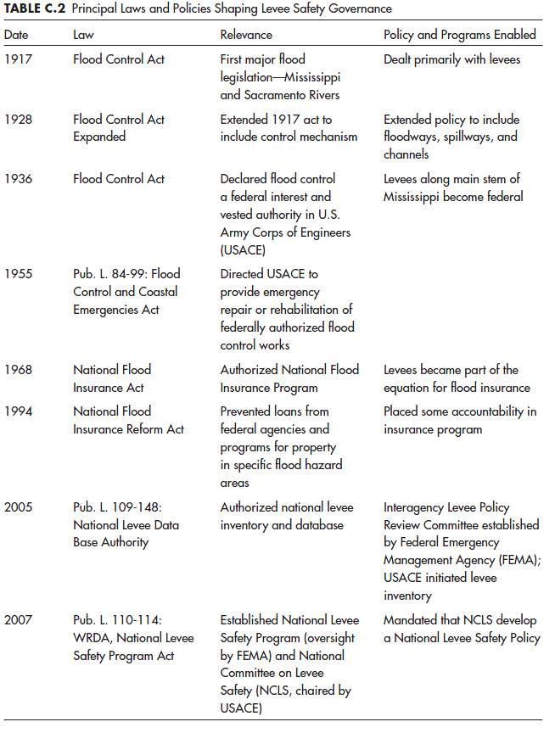
Table C.2 – Levee Safety
Dam and Levee Safety and Community Resilience – a Vision for Future Practice, NRC 2012

Slide 33
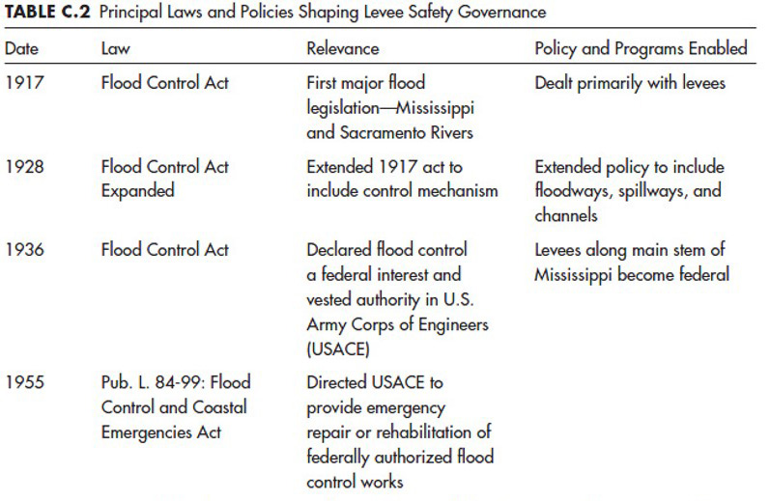
US population 103 Mi.
US population 166 Mi.
Reflects evolving issues of societal structure and needs

Slide 34
1936 Flood Control Act specified:
“the benefits to whomsoever they may accrue should exceed the costs”.
What constituted “benefits” was not defined.
See: discussion of “welfare economics” and “benefits” in:
Arthur Maass, Benefit-Cost Analysis Its Relevance to Public Investment Decisions, Quarterly Journal of Economics, 1966.
Martin Reuss, Water Resources, People, and Issues - Interview with Professor Arthur Maass, USACE Office of History, 1989.pdf
https://usace.contentdm.oclc.org/digital/collection/p16021coll4/id/358

Slide 35
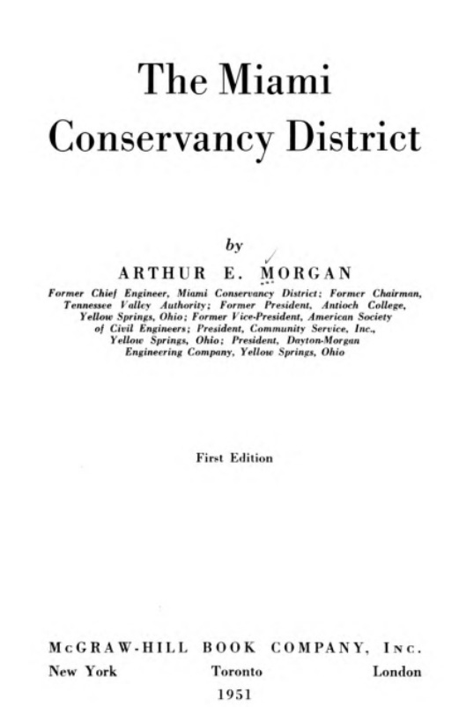
Rare 25-years post project effectiveness assessment
Excellent social-political-economic flood engineering
504 pp

Slide 36
The flood protection works of the Miami Conservancy District, have been in place since 1922.
Built following disastrous flooding in March 1913 in the Dayton, Ohio region - 360 bodies were recovered; hundreds disappeared.
An estimated 20,000 homes were destroyed in Ohio, mainly in the Great Miami River Valley.
Hamilton and Dayton suffered the greatest damage.

Slide 37
Approximately 10 square miles of Dayton were inundated.
Excellent example of integrated flood damage disaster prevention and systems and life cycle engineering.

Slide 38
The Morgan Engineering Company (headed by Arthur E. Morgan) was asked on May 5, 1913, to examine the entire problem.
From a “Systems Engineering Approach” the charge of the local Citizens' Flood Prevention Committee was a rare single objective:
"The valley has suffered a calamity that must not be allowed to occur again. Find a way out."

Slide 39
What and where are the flood works of the Miami Conservancy District?

Slide 40
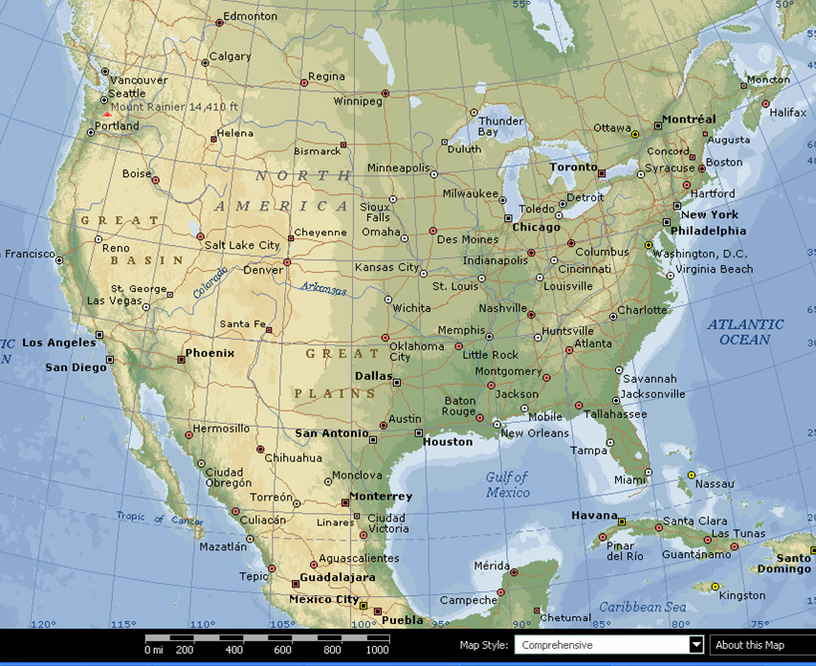
Dayton, OH

Slide 41
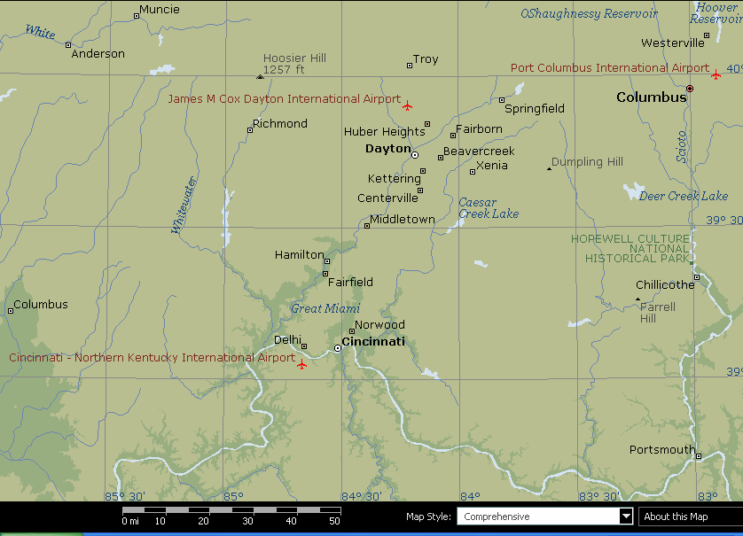
Great Miami R.
Ohio River

Slide 42
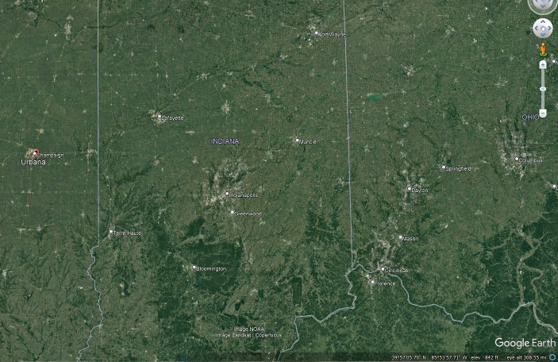
Urbana, IL
220 miles
Dayton, OH

Slide 43
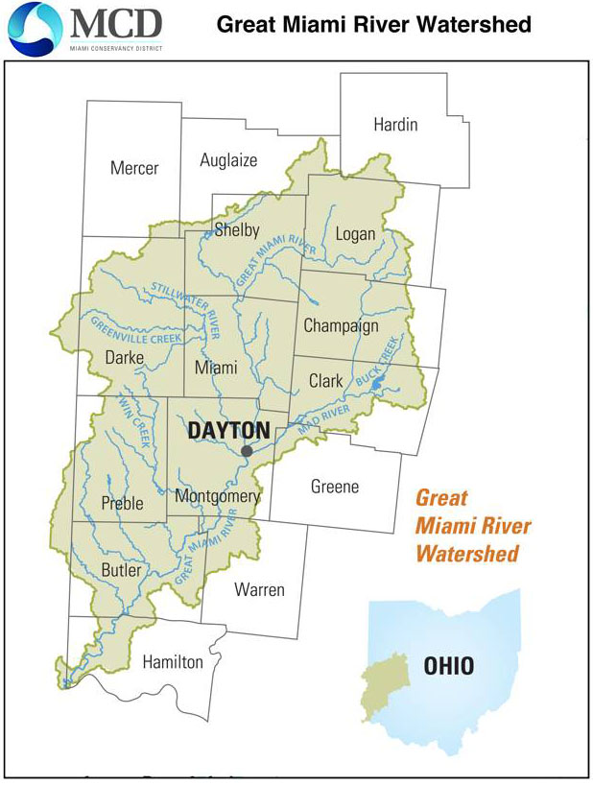
Miami Conservancy District
15 Counties
https://www.mcdwater.org/wp-content/uploads/2017/04/Great-Miami-River-Watershed.png

Slide 44
Miami Conservancy District – established 1914
Encompasses entire catchment - 4,000 sq. miles, 15 counties
Model for governance and public infrastructure funding that provides ongoing financing for operations and maintenance, and replacement

Slide 45
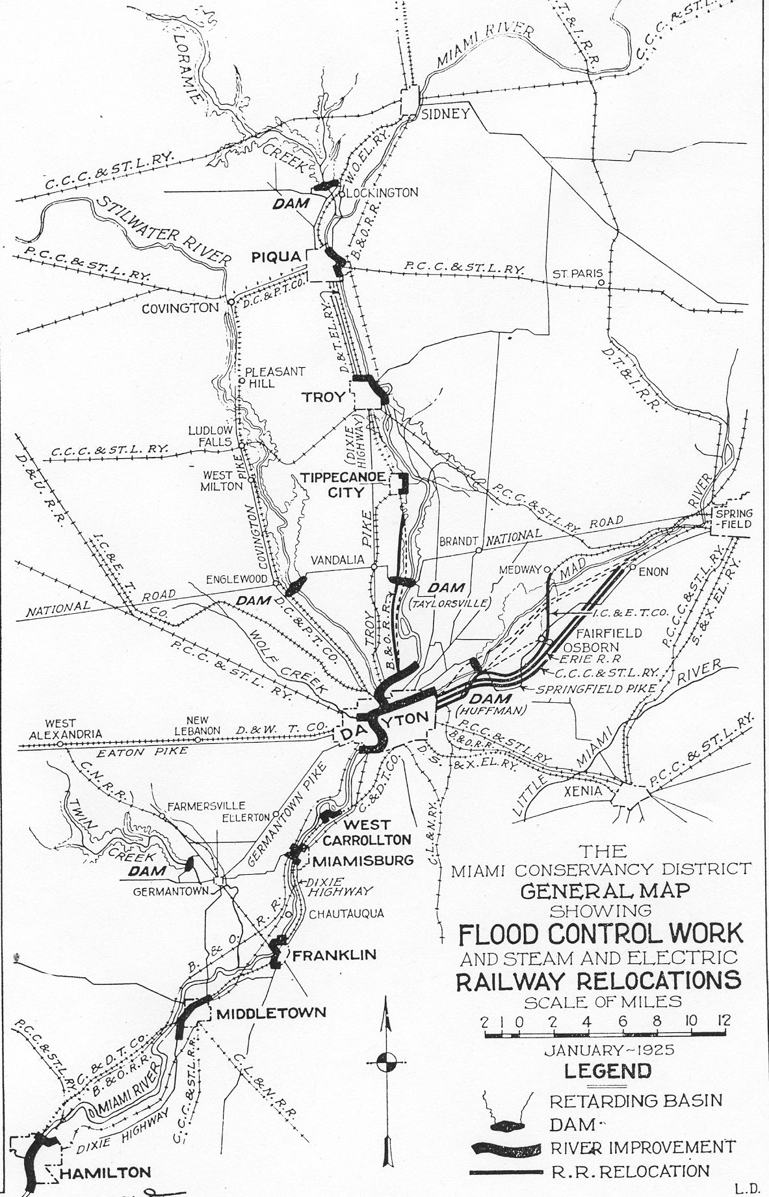
50 miles

Slide 46
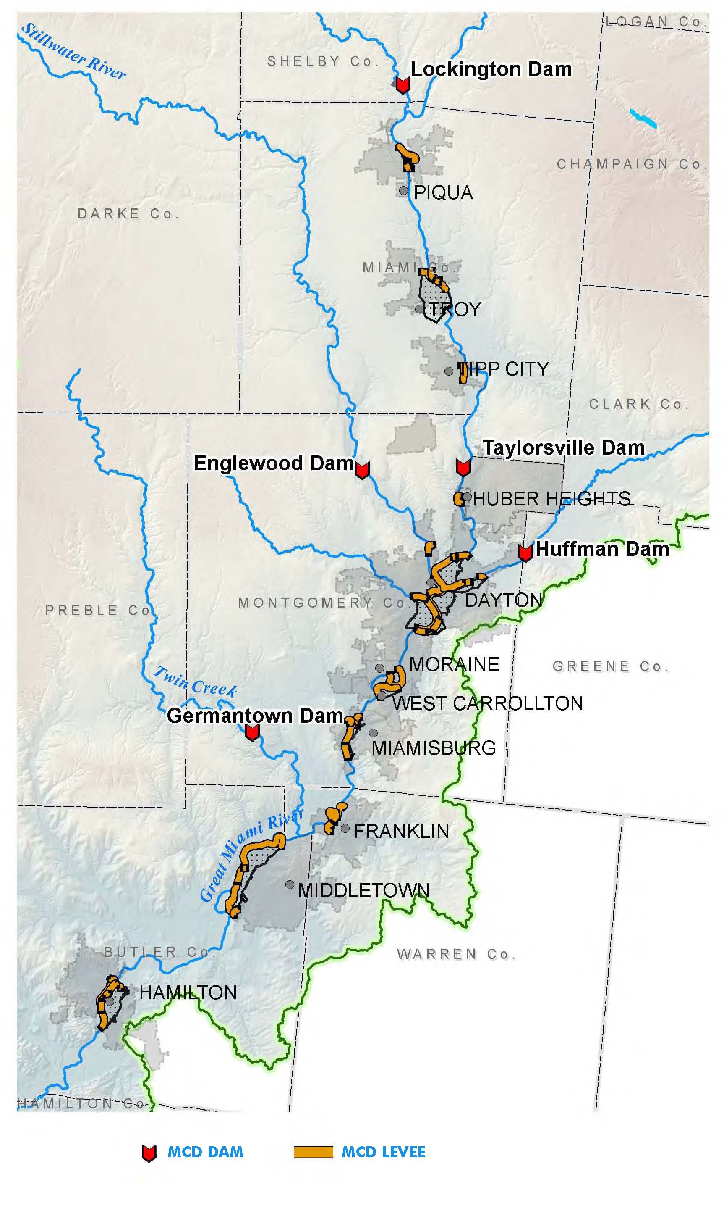
Integrated river basin solution
Three dams on major tributaries are critical components

Slide 47
Pioneering work on reconstructing flood producing rain and assessing future possible major storms
Extensive scientific and engineering hydro-meteorological investigation and international data gathering and assessment.
Documented in Technical Reports Part V, 1917.

Slide 48
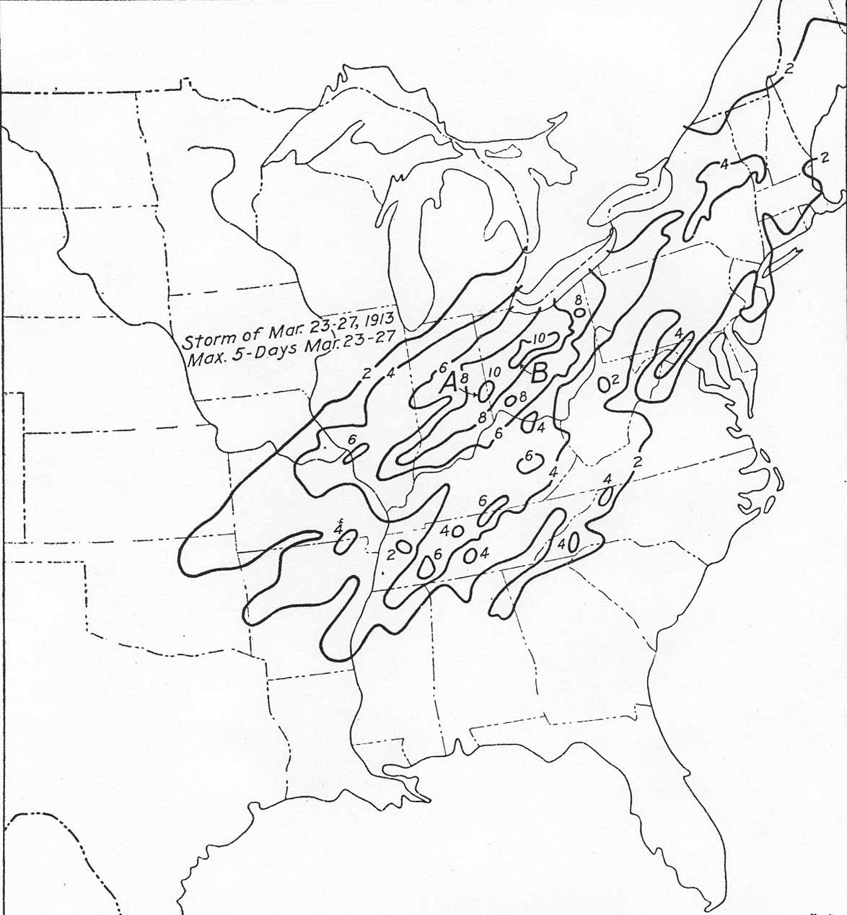
Reconstructed cumulative daily rainfall
Rain fell on saturated ground – approximately 90% runoff
254 mm
Origin of Probable Maximum Precipitation
203 mm

Slide 49
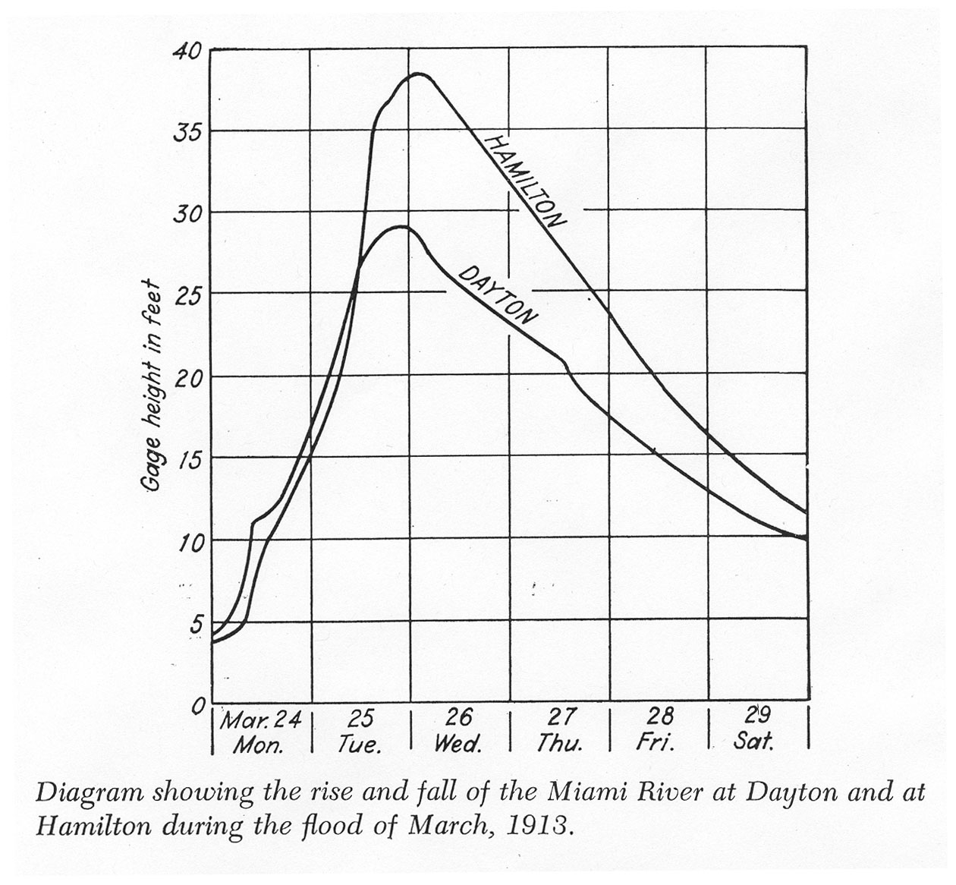
Rapid rise

Slide 50
What dominated the hydrograph shape?
Storm orientation – alignment with catchment
The channel system is a highly efficient drainage concentrator

Slide 51
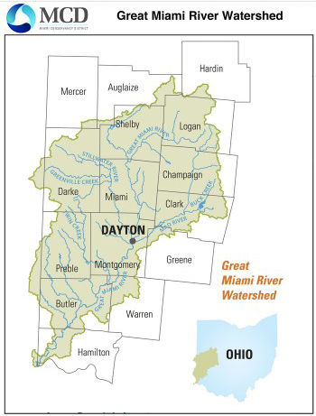
Efficient second-order feeder channels
Third-order main channel; multiple inputs – Dayton to Hamilton

Slide 52
Channel hydraulic improvements including 55 miles of levees
5 major “dry” dams
Gaps between levees are open flood plains

Slide 53
Examples of levees and channel armoring

Slide 54
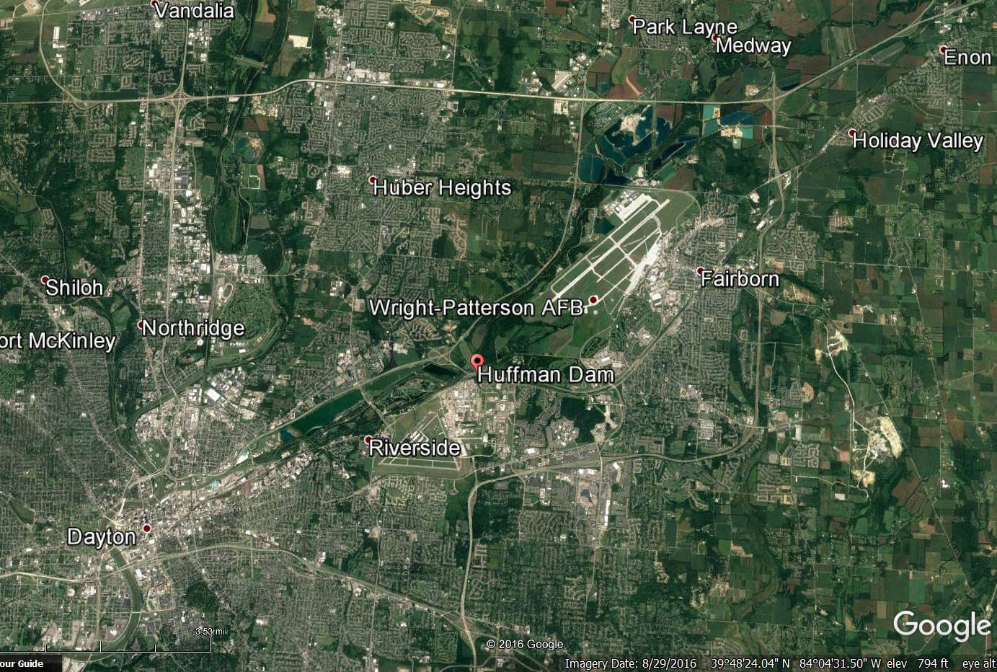
Site selected by Orville Wright and Arthur Morgan in 1917 –
US had entered World War I
Engineered channel and levees
1 mile
Dayton region – major levees and channel widening

Slide 55
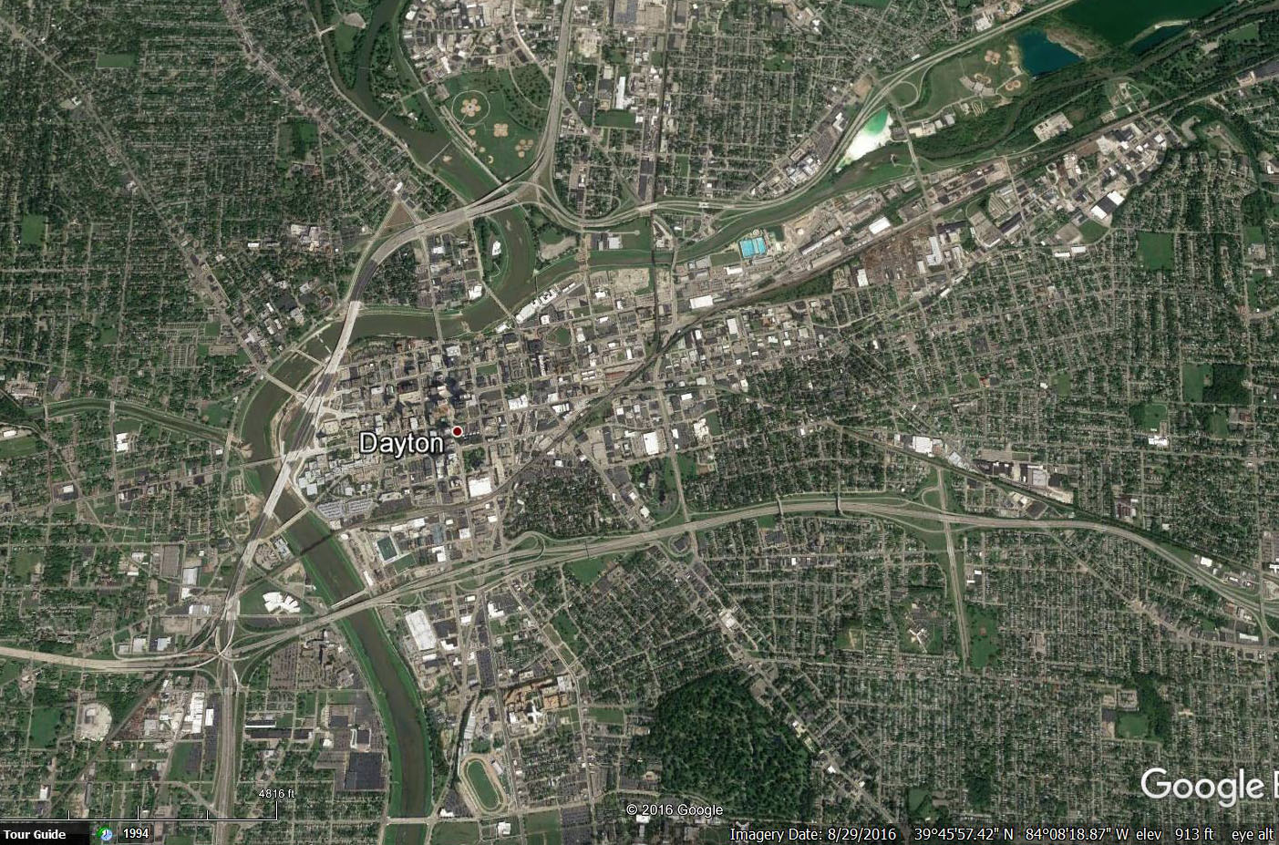
No levees
Engineered channel and levees
0.5 miles
Dayton – major levees and channel widening

Slide 56
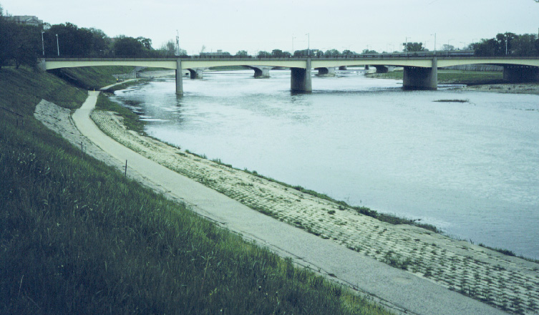
Levee top
Innovative flexible revetment to retard bank undercutting
Levee and hydraulically efficient channel liner near Dayton – original materials - photograph (Steve Burges)
May 1984

Slide 57
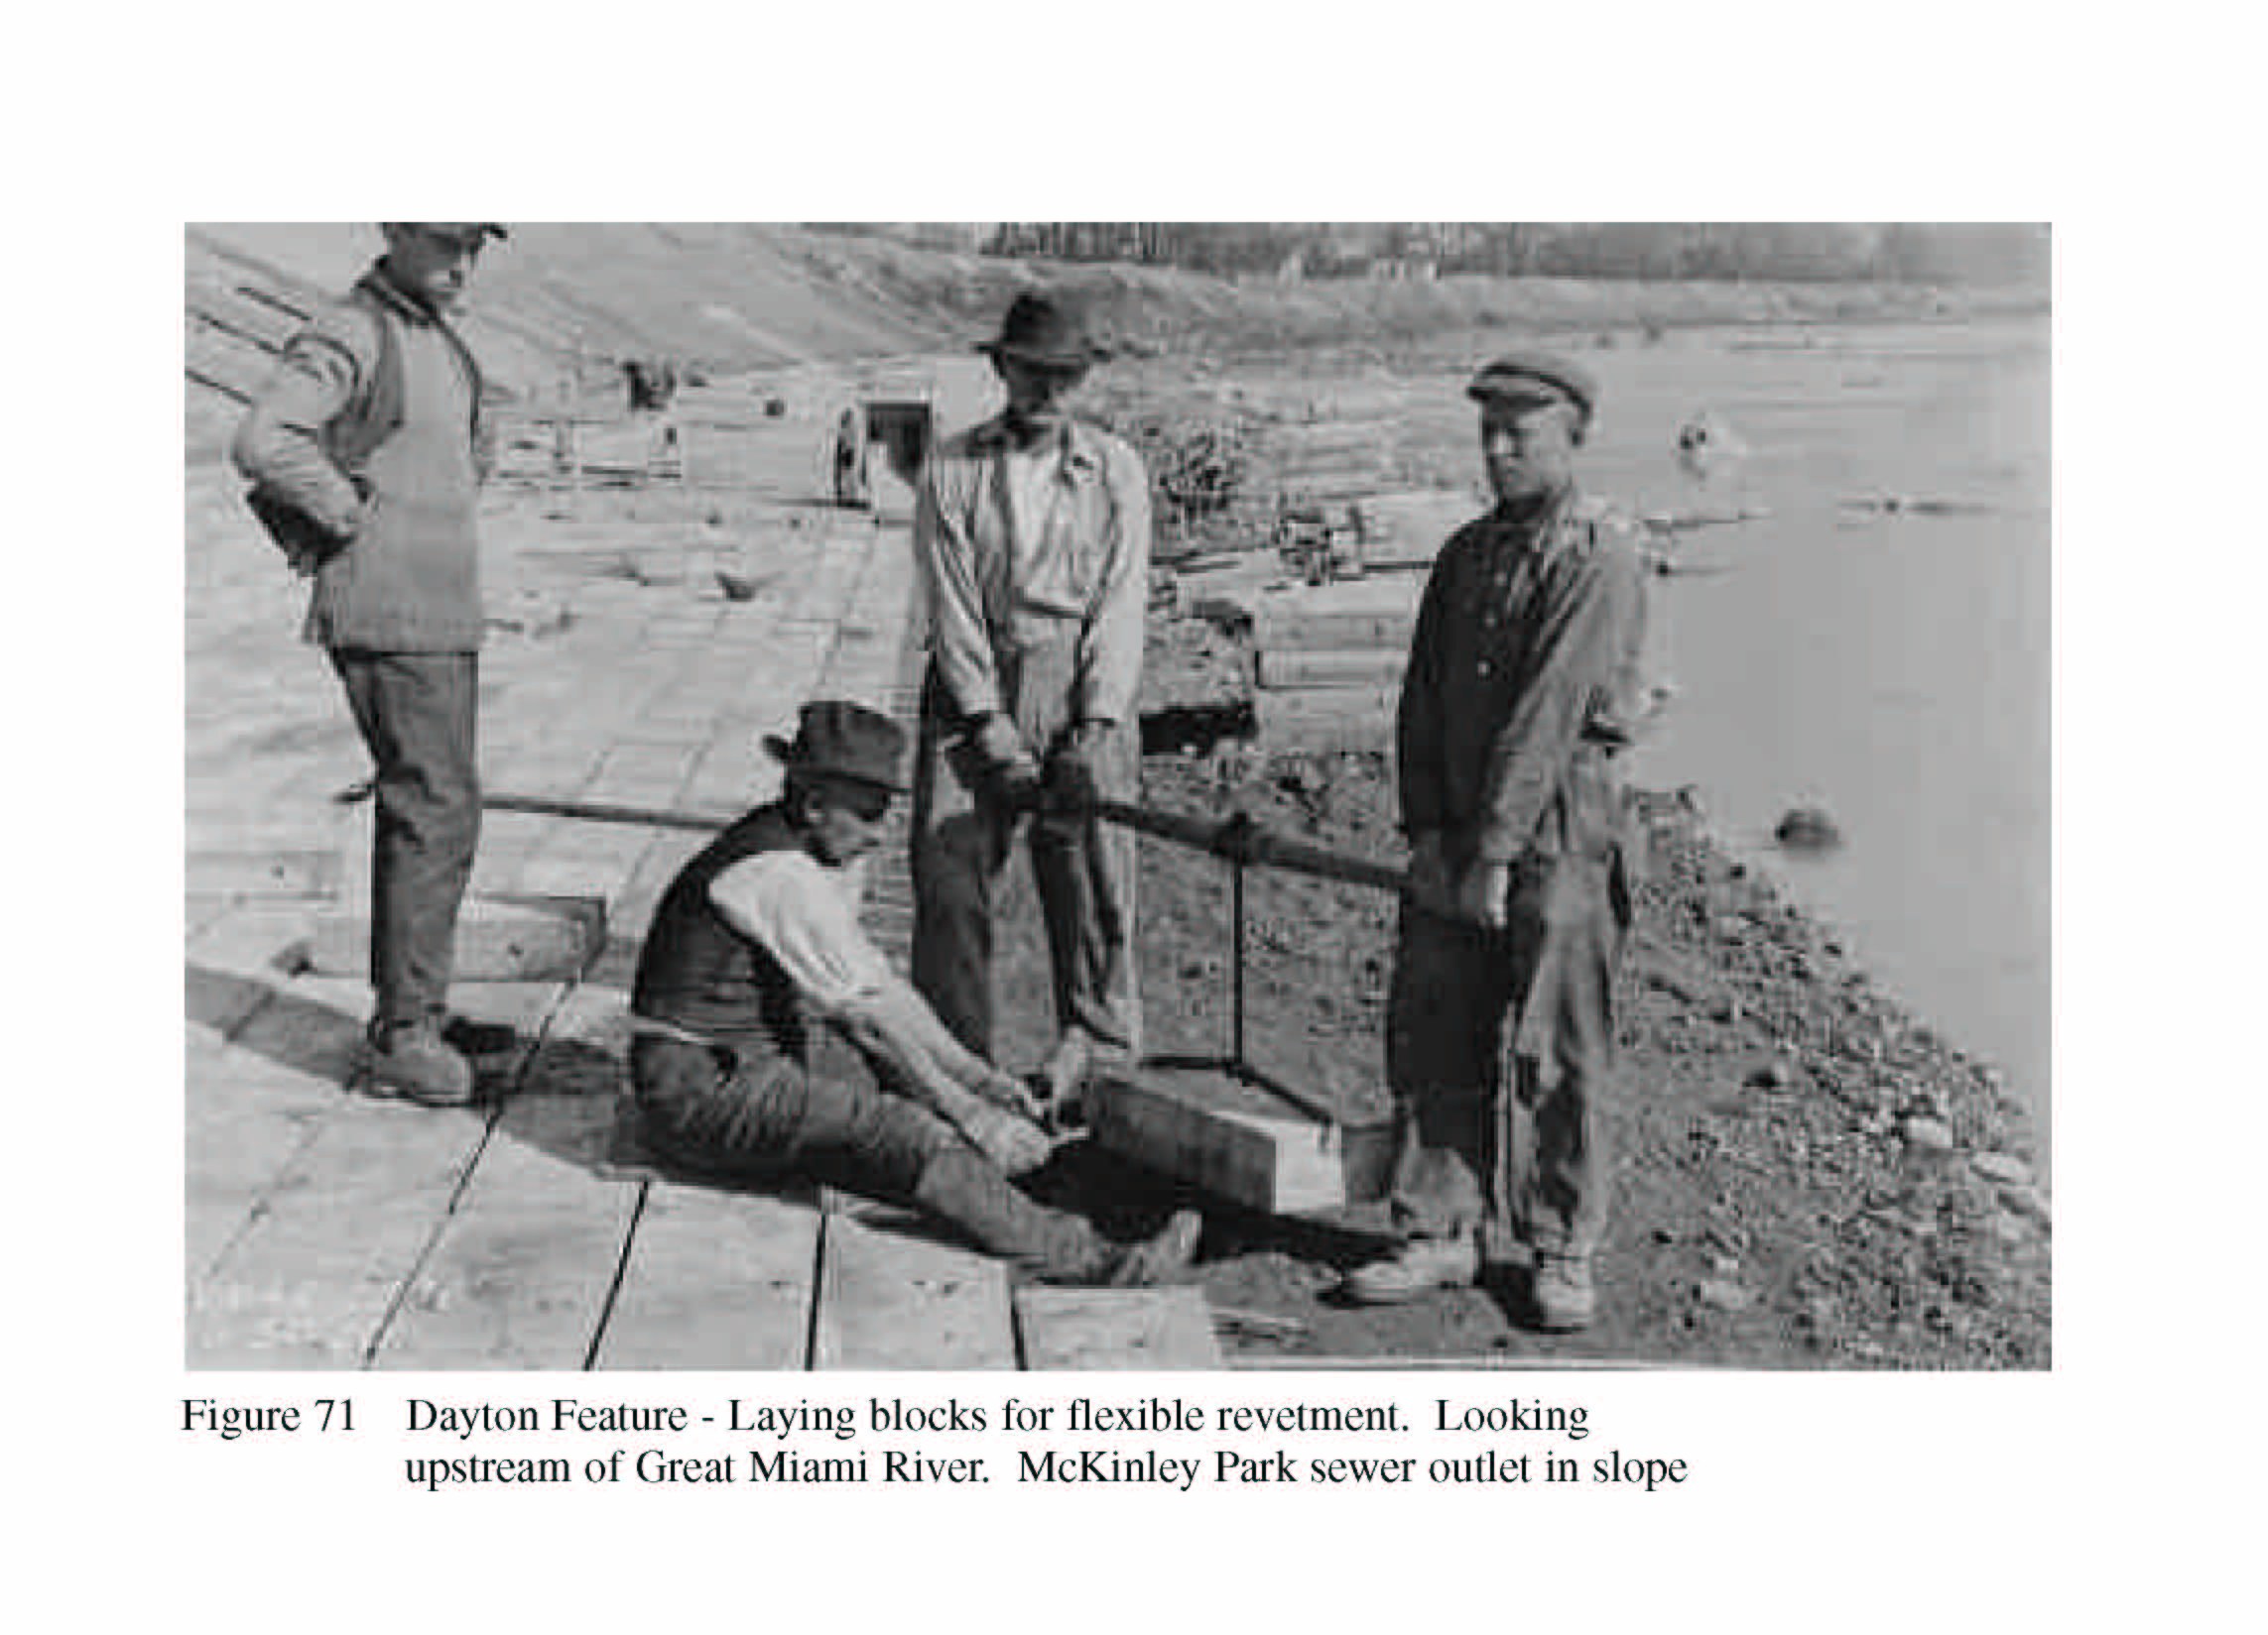
Threading steel cables through “two – man” concrete block

Slide 58
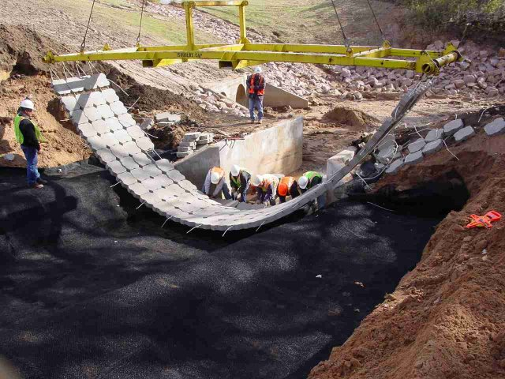
Modern equivalent
Geotextile
http://www.cfmwi.com/images/petraflex.jpg

Slide 59
Flexible revetment
Best practices – concrete placement

Slide 60
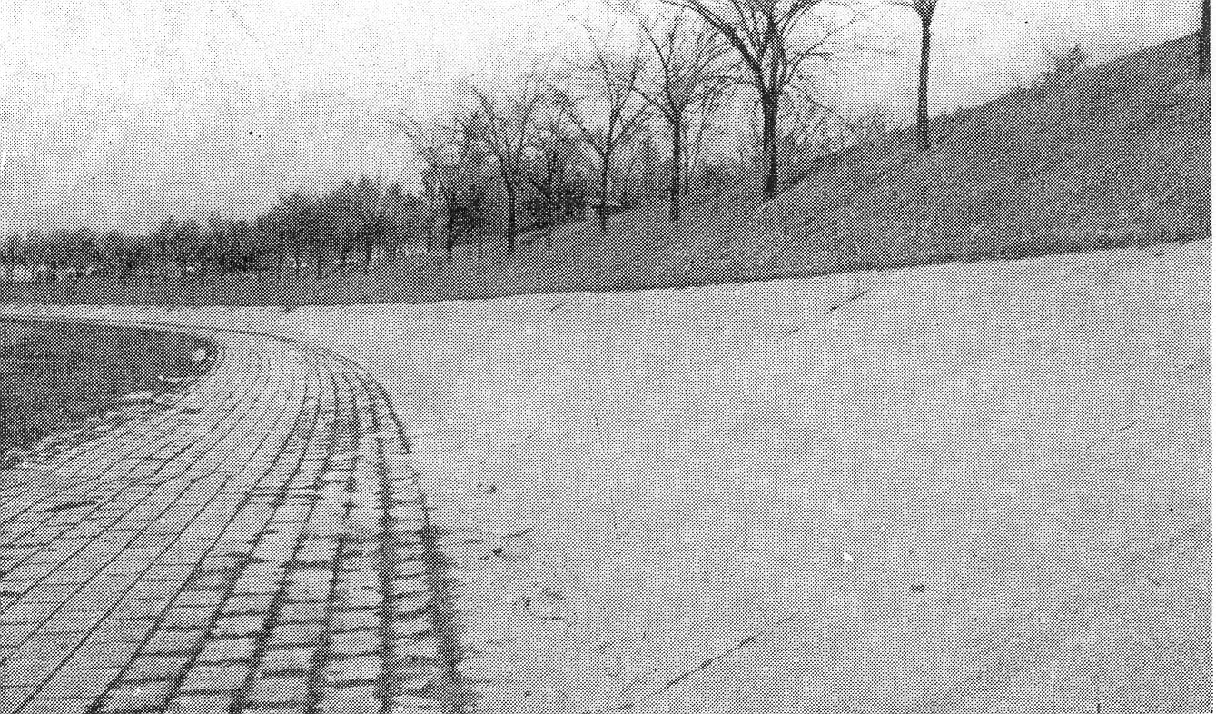
From Morgan, 1951 - same location - photo circa 1942

Slide 61
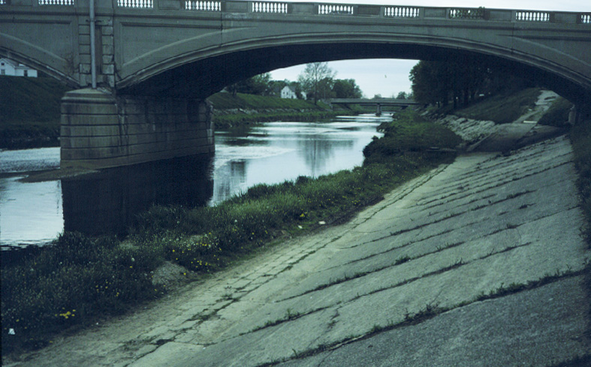
Bridge built 1927 - replaced 2010
Wolf Creek - tributary to Great Miami River at Dayton – Bridges and revetment
May 1984

Slide 62
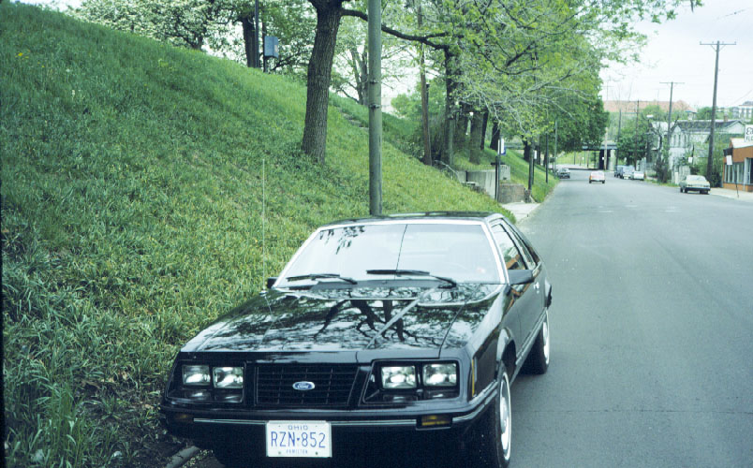
Great Miami River near Dayton – Scale of Levee
May 1984

Slide 63
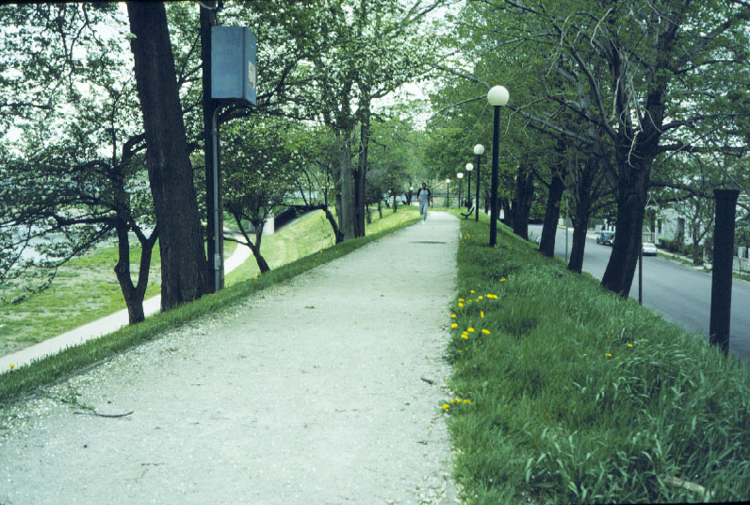
Great Miami River near Dayton - Levee section – Recreation paths
May 1984

Slide 64
Significance of first use of “dry dams” in the U.S. – effectively large detention reservoirs.
How did dry dams become part of the system-wide flood damage mitigation design?
This resulted from application of “Conclusive Engineering Analysis” as explained in material from pages 284 – 286 of “The Miami Conservancy District”, A. E. Morgan, 1951.

Slide 65
Page 284
A general principle was adopted for approaching the solution of the engineering problems of the Miami flood-control project which I have termed "conclusive engineering analysis."

Slide 66
The principle in essence is that, to whatever extent the importance of the work justifies, every possibility for solution of the problem, whether promising or not, should be explored, with effort to become aware of unrealized and unexpected ways of approach;
and that each such possibility be explored to a point where, in comparison with other methods of solution, it either is proved to be inferior or finally emerges as the best possible solution.

Slide 67
Page 285
In the search for solutions to the Miami River flood problem, the different ways of approach were assigned to different engineers or groups of engineers.
At that time, I had little or no expectation of finding a solution by means of dams and retarding basins.

Slide 68
One reason why the possibilities of dams and retarding basins on the Miami Conservancy project were not sooner appreciated was that at that time few topographic maps of the possible basin sites had been published …
it would not have been supposed that here, in populous Ohio, would exist some of the finest and least obstructed sites in the country.

Slide 69
While the process of conclusive engineering analysis had its most spectacular result in developing the possibility of retarding basins, it was applied in practice throughout the job, and with many interesting results.
One of the most distinctive of these was the development of the hydraulic-jump design for dissipating energy at the dam outlets.

Slide 70
286 The Miami Conservancy District
Years later, while spending an evening with Thomas A. Edison at his home, I asked him this point-blank question: "Do you have any general method for solving a problem?"
He said he did and outlined substantially the process I have described but with greater elaboration.
In some cases, he said, he would have as many as forty possible answers to a problem before he would begin the process of comparison and elimination.
Rarely, he said, did his final solution have "any noticeable similarity to my first inspiration or 'hunch.' "

Slide 71
Was there existing proof of the effectiveness of the use of “retarding basins” for flood damage mitigation?
Yes. The Pinay Dam on the Loire River in France.
Waters that were retained for short duration behind the Pinay Dam deposited rich sediments that enhanced the productivity of the inundated land.

Slide 72
Pinay “retarding basin”
Open width 19.7m
Constructed in 1711

Slide 73
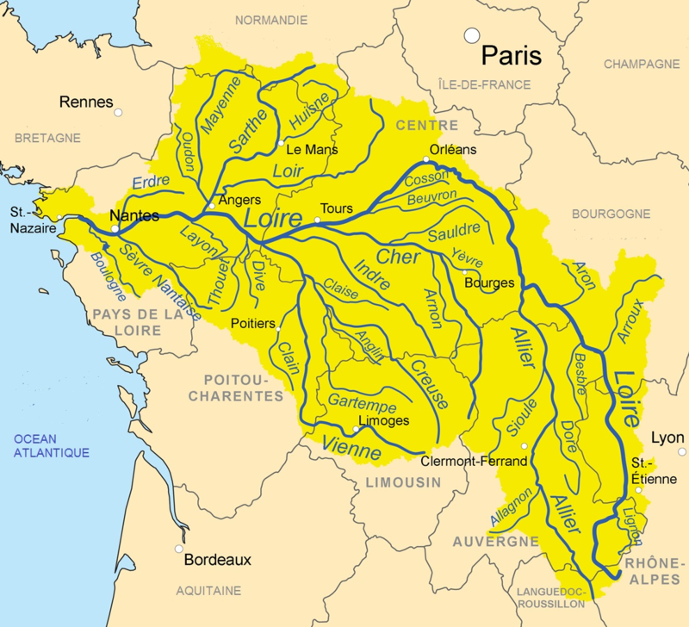
Loire Catchment 117,000 km²
(45,000 sq. mi) ~ 1/5th of France
Pinay

Slide 74
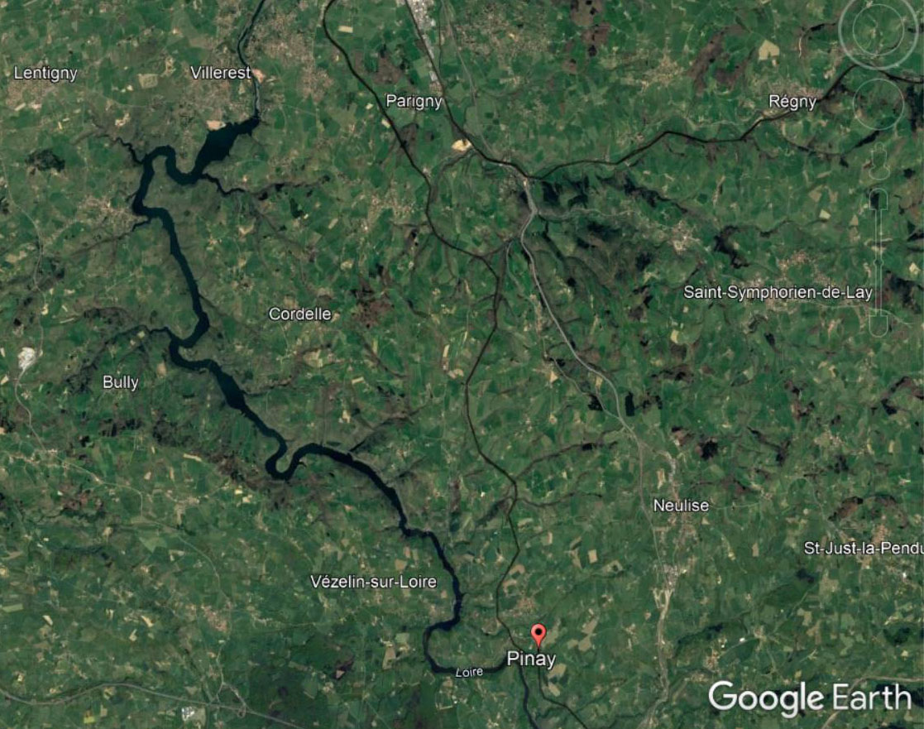
Multi-purpose Villerest Dam (hydro-water supply-flood mitigation).
Opened on 11 September 1982; made Pinay Dam redundant
Pinay
1 mile

Slide 75
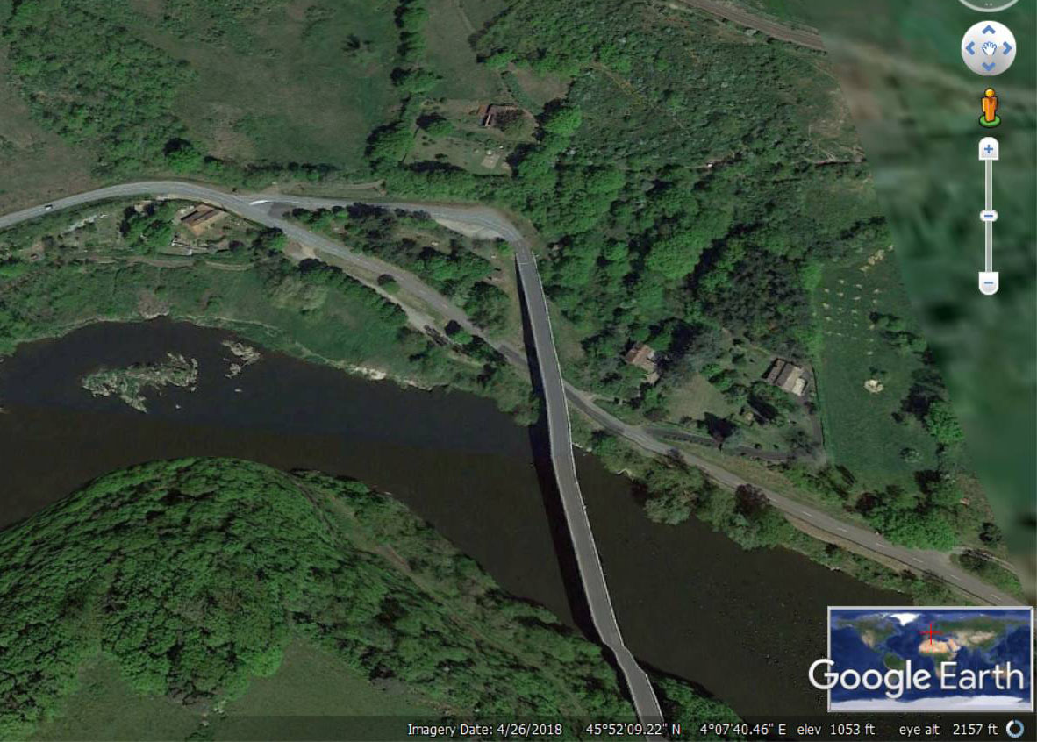
Approximate location of Pinay “retarding basin” – Operated from 1711 to 1984
0.05 miles

Slide 76
Features of the five “dry dams” and their locations

Slide 77
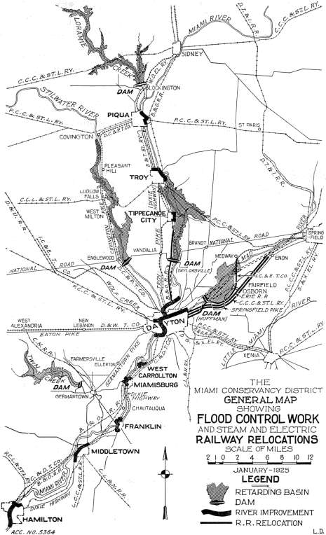
Area flooded 6,350 acres
Inundation extent when dams operated for the design flood
Map prepared 1925

Slide 78
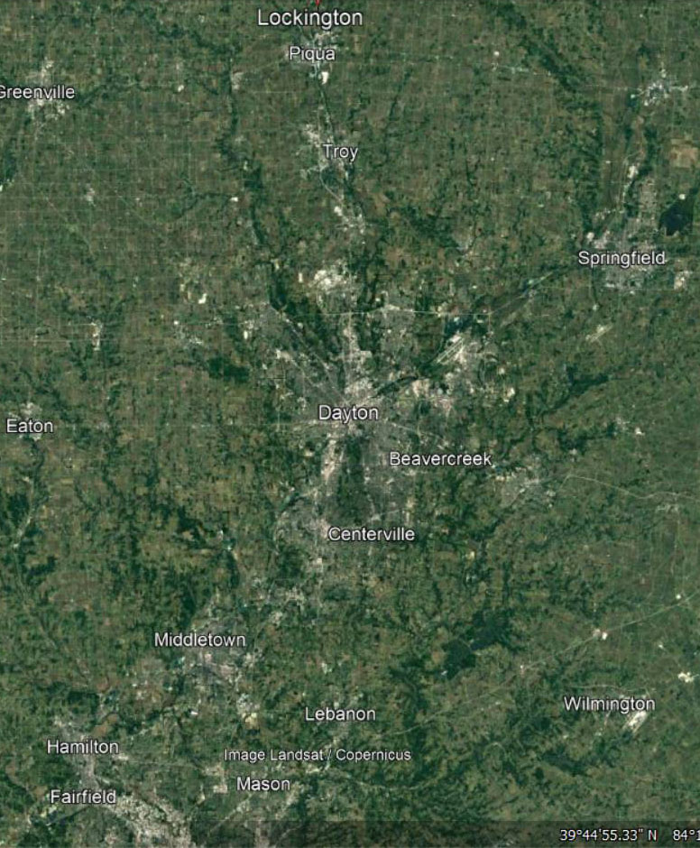
Google Earth Image of Region

Slide 79
All five earth dams were constructed by the “hydraulic fill method” using materials dredged up river.
This was done before the development, by Karl von Terzaghi and others, of “soil mechanics” now called “geotechnical engineering”.

Slide 82
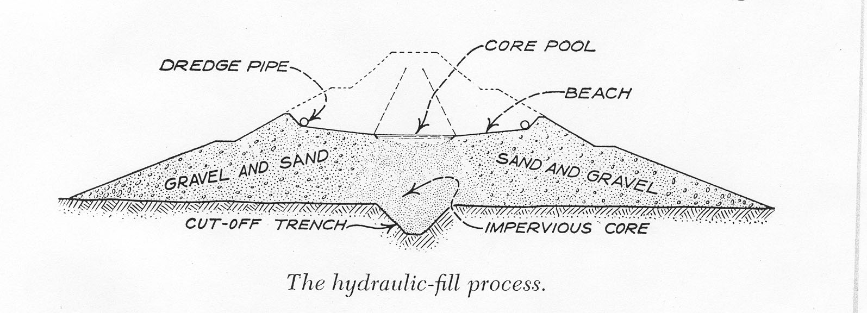
Fine sediments settle

Slide 83
Note – upper part lacks impervious core – added in dam safety upgrades starting 1999 at Englewood Dam

Slide 84
Lockington Dam on Loramie Creek
Google images of “dry” dam location

Slide 85
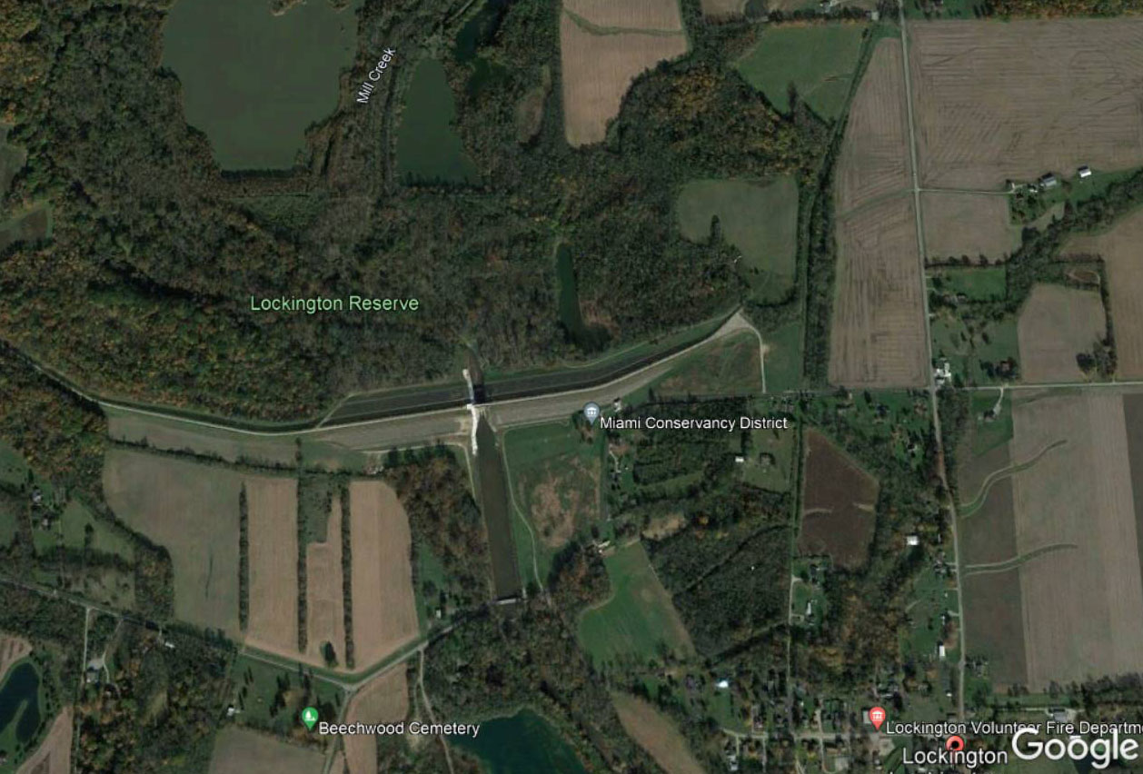
Lockington Dam
Controlled outflow
Emergency Spillway
0.1 miles

Slide 86
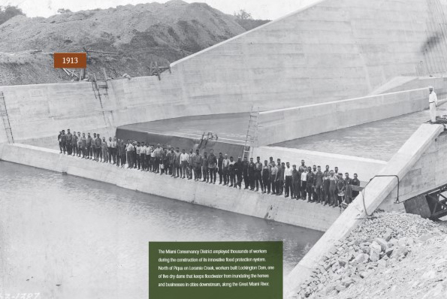
Source:
A Flood of Memories | Images from the 1913 Flood and Today
Lockington Dam - completed outlet structure:
workers at hydraulic jump formation structure

Slide 87
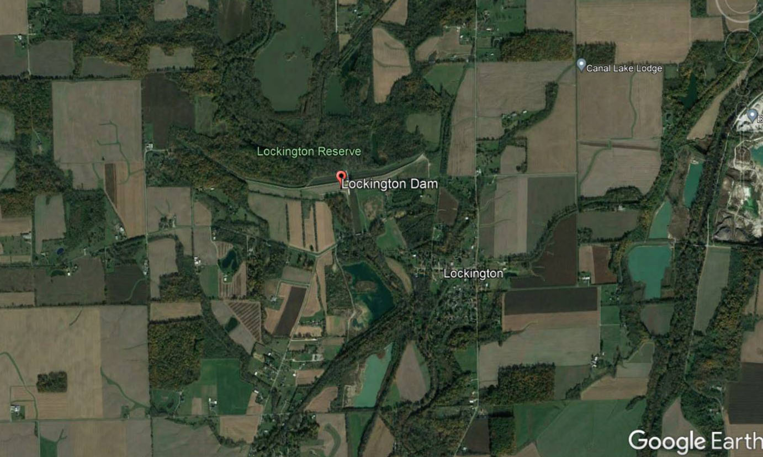
0.1 miles
Lockington Region – Farmland

Slide 88
Google images of “dry” dams
Taylorsville Dam on Great Miami River

Slide 89
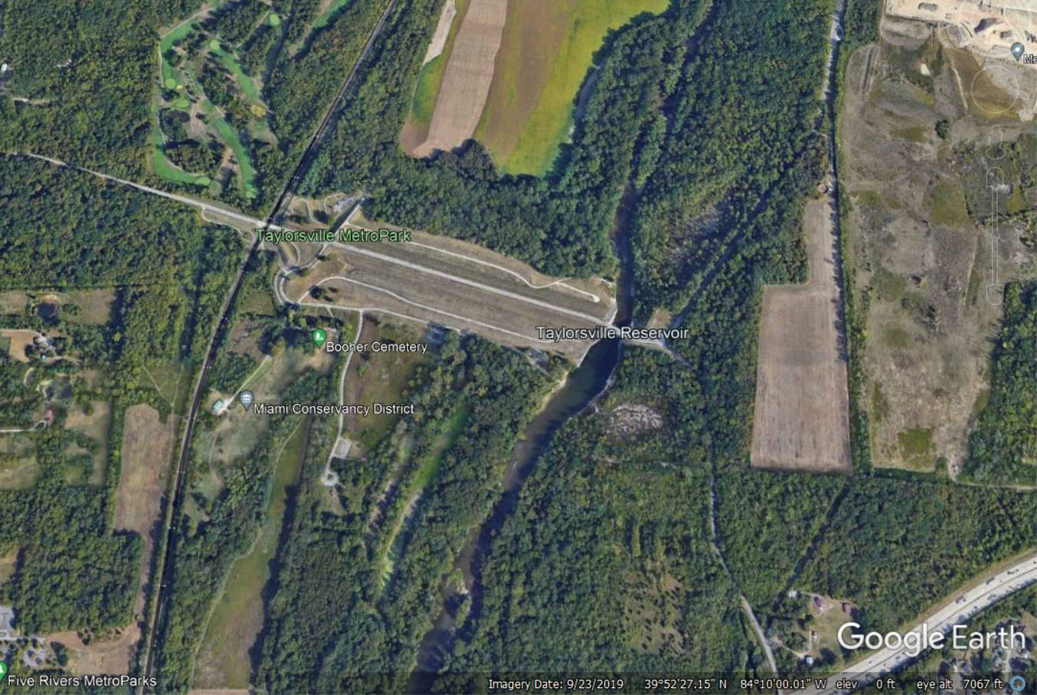
Taylorsville Dam on Great Miami River
Emergency Spillway
Controlled outflow
0.1 miles

Slide 90
Crest of Emergency Ogee Spillway
Maximum Controlled Outflow Structure: Hydrodynamic design for efficiency -
debris removal required after floods
Unconstrained River Flow
May 1984

Slide 91
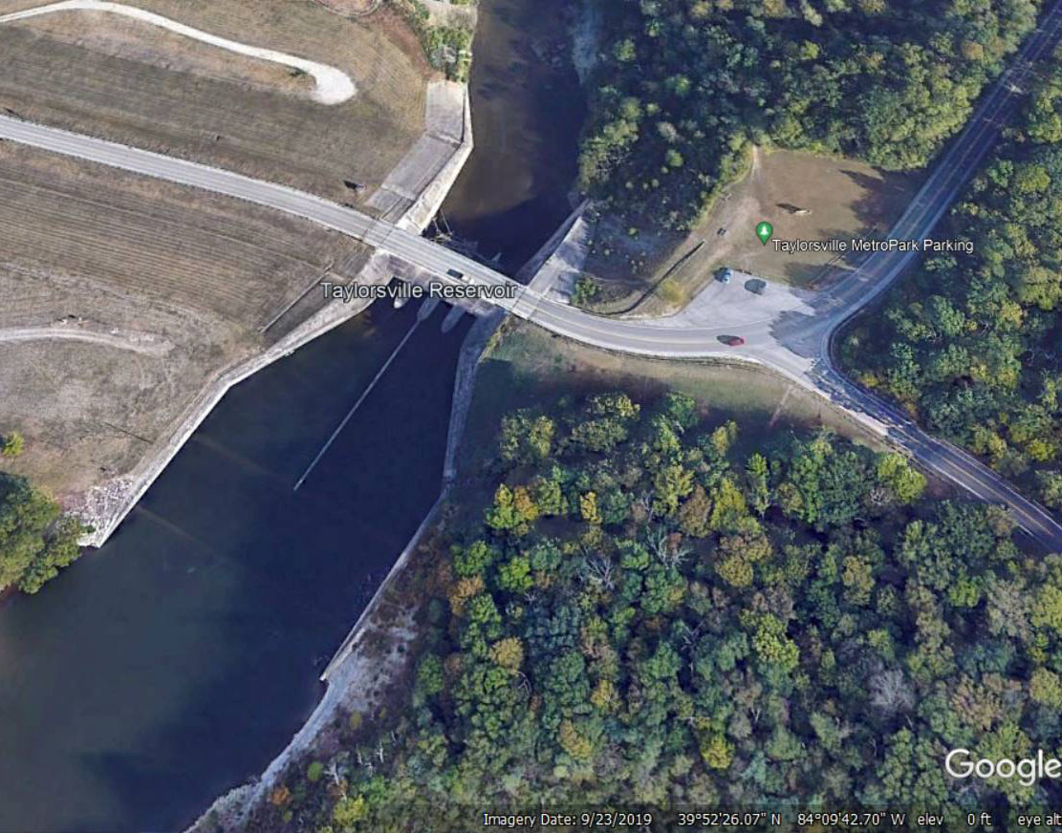
Hydrodynamic control wall to prevent outflow cross-over and choking
Woody Debris
Bed rock
0.05 miles
9/23/2019

Slide 92
Reinforced concrete structures to contain hydraulic jump produced by flow over emergency spillway
0.05 miles

Slide 93
Hydraulic jump forming domain
0.05 miles

Slide 94
Bed rock
Wing Walls
Great Miami River unregulated flow
May 1984

Slide 95
Google images of “dry” dams
Germantown Dam on Twin Creek

Slide 96
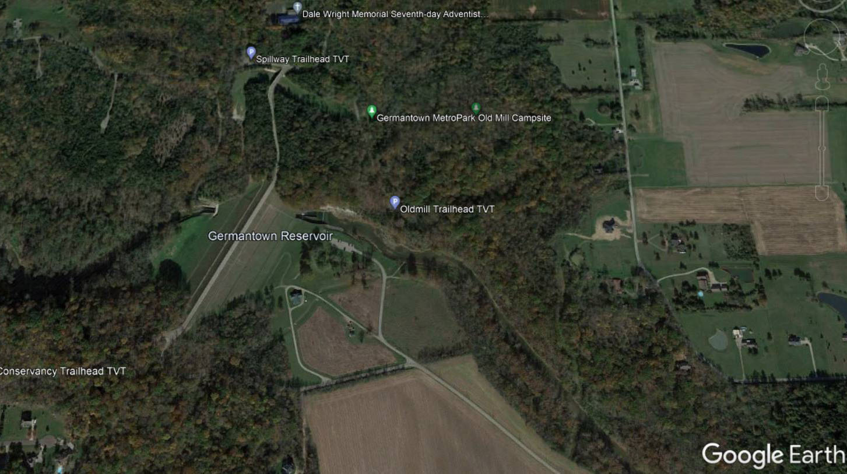
Germantown Dam
Emergency Spillway
Controlled outflow
0.1 miles

Slide 97
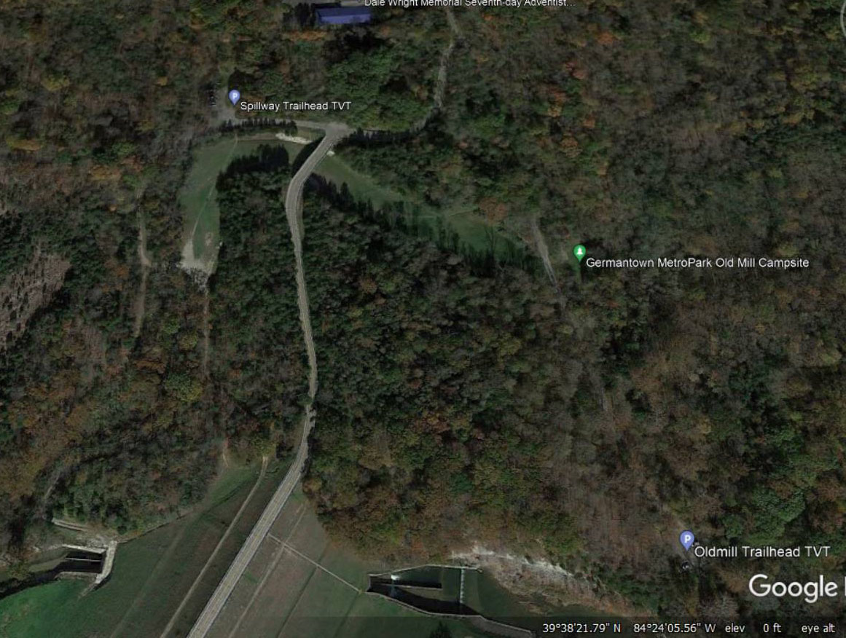
Emergency “Open Channel” Spillway
0.1 miles

Slide 98
Inexpensive and Efficient Emergency Spillway – Bypass Channel
Soil Covered Bedrock
May 1984

Slide 99
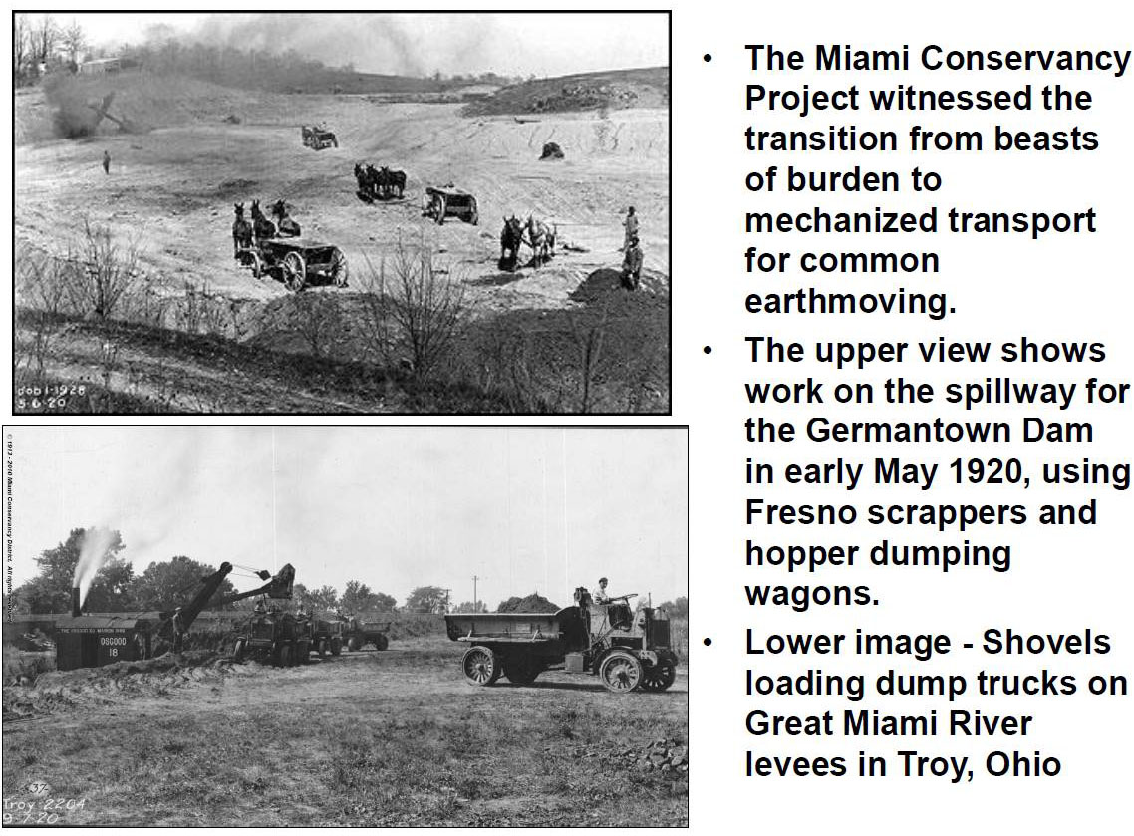
Slide courtesy of Professor J. David Rogers, Missouri University of Science & Technology

Slide 100
Controlled outflow
Energy dissipation
0.1 miles

Slide 101
Stable Bedrock
0.1 miles

Slide 102
Outflow Controls
Twin Creek unconstrained flow
May 1984

Slide 103
Huffman Dam on Mad River

Slide 104
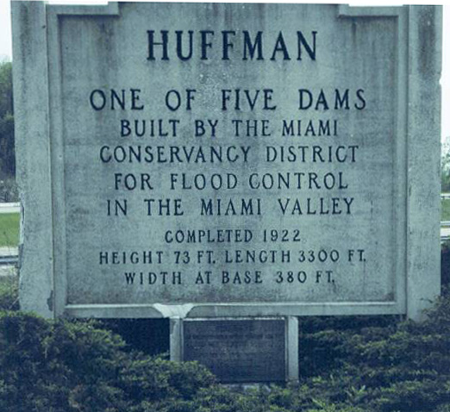
May 1984

Slide 105
THE DAMS
OF THE MIAMI CONSERVANCY DISTRICT ARE FOR
FLOOD PREVENTION PURPOSES
THEIR USE FOR POWER DEVELOPMENT
OR FOR STORAGE
WOULD BE A MENACE
TO THE CITIES BELOW

Slide 106
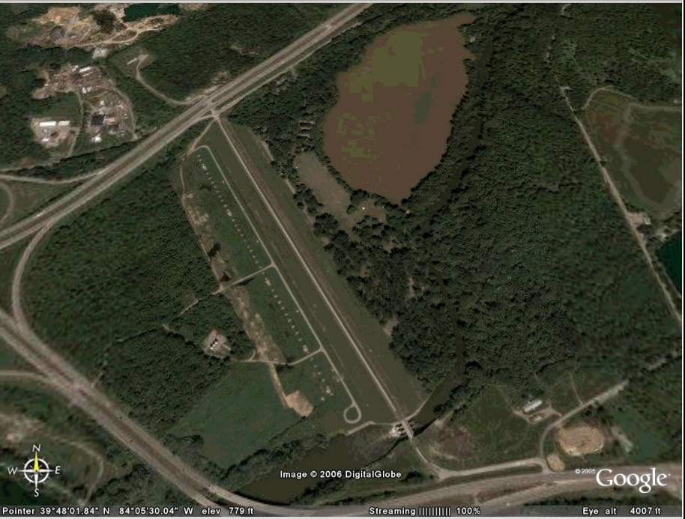
Huffman Dam
3300 Ft.
?

Slide 107
Dam safety:
48 relief wells to control under seepage -
reduce uplift forces - installed 1979 - 1983
Dam safety:
All five dams now
have relief wells
Mad River

Slide 108
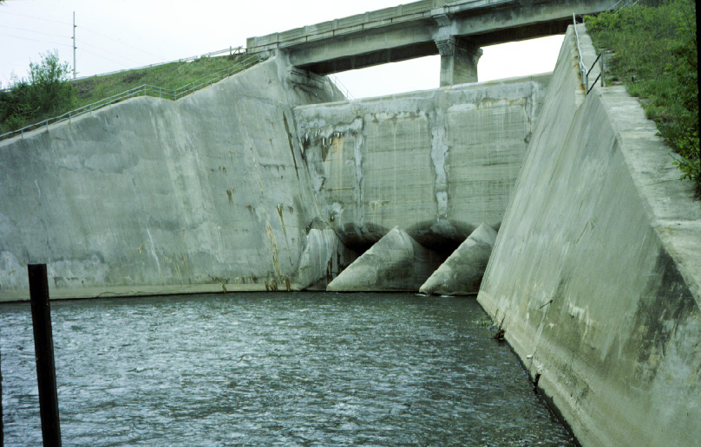
Unconstrained Mad River flow – Huffman Dam Outlet works
May 1984

Slide 109
Emergency spillway
Time history of Portland cement concrete chemistry
Controlled release
Huffman Dam Outlet works – Hydrodynamic Design
May 1984

Slide 110

Hydraulically efficient divided outlet flow
May 1984

Slide 111

Outflow Controls – Similar design to Taylorsville Dam
Mad River unconstrained flow
200 Feet
9/23/2019

Slide 112
Englewood Dam on Stillwater River

Slide 113

Lake and picnic area
Dam
Stillwater River
0.1 miles
Englewood Dam and region

Slide 114

Granite sign

Slide 115

Englewood “Dry” Dam
Dry side - no “permanent flood”
1972 National Historic Civil Engineering Landmark, ASCE
0.1 miles

Slide 116
Outlet works
0.89 miles
Spillway
0.1 miles

Slide 117

Relief wells to control under seepage - reduce uplift forces
Controlled seepage
release structures
0.05 miles
6/29/2016

Slide 118

Low Cost Emergency Spillway
Existing rock with shallow soil cover
Overflow path
May 1984

Slide 119

Top of dam
Original Bridge
Outflow armoring

Slide 120

Clear span bridge
Engineered Ogee Spillway
100 Ft.
May 1984

Slide 121

Recreational Lake
Stillwater River
Weir
May 1984

Slide 122

Gravel Bed Stillwater River
Sediment transport difficult to predict
Spillway overflow path
Engineered wing walls
May 1984

Slide 123

1919
Consulting Board
Slide courtesy of Professor J. David Rogers, Missouri University of Science & Technology

Slide 124

Maximum outflow rate

Slide 125
Englewood Dam construction

Slide 126
Dragline Excavator

Slide 127

Stillwater R.
Trench excavated in bedrock
Two conduits – X section:
Horseshoe shape, each
13 ft. wide x 10.5 ft. high
Conduits at Englewood Dam under construction

Slide 128
Horizontal seepage retarding barriers

Slide 129
Englewood – similar to Germantown

Slide 130
Coarse materials
Hydraulic fill direction
Fines

Slide 131
How does a “dry dam” work?

Slide 132

85,000 cubic feet per second without dam
Inflow
11,000 cubic feet per second with dam
outflow
Design flood peak flow reduction – Englewood Dam

Slide 133
No human intervention needed
Flood water stored
Flood water released
Filling
Emptying
Design flood peak flow reduction – Englewood Dam

Slide 134
Flood peak flow reduction – Englewood Dam
January 1937
Inflow and outflow Stillwater River
Inflow measured at Pleasant Hill, Ohio
Outflow measured at Englewood, Ohio

Slide 135

Pleasant Hill
Englewood Dam
Englewood
5 miles
Flood peak flow reduction – Englewood Dam

Slide 136
Source: Linsley, Kohler, and Paulhus, “Hydrology for Engineers, 1958

Slide 137
Emptying times for dams from peak design flood stage
Englewood – 28 days
Huffman – 5 days
Germantown – 8 days

Slide 138
Annual flood peak flow rate at Dayton - 1895 - 2021

Slide 139


Slide 140
The 1913 flood was the “flood of record”.
The facilities (levees, dams, and hydraulically efficient channels) were designed for the 1913 flood peak plus 40% additional runoff.
There has not been a flooding problem since implementation.
There is ongoing updating for dam and levee safety and repair and replacement of aged concrete.

Slide 141

Example - Lockington Dam Concrete replacement 2020 - Sunesis Construction

Slide 142

Latest details of life-cycle system updates in annual reports

Slide 143


Slide 144

Includes details of rate structure – Page 4
“How is the MCD
Flood Protection
System Funded?”

Slide 145
Why is this work exceptional and inspiring?
First U.S. integrated river basin solution
Total community involvement
First U.S. dams and levees engineering solution
Much modern engineering was done here first

Slide 146
The work was done under the exceptional leadership of Arthur E. Morgan without Federal funding.
It was path setting, innovative, and inspires.
It includes fail-safe and safe-fail features worthy of study.
The 1917 Federal Flood Act required “Levees only” solutions to flooding.
The 1928 Flood Act included Dams and Spillways.

Slide 147
Project time-line:
Flooding and deaths – March 1913
Designs – 1915
Completion – 1922
Typical modern project 30 to 40 years
MCD detailed reports
https://www.mcdwater.org/resources/mcd-publications/
https://www.mcdwater.org/MCD-Flip/MCD-A-Flood-of-Memories-Book/
https://www.mcdwater.org/water-stewardship/state-of-the-water/all-about-the-great-miami-river-watershed/

Slide 148
MCD – Additional Observations
Miami Valley aquifers and aquifer recharge
Family connection - W Burges Report 1960

Slide 149
MCD – Additional Observations
Miami Valley aquifers and aquifer recharge
Family connection - W Burges Report 1960

Slide 150
Other notable features MCD and Dayton region:
Major aquifer system
Sole source supply for approx. 2.3 Million people
Natural recharge - stream - aquifer connections
Artificial recharge in Mad River basin since 1930s

Slide 151

Managed aquifer recharge since 1930s
Aquifer storage ~
4.6 Million Acre Feet
Shasta Dam, CA
4.55 Million Acre Feet
Natural River to
aquifer recharge

Slide 152

Huffman Dam
Managed aquifer recharge since 1930s
0.5 miles

Slide 153

0.2 miles

Slide 154
MCD – Additional Observations
Miami Valley aquifers and aquifer recharge
Family connection - W Burges Report 1960

Slide 155

My Dad:
Findings from a 6-month world study tour in 1960.
I was 16, Dad was 44
I read the report in April 2018
Scanned from University of Newcastle’s Auchmuty Library copy

Slide 156

W. C. (Bill) Burges (1916 – 2002), circa 1960

Slide 157
I did not know why Dad included Dayton in his study tour.
It became clear after I read his report.

Slide 158
Dayton … . In 1913 it became the first city in the United States with a population over 8,000 to adopt the Council-Manager form of government.
The City of Dayton is located on a flood plain and it was the result of severe flooding and subsequent devastation in 1913 which led to the then new form of Council-Manager city government being adopted to expeditiously and systematically restore and manage the city.

Slide 159
At that time also, the “Miami Conservancy District” was formed, about which I will report separately, and as a result of the work of the Conservancy District, Dayton is now safe from future flood-rains.
From page 110: “Some Aspects of City Government and Other Practices Overseas”, Report by, W. Burges, Town Clerk, City of Newcastle, N.S.W., 1960, p221.
Sadly, I have not found Dad’s report on the MCD.

Slide 160
Summary observations from personal experience and studying excellent water resources engineering works

Slide 161
Make sure that there is a “captain of the ship”. The captain has full knowledge of the operation and delegates.
Arthur Morgan was an exceptional “captain of the ship”. He had detailed understanding of every aspect of the flood protection scheme.
He and colleagues hired the best engineers they could find to do this innovative work.

Slide 162
The establishment with the full engagement of the community of the “Miami Conservancy District” and its governing structure guaranteed there would be no loss of “institutional memory” and ensured “life cycle” engineering and societal engagement.
The "District" is overseen by its chief engineer, board of directors and board of (world class) consultants who meet in Dayton for "five-year" inspection tours.

Slide 163
How do we replicate the spirit of Morgan and his approach?
In addition to a “ship’s captain”
Seek out several wise colleagues 30+ years older including retired professionals to serve as mentors; engineering mistakes are repeated about every 30 years.
Invite colleagues to help you think of all ways that your design or system could possibly fail and the societal consequences.
“Hope” is not a strategy!

Slide 165
Epilogue:
Oroville Dam chute spillway failure, February 2017

Slide 166
An example of the importance of loss of “institutional memory”
Failure of the spillway and severe damage from flow over the emergency spillway at Oroville Dam, California, the most important reservoir in the California State Water Project, in February 2017
The January 2018 Independent Team Forensic Report highlights the failure to consider full “life-cycle” design and maintenance.
There was no oversight of the system of comparable robustness to that for the MCD

Slide 167

Emergency spillway -1,730 ft. long - for uncontrolled release of floods up to PMF
Earth dam – 6,920 ft. long
Discharge – Failed Chute Spillway
March 2017

Slide 168

Back cutting at 10 ft./hour
Damage from use of emergency spillway
March 2017

Slide 169

Emergency spillway
Note location similarity to Englewood Dam emergency spillway
Major difference – greater erosional potential at Oroville: longer hillside runout length to river. Runout domain rock stability critical to safe performance
June 7 2013

Slide 170
Englewood Dam
Outlet works
Emergency spillway
0.1 miles

Slide 171

Emergency Spillway and overflow region before use
April 14, 2015

Slide 172

Emergency Spillway and overflow region after erosion damage
May 18, 2017

Slide 173

Emergency Spillway overflow region after extensive repair
Sep 21, 2020

Slide 174

Cost of replacement of spillway 2017-2018 and stabilization below emergency spillway – 2018, $1.2B (DWR Feb. 2021)

Slide 175
Questions?

Slide 177
Access to the Technical Reports of the MCD

Slide 178
Arthur Morgan and colleagues published Ten comprehensive “Technical Reports” between 1917 and 1922.
The reports describe some of the best scientific hydrology and hydrologic engineering work that has been done.

Slide 179
Technical reports of The Miami Conservancy District
Available at:
https://depts.washington.edu/sjbx/
Download file "MCD Reports.zip"
There are ten reports starting in 1917 and ending in 1922. There is an updated version of Report V (Rainfall) published in 1936. I did not know about this report until I requested all the reports from our UW Library. I scanned in its entirety the 1936 report (it is the largest file). The other ten reports were all scanned initially by Google. I found numerous badly copied, unreadable, and missing pages (particularly fold out figures). I copied and replaced such pages in all the reports. I was restricted to copying from bound copies of the reports hence a few pages are a bit out of alignment. The pages I scanned are all at 300 dpi. I found this necessary to ensure that dimensions on figures etc., were readable.
I have also included scans of two figures and a location map. I do not know from which report they were extracted; my source was pages at the end of a single bound copy of reports 1-V.
I have also included a copy of a 1928 paper by Arthur Morgan. That paper provides essential background about how he located his top engineers and their experience coming to the Miami Valley flood problem.

Slide 180
Reading Guide - Extreme Flood Issues and System Design:
1. Burges-Water Systems Planning-ASCE-WRPM-1979 pages 98-100 for a brief coverage of The Miami Conservancy District flood mitigation work.
2. “Storm Rainfall of Eastern United States - The Engineering Staff - Miami Conservancy District Technical Reports Part V, 1917” for investigations to determine major flood producing rain.
Recommended initial reading: Chapter XI (page 241) and then Chapter XII (page 268).
There was a follow up to Report V published in 1936 (“Storm Rainfall of Eastern United States - The Engineering Staff - Miami Conservancy District Technical Reports Part V, Rev 1936-sjb”) that included 20 more years of data. See: Chapter 1 pages 1 - 5.
3. “Hydraulics of the Miami Flood Control Project - Sherman M. Woodward - Miami Conservancy District - Technical Reports Part VII, 1920” for details of the actual design. Most notable are Chapters XII and XIII. This was exceptional water resources engineering.

Slide 182
REASONS FOR CHOOSING AS BASIS OF DESIGN A FLOOD 40 PER CENT GREATER THAN THAT OF MARCH 1913
The extensive investigation of storms in the eastern United States leads to the belief that the March, 1913, flood was one of the great floods of centuries in the Miami Valley.
In the course of three or four hundred years, however, a flood 15 or 20 per cent greater may occur. It is not believed that a flood will ever occur which is more than 20 or 25 per cent in excess of that of March 1913.
There is a factor of ignorance, however, which should be provided against, and the only way this could be done was arbitrarily to increase the size of maximum flood provided for.
If longer records were available a closer estimate could be made, but in planning works on which the protection of the Miami Valley depends, it was necessary to go beyond human judgment.

Slide 183
This was done on all the other phases of the design, and it was believed that it would not be good engineering practice to stop at individual judgment on this phase.
The planners of the project felt that they must be able to say that the engineering works are safe in every respect.
For this reason provision was made for a flood nearly 40 per cent greater than that of March 1913.
This is 15 or 20 per cent in excess of what is believed to be the greatest possible flood that will ever occur.
STORM RAINFALL OF EASTERN UNITED STATES, 1936 Page 335

Slide 184


Slide 185

20 velocity formulae tested (including Manning, Basin and Kutter)
Kutter equation adopted - pages 125-129

Slide 186


Slide 187

Includes full details of the actual design.
Notable are Chapters XII and XIII.
This was exceptional water resources engineering.

Slide 188


Slide 189
Arthur Morgan had an extensive knowledge of flood hydrology - see, e.g.
Discussion by Arthur Morgan (pages 618 - 621) of paper by W. B. Fuller, Flood Flows, ASCE Transaction Paper 1293, 1914

Slide 190
Source Materials:

Slide 191
Two Oroville Spillway webinars:
Physical Aspects of the Oroville Dam Incident
https://www.youtube.com/watch?v=3JygTm8iiWQ
March 5, 2018, 2:00 PM EST
John W. France, PE, D.GE, D.WRE; Vice President, AECOM, Independent Forensic Team Leader
Lessons for Dam Safety from the Oroville Dam Incident
https://www.youtube.com/watch?v=YjgugkIfwWQ
March 14, 2018, 2:00 PM EST
Stephen J. Rigbey, Director Dam Safety at BC Hydro, Independent Forensic Team member
Independent Forensic Team Report Final 01-05-18.pdf 584 p https://damsafety.org/sites/default/files/files/Independent%20Forensic%20Team%20Report%20Final%2001-05-18.pdf

