Slide 1
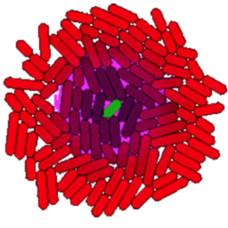
gro Tutorial 3

Slide 2
Signals
Declaring Signals
Sending Signals
Sensing Signals
Absorbing Signals
Reaction-Diffusion
Bioprocessing example

Slide 3
Declaring Signals
This line defines a signal called “ahl”.
signal() takes two arguments: degradation rate
diffusion rate
include gro
ahl := signal(5, 0.1);
By itself, declaring a signal doesn’t do anything! It only defines a signal for use later in the program, either by a cell or the environment (main loop). Don’t set the diffusion rate too high or you will run into numerical integration errors.

Slide 4
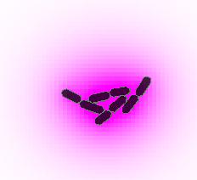
Sending Signals with Cells
include gro
ahl := signal(5, 0.1);
program signaler() := {
true : {
emit_signal(ahl,0.2)
}
};
ecoli ( [], program signaler() );
A cell can send a signal using the emit_signal() function. It has two arguments:
The signal to use
How much to release
These cells constantly emit signal. Try varying the parameters – what happens as you vary the diffusion and degradation rates of the signal, but keep their ratio the same?

Slide 5
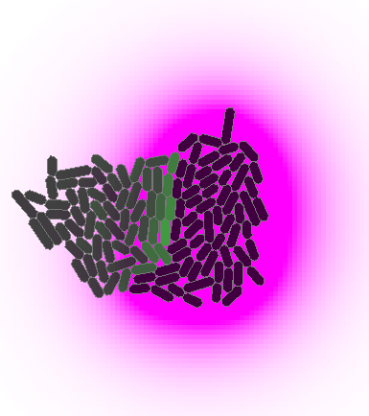
Receiving Signals
include gro
ahl := signal(5, 0.1);
k := 2; // reporter scaling factor
program signaler() := {
true : {
emit_signal(ahl,0.2)
}
};
program receiver() := {
gfp := 0;
rate(k*get_signal(ahl)) : {
gfp := gfp + 1
}
};
ecoli ( [x:=50,theta:=3.14/2], program signaler() );
ecoli ( [x:=-50], program receiver() );
To have a cell sense a signal, use get_signal(). This function takes one argument: the signal to detect.
This program has two cell types. The new cell type, “receiver”, produces gfp at a rate proportional to the signal it receives

Slide 6
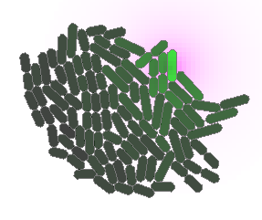
Setting Environment Signals
include gro
ahl := signal(5, 0.1);
k := 10; // reporter scaling factor
program receiver() := {
gfp := 0;
rate(k*get_signal(ahl)) : {
gfp := gfp + 1
}
};
program main() := {
true : {
set_signal(ahl,50,-50,1)
}
};
ecoli ( [], program receiver() );
When defining a signal in main, use set_signal(). set_signal() takes four arguments:
the signal to set
x coordinate
y coordinate
the amount of signal to release
Coordinates in gro have the origin in the center of the screen, with x coordinates increasing from left to right and y coordinates increasing from top to bottom.

Slide 7
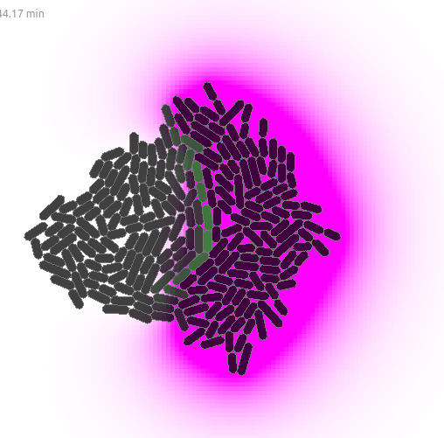
Absorbing Signals
include gro
ahl := signal(5, 0.1);
k := 2; // reporter scaling factor
program signaler() := {
true : {
emit_signal(ahl,0.2)
}
};
program receiver() := {
gfp := 0;
true : {
absorb_signal(ahl,0.1)
}
rate(k*get_signal(ahl)) : {
gfp := gfp + 1
}
};
ecoli ( [x:=50,theta:=3.14/2], program signaler() );
ecoli ( [x:=-50], program receiver() );
To have cells absorb a signal, use absorb_signal(), which takes two arguments:
signal to absorb
how much signal to absorb
This program is identical to the receiving signals program, but receiver cells eat up the signal. Absorption is useful both for accuracy and multicellular behaviors: cells that eat up a nutrient signal should absorb it, and signal removal is found in many natural multicellular signaling circuits.

Slide 8
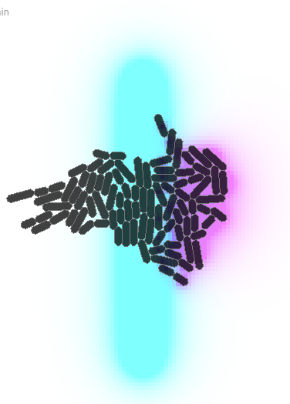
Reaction-Diffusion
include gro
ahl := signal(5, 0.1);
antiahl := signal(1, 0.1);
reaction({ahl,antiahl},{antiahl},10);
program signaler() := {
true : {
emit_signal(ahl,2)
}
};
program receiver() := {
gfp := 0;
rate(get_signal(ahl)) : {
gfp := gfp + 1
}
};
program main() := {
true: {
foreach i in range 10 do {
set_signal(antiahl,0,(200-40*i),10)
} end;
}
};
ecoli ( [x:=50,theta:=3.14/2], program signaler() );
ecoli ( [x:=-50], program receiver() );
reaction() defines how signals interact and takes 3 arguments:
A list of reactants
A list of products
The reaction rate
Reaction-diffusion reactions are based on chemicals that can (1) react with each other (or themselves) and (2) diffuse. Basic pattern formation can be generated via reaction-diffusion alone.
It can also be used for simpler behaviors: this program is identical to the receiving signals program, but with a line of “anti-ahl” signal that destroys ahl separating sending and receiving cells. How does this change the behavior of the receiver cells?

Slide 9
Example: Bioprocessing
include gro
set_theme ( bright_theme << [ signals := { { 1,0,0 }, { 0,1,0 } , { 0,0,1 } } ] );
biomass := signal(0, 0);
enzyme := signal(4,0.3);
food := signal(5, 0.1);
reaction({biomass,enzyme},{food,enzyme},5);
set("ecoli_growth_rate",0.0);
program bioprocessor() := {
true : {
set("ecoli_growth_rate",get_signal(food)),
emit_signal(enzyme,1)
}
};
program main() := {
t := 0;
true: { t := t + dt }
foreach i in range 2000 do {
set_signal(biomass,rand(400),(rand(800)-400),10)
} end;
};
ecoli ( [], program bioprocessor() );
Biomass is red, enzyme is green, food is blue
In this simulation, food (and therefore growth) can only come from degradation of the biomass via an excreted enzyme
Cell growth rate depends on nutrient availability
Uneven distribution of non-diffusing feedstock
Run the code! See what happens to the growing cell distribution by changing the diffusion rates.

Slide 10
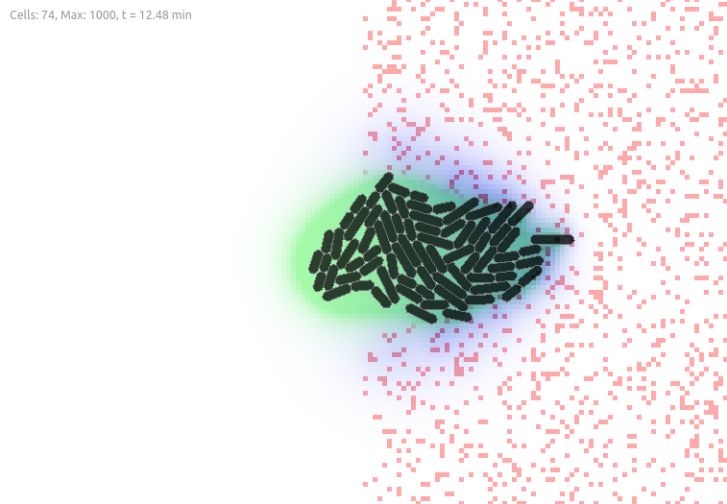
Example: Bioprocessing
Red, non-diffusing biomass particulates
Green ‘enzyme’ that reacts with biomass to produce food
Blue food that determines the growth rate

