Slide 1
Neural mechanisms of sound localization
How the brain calculates interaural time and intensity differences

Slide 2
Bottom line
Calculation of interaural differences in the brain depends on “wiring” and a balance between neural excitation and inhibition.

Slide 3
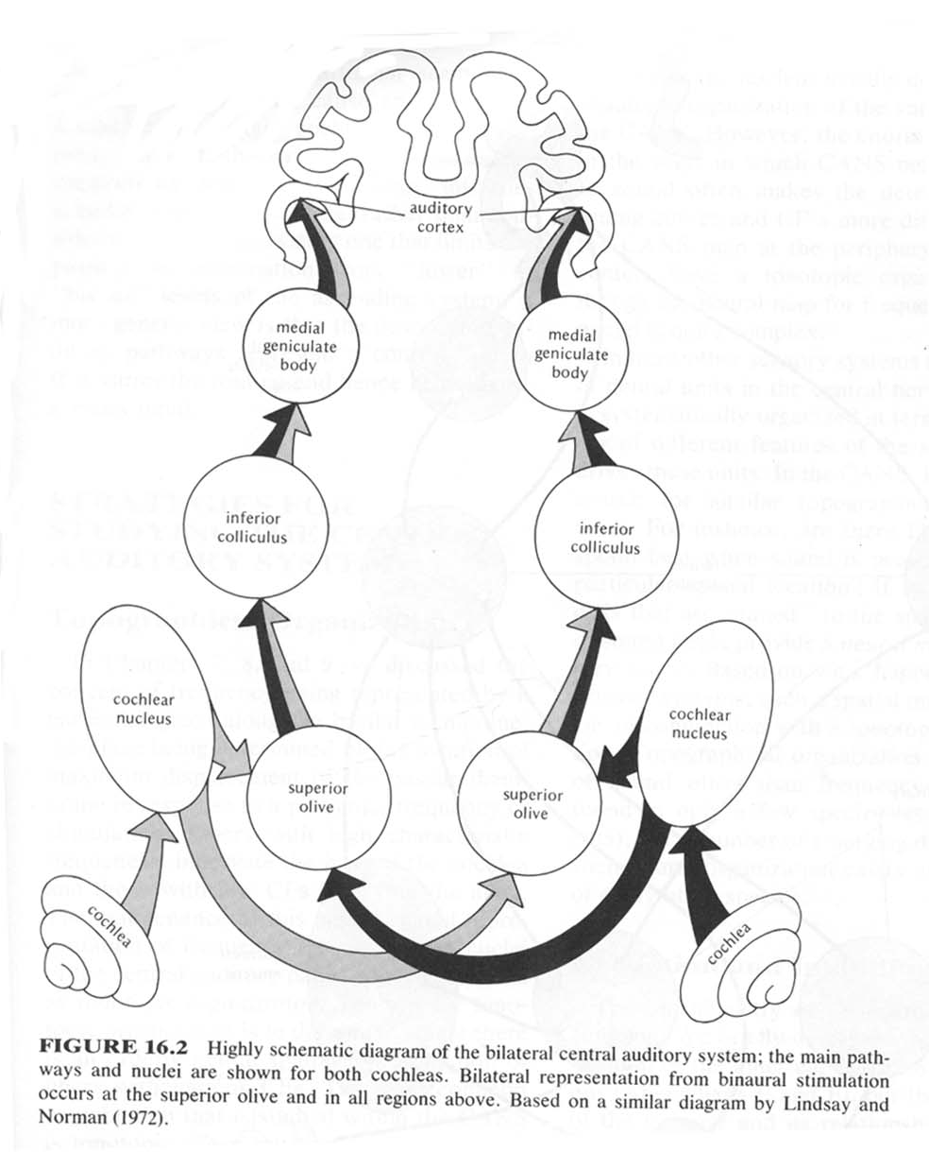
An overview of the auditory pathway
Notes:
This is a highly schematic representation of the auditory pathways. The auditory nerve projects from the ear to the cochlear nucleus. The cochlear nucleus projects to the superior olive, on both the ipsilateral (same) and contralateral (opposite) side of the brain. Notice that information from both ears is carried along the pathway beginning with the superior olive. The superior olive projects to the inferior colliculus which projects to the medial geniculate body, or nucleus. The MGB projects to the auditory cortex, in the temporal lobe of the brain.

Slide 4
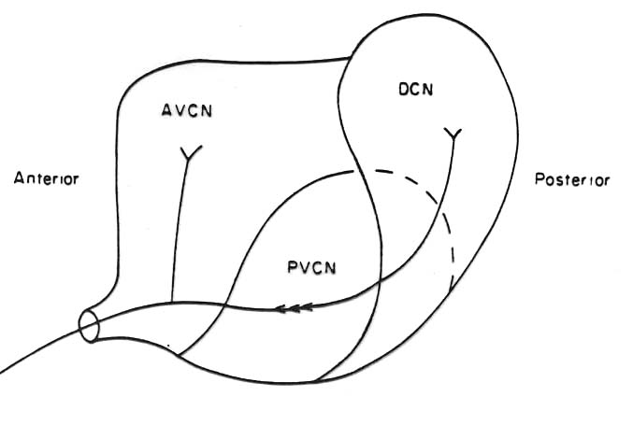
The circuit for sound localization starts in the cochlear nucleus
From Pickles (1988)
Notes:
AVCN = anteroventral cochlear nucleus
PVCN = posteroventral cochlear nucleus
DCN = dorsal cochlear nucleus

Slide 5
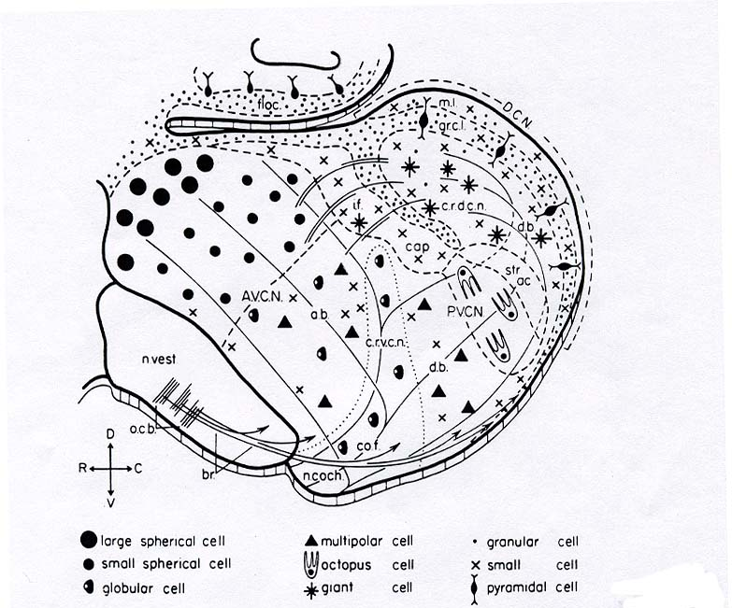
Principal cells of the AVCN are spherical or bushy cells
From Pickles (1988)
Notes:
AVCN neurons respond like auditory nerve fibers do. We call them primarylike for that reason. AVCN is tonotopically organized.

Slide 6
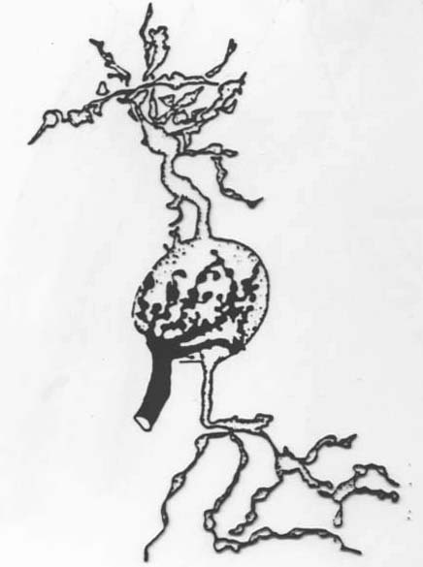
Bushy cell and auditory nerve connection
From Ryugo & Fekete (1982)
Notes:
Auditory nerve fibers make a large number of contacts with bushy cells, directly on the cell body. This connection is called an endbulb of Held, and it is what is called a secure connection. The bushy cell will fire each time the auditory nerve fiber fires.

Slide 7
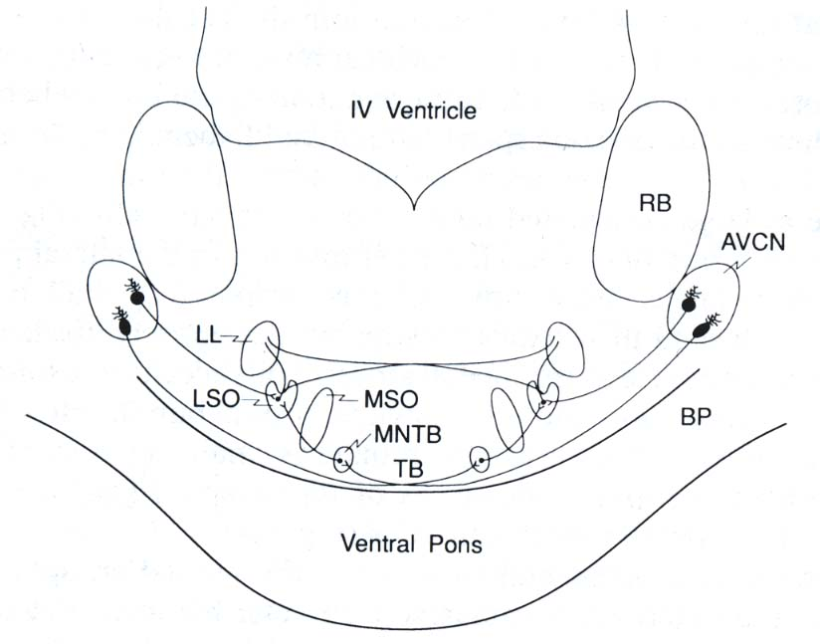
Nuclei involved in interaural intensity comparisons
AVCN = anteroventral cochlear nucleus
LL = lateral lemniscus
LSO = lateral superior olive
MNTB = medial nucleus of the trapezoid body
MSO = medial superior olive
TB = trapezoid body
From Webster (1992)
Notes:
Neurons in the AVCN project to the ipsilateral LSO and the contralateral MNTB. The MNTB projects to the ipsilateral LSO. So essentially, AVCN projects to LSO on both sides, but the contralateral projection makes a stop in MNTB. AVCN neurons respond like auditory nerve fibers do. We call them primarylike for that reason. AVCN is tonotopically organized.

Slide 8
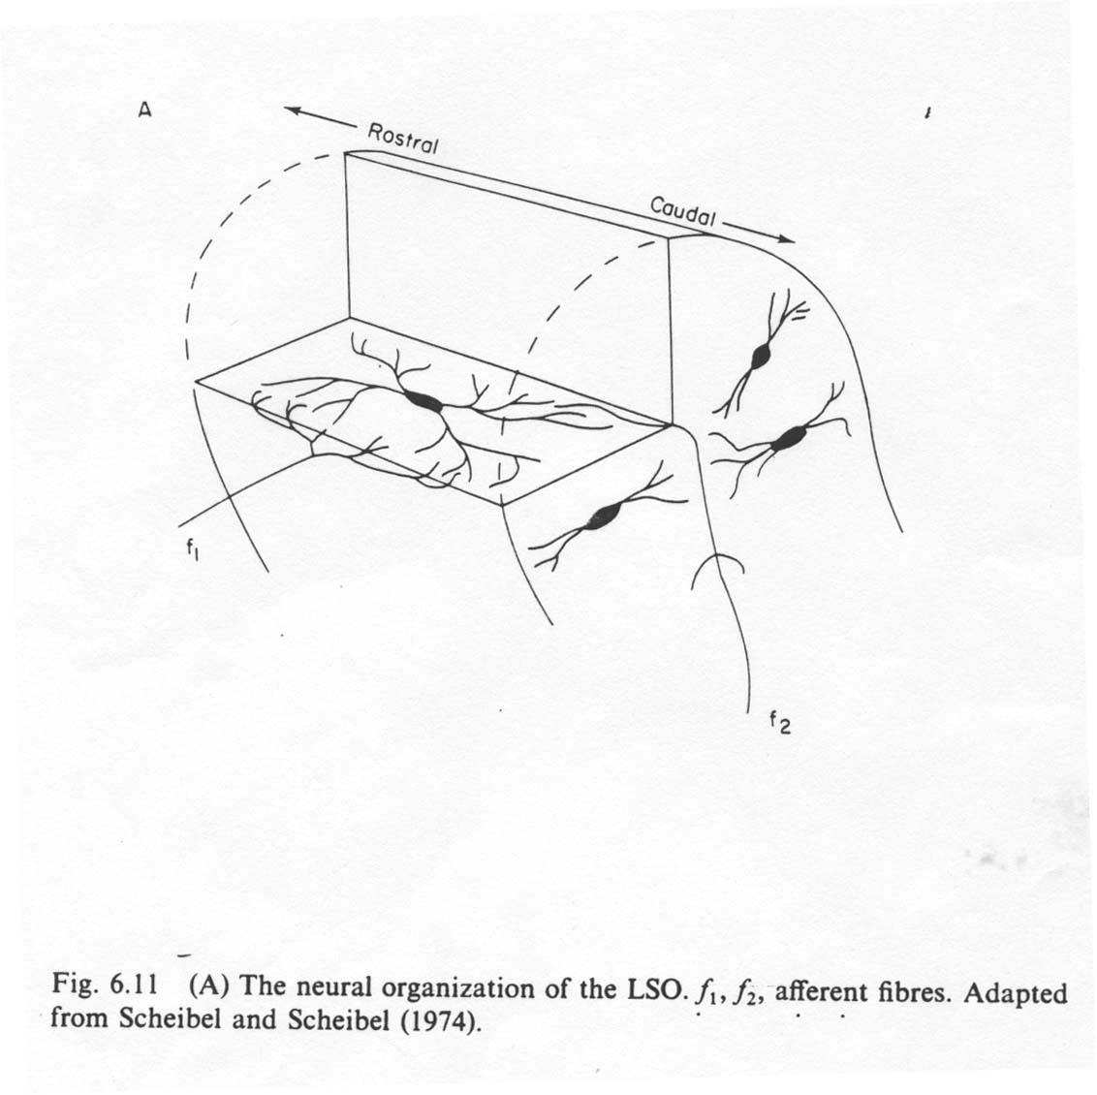
Lateral superior olive (LSO)
EI
(Excitatory- Inhibitory)
Response
From Pickles (1988)
Notes:
Neurons in the LSO have dendrites arrayed in two directions. They receive inputs from one set of (ipsilateral ) fibers on the dendrites on one side, and inputs from another set of (contralateral via MNTB) fibers on the other side. Nerve fibers don’t cross over to the other set of dendrites. LSO neurons seem to be structured to make comparisons across ears. The neurons are tonotopically organized. Neurons are excited by ipsilateral inputs and inhibited by contralateral inputs.

Slide 9
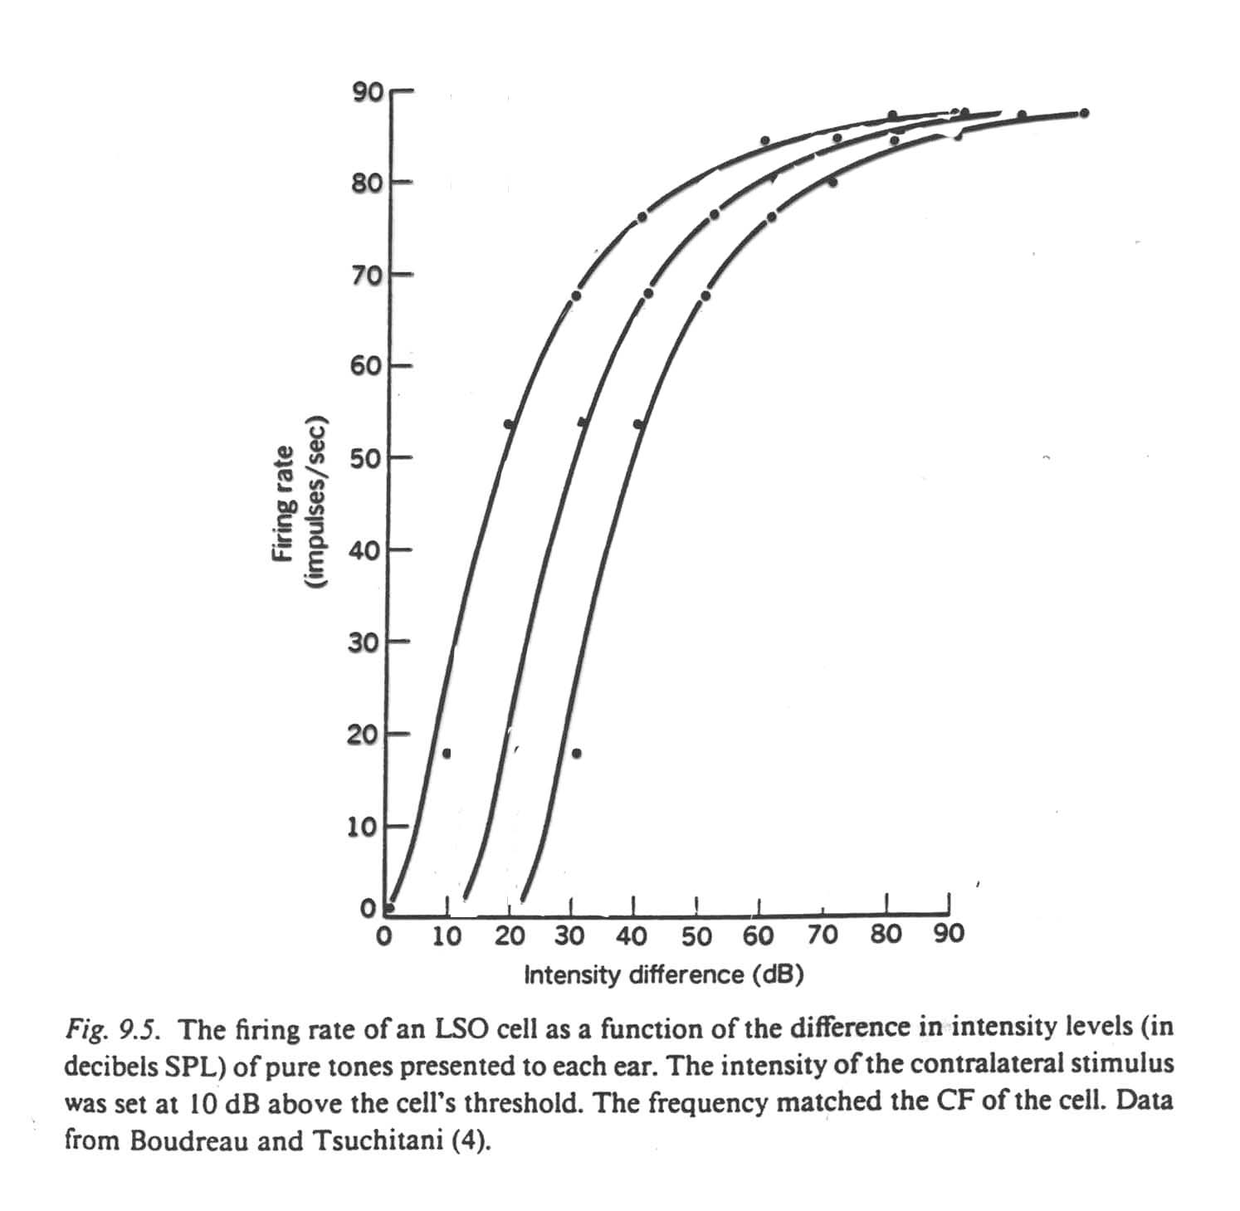
Response properties of LSO neurons
Modified from Pickles (1988)
Notes:
LSO neurons respond to intensity differences between the ears. Neurons start to respond at different IIDs and increase their response rate as the IID increases over a range of about 40 dB. By seeing which neurons are responding, a code for IID could be obtained.

Slide 10
Layout of LSO (rolled out)
Frequency
IID
Notes:
We can think of LSO as a sheet of cells. All the neurons in one row respond to the same frequency. All the neurons in one column respond to the same IID.

Slide 11
One frequency row in LSO
1 2 3 4 5 6 7 8 9 10
IID threshold
IID must be around here
Notes:
So as you move along one row, each neuron responds over a slightly different range of IIDs. In this picture, if the IID is 5 dB, the neurons with IID thresholds of 5 dB or less will respond, but the ones with higher IID thresholds won’t.

Slide 12
Pattern of activity gives IID across the spectrum
Frequency
IID
Notes:
So LSO neurons form a sort of graph or chart that tells what the IID is across the range of frequencies.

Slide 13
If the LSO were a graph, and the x-axis is frequency, then the y-axis is
Intensity
Spectral shape
Interaural intensity difference
Interaural time difference

Slide 14
How does response in LSO become specific for IID?

Slide 15
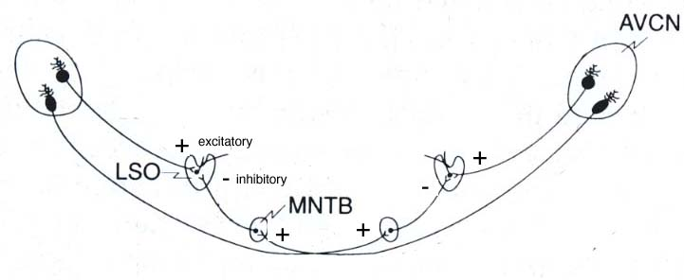
LSO wiring diagram
Notes:
The output of AVCN is exitatory, but the output of MNTB is inhibitory. When AVCN excites MNTB, MNTB inhibits LSO.

Slide 16
The balance between excitation and inhibition determines response
Ipsilateral input from AVCN
Response = excitation - inhibition
LSO neuron
If ipsilateral AVCN is responding more than contralateral AVCN (adjusted by MNTB), respond.
Contralateral input from MNTB
Notes:
This picture illustrates the inputs to one LSO neuron.

Slide 17
The LSO calculates IID by subtracting the response of the contralateral ear from the response of the ipsilateral ear using inhibition.
By adjusting the amount of inhibition delivered by MNTB, can make different LSO neurons respond over different ranges of IIDs.
Notes:
This excitation/inhibition mechanism is a good example of how the auditory nervous system derives information from the code carried by the auditory nerve.

Slide 18
If the sound source is close to the right ear, then the LSO neurons on the left side of the brain
respond a lot
respond a little
don’t respond at all

Slide 19
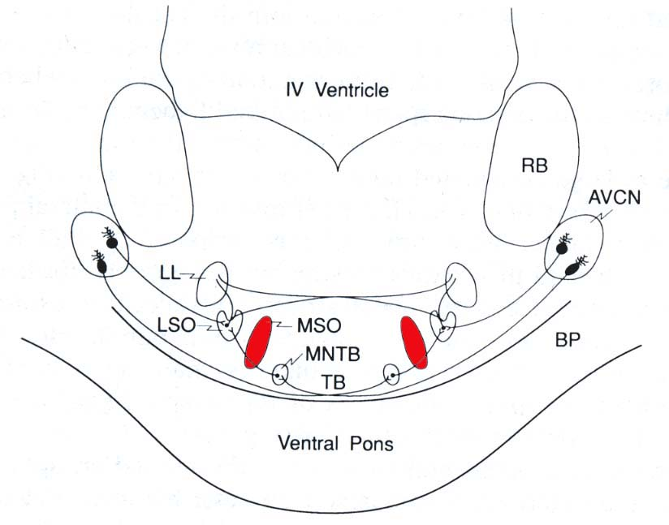
How about MSO?
From Webster (1992)

Slide 20
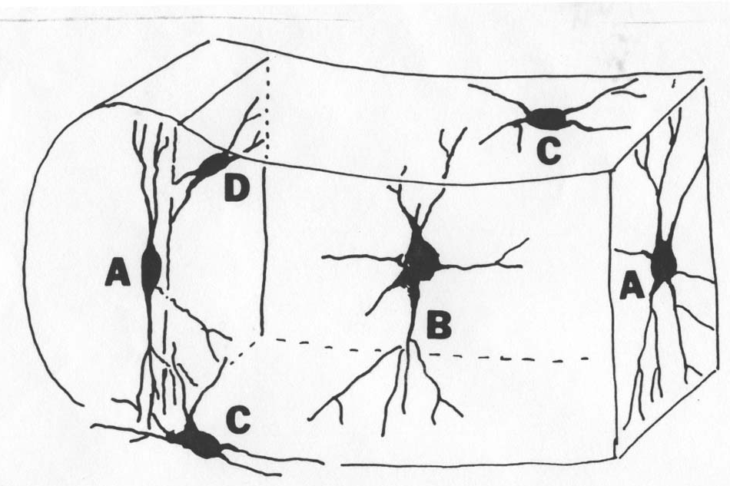
Like LSO neurons, MSO neurons look like they make comparisons
EE
(Excitatory-Excitatory)
Response
From Pickles (1988)

Slide 21
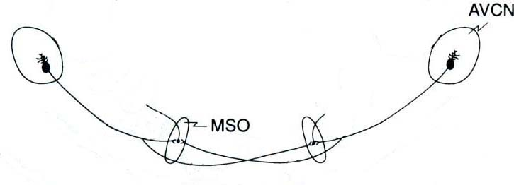
MSO neurons receive inputs from both AVCNs.
Notes:
Each AVCN axon splits and sends a branch to the MSO on each side.

Slide 22
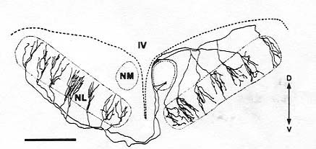
Branching pattern of AVCN axons is different on ipsilateral and contralateral sides
From Sullivan & Konishi (1986)
Notes:
The branches of the axons on the ipsilateral side are all around the same distance from the branch point. On the contralateral side, a main axon branch extends along the nucleus, sending off a branch every so often. This drawing was made in an owl. NM is nucleus magnocellularis, which is homologus to the AVCN in mammals.

Slide 23
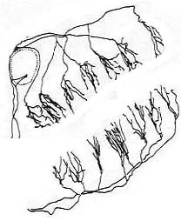
MSO neurons receive a different sort of projection from the 2 AVCNs
Notes:
The neurons in each MSO, represented by the shaded ovals, will have one sort of branching pattern approaching them from the ipsilateral side and the other sort approaching them from the contralateral side. Remember that the input to the MSO is the phase-locked response of AVCN neurons.

Slide 24
MSO receives the output of a neural delay line
Left ear response
delayed by 0.1 ms
Coincidence detectors
Right ear response
0 .1 .2 .3 .4 ms
Notes:
The boxes in the center of the diagram are coincidence detectors. A box lights up when it receives two inputs simultaneously. The time it takes an input to travel from the right ear to the coincidence detectors is longer for the “later” branches, so the .4 ms box will receive right ear inputs .4 of a ms later than the 0 ms box does. The inputs from the left ear travel along equal length branches, so they all arrive at all the coincidence detectors at the same time. Now if the message from the left ear arrives a little later than the message from the right, then the message from the left ear will arrive at all the boxes at the same time as the message from the right ear arrives at one of the boxes, determined by the interaural delay. The action potentials from each ear are phase-locked to the same frequency-- so the delay we’re talking about is the time between action potentials coming from the two ears. If the sound continues, then after a time coincidence detectors for longer delays will respond, but no coincidence detectors for shorter delays will respond.

Slide 25
MSO calculates ITDs by detecting coincident inputs from a delay line constructed from the axons of AVCN neurons.

Slide 26
IIDs are useful for localizing ____-frequency sounds; ITDs are useful for localizing ____-frequency sounds.
high, high
high, low
low, high
low, low

Slide 27
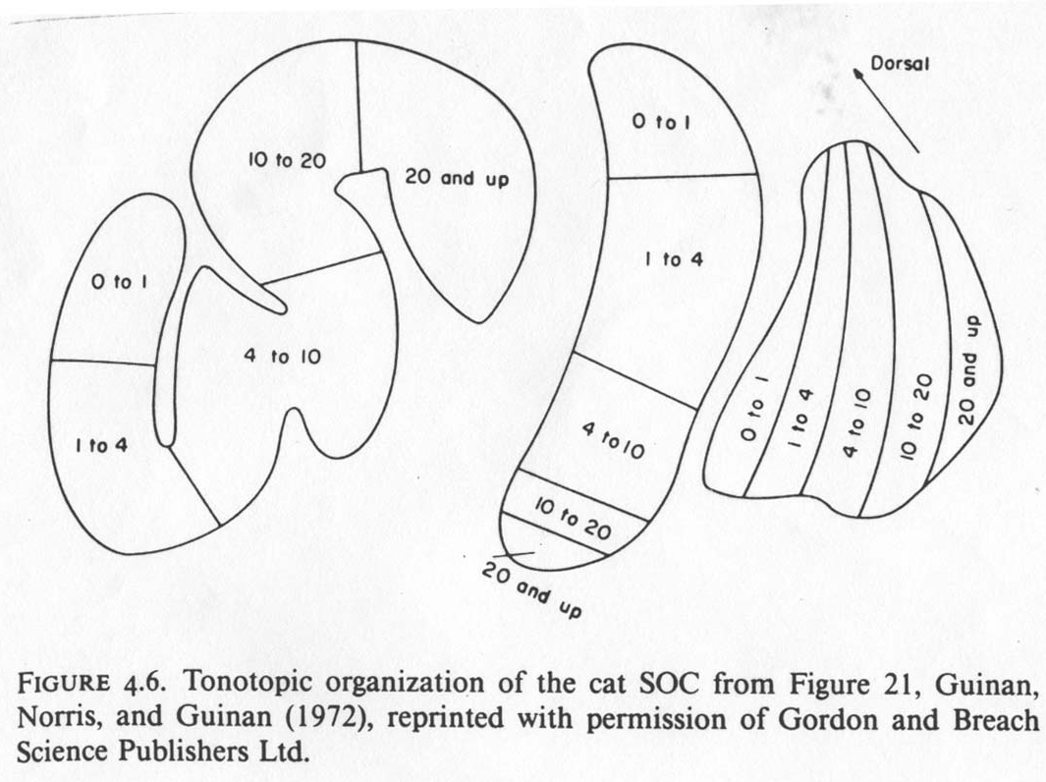
The tonotopic organization of the parts of the SOC matches the interaural calculations performed
MSO
MNTB
LSO
From Pickles (1988)
Notes:
Most neural space in LSO is devoted to high frequencies--the frequencies where IIDs occur in nature. By contrast, most neural space in MSO is devoted to low frequenices--the frequenciees for which ITD can be calculated unambiguously. MNTB’s tonotopic organization matches that of LSO, as expected.

Slide 28
Conclusions
The neurons of the superior olive calculate interaural differences in intensity and time.
The LSO uses a balance of inhibition and excitation to calculate IIDs.
The MSO uses a circuit established by the axons of AVCN neurons to calculate ITDs.

Slide 29
Text sources
Pickles, J.O. (1988) An introduction to the physiology of hearing. Berkeley: Academic Press.
Ryugo, D. & Fekete, D. (1982) Morphology of primary axosomatic endings in the anteroventral cochlear nucleus of the the cat: A study of the endbulbs of Held. J. Comp. Neurol. 210, 239-257.
Sullivan, W. & Konishi, M. (1986) Neural map of interaural phase difference in the owl’s brainstem. Proc. Natl. Acad. Sci. 83, 8400-8404.
Webster, D.B. (1992). An overview of mammalian auditory pathways with an emphasis on humans. In D.B. Webster, A.N. Popper & R.R. Fay (Eds.) The mammalian auditory pathway: Neuroanatomy. New York: Springer-Verlag.

