Slide 1
Periodicity and Pitch
Importance of fine structure representation in hearing

Slide 2
The bottom line
Pitch perception involves the integration of rate-place and temporal codes across the spectrum.

Slide 3
Pitch
the perceptual aspect of sound that varies from low to high.

Slide 4
Topics in pitch perception
Pitch of pure tones
Complex pitch

Slide 5
2AFC Frequency Discrimination
F + ∆F
F
Feedback
Time
Warning
Interval 1
Interval 2
Respond: 1 or 2?
Trial 1
1
Warning
Interval 1
Interval 2
Respond: 1 or 2?
Trial 2
2
Warning
Interval 1
Interval 2
Respond: 1 or 2?
Trial 3
2
Which one was higher?
Vary ∆F to find a threshold
Notes:
In psychoacoustics, pitch scales have received less attention than other aspects of pitch perception. Pure-tone frequency discrimination is one task that has been used to assess the accuracy of people’s pitch perception. On each trial, the listener receives a warning that the trial is starting, then hears two “intervals”. The signal occurs in one, but not in the other, randomly. The listener chooses the interval that contained the higher tone, and the difference between the two tones in frequency, ∆F, can be manipulated to find a threshold.

Slide 6
Terms for frequency discrimination threshold
∆F
frequency DL, DLF, FDL
∆F/F, Weber Fraction
jnd for frequency
Notes:
There are various terms for the frequency discrimination threshold.

Slide 7
Frequency discrimination
What code do people use to figure out what the frequency of a pure tone is?
Rate-place code
Temporal code
Combined firing rate of ANF
with the same CF
# action potentials
Position on basilar membrane
Time
Notes:
Two major questions about frequency discrimination have been of interest .

Slide 8
Frequency discrimination demo
1000 + ∆f
1000 + ∆f
1000 + ∆f
1000 + ∆f
Frequency (Hz)
1000
1000
1000
1000
1 2
1 2
1 2
1 2
Time
Time
Time
Time
UP
DOWN
DOWN
UP
Ten times, each time ∆f decreases
Notes:
Test yourself on frequency discfrmination. You will hear 4 pairs of tones. In each piar, one is 1000 Hz, and th eohter is slightly higher. In each pair, write down whether you hear the frequency go up or down. In the first 4 pairs ∆f is 10 Hz (so the tones are 1000 and 1010). Then the pairs are repepeated with ∆f = 9 Hz, 8 Hz and so on down to 1 Hz.

Slide 9
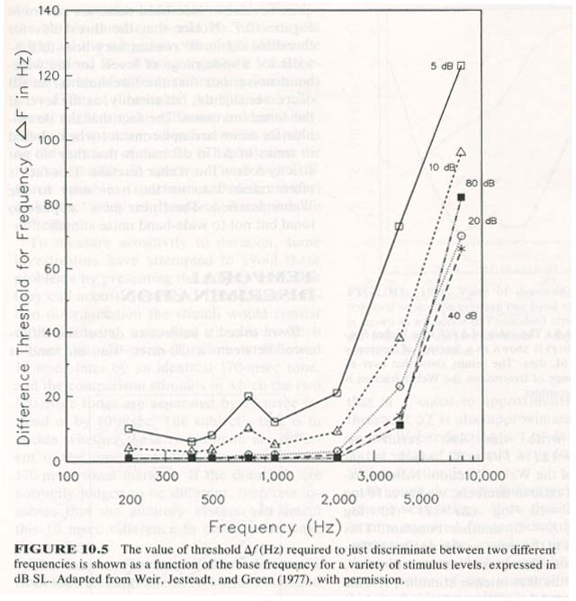
Pure-tone frequency discrimination
From Yost (1994)
Notes:
Each curve shows the jnd for frequency as a function of frequency, each curve at a different sensation level. Once the level of the tone reaches about 40 dB SL, level isn’t very important. At frequencies below about 2000 Hz, the jnd is quite small, a Hz or two. At higher frequencies, the jnd increases with increasing frequency.

Slide 10
If Weber’s Law held for frequency discrimination then ∆f/f would be
the same at all frequencies.
Worse at high frequencies
Worse at low frequencies
unpredictable

Slide 11
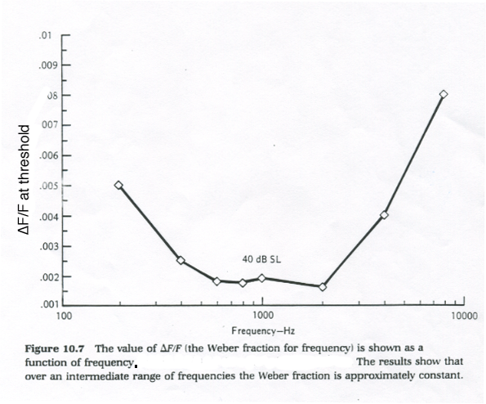
Weber’s Law and Frequency Discrimination
From Yost (1994)
Notes:
Does Weber’s Law hold? In the midrange of frequency, the Weber fraction, ∆F/F is pretty much constant. At higher and lower frequencies it is worse. In fact, Weber’s Law generally doesn’t hold for “quality” dimensions like pitch, but does for “quantity” dimensions.

Slide 12
Why does it get worse at high frequencies?
From Yost (1994)
Notes:
One explanation for the difference between low-ish frequencies and high frequencies is the code that is used to represent frequencies in these frequency ranges. While phase-locking could be used to represent a low frequency, only the place code is available to code high frequencies (over 5000 Hz, and phase locking starts to deteriorate above 1000 Hz or so).

Slide 13
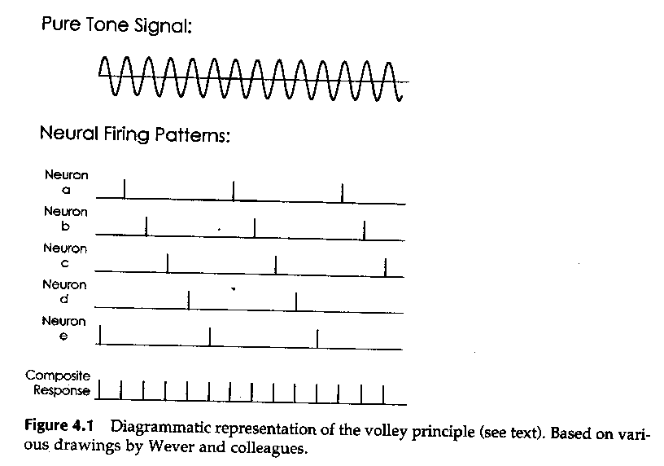
Representation of time waveform of a tone
From Gelfand (1998)
Notes:
Remember that the representation of the time waveform of sound depends on combining responses across nerve fibers to determine the interval between peaks in the waveform. Moore suggested that one way to tell whether different codes are used for low and high frequencies would be to see what would happen if you varied the duration of the tone.

Slide 14
Effects of tone duration
Time (ms)
Time (ms)
Time (ms)
Time (ms)
Notes:
Consider that as the duration of the tone gets shorter and shorter, the information available to the auditory system to calculate that interval gets degraded severely.

Slide 15
Duration and the place code
Time (ms)
Time (ms)
Relative
amplitude (dB)
Relative
amplitude (dB)
794 1000 1260 1588
794 1000 1260 1588
Frequency (kHz)
Frequency (kHz)
Time (ms)
Time (ms)
Relative
amplitude (dB)
Relative
amplitude (dB)
794 1000 1260 1588
794 1000 1260 1588
Frequency (kHz)
Frequency (kHz)
Notes:
As far as the place code is concerned, you might expect more activity as the duration of the tone is increased, but the task is always to figure out which one of those auditory nerve fibers is responding. So duration may not have such a dramatic effect on the place code.

Slide 16
Pitch salience depends on duration and frequency
Tones don’t have very distinct pitch when they are very short.
Notes:
In fact, we know that making a tone very short makes it hard to judge its pitch.

Slide 17
Prediction
Shortening the duration of the tone should have a bigger effect on frequency discrimination if frequency is being coded temporally than if it is coded by place.

Slide 18
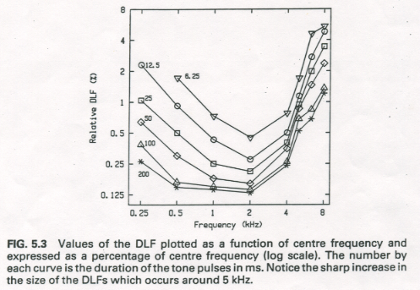
Effects of duration of pure-tone frequency discrimination
From Moore (1997)
Notes:
Moore’s results are consistent with this prediction. Each of these curves represents the Weber fraction as a function of frequency for a different tone duration. As the duration gets shorter, the jnd gets worse. But this effect is more pronounced at low frequencies, where the temporal code is thought to be used.

Slide 19
These and other findings suggest that a temporal code (phase-locking) is used to code low frequency tones, but that the place code is used to code high frequency tones
But notice that we do better, relatively speaking, with the temporal code. People use whatever works best.

Slide 20
People discriminate to smallest changes in frequency
In the low frequencies at low intensities
In the middle frequencies at low intensities
In the middle frequencies at medium to high intensities
In the high frequencies at high intensities

Slide 21
When discriminating frequency differences people use the ____ code at low frequencies and the ___ code at high frequencies
Firing rate, temporal
Temporal, spread of excitation
Temporal, rate-place
Rate-place, temporal

Slide 22
Complex pitch
Most sounds are complex. How do we perceive the pitch of complex sounds?

Slide 23
Harmonic complex
Fundamental, f₀
harmonics, f_{1,} f_{2,} f_{3,} etc.
Level (dB SPL)
200 400 600 800 1000 1200 1400
Frequency (Hz)
Fundamental = 1st harmonic
nth harmonic = n f₀
Notes:
A harmonic complex contains a series of tones, each one is an integer multiple of one frequency, called the fundamental frequency. The fundamental is the first harmonic, the harmonic with a freuency of 2 X the fundamental is the second harmonic, and so on.

Slide 24
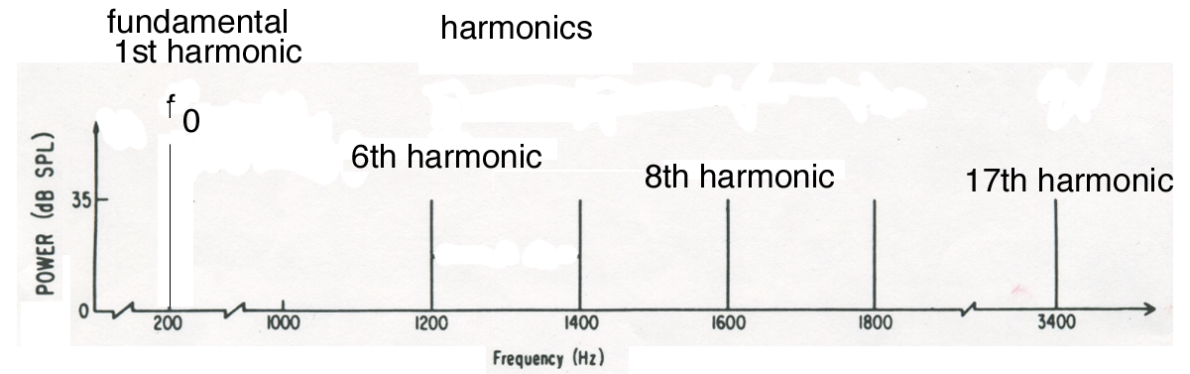
The pitch of a harmonic complex
Pitch is a unitary percept: You hear one complex tone, not 6 separate pitches.
If a listener is asked to match the pitch of the complex to the pitch of a pure tone, they will choose a pure tone at the fundamental frequency.
Notes:
Many sound sources (e.g., voices, musical instruments) produce complex sounds with harmonically related components.

Slide 25
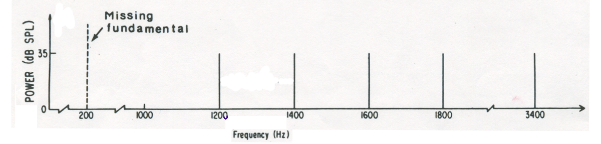
In fact, if you present the harmonics alone, you still hear the pitch of the fundamental
Pitch of the missing fundamental
Virtual pitch
Residue pitch
Low pitch
Notes:
The pitch that you hear when the fundamental is missing goes by various names.

Slide 26
Possible explanations for virtual pitch: Distortion
f₇ – f₆ = f₀
Distortion? No, because masking the frequency of the fundamental doesn’t affect the pitch.
Level (dB)
Frequency (Hz)
Notes:
One theory was that the ear is producing distortion products at f_{i+1} - f_{i} which would be the frequency of the fundamentsl and that we are hearing that distortion. However, if you play a noise band centered on the frequency of the fundamental along with the harmonic complex, it would mask the distortion product, yet you still hear the pitch of the fundamental.

Slide 27
Possible explanations for virtual pitch: the brain calculates f₇ – f₆
The system isn’t just taking the difference between harmonic frequencies, because shifting the harmonics, but keeping the difference the same, changes the pitch.
f₀ = 200
f₀ = 200
f₀ = 210
Level (dB)
Frequency (Hz)
Notes:
Another theory was that the pitch of complex is just the frequency difference between the harmonics, but that is what the brain does to derive the complex pitch. If that theory were true, then if all the harmonics were shifted up by some amount, the difference between them would stay the same, so the pich of the complex should not change. In fact, if the harmonics are all shifted up by 50 or 60 Hz, the listner matches the pitch to a tone that is about 10 Hz higher than the difference between the components in frequency.

Slide 28
Two classes of theories of complex pitch
Pattern Recognition
Temporal Models
Notes:
There are many other theories of how complex pitch is derived, but they fall into two broad categories. Pattern recognition models are based on the rate-place code– the pattern of neural activity evoked by a complex tone. Temporal models are based on the temporal code– the phase-locked response of auditory nerve fibers represents the complex pitch.

Slide 29
Pattern recognition models
Patterns heard
Stored pattern of activity associated
with this fundamental
1200 1000 800 600 400 200
Firing rate
Firing rate
Base apex
Base apex
Position along the basilar membrane
Position along the basilar membrane
Firing
rate
New complex
200 Hz
Base apex
Position along the basilar membrane
Firing rate
Level
(dB)
Base apex
Position along the basilar membrane
Base apex
Position along the basilar membrane
Notes:
The idea behind template or pattern recognition theories is that when we hear periodic sounds, the fundamental is in there, and some harmonics are there, but not always the not always the same ones. But over many experiences with sound you learn a pattern, these harmonics go with that fundamental. So when you hear a sound you compare what you hear with what you have heard in the past and pick the fundamental pitch that matches the best. Even when the fundamental isn’t there the harmonics match best with the pattern or template for the fundamental.

Slide 30
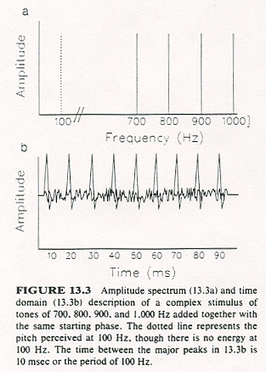
Temporal theories
From Yost (1994)
Notes:
Temporal theories point out that when you combine the harmonics of a given fundamental, even when the fundamental isn’t there, the combined time waveform repeats at the rate of the fundamental frequency. As we know, auditory nerve fibers will be phase=locked to the high positive peaks in the time waveform-- which are at the period of the fundamental. These theories say that that is the information you use to assign a pitch to the complex.

Slide 31
Resolved harmonics
f₀ = 200 Hz
f₀ = 220 Hz
Level
(dB)
Level
(dB)
200 400 600 800 1000 1200
220 440 660 880 1100 1320
Frequency (Hz)
Frequency (Hz)
Relative
amplitude (dB)
Relative
amplitude (dB)
360 440 540 660 800 1020 1200
360 440 540 660 800 1020 1200
Frequency (kHz)
Frequency (kHz)
Notes:
To understand the results of studies that test these theories you have to understand the difference between resolved and unresolved harmonics. Resolved harmonics fall into different auditory filters. A different set of harmonics will create a different activity pattern across auditory filters.

Slide 32
Unresolved harmonics
f₀ = 200 Hz
f₀ = 220 Hz
Level
(dB)
Level
(dB)
2000 2200 2400 2600 2800
2200 2420 2640 2860 3080
Frequency (Hz)
Frequency (Hz)
Relative
amplitude (dB)
Relative
amplitude (dB)
1800 2160 2500 3100 3700 4500
1800 2160 2500 3100 3700 4500
Frequency (kHz)
Frequency (kHz)
Notes:
Unresolved harmonics pass through the same auditory filter. Different sets of harmonics could create the same pattern of activity across auditory filters. So if you hear different virtual pitches when the harmonics are unresolved, then you can’t be using a pattern to do that because the pattern is the same. You could be using temporal information because the combined waveform of the harmonics repeats at the rate of the fundamental frequency.
Remember that auditory filters are wider (in terms of linear Hz) at high frequencies. So generally unresolved harmonics will occur at high frequencies. So this would be a case where we areusing phase-locking to low-frequency modulations of a high-frequency carrier to identify sound.
Also notice that this situation is the opposite of the frequency dependence observed for pure-tone frequency discrimination, where the place code was the only code for a high frequency. Now we are using phase locking in high-frequency nerve fibers to identify the pitch.

Slide 33
Temporal response to resolved and unresolved harmonics
f₀ = 200 Hz
f₀ = 200 Hz
Level
(dB)
Level
(dB)
200 400 600 800 1000 1200
2000 2200 2400 2600 2800
Frequency (Hz)
Frequency (Hz)
200
neuron 1
400
neuron 1
200
neuron 2
600
neuron 2
1000
neuron 3
Notes:
For the resolved harmonics, the neurons will be phase-locked to the fine structure of each harmonic. For the unresolved harmonics, the neurons will be phase-locked to the envelop of the sound, which has a periodicity of 200 Hz, the fundamental frequency.

Slide 34
Temporal theories would predict that complex pitch perception will be good with unresolved harmonics.
True
False

Slide 35
Pattern recognition theories would predict that complex pitch perception will be good with unresolved harmonics.
True
False

Slide 36
Pattern recognition v. temporal theories: Evidence
Existence region of virtual pitch: Can you get virtual pitch with harmonics too high to be resolved? YES
Dominance region: Which harmonics are most important to determining pitch? RESOLVED HARMONICS
Level (dB)
Level (dB)
Level (dB)
Frequency (Hz)
Frequency (Hz)
Frequency (Hz)
Notes:
Studies that show that resolved harmonics produce stronger impressions of pitch than unresolved harmonics support pattern recogntion theories. But because virtual pitch does occur when all harmonics are unresolved, it is clear that temporal information is also being used.

Slide 37
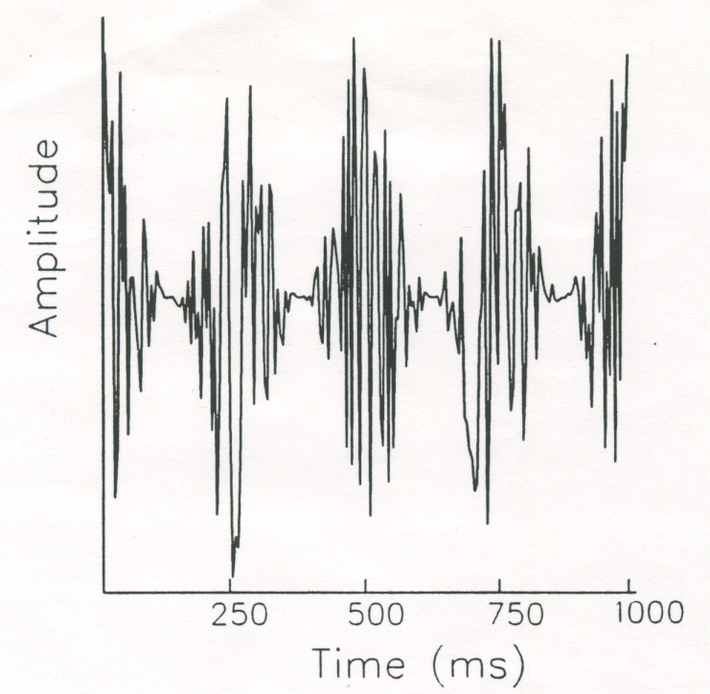
Evidence that argues that temporal coding must play a role
Burns & Viemeister (1982): Can listeners identify melodies played with sinusoidally amplitude modulated noise?
YES.
(From Yost (1994)
Notes:
A sinusoidally amplitude modulated noise does not create a spectral “pattern”; it elicits about the same activity over the whole basilar membrane. But we know that auditory nerve fibers will phase-lock to the amplitude modulation. But SAM noise has a pitch that corresponds to the rate of amplitude modulation that is strong enough that people can identify melodies played with SAM noise.

Slide 38
Is pitch peripheral?
Both the place code and the temporal code in the auditory nerve response are used in pitch perception.
But pitch perception must involve neural, central processes too
Where are the patterns stored and compared?
How are place and temporal information combined?
Notes:
Pitch perception must involve central processing.

Slide 39
In complex pitch, the temporal code would be most important for
High frequency harmonics
Middle frequency harmonics
Low frequency harmonics

Slide 40
In pure tone pitch, the rate-place code would be most important for
High frequency tones
Middle frequency tones
Low frequency tones

Slide 41
Scales of pitch
Notes:
There have been some attempts to develop scales of pitch.

Slide 42
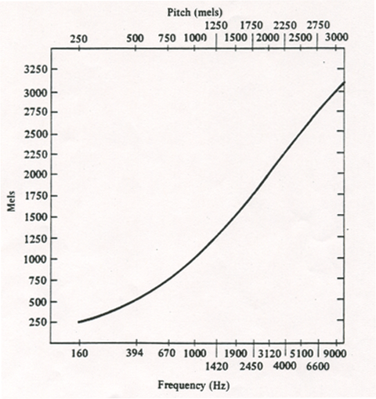
mel scale
From Gelfand (1998)
Notes:
Stevens used magnitude estimation to establish the mel scale. The pitch of 1000 Hz is 1000 mels. A sound that sounds half as high would have a pitch of 500 mels, while a sound that sounds twice as high would have a pitch of 2000 mels. Notice that the frequency that is twice as high as 1000 Hz is 3120 Hz and the one that is 3 times as high is 9000 Hz. The relationship between frequency and pitch is not simple. IN general qualitative perceptions like pitch don’t adhere to a power law like quantitaive percepts (e.g., loudness) do.

Slide 43
Pitch has two qualities
Pitch height
Pitch chroma
Notes:
The idea of the mel scale is frequently criticized because it ignores one aspect of pitch altogether. Pitch height is the quality of pitch that continues to get higher as the frequency is increased. Pitch chroma is the cyclic quality of pitch: sounds that are separated by an octave have a similar pitch quality. We say that octaves are equivalent in that sense.

Slide 44
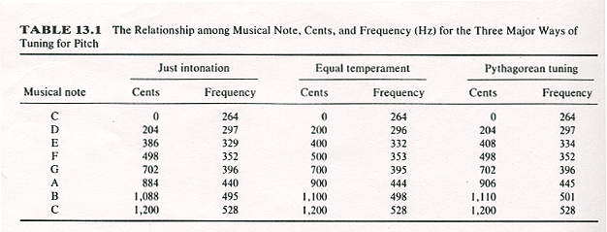
musical scales
1200 cents = 1 octave
Equal logarithmic steps
From Yost (1994)
Notes:
For that reason some people prefer to describe pitch in terms of musical scales. The unit of the scale is the octave, where an octave is a doubling of frequency. Each octave is broken into 1200 logarithmically equal steps called cents. This table shows the values of notes in the Western musical scale in cents and in frequency. Notice that the exact pitch of the notes is not generally agreed upon; there are different versions of the scale. That means that different people “hear” the steps in scale as being correctly spaced at different frequencies.

Slide 45
Scales of pitch
Mel scale is “universal”, but doesn’t capture pitch chroma.
Musical scales capture both pitch height and pitch chroma, but they differ across cultures.

Slide 46
Conclusions
Both spectral (place) and temporal (phase-locking) information appear to be important in pitch perception.
The situations in which spectral and temporal information are useful in determining pitch differ.
There is no consensus on the appropriate scale of pitch.

Slide 47
Text sources
Gelfand, S.A. (1998) Hearing: An introduction to psychological and physiological acoustics. New York: Marcel Dekker.
Moore, B.C.J. (1997) An introduction to the psychology of hearing. (4th Edition) San Diego: Academic Press.
Yost, W.A. (1994) Fundamentals of hearing: an introduction. San Diego: Academic Press.

