Slide 1
Fundamental aspects of hearing
How the response of auditory nerve fibers is reflected in basic hearing capacities

Slide 2
How do you measure perception?
Notes:
Before we can talk about the relationship between the peripheral response and hearing, we have to talk about how to measure hearing.

Slide 3
The bottom line
Our measures of sensation and perception are by their nature arbitrary, but by using the appropriate methods we can be confident that we’re measuring sensation or perception and not bias, memory or attention.

Slide 4
Part 1: Psychophysical methods
Psychophysics is a set of methods (and the results obtained using these methods) relating sensation to the physical characteristics of a stimulus

Slide 5
Two basic approaches
Thresholds: Measuring limits of sensitivity
Scaling: Ordering and distributing stimuli along a perceptual dimension
Notes:
In this lecture, we only talk about threshold estimation. We will discuss scaling when we get to the topics for which scaling is used.

Slide 6
Fechner
Notes:
Gustav Fechner developed the basic psychophysical methods that we use today. Fechner was interested in studying the soul, and he felt that by studying sensation he was studying the soul.

Slide 7
Concept of threshold
“The smallest stimulus that can be perceived”
Notes:
Common sense definition of threshold

Slide 8
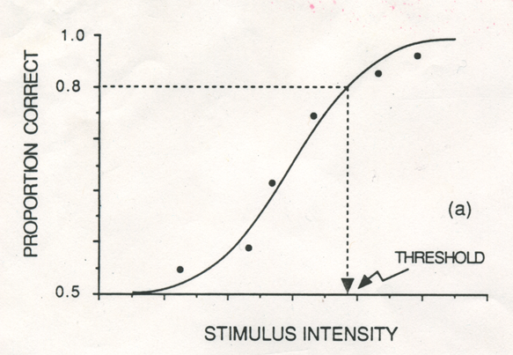
Psychometric function
0.0
From Gescheider (1985)
Notes:
For each level, the proportion of times that the subject correctly heard the sound is determine. The plot of the proportion of correct detections as a function of level is called the psychometric function. A psychometric function for frequency discrimination would show the proportion of times the listener could tell that the frequency of a tone, for example, had changed, as a function of the size of the frequency change. The psychometric function would look similar in form.
An important point about the psychometric function is that there is no common sense threshold. There is no level above which the listener always hears the sound and below which he never hears the sound. Rather, there is a gradual improvement in detection with level. So how do we define threshold? We define the threshold as the level at which the listener achieves some arbitrary proportion of correct detections.

Slide 9
The reality of threshold
“The stimulus that produces an arbitrary, but defined, level of performance”
Notes:
The reality doesn’t exactly match common sense. This is the definition we use in psychophysics (and in this course).

Slide 10
Three psychophysical methods used to estimate thresholds
Method of constant stimuli
Choose stimuli of several values, some that you think people will always be able to hear, some that you think that they will never be able to hear, and some in between.
Present these stimuli to listeners, ask whether they hear each one or not
Record the proportion of times they report hearing each one

Slide 11
Method of constant stimuli
Etc.
Notes:
On each trial one of the designated levels is presented and the listener is asked to say whether or not she heard the sound. The levels here are presented in random order, each many times, and many more trials would be presented than shown in the table. Another way to do this would be to give the listener many trials at one level, then many trials at another level, and so on, until all the levels had been given, in random order.

Slide 12
Method of Constant Stimuli
Provides complete picture of sensitivity
Easy to administer
Have to know what the threshold is going to be (approximately) before you start
If you just want a threshold, a lot of trials and time are wasted
Notes:
Advantages and disadvantages of the method of constant stimuli.

Slide 13
Three basic psychophysical methods
Method of constant stimuli
Method of limits
Start with a level that you think the listener will hear
If they hear that one, then present a lower level
If they hear that one, then present a lower level
Continue until the listener says she can’t hear the stimulus
Repeat (but sometimes start with a level you think she won’t hear and go up)

Slide 14
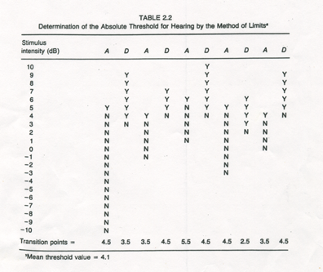
Method of limits (adaptive methods)
From Gescheider (1985)
Notes:
The first series here started at a level that the listener did not hear. The listener did not report hearing the sound until it reached 5 dB. On the next series the level started above the expected threshold and went down. This process is repeated. Notice that on subsequent series you don’t present levels that are far from the threshold, making the method more efficient. The threshold is taken as the average of the Y-N transition points from each series.

Slide 15
“Staircase”, or “up-down”, method
From Gelfand (1998)
Notes:
A variation on the method of limits is the staircase or up-down method, where the level is changed on a trial by trial basis according to the listener’s response. The transition points, or reversals, are averaged to obtain the threshold. This is a very efficient method for estimating threshold. The method shown here gives you the level that would produce 50% correct detections.

Slide 16
Method of limits
Efficient: you get a threshold in a small number of trials because observations are concentrated around threshold
You don’t need to know where the threshold is at the start
Spurious thresholds may be obtained without evidence that the listener was really listening
Notes:
Advantages and disadvantages of the method of limits.

Slide 17
Three basic psychophysical methods
Method of constant stimuli
Method of limits
Method of adjustment
Give the listener control of the stimulus level
Instruct listener to adjust level until she can just not hear the stimulus
Repeat

Slide 18
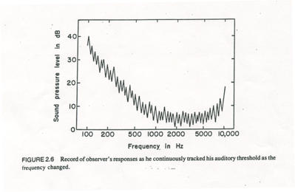
Method of adjustment
Bekesy tracking
From Gescheider (1985)
Notes:
This is an example of Bekesy tracking, a type of method of adjustment. The listener pushes a button as long as he can hear the tone and lets go when he stops hearing the tone, so the level goes up and down around threshold. In Bekesy tracking the frequency of the tone changes during the course of the test so that thresholds can be estimated at many frequencies.

Slide 19
Method of adjustment
Easy
Intuitively appealing
Produces unreliable results
Notes:
Advantages and disadvantages of the method of adjustment.

Slide 20
Which method would you use to get the quickest threshold if reliability isn’t a big issue?
Method of constant stimuli
Method of limits
Method of adjustment
Answer Now
10
Notes:
Each of the three basic methods will give you a threshold. They differ in terms of how complete a picture of sensitivity they provide and the efficiency with which the threshold is estimated. Reliability is also a very important consideration of course.

Slide 21
Which method would you use to get the most complete description of sensitivity?
Method of constant stimuli
Method of limits
Method of adjustment
10
Answer Now
Notes:
Each of the three basic methods will give you a threshold. They differ in terms of how complete a picture of sensitivity they provide and the efficiency with which the threshold is estimated. Reliability is also a very important consideration of course.

Slide 22
Which method is used to find thresholds clinically?
Method of constant stimuli
Method of limits
Method of adjustment
10
Answer Now
Notes:
Each of the three basic methods will give you a threshold. They differ in terms of how complete a picture of sensitivity they provide and the efficiency with which the threshold is estimated. Reliability is also a very important consideration of course.

Slide 23
Part 2: Behavior is influenced by factors other than sensitivity
Response bias (the listener’s tendency to say “Yes, I heard that”)
Attention
Memory
Motivation (rather small effect on threshold)
Notes:
An important point is that people say “yes” on trials when no sound is presented because they think there was a sound presented, not because they are lying. When sounds are close to threshold, it is hard to tell whether there was a sound there or not.
For example, people often swear that they heard the phone ring when they’re in the shower, even though it didn’t. And we would expect that the more important the call expected, the more likely the person would be to think that the phone rang.
Other factors that influence a person’s threshold are attention (was he listening at all?), memory (did he forget what he was supposed to respond to?), and motivation (does he really want to get it right?) As it turns out, response bias is the biggest factor of these four, although attention and memory can be problems in some populations (e.g., young children)

Slide 24
Response bias: Should he call the general?

Slide 25
Which scenario is most likely to lead to a call?
It’s 3:00 am. He called the general last week at 3:00 am and it was a seagull. There hasn’t been a bomber in these parts for 50 years.
It’s 10:00 am. A bomber was sighted in California last week. The guy who sighted the bomber was awarded a medal.

Slide 26
Response bias
When the sound is near threshold, it is hard to tell the difference between “sound” and “no sound”.
People use the evidence their ears and brain provide, but whether they say “yes” or “no” depends on
How much they like to say “yes”
Other things they know about the situation (e.g., sounds are presented on 90% of the trials).

Slide 27
Response bias and catch trials
Present “no sound” sometimes
If the person says “yes” a lot, conclude that the person has a liberal response bias.
But then what? How do you adjust the threshold?
In reality, an unbiased listener should say “yes” on some no-sound trials.

Slide 28
Response bias: hit and false alarm rates
 | “yes” | “no”
Sound | HITS | MISS
No sound | FALSE ALARM | CORRECT REJECTION
“bias-free” measure of sensitivity
Notes:
One way to deal with the issue of bias is to measure how often a person says “yes” and “no” on sound and no-sound trials for every sound level that you want to test.
This table shows all the things that could happen– it could be a sound or no-sound trial and the person could say “yes” or “no”.
When people say “yes” on a sound trial, that is called a “hit”. When they say “no” on a sound trial that is called a “miss”.
When they say “yes” on a no-sound trial, that is called a “false alarm” and when they say “no” on a no-sound trial that is called a “correct rejection”.

Slide 29
Memory
What frequency am I listening for again?

Slide 30
Two-alternative forced choice 2AFC
If the listener listens to a signal and to a “no-signal”, and then chooses the one that was the signal, then bias applies equally to the two observations and is canceled out
Notes:
Measuring the hit and false alarm rate for every level is a pain. There is an easier way, a two-alternative forced-choice method.

Slide 31
Two-alternative forced-choice
Signal
No Signal
Feedback
Time
Warning
Interval 1
Interval 2
Respond: 1 or 2?
Trial 1
1
Warning
Interval 1
Interval 2
Respond: 1 or 2?
Trial 2
2
Warning
Interval 1
Interval 2
Respond: 1 or 2?
Trial 3
2
Sensation 1
+ Bias
Sensation 2
+ Bias
The bias is the same– just pick the one with the most “evidence”.
Notes:
On each trial, the listener receives a warning that the trial is starting, then hears two “intervals”. The signal occurs in one, but not in the other, randomly. On interval one, what the listener thinks happened is affected by both his sensation and his response bias. The same is true in the second interval. When the subject is asked to choose which interval contains the signal, he could take the difference between what he though happened in each interval and pick the second interval if the difference is positive and the first interval if the difference is negative. Notice that the bias cancels out in the subtraction. (The details of this analysis explain the concept, but may not be exactly the process that occurs.)

Slide 32
Two-alternative forced choice
Bias-free threshold estimates without the muss and fuss
Eliminates memory load because hear no-signal on every trial
Can combine with any psychophysical method
Administration not all that straight forward
Possible interval bias
Notes:
Advantages of 2AFC method. Interval bias is really only a problem if it is extreme.

Slide 33
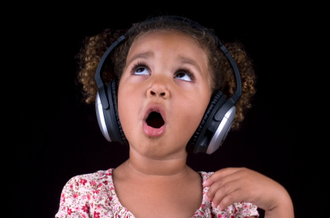
Attention and memory
Notes:
Even in a 2AFC procedure, however, people can be inattentive (off-task) or forget which one they are supposed to respond to.

Slide 34
Attention and memory
Notes:
The psychometric function of a listener who has forgotten or is inattentive tells us that something is wrong. Here, for example, is a psychometric function that never gets to 100% correct. That is a sign of either inattentiveness or forgetting. So it is often helpful to see the whole function rather than just the threshold.

Slide 35
When a listener has a conservative bias it means that
He is dishonest about what he hears
He is trying to fake a hearing loss
He doesn’t say “yes” unless he is really sure.
10
Answer Now

Slide 36
Which has the largest effect on threshold?
Hearing sensitivity
Response bias
Attention
Memory
Motivation
10
Answer Now

Slide 37
Which has the second largest effect on threshold?
Hearing sensitivity
Response bias
Attention
Memory
Motivation
10
Answer Now

Slide 38
Which has the smallest effect on threshold?
Hearing sensitivity
Response bias
Attention
Memory
Motivation
10
Answer Now

Slide 39
Which is a good way to control response bias?
2AFC
Psychometric function
Catch trials
Method of limits
10
Answer Now

Slide 40
Which is a good way to check for attentiveness?
2AFC
Psychometric function
Catch trials
Method of limits
10
Answer Now

Slide 41
Conclusions
Psychophysical methods vary from inefficient and limited in scope to efficient and complete.
Bias always affects the results of a psychophysical experiment; methods to control bias are available.
The psychometric function provides information about attentiveness and memory.
The most popular means of studying hearing sensitivity is an adaptive 2AFC method. Bias-free thresholds can be estimated efficiently using this combination.

Slide 42
Text sources
Gelfand, S.A. (1998) Hearing: An introduction to psychological and physiological acoustics. New York: Marcel Dekker.
Gescheider, G.A. Psychophysics: Method, theory, and application (Second Ed). Hillsdale, NJ: Lawrence Erlbaum Associates.

