Slide 1
Speech perception 2
Perceptual organization of speech

Slide 2
Bottom Line
Whether speech is “special” or relies on general perceptual mechanisms, its organization helps to deal with variability in the speech signal and in listening conditions

Slide 3
Is speech “special”?
Chomsky and language
Discovery of variability in the acoustic properties of speech – the normalization problem
Discovery of certain perceptual tendencies that make speech seem different from other auditory signals
Notes:
An important issue in the study of speech perception 30 years ago was the extent to which the perception of speech is different from other types of perception. Chomsky had theorized years before that for children to acquire language as quickly and effectively as they do, the brain must contain some special mechanism for language and language learning. People applied the same idea to speech perception. This idea was reinforced when people first started looking at speech spectrograms and saw that the same phoneme had different acoustic properties depending on the speaker, the phonetic context and many other factors. For people to be able to make sense of speech in the face of all that variability, the reasoning went, there has to be some special mechanism that allows them to “normalize” the speech, to adjust the input to take into account the context or speaker. Researchers also discovered some things about speech perception that they considered unusual for perception, that they figured meant that speech is different. This lecture is mainly about those special perception issues.

Slide 4
Categorical perception
Listeners can only discriminate between sounds that they would identify as belonging to different categories
Notes:
Probably the most important “special” perceptual tendency of speech was categorical perception.

Slide 5
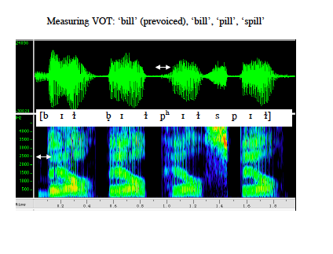
Speech acoustics can be varied along a continuum
Notes:
One can create stimuli with different VOT, for example, to determine when people hear “bet” and when they hear “pet”.

Slide 6
Identification
Was that “ba” or “pa”?
Notes:
If you present exemplars of the stimuli along this continuum to people and ask them to say which of the two phones they heard, we call that an identification task.

Slide 7
Identification functions
Category boundary
100
50
0
100
50
0
Percent “pa” responses
Percent“ba” responses
0 5 10 15 20 25 30 35 40
Voice onset time (ms)
Notes:
The results of an experiment like that are shown here. The green line shows the proportion of times that people said “ba”, the red line the proportion of times they said “pa”. If people are presented with sounds that vary in VOT along a continuum and asked to identify them as, for example, “pa” or “ba”, their identifications change rapidly from one category to another. The point where the two identification functions cross is referred to as the category boundary.

Slide 8
Discrimination
Were those the same or different?
Notes:
Now for this to be categorical perception, we have to also ask people to discriminate between the exemplars. We play two exemplars, say from adjacent positions along the continuum, and ask them whether the two sounds are the same or different.

Slide 9
Discrimination functions
Category boundary
100
50
Percent correct
0-5 5-10 10-15 15-20 20-25 25-30 30-35 35-40
Voice onset time (ms)
Notes:
This shows the results of a hypothetical discrimination experiment. The numbers on the x-axis show the two VOT that were compared. When the two VOT span the category boundary, people can discriminate them very well. When the two VOT are on the same side of the category boundary, they can’t tell them apart, even though the difference between the VOT is the same in all comparisons. People get 50% correct if they guess, or always say same.

Slide 10
Identification v. discrimination functions
Category boundary
100
50
0
100
50
Percent “a” responses
Percent correct
F1 frequency (Hz)
Notes:
So the idea here is that you could predict the discrimination result if you knew the identification result: People can only discriminate sounds that they would have identified differently.

Slide 11
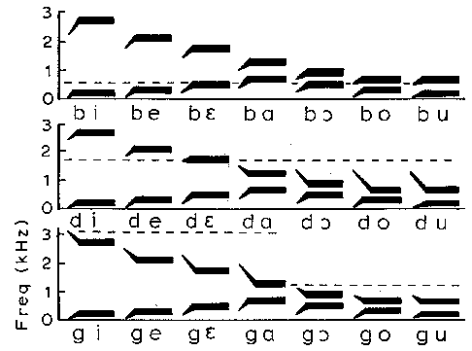
Variability in acoustics: Co-articulation
Notes:
Remember that the same phoneme in different contexts will be acoustically different. For example, these are schematic speech spectrograms of three voiced consonants played with seven different vowels. The formant transitions that designate the consonant, where the formant changes over from the consonant to the vowel can be longer or shorter or move in different directions depending on the following vowel.

Slide 12
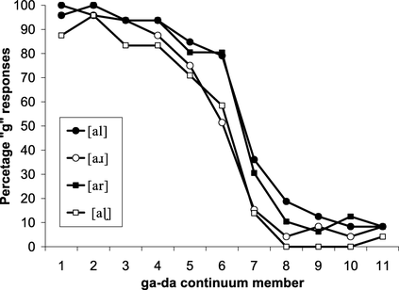
Boundaries shift with the context
Notes:
Interestingly, the category boundary shifts when the context changes. These are the results of an identification experiment, where the syllabic context was varied.

Slide 13
Why would you have categorical perception?
Allows listeners to “ignore” irrelevant variations in speech signal.

Slide 14
Is this a special characteristic of speech?
Notes:
Several findings convinced researchers, however, that categorical perception was not just about speech.

Slide 15
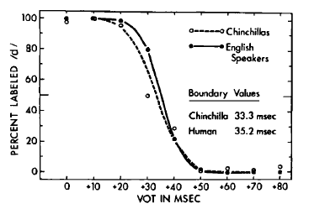
Chinchillas also have categorical perception of VOT
Kuhl and Miller, 1978
Notes:
For example, Kuhl & Miller showed that chinchillas who learned to respond when the heard /da/ but not when they heard /ga/ produced an identification function that looks just like that of humans. Because it is hard to believe that chinchillas had a special speech mechanism in their brains, this suggests that the way we categorize consonants has something to do with general auditory abilities.

Slide 16
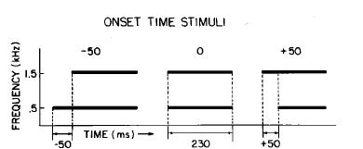
Categorical perception of nonspeech sounds
Pisoni, 1977
Notes:
Another finding that influenced the way that researchers thought about categorical perception was that there are nonspeech sounds that are also perceived categorically. For example Pisoni asked listeners to judge whether two tones came on at the same time or not. He varied the delay between the onsets of the two tones.

Slide 17
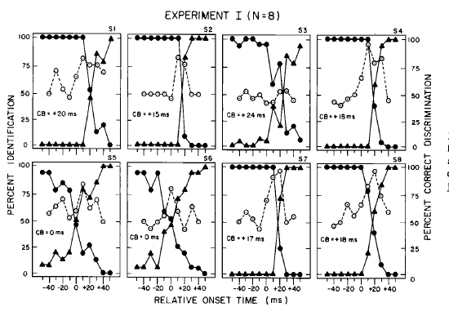
Categorical perception of nonspeech sounds
Pisoni, 1977
Notes:
These are Pisoni’s results. The filled symbols show identification results, where people were asked to identify “high tone first” or “low tone first”. The proportion of Low first responses stays high until the delay time approaches a values around 20 ms, then the proportion of “High first” response rises to 100%, pretty rapidly. And if you ask people to discriminate between tone pairs with different delays, they have trouble doing that when the two delays are on the “high first” or “low first” side of the boundary, but they can do it well, when the two delay times are on opposite sides of the category boundary.

Slide 18
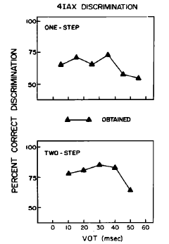
Changing the procedure can eliminate categorical discrimination
(Pisoni & Lazarus, 1974)
Notes:
It also turns out that if you change the discrimination procedure, you can eliminate categorical perception. In one experiment, Pisoni and Lazarus asked people to listen to 2 pairs of speech tokens. In one pair, the two had the same VOT; in the other they had different VOT. People chose the pair that had different VOT. The results showed little evidence of a peak in performance at the category boundary.

Slide 19
Conclusions: categorical perception
People tend to hear speech categories, rather than the small acoustic variations across exemplars of the same phoneme.
People’s sensitivity at category boundaries reflects general auditory sensitivities, but also depends on memory and other processes.
Speech and hearing evolved together: speech takes advantage of our specific auditory sensitivities.

Slide 20
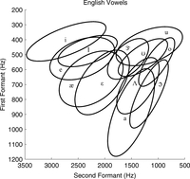
Vowel perception not categorical, but continuous
Notes:
This slide shows some vowel of English in F1-F2 space. The ellipse around each vowel symbol represents the range of F1-F2 combinations that people will recognize as that vowel. Notice that there is considerable overlap between vowel categories. Depending on the speaker and context the same sound may be labeled /i/ sometimes, and /I/ sometimes.

Slide 21
Identification v. discrimination functions - vowels
Category boundary
100
50
0
100
50
Percent “a” responses
Percent correct
F1 frequency (Hz)
Notes:
The green line shows the proportion of times that people said “ee”, the red line the proportion of times they said “oo”. If people are presented with sounds that vary in F1 along this continuum and asked to identify them as, for example, “ee” or “oo”, their identifications change as F1 changes, but in a less dramatic way than we might see with a consonant. We could call a particular F1 value a category boundary. However, people are able to discriminate between vowels with different F1, even when they would say that both of those vowels are /i/. This makes sense if we have to use new boundaries all the time.

Slide 22
Effects of experience on speech perception
Speech can’t be totally “innate”, because different languages have different phonemic inventories.
Notes:
Another important question in speech perception is how our speech categories get set up the way they are.

Slide 23
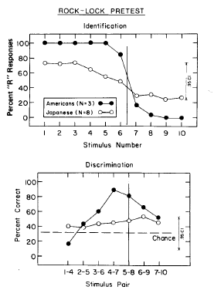
Example: /r/-/l/ distinction in native speakers of Japanese
(Logan et al., 1991)
Notes:
A well-known example of a perceptual difference between native speakers of different languages is the difference between native speakers of English and native speakers of Japan in the ability to hear the distinction between the phones /r/ and /l/. The top graph here shows the identification functions of the two language groups listening to tokens that crossed the continuum from “rock” to “lock”. The Americans show a transition from rock to lock at a clear boundary. The Japanese listeners show a very shallow function. The discrimination results are below. The Americans show a peak in performance near the category boundary; the Japanese do not. So the question is, why? We know that the /r/-/l/ distinction isn’t used in Japanese, but why can’t Japanese speakers here the difference?

Slide 24
“Theories” accounting for cross-language differences in phonetic perception
Infants learn the phonetic contrasts of their native language from scratch.
Infants know all of the phonetic contrasts in the world, but they “forget” the ones that they don’t hear around them.
Infants know a lot of phonetic contrasts, but the boundaries between phonetic categories shift depending on what they hear.

Slide 25
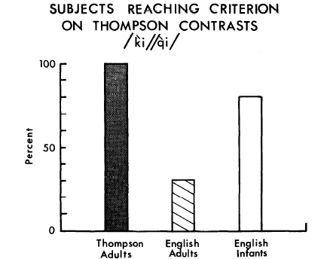
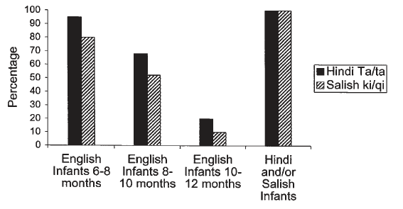
Infants lose the ability to discriminate nonnative contrasts
Werker & Tees, 1984
Notes:
These are the results of an experiment by Werker and Tees. They test Infants who were learning English, and infants who wer learning Hindi or infants who were learning Salish– the language of some native people of British Columbia on their perception of a Hindi or Salish phonetic contrast that does not occur in English and was unlikely to have been heard by English-learning infants. They also tested adult native speakers of Salish (also called Thompson) and adult native speakers of English. The results on the left compare the two groups of adults to English learning infants on the Salish (Thompson) contrast. All the Thompson (Salish) adults could discriminate the contrast; few English speaking adults could discriminate, but the vast majority of English learning infants could discriminate. This finding is consistent with a couple of our theories, that say that infants know a lot of phonetic contrasts.
The results on the right show how the ability to discriminate changes with age during infancy. Nearly all 6-8-month-old English-learning infants can discriminate both Salish and Hindi contrasts; fewer 8-10 month olds discriminate less well. Very few 10-12 month olds can discriminate– but 10-12 month old infants who are learning Hindi or Salish can all discriminate.
So something about the speech that infants hear around them is affecting their ability to hear the difference between speech sounds.

Slide 26
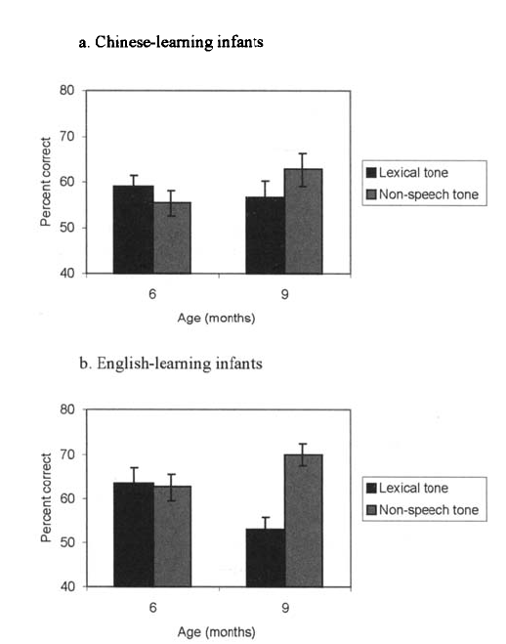
Infants lose the ability to discriminate nonnative contrasts
(Mattock & Burnham, 2006)
Notes:
These are the results of a similar experiment looking at the perception of lexical tone by infants who were learning Chinese and infants who were learning English. The infants were test on lexical tone– actual speech sounds– on discrimination of pure tones that had the same difference in shape (rising v. steady and rising v. falling). Both Chinese and English learning infants could discriminate lexical tones about as well as they discriminated nonspeech tones at 6 months, but at 9 months, the English-learning infants were worse at lexical tone, while the Chinese learning infants maintained their ability to discriminate lexical tones.

Slide 27
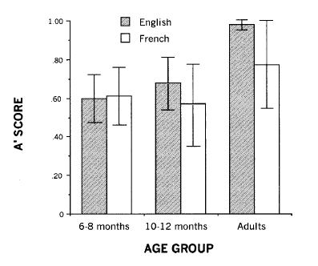
Different patterns for different contrasts
(Polka, 2001)
Notes:
Tin the lexical tone study, the big perceptual change happened between 6 and 9 months. In the Werker and Tees study, the change was later– 10-12 moths. This study by Polka looked at /d/ v. /voiced th/ discrimination in English and French learning infants. 10-12 month olds in both language groups can still discriminate at 10-12 months, even though this distinction is not made in French. However, French speaking adults are worse than English speaking adults in this case. So the transition can happen at different ages, and in sme cases, adults can make a discrimination that 10-12 month olds have lost the ability to do.

Slide 28
Vowel perception becomes language specific for infants, but not monkeys
100
Prototype
80
Nonprototype
60
Percent correct
40
20
0
Adults
Infants
Monkeys
(Kuhl, 1991)
Notes:
Kuhl did a study of vowel discrimination with English speaking adults, English learning infants, and monkeys. She showed that if a vowel was a good exemplar of a vowel in English– a prototypical exemplar, that people actually were worse at discriminating small changes is a formant frequency of the vowel– it is as if you are more tolerant of a little variation if you are hearing a “good” vowel. However, if you were hearing a poor exemplar– a nonprototypical exemplar, then you can discriminate small changes. These are the sorts of vowels that listeners would say about “Well, it’s an /a/, but not a very good one”. This is language specific: The prototypical vowel in English is different from that in Finnish or Spanish. So what you see hear is that the percent correct discrimination is better for the prototype than for the nonprototype– for adults, for 6 month old infants– but not for monkeys. Thus, it is clear that your “prototype” is built up through experience listening to the vowels of your native language.

Slide 29
Adults maintain the ability to hear some nonnative distinctions
zulu click video
Notes:
However, there are some nonnative distinctions that infants make and that adults continue to be able to make. Examples are the “click” phones used in Zulu and some other African languages. Native speakers of English have no trouble discriminating between different clicks, regardless of age.

Slide 30
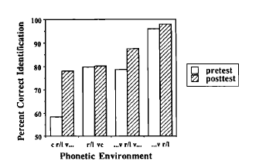
People can “relearn” nonnative distinctions
(Logan et al., 1991)
Notes:
So what happens to the nonnative distinctions that we lose in infancy and childhood? Are they gone forever? It turns out that they aren’t. People can relearn a distinction, as shown in some training study results here, for native speakers of Japanese who were trained to distinguish /r/ form /l/. Although the ability before training depended on the phonetic context, there were some cotnexts in which these listeners could hardly discriminate at all before training, but could get 80% correct or so after training.

Slide 31
How experience can affect speech perception
g
k
r
t
d
Prevoiced stops
p
b
l
i
Click 3
Click 4
Click 1
Click 2
a
Perceptual reorganization
Notes:
So there are several formal theories describing current thinking about these results. I’ve drawn a cartoon here to illustrate the idea that exposure to native speech leads to a reorganization of the perception of speech sounds. Infants come into the world with the auditory ability to distinguish many phones. In some cases, if they don’t hear a distinction used, two categories may merge into one– as in the /r/-/l/ distinction. Then when you ask a listener to discriminate between two sounds that fall in that category, they can’t– the two sound the same. In other cases, a boundary that is present to begin with shifts some– for example in the case of vowels where the prototypical vowel varies across languages. So most of the time, I will hear the saem distinctions as an adult as I did as an infant– there will be only a few instances that are different. In still other cases, a boundary may be missing in infants, but form based on experience. The prevoicing distinction in stops is an example of this. It seems that infants don’t distinguish between voice and prevoiced stops, but must learn to do so if that distinction is meaningful in the native language. So what wel will be able to do as adults depends on how the contrast we’re asked to make is related to the categories we have formed for our native langauge. And the finally, there can be contrasts– like the Zulu clicks for speakers of non-click languages– that are not close to anything that the listener uses in the native language. Because perceptual re-organization hasn’t even happened in that dimension, people will continue to hear the distinction as they did as infants.

Slide 32
General Conclusions
Auditory sensitivity constrains the phonetic distinctions that we are able to make.
Phonetic categories are organized in such a way as to optimize our ability to discriminate and to adapt to changing conditions.
Experience with speech sounds reorganizes phonetic categories, and it is the reorganization that makes it difficult to hear phonetic contrasts in the reorganized region.

Slide 33
References
Best, C. T., McRoberts, G. W., & Sithole, N. M. (1988). EXAMINATION OF PERCEPTUAL REORGANIZATION FOR NONNATIVE SPEECH CONTRASTS - ZULU CLICK DISCRIMINATION BY ENGLISH-SPEAKING ADULTS AND INFANTS. Journal of Experimental Psychology-Human Perception and Performance, 14(3), 345-360.
Kuhl, P. K. (1991). HUMAN ADULTS AND HUMAN INFANTS SHOW A PERCEPTUAL MAGNET EFFECT FOR THE PROTOTYPES OF SPEECH CATEGORIES, MONKEYS DO NOT. Perception & Psychophysics, 50(2), 93-107.
Kuhl, P. K., & Miller, J. D. (1974). DISCRIMINATION OF SPEECH SOUNDS BY CHINCHILLA - (T) VS (D) IN CV SYLLABLES. J. Acoust. Soc. Am., 56, S52-S52.
Logan, J. S., Lively, S. E., & Pisoni, D. B. (1991). TRAINING JAPANESE LISTENERS TO IDENTIFY ENGLISH /R/ AND /1/ - A 1ST REPORT. J. Acoust. Soc. Am., 89(2), 874-886.
Mattock, K., & Burnham, D. (2006). Chinese and English infants' tone perception: Evidence for perceptual reorganization. Infancy, 10(3), 241-265.
Pisoni, D. B., & Lazarus, J. H. (1974). CATEGORICAL AND NONCATEGORICAL MODES OF SPEECH-PERCEPTION ALONG VOICING CONTINUUM. J. Acoust. Soc. Am., 55(2), 328-333.
Polka, L., Colantonio, C., & Sundara, M. (2001). A cross-language comparison of (d)-(male) perception: Evidence for a new developmental pattern. J. Acoust. Soc. Am., 109(5), 2190-2201.
Werker, J. F., & Tees, R. C. (1984). CROSS-LANGUAGE SPEECH-PERCEPTION - EVIDENCE FOR PERCEPTUAL REORGANIZATION DURING THE 1ST YEAR OF LIFE. Infant Behavior & Development, 7(1), 49-63.

