Slide 1
Speech perception
Relating features of hearing to the perception of speech

Slide 2
The bottom line
The auditory system encodes the properties of sound that are essential to recognizing speech, but it’s a lot more complicated than that.

Slide 3
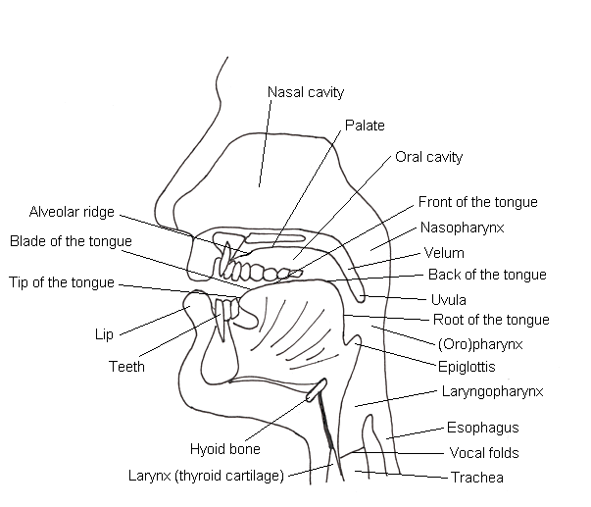
Production
Notes:
Speech is produced by forcing air through the vibrating vocal folds to produce a periodic sound. The amplitude spectrum of the sound is shaped by movement of the articulators– the lips, tongue, velum, etc.

Slide 4
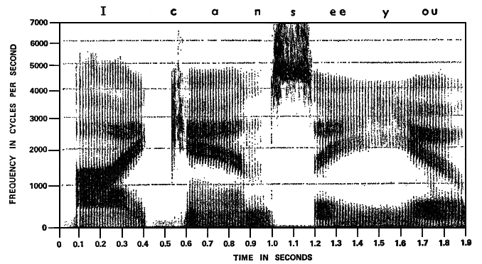
Acoustics
Notes:
This is an example of speech spectrogram. It shows the frequencies in a sound at each point in time, The darker the trace, the more intense the sound in a certain frequency band at a certain time. The sentence produced in this example is “I can see you”. Notice that the speech sound looks like a series of vowels interrupted by consonants. The dark “stripes” in the spectrum are the formants of the vowels.

Slide 5
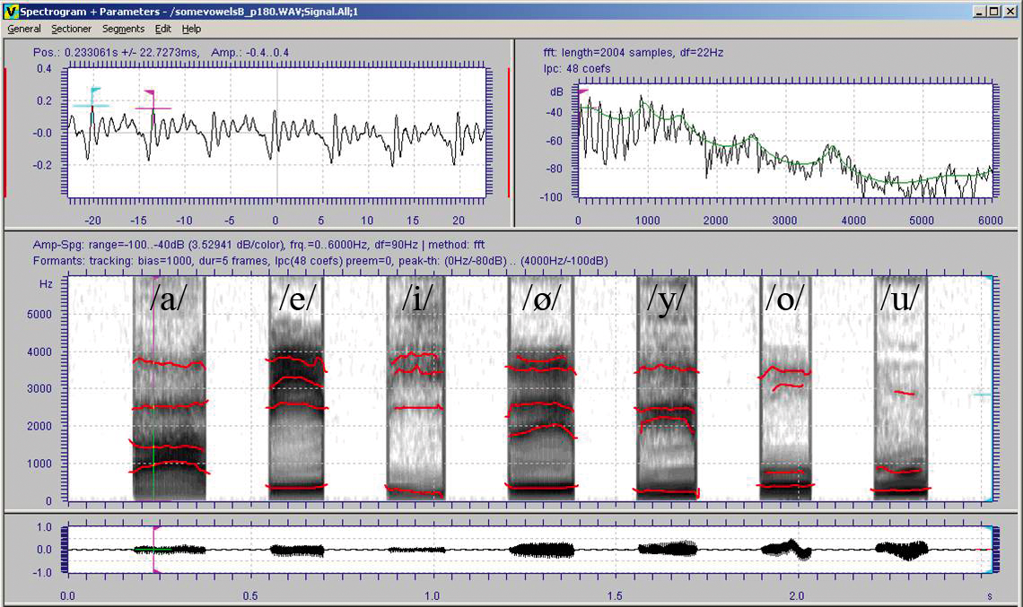
Vowels
Notes:
This picture shows three different representations of a vowel: the waveform (top left and bottom), the amplitude spectrum (top right), and the speech spectrogram (middle). It is clear from the waveform that this is a periodic sound– the waveform repeats at the fundamental frequency. The amplitude spectrum has amplitude peaks at certain frequencies that are called the formant frequencies. The format frequencies of 7 different vowels are traced in red in the spectrograms. The vowels are distinguished by their formant frequencies.

Slide 6
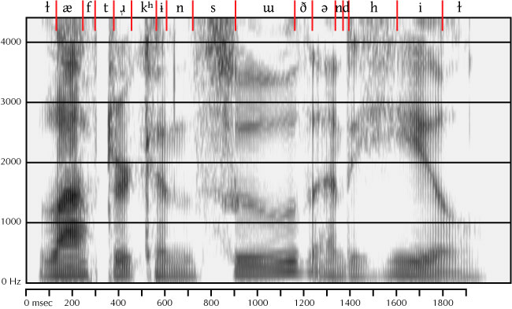
Consonants
Laughter can soothe and heal
Notes:
Consonants are produced by constricting the vocal tract. Consonants differ in how the vocal tract is constricted, where it is constricted, and whether the timing of vocal fold vibration relative to the release of the constriction.

Slide 7
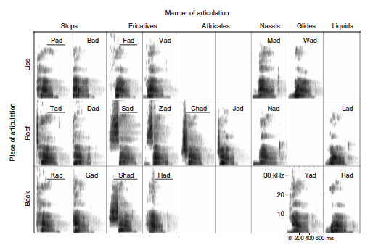
Place and manner of articulation
Notes:
How the bovcal tract is contricted is referred to as the manner of articulation. A stop like /p/ closes the vocal tract all together. A fricative like /s/ involves not quite closing the vocal tract so that a noise is produced. Consonants also differ in where the vocal tract is constricted– at the lips like b/ or at the back of the mouth (the velum like) /k/. Finally consonants can be voiced– the vocal folds begin to vibrate (voicing begins) just as the consonant is released as in /g/ in soothe or after the consonant is released as in /k/.

Slide 8
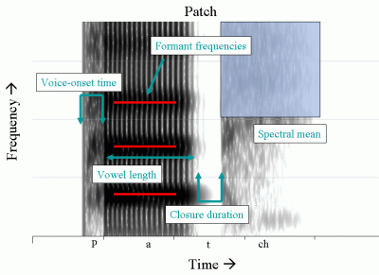
Speech cues
Notes:
These are examples of the articulation-related acoustic variables that we use to distinguish between vowels and consonants.

Slide 9
Important acoustic features
Notes:
This is a figure from your textbook that summarizes the idea that the speech spectrogram has two types of information in it, spectral information, shown on the lower left and temporal information shown on the upper right. Each curve on the bottom left shows the amplitude spectrum of the speech sound at one point in time. Each curve on the upper right shows the envelope of sound at a particular frequency. We use these two cues to recognize speech sounds together and depending on the situation, interchangeably.

Slide 10
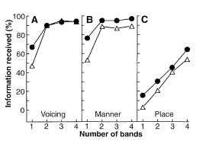
Envelope v. Spectral Information
Notes:
Shannon et al 1995 showed normal hearing listeners could get manner and voicing 100% correct with envelope information in only 2 frequency channel. To get place of articulation they needed better spectral information. And as you remember, in noise, they needed better spectral information. So noise obscures the envelope– and to identify speech in noise, you need to have the amplitude spectrum. People switch from one type of information to another depending on conditions. It is only as teenagers that we get this flexibility in speech perception.

Slide 11
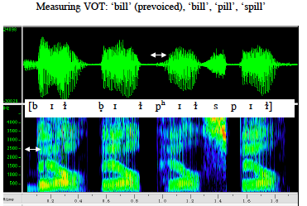
Fine structure: Voicing
Notes:
The fine structure can also be used to identify voicing. Voice onset time is the time between the onset of voicing and the release of the consonant. In some languages, voicing can start before, in voiced consonants in English voicing starts close to the release, and in unvoiced consonants, voicing doesn’t’ start until after the release. This demo shows how the perception of a stop consonant changes from /b/ to /p/ as I increase the voice onset time from 0 to 40 ms.

Slide 12
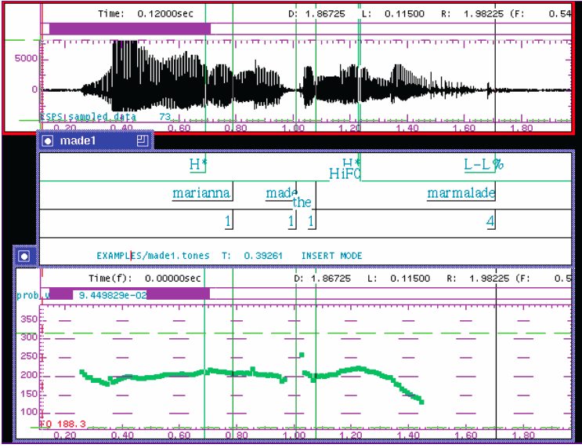
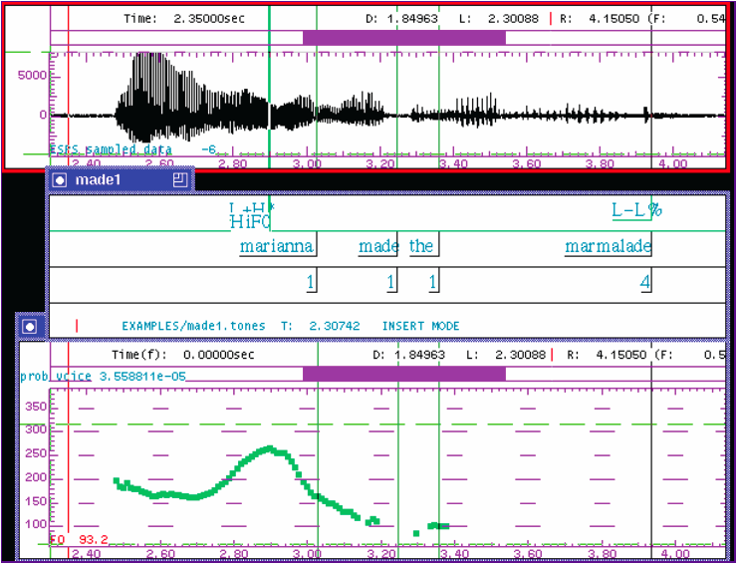
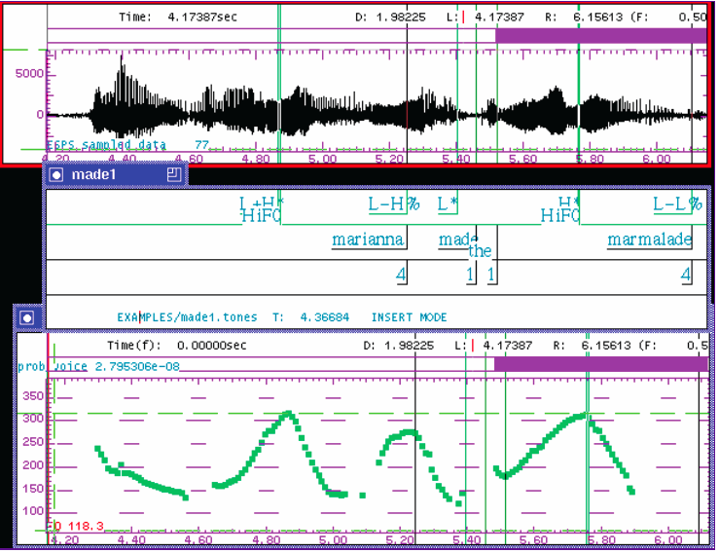
Fine structure: Intonation contour
Marianna made the marmalade.
Notes:
Fine structure can also carry information about the intonation contour. In English and many other languages, the way that the fundamental frequency and timing changes the meaning of a phrase or sentence.

Slide 13
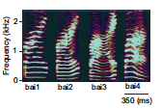
Fine structure: Tone
split white swing defeat
high level
rising
falling- rising
falling
mother
hemp
horse
scold
Notes:
In many languages– not English– the intonation of an utterance changes its meaning. In Mandarin, for example, the same word can have different meanings if the intonation is flat, rising, falling-rising or falling, as shown in this speech spectrogram. The different intonation patterns are referred to as “tones.”

Slide 14
Redundancy leads to robust perception
Interrupted
Filtered
1 Hz
.5 1 1.5 2.0
400 Hz bandwidth
4 Hz
Amplitude (dB)
Amplitude (dB)
.5 1 1.5 2.0
2100
64 Hz
Frequency (Hz)
.5 1 1.5 2.0
Notes:
Because speech contains more than one type of information that specify the same speech sound, we say that speech is redundant. What that means is that I can distort speech in many ways, and it will still be understandable. In the example on the left, the speech was banpassed filtered so that only a band about 400 HZ wide around 2100 Hz is presented. We still understand the sentence. In the examples on the left, 50% of the sentence is cut out, first at a slow rate, then at two faster rates. Even though only half of the sound is available, we still understand the sentence, at least for interruption rates of 4 Hz or so.

Slide 15
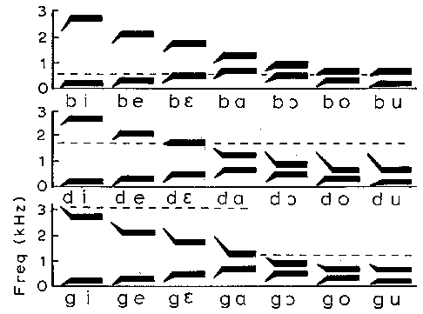
Variability in acoustics: Co-articulation
Notes:
Speech perception is not just about learning which specific sounds designate which phonemes. The same phoneme in different contexts will be acoustically different. For example, these are schematic speech spectrograms of three voiced consonants played with seven different vowels. The formant transitions that designate the consonant, where the formant changes over from the consonant to the vowel can be longer or shorter or move in different directions depending on the following vowel.

Slide 16
Variability in acoustics: Speaker
Brooklyn, NY
Vancouver, BC
Winnfield, LA
Notes:
Different speakers produce the same speech sounds differently, and yet we still understand the speech. These speakers have different American English accents.

Slide 17
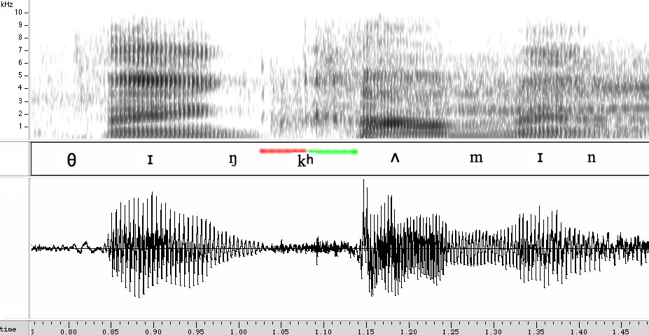
Variability in acoustics: Top-down influences
another thing coming OR another think coming?
Notes:
Finally, the way we interpret what we hear depends on what we expect to hear and whether a sound makes sense in the semantic context.

Slide 18
Multisensory integration
Notes:
Finally, what we see also influences our interpretation of a sound. A famous example is the McGurk effect. The speaker is producing a “ga”– that’s what we see, but the sound “ba” has been synchronized with the movement of the mouth. Most people hear the speaker saying “da” when they watch the video, but “ba” when they listen to the sound without watching the face.

Slide 19
Conclusions
Speech is produced by spectral and temporal modifications (by articulators) of a vibrating source (vocal folds).
The amplitude spectrum and the envelope of sound carry much of the information in speech. The fine structure contributes to pitch-related aspects of speech.
Sound associated with a phoneme is influenced by preceding and following phonemes, by the speaker, and by many other factors.
Speech is highly resistant to corruption and interference.
Acoustic and semantic context important in speech recognition.
Speech is a multisensory phenomenon.

