Slide 1
Temporal coding and
Temporal resolution
The ability to follow rapid changes in a sound over time

Slide 2
The bottom line
People manage to maintain good temporal resolution without compromising sensitivity by using intelligent processing.

Slide 3
Auditory system represents sound in two ways
“rate-place code”
“temporal code”
Fine structure
+ envelope
Firing rate
Number of action potentials
apex
base
Position on the basilar membrane
Time (ms)
“neural amplitude spectrum”
Notes:
We move on to the representation of the envelop of the waveform of sound.

Slide 4
The fine structure and envelope are represented for _____ frequencies, but only the envelope is represented for ____ frequencies.
High, low
Low, high
Middle, low
Middle, high

Slide 5
Envelope coding
500 Hz
Receptor potential (mV)
5000 Hz
Time (ms)
Notes:
At low frequencies, both the fine structure and the envelope are represented. At high frequencies, only the envelope is represented.

Slide 6
The same processes limit the coding of the envelope and the fine structure.
True
False

Slide 7
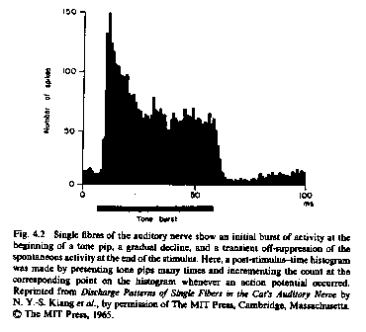
Post-stimulus Time (PST) Histogram of auditory nerve fiber
Onset response
Adaptation
Recovery
From Gelfand (1998)
Notes:
Before the sound comes on the nerve fiber is spontaneously active. At the onset of sound, the response rate of auditory nerve fibers is high. This is called the onset response. Within 50 ms, the response rate drops. The reduction in firing rate is called adaptation. Once the response rate has adapted it remains more or less constant for the duration of the sound. However, once the sound has gone off, spontaneous activity does not return immediately. There is a “silent” period just after sound onset referred to as recovery form adaptation. During this period the neuron’s response threshold is higher than it is when it has not been stimulated recently.

Slide 8
Temporal effects
Masking
Absolute sensitivity and loudness
Detecting envelope changes

Slide 9
Masking over time
Temporal effects in simultaneous masking
Nonsimultaneous masking

Slide 10
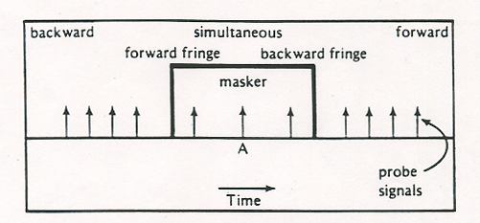
When masking happens
From Yost (1994)
Notes:
Masking happens, of course, when the masker and the “probe” or “signal” occur simultaneously. We distinguish between forward fringe masking, when the probe occurs right at the beginning of the masker, backward fringe, when the probe occurs right at the end of the masker, and “true” simultaneous masking when the probe is centered temporally in the masker. Masking also occurs when the probe precedes the masker, backward masking, and when the probe follows the masker, forward masking.

Slide 11
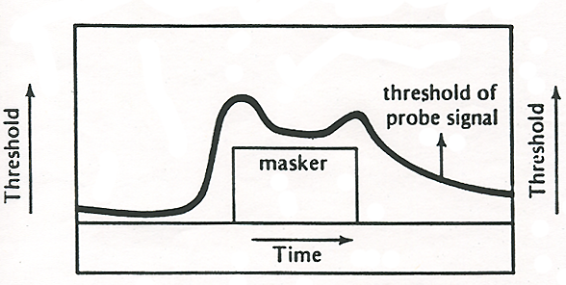
When masking happens
From Yost (1994)
Notes:
For the same masker intensity, you get different amounts of masking, depending on when the probe occurs relative to the signal. Simultaneous masking is greater than backward or forward masking, with backward fringe and forward fringe being particularly effective. Forward masking is generally greater than backward masking, and forward masking can occur over a longer time period than backward masking.

Slide 12
Types of masking
Simultaneous
  Backward fringe
  Forward fringe
  “true” simultaneous
Nonsimultaneous (temporal)
  Backward
  Forward
From Yost (1994)
Notes:
How do these different types of masking work? We have already discussed the mechanisms responsible for simultaneous masking, but we haven’t covered the temporal effects in simultaneous masking

Slide 13
Which type of masking is the most effective?
Forward fringe
Backward fringe
True simultaneous
Backward masking

Slide 14
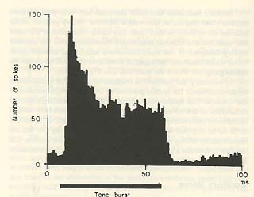
Fringe masking
Onset response
“Perceptual separation” problems - common onsets and offsets
Notes:
Neither swamping nor suppression can explain why you get more masking in backward and forward fringe conditions. In the case of backward fringe masking, when the probe occurs at the onset of the masker, the onset response of auditory nerve fibers may be involved: It will be more difficult to detect the probe at the point when the masker is eliciting the greatest response. Another phenomenon that may be important is that when two sounds come on or go off at the same time, we tend to group them together perceptually, to think that the two sounds come from a single sound source. Because we group the sounds together, it is more difficult to hear the probe as a separate entity. This would contribute to both backward and forward fringe masking.

Slide 15
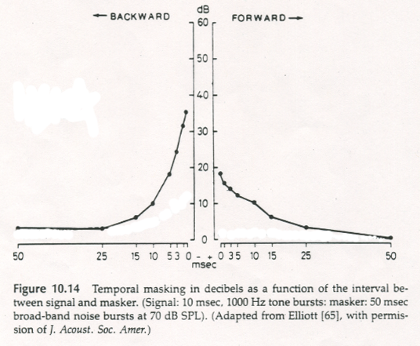
Characteristics of nonsimultaneous masking: timing effects
Modified from Gelfand (1998)
Notes:
This figure compares backward and forward masking in time course. Notice that at very short probe-masker intervals, there is more backward than forward masking. But forward masking tends to persist at longer time intervals, while backward masking does not.

Slide 16
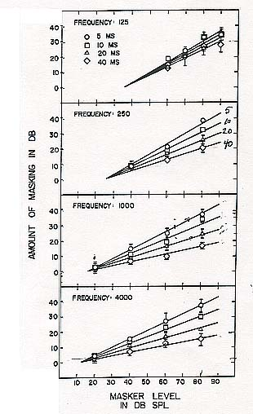
Growth of forward masking
7
10
3
10
From Jesteadt et al. (1982)
Notes:
Unlike simultaneous masking, the growth of nonsimultaneous masking is not a 1-dB for 1-dB affair. Each of these curves shows the amount of forward masking as a function of masker level, each panel is for a different frequency, and each curve is for a different masker-probe interval, 5-40 ms. The shorter the masker-probe interval, the steeper the growth of forward masking, but even at 5 ms interval, as indicated by the dotted red lines, increasing masker level by 10 dB only produces a 7 dB increase in masking. At a 40-ms interval a 10-dB increase in masker level may only produce 3 dB more masking, as indicated by solid red lines.

Slide 17
Growth of forward masking
10 dB increase in masker level leads to less than 10 dB increase in amount of masking
Growth of forward masking depends on timing and frequency

Slide 18
Why does nonsimultaneous masking happen?

Slide 19
Forward masking
Recovery from adaptation
Confusions (or perceptual separation problems)
Notes:
Adaptation is one factor that probably causes forward masking: During the period when an auditory nerve fiber is recovering from stimulation by one noise (the masker) it is difficult to get it to respond to another sound (the probe). People also sometimes “confuse the probe with the masker”: in other words, they hear the probe but they think it’s a continuation of the masker.

Slide 20
Backward masking?
Notes:
The causes of backward masking are not well understood.

Slide 21
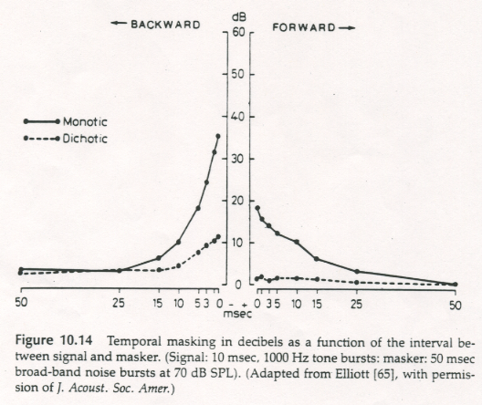
“Central masking”
From Gelfand (1998)
Notes:
The dashed curve shows the amount of masking as a function of masker-probe interval, when the probe is presented in one ear and the masker is presented in the other (dichotic). In the monotic condition, masker and probe are presented to the same ear. Notice, that backward masking, but not forward masking, is obtained in the dichotic listening condition. That means that backward masking occurs even when there is no chance for the responses to the masker and probe to interact in the ear. It must involve processes in the central nervous system.

Slide 22
Backward masking
Not well understood, but “central” masking occurs
Interruption in processing
May be a measure of processing time
Notes:
Backward masking involves an interruption in processing of the probe: in other words, perceiving takes time, and if another sound comes along too soon, it interrupts your processing of the first sound.

Slide 23
Simultaneous and temporal masking occur for the same reasons.
True
False

Slide 24
A psychophysical tuning curve measured with forward masking would be similar to one measured with simultaneous masking.
True
False

Slide 25
Temporal effects on absolute sensitivity and loudness
Loudness adaptation
Temporal integration

Slide 26
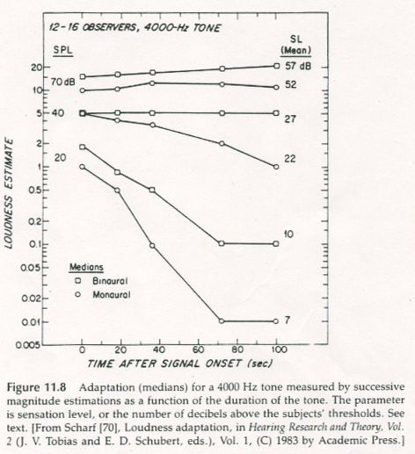
Loudness adaptation
From Gelfand (1998)
Notes:
If people are asked to make loudness judgments periodically while a sound is played continuously for durations longer than a minute or so, loudness can decrease over time. This phenomenon is called loudness adaptation. It is most pronounced for high frequencies and as shown in this graph, at low levels.

Slide 27
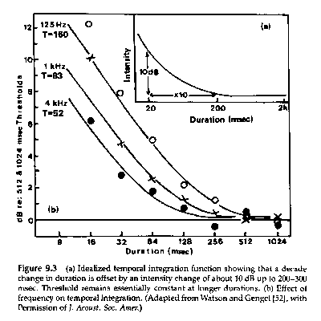
Effects of duration on absolute sensitivity
Critical Duration
Temporal summation or temporal integration
From Gelfand (1998)
Notes:
As the duration of a tone is increased by a factor of 10, threshold decreases by close to 10 dB. So the auditory system integrates energy over frequency (within the critical band) and over time (within the critical duration).

Slide 28
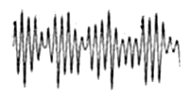
The temporal window
Notes:
The fact that temporal integration occurs suggests that the auditory system deals with sound in “chunks” There is some device, often referred to as the temporal wondow, tht “gates” the information going to the brain at regular intervals.. Information only gets through when the window is open. So if we have very short sound, and we make it intense enough, it creates an electrical change in the audiotry nerve fibers that is big enough to produce an action potential. If the sound is a little longer, then it doesn’t have to be so intense to produce an action potential. But when a sound is longer than the time that the wiindow is open, the sound that gets through the window laways havs to have a certain intensity. The rest of the sound has to “wait” for the window to open again, and what is left doesn’t have the intensity reuired to produce an action potential.

Slide 29
Temporal windows
Relative
amplitude (dB)
800 600 400 200 0
Time (ms)
16
Level
(dB)
16
16
Level
(dB)
Level
(dB)
0 200 400
0 200 400
0 200 400
Duration (ms)
Duration (ms)
Duration (ms)
Notes:
Temporal windows are sort of like filters, but in time instead of frequency. The window lets all the sound through as long as it is open, but after it closes, whatever sound that comes in can only go through the next window. So for a short sound, you might find that you have to turn up the sound to, say 16 dB, to get enough activity for a person to detect the sound. But if the sound is longer, maybe 200 ms, you wouldn’t have to turn the sound up to as high a level, because all of the sound will be able to pass through the same temporal window. If the temporal window is only open for 200 ms, then making the sound longer than that won’t improve your threshold, because the sound after 200 ms has to wait for the next window that opens.

Slide 30
Loudness adaptation occurs because of the adaptation in auditory nerve fibers that we see in the PDT histogram.
True
False

Slide 31
Conclusions 1
Masking occurs even when sounds are not presented simultaneously.
Our sensitivity and representation of sound changes over time.

Slide 32
Detecting changes in a sound’s envelope

Slide 33
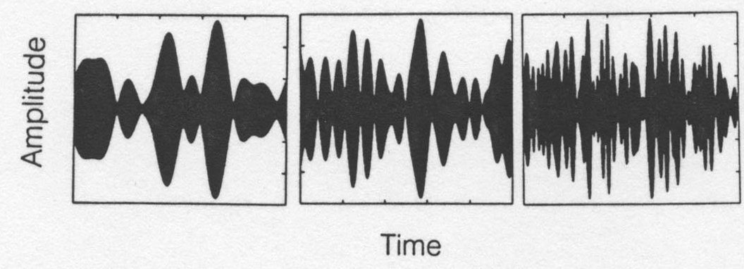
Temporal resolution: How good is a listener at following rapid changes in a sound?
Spontaneous activity occurs when no sound is present
Auditory nerve fibers do not fire at the instant at which sounds begin or end.
Adaptation occurs.
Neurons need time to recover from adaptation.
Notes:
Several characteristics of the auditory nerve response will limit the fidelity with which fluctuations in a sound can be represented.

Slide 34
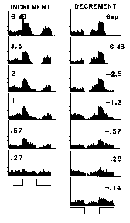
Following rapid changes in sound
The auditory nerve response does not follow changes with perfect precision
Notes:
In the PST histograms on the right, the auditory nerve response does not exactly follow the clean increment or decrement in sound that is shown at the bottom of the panel.
The auditory system can’t really respond fast enough to capture little fluctuations, and even if it could, a lot of those little fluctuations in the auditory nerve response would be misleading.

Slide 35
Averaging over time is one way the auditory system could “smooth out” the bumpy response of auditory nerve fibers
AVERAGE
Firing rate
Firing rate
Time
Time

Slide 36
The time over which you average makes a difference
AVERAGE
Firing rate
Long time
averaging
Firing rate
Time
Time
AVERAGE
Firing rate
Short time
averaging
Firing rate
Time
Time
Notes:
If you average over too long a time, you won’t know when the intensity has changed. But if you average over too short a time, you will be fooled into thinking that an onset response or a recovery period represents a change in intensity.

Slide 37
The temporal window averages sound as long as it is open

Slide 38
The temporal window
Averaged
Firing rate (s/s)
Time (ms)
Notes:
If the temporal window only lets information through in chunks, then eahc chunk represents the a part of the sound’s envelope, and if fluctuations in the envelop occur during one of those chunks of time, the firing rate won’t indicate that.

Slide 39
The temporal window
Averaged
Firing rate (s/s)
Time (ms)
Notes:
If the temporal window says open for a long time, then a lot of information about the envelope is lost.

Slide 40
Hydraulic analogy: How long before the next bucket leaves for the brain?
Inner HC
Auditory nerve fiber
To the Brain
Notes:
One way to think of this: The auditory nerve is delivering the message from the cochlea to the brain in “chunks”, like the buckets in a bucket brigade. Each bucket is under the spigot for a certain period of time before it proceeds. Whatever message (“water”) collects in the bucket during that time is what the brain has to tell it what the sound amplitude was during that time period.
It could go fast. In that case each bucket (or action potential) carries information about a brief period of time

Slide 41
Hydraulic analogy: How long before the next bucket leaves for the brain?
Inner HC
Auditory nerve fiber
To the Brain
Notes:
If it goes slowly, then each bucket carries information about sound over a longer period of time, but the detail about changes in the sound during that period of time is lost.

Slide 42
Temporal resolution: How short are the “samples” of sound?
Hypothesis # 1: We integrate over 200-300 ms.
From Gelfand (1997)
Notes:
We already know something that might tell us about the size of the temporal chunk: We know that absolute threshold improves with duration up to 200-300 ms. The system integrates information over that time period. So that would suggest that the “buckets collect water” for 200 or 300 ms and that maybe we could tell that there was a change in the timing if it was 50-75 ms long because that would be like a 1 dB change in overall intensity.

Slide 43
What would be the smallest difference in sound duration you could detect then?
jnd for intensity ~ 1 dB
1 dB ~ 25% intensity change
25% of 200-300 ms ~ 50-75 ms
200 ms sound
150 ms sound
Those sound different

Slide 44
Sensitivity-resolution tradeoff
If you extend the integration time to improve sensitivity, you lose resolution.

Slide 45
How short a change in a sound can we hear?
Duration discrimination
Gap detection
Amplitude modulation detection
Notes:
To test this hypothesis, we test people’s ability to detect for short changes in a sound. These are the methods typically used.

Slide 46
Problem in measuring temporal resolution: “Spectral splatter”
Amplitude (dPa)
Level (dB)
- Forever
Forever
Frequency (Hz)
Time (ms)
Amplitude (dPa)
Level (dB)
0
5
Frequency (Hz)
Time (ms)
Notes:
A major problem with testing temporal resolution is that when we make temporal changes in a frequency-specific sound, we also make spectral changes. For example, a long duration tone has a single peak in its spectrum, but when we make the same sound short in duration by turning it on and off abruptly, sound energy spreads to adjacent frequencies . This phenomenon is called “spectral splatter”. The problem is that a listener could tell, for example, that the duration of the sound changed by detecting the change in the spectrum, not the time waveform.

Slide 47
Duration discrimination
Interval 1
Interval 2
Level (dB)
Level (dB)
Time (ms)
Time (ms)
Which gap was longer?
Notes:
In duration discrimination, the subject chooses the interval with the longer gap in it.

Slide 48
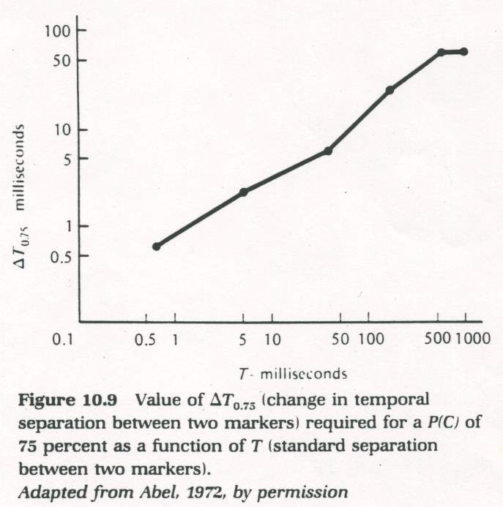
Duration discrimination
Weber’s Law? NO
Duration discrimination can be very acute - much better than 50-75 ms.
From Yost (1994)
Notes:
Duration discrimination thresholds go up as the duration goes up, but not at a constant rate as Weber’s Law predicts.
Notice that people can discriminate very short differences in duration, much shorter than their performance in temporal integration would lead us to believe.

Slide 49
Gap detection
Interval 1
Interval 2
Level (dB)
Level (dB)
Time (ms)
Time (ms)
Which one had a gap?
Notes:
In gap detection, the listener chooses the interval with the gap in it.

Slide 50
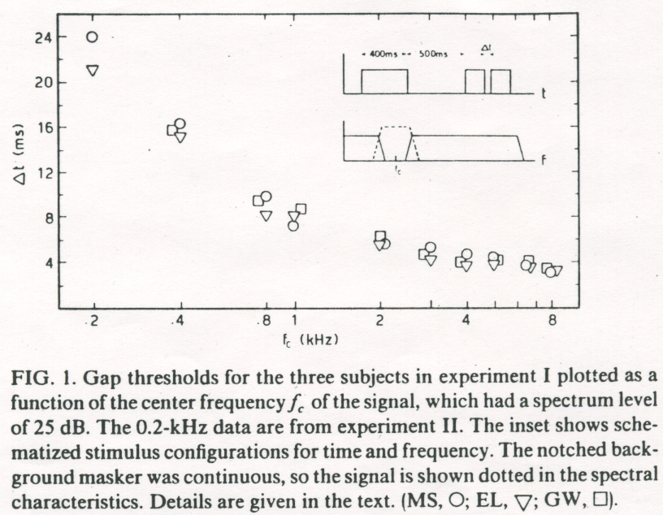
Gap detection
Masking spectral splatter
From Moore (1997)
Notes:
Moore et al. measured gap detection threshold in noise bands centered at various frequencies. To mask spectral splatter they played the noise band in a continuous background of notched noise. Gap detection threshold improved from about 22 ms at 200 Hz to about 3 ms at 8000 Hz-- certainly much better than 50-75 ms.

Slide 51
Is it temporal resolution or intensity resolution?
Good intensity resolution
Nice long gap
Firing rate
Level (dB)
Time (ms)
Bad intensity resolution
Time (ms)
Firing rate
Time (ms)
Notes:
But even if the gap is long enough that we can easily detect it, it will be harder to detect a gap if the auditory system doesn’t respond to the change in intensity very much. In other words, intensity resolution will also influence how well we detect gaps. How can we separate temporal and intensity resolution?

Slide 52
Amplitude modulation detection
By how much do I have to modulate the amplitude of the sound for the listener to tell that it is amplitude modulated, at different rates of modulation?

Slide 53
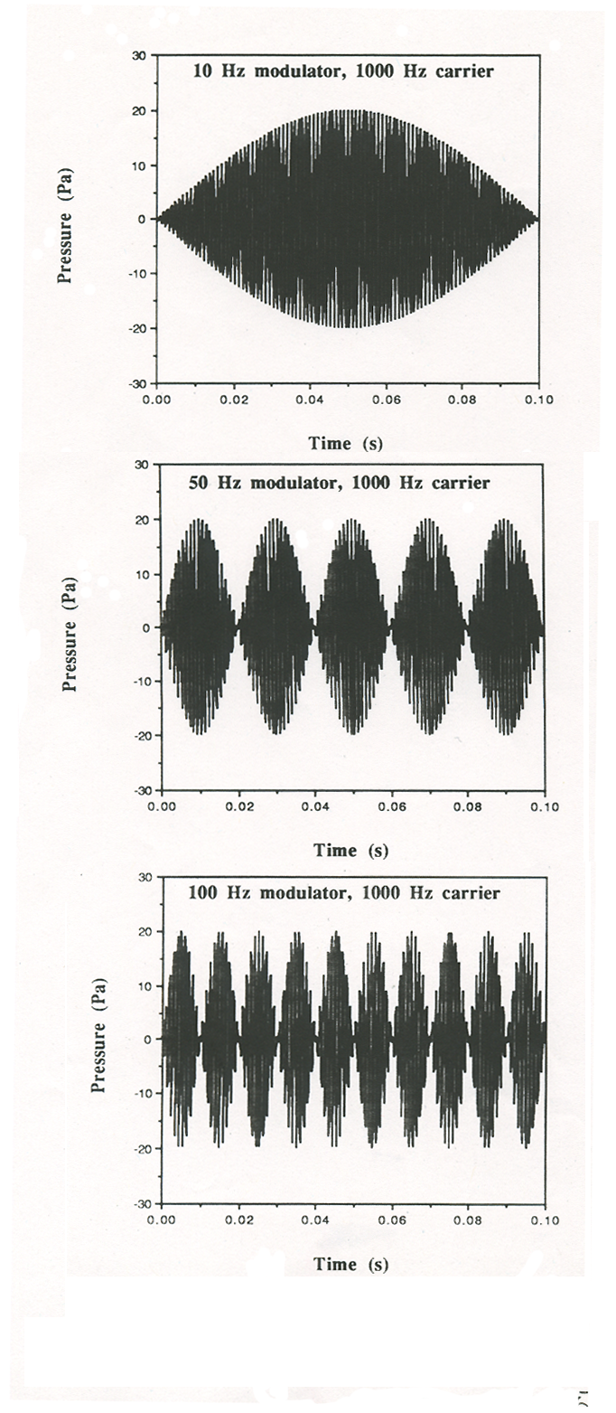
Amplitude modulation rate
Notes:
By AM rate is meant how often the amplitude of the sound goes from minimum to maximum to minimum in a second. These graphs represent a 1000-Hz carrier tone modulated at 3 different rates.

Slide 54
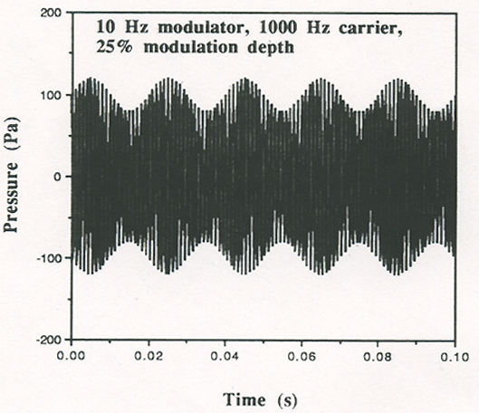
Modulation depth
25%
100%
50
Notes:
The minimum amplitude doesn’t have to be zero. The modulation depth is the percentage by which the amplitude changes between the maximum and the minimum.

Slide 55
2AFC AM Detection
AM
Not AM
Feedback
Time
Warning
Interval 1
Interval 2
Respond: 1 or 2?
Trial 1
1
Warning
Interval 1
Interval 2
Respond: 1 or 2?
Trial 2
2
Warning
Interval 1
Interval 2
Respond: 1 or 2?
Trial 3
2
Which one was AM?
Vary depth of AM to find a threshold
Notes:
The task in AM detection is illustrated here. The listener gets a warning followed by two interval indicators. During one interval, randomly chosen, an AM sound is presented; in the other interval the same sound but unmodulated is presented. The listener chooses the interval containing the AM sound and receives feedback. The modulation depth is varied to find the threshold for AM detection, the amount of modulation required to hear the modulation some proportion of the time.

Slide 56
Modulation depth, 20 log m
Notes:
Modulation depth is usually expressed in deciBels, calculated as 20 times the log of the percent modulation.

Slide 57
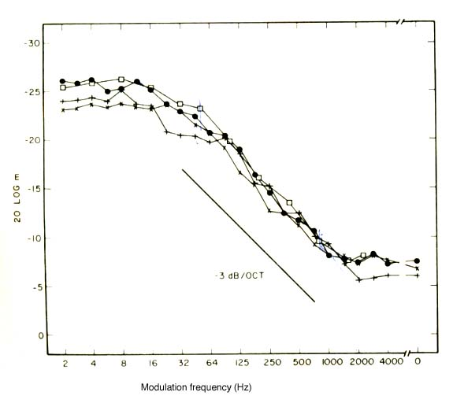
AM detection as a function of modulation rate
The temporal modulation transfer function (TMTF)
From Viemeister (1979)
Notes:
The plot of AM detection thresholds as a function of modulation rate is called the temporal modulation transfer function. Threshold is plotted as modulation depth in dB with low (good) values at the top. The carrier in this case was a broadband noise. Each curve in the graph represents the data of one listener.
Notice that for modulation rates below 50-60 Hz, thresholds are about -23 to -26 dB, about 5% modulation depth. Above 50-60 Hz thresholds get worse. At 500 Hz modulation rate, something like 50% modulation is needed before we hear it.
So the auditory system acts like a low-pass filter when it comes to temporal fluctuations in sounds-- with a cutoff frequency (3-dB down point) around 50-60 Hz. We can follow fluctuations up that modulation rate fine, but at higher rates we don’t follow as well.

Slide 58
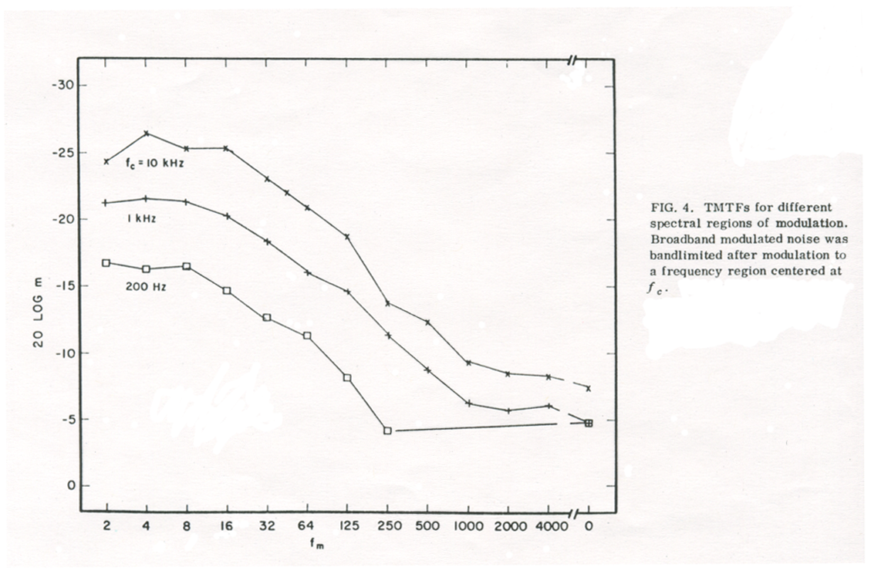
TMTF at different carrier frequencies
About 3 dB
About 3 dB
About 3 dB
From Viemeister (1979)
Notes:
If you use a band of noise centered at some frequency as the carrier, sensitivity is better at higher frequencies, but the shape of the TMTF (the 3 dB down point) is the same at all frequencies. That would suggest that temporal resolution does not depend on frequency.

Slide 59
Which of these measures indicates that the temporal window duration is 200 ms?
Forward masking
The TMTF
Gap detection
Temporal integration

Slide 60
Conclusions from TMTF
People are very good at AM detection up to 50-60 Hz modulation rate (and intensity resolution effects are controlled)
50-60 Hz = 17-20 ms/cycle of modulation
17-20 ms < 50-75 ms
Somehow the auditory system is getting around the sensitivity-resolution tradeoff

Slide 61
Effects of duration on absolute sensitivity
Critical Duration
From Gelfand (1998)
Temporal summation or temporal integration
Notes:
As the duration of a tone is increased by a factor of 10, threshold decreases by close to 10 dB. So the auditory system integrates energy over frequency (within the critical band) and over time (within the critical duration).

Slide 62
So how can we detect such short changes in a sound and still be able to integrate sound energy over 200-300 ms?

Slide 63
Two theories of temporal resolution-temporal integration discrepancy
Multiple integrators
Multiple looks

Slide 64
Multiple integrators
Inner HC
Buckets leave every 200 ms
AN fiber 1
Buckets leave every 100 ms
AN fiber 2
AN fiber 3
Buckets leave every 50 ms
To the Brain
Etc.
Etc.
Notes:
The multiple integrator model says that different nerve fibers have different integration times, some long, some short.

Slide 65
Multiple integrators
For detecting sounds
Inner HC
Buckets leave every 200 ms
AN fiber 1
Buckets leave every 100 ms
AN fiber 2
AN fiber 3
Buckets leave every 50 ms
To the Brain
Etc.
Etc.
Notes:
If you are trying to detect a sound, you “listen” to the fibers with long integration times, so you can add up as much sound energy as possible.

Slide 66
Multiple integrators
Inner HC
Buckets leave every 200 ms
AN fiber 1
Buckets leave every 100 ms
AN fiber 2
AN fiber 3
Buckets leave every 50 ms
To the Brain
Etc.
Etc.
For detecting gaps
Notes:
If you want to detect a short gap, you “listen” to the fibers with short integration times, so you can get as much detail as possible about how the intensity changed over time.

Slide 67
AN fibers don’t have different integration times
But of course the integrators could be somewhere else in the brain.

Slide 68
Multiple looks
Inner HC
In the brain...
AN fiber 1
Buckets leave every 50 ms
AN fiber 2
Buckets leave every 50 ms
AN fiber 3
Buckets leave every 50 ms
Memory:
Hold on to those buckets for 200 ms and check them out
To the Brain
Etc.
Etc.
Notes:
The multiple looks model holds that all of the nerve fibers have similar integration times, but that at some point in the brain, a kind of memory operates. The outputs of the nerve fibers (the buckets) are stored for 200 or 300 ms, while the listener scans their contents. If you are trying to detect a sound, you add up the contents of all the buckets. If you are trying to detect a gap, you look in the bucket where the gap was supposed to have occurred to so if there is less of a response in it.The buckets in our analogy are referred to as “looks”.

Slide 69
A test of the multiple looks theory: Viemeister & Wakefield (1991)
Set up a situation in which the two theories predict different outcomes...

Slide 70
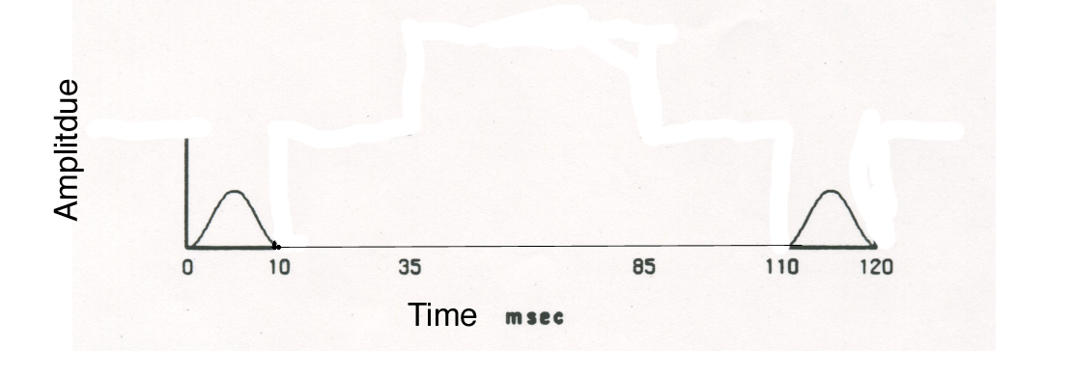
Viemeister & Wakefield (1991)
It would be useful to integrate the 2 tone pips to improve detection, and both theories say you could do that.
Notes:
Viemeister & Wakefield asked listeners to detect two short tone pips-- when each was presented alone and when both were presented in sequence. You would expect people to be able to detect the two tones better than they do either tone alone by any theory of temporal processing.

Slide 71
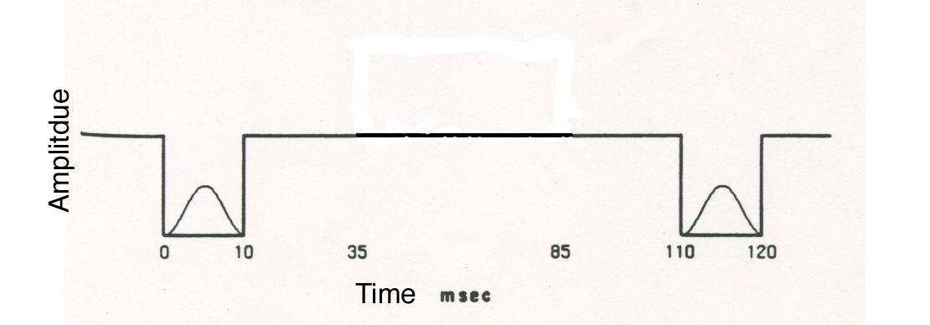
Viemeister & Wakefield (1991)
But if you put noise on between the tone pips, you can’t integrate them without integrating in the noise. If you’re taking short looks, you can use the looks with the tone pips, but ignore the looks in between.
Notes:
Viemeister and Wakefield also presented the tones when there was a noise background that stopped just when the tones were presented, but was on in the time between the tones. The multiple integrator theory says that you would not be able to hear two tones better than one in this situation because to add the energy of the two tones you need an integrator that integrates for 120 ms, but that integrator will also have to add in the noise between the tones, making it harder to hear them. Multiple looks theory says that it shouldn’t matter if there is noise between the tones.

Slide 72
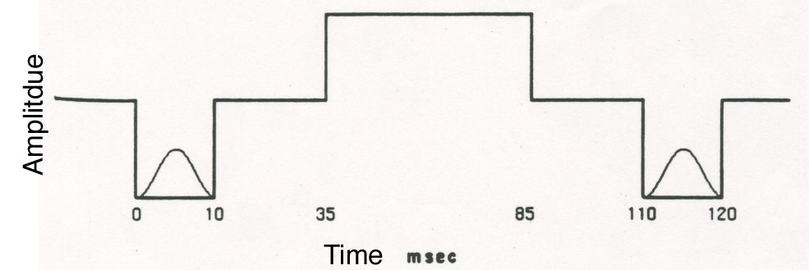
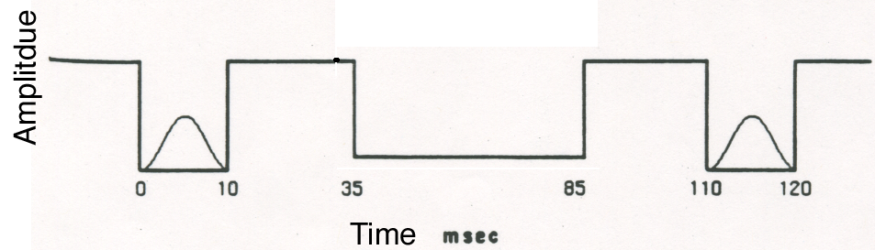
Viemeister & Wakefield (1991)
Multiple integrator “performance” will get worse if the noise goes up more, and better if the noise goes down some, but multiple looks are not affected by what happens between the tone pips.
Notes:
The top panel shows another condition in which the noise between the tones goes up in intensity by 6 dB, the bottom panel shows the case where the noise goes down by 6 dB between the tones. Multiple integrator theory says that the changes in the noise level will affect detection of the two tones, but multiple looks theory says it won’t matter.

Slide 73
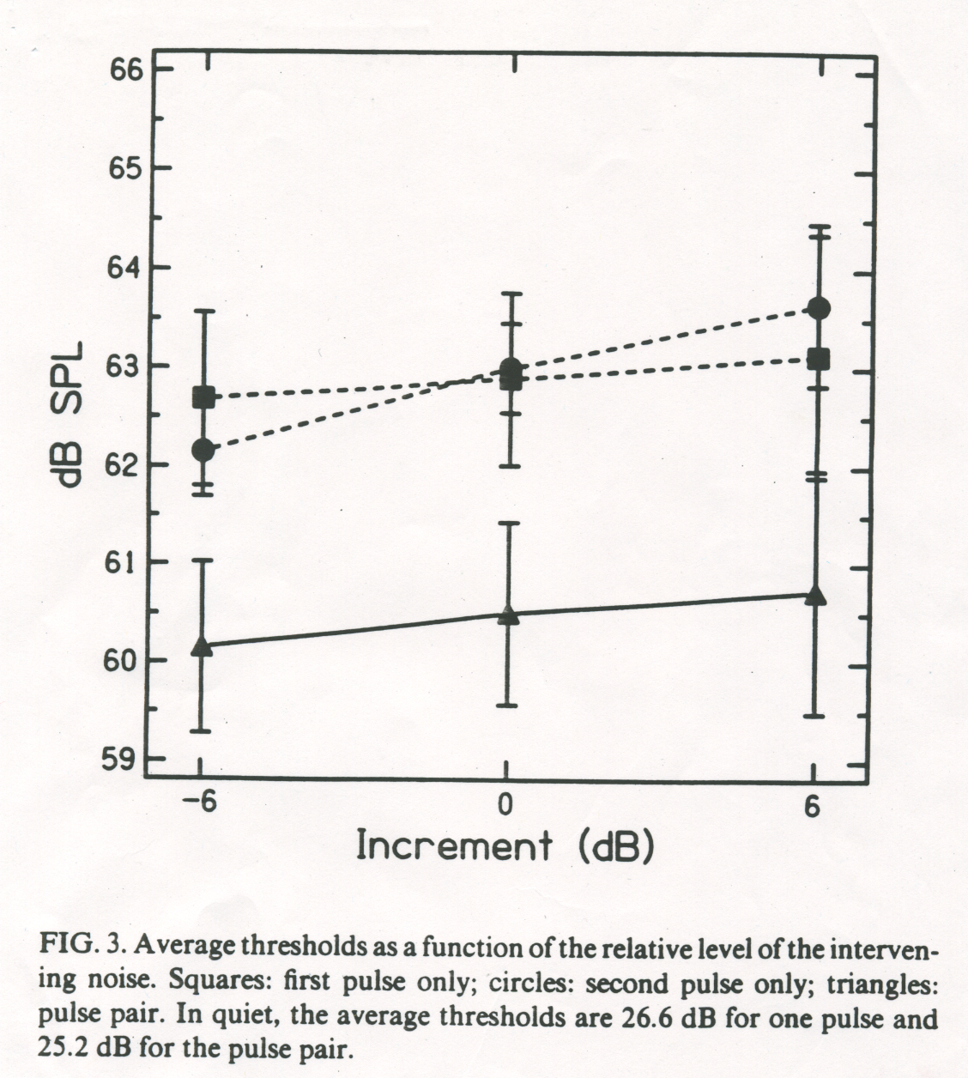
Viemeister & Wakefield (1991): Results
Notes:
This graph shows the results of the experiment. The dashed lines show the thresholds when just one of the tone (1st or 2nd) is presented; the solid curve shows thresholds when the tones are presented in sequence. On the x-axis is the level of the noise between the tones in the three conditions. Thresholds were better when there were two tones instead of one, and the level of the noise doesn’t make much difference. This result supports the multiple looks theory and argues against the multiple integrators theory,

Slide 74
Which of these can be explained by the response of auditory nerve fibers?
Forward masking
Backward masking
Temporal resolution
Loudness adaptation

Slide 75
Conclusions 2
People can detect very short duration changes in sound, such as 2-3 ms long interruptions.
People can integrate sound energy over 200-300 ms to improve sound detection.
The auditory system gets around the sensitivity-resolution tradeoff by using short-term integration and intelligent central processing.

Slide 76
Text sources
Gelfand, S.A. (1998) Hearing: An introduction to psychological and physiological acoustics. New York: Marcel Dekker.
Moore, B.C.J. (1997) An introduction to the psychology of hearing. (4th Edition) San Diego: Academic Press.
Viemeister, N.F. (1979). Temporal modulation transfer functions based upon modulation thresholds. J. Acoust. Soc. Am., 66, 1564-1380.
Viemeister, N.F. & Wakefield, G. (1991) Temporal integration and multiple looks. J. Acoust. Soc. Am., 90, 858-865.
Yost, W.A. (1994) Fundamentals of hearing: an introduction. San Diego: Academic Press.

Slide 77
Text sources
Gelfand, S.A. (1998) Hearing: An introduction to psychological and physiological acoustics. New York: Marcel Dekker.
Moore, B.C.J. (1997) An introduction to the psychology of hearing. (4th Edition) San Diego: Academic Press.
Viemeister, N.F. (1979). Temporal modulation transfer functions based upon modulation thresholds. J. Acoust. Soc. Am., 66, 1564-1380.
Viemeister, N.F. & Wakefield, G. (1991) Temporal integration and multiple looks. J. Acoust. Soc. Am., 90, 858-865.
Yost, W.A. (1994) Fundamentals of hearing: an introduction. San Diego: Academic Press.

