Slide 1
Auditory Transduction
How the ear converts acoustic energy into a neural response

Slide 2
The bottom line
Hair cells are specialized so that motion of their stereocilia changes their electrical potential, resulting in neurotransmitter release and action potentials in the nerve fibers that contact the hair cells.
Notes:
{comment="QWIZDOM MARKUP EDITOR OUTPUT. Your notes, if any, should appear before this markup. EDIT BY HAND AT YOUR OWN RISK!"; type="0";expectedAnswer="(null)";points="0";timerValue="0";title="(null)";}

Slide 3
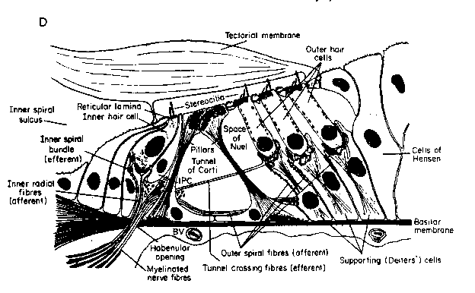
A closer look at the organ of Corti
From Pickles (1992)
Notes:
Remember that the hair cell bodies are beneath a solid barrier, while their stereocilia extend above that barrier.

Slide 4
The solid barrier between the hair cell bodies and the stereocilia is the
Reissner’s membrane
basilar membrane
helicotrema
reticular lamina
4

Slide 5
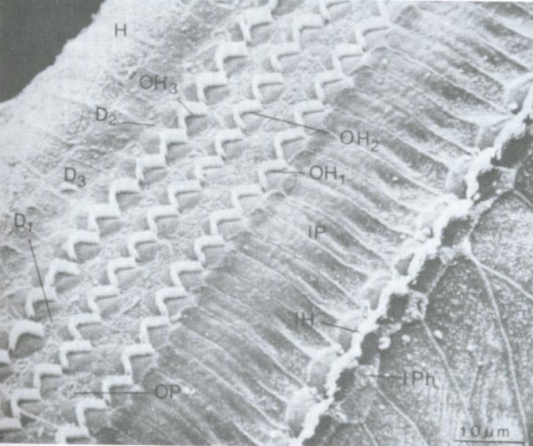
Reticular lamina
From Gelfand (1998), Lim (1986)
Notes:
The reticular lamina is the solid surface at the tops of the hair cells.

Slide 6
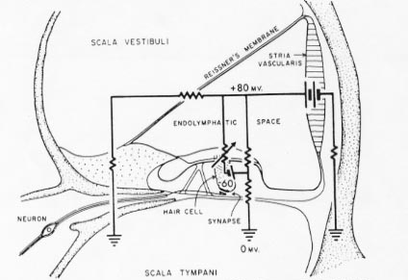
Electrical situation in the organ of Corti
From Gelfand (1998)
Notes:
This is important in maintaining the electrical potential differences that “drive” the transduction process. The inside of the hair cell is about 40-60 mV more negative than the perilymph. The endolymph is about 80 mV more positive than the perilymph. The positive charge is carried by potassium (K) ions; endolymph is produced by the stria vascularis. The 120-140 mV potential difference between the endolymph and the inside of the hair cells is called the endocochlear potential.

Slide 7
If there is a positive potential difference between the endolymph and the inside of the hair cells, electrical currents will tend to flow
into the hair cells
out of the hair cells
into the stria vascularis
across Reissner’s membrane
7

Slide 8
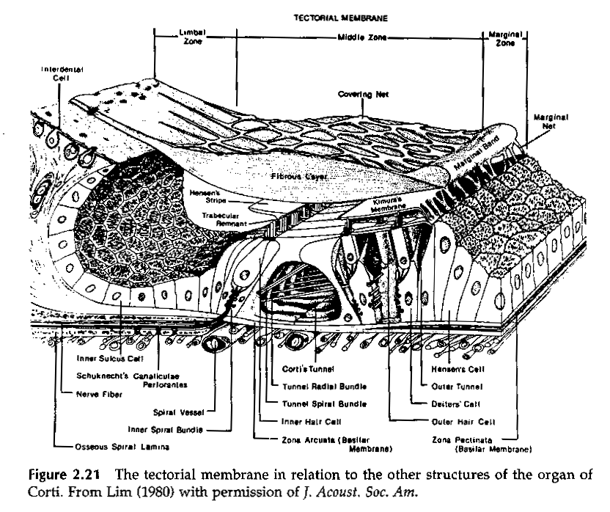
Another view...
From Gelfand (1998)
Notes:
This picture shows the mechanical arrangement of the parts of the organ of Corti. Notice that the tectorial membrane is only attached to the rest of the organ of Corti by thin strands on its outer edge. It is solidly attached on the modiolar side (cut off in this picture).
{comment="QWIZDOM MARKUP EDITOR OUTPUT. Your notes, if any, should appear before this markup. EDIT BY HAND AT YOUR OWN RISK!"; type="0";expectedAnswer="(null)";points="0";timerValue="0";title="(null)";}

Slide 9
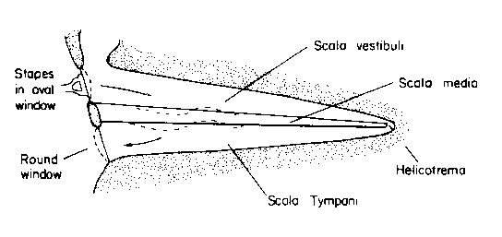
Basilar membrane motion
From Pickles (1992)
Notes:
Motion of the stapes footplate in the oval window leads to a pressure change in the cochlear fluids which is offset by the “bulging” of the round window. Thus, there is a pressure differential across the basilar membrane that sets it in motion. The length of the basilar membrane is short compared to the wavelength of sounds, so it is NOT as if the sound is transmitted along the cochlear duct. The pressure change is simultaneous along the duct.
{comment="QWIZDOM MARKUP EDITOR OUTPUT. Your notes, if any, should appear before this markup. EDIT BY HAND AT YOUR OWN RISK!"; type="0";expectedAnswer="(null)";points="0";timerValue="0";title="(null)";}

Slide 10
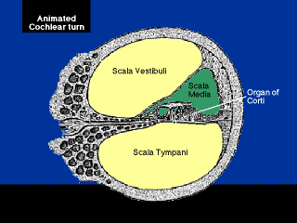
Cochlear motion
http://www.neurophys.wisc.edu/h&b/animation/animationmain.html
Notes:
Another view of how the basilar membrane moves.
{comment="QWIZDOM MARKUP EDITOR OUTPUT. Your notes, if any, should appear before this markup. EDIT BY HAND AT YOUR OWN RISK!"; type="0";expectedAnswer="(null)";points="0";timerValue="0";title="(null)";}

Slide 11
The motion of the basilar membrane is similar to the motion
of a sine wave
of a triangular wave
of a rope that is “flicked” at one end
11
Notes:
{comment="QWIZDOM MARKUP EDITOR OUTPUT. Your notes, if any, should appear before this markup. EDIT BY HAND AT YOUR OWN RISK!"; type="67";expectedAnswer="C";points="1";timerValue="20";title="(null)";}

Slide 12
If I play a tone into the ear, the motion of the basilar membrane will be most like
a sine wave.
a triangular wave.
a rope alternately “flicked” up and down.
12

Slide 13
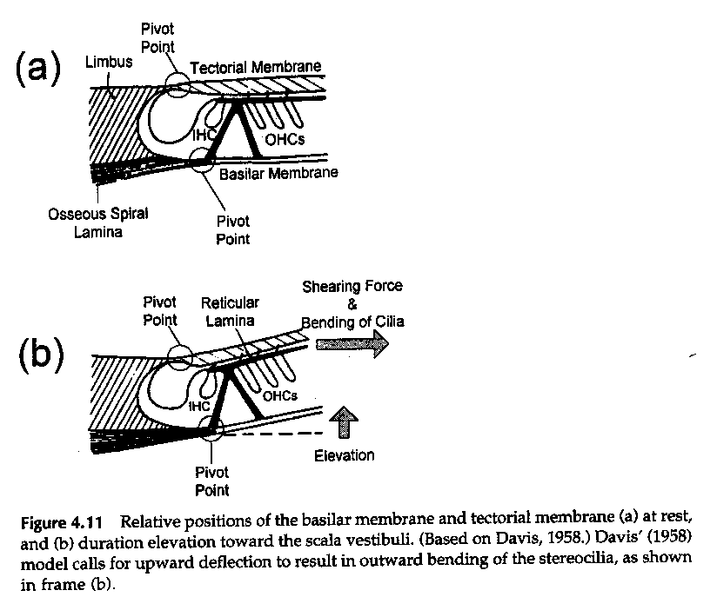
“shearing action”
From Gelfand (1998)
Notes:
Because the tectorial membrane is not tightly coupled to the reticular lamina, when the basilar membrane moves, the tectorial membrane lags behind due to inertia, and the angle between the reticular lamina and the tectorial membrane changes. The tectorial membrane “shears” across the reticular lamina, and the stereocilia of the hair cells.

Slide 14
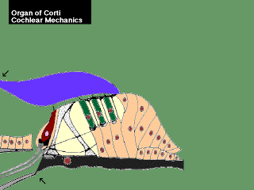
“shearing action” movie
http://www.neurophys.wisc.edu/h&b/animation/animationmain.html

Slide 15
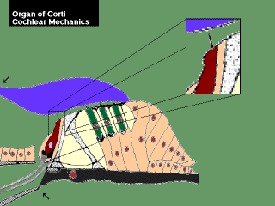
Inner hair cell stereocilia
http://www.neurophys.wisc.edu/h&b/animation/animationmain.html
Notes:
The stereocilia of the inner hair cells are not embedded in the tectorial membrane, but those of outer hair cells are. Motion of the fluid aurrounding the IHC stereocilia, however, moves them.

Slide 16
Shearing of the tectorial membrane across the reticular lamina displaces the
stereocilia
basilar membrane
Deiter’s cells
pillar cells
16

Slide 17
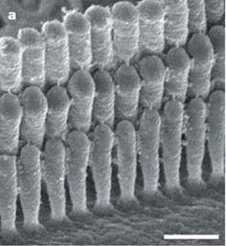
Stereocilia
From Schneider et al. (2002)
Notes:
Remember that each row of stereocilia is taller than the next, and that the tip of each stereocilium is linked to the side of the stereocilium behind it by a tip link.

Slide 18
IHC excitation
probelft.mov
http://www.neurophys.wisc.edu/h&b/animation/animationmain.html
Notes:
Moving the stereocilia toward the tallest row makes the voltage within the hair cells more positive and increases the firing of the auditory nerve fibers contacting the hair cell.

Slide 19
IHC inhibition
probergh.mov
http://www.neurophys.wisc.edu/h&b/animation/animationmain.html
Notes:
Pushing the stereocilia toward the shortest row, makes the voltage inside the hair cell more negative and reduces the response rate of the auditory nerve fibers contacting the hair cell.

Slide 20
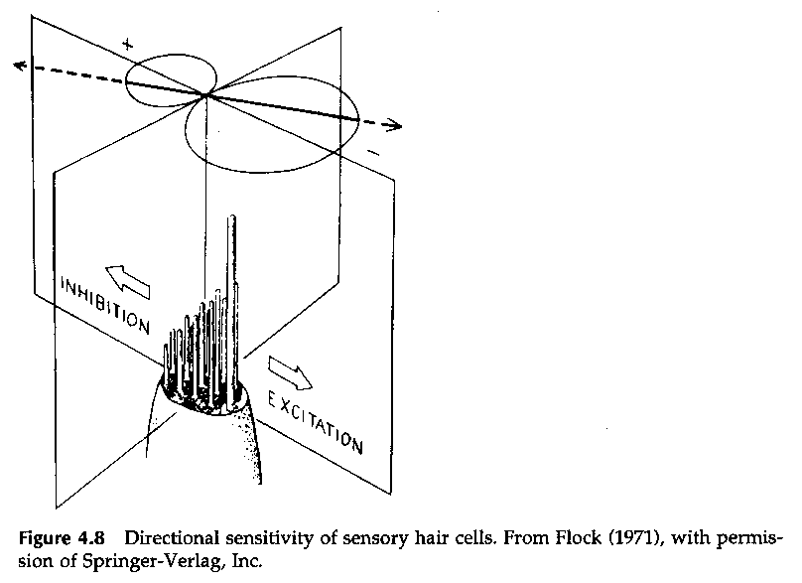
Stereocilia motion
From Gelfand (1998)
Notes:
This figure summarizes the directional sensitivity of stereocilia.

Slide 21
Neural response
phaslock.mov
http://www.neurophys.wisc.edu/h&b/animation/animationmain.html
Notes:
So, for example, if you play a tone, the neurons attached to this hair cell will tend to fire at the positive peaks in the pressure waveform and be inhibited when the pressure goes negative. As a result, the neurons tend to respond at the same phase of the sine wave on each cycle. This tendency is called phase-locking.

Slide 22
Positive pressure ________ the hair cells; negative pressure _______ the hair cells.
excites; excites
excites; inhibits
inhibits; excites
inhibits; inhibits
22

Slide 23
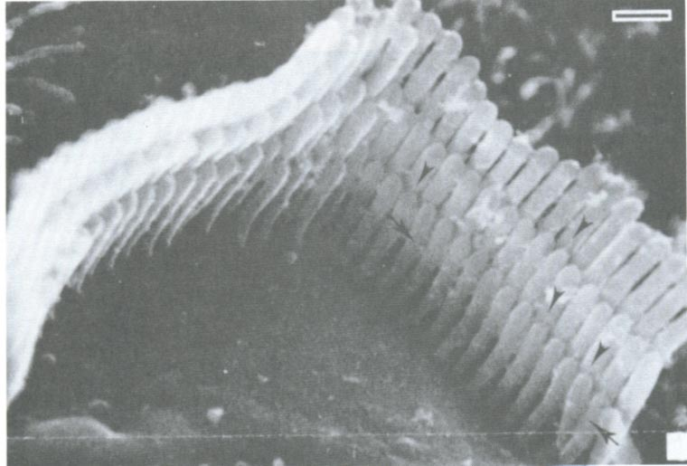
Tip links
From Gelfand (1998)
Notes:
The connections between stereocilia by tip links is crucial to tranduction.

Slide 24
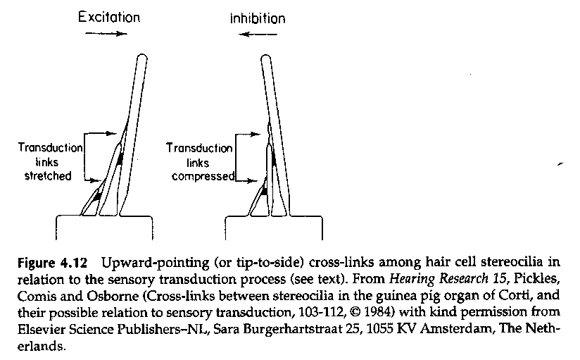
Opening transduction channels
From Gelfand (1998)
Notes:
Pushing over the stereocilia gets the current flowing (and the voltage in the HC more positive) by stretching the tip links between stereocilia (here called transduction links). Pushing in the opposite direction leads to a negative voltage change in the HC which inhibits the neural response.

Slide 25
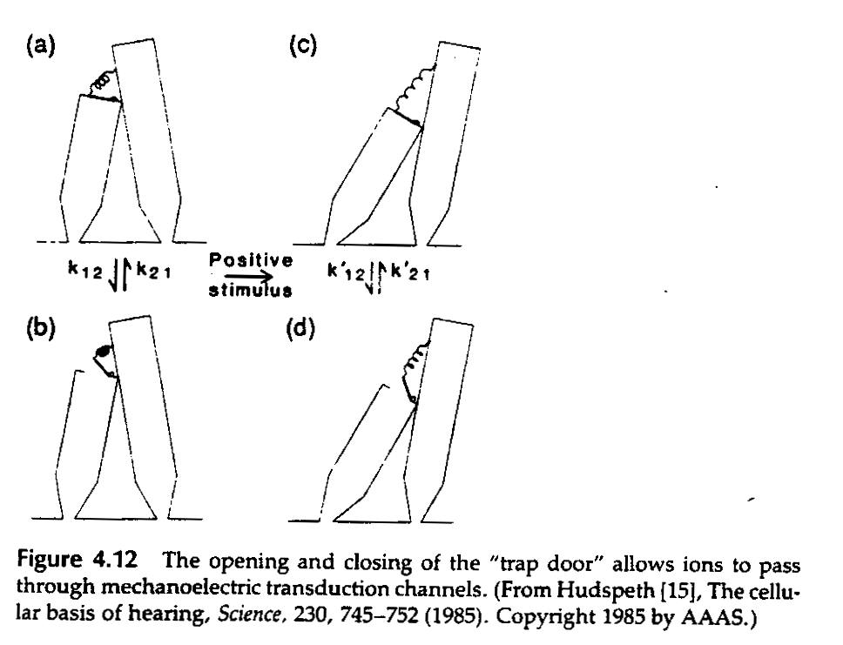
Transduction channels
From Gelfand (1998)
Notes:
Stretching the tip links opens ion channels in the tips of the stereocilia . In this figure the ion channels are portrayed as trap doors. In the “resting” state (pictures a and b) the tip link is not stretched and the trap door is closed most of the time. When the tip links are stretched by a stimulus, the trap door is open most of the time (pictures c and d).

Slide 26
Positive pressure _________ the tip links; negative pressure _______ the tip links
stretches; stretches
stretches; compresses
compresses; stretches
compresses; compresses
26
Notes:
{comment="QWIZDOM MARKUP EDITOR OUTPUT. Your notes, if any, should appear before this markup. EDIT BY HAND AT YOUR OWN RISK!"; type="68";expectedAnswer="B";points="1";timerValue="20";title="(null)";}

Slide 27
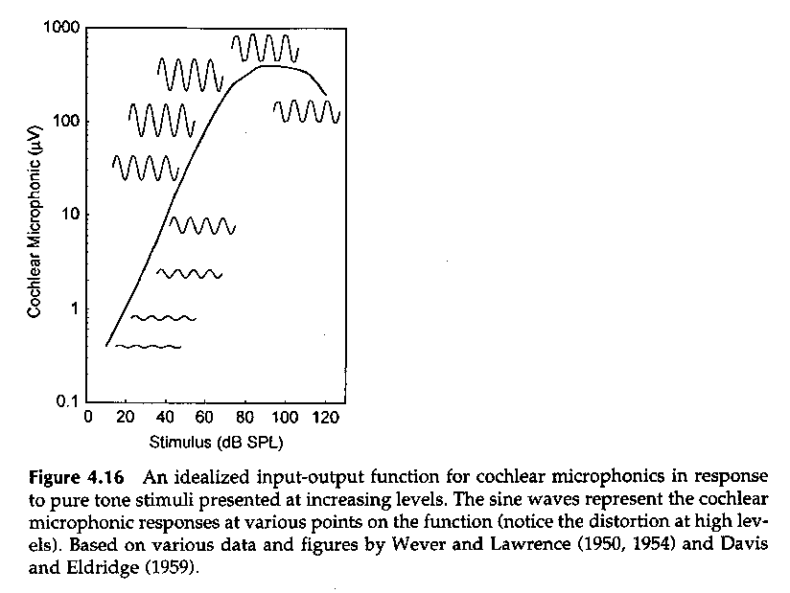
Receptor potential
From Gelfand (1998)
Notes:
So the ions flow into the hair cell following the motion of the basilar membrane which follows the changes in sound pressure. If we measured the ion flow, the graph of the electrical potential over time would resemble the time waveform of the sound. This electrical potential is called a receptor potential and in the inner ear we call it the cochlear microphonic. Notice that as the sound pressure level goes up, the amplitude of the cochlear microphonic goes up.
{comment="QWIZDOM MARKUP EDITOR OUTPUT. Your notes, if any, should appear before this markup. EDIT BY HAND AT YOUR OWN RISK!"; type="0";expectedAnswer="(null)";points="0";timerValue="0";title="(null)";}

Slide 28
As the sound pressure increases
the amplitude of basilar membrane motion increases.
the displacement of the stereocilia increases.
the tip links are stretched more.
more ions flow into the hair cell.
all of the above.
28
Notes:
{comment="QWIZDOM MARKUP EDITOR OUTPUT. Your notes, if any, should appear before this markup. EDIT BY HAND AT YOUR OWN RISK!"; type="69";expectedAnswer="E";points="1";timerValue="20";title="(null)";}

Slide 29
If more ions flow into the hair cell
the neurons contacting the hair cell will respond more.
the neurons contacting the hair cell wil respond less.
29
Notes:
{comment="QWIZDOM MARKUP EDITOR OUTPUT. Your notes, if any, should appear before this markup. EDIT BY HAND AT YOUR OWN RISK!"; type="66";expectedAnswer="A";points="1";timerValue="20";title="(null)";}

Slide 30
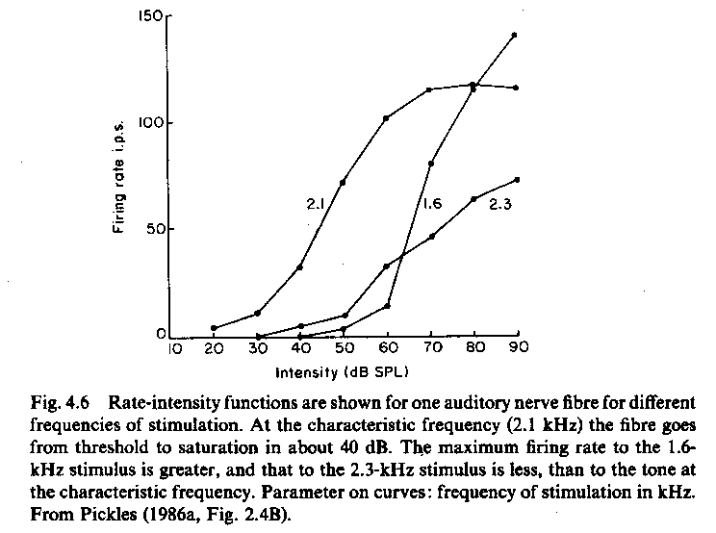
Neural response rate
From Pickles (1992)
Notes:
And of course, the bigger the receptor potential, the greater the number of action potentials. So the firing rate of the auditory nerve fibers is a potential “code” for sound intensity.
{comment="QWIZDOM MARKUP EDITOR OUTPUT. Your notes, if any, should appear before this markup. EDIT BY HAND AT YOUR OWN RISK!"; type="0";expectedAnswer="(null)";points="0";timerValue="0";title="(null)";}

Slide 31
If I play a tone into the ear, action potentials in the neurons contacting a hair cell
will tend to occur at the negative phase of the sound wave.
will tend to occur at the positive phase of the sound wave.
will occur equally often at all phases of the sound wave.
31

Slide 32
Neural response
phaslock.mov
http://www.neurophys.wisc.edu/h&b/animation/animationmain.html
Notes:
The timing of the action potentials is also important, because if neurons always respond at one phase of the stimulus, then that could be a code for sound frequency. In other words, the timing of action potentials could represent the time waveform of the sound.

Slide 33
Conclusions
The stria vascularis maintains a potential difference between the tops and bottoms of hair cells.
When the basilar membrane is set into motion, the tectorial membrane shears across the hair cell stereocilia.
When the stereocilia are pushed “out”, the tip links are stretched, opening ion channels in the stereocilia tips that allow ions to flow into the hair cell.
Notes:
{comment="QWIZDOM MARKUP EDITOR OUTPUT. Your notes, if any, should appear before this markup. EDIT BY HAND AT YOUR OWN RISK!"; type="0";expectedAnswer="(null)";points="0";timerValue="0";title="(null)";}

Slide 34
Conclusions (continued)
This electrical change results in neurotransmitter release and a response in the auditory nerve fibers contacting the hair cell.
Notes:
{comment="QWIZDOM MARKUP EDITOR OUTPUT. Your notes, if any, should appear before this markup. EDIT BY HAND AT YOUR OWN RISK!"; type="0";expectedAnswer="(null)";points="0";timerValue="0";title="(null)";}

Slide 35
Text sources
Gelfand, S.A. (1998) Hearing: An introduction to psychological and physiological acoustics. New York: Marcel Dekker.
Pickles, J.O. (1988) An introduction to the physiology of hearing. Berkeley: Academic Press.
Schneider, M.E., Belyantseva, I.A., Azevedo, R.B. & Kachar, B. (2002) Structural cell biology: Rapid renewal of auditory hair bundles. Nature, 418:837-838.
Notes:
{comment="QWIZDOM MARKUP EDITOR OUTPUT. Your notes, if any, should appear before this markup. EDIT BY HAND AT YOUR OWN RISK!"; type="0";expectedAnswer="(null)";points="0";timerValue="0";title="(null)";}

