Slide 1
The Traveling Wave

Slide 2
Reminder
Amplitude spectrum
Frequency domain
Time domain
Amplitude
Frequency
Phase
Frequency
(time) waveform

Slide 3
The bottom line
Besides being able to encode the time waveform of sound, the cochlea can break a sound down into its component frequencies because of the mechanical properties of the basilar membrane.

Slide 4
Phase-locking
transdct.mov
http://www.neurophys.wisc.edu/h&b/animation/animationmain.html
Notes:
Auditory nerve fibers tend to respond at the same phase of a tone when they respond. The tendency to respond at the same phase of a tone is called phase-locking. This could be a code for frequency, but individual nerve fibers don’t respond on every cycle of the tone.

Slide 5
Basilar membrane width increases from base to apex
From Gelfand (1998)
Notes:
The basilar membrane is narrow near the base of the cochlea and wide at the apex. It is stiffer at the base than at the apex.

Slide 6
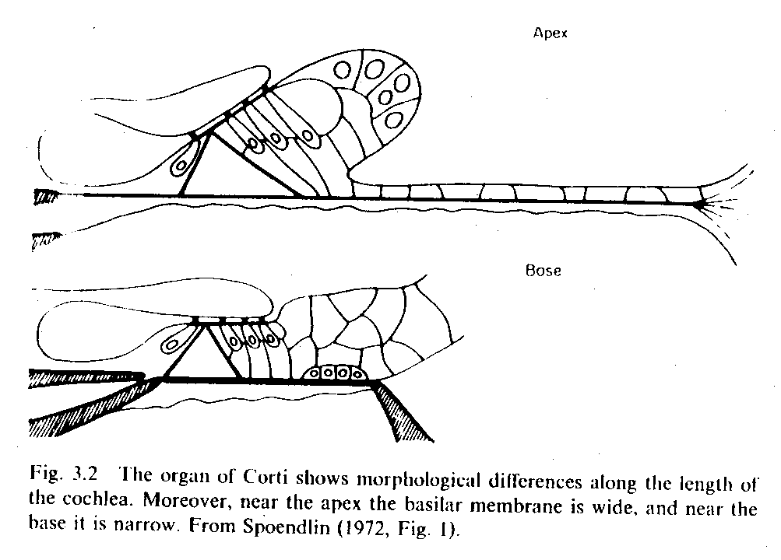
Morphological differences along the length of the basilar membrane
From Pickles (1988)
Notes:
The arrangement of the organ of Corti is tighter at the base and “floppier” at the apex of the cochlea.

Slide 7
Notes:
Helmholtz theorized that these anatomical differences would make different parts of the basilar membrane respond best at different frequencies, just as short piano wires produce high frequency notes and long wires produce low frequency notes. This is called a place theory because it holds that the code for frequency is the place on the basilar membrane that responds.

Slide 8
Georg von Bekésy
Notes:
von Bekesy was the first to directly observe the motion of the basilar membrane. He received the Nobel prize for his work in this area.

Slide 9
von Bekesy’s experiments
Observed basilar membrane motion in human cadavers
Observations near the cochlear apex
Used intense sounds to elicit responses big enough to see under the light microscope

Slide 10
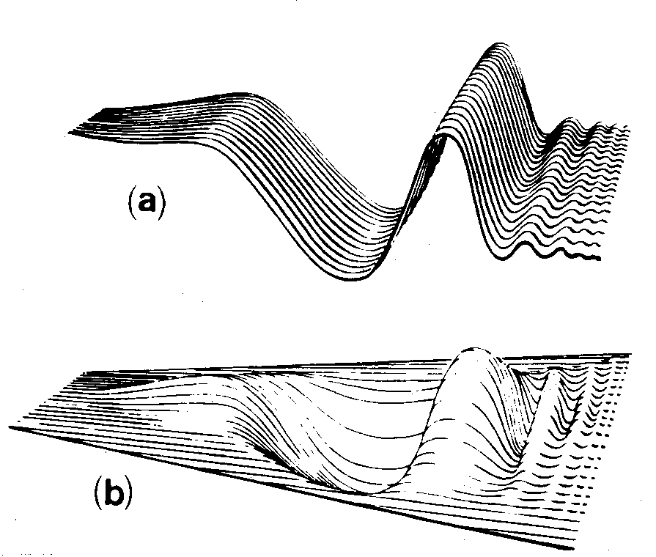
Traveling wave
From von Bekesy (1960), Gelfand (1998)
Notes:
Von Bekesy noted that the motion of the basilar membrane was in the form of a traveling wave, like the one that occurs when you flick a rope. The wave oscillates at the frequency of stimulation, but it is not a sinusoidal wave.

Slide 11
Traveling wave characteristics
Always starts at the base of the cochlea and moves toward the apex
Its amplitude changes as it traverses the length of the cochlea
The position along the basilar membrane at which its amplitude is highest depends on the frequency of the stimulus
Notes:
All of these characteristics depend on the change in stiffness along the length of the basilar membrane.

Slide 12
Traveling wave - 1000 Hz
http://www.neurophys.wisc.edu/~ychen/auditory/animation/animationmain.html
Notes:
A low-frequency tone, like 1000 Hz, would produce the highest traveling wave amplitude near the apex of the cochlea.

Slide 13
Traveling wave - 8000 Hz
http://www.neurophys.wisc.edu/~ychen/auditory/animation/animationmain.html
Notes:
A high-frequency tone, like 8000 Hz, would produce the largest traveling wave amplitude near the base of the cochlea.

Slide 14
Most sounds in the world contain
a single frequency
multiple frequencies
14

Slide 15
If I play a complex sound into the ear, the traveling wave
will have a single peak.
will not have a peak.
will have a peak for each frequency in the sound.
15

Slide 16
Traveling wave 1000 and 8000 Hz
http://www.neurophys.wisc.edu/~ychen/auditory/animation/animationmain.html
Notes:
If you put in two tones, you get a traveling wave that is high in amplitude in two places.

Slide 17
If each place on the basilar membrane responds to a narrow range of frequencies, each place on the basilar membrane is acting like
a high-pass filter
a low-pass filter
a bandpass filter
17

Slide 18
As the sound pressure increases
the amplitude of basilar membrane motion increases.
the displacement of the stereocilia increases.
the tip links are stretched more.
more ions flow into the hair cell.
the auditory neurons produce more action potentials.
All of the above
18

Slide 19
Traveling wave - 1000 Hz, Intensity effects
http://www.neurophys.wisc.edu/~ychen/auditory/animation/animationmain.html
Notes:
The higher the intensity of the sound, the higher the amplitude of the traveling wave.

Slide 20
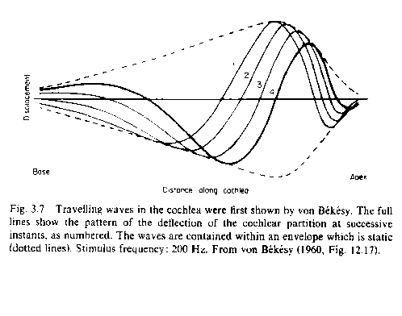
Traveling wave envelope
envelope
From Gelfand (1998)
Notes:
The curve that shows the amplitude of the traveling wave at each point along the basilar membrane is called its envelope. The envelope has a positive and a negative side, but we generally only talk about the positive half (because that’s when the stereocilia get pushed over in the right direction to get a neural response). The peak of the envelope is at the place where the traveling wave is biggest.

Slide 21
Traveling wave envelopes at different frequencies
base
apex
From www.sfu.ca/.../handbook/Basilar_Membrane.html
Notes:
So if you plotted the traveling wave envelopes for different tone frequencies, they’d look something like this-- high frequencies have peak amplitudes at the base, and lower frequencies have peak amplitudes at progressively more apical positions.

Slide 22
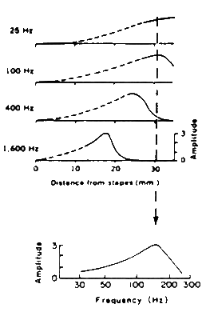
The response of a “place” on the basilar membrane
Notes:
If you played sounds of different frequencies and measured how much a certain place on the basilar membrane moved for each frequency, you would get a result like the one shown in the bottom panel or the 30 mm place on the basilar membrane.

Slide 23
If each place on the basilar membrane responds best at a different frequency, the whole basilar membrane is
measuring how much sound energy there is at one frequency
representing the waveform of the sound
representing the amplitude spectrum of the sound
23

Slide 24
Conclusions
The mechanical properties of the basilar membrane make it respond at different positions to different frequencies.
High frequencies produce big responses near the base of the cochlea; low frequencies produce big responses near the apex of the cochlea.
The basilar membrane can “decompose” a complex sound into its component frequencies.

Slide 25
Text sources
Gelfand, S.A. (1998) Hearing: An introduction to psychological and physiological acoustics. New York: Marcel Dekker.
Pickles, J.O. (1988) An introduction to the physiology of hearing. Berkeley: Academic Press.

